Slide 1
HUM-BUILD-S1-W04 · Year A
Public edition
Change in a local area
Then and now
Look at a made-up town.
Share one change in a quiet way.
You can point or ask an adult to write.
Thursday 28 January 2027 · P3 · 40 minutes
01
CC BY-NC-SA 4.0: free for classroom use, share and adapt with credit, no resale
Notes:
HUM-BUILD-S1-W04 · Year A · Thursday 28 January 2027 · P3
Change in a local area: 0 minutes.
Teacher: Set out Source Cards pages 1–2, Support Cards page 1, word mat and books. Three to four pupils. Three blocks: 0–10 arrive/find; 10–25 learn/compare; 25–40 share/record. Every task keeps bank, starters and visible model. Use the invented town as a local-area teaching example. Do not describe its changes as verified facts about a pupil’s actual area.
Outcome verbatim: Talk about how my local area has changed.
Theme: Resilience & Change
Unit: Then & now, how things change
Source: BUILD Weekly - Spring!A40/B43/C43; BUILD - Spring!C10/D10/E10/J10. Invented scenes and comparisons: assets/MODEL_DATA.json.
CC BY-NC-SA 4.0: free for classroom use, share and adapt with credit, no resale

Slide 2
HUM-BUILD-S1-W04 · Year A
Public edition
A calm start
Check how you feel.
BLUE
GREEN
AMBER
RED
Low energy
Ready
Pause
Adult help
Words: look, help, pass. Start: I choose __.
Model: I choose to look. Show an adult quietly.
02
CC BY-NC-SA 4.0: free for classroom use, share and adapt with credit, no resale
Notes:
HUM-BUILD-S1-W04 · Year A · Thursday 28 January 2027 · P3
A calm start: 2 minutes.
Teacher: Private settle. Words: look, help, pass. Stem: I choose __. Model: I choose to look. Pointing or usual aid is enough. Offer quiet support or an agreed supervised pause. No public questioning, cold calling or required reading aloud.
Outcome verbatim: Talk about how my local area has changed.
Theme: Resilience & Change
Unit: Then & now, how things change
Source: BUILD Weekly - Spring!A40/B43/C43; BUILD - Spring!C10/D10/E10/J10. Invented scenes and comparisons: assets/MODEL_DATA.json.
CC BY-NC-SA 4.0: free for classroom use, share and adapt with credit, no resale

Slide 3
HUM-BUILD-S1-W04 · Year A
Public edition
Ready starter
Use the park pair on the picture card.
Find the tree in both views.
Words: park, tree, same.
Start: Both have __. Model: Both have a tree.
Finish: show one same feature in a quiet way.
An adult can read or write with you.
03
CC BY-NC-SA 4.0: free for classroom use, share and adapt with credit, no resale
Notes:
HUM-BUILD-S1-W04 · Year A · Thursday 28 January 2027 · P3
Ready starter: 8 minutes.
Teacher: Ready starter: use the middle pair on Source Cards page 1. Point to the park then and the park now. Find the tree in both. Words: park, tree, same. Stem: Both have __. Model: Both have a tree. Finish one matched place pair. This retrieves comparison from Week 2 and earlier/later ordering from Week 3.
Outcome verbatim: Talk about how my local area has changed.
Theme: Resilience & Change
Unit: Then & now, how things change
Source: BUILD Weekly - Spring!A40/B43/C43; BUILD - Spring!C10/D10/E10/J10. Invented scenes and comparisons: assets/MODEL_DATA.json.
CC BY-NC-SA 4.0: free for classroom use, share and adapt with credit, no resale

Slide 4
HUM-BUILD-S1-W04 · Year A
Public edition
Today
Talk about how my local area has changed.
A local area has places near us. This town is made up.
Words: then, now, bench, no bench.
Start: Then __. Now __.
Model: Then no bench. Now a bench.
Theme: Resilience & Change
04
CC BY-NC-SA 4.0: free for classroom use, share and adapt with credit, no resale
Notes:
HUM-BUILD-S1-W04 · Year A · Thursday 28 January 2027 · P3
Today: 0 minutes.
Teacher: State the exact outcome. Explain that a local area means places near us. The picture town is made up. It has a high street, a park and a bus route. Finish one then/now change, shared privately through speech, pointing, usual aid or directed scribing. Record whether it is a model example or a pupil’s known generic example.
Outcome verbatim: Talk about how my local area has changed.
Theme: Resilience & Change
Unit: Then & now, how things change
Source: BUILD Weekly - Spring!A40/B43/C43; BUILD - Spring!C10/D10/E10/J10. Invented scenes and comparisons: assets/MODEL_DATA.json.
CC BY-NC-SA 4.0: free for classroom use, share and adapt with credit, no resale

Slide 5
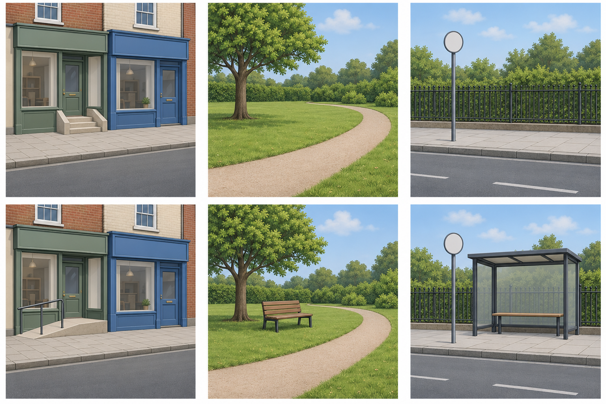
HUM-BUILD-S1-W04 · Year A
Public edition
Our made-up town
Top: then. Bottom: now.
Left: high street. Middle: park.
Right: bus stop.
Words: then, now, bench.
Start: Then __. Now __.
Model: Then no bench.
Now a bench.
These places are made up.
05
CC BY-NC-SA 4.0: free for classroom use, share and adapt with credit, no resale
Notes:
HUM-BUILD-S1-W04 · Year A · Thursday 28 January 2027 · P3
Our made-up town: 5 minutes.
Teacher: Top row then, bottom row now. Left high street: steps replaced by a ramp. Middle park: a bench added beside the path. Right stop on a bus route: shelter added. Shops, tree/path, and stop pole/fence remain. These are invented paired scenes with supplied earlier/later labels; no real place or historical date. The pictures do not show bus times, fares, route length or reasons for change.
Outcome verbatim: Talk about how my local area has changed.
Theme: Resilience & Change
Unit: Then & now, how things change
Source: BUILD Weekly - Spring!A40/B43/C43; BUILD - Spring!C10/D10/E10/J10. Invented scenes and comparisons: assets/MODEL_DATA.json.
CC BY-NC-SA 4.0: free for classroom use, share and adapt with credit, no resale

Slide 6
HUM-BUILD-S1-W04 · Year A
Public edition
A change in the park
Use the same place then and now.
Part | Park example
Then | There was no bench.
Now | There is a bench.
Same | The tree and path.
Words | then, now, bench
Start | Then __. Now __.
Check | Point to both clues.
A quiet check.
Was the bench added or taken away?
Words: added, bench.
Start: The __ was __.
Model: The bench was added.
The park and its change are made up.
06
CC BY-NC-SA 4.0: free for classroom use, share and adapt with credit, no resale
Notes:
HUM-BUILD-S1-W04 · Year A · Thursday 28 January 2027 · P3
A change in the park: 5 minutes.
Teacher: Model the park comparison. Then there was no bench. Now there is a bench. Point to the same tree and path to match the place. Quiet hinge: was the bench added or taken away? Added. If unsure, trace then without bench and now with bench, keeping word bank and model. Parallel check: was the bus shelter added or taken away? Added. No public question.
Outcome verbatim: Talk about how my local area has changed.
Theme: Resilience & Change
Unit: Then & now, how things change
Source: BUILD Weekly - Spring!A40/B43/C43; BUILD - Spring!C10/D10/E10/J10. Invented scenes and comparisons: assets/MODEL_DATA.json.
CC BY-NC-SA 4.0: free for classroom use, share and adapt with credit, no resale

Slide 7
HUM-BUILD-S1-W04 · Year A
Public edition
One place then and now
Choose the high street or bus stop pair.
Words: then, now, steps, ramp, stop, roof.
Start: Then __. Now __.
Model: Then there were steps. Now there is a ramp.
SUPPORTED
INDEPENDENT
ASPIRE
Choose one pair and two labels. Point or ask an adult to write. Use the words and model.
Use both views. Share one change quietly. Keep your words in your book. Use the words and model.
Add a same feature or a possible use. Words: tree, bench, rest, may. Start: A __ may help us __. Model: A bench may help us rest.
07
CC BY-NC-SA 4.0: free for classroom use, share and adapt with credit, no resale
Notes:
HUM-BUILD-S1-W04 · Year A · Thursday 28 January 2027 · P3
One place then and now: 5 minutes.
Teacher: Guided practice: choose the high street or bus stop pair. Point to both views and select a change. Words: then, now, steps, ramp, stop, roof. Stems: Then there was __. Now there is __. Model: Then there were steps. Now there is a ramp. Accept the plural stem as modelled. Do not infer when or why the real local area changed.
Outcome verbatim: Talk about how my local area has changed.
Theme: Resilience & Change
Unit: Then & now, how things change
Source: BUILD Weekly - Spring!A40/B43/C43; BUILD - Spring!C10/D10/E10/J10. Invented scenes and comparisons: assets/MODEL_DATA.json.
CC BY-NC-SA 4.0: free for classroom use, share and adapt with credit, no resale

Slide 8
HUM-BUILD-S1-W04 · Year A
Public edition
My change talk
Share one change quietly. Keep it in your book.
Words: then, now, bench, no bench.
Start: Then __. Now __.
Model: Then there was no bench. Now there is a bench.
SUPPORTED
INDEPENDENT
ASPIRE
Choose one pair and two labels. Point or ask an adult to write. Use the words and model.
Use both views. Share one change quietly. Keep your words in your book. Use the words and model.
Add a same feature or a possible use. Words: tree, bench, rest, may. Start: A __ may help us __. Model: A bench may help us rest.
08
CC BY-NC-SA 4.0: free for classroom use, share and adapt with credit, no resale
Notes:
HUM-BUILD-S1-W04 · Year A · Thursday 28 January 2027 · P3
My change talk: 10 minutes.
Teacher: At minute 25 include a short reset within this ten-minute block. Choose a model pair and share one change privately, then keep the selected words or picture record in a book. A pupil may offer an already-known change in their own area using type words only, with no names or directions; there is no requirement to disclose. Record its basis and any uncertainty. Supported: select two labels and direct an exact scribe. Independent: form the paired statement with all supports. Aspire: add a same feature or a possible effect, marked may.
Outcome verbatim: Talk about how my local area has changed.
Theme: Resilience & Change
Unit: Then & now, how things change
Source: BUILD Weekly - Spring!A40/B43/C43; BUILD - Spring!C10/D10/E10/J10. Invented scenes and comparisons: assets/MODEL_DATA.json.
CC BY-NC-SA 4.0: free for classroom use, share and adapt with credit, no resale

Slide 9
HUM-BUILD-S1-W04 · Year A
Public edition
My quiet check
Show the two clues to an adult.
Words: then, now, bench, keep, change.
Start: Then __. Now __.
Model: Then no bench. Now a bench.
Hear one next step in a quiet way.
Finish: keep a change or point to it.
09
CC BY-NC-SA 4.0: free for classroom use, share and adapt with credit, no resale
Notes:
HUM-BUILD-S1-W04 · Year A · Thursday 28 January 2027 · P3
My quiet check: 3 minutes.
Teacher: Private review. Pupil points to the two clues or confirms a known generic example. Exact scribe reads back for keep/change. Separate what is visible from what might happen. Record actual help and the basis: invented model or pupil’s stated experience. An actual audience reply, one NS and the pupil’s response in the same colour, on the same page or usual mode precede R.
Outcome verbatim: Talk about how my local area has changed.
Theme: Resilience & Change
Unit: Then & now, how things change
Source: BUILD Weekly - Spring!A40/B43/C43; BUILD - Spring!C10/D10/E10/J10. Invented scenes and comparisons: assets/MODEL_DATA.json.
CC BY-NC-SA 4.0: free for classroom use, share and adapt with credit, no resale

Slide 10
HUM-BUILD-S1-W04 · Year A
Public edition
Keep and finish
Keep your pair and one change in your book.
Words: then, now, bench, help.
Start: Then __. Now __.
Model: Then no bench. Now a bench.
Share in a quiet way. The picture town is made up.
You can point or ask an adult to write.
10
CC BY-NC-SA 4.0: free for classroom use, share and adapt with credit, no resale
Notes:
HUM-BUILD-S1-W04 · Year A · Thursday 28 January 2027 · P3
Keep and finish: 2 minutes.
Teacher: Private exit: retain one then/now change in a book, as words, selected labels or a photo of paired cards with pupil choices. Words: then, now, bench, help. Stem: Then __. Now __. Model: Then no bench. Now a bench. E follows actual banking. This lesson is formative; owner sets Week 6 as assessing.
Outcome verbatim: Talk about how my local area has changed.
Theme: Resilience & Change
Unit: Then & now, how things change
Source: BUILD Weekly - Spring!A40/B43/C43; BUILD - Spring!C10/D10/E10/J10. Invented scenes and comparisons: assets/MODEL_DATA.json.
CC BY-NC-SA 4.0: free for classroom use, share and adapt with credit, no resale

Slide 11
HUM-BUILD-S1-W04 · Year A
Public edition
Words about change
local area
then
The places near us.
An earlier time.
now
change
The time we are in.
Something becomes different.
same
clue
Not changed.
A sign that helps us.
ramp
shelter
A slope to go up or down.
A place with a roof for cover.
11
CC BY-NC-SA 4.0: free for classroom use, share and adapt with credit, no resale
Notes:
HUM-BUILD-S1-W04 · Year A · Thursday 28 January 2027 · P3
Words about change: 0 minutes.
Teacher: Keep the word mat available. Read short labels quietly on request. Plan in any language. Use speech, pointing, usual communication aid, drawing, writing or exact scribing. Talk is supported communication, not a requirement to perform aloud. Record selected ideas rather than inferring understanding from copying.
Outcome verbatim: Talk about how my local area has changed.
Theme: Resilience & Change
Unit: Then & now, how things change
Source: BUILD Weekly - Spring!A40/B43/C43; BUILD - Spring!C10/D10/E10/J10. Invented scenes and comparisons: assets/MODEL_DATA.json.
CC BY-NC-SA 4.0: free for classroom use, share and adapt with credit, no resale

Slide 12
HUM-BUILD-S1-W04 · Year A
Public edition
Adult support brief
Three to four pupils. Pupil number: ____.
Keep word bank, starter and model in view.
Use 10, 15 and 15 minute blocks.
One matched pair and one then/now change.
Record two clues and actual help.
Mark invented model or pupil-stated example.
No public questions or required reading aloud.
Point, private prompt, rephrase, choice.
No names, directions or personal details.
R: reply, NS, own response. E: actual banking.
12
CC BY-NC-SA 4.0: free for classroom use, share and adapt with credit, no resale
Notes:
HUM-BUILD-S1-W04 · Year A · Thursday 28 January 2027 · P3
Adult support brief: 0 minutes.
Teacher: Hidden adult brief: Level 2 means bank, starter and visible model every task, not a qualification level. Prompt ladder: point, short private prompt, rephrase, choice/scaffold, model first step then return task. Invented town examples are not verified personal local history. No place names, directions, addresses, online research or personal disclosure required. Record model/known-example basis. R follows actual reply/NS/response; E follows banking.
Outcome verbatim: Talk about how my local area has changed.
Theme: Resilience & Change
Unit: Then & now, how things change
Source: BUILD Weekly - Spring!A40/B43/C43; BUILD - Spring!C10/D10/E10/J10. Invented scenes and comparisons: assets/MODEL_DATA.json.
CC BY-NC-SA 4.0: free for classroom use, share and adapt with credit, no resale

