Slide 1

CREATIVE ARTS BUILD SPRING 1 WEEK 4 LESSON 1
OPENING RESILIENCE & CHANGE
New marks from texture
I can try a rubbing to show a feeling.
Weekly outcome
Try a new expressive technique.
Explore level. You can point, speak, sign, draw or write. You may share privately.
ART_BUILD_S1_W04_P1 Monday 25 January 2027 P5 1/11
Made by Matt
Notes:
Monday 25 January 2027 P5. BUILD Weekly Spring row 91. Year A. Explore. Weekly outcome verbatim: Try a new expressive technique.
I can try the new way with help if I need it.
I can compare two tests.
I can choose one and say or show why.
For four pupils: four books or arts logs, eight small sheets of thin paper, four broad wax crayons and four clear table spaces.
Provide four clean pieces of ridged card and four smooth pieces of card, with safe edges. Shared trays can be used in pairs. No cutting tools, wet paint or adhesive are needed.
Prepare two small real rubbings for demonstration, four storage trays and spare paper. Check that the surfaces give a visible mark before teaching.
No-materials route: seated or standing silent hand movement. No device, body contact or personal story is required.
If prior work is missing, offer a brief honest restart: choose an invented idea and a small achievable form, state a first step and needed tools or no-materials route, then make a first version. Date it today and label it a new start. Do not claim missing earlier evidence.

Slide 2
CREATIVE ARTS BUILD SPRING 1 WEEK 4 LESSON 1
ARRIVAL 3 MINUTES
A choice and a new start
You can point, speak, sign or watch first.
Pick a made-up feeling for your art.
Today we will try texture rubbing.
ART_BUILD_S1_W04_P1 Monday 25 January 2027 P5 2/11
Made by Matt
Notes:
Say and do: Show a safe piece of ridged card and a smooth card. We will put paper on top and rub a crayon across it. The bumps can make marks show through. This is a new way of making marks for our lessons. You may watch, direct me or use the silent option.
Look for: Pupil chooses an invented feeling or confirms one. No personal story is needed.
Materials-free: Offer two silent hand textures: a smooth glide or small uneven stops. Pupil can direct the adult.
Check and response: Any chosen feeling is valid. A texture has no fixed emotional meaning.

Slide 3
CREATIVE ARTS BUILD SPRING 1 WEEK 4 LESSON 1
STARTER 3 MINUTES
A feature to notice
Look at a smooth surface and one with ridges.
Which has bumps?
You may look without touching.
ART_BUILD_S1_W04_P1 Monday 25 January 2027 P5 3/11
Made by Matt
Notes:
Say and do: Show the two surfaces. Ask permission before offering touch; do not place a pupil hand on an object. Describe flat and ridged. Ask how a rough-looking mark might suggest an invented feeling.
Look for: Pupil notices an actual surface feature before suggesting a feeling.
Materials-free: Adult makes a smooth hand path and a path with small stops; pupil identifies the difference.
Check and response: Ridges are raised lines. Either texture can express calm or energy if the maker gives a reason.

Slide 4
CREATIVE ARTS BUILD SPRING 1 WEEK 4 LESSON 1
I DO 6 MINUTES
The method in small steps
Put safe card on the table.
Lay thin paper on top. Hold its edge.
Use the side of a crayon. Rub lightly.
Lift the paper. Look at the marks.
ART_BUILD_S1_W04_P1 Monday 25 January 2027 P5 4/11
Made by Matt
Notes:
Say and do: 1. Put a clean, dry, flat piece of ridged card on a clear table. 2. Lay a small sheet of thin paper on it. Hold the paper at the edge, outside the rubbing area. 3. Lay a broad wax crayon on its side. Move it gently back and forth for four short sweeps. 4. Lift the paper and show the pattern. Make a second test on smoother card with the same crayon. If little shows, check paper contact, use thinner paper or try a little more pressure. Stop before paper tears. Heavy pressure can hide the pattern. Keep the two real tests.
Look for: Adult demonstrates each step slowly and compares the actual prints, even if one is faint. This is rubbing over a surface, different from drawing each line or moving loose shapes.
Materials-free: Model a new texture translation: one continuous hand glide, then four small stop-start moves. Hold each end pose for a slow count of two. Pupil chooses the movement texture. Call this silent movement, not a completed rubbing.
Check and response: CfU: Is the textured card above or below the paper? Below. If unsure, lift the paper and reset it together, then ask again.

Slide 5
CREATIVE ARTS BUILD SPRING 1 WEEK 4 LESSON 1
WITHIN I DO STEP BY STEP
Texture rubbing
A new way to make marks
1. Put ridged card on the table. Lay thin paper over it. Hold the paper edge.
2. Place the crayon on its side. Make four light back-and-forth sweeps.
3. Lift the paper. Notice the ridges. Make a small second test over smooth card.
4. Compare the actual marks. Choose a test and explain a possible feeling.
What is under the paper? Why use light pressure?
ART_BUILD_S1_W04_P1 Monday 25 January 2027 P5 5/11
Made by Matt
Notes:
1. Put a clean, dry, flat piece of ridged card on a clear table. 2. Lay a small sheet of thin paper on it. Hold the paper at the edge, outside the rubbing area. 3. Lay a broad wax crayon on its side. Move it gently back and forth for four short sweeps. 4. Lift the paper and show the pattern. Make a second test on smoother card with the same crayon. If little shows, check paper contact, use thinner paper or try a little more pressure. Stop before paper tears. Heavy pressure can hide the pattern. Keep the two real tests.
Model a new texture translation: one continuous hand glide, then four small stop-start moves. Hold each end pose for a slow count of two. Pupil chooses the movement texture. Call this silent movement, not a completed rubbing.

Slide 6
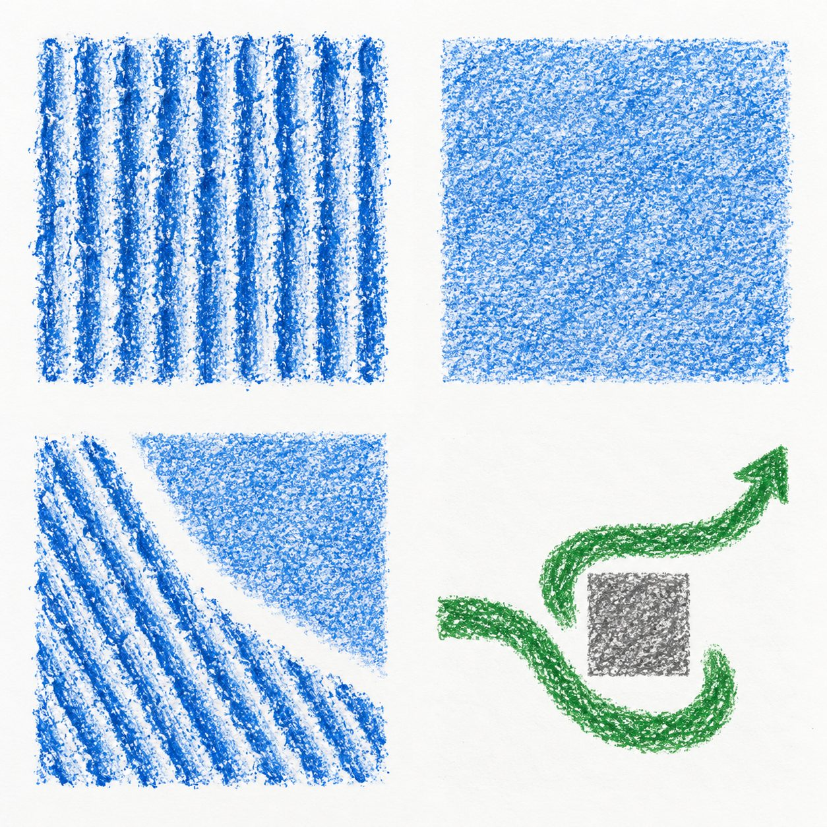
CREATIVE ARTS BUILD SPRING 1 WEEK 4 LESSON 1
WITHIN I DO ORIGINAL CLASS MODELS
Original examples and your own choices
Look at the textures and the path.
These are original class examples.
What feature could fit your idea?
Your work can look different.
ART_BUILD_S1_W04_P1 Monday 25 January 2027 P5 6/11
Made by Matt
Notes:
Original generated classroom examples, not pupil evidence or photographs of actual rubbings. Show real tests alongside these.
Teacher example only: the ridged marks suggest energy to me. Another maker may read them as calm.
Teacher example only: I used a smooth glide and stop-start hand movement. I chose the stops for surprise. This is movement evidence, not a rubbing.

Slide 7
CREATIVE ARTS BUILD SPRING 1 WEEK 4 LESSON 1
WE DO 6 MINUTES
A shared choice
Help the adult make two tests.
Which marks can you see?
Choose a test for a made-up feeling.
Say: I chose ___ because ___.
ART_BUILD_S1_W04_P1 Monday 25 January 2027 P5 7/11
Made by Matt
Notes:
Say and do: Pupils direct where the paper and crayon go. Compare the ridged and smoother tests. Ask each pupil for one choice. Hinge: the paper is tearing. A: press harder; B: stop and try lighter pressure. Show hands or point.
Look for: Each pupil makes a choice and identifies a feature. They choose B for the tearing paper.
Materials-free: Compare the smooth glide and stop-start motion. Pupil directs a lighter or smaller version if the movement is uncomfortable.
Check and response: B. If A is chosen, show a gentle sweep on fresh scrap. Parallel check: to protect the next sheet, press hard or lightly? Lightly. Proceed when the pupil can choose a gentle action or direct one.

Slide 8
CREATIVE ARTS BUILD SPRING 1 WEEK 4 LESSON 1
CREATE 14 MINUTES
Your own making
In your book or arts log, choose a feeling.
Make two small texture tests.
Pick the test that fits your idea.
Keep both tests and your own reason.
ART_BUILD_S1_W04_P1 Monday 25 January 2027 P5 8/11
Made by Matt
Notes:
Say and do: Give each pupil two small sheets and two safe flat surfaces, or let them take turns at a stable shared tray. Repeat the four rubbing steps. Keep the colour the same while testing textures so the texture difference is clearer. The pupil chooses the preferred test. Adult help may hold paper or move the crayon under the pupil direction. Do not rub on skin, walls, fittings or sharp objects. Use familiar materials and the setting procedures.
Look for: Two actual tests with a pupil-selected texture and a reason, or two witnessed silent movement textures with the same choice and reason. Completion does not require a tidy or dark rubbing.
Materials-free: Make a smooth glide and a stop-start hand path, with a still end pose. Choose one texture for the invented feeling. Pupil may direct the adult or use eye-pointing. Staff record the actual movement method, not rubbing.
Check and response: Example only: I chose ridges because the broken marks feel busy to me. A different reading is valid. Record what was actually tried.
Keep actual tests or versions, the pupil choice and reason, dated arts-log entry and actual support. A precise confirmed witness note is valid for performance or directed work. Do not prefill model answers as pupil evidence.

Slide 9
CREATIVE ARTS BUILD SPRING 1 WEEK 4 LESSON 1
WITHIN CREATE ONE ROUTE AT A TIME
Supported, Independent or Aspire
Supported
Independent
Aspire
Pick a feeling or point to a choice.
Choose a made-up feeling.
Complete the same two tests.
Direct an adult through two small tests.
Make two texture tests with the same crayon.
Try a lighter sweep on a small spare area.
Choose one texture.
Pick the texture that fits your idea.
Say what changes in the marks.
Say or show why you chose it.
Keep both tests and your reason.
Choose a version for a reason.
ART_BUILD_S1_W04_P1 Monday 25 January 2027 P5 9/11
Made by Matt
Notes:
Use one route at a time within Create. All routes retain pupil choices.
Keep actual tests or versions, the pupil choice and reason, dated arts-log entry and actual support. A precise confirmed witness note is valid for performance or directed work. Do not prefill model answers as pupil evidence.

Slide 10
CREATIVE ARTS BUILD SPRING 1 WEEK 4 LESSON 1
REVIEW 5 MINUTES
A check and a reason
Show the two tests to an adult.
Point to the texture you chose.
Say what you notice.
Tidy and keep the tests for next time.
ART_BUILD_S1_W04_P1 Monday 25 January 2027 P5 10/11
Made by Matt
Notes:
Say and do: Share privately if preferred. Ask the pupil what the texture suggests to them. The listener says I notice, then checks the maker meaning. In the last two minutes collect crayons, stack clean card, collect scraps and keep tests in each pupil tray.
Look for: The choice stays with the pupil; both tests are stored and no private feeling is inferred.
Materials-free: Pupil repeats or directs the two motions. Adult notes their sequence and chosen version for tomorrow.
Check and response: A useful observation names repeated ridges, faint patches or smooth movement rather than judging the maker.

Slide 11
CREATIVE ARTS BUILD SPRING 1 WEEK 4 LESSON 1
EXIT 3 MINUTES
Your arts log
Arts log: I tried ___.
My two tests were ___.
I chose ___ because ___.
Next time I will ___.
ART_BUILD_S1_W04_P1 Monday 25 January 2027 P5 11/11
Made by Matt
Notes:
Say and do: Date the real work. Scribe the pupil own words if requested, then read them back. Note the actual help and method. Keep the tests for the next lesson. If only a rehearsal happened, record rehearsal honestly.
Look for: Dated entry retains technique, two trials, choice, reason and support actually used.
Materials-free: Pupil gives or confirms an oral log. Staff record it at the next opportunity with the true activity date.
Check and response: Example only: I tried texture rubbing. I chose the ridged test because it feels full of energy.

