Slide 1
HUM-BUILD-S1-W05 · Year A
Public edition
Ask about the past
What do I want to know?
Look at a made-up object story.
Choose and ask your own question.
You can point or ask an adult to write.
Thursday 4 February 2027 · P3 · 40 minutes
01
CC BY-NC-SA 4.0: free for classroom use, share and adapt with credit, no resale
Notes:
HUM-BUILD-S1-W05 · Year A · Thursday 4 February 2027 · P3
Ask about the past: 0 minutes.
Teacher: Set out the reused invented bag and box picture stories, Support Cards, word mat and books. Three to four pupils. Blocks: 0–10 settle/find; 10–25 model/build; 25–40 ask/record. Every task has bank, starter and visible model. Success is a pupil-chosen question about the past directed to an adult privately. Do not require a known answer.
Outcome verbatim: Ask a question about the past.
Theme: Resilience & Change
Unit: Then & now, how things change
Source: BUILD Weekly - Spring!A40/B44/C44; BUILD - Spring!C10/D10/E10/J10. Invented stories and question replies: assets/MODEL_DATA.json.
CC BY-NC-SA 4.0: free for classroom use, share and adapt with credit, no resale

Slide 2
HUM-BUILD-S1-W05 · Year A
Public edition
A calm start
Check how you feel.
BLUE
GREEN
AMBER
RED
Low energy
Ready
Pause
Adult help
Words: look, help, pass. Start: I choose __.
Model: I choose to look. Show an adult quietly.
02
CC BY-NC-SA 4.0: free for classroom use, share and adapt with credit, no resale
Notes:
HUM-BUILD-S1-W05 · Year A · Thursday 4 February 2027 · P3
A calm start: 2 minutes.
Teacher: Private settle. Words: look, help, pass. Start: I choose __. Model: I choose to look. Use pointing or usual aid. Offer quiet support or an agreed supervised pause. No public questioning, cold calling or required reading aloud.
Outcome verbatim: Ask a question about the past.
Theme: Resilience & Change
Unit: Then & now, how things change
Source: BUILD Weekly - Spring!A40/B44/C44; BUILD - Spring!C10/D10/E10/J10. Invented stories and question replies: assets/MODEL_DATA.json.
CC BY-NC-SA 4.0: free for classroom use, share and adapt with credit, no resale

Slide 3
HUM-BUILD-S1-W05 · Year A
Public edition
Ready starter
Look at the bag cards on the top row.
Find the torn strap and the sewn strap.
Words: strap, torn, sewn.
Start: The strap was __.
Model: The strap was torn.
Finish: point to one clue. An adult can read with you.
03
CC BY-NC-SA 4.0: free for classroom use, share and adapt with credit, no resale
Notes:
HUM-BUILD-S1-W05 · Year A · Thursday 4 February 2027 · P3
Ready starter: 8 minutes.
Teacher: Ready starter: top row bag cards A sewn, B whole, C torn. Point to C torn and A sewn. Words: strap, torn, sewn. Start: The strap was __. Model: The strap was torn. Finish: find one clue. Story order B C A retrieves Week 3. Use labelled whole sheet; adult may cut cards and mark letters on the reverse.
Outcome verbatim: Ask a question about the past.
Theme: Resilience & Change
Unit: Then & now, how things change
Source: BUILD Weekly - Spring!A40/B44/C44; BUILD - Spring!C10/D10/E10/J10. Invented stories and question replies: assets/MODEL_DATA.json.
CC BY-NC-SA 4.0: free for classroom use, share and adapt with credit, no resale

Slide 4
HUM-BUILD-S1-W05 · Year A
Public edition
Today
Ask a question about the past.
Our objects and their stories are made up.
Words: who, what, bag, strap.
Start: What happened to __? Who __?
Model: What happened to the strap?
Theme: Resilience & Change
04
CC BY-NC-SA 4.0: free for classroom use, share and adapt with credit, no resale
Notes:
HUM-BUILD-S1-W05 · Year A · Thursday 4 February 2027 · P3
Today: 0 minutes.
Teacher: State exact outcome. These are made-up objects and stories from Week 3, not real product histories. We ask about what happened before now. Keep all six stems visible. Pupil may plan in any language. The pupil chooses a stem and detail; the teacher can help grammar without supplying the whole idea.
Outcome verbatim: Ask a question about the past.
Theme: Resilience & Change
Unit: Then & now, how things change
Source: BUILD Weekly - Spring!A40/B44/C44; BUILD - Spring!C10/D10/E10/J10. Invented stories and question replies: assets/MODEL_DATA.json.
CC BY-NC-SA 4.0: free for classroom use, share and adapt with credit, no resale

Slide 5
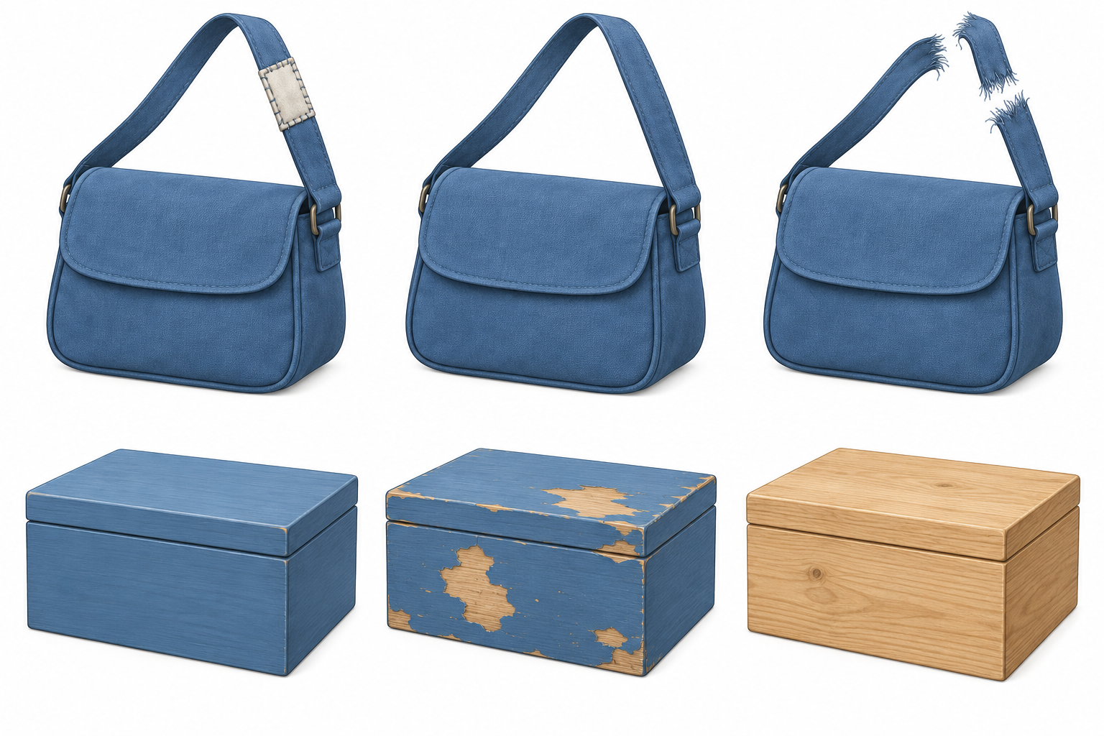
HUM-BUILD-S1-W05 · Year A
Public edition
Made-up object stories
Top: A sewn, B whole, C torn.
Bag story order: B C A.
Bottom: D paint, E chips,
F bare wood. Order: F D E.
Words: strap, torn, sewn.
Start: The strap was __.
Model: The strap was torn.
These stories are made up.
05
CC BY-NC-SA 4.0: free for classroom use, share and adapt with credit, no resale
Notes:
HUM-BUILD-S1-W05 · Year A · Thursday 4 February 2027 · P3
Made-up object stories: 5 minutes.
Teacher: Top row A sewn, B whole, C torn. Bag story: whole strap, then torn, then someone sews it. Bottom D paint, E chips, F bare wood. Box story: bare wood, then painted, then chips from use. Orders B C A and F D E are supplied fictional story clues, not claims about all old objects. No names, dates, places or motives are given.
Outcome verbatim: Ask a question about the past.
Theme: Resilience & Change
Unit: Then & now, how things change
Source: BUILD Weekly - Spring!A40/B44/C44; BUILD - Spring!C10/D10/E10/J10. Invented stories and question replies: assets/MODEL_DATA.json.
CC BY-NC-SA 4.0: free for classroom use, share and adapt with credit, no resale

Slide 6
HUM-BUILD-S1-W05 · Year A
Public edition
I ask and wait
A model question about the bag.
Step | Bag model
Clue | The torn strap in C.
Stem | What
Start | What happened to __?
Question | What happened to the strap?
Reply | The strap tore.
Check | It asks for a reply.
A quiet check. Which asks?
What happened to the strap?
The strap tore.
Words: what, strap. Start: What happened to __?
Model: What happened to the strap?
The reply comes from the made-up story.
06
CC BY-NC-SA 4.0: free for classroom use, share and adapt with credit, no resale
Notes:
HUM-BUILD-S1-W05 · Year A · Thursday 4 February 2027 · P3
I ask and wait: 5 minutes.
Teacher: Model What happened to the strap? Point to C. Ask a nearby adult quietly. Reply: The strap tore, from the story. Contrast The strap tore as a statement. Private hinge: which asks for a reply? What happened to the strap? If unsure, model asking and waiting. Parallel check: Who sewed the strap? is a question; The strap was sewn is a statement. Keep stems and models available.
Outcome verbatim: Ask a question about the past.
Theme: Resilience & Change
Unit: Then & now, how things change
Source: BUILD Weekly - Spring!A40/B44/C44; BUILD - Spring!C10/D10/E10/J10. Invented stories and question replies: assets/MODEL_DATA.json.
CC BY-NC-SA 4.0: free for classroom use, share and adapt with credit, no resale

Slide 7
HUM-BUILD-S1-W05 · Year A
Public edition
Build my question
Choose a clue and a stem from the help cards.
Words: who, what, when, where, why, how, bag.
Start: Where was __? Who __?
Model: Where was the bag kept?
SUPPORTED
INDEPENDENT
ASPIRE
Choose a stem and a detail. Point or ask an adult to write. Keep the words and model.
Build your own question. Ask quietly. Keep it in your book. Use the words and model.
Try a new stem or check a reply. Words: clue, know. Start: We know __. Model: We know the strap tore.
07
CC BY-NC-SA 4.0: free for classroom use, share and adapt with credit, no resale
Notes:
HUM-BUILD-S1-W05 · Year A · Thursday 4 February 2027 · P3
Build my question: 5 minutes.
Teacher: Guided build: pupil chooses bag or box and a stem from who, what, when, where, why, how. Words: bag, box, strap, paint, sewn, kept. Starters: Who __? What happened to __? When was __? Where was __? Why was __? How was __? Visible model: Where was the bag kept? Use a private rehearsal; adult recasts grammar then asks pupil to confirm meaning. Changing a stem or detail creates a personal choice; spontaneous questions also count.
Outcome verbatim: Ask a question about the past.
Theme: Resilience & Change
Unit: Then & now, how things change
Source: BUILD Weekly - Spring!A40/B44/C44; BUILD - Spring!C10/D10/E10/J10. Invented stories and question replies: assets/MODEL_DATA.json.
CC BY-NC-SA 4.0: free for classroom use, share and adapt with credit, no resale

Slide 8
HUM-BUILD-S1-W05 · Year A
Public edition
Ask my question
Ask or show your own question to an adult quietly.
Words: what, who, strap, box.
Start: What happened to __? Who __?
Model: What happened to the strap?
SUPPORTED
INDEPENDENT
ASPIRE
Choose a stem and a detail. Point or ask an adult to write. Keep the words and model.
Build your own question. Ask quietly. Keep it in your book. Use the words and model.
Try a new stem or check a reply. Words: clue, know. Start: We know __. Model: We know the strap tore.
08
CC BY-NC-SA 4.0: free for classroom use, share and adapt with credit, no resale
Notes:
HUM-BUILD-S1-W05 · Year A · Thursday 4 February 2027 · P3
Ask my question: 10 minutes.
Teacher: At minute 25 include a brief reset within this block. Pupil builds and asks one chosen question privately to an adult using speech, showing selected words, usual aid or directed scribing. An adult may read the pupil-approved question to the listener, with pupil present and directing it. Supported selects a stem and subject and confirms. Independent builds and asks with scaffolds. Aspire adds a second stem or sorts known/not known. Record question, source clue, response mode, actual reply and help.
Outcome verbatim: Ask a question about the past.
Theme: Resilience & Change
Unit: Then & now, how things change
Source: BUILD Weekly - Spring!A40/B44/C44; BUILD - Spring!C10/D10/E10/J10. Invented stories and question replies: assets/MODEL_DATA.json.
CC BY-NC-SA 4.0: free for classroom use, share and adapt with credit, no resale

Slide 9
HUM-BUILD-S1-W05 · Year A
Public edition
My quiet check
Did you choose and ask your question?
Words: question, asked, keep, change.
Start: I asked __.
Model: I asked what happened to the strap.
Hear one next step in a quiet way.
A reply may be: We do not know.
09
CC BY-NC-SA 4.0: free for classroom use, share and adapt with credit, no resale
Notes:
HUM-BUILD-S1-W05 · Year A · Thursday 4 February 2027 · P3
My quiet check: 3 minutes.
Teacher: Private check: is the question about the past, and was it asked to someone? Pupil confirms exact scribe through keep/change. Reply only from supplied story or picture; say we do not know for missing who, place, date or reason. A reason may be a guess, never evidence. One actual reply, one NS and pupil response in the same colour, on the same page or usual mode precede R.
Outcome verbatim: Ask a question about the past.
Theme: Resilience & Change
Unit: Then & now, how things change
Source: BUILD Weekly - Spring!A40/B44/C44; BUILD - Spring!C10/D10/E10/J10. Invented stories and question replies: assets/MODEL_DATA.json.
CC BY-NC-SA 4.0: free for classroom use, share and adapt with credit, no resale

Slide 10
HUM-BUILD-S1-W05 · Year A
Public edition
Keep and finish
Keep your question and picture clue in your book.
Words: question, asked, help.
Start: I asked __.
Model: I asked what happened to the strap.
Finish: one question you chose and asked quietly.
You can point or ask an adult to write.
10
CC BY-NC-SA 4.0: free for classroom use, share and adapt with credit, no resale
Notes:
HUM-BUILD-S1-W05 · Year A · Thursday 4 February 2027 · P3
Keep and finish: 2 minutes.
Teacher: Keep chosen picture reference and own question in a book; selected labels or photo of card choices with exact scribe are valid. Words: question, asked, keep, help. Start: I asked __. Model: I asked what happened to the strap. Finish one chosen question asked privately and recorded. E only after actual banking. Week 5 is formative; Week 6 assesses.
Outcome verbatim: Ask a question about the past.
Theme: Resilience & Change
Unit: Then & now, how things change
Source: BUILD Weekly - Spring!A40/B44/C44; BUILD - Spring!C10/D10/E10/J10. Invented stories and question replies: assets/MODEL_DATA.json.
CC BY-NC-SA 4.0: free for classroom use, share and adapt with credit, no resale

Slide 11
HUM-BUILD-S1-W05 · Year A
Public edition
Words for asking
past
question
A time before now.
Words we use to ask.
who
what
Asks about a person.
Asks about a thing or change.
when
where
Asks about a time.
Asks about a place.
why
how
Asks for a reason.
Asks about the way it was done.
11
CC BY-NC-SA 4.0: free for classroom use, share and adapt with credit, no resale
Notes:
HUM-BUILD-S1-W05 · Year A · Thursday 4 February 2027 · P3
Words for asking: 0 minutes.
Teacher: Use the eight-word mat and all six question stems. Read short labels quietly if wanted. A pupil need not use every stem, speak aloud or know an answer. Word choice, pointing, usual aid, writing and exact scribing are valid communication. Distinguish selecting a question from copying the adult model without an individual choice.
Outcome verbatim: Ask a question about the past.
Theme: Resilience & Change
Unit: Then & now, how things change
Source: BUILD Weekly - Spring!A40/B44/C44; BUILD - Spring!C10/D10/E10/J10. Invented stories and question replies: assets/MODEL_DATA.json.
CC BY-NC-SA 4.0: free for classroom use, share and adapt with credit, no resale

Slide 12
HUM-BUILD-S1-W05 · Year A
Public edition
Adult support brief
Three to four pupils. Pupil number: ____.
Keep word bank, starter and model in view.
Use 10, 15 and 15 minute blocks.
Pupil chooses stem and subject or detail.
Record exact question, asking mode and help.
Reply from clues; unknown is a valid answer.
No public questions or required reading aloud.
Point, private prompt, rephrase, choice.
No real people, places or events as subjects.
R: reply, NS, own response. E: actual banking.
12
CC BY-NC-SA 4.0: free for classroom use, share and adapt with credit, no resale
Notes:
HUM-BUILD-S1-W05 · Year A · Thursday 4 February 2027 · P3
Adult support brief: 0 minutes.
Teacher: Hidden adult brief: Level 2 means bank, starters and visible model every task, not qualification level. Prompt ladder point, private prompt, rephrase, choice, model first step then return. Keep all subjects invented. No personal disclosure or live research. Honest unknowns are acceptable. Record independent choice and asking separately; R requires actual reply/NS/own response, E actual banking. Week 6 evidence grid is queued, not included.
Outcome verbatim: Ask a question about the past.
Theme: Resilience & Change
Unit: Then & now, how things change
Source: BUILD Weekly - Spring!A40/B44/C44; BUILD - Spring!C10/D10/E10/J10. Invented stories and question replies: assets/MODEL_DATA.json.
CC BY-NC-SA 4.0: free for classroom use, share and adapt with credit, no resale

