Slide 1
HUM-BUILD-S1-W06 · Year A
Public edition
My then and now record
Two pictures. Two captions.
Choose one made-up place.
Draw or use the picture pair.
Keep a caption with each picture.
Thursday 11 February 2027 · P3 · 40 minutes
01
CC BY-NC-SA 4.0: free for classroom use, share and adapt with credit, no resale
Notes:
HUM-BUILD-S1-W06 · Year A · Thursday 11 February 2027 · P3
My then and now record: 0 minutes.
Teacher: Set out Week4 invented town picture pairs, Support Cards, word mat and books. Three to four pupils. Blocks: 0–10 settle/find; 10–25 model/plan; 25–40 make/review. Assessing week under owner instruction. Every task retains bank, starters and visible model. Finish two labelled panels of one invented place and one caption per panel. Supplied pictures or drawings replace photos; no device or personal photos needed.
Outcome verbatim: Record 'then & now' with photos/captions.
Theme: Resilience & Change
Unit: Then & now, how things change
Source: BUILD Weekly - Spring!A40/B45/C45; six-outcome grid C40:C45; BUILD - Spring!C10/D10/E10/J10. Invented pictures and captions: assets/MODEL_DATA.json.
CC BY-NC-SA 4.0: free for classroom use, share and adapt with credit, no resale

Slide 2
HUM-BUILD-S1-W06 · Year A
Public edition
A calm start
Check how you feel.
BLUE
GREEN
AMBER
RED
Low energy
Ready
Pause
Adult help
Words: look, help, pass. Start: I choose __.
Model: I choose to look. Show an adult quietly.
02
CC BY-NC-SA 4.0: free for classroom use, share and adapt with credit, no resale
Notes:
HUM-BUILD-S1-W06 · Year A · Thursday 11 February 2027 · P3
A calm start: 2 minutes.
Teacher: Private settle. Words: look, help, pass. Start: I choose __. Model: I choose to look. Pointing or usual aid is enough. Offer quiet support or agreed supervised pause. No public questioning, cold calling or required reading aloud. Assessment is a calm supported record task.
Outcome verbatim: Record 'then & now' with photos/captions.
Theme: Resilience & Change
Unit: Then & now, how things change
Source: BUILD Weekly - Spring!A40/B45/C45; six-outcome grid C40:C45; BUILD - Spring!C10/D10/E10/J10. Invented pictures and captions: assets/MODEL_DATA.json.
CC BY-NC-SA 4.0: free for classroom use, share and adapt with credit, no resale

Slide 3
HUM-BUILD-S1-W06 · Year A
Public edition
Ready starter
Look at the park pair on the picture sheet.
Find the tree in both views.
Words: then, now, tree, same.
Start: Both have __. Model: Both have a tree.
Finish: match one pair. Show a shared clue.
An adult can read or write with you.
03
CC BY-NC-SA 4.0: free for classroom use, share and adapt with credit, no resale
Notes:
HUM-BUILD-S1-W06 · Year A · Thursday 11 February 2027 · P3
Ready starter: 8 minutes.
Teacher: Ready starter: match top and bottom park views on Source Cards page1. Find the tree in both. Words: then, now, tree, same. Start: Both have __. Model: Both have a tree. Finish one matched pair. Privately look at earlier book evidence if available; do not make pupils retell personal events or disclose details.
Outcome verbatim: Record 'then & now' with photos/captions.
Theme: Resilience & Change
Unit: Then & now, how things change
Source: BUILD Weekly - Spring!A40/B45/C45; six-outcome grid C40:C45; BUILD - Spring!C10/D10/E10/J10. Invented pictures and captions: assets/MODEL_DATA.json.
CC BY-NC-SA 4.0: free for classroom use, share and adapt with credit, no resale

Slide 4
HUM-BUILD-S1-W06 · Year A
Public edition
Today
Record 'then & now' with photos/captions.
We can draw or use made-up pictures, in place of photos.
Words: then, now, bench, no bench.
Start: Then __. Now __.
Model: Then no bench. Now a bench.
Theme: Resilience & Change
04
CC BY-NC-SA 4.0: free for classroom use, share and adapt with credit, no resale
Notes:
HUM-BUILD-S1-W06 · Year A · Thursday 11 February 2027 · P3
Today: 0 minutes.
Teacher: State exact outcome. For this lesson a supplied invented picture or a drawing stands in for a photo. Explain two panels: then on the left, now on the right, with one caption each. A caption is words that tell about its picture. All sources are invented. Week6 is assessing; scaffolds remain available and use is recorded.
Outcome verbatim: Record 'then & now' with photos/captions.
Theme: Resilience & Change
Unit: Then & now, how things change
Source: BUILD Weekly - Spring!A40/B45/C45; six-outcome grid C40:C45; BUILD - Spring!C10/D10/E10/J10. Invented pictures and captions: assets/MODEL_DATA.json.
CC BY-NC-SA 4.0: free for classroom use, share and adapt with credit, no resale

Slide 5
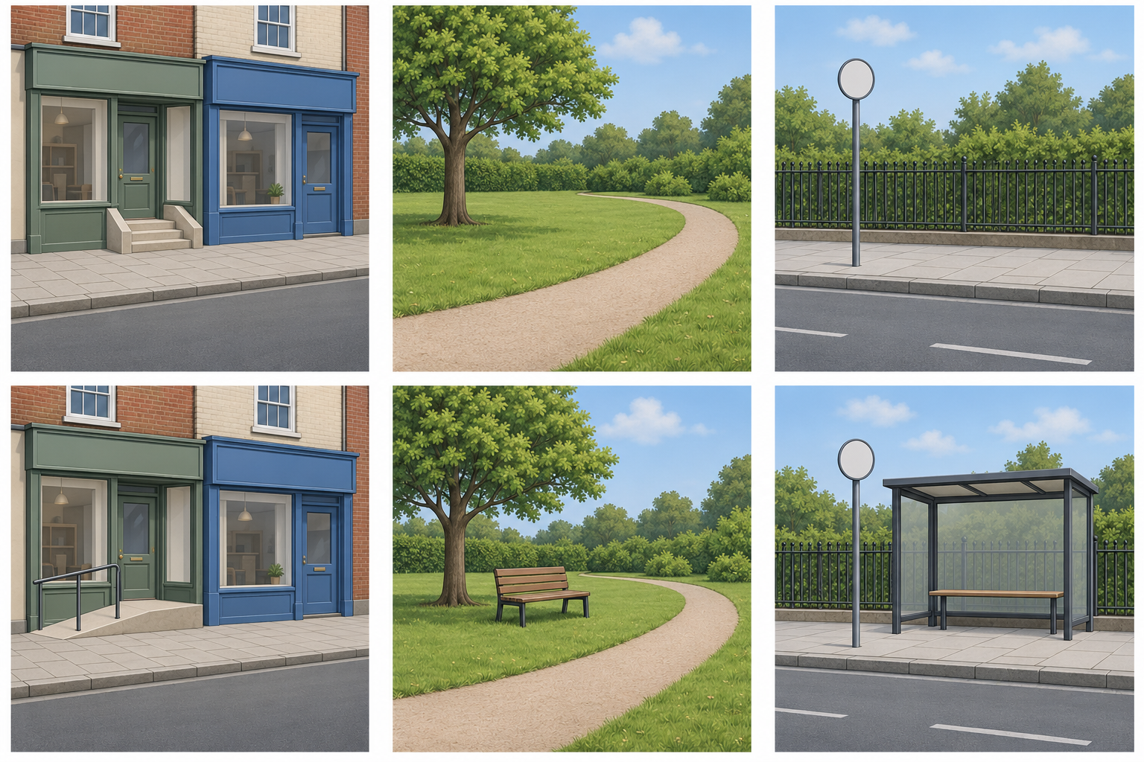
HUM-BUILD-S1-W06 · Year A
Public edition
Choose one made-up place
Top: then. Bottom: now.
Left: high street.
Middle: park. Right: bus stop.
Words: then, now, bench.
Start: Then __. Now __.
Model: Then no bench.
Now a bench.
All these places are made up.
05
CC BY-NC-SA 4.0: free for classroom use, share and adapt with credit, no resale
Notes:
HUM-BUILD-S1-W06 · Year A · Thursday 11 February 2027 · P3
Choose one made-up place: 5 minutes.
Teacher: Top then, bottom now; columns high street, park, bus stop. Reuse the same invented scenes from Week4. Steps/ramp, no bench/bench, no shelter/shelter. Shops, tree/path and pole/fence remain. No real place, building, event or historical date is shown. Labels provide the fictional earlier/later context. Do not infer reasons, bus times or dates.
Outcome verbatim: Record 'then & now' with photos/captions.
Theme: Resilience & Change
Unit: Then & now, how things change
Source: BUILD Weekly - Spring!A40/B45/C45; six-outcome grid C40:C45; BUILD - Spring!C10/D10/E10/J10. Invented pictures and captions: assets/MODEL_DATA.json.
CC BY-NC-SA 4.0: free for classroom use, share and adapt with credit, no resale

Slide 6
HUM-BUILD-S1-W06 · Year A
Public edition
My two-panel model
Use the park pair. Draw or place the two pictures.
Then | left panel | Now | right panel
Park: no bench | Park: a bench
Caption: Then no bench. | Caption: Now a bench.
Use a picture or draw. | Use a picture or draw.
Words: then, no bench | Words: now, bench
Start: Then __. | Start: Now __.
Match this picture. | Match this picture.
A quiet check.
Now there is a bench.
Which park view fits?
Words: then, now, bench.
Start: The __ view.
Model: The now view.
Keep one caption with each picture. The park is made up.
06
CC BY-NC-SA 4.0: free for classroom use, share and adapt with credit, no resale
Notes:
HUM-BUILD-S1-W06 · Year A · Thursday 11 February 2027 · P3
My two-panel model: 5 minutes.
Teacher: Model the park pair. Put the then picture at left and now at right in a book. Model caption1 Then there was no bench. Caption2 Now there is a bench. Point to each matching clue. Private hinge: does Now there is a bench fit the then or now park picture? Now. If unsure, trace no bench then bench. Parallel check: Now there is a shelter fits the now bus-stop view. Keep supports available.
Outcome verbatim: Record 'then & now' with photos/captions.
Theme: Resilience & Change
Unit: Then & now, how things change
Source: BUILD Weekly - Spring!A40/B45/C45; six-outcome grid C40:C45; BUILD - Spring!C10/D10/E10/J10. Invented pictures and captions: assets/MODEL_DATA.json.
CC BY-NC-SA 4.0: free for classroom use, share and adapt with credit, no resale

Slide 7
HUM-BUILD-S1-W06 · Year A
Public edition
Plan my two panels
Pick a pair. Put then left and now right in your book.
Words: then, now, steps, ramp, bench, shelter.
Start: Then __. Now __.
Model: Then there were steps. Now there is a ramp.
SUPPORTED
INDEPENDENT
ASPIRE
Choose a pair and words. Point or ask an adult to write. Use the bank, starts and model.
Make two panels and two captions. Check each picture and its words. Keep all the help.
Add a same thing or a question. Words: same, tree, who. Start: The __ is still here. Model: The tree is still here.
07
CC BY-NC-SA 4.0: free for classroom use, share and adapt with credit, no resale
Notes:
HUM-BUILD-S1-W06 · Year A · Thursday 11 February 2027 · P3
Plan my two panels: 5 minutes.
Teacher: Guided plan: pupil chooses park, high street or bus stop and drawing or supplied-picture mode. Label two book panels Then and Now. Words: then, now, steps, ramp, bench, shelter. Starts: Then __. Now __. Model: Then there were steps. Now there is a ramp. Pupil points to picture clues and chooses caption words before the adult writes. Do not judge drawing skill or spelling.
Outcome verbatim: Record 'then & now' with photos/captions.
Theme: Resilience & Change
Unit: Then & now, how things change
Source: BUILD Weekly - Spring!A40/B45/C45; six-outcome grid C40:C45; BUILD - Spring!C10/D10/E10/J10. Invented pictures and captions: assets/MODEL_DATA.json.
CC BY-NC-SA 4.0: free for classroom use, share and adapt with credit, no resale

Slide 8
HUM-BUILD-S1-W06 · Year A
Public edition
Make my record
Add one caption to each picture or drawing.
Words: then, now, bench, no bench, caption.
Start: Then __. Now __.
Model: Then there was no bench. Now there is a bench.
SUPPORTED
INDEPENDENT
ASPIRE
Choose a pair and words. Point or ask an adult to write. Use the bank, starts and model.
Make two panels and two captions. Check each picture and its words. Keep all the help.
Add a same thing or a question. Words: same, tree, who. Start: The __ is still here. Model: The tree is still here.
08
CC BY-NC-SA 4.0: free for classroom use, share and adapt with credit, no resale
Notes:
HUM-BUILD-S1-W06 · Year A · Thursday 11 February 2027 · P3
Make my record: 10 minutes.
Teacher: At minute25 include a brief reset within the ten-minute record block. Pupil places or draws one pair and adds one caption to each panel. Adult may cut pictures and scribe pupil-selected words, read back quietly and offer keep/change. Supported chooses labels and directs a scribe. Independent makes the pair and captions with all supports. Aspire adds a same feature or a past question after the shared finish. Record exact help; scaffolding is not failure.
Outcome verbatim: Record 'then & now' with photos/captions.
Theme: Resilience & Change
Unit: Then & now, how things change
Source: BUILD Weekly - Spring!A40/B45/C45; six-outcome grid C40:C45; BUILD - Spring!C10/D10/E10/J10. Invented pictures and captions: assets/MODEL_DATA.json.
CC BY-NC-SA 4.0: free for classroom use, share and adapt with credit, no resale

Slide 9
HUM-BUILD-S1-W06 · Year A
Public edition
My quiet check
Check two panels and two captions with an adult.
Words: then, now, bench, keep, change.
Start: Then __. Now __.
Model: Then no bench. Now a bench.
Point to each picture and its words.
Hear one next step. Keep or change your words.
09
CC BY-NC-SA 4.0: free for classroom use, share and adapt with credit, no resale
Notes:
HUM-BUILD-S1-W06 · Year A · Thursday 11 February 2027 · P3
My quiet check: 3 minutes.
Teacher: Private review: two panels, one place, correct then/now order and one matching caption each. Pupil confirms each caption using speech, pointing or usual aid. Record actual review and one next step. R only after actual audience reply, one NS and pupil response in the same colour, on the same page or usual mode. Review previous book evidence against all six exact outcomes; keep not seen distinct from not yet shown.
Outcome verbatim: Record 'then & now' with photos/captions.
Theme: Resilience & Change
Unit: Then & now, how things change
Source: BUILD Weekly - Spring!A40/B45/C45; six-outcome grid C40:C45; BUILD - Spring!C10/D10/E10/J10. Invented pictures and captions: assets/MODEL_DATA.json.
CC BY-NC-SA 4.0: free for classroom use, share and adapt with credit, no resale

Slide 10
HUM-BUILD-S1-W06 · Year A
Public edition
Keep and finish
In your book: two labelled panels and two captions.
Words: then, now, bench, help.
Start: Then __. Now __.
Model: Then no bench. Now a bench.
Finish: one picture or drawing and caption in each.
You can point or ask an adult to write.
10
CC BY-NC-SA 4.0: free for classroom use, share and adapt with credit, no resale
Notes:
HUM-BUILD-S1-W06 · Year A · Thursday 11 February 2027 · P3
Keep and finish: 2 minutes.
Teacher: Finish: keep two labelled panels and two captions in a book. Words: then, now, keep, change. Start: Then __. Now __. Model: Then no bench. Now a bench. E only after actual banking. Supply one teacher grid per pupil; outcomes from earlier weeks require dated evidence or observed checks, not inference from this record alone. Pause after this final BUILD lesson.
Outcome verbatim: Record 'then & now' with photos/captions.
Theme: Resilience & Change
Unit: Then & now, how things change
Source: BUILD Weekly - Spring!A40/B45/C45; six-outcome grid C40:C45; BUILD - Spring!C10/D10/E10/J10. Invented pictures and captions: assets/MODEL_DATA.json.
CC BY-NC-SA 4.0: free for classroom use, share and adapt with credit, no resale

Slide 11
HUM-BUILD-S1-W06 · Year A
Public edition
Words for my captions
then
now
An earlier time.
The time we are in.
past
change
A time before now.
Something becomes different.
same
caption
Not changed.
Words that tell about a picture.
panel
clue
One part of a picture record.
A sign that helps us.
11
CC BY-NC-SA 4.0: free for classroom use, share and adapt with credit, no resale
Notes:
HUM-BUILD-S1-W06 · Year A · Thursday 11 February 2027 · P3
Words for my captions: 0 minutes.
Teacher: Keep the eight-word mat and picture words available. Read short labels quietly on request. Plan in any language. Captions can be written, selected labels or exact scribe directed and confirmed by the pupil. Drawing is an equal alternative to the supplied pictures. The work is about meaning, not performance aloud or independent handwriting.
Outcome verbatim: Record 'then & now' with photos/captions.
Theme: Resilience & Change
Unit: Then & now, how things change
Source: BUILD Weekly - Spring!A40/B45/C45; six-outcome grid C40:C45; BUILD - Spring!C10/D10/E10/J10. Invented pictures and captions: assets/MODEL_DATA.json.
CC BY-NC-SA 4.0: free for classroom use, share and adapt with credit, no resale

Slide 12
HUM-BUILD-S1-W06 · Year A
Public edition
Adult assessment brief
Three to four pupils. Pupil number: ____.
Assessing week: keep all scaffolds available.
Use 10, 15 and 15 minute blocks.
One invented pair; two panels and captions.
Six-outcome grid: use dated evidence and note help.
Do not infer every outcome from one piece.
No public questions or required reading aloud.
S shown; P part; N not yet; U not seen.
Keep missing evidence distinct from not yet.
R: reply, NS, own response. E: actual banking.
12
CC BY-NC-SA 4.0: free for classroom use, share and adapt with credit, no resale
Notes:
HUM-BUILD-S1-W06 · Year A · Thursday 11 February 2027 · P3
Adult assessment brief: 0 minutes.
Teacher: Hidden adult brief: Level2 means bank, starters and visible model every task, not a qualification level. Prompt ladder point, short private prompt, rephrase, choice/scaffold, model first step then return. Pupil number: ____; no real people, places or events as subjects. Grid S shown, P part shown, N not yet shown after a fair supported chance, U not seen/no evidence. One per pupil. Comment with date/reference, what was seen and actual help. No retrospective invented evidence or automatic award decisions.
Outcome verbatim: Record 'then & now' with photos/captions.
Theme: Resilience & Change
Unit: Then & now, how things change
Source: BUILD Weekly - Spring!A40/B45/C45; six-outcome grid C40:C45; BUILD - Spring!C10/D10/E10/J10. Invented pictures and captions: assets/MODEL_DATA.json.
CC BY-NC-SA 4.0: free for classroom use, share and adapt with credit, no resale

