Slide 1
BUILD RSHE
1 / 12
Talk to a trusted adult
Year A · Wednesday 27 January 2027 · P1 · 40 minutes
Use the story. Pick a way to ask for help.
Theme: Resilience & Change
You can pass, point or ask for help.
RSHE-BUILD-S1-W04
Public edition
Lesson resource · CC BY-NC-SA 4.0: free for classroom use, share and adapt with credit, no resale
Notes:
Opening only. One forty-minute formative lesson for three to four learners. No real worry or personal adult identification required. Pupil-facing scene is entirely invented.
Source: owner brief, BUILD Weekly Spring row 67; accepted Week 3 format. No external source reproduced. Lesson resource · CC BY-NC-SA 4.0: free for classroom use, share and adapt with credit, no resale

Slide 2
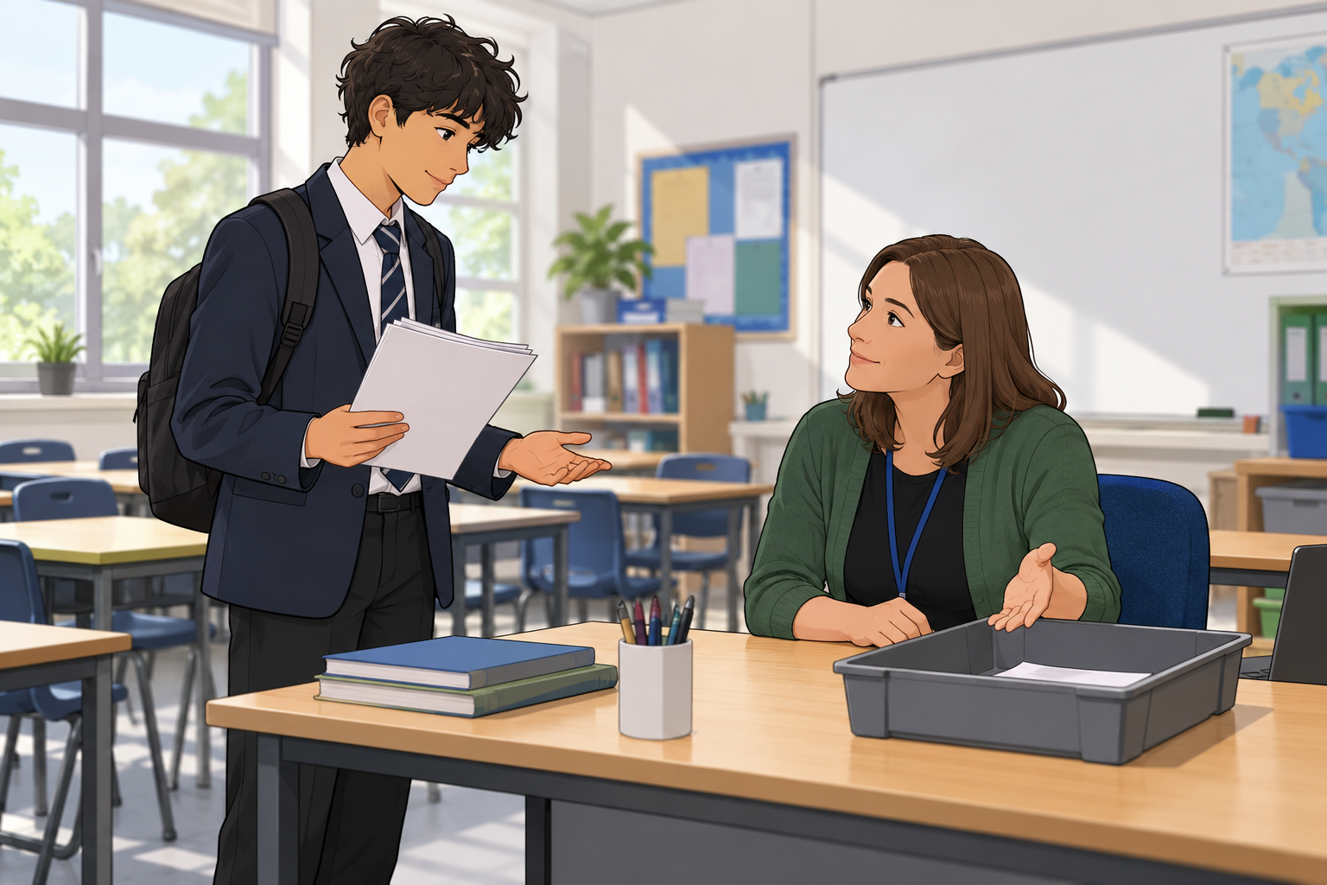
CHUNK 1
2 / 12 · 0–3 min
A small worry in a story
A pupil is not sure where their work goes.
Who could help the pupil?
Words: pupil, work, worry, help
Start: The pupil could ask ... .
Model: The pupil could ask a teaching assistant.
RSHE-BUILD-S1-W04
Public edition
Lesson resource · CC BY-NC-SA 4.0: free for classroom use, share and adapt with credit, no resale
Notes:
Read the invented mild scene. No question about the learner’s own worry. Image shows fictional people, not a test of reading facial expressions. Accept role choice via usual mode.
Source: owner brief, BUILD Weekly Spring row 67; accepted Week 3 format. No external source reproduced. Lesson resource · CC BY-NC-SA 4.0: free for classroom use, share and adapt with credit, no resale

Slide 3
CHUNK 1
3 / 12 · 3–7 min
A trusted adult
Talk about a worry with a trusted adult (Time to Talk).
In plain words: ask a safe adult for help.
Teacher. Teaching assistant. Parent or carer.
A trusted adult listens and helps in a safe way.
Words: adult, listen, safe, help
Start: They can start with ... .
Model: They can start with: Can I talk to you?
RSHE-BUILD-S1-W04
Public edition
Lesson resource · CC BY-NC-SA 4.0: free for classroom use, share and adapt with credit, no resale
Notes:
School support adult is another role type. A role title alone does not prove someone is trusted: they listen, take worries seriously and help safely. Never ask who the pupil trusts in front of others. Read exact outcome aloud; Time to Talk is included only because it is in the supplied outcome.
Source: owner brief, BUILD Weekly Spring row 67; accepted Week 3 format. No external source reproduced. Lesson resource · CC BY-NC-SA 4.0: free for classroom use, share and adapt with credit, no resale

Slide 4
CHUNK 1
4 / 12 · 7–11 min
The story talk
Pupil: Can I talk to you?
Adult: Yes. I can listen.
Pupil: I am not sure where my work goes.
Adult: We can check the right place together.
Words: adult, listen, safe, help
Start: They can start with ... .
Model: They can start with: Can I talk to you?
RSHE-BUILD-S1-W04
Public edition
Lesson resource · CC BY-NC-SA 4.0: free for classroom use, share and adapt with credit, no resale
Notes:
TA models the four exact fictional lines. Check by asking which line starts the talk; point/select is fine. First-person words belong to the fictional character. 11–12 minute reset is inside the forty minutes; no forced movement or sound.
Source: owner brief, BUILD Weekly Spring row 67; accepted Week 3 format. No external source reproduced. Lesson resource · CC BY-NC-SA 4.0: free for classroom use, share and adapt with credit, no resale

Slide 5
CHUNK 2
5 / 12 · 12–17 min
Three ways to start
Can I talk to you?
I have a worry. Can you help?
Can we talk in a quiet place?
Words: talk, worry, help, quiet
Start: They could say ... .
Model: They could say: I have a worry. Can you help?
RSHE-BUILD-S1-W04
Public edition
Lesson resource · CC BY-NC-SA 4.0: free for classroom use, share and adapt with credit, no resale
Notes:
Teach all three, then choose one for the fictional talk. Keep all three exact openers on the pupil keep card. An adult chooses a school-agreed quiet place with normal supervision. Quiet does not mean secret or isolated. No private worry is requested. Optional guided rehearsal can be a choice/point while TA voices the exact chosen opener.
Source: owner brief, BUILD Weekly Spring row 67; accepted Week 3 format. No external source reproduced. Lesson resource · CC BY-NC-SA 4.0: free for classroom use, share and adapt with credit, no resale

Slide 6
CHUNK 2
6 / 12 · 17–20 min
If the adult is busy
The adult is busy. What could the story pupil do?
A. Give up and keep the worry.
B. Ask when to talk or try another trusted adult.
Words: busy, when, next, adult
Start: If the adult is busy, they could ... .
Model: They could ask when to talk or try another trusted adult.
RSHE-BUILD-S1-W04
Public edition
Lesson resource · CC BY-NC-SA 4.0: free for classroom use, share and adapt with credit, no resale
Notes:
Main hinge answer B. Check privately by pointing, speaking or usual aid. If B and a safe reason/choice, proceed. If A, unclear or no response, re-model the busy-adult reply, offer two choices and use the parallel check; do not treat pass as misunderstanding. Parallel check: The worry is still there after a talk. What could the story pupil do? A. Ask a trusted adult again or try another trusted adult. B. Stop asking for help. Answer A. No public questioning.
Source: owner brief, BUILD Weekly Spring row 67; accepted Week 3 format. No external source reproduced. Lesson resource · CC BY-NC-SA 4.0: free for classroom use, share and adapt with credit, no resale

Slide 7
CHUNK 2
7 / 12 · 20–24 min
Plan the story talk
Pick a role for the story adult.
Pick one way to start.
Use the story about class work.
In your book: draw or note the plan, if you wish.
Words: adult, opener, work, help
Start: They will ask ... . They could say ... .
Model: They will ask a teaching assistant. They could say: Can I talk to you?
RSHE-BUILD-S1-W04
Public edition
Lesson resource · CC BY-NC-SA 4.0: free for classroom use, share and adapt with credit, no resale
Notes:
Choose Supported, Independent or Aspire as appropriate; all keep word bank, starter, visible model and usual aids. An optional book plan or faithful scribe is preparation, not evidence of actual role-play initiation. 24–25 reset included. Aspire may choose busy-adult version.
Source: owner brief, BUILD Weekly Spring row 67; accepted Week 3 format. No external source reproduced. Lesson resource · CC BY-NC-SA 4.0: free for classroom use, share and adapt with credit, no resale

Slide 8
CHUNK 3
8 / 12 · 25–33 min
Try the story with a TA
Use your chosen way to start.
The TA is the story adult.
Talk, read, point or use your usual aid.
You can watch a model or pass.
Words: talk, work, role, help
Start: In the story, they could say ... .
Model: In the story, they could say: I am not sure where my work goes.
RSHE-BUILD-S1-W04
Public edition
Lesson resource · CC BY-NC-SA 4.0: free for classroom use, share and adapt with credit, no resale
Notes:
All classroom prompts and role play use the invented story. Reading a first-person opener is speaking as the fictional pupil, never a request to describe the learner's own worry. A pupil may speak, read, point/select through their usual communication aid, or ask the TA to voice their selected opener. Record the mode and all content prompts. An observer/pass alternative is valid; record practice not observed and plan a later supported opportunity. Never infer an actual disclosure or real-life help-seeking. Normal word bank, sentence starter, visible model, role card and usual aids stay on all routes. Independent means the learner selects a suitable adult role and initiates the fictional conversation using their usual mode after a general cue, without adult next-step content prompts. Do not remove access aids. TA voicing of a pupil's exact selected words is communication access, not independent spoken speech; record it precisely. Up to four private two-minute turns. Others can revisit neutral story roles/openers in their books; no group performance or public discussion of real worries. Record no observation honestly, never as failure.
Source: owner brief, BUILD Weekly Spring row 67; accepted Week 3 format. No external source reproduced. Lesson resource · CC BY-NC-SA 4.0: free for classroom use, share and adapt with credit, no resale

Slide 9
CHUNK 3
9 / 12 · 33–36 min
My trusted adults card
Fill this card in private. Use roles, not names.
An adult at school. Another adult I could ask.
You may leave a space blank.
Not sure who to choose? Ask for help in private.
Words: talk, work, role, help
Start: In the story, they could say ... .
Model: In the story, they could say: I am not sure where my work goes.
RSHE-BUILD-S1-W04
Public edition
Lesson resource · CC BY-NC-SA 4.0: free for classroom use, share and adapt with credit, no resale
Notes:
The card is the personal private exception to story-only class practice. It is optional, stays with the pupil and is not collected, photographed, displayed or used as a learning assessment. Do not scribe without agreement. If a pupil cannot identify a trusted adult, support them privately and do not press them. Offer a familiar school role and help make contact through the school route; accept a blank card or pass. Any disclosure goes to the safeguarding lead through school procedure. Listen calmly, reassure, do not probe or promise secrecy. Follow urgent school procedures where needed. Do not write disclosure details in this pack, the private card, a book task or shared learning evidence. Do not read private cards aloud, collect or photograph them for assessment. Staff may support completion only with pupil agreement; the pupil keeps the card.
Source: owner brief, BUILD Weekly Spring row 67; accepted Week 3 format. No external source reproduced. Lesson resource · CC BY-NC-SA 4.0: free for classroom use, share and adapt with credit, no resale

Slide 10
CHUNK 3
10 / 12 · 36–38 min
One next step
Keep the card and the three ways to start.
What could the story pupil try next?
Use one next step from the adult.
Show your own reply in your usual way.
Words: next, busy, help, adult
Start: Their next step could be ... .
Model: Their next step could be to ask another trusted adult.
RSHE-BUILD-S1-W04
Public edition
Lesson resource · CC BY-NC-SA 4.0: free for classroom use, share and adapt with credit, no resale
Notes:
One concrete NS from actual observed practice, such as choose a second safe adult role when first busy. Learner responds in the same colour, on the same page or usual mode. Voice and Audience plus NS and actual response required for R; never invent evidence. Do not assess private-card completion.
Source: owner brief, BUILD Weekly Spring row 67; accepted Week 3 format. No external source reproduced. Lesson resource · CC BY-NC-SA 4.0: free for classroom use, share and adapt with credit, no resale

Slide 11
CHUNK 3
11 / 12 · 38–40 min
A safe next step
If the worry is still there, keep asking for help.
Try another trusted adult if you need to.
For a real worry, ask a trusted adult in private.
A pupil can pass in class and still get help.
Words: next, busy, help, adult
Start: Their next step could be ... .
Model: Their next step could be to ask another trusted adult.
RSHE-BUILD-S1-W04
Public edition
Lesson resource · CC BY-NC-SA 4.0: free for classroom use, share and adapt with credit, no resale
Notes:
Private fictional exit prompt: what could the story pupil do if adult is busy or worry remains? Accept pointing/selection. Talking may be a helpful next step, not a promise that every worry disappears. This helps me ask for support when I learn or do a job. If a pupil cannot identify a trusted adult, support them privately and do not press them. Offer a familiar school role and help make contact through the school route; accept a blank card or pass. Any disclosure goes to the safeguarding lead through school procedure. Listen calmly, reassure, do not probe or promise secrecy. Follow urgent school procedures where needed. Do not write disclosure details in this pack, the private card, a book task or shared learning evidence. Do not read private cards aloud, collect or photograph them for assessment. Staff may support completion only with pupil agreement; the pupil keeps the card.
Source: owner brief, BUILD Weekly Spring row 67; accepted Week 3 format. No external source reproduced. Lesson resource · CC BY-NC-SA 4.0: free for classroom use, share and adapt with credit, no resale

Slide 12
STAFF ONLY
12 / 12
Staff reference
BUILD Weekly Spring row 67: owner-supplied outcome.
Wednesday 27 January 2027 · P1 · Year A
Chunks: 12, 13 and 15 minutes. Resets included.
Private cards stay with pupils. A blank card is valid.
Any disclosure goes to the safeguarding lead.
RSHE-BUILD-S1-W04
Public edition
Lesson resource · CC BY-NC-SA 4.0: free for classroom use, share and adapt with credit, no resale
Notes:
Outcome and row reference supplied verbatim in the owner's Week 4 brief. Accepted Week 3 supplies format only. The underlying workbook was not reopened in this return; no independent cell check or source hash is claimed. Time to Talk is retained only as part of the exact outcome, with no named campaign resources or claims. If a pupil cannot identify a trusted adult, support them privately and do not press them. Offer a familiar school role and help make contact through the school route; accept a blank card or pass. Any disclosure goes to the safeguarding lead through school procedure. Listen calmly, reassure, do not probe or promise secrecy. Follow urgent school procedures where needed. Do not write disclosure details in this pack, the private card, a book task or shared learning evidence. Do not read private cards aloud, collect or photograph them for assessment. Staff may support completion only with pupil agreement; the pupil keeps the card. VF verbal feedback; WS worked with support; I independent; NS next step in green; // self-edit; ? read this back to me; E actual evidence banked; R responded. R only when Voice and Audience are present, one NS is set and the pupil responds in the same colour, on the same page or usual mode. Offer to the Communication portfolio; staff confirm mapping. Only Week 4 authored; Weeks 5–6 follow after Downloaded, one per return.
Source: owner brief, BUILD Weekly Spring row 67; accepted Week 3 format. No external source reproduced. Lesson resource · CC BY-NC-SA 4.0: free for classroom use, share and adapt with credit, no resale

