Slide 1

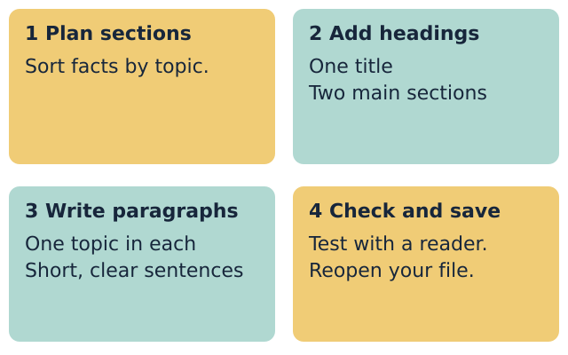
LAUNCH ICT • YEAR A • AUTUMN 2 WEEK 2
OPENING
A clear structured document
I can give my document a clear title.
I can group facts under headings.
I can write short, clear paragraphs.
I can save and check my work.
Fictional teaching model
ICT-LAUNCH-A2-W02 • Year A • 1/14
Made by Matt
Notes:
ICT_LAUNCH_A2_W02; Year A; week commencing 9 November 2026.
Introduce a fictional hobby-group welcome sheet for someone thinking of joining. All facts come from supplied made-up source cards. Keep personal names, contacts, places and meeting details out of the task.
Term theme: Identity & Belonging. Careers: Office support staff use headings and clear paragraphs so readers can find the right information.
Source: OWNER_APPROVED_ICT_OUTLINE.txt, issue 1. Context: LAUNCH KS4 - 2026-27-2.xlsx, LAUNCH - Autumn C19 and E19; Theme & Text Map B5. Accepted predecessor: LAUNCH_ICT_A2_W01_BUNDLE.zip, School/ICT_LAUNCH_A2_W01_Slides.pptx.

Slide 2
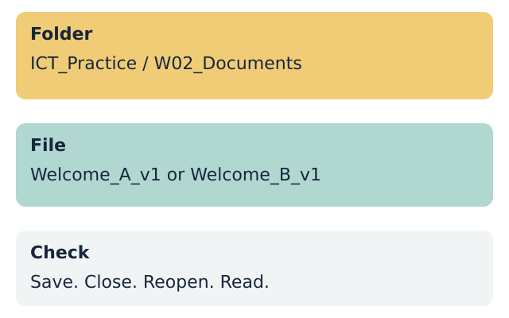
LAUNCH ICT • YEAR A • AUTUMN 2 WEEK 2
ARRIVAL • 3 MIN
Our file skills from last week
Where did you save your file?
How did you check that it saved?
What makes a file name useful?
Use a made-up profile again today.
Fictional teaching model
Your response: Show or explain the save-and-open check.
ICT-LAUNCH-A2-W02 • Year A • 2/14
Made by Matt
Notes:
ICT_LAUNCH_A2_W02; Year A; week commencing 9 November 2026.
Retrieve the Week 1 routine: agreed folder, useful file name, save, close, reopen and verify text. If the prior file is absent, model with a blank practice document. Do not imply that missing prior work is complete.
Term theme: Identity & Belonging. Careers: Office support staff use headings and clear paragraphs so readers can find the right information.
Source: OWNER_APPROVED_ICT_OUTLINE.txt, issue 1. Context: LAUNCH KS4 - 2026-27-2.xlsx, LAUNCH - Autumn C19 and E19; Theme & Text Map B5. Accepted predecessor: LAUNCH_ICT_A2_W01_BUNDLE.zip, School/ICT_LAUNCH_A2_W01_Slides.pptx.

Slide 3
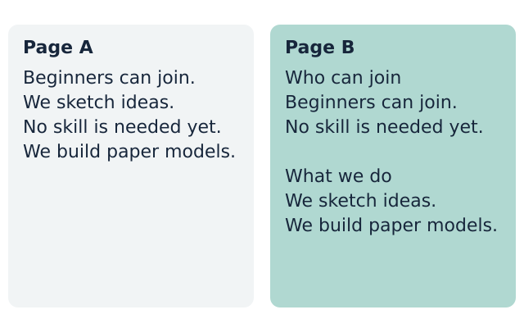
LAUNCH ICT • YEAR A • AUTUMN 2 WEEK 2
STARTER • 4 MIN
Which page helps the reader?
Find who can join. Which page helps you?
Fictional teaching model
Your response: Choose a page and explain what helped.
ICT-LAUNCH-A2-W02 • Year A • 3/14
Made by Matt
Notes:
ICT_LAUNCH_A2_W02; Year A; week commencing 9 November 2026.
Compare the same facts in an unbroken block and under meaningful headings. Ask pupils to locate who can join. Explain that structure helps the reader scan, not just makes a page look attractive.
The page with clear headings makes the joining facts easier to find.
Both pages need accurate words. A neat page can still contain mistakes.
Term theme: Identity & Belonging. Careers: Office support staff use headings and clear paragraphs so readers can find the right information.
Source: OWNER_APPROVED_ICT_OUTLINE.txt, issue 1. Context: LAUNCH KS4 - 2026-27-2.xlsx, LAUNCH - Autumn C19 and E19; Theme & Text Map B5. Accepted predecessor: LAUNCH_ICT_A2_W01_BUNDLE.zip, School/ICT_LAUNCH_A2_W01_Slides.pptx.

Slide 4
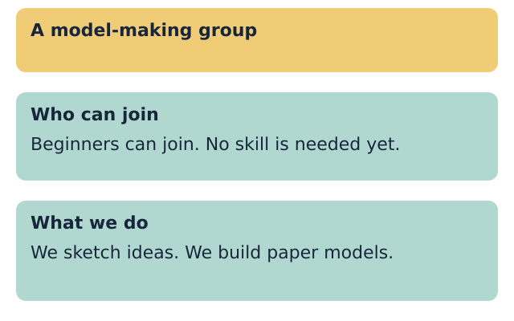
LAUNCH ICT • YEAR A • AUTUMN 2 WEEK 2
MODEL • 3 MIN
A title and useful headings
Give the whole page one clear title.
Use a heading style for each main section.
Fictional teaching model
Your response: Show the title and the two main headings.
ICT-LAUNCH-A2-W02 • Year A • 4/14
Made by Matt
Notes:
ICT_LAUNCH_A2_W02; Year A; week commencing 9 November 2026.
Demonstrate the built-in title style for the document title and the same heading level for main sections. Use the tool's equivalent if labels differ. Show Who can join and What we do. A larger or bold font alone does not create structural heading information. Do not use a table or repeated spaces to lay out the prose.
Term theme: Identity & Belonging. Careers: Office support staff use headings and clear paragraphs so readers can find the right information.
Source: OWNER_APPROVED_ICT_OUTLINE.txt, issue 1. Context: LAUNCH KS4 - 2026-27-2.xlsx, LAUNCH - Autumn C19 and E19; Theme & Text Map B5. Accepted predecessor: LAUNCH_ICT_A2_W01_BUNDLE.zip, School/ICT_LAUNCH_A2_W01_Slides.pptx.

Slide 5
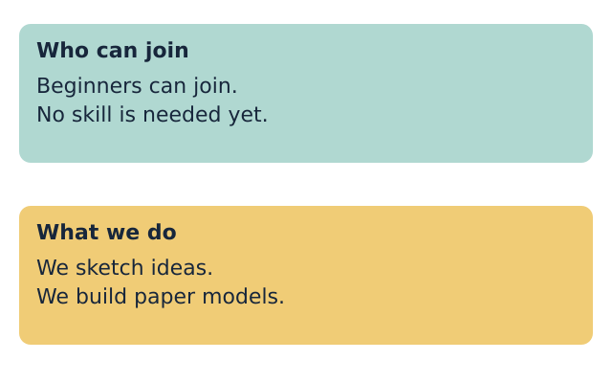
LAUNCH ICT • YEAR A • AUTUMN 2 WEEK 2
MODEL • 3 MIN
One topic in each paragraph
Put facts about the same topic together.
Write short sentences with full stops.
Fictional teaching model
Your response: Point to the facts that belong together.
ICT-LAUNCH-A2-W02 • Year A • 5/14
Made by Matt
Notes:
ICT_LAUNCH_A2_W02; Year A; week commencing 9 November 2026.
Model two sentences about joining, then two about the activity. Use normal paragraph text under the heading. Use paragraph breaks between sections, not a new line after every word. Leave clear space and keep text left aligned. Read the model aloud.
Term theme: Identity & Belonging. Careers: Office support staff use headings and clear paragraphs so readers can find the right information.
Source: OWNER_APPROVED_ICT_OUTLINE.txt, issue 1. Context: LAUNCH KS4 - 2026-27-2.xlsx, LAUNCH - Autumn C19 and E19; Theme & Text Map B5. Accepted predecessor: LAUNCH_ICT_A2_W01_BUNDLE.zip, School/ICT_LAUNCH_A2_W01_Slides.pptx.

Slide 6
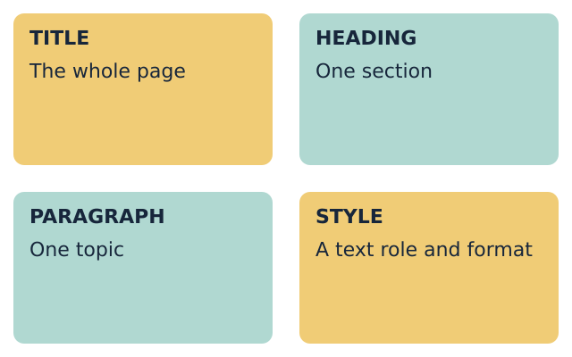
LAUNCH ICT • YEAR A • AUTUMN 2 WEEK 2
WORDS • 2 MIN
Words for a clear page
title: the name of the whole document
heading: a label for one section
paragraph: sentences about one topic
style: a set format with a text role
Fictional teaching model
Your response: Explain one word using the model page.
ICT-LAUNCH-A2-W02 • Year A • 6/14
Made by Matt
Notes:
ICT_LAUNCH_A2_W02; Year A; week commencing 9 November 2026.
Teach the four terms with the marked page. The styles menu gives text a role, such as heading, as well as a consistent appearance. Keep to one main heading level in this short document.
Term theme: Identity & Belonging. Careers: Office support staff use headings and clear paragraphs so readers can find the right information.
Source: OWNER_APPROVED_ICT_OUTLINE.txt, issue 1. Context: LAUNCH KS4 - 2026-27-2.xlsx, LAUNCH - Autumn C19 and E19; Theme & Text Map B5. Accepted predecessor: LAUNCH_ICT_A2_W01_BUNDLE.zip, School/ICT_LAUNCH_A2_W01_Slides.pptx.

Slide 7
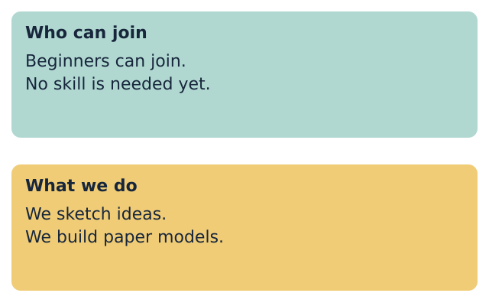
LAUNCH ICT • YEAR A • AUTUMN 2 WEEK 2
TOGETHER • 5 MIN
Two facts under the right heading
Beginners can join. No skill is needed yet.
We sketch ideas. We build paper models.
Fictional teaching model
Your response: Match each pair of facts to its heading.
ICT-LAUNCH-A2-W02 • Year A • 7/14
Made by Matt
Notes:
ICT_LAUNCH_A2_W02; Year A; week commencing 9 November 2026.
Use Model group source A. Joining facts go under Who can join. Sketching and building facts go under What we do. Allow pointing or moving printed cards before typing. Each pupil should explain one choice.
Who can join: beginners; no skill is needed yet.
What we do: sketch ideas; build paper models.
Term theme: Identity & Belonging. Careers: Office support staff use headings and clear paragraphs so readers can find the right information.
Source: OWNER_APPROVED_ICT_OUTLINE.txt, issue 1. Context: LAUNCH KS4 - 2026-27-2.xlsx, LAUNCH - Autumn C19 and E19; Theme & Text Map B5. Accepted predecessor: LAUNCH_ICT_A2_W01_BUNDLE.zip, School/ICT_LAUNCH_A2_W01_Slides.pptx.

Slide 8
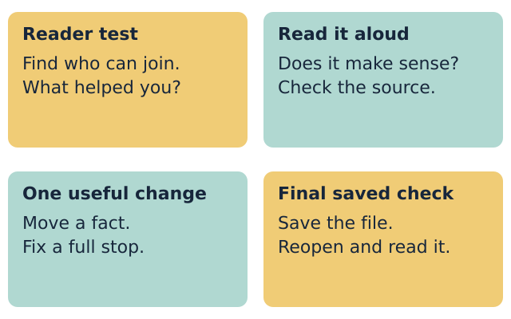
LAUNCH ICT • YEAR A • AUTUMN 2 WEEK 2
CHECK • 3 MIN
A reader checks the page
Can your partner find one fact quickly?
Read one paragraph. Does it make sense?
Fictional teaching model
Your response: Give one useful change for this reader.
ICT-LAUNCH-A2-W02 • Year A • 8/14
Made by Matt
Notes:
ICT_LAUNCH_A2_W02; Year A; week commencing 9 November 2026.
Ask the partner to find who can join without coaching. Then read one paragraph aloud or have staff read it back. Check source accuracy, missing full stops, accidental repeats and private details. Give specific feedback. Avoid judging the pupil's general literacy from this short task.
A useful heading tells the reader what is in that section.
Move a fact to the right section or fix a sentence that is hard to follow.
Term theme: Identity & Belonging. Careers: Office support staff use headings and clear paragraphs so readers can find the right information.
Source: OWNER_APPROVED_ICT_OUTLINE.txt, issue 1. Context: LAUNCH KS4 - 2026-27-2.xlsx, LAUNCH - Autumn C19 and E19; Theme & Text Map B5. Accepted predecessor: LAUNCH_ICT_A2_W01_BUNDLE.zip, School/ICT_LAUNCH_A2_W01_Slides.pptx.

Slide 9
LAUNCH ICT • YEAR A • AUTUMN 2 WEEK 2
YOUR TASK • 12 MIN
A welcome sheet for a new member
Supported: use the heading and sentence frame.
Independent: build your page from the facts.
Aspire: add a useful section and test it.
Each person saves and checks their own file.
Fictional teaching model
Your response: Choose a route and start your document.
ICT-LAUNCH-A2-W02 • Year A • 9/14
Made by Matt
Notes:
ICT_LAUNCH_A2_W02; Year A; week commencing 9 November 2026.
Slides 10-13 share this 12-minute task time. Each learner makes their own short welcome sheet. A shared device uses six-minute turns: source A then source B, with operator and reader roles. Keep the focus on structure and two accurate paragraphs.
Term theme: Identity & Belonging. Careers: Office support staff use headings and clear paragraphs so readers can find the right information.
Source: OWNER_APPROVED_ICT_OUTLINE.txt, issue 1. Context: LAUNCH KS4 - 2026-27-2.xlsx, LAUNCH - Autumn C19 and E19; Theme & Text Map B5. Accepted predecessor: LAUNCH_ICT_A2_W01_BUNDLE.zip, School/ICT_LAUNCH_A2_W01_Slides.pptx.

Slide 10
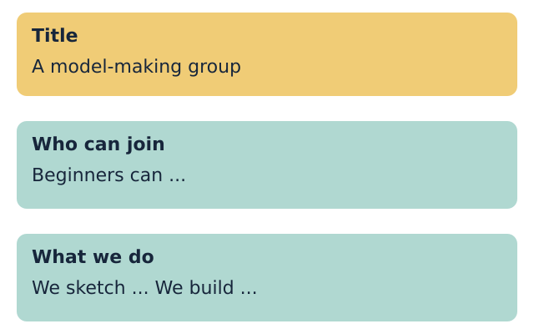
LAUNCH ICT • YEAR A • AUTUMN 2 WEEK 2
ROUTE
Supported
Choose made-up source A or source B.
Use the title and two heading prompts.
Write one short paragraph under each heading.
Use the style controls with help.
Save, reopen and check your document.
Fictional teaching model
Your response: Show one heading and the facts beneath it.
ICT-LAUNCH-A2-W02 • Year A • 10/14
Made by Matt
Notes:
ICT_LAUNCH_A2_W02; Year A; week commencing 9 November 2026.
Offer a blank document or use the editable route page as a planning frame. The pupil creates a new digital document. Provide one instruction at a time or exact scribing, then record that support. Aim for two short sentences per paragraph; accept one accurate sentence initially and record the next step.
Term theme: Identity & Belonging. Careers: Office support staff use headings and clear paragraphs so readers can find the right information.
Source: OWNER_APPROVED_ICT_OUTLINE.txt, issue 1. Context: LAUNCH KS4 - 2026-27-2.xlsx, LAUNCH - Autumn C19 and E19; Theme & Text Map B5. Accepted predecessor: LAUNCH_ICT_A2_W01_BUNDLE.zip, School/ICT_LAUNCH_A2_W01_Slides.pptx.

Slide 11
LAUNCH ICT • YEAR A • AUTUMN 2 WEEK 2
ROUTE
Independent
Give the document one clear title.
Add two useful headings with heading styles.
Write two short, accurate paragraphs.
Check the facts, spacing and full stops.
Save your file, then reopen it to check.
Fictional teaching model
Your response: Ask your reader to find who can join.
ICT-LAUNCH-A2-W02 • Year A • 11/14
Made by Matt
Notes:
ICT_LAUNCH_A2_W02; Year A; week commencing 9 November 2026.
The pupil uses the chosen source card, not a model to copy blindly. Check genuine heading styles and normal body text. Save in the agreed Week 2 folder under Welcome_A_v1 or Welcome_B_v1 with the software's native extension.
Term theme: Identity & Belonging. Careers: Office support staff use headings and clear paragraphs so readers can find the right information.
Source: OWNER_APPROVED_ICT_OUTLINE.txt, issue 1. Context: LAUNCH KS4 - 2026-27-2.xlsx, LAUNCH - Autumn C19 and E19; Theme & Text Map B5. Accepted predecessor: LAUNCH_ICT_A2_W01_BUNDLE.zip, School/ICT_LAUNCH_A2_W01_Slides.pptx.

Slide 12
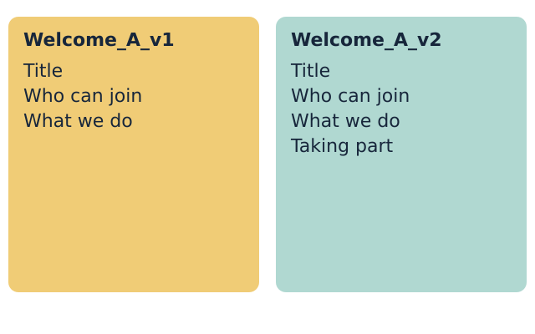
LAUNCH ICT • YEAR A • AUTUMN 2 WEEK 2
ROUTE
Aspire
Complete the Independent task first.
Add a useful section from the source facts.
Use the same main heading level.
Ask a reader to test the new section.
Save a new version and explain one change.
Fictional teaching model
Your response: Show how a change helped your reader.
ICT-LAUNCH-A2-W02 • Year A • 12/14
Made by Matt
Notes:
ICT_LAUNCH_A2_W02; Year A; week commencing 9 November 2026.
Use the source's turn-taking facts to create a Taking part section. Keep the same heading level as the other sections. Do not invent dates, fees or places. Save a separate v2 copy and retain v1. Explain a specific improvement using reader feedback.
Term theme: Identity & Belonging. Careers: Office support staff use headings and clear paragraphs so readers can find the right information.
Source: OWNER_APPROVED_ICT_OUTLINE.txt, issue 1. Context: LAUNCH KS4 - 2026-27-2.xlsx, LAUNCH - Autumn C19 and E19; Theme & Text Map B5. Accepted predecessor: LAUNCH_ICT_A2_W01_BUNDLE.zip, School/ICT_LAUNCH_A2_W01_Slides.pptx.

Slide 13
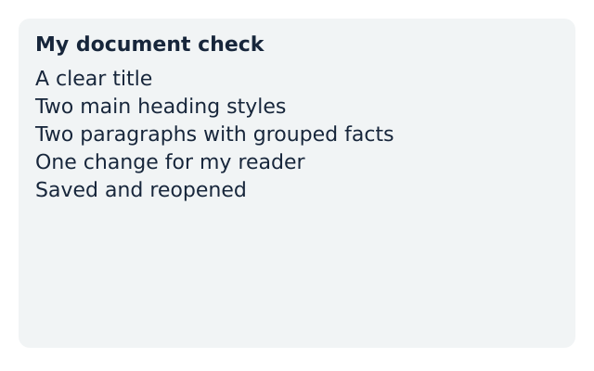
LAUNCH ICT • YEAR A • AUTUMN 2 WEEK 2
EVIDENCE
My evidence record
My file name is ...
My title tells the reader ...
My headings help the reader find ...
I changed ... because ...
I reopened the saved file and checked it.
Fictional teaching model
Your response: Record your own choices and the help used.
ICT-LAUNCH-A2-W02 • Year A • 13/14
Made by Matt
Notes:
ICT_LAUNCH_A2_W02; Year A; week commencing 9 November 2026.
Observe title, two real heading styles, grouped paragraphs and reopen result. Record actual prompts or scribing. One next-step prompt is followed by the pupil's response and an adult acknowledgement. Do not prefill success or use the partner's file as individual evidence.
Term theme: Identity & Belonging. Careers: Office support staff use headings and clear paragraphs so readers can find the right information.
Source: OWNER_APPROVED_ICT_OUTLINE.txt, issue 1. Context: LAUNCH KS4 - 2026-27-2.xlsx, LAUNCH - Autumn C19 and E19; Theme & Text Map B5. Accepted predecessor: LAUNCH_ICT_A2_W01_BUNDLE.zip, School/ICT_LAUNCH_A2_W01_Slides.pptx.

Slide 14
LAUNCH ICT • YEAR A • AUTUMN 2 WEEK 2
EXIT • 5 MIN
What makes my page clear?
Show your title, headings and paragraphs.
Explain one choice that helps the reader.
Open your saved file and check the text.
Fictional teaching model
Your response: Show your document and give one reason.
ICT-LAUNCH-A2-W02 • Year A • 14/14
Made by Matt
Notes:
ICT_LAUNCH_A2_W02; Year A; week commencing 9 November 2026.
Three minutes for individual checks, two for feedback and close. Check the saved version, not just the open draft. Week 3 evaluates sources. Week 7 is the assessing lesson; this is formative. Keep unfinished checks marked not yet observed.
Term theme: Identity & Belonging. Careers: Office support staff use headings and clear paragraphs so readers can find the right information.
Source: OWNER_APPROVED_ICT_OUTLINE.txt, issue 1. Context: LAUNCH KS4 - 2026-27-2.xlsx, LAUNCH - Autumn C19 and E19; Theme & Text Map B5. Accepted predecessor: LAUNCH_ICT_A2_W01_BUNDLE.zip, School/ICT_LAUNCH_A2_W01_Slides.pptx.

