Slide 1

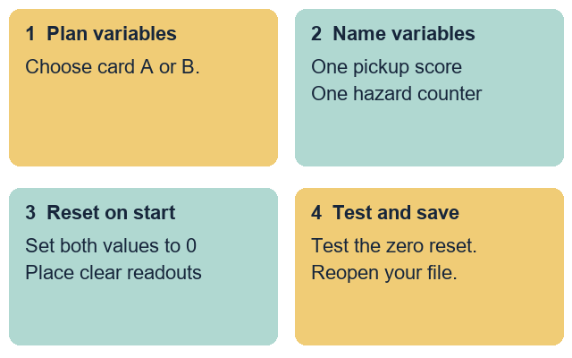
GROW ICT • YEAR A • AUTUMN 2 · WEEK 1
OPENING
Add and reset two score variables
I can create two clear score variables.
I can set both variables to zero on start.
I can place both readouts clearly on the stage.
I can save and check my maze project.
Fictional teaching model
ICT-GROW-A2-W01 • Year A • 1/14
Made by Matt
Notes:
ICT_GROW_A2_W01; Year A; week commencing 2 November 2026 (taught 3 November 2026).
Introduce the Autumn 2 continuation of the two-level maze project for the unit award. All variable names and rules come from supplied made-up project cards A and B. Keep personal names, places and external account details out of the task.
Term theme: Identity & Belonging. Careers: Software testers check that counters and displays reset cleanly before a new user starts.
Source: OWNER_APPROVED_ICT_OUTLINE.txt, issue 1. Continuation of Autumn 1 GROW Computing two-level maze sequence for the unit award.

Slide 2
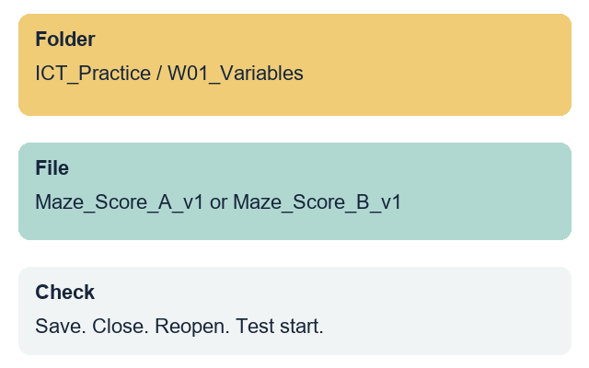
GROW ICT • YEAR A • AUTUMN 2 · WEEK 1
ARRIVAL • 3 MIN
Our maze skills from last half-term
Where does your player sprite start?
How does your start script reset the maze?
Where do you save your project file?
Choose made-up project card A or B today.
Fictional teaching model
Your response: Show or explain how your maze resets on start.
ICT-GROW-A2-W01 • Year A • 2/14
Made by Matt
Notes:
ICT_GROW_A2_W01; Year A; week commencing 2 November 2026 (taught 3 November 2026).
Retrieve the Autumn 1 maze routine: agreed folder, useful file name, start-position reset, save, close and reopen check. If a pupil's Autumn 1 maze file is absent, open the clean two-level starter maze file from the practice folder.
Term theme: Identity & Belonging. Careers: Software testers check that counters and displays reset cleanly before a new user starts.
Source: OWNER_APPROVED_ICT_OUTLINE.txt, issue 1. Continuation of Autumn 1 GROW Computing two-level maze sequence for the unit award.

Slide 3
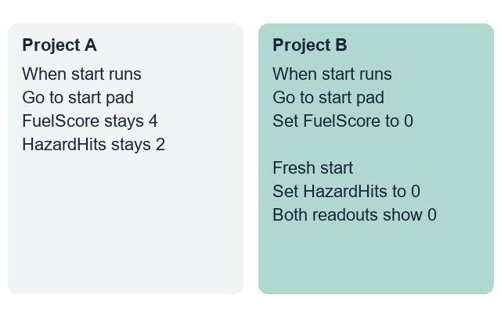
GROW ICT • YEAR A • AUTUMN 2 · WEEK 1
STARTER • 4 MIN
Which start script is fair?
Look at Project A and Project B. Which start script gives a fair fresh start?
Fictional teaching model
Your response: Choose a project and explain why it is fair.
ICT-GROW-A2-W01 • Year A • 3/14
Made by Matt
Notes:
ICT_GROW_A2_W01; Year A; week commencing 2 November 2026 (taught 3 November 2026).
Compare a start script that leaves old scores untouched with one that resets both score variables to zero on start. Explain that initialising variables on start gives every player a fair turn.
Term theme: Identity & Belonging. Careers: Software testers check that counters and displays reset cleanly before a new user starts.
Source: OWNER_APPROVED_ICT_OUTLINE.txt, issue 1. Continuation of Autumn 1 GROW Computing two-level maze sequence for the unit award.
Term theme: Identity & Belonging. Careers: Office support staff use headings and clear paragraphs so readers can find the right information.
Source: OWNER_APPROVED_ICT_OUTLINE.txt, issue 1. Context: LAUNCH KS4 - 2026-27-2.xlsx, LAUNCH - Autumn C19 and E19; Theme & Text Map B5. Accepted predecessor: LAUNCH_ICT_A2_W01_BUNDLE.zip, School/ICT_LAUNCH_A2_W01_Slides.pptx.

Slide 4
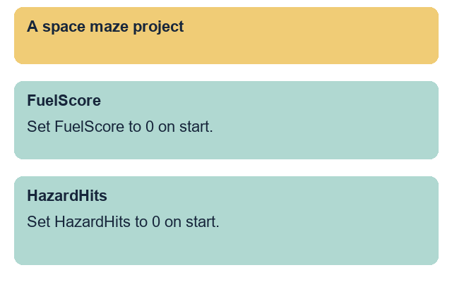
GROW ICT • YEAR A • AUTUMN 2 · WEEK 1
MODEL • 3 MIN
Clear names for two variables
Give each score variable a name that matches its job.
Create one variable for pickups and one for hazards.
Fictional teaching model
Your response: Point to the two variable names on the model.
ICT-GROW-A2-W01 • Year A • 4/14
Made by Matt
Notes:
ICT_GROW_A2_W01; Year A; week commencing 2 November 2026 (taught 3 November 2026).
Demonstrate making two variables in the block editor using Card A: FuelScore and HazardHits. Show how clear names tell anyone reading the script what each number tracks. Avoid vague names such as number1 or var.
Term theme: Identity & Belonging. Careers: Software testers check that counters and displays reset cleanly before a new user starts.
Source: OWNER_APPROVED_ICT_OUTLINE.txt, issue 1. Continuation of Autumn 1 GROW Computing two-level maze sequence for the unit award.

Slide 5
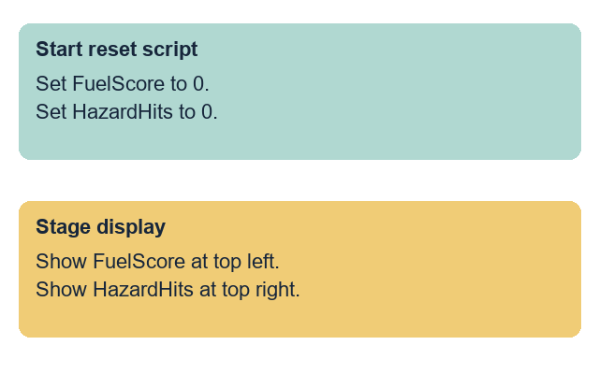
GROW ICT • YEAR A • AUTUMN 2 · WEEK 1
MODEL • 3 MIN
Reset both variables on start
Place two set-to-zero blocks directly under the start event.
Keep the variable readouts away from the maze walls.
Fictional teaching model
Your response: Point to the two blocks that reset the scores.
ICT-GROW-A2-W01 • Year A • 5/14
Made by Matt
Notes:
ICT_GROW_A2_W01; Year A; week commencing 2 November 2026 (taught 3 November 2026).
Model attaching set FuelScore to 0 and set HazardHits to 0 directly under the start hat block on the player sprite. Drag the two stage readouts to the top corners so the start pad and maze walls stay visible.
Term theme: Identity & Belonging. Careers: Software testers check that counters and displays reset cleanly before a new user starts.
Source: OWNER_APPROVED_ICT_OUTLINE.txt, issue 1. Continuation of Autumn 1 GROW Computing two-level maze sequence for the unit award.

Slide 6
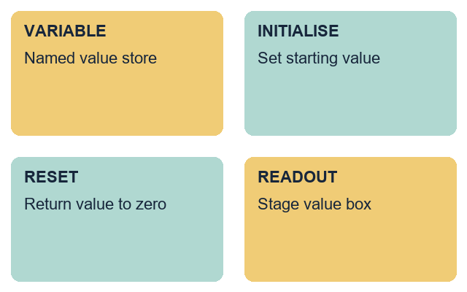
GROW ICT • YEAR A • AUTUMN 2 · WEEK 1
WORDS • 2 MIN
Words for score variables
variable: a named store for a value that can change
initialise: set a starting value when the project begins
reset: return a value to zero for a fresh start
readout: the box on stage that shows a variable value
Fictional teaching model
Your response: Explain one word using the model script.
ICT-GROW-A2-W01 • Year A • 6/14
Made by Matt
Notes:
ICT_GROW_A2_W01; Year A; week commencing 2 November 2026 (taught 3 November 2026).
Teach the four terms with the model script and stage view. Connect initialise and reset to the two set-to-zero blocks under the start event.
Term theme: Identity & Belonging. Careers: Software testers check that counters and displays reset cleanly before a new user starts.
Source: OWNER_APPROVED_ICT_OUTLINE.txt, issue 1. Continuation of Autumn 1 GROW Computing two-level maze sequence for the unit award.

Slide 7
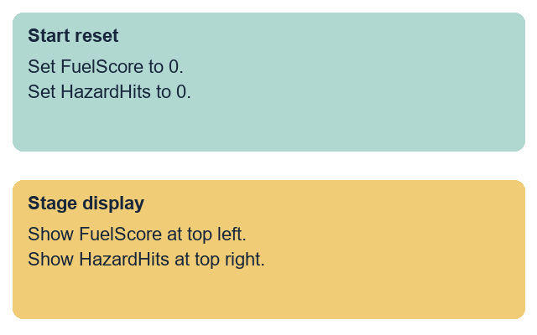
GROW ICT • YEAR A • AUTUMN 2 · WEEK 1
TOGETHER • 5 MIN
Match each block to its job
Set FuelScore to 0. Set HazardHits to 0.
Show FuelScore at top left. Show HazardHits at top right.
Fictional teaching model
Your response: Match each pair of rules to its setup step.
ICT-GROW-A2-W01 • Year A • 7/14
Made by Matt
Notes:
ICT_GROW_A2_W01; Year A; week commencing 2 November 2026 (taught 3 November 2026).
Use Space maze card A. The two set-to-zero blocks belong under Start reset. The two readout positions belong under Stage display. Allow pointing or sorting printed cards before building the script.
Term theme: Identity & Belonging. Careers: Software testers check that counters and displays reset cleanly before a new user starts.
Source: OWNER_APPROVED_ICT_OUTLINE.txt, issue 1. Continuation of Autumn 1 GROW Computing two-level maze sequence for the unit award.
Term theme: Identity & Belonging. Careers: Office support staff use headings and clear paragraphs so readers can find the right information.
Source: OWNER_APPROVED_ICT_OUTLINE.txt, issue 1. Context: LAUNCH KS4 - 2026-27-2.xlsx, LAUNCH - Autumn C19 and E19; Theme & Text Map B5. Accepted predecessor: LAUNCH_ICT_A2_W01_BUNDLE.zip, School/ICT_LAUNCH_A2_W01_Slides.pptx.

Slide 8
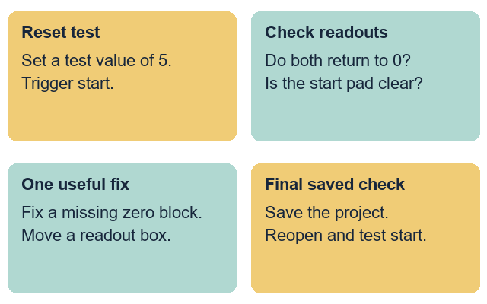
GROW ICT • YEAR A • AUTUMN 2 · WEEK 1
CHECK • 3 MIN
A partner tests the start reset
Change one variable to 5, then trigger start. Does it return to 0?
Can the player see the start zone and both readouts clearly?
Fictional teaching model
Your response: Give one useful fix after the reset test.
ICT-GROW-A2-W01 • Year A • 8/14
Made by Matt
Notes:
ICT_GROW_A2_W01; Year A; week commencing 2 November 2026 (taught 3 November 2026).
Model a deliberate test: temporarily set a variable to 5, trigger the start event, and verify that both readouts return to 0. Check that neither readout covers the start zone or finish target.
Term theme: Identity & Belonging. Careers: Software testers check that counters and displays reset cleanly before a new user starts.
Source: OWNER_APPROVED_ICT_OUTLINE.txt, issue 1. Continuation of Autumn 1 GROW Computing two-level maze sequence for the unit award.
Term theme: Identity & Belonging. Careers: Office support staff use headings and clear paragraphs so readers can find the right information.
Source: OWNER_APPROVED_ICT_OUTLINE.txt, issue 1. Context: LAUNCH KS4 - 2026-27-2.xlsx, LAUNCH - Autumn C19 and E19; Theme & Text Map B5. Accepted predecessor: LAUNCH_ICT_A2_W01_BUNDLE.zip, School/ICT_LAUNCH_A2_W01_Slides.pptx.

Slide 9
GROW ICT • YEAR A • AUTUMN 2 · WEEK 1
YOUR TASK • 12 MIN
Add two score variables to your maze
Supported: use the variable name and reset frame.
Independent: create and reset both score variables.
Aspire: add a round counter that starts at one.
Each person saves and checks their own project file.
Fictional teaching model
Your response: Choose a route and set up your variables.
ICT-GROW-A2-W01 • Year A • 9/14
Made by Matt
Notes:
ICT_GROW_A2_W01; Year A; week commencing 2 November 2026 (taught 3 November 2026).
Slides 10-13 share this 12-minute task time. Each pupil updates their own maze file. A shared device uses six-minute turns: Card A then Card B, with builder and tester roles. Keep the focus on naming and resetting two variables.
Term theme: Identity & Belonging. Careers: Software testers check that counters and displays reset cleanly before a new user starts.
Source: OWNER_APPROVED_ICT_OUTLINE.txt, issue 1. Continuation of Autumn 1 GROW Computing two-level maze sequence for the unit award.

Slide 10
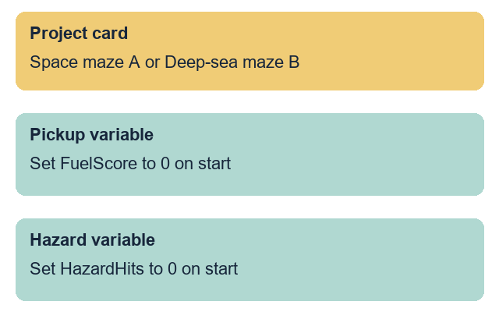
GROW ICT • YEAR A • AUTUMN 2 · WEEK 1
ROUTE
Supported
Choose made-up project card A or card B.
Create the two named variables on your card.
Attach two set-to-zero blocks to the start event.
Place both readouts at the top with help.
Save, reopen and test the start reset.
Fictional teaching model
Your response: Show your two variables and their zero values.
ICT-GROW-A2-W01 • Year A • 10/14
Made by Matt
Notes:
ICT_GROW_A2_W01; Year A; week commencing 2 November 2026 (taught 3 November 2026).
Use the editable route page as a planning frame. Provide one step at a time or exact scribing for variable names, then record that support. The pupil selects the blocks and runs the start reset test.
Term theme: Identity & Belonging. Careers: Software testers check that counters and displays reset cleanly before a new user starts.
Source: OWNER_APPROVED_ICT_OUTLINE.txt, issue 1. Continuation of Autumn 1 GROW Computing two-level maze sequence for the unit award.

Slide 11
GROW ICT • YEAR A • AUTUMN 2 · WEEK 1
ROUTE
Independent
Choose project card A or B and create both variables.
Attach both set-to-zero blocks to the start script.
Place both stage readouts clear of the maze path.
Test the reset by setting a test number and restarting.
Save your file, then reopen it to check.
Fictional teaching model
Your response: Ask your partner to test your start reset.
ICT-GROW-A2-W01 • Year A • 11/14
Made by Matt
Notes:
ICT_GROW_A2_W01; Year A; week commencing 2 November 2026 (taught 3 November 2026).
The pupil uses the chosen project card to create and initialise both variables on the player sprite. Save in the agreed Week 1 folder under Maze_Score_A_v1 or Maze_Score_B_v1 with the software's native extension.
Term theme: Identity & Belonging. Careers: Software testers check that counters and displays reset cleanly before a new user starts.
Source: OWNER_APPROVED_ICT_OUTLINE.txt, issue 1. Continuation of Autumn 1 GROW Computing two-level maze sequence for the unit award.

Slide 12
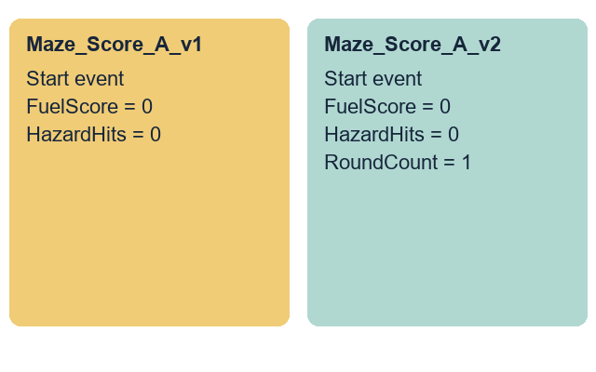
GROW ICT • YEAR A • AUTUMN 2 · WEEK 1
ROUTE
Aspire
Complete the Independent task first.
Add the third variable from your card for the round count.
Set the round variable to 1 under the start event.
Ask a partner to test all three readouts on start.
Save a new version and explain one change.
Fictional teaching model
Your response: Show how all three variables initialise on start.
ICT-GROW-A2-W01 • Year A • 12/14
Made by Matt
Notes:
ICT_GROW_A2_W01; Year A; week commencing 2 November 2026 (taught 3 November 2026).
Use the card's stretch rule to add RoundCount (Card A) or DiveCount (Card B) initialised to 1 on start. Save a separate v2 copy and retain v1. Explain why a round counter starts at 1 while scores start at 0.
Term theme: Identity & Belonging. Careers: Software testers check that counters and displays reset cleanly before a new user starts.
Source: OWNER_APPROVED_ICT_OUTLINE.txt, issue 1. Continuation of Autumn 1 GROW Computing two-level maze sequence for the unit award.

Slide 13
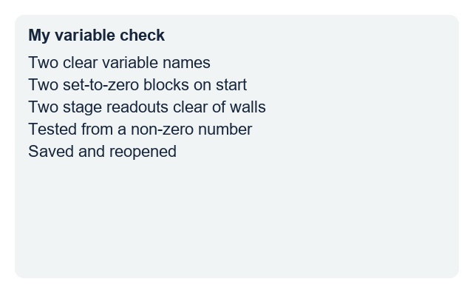
GROW ICT • YEAR A • AUTUMN 2 · WEEK 1
EVIDENCE
My evidence record
My file name is ...
My pickup variable is ...
My hazard variable is ...
I changed ... because ...
I reopened the saved file and tested the reset.
Fictional teaching model
Your response: Record your own variable names and the help used.
ICT-GROW-A2-W01 • Year A • 13/14
Made by Matt
Notes:
ICT_GROW_A2_W01; Year A; week commencing 2 November 2026 (taught 3 November 2026).
Observe two named variables, two set-to-zero blocks attached to start, clear readout placement and reopen result. Record actual prompts or scribing. One next-step prompt is followed by the pupil's response and an adult acknowledgement. Do not prefill pupil codes or success boxes.
Term theme: Identity & Belonging. Careers: Software testers check that counters and displays reset cleanly before a new user starts.
Source: OWNER_APPROVED_ICT_OUTLINE.txt, issue 1. Continuation of Autumn 1 GROW Computing two-level maze sequence for the unit award.

Slide 14
GROW ICT • YEAR A • AUTUMN 2 · WEEK 1
EXIT • 5 MIN
How do we know the start is fair?
Show your two variables and your start reset blocks.
Explain why both scores must reset to zero on start.
Open your saved file and run the start check.
Fictional teaching model
Your response: Show your project and give one reason.
ICT-GROW-A2-W01 • Year A • 14/14
Made by Matt
Notes:
ICT_GROW_A2_W01; Year A; week commencing 2 November 2026 (taught 3 November 2026).
Three minutes for individual checks, two for feedback and close. Check the saved file, not just the open draft. Week 2 updates scores from two maze events. Week 7 is the assessing lesson; this week is formative.
Term theme: Identity & Belonging. Careers: Software testers check that counters and displays reset cleanly before a new user starts.
Source: OWNER_APPROVED_ICT_OUTLINE.txt, issue 1. Continuation of Autumn 1 GROW Computing two-level maze sequence for the unit award.

