Slide 1

CREATIVE ARTS BUILD SPRING 1 WEEK 4 LESSON 2
OPENING RESILIENCE & CHANGE
A piece with my new texture
I can use my new texture in a small piece.
Weekly outcome
Try a new expressive technique.
Explore level. You can point, speak, sign, draw or write. You may share privately.
ART_BUILD_S1_W04_P2 Tuesday 26 January 2027 P1 1/11
Made by Matt
Notes:
Tuesday 26 January 2027 P1. BUILD Weekly Spring row 91. Year A. Explore. Weekly outcome verbatim: Try a new expressive technique.
I can use the new way I tried.
I can keep or change one part for a reason.
I can show what I did in my arts log.
For four pupils: four retained trial sets, four books or arts logs, four small sheets plus spare thin paper, four broad wax crayons and four clear table spaces.
Provide four clean pieces of ridged card and four smooth pieces of card, with safe edges. Shared trays can be used in pairs. No cutting tools, wet paint or adhesive are needed.
Prepare two small real rubbings for demonstration, four storage trays and spare paper. Check that the surfaces give a visible mark before teaching.
No-materials route: seated or standing silent hand movement. No device, body contact or personal story is required.
If prior work is missing, offer a brief honest restart: choose an invented idea and a small achievable form, state a first step and needed tools or no-materials route, then make a first version. Date it today and label it a new start. Do not claim missing earlier evidence.

Slide 2
CREATIVE ARTS BUILD SPRING 1 WEEK 4 LESSON 2
ARRIVAL 3 MINUTES
A choice and a new start
Find the tests you made last time.
Point to the one you chose.
Today you can use it in a small piece.
ART_BUILD_S1_W04_P2 Tuesday 26 January 2027 P1 2/11
Made by Matt
Notes:
Say and do: Retrieve the real tests and confirmed reason. If absent or missing, make two tiny tests now with adult help; record them as today rather than inventing earlier work. Offer the same silent movement route.
Look for: Pupil reconnects with a real choice or makes an honest new start.
Materials-free: Recall or repeat the witnessed smooth and stop-start motions. Pupil confirms the choice.
Check and response: A new start is valid. Do not claim an earlier trial without evidence.

Slide 3
CREATIVE ARTS BUILD SPRING 1 WEEK 4 LESSON 2
STARTER 3 MINUTES
A feature to notice
Which texture did you choose?
What could it show in your piece?
You may keep your idea or change it.
ART_BUILD_S1_W04_P2 Tuesday 26 January 2027 P1 3/11
Made by Matt
Notes:
Say and do: Compare the two tests. Ask the pupil to name or show one feature and a reason. A change of idea is allowed and goes in the log.
Look for: Pupil links a visible or movement feature to an intended feeling.
Materials-free: Pupil chooses a silent movement texture and an invented feeling.
Check and response: The maker chooses meaning. Busy marks can feel joyful, tense or something else.

Slide 4
CREATIVE ARTS BUILD SPRING 1 WEEK 4 LESSON 2
I DO 6 MINUTES
The method in small steps
Watch a small texture piece.
Put paper over the safe card.
Rub lightly in two small spaces.
Leave a gap. Check your idea.
ART_BUILD_S1_W04_P2 Tuesday 26 January 2027 P1 4/11
Made by Matt
Notes:
Say and do: My invented idea is energy settling down. On one small sheet I rub a ridged patch on the left and a lighter patch on the right, leaving a gap. I keep the same crayon so I can see texture and pressure. I look back at my tests. I keep the left patch and lighten the right because I want less busy marks at the end. I use the side of the crayon, with fingers outside the rubbing area. This is one adult idea, not a design to copy.
Look for: Adult shows the technique, a deliberate choice and a small change; the pupil can make a different arrangement.
Materials-free: Show stop-start movement, hold still for two counts, then a smooth glide and hold. Explain the shift in texture. Use a comfortable range or direct the adult.
Check and response: CfU: How is this made: drawing each ridge, or rubbing over card under the paper? Rubbing over card. Re-show if needed.

Slide 5
CREATIVE ARTS BUILD SPRING 1 WEEK 4 LESSON 2
WITHIN I DO STEP BY STEP
Texture rubbing
A new way to make marks
1. Show yesterday tests and state the maker choice. Put a fresh small sheet over ridged card.
2. Rub one patch gently. Leave a gap before a second patch.
3. Make the second patch lighter. Point out the actual difference in marks.
4. Explain the decision. Show how the tests and piece stay together with a true log entry.
What is under the paper? Why use light pressure?
ART_BUILD_S1_W04_P2 Tuesday 26 January 2027 P1 5/11
Made by Matt
Notes:
My invented idea is energy settling down. On one small sheet I rub a ridged patch on the left and a lighter patch on the right, leaving a gap. I keep the same crayon so I can see texture and pressure. I look back at my tests. I keep the left patch and lighten the right because I want less busy marks at the end. I use the side of the crayon, with fingers outside the rubbing area. This is one adult idea, not a design to copy.
Show stop-start movement, hold still for two counts, then a smooth glide and hold. Explain the shift in texture. Use a comfortable range or direct the adult.

Slide 6
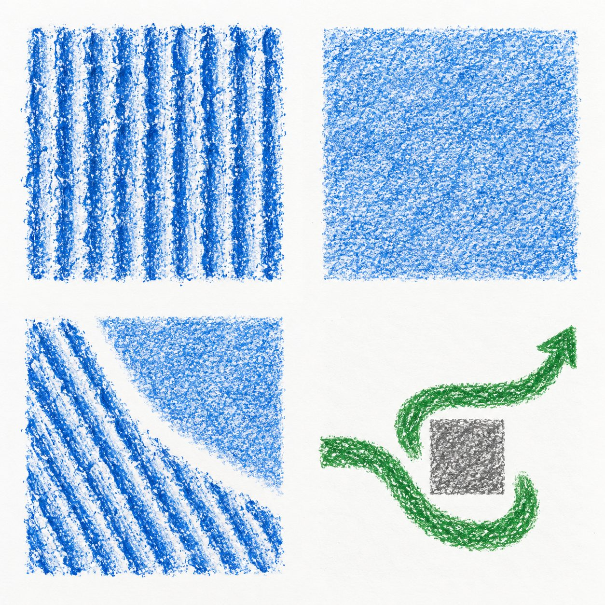
CREATIVE ARTS BUILD SPRING 1 WEEK 4 LESSON 2
WITHIN I DO ORIGINAL CLASS MODELS
Original examples and your own choices
Look at the textures and the path.
These are original class examples.
What feature could fit your idea?
Your work can look different.
ART_BUILD_S1_W04_P2 Tuesday 26 January 2027 P1 6/11
Made by Matt
Notes:
Original generated classroom examples, not pupil evidence or photographs of actual rubbings. Show real tests alongside these.
Teacher example only: the ridged marks suggest energy to me. Another maker may read them as calm.
Teacher example only: I used a smooth glide and stop-start hand movement. I chose the stops for surprise. This is movement evidence, not a rubbing.

Slide 7
CREATIVE ARTS BUILD SPRING 1 WEEK 4 LESSON 2
WE DO 6 MINUTES
A shared choice
Choose one texture for the class piece.
Where will it go?
Try one small change.
Keep or change it for a reason.
ART_BUILD_S1_W04_P2 Tuesday 26 January 2027 P1 7/11
Made by Matt
Notes:
Say and do: Let pupils direct the class trial. Change the pressure or space, not every feature at once. Hinge: an adult likes a different layout. A: the pupil must copy it; B: the pupil can keep their own choice and explain.
Look for: Pupil retains ownership and selects B.
Materials-free: Pupil directs a smaller movement or a longer still pause and chooses its effect.
Check and response: B. If A, model listening to advice then choosing. Parallel check: may two makers choose different textures for calm? Yes.

Slide 8
CREATIVE ARTS BUILD SPRING 1 WEEK 4 LESSON 2
CREATE 14 MINUTES
Your own making
Make a small piece with your new texture.
Use your tests to help you choose.
Check one part. Keep it or change it.
Keep your work and your own reason.
ART_BUILD_S1_W04_P2 Tuesday 26 January 2027 P1 8/11
Made by Matt
Notes:
Say and do: Use one small sheet. Place safe card beneath it and rub gently with the side of the crayon. Make two areas with a chosen space or pressure difference. A pupil may use just one texture deliberately. Stop before paper tears. Ask the pupil to choose one keep-or-change decision; do not make that decision for them. Record whether the piece is finished or still in progress.
Look for: A small original piece shows an intentional use of rubbing and a reasoned choice, or a witnessed movement piece shows contrasting movement textures.
Materials-free: Use or direct a short silent sequence: one texture, a still pose, a second texture, then stop. Choose the size or pace. Record the real sequence and the pupil meaning.
Check and response: Example only: I kept the rough patch and made the next one light because I wanted the energy to fade. A one-texture piece can also be deliberate.
Keep actual tests or versions, the pupil choice and reason, dated arts-log entry and actual support. A precise confirmed witness note is valid for performance or directed work. Do not prefill model answers as pupil evidence.

Slide 9
CREATIVE ARTS BUILD SPRING 1 WEEK 4 LESSON 2
WITHIN CREATE ONE ROUTE AT A TIME
Supported, Independent or Aspire
Supported
Independent
Aspire
Find or remake two small tests.
Use your chosen texture in a small piece.
Complete the same small piece.
Choose a texture and direct the adult.
Check one feature against your idea.
Compare a first version with one small change.
Make a small piece or silent sequence.
Keep or change it for a reason.
Explain what the change does to the feeling.
Show one choice and your reason.
Keep your work and dated arts-log entry.
Choose the version you want to keep.
ART_BUILD_S1_W04_P2 Tuesday 26 January 2027 P1 9/11
Made by Matt
Notes:
Use one route at a time within Create. All routes retain pupil choices.
Keep actual tests or versions, the pupil choice and reason, dated arts-log entry and actual support. A precise confirmed witness note is valid for performance or directed work. Do not prefill model answers as pupil evidence.

Slide 10
CREATIVE ARTS BUILD SPRING 1 WEEK 4 LESSON 2
REVIEW 5 MINUTES
A check and a reason
Show one part you chose.
Say: I kept or changed ___ because ___.
You can share with just an adult.
Tidy your space.
ART_BUILD_S1_W04_P2 Tuesday 26 January 2027 P1 10/11
Made by Matt
Notes:
Say and do: Ask the maker whether the piece matches their idea. A listener notices one feature without guessing personal feelings. Use the last two minutes to collect crayons and card, remove scraps and store the work flat.
Look for: Pupil confirms one decision and the real completion stage.
Materials-free: Pupil repeats or directs the final movement once. Adult reads the description back for correction.
Check and response: Keep and change are both valid when the reason relates to the intended effect.

Slide 11
CREATIVE ARTS BUILD SPRING 1 WEEK 4 LESSON 2
EXIT 3 MINUTES
Your arts log
Arts log: I tried the new way by ___.
I made ___.
I kept or changed ___ because ___.
Next I would ___.
ART_BUILD_S1_W04_P2 Tuesday 26 January 2027 P1 11/11
Made by Matt
Notes:
Say and do: Retain the earlier tests with the actual piece or witness note. Record date, technique, choice, change and help. The pupil checks any scribed words. Do not claim rubbing for a movement-only response.
Look for: The record distinguishes tests, actual piece and a next step.
Materials-free: Use a confirmed oral entry; record at the next available opportunity.
Check and response: Example only: I made a silent texture sequence. I changed the last move to a smooth glide to show calm.

