Slide 1

CREATIVE ARTS GROW SPRING 1 WEEK 4 LESSON 1
OPENING RESILIENCE & CHANGE
Making from my resilience plan
I can start my piece from my own plan.
Weekly outcome
Create my resilience-themed piece.
Explore level. You can point, speak, sign, draw or write. You may share privately.
ART_GROW_S1_W04_P1 Monday 25 January 2027 P6 1/11
Made by Matt
Notes:
Monday 25 January 2027 P6. GROW Weekly Spring row 91. Year A. Explore. Weekly outcome verbatim: Create my resilience-themed piece.
I can use my plan to start making.
I can explain a making decision.
I can record what I made and what changed.
For up to five pupils: five Week 3 plans, arts logs and actual Week 2 skill records; five pencils and small workspaces.
Check each plan materials list in advance. Drawing fallback: five sheets plus scrap and five familiar drawing tools. Paper route: clean scrap and shared glue sticks. Use familiar materials and local procedures.
For paint only if planned and approved: mats, stable water pots, brushes, a small amount of familiar washable paint and cloths. Keep wet work away from electrical equipment.
Sound needs no instrument: quiet fingertips and a stop signal. Silent movement or directed adult actions need no materials. Offer seated, quiet and private options.
Set aside five safe storage places for unfinished work with its plan and actual log. No phone or media recording is required.
If prior work is missing, offer a brief honest restart: choose an invented idea and a small achievable form, state a first step and needed tools or no-materials route, then make a first version. Date it today and label it a new start. Do not claim missing earlier evidence.

Slide 2
CREATIVE ARTS GROW SPRING 1 WEEK 4 LESSON 1
ARRIVAL 3 MINUTES
A choice and a new start
Find your chosen Week 3 plan.
Say what your piece will show.
Choose a quiet way to work and share.
ART_GROW_S1_W04_P1 Monday 25 January 2027 P6 2/11
Made by Matt
Notes:
Say and do: Retrieve the annotated plan, tool quantities, access notes and intended effect. Pupils may use an invented seed, a path or their own abstract idea. If the plan is missing, use the brief catch-up in the cover plan. Do not claim it was made last week.
Look for: Pupil identifies their actual plan and a first making step.
Materials-free: Read back the retained oral sequence. If absent, the pupil chooses a simple new sequence and confirms it.
Check and response: Resilience may involve help, rest or a different route. It does not mean ignoring discomfort.

Slide 3
CREATIVE ARTS GROW SPRING 1 WEEK 4 LESSON 1
STARTER 3 MINUTES
A feature to notice
Check your tools, space and first step.
You have 14 minutes to make today.
What small part can you make in that time?
ART_GROW_S1_W04_P1 Monday 25 January 2027 P6 3/11
Made by Matt
Notes:
Say and do: Check real supplies against the Week 3 plan. Its draft time split was provisional. Today the shared taught structure gives fourteen minutes of making, with a further fourteen next lesson. Scale the first section to fit; note this change in the log. Preserve the maker intention.
Look for: Pupil sets a manageable first section and confirms actual resources.
Materials-free: Choose a short silent sequence that can be made and repeated within fourteen minutes.
Check and response: A smaller piece can still express the whole idea. Record a changed time or resource choice honestly.

Slide 4
CREATIVE ARTS GROW SPRING 1 WEEK 4 LESSON 1
I DO 6 MINUTES
The method in small steps
Look back at the plan before each step.
Make a small first section.
Check the feature that shows your idea.
Record one decision as you work.
ART_GROW_S1_W04_P1 Monday 25 January 2027 P6 4/11
Made by Matt
Notes:
Say and do: Use an original adult plan: a line meets a block and turns towards open space. Point to the start, block and new route on the plan. On paper make the first line and block, then test the turn. My line almost touches the block, so I leave a small gap to make the new route clear. I note: I left a gap because I wanted the turn to show. For silent movement, start a forward hand path, stop, turn sideways and continue. Explain which version is actually being made.
Look for: Adult shows plan-to-making links and a real practical decision. The adult sample is never used as pupil evidence.
Materials-free: Model the same sequence silently with one hand. Pupil can direct position, pause or route without moving.
Check and response: CfU: Which note records a decision: I worked hard, or I left a gap to show the turn? The second. Model a specific feature if the answer is vague.

Slide 5
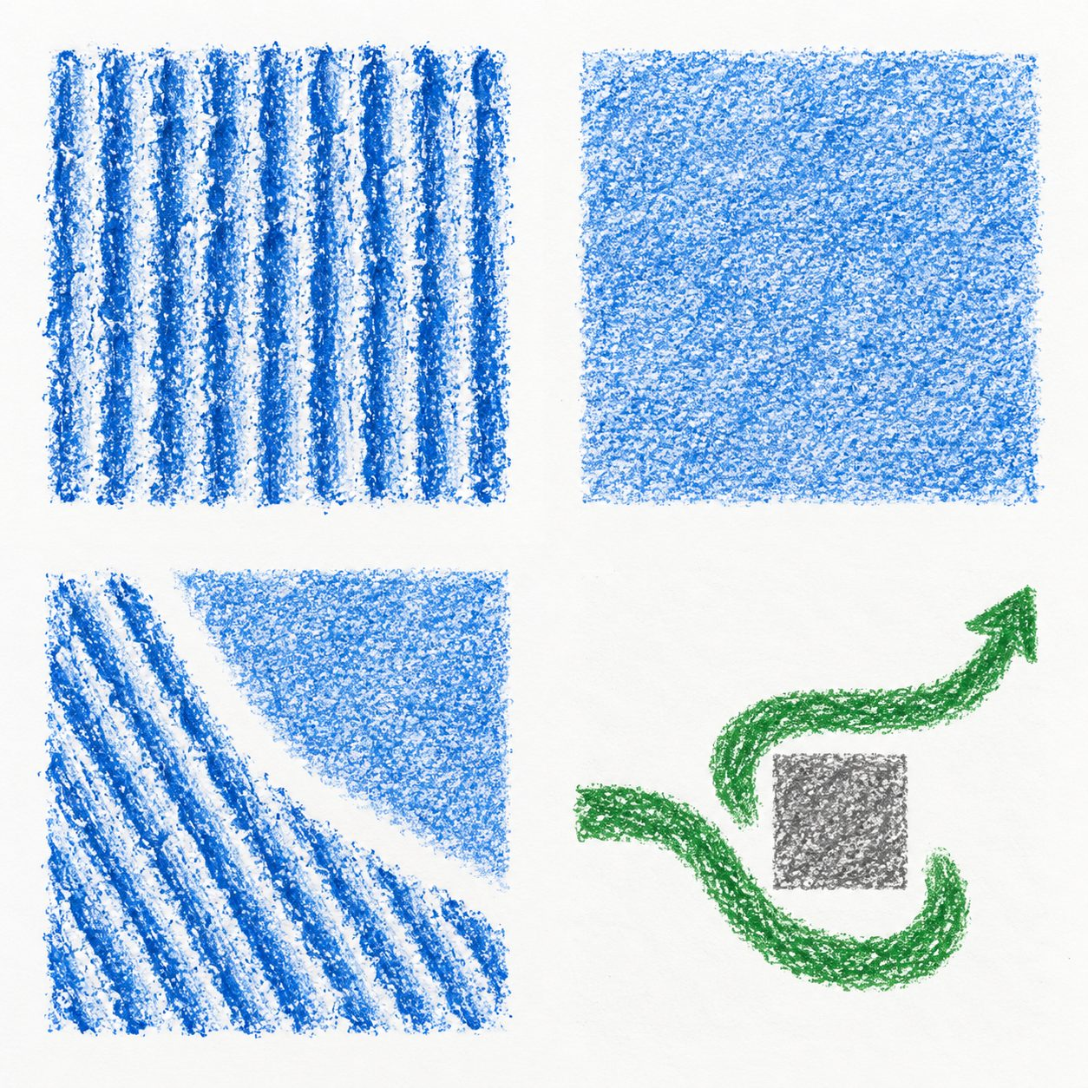
CREATIVE ARTS GROW SPRING 1 WEEK 4 LESSON 1
WITHIN I DO ORIGINAL CLASS MODELS
Original examples and your own choices
Look at the textures and the path.
These are original class examples.
What feature could fit your idea?
Your work can look different.
ART_GROW_S1_W04_P1 Monday 25 January 2027 P6 5/11
Made by Matt
Notes:
Original generated classroom examples, not pupil evidence or photographs of actual rubbings. Show real tests alongside these.
Teacher example only: I made the start and turn. I left a gap because it makes the new route clear. The ending still needs making.
Teacher example only: I changed a loud sound idea to silent movement. I kept the pause and turn because they show a new way forward.

Slide 6
CREATIVE ARTS GROW SPRING 1 WEEK 4 LESSON 1
WE DO 6 MINUTES
A shared choice
Help check a first section against a plan.
What matches the intended idea?
Choose one small change if needed.
Say: I chose ___ because ___.
ART_GROW_S1_W04_P1 Monday 25 January 2027 P6 6/11
Made by Matt
Notes:
Say and do: Invite each pupil to identify one feature. Hinge: a planned material is unavailable. A: pretend it was used; B: choose an available method, keep the idea and record the change; C: copy another pupil piece.
Look for: Pupils select B and explain how an available method can keep the intention.
Materials-free: Offer silent movement or pupil-directed adult actions and ask which part still expresses the planned idea.
Check and response: B. If unsure, model an unavailable paint colour replaced with pencil marks. Parallel check: a larger sheet is unavailable; can a smaller sheet work if the layout is adjusted and logged? Yes. Start making once each pupil identifies an achievable next step.

Slide 7
CREATIVE ARTS GROW SPRING 1 WEEK 4 LESSON 1
CREATE 14 MINUTES
Your own making
Use your Week 3 plan to make a first section.
Keep your chosen idea visible or clear in the sequence.
Pause once to check. Keep or change one feature.
Record your decision and the real next step.
ART_GROW_S1_W04_P1 Monday 25 January 2027 P6 7/11
Made by Matt
Notes:
Say and do: Use the pupil chosen art form. Visual route: follow the labelled layout using familiar drawing tools, paper shapes or approved paint. Sound route: use the planned short original pattern below talking volume, stop on a raised hand. Silent route: use the planned order of actions, with comfortable movement. In the fourteen minutes, use about two to set up, nine to make and three to check and note a decision; adapt to access needs. Make a first version rather than expanding the task. Staff scribe only confirmed words.
Look for: A genuine first section or whole short first version follows the plan. The pupil records one decision, any change and the actual remaining work.
Materials-free: Perform or direct the planned silent sequence. Adult records exact actions, order, pauses, support and confirmed intention. No media capture is needed.
Check and response: Example only: I changed to a small sheet. I left more space round the turn to show another way forward. The final section is still to do.
Keep actual tests or versions, the pupil choice and reason, dated arts-log entry and actual support. A precise confirmed witness note is valid for performance or directed work. Do not prefill model answers as pupil evidence.

Slide 8
CREATIVE ARTS GROW SPRING 1 WEEK 4 LESSON 1
WITHIN CREATE ONE ROUTE AT A TIME
Supported, Independent or Aspire
Supported
Independent
Aspire
Read your plan with an adult.
Check your plan and available tools.
Complete the core making task.
Choose the first small section.
Make the planned first section.
Test two small versions of one feature.
Make or direct it. Pause to check.
Keep or change one feature for a reason.
Choose the version that fits your intention.
Say one choice and what comes next.
Log the real work, decisions and next step.
Keep the comparison and your reason.
ART_GROW_S1_W04_P1 Monday 25 January 2027 P6 8/11
Made by Matt
Notes:
Use one route at a time within Create. All routes retain pupil choices.
Keep actual tests or versions, the pupil choice and reason, dated arts-log entry and actual support. A precise confirmed witness note is valid for performance or directed work. Do not prefill model answers as pupil evidence.

Slide 9
CREATIVE ARTS GROW SPRING 1 WEEK 4 LESSON 1
WITHIN CREATE OPTIONAL STRETCH
Optional next level stretch
Your Explore work is complete without this task.
Use your Week 2 skill goal while making. Compare two small versions of a feature. Ask for one useful comment. Explain which version fits your intention and why. Note a time, tool or access limit.
Keep the actual tests or witness descriptions, skill goal, feedback, pupil decision and reason.
ART_GROW_S1_W04_P1 Monday 25 January 2027 P6 9/11
Made by Matt
Notes:
Pupil applies a chosen skill, compares actual alternatives and explains a decision against intention and a real constraint.
Your Explore work is complete without this task. Retain additional evidence for a later level review; this task does not complete a higher award.
Adult witnesses both silent versions and records the same prompts in the pupil confirmed words.

Slide 10
CREATIVE ARTS GROW SPRING 1 WEEK 4 LESSON 1
REVIEW 5 MINUTES
A check and a reason
Compare your work with the plan.
Ask for one useful observation.
Decide what you will keep or change next.
Store the work safely.
ART_GROW_S1_W04_P1 Monday 25 January 2027 P6 10/11
Made by Matt
Notes:
Say and do: A listener names a feature, then asks if it fits the maker idea. The maker can accept or decline a suggestion with a reason. Use the final two minutes for caps, water, scraps and safe storage. Keep the work with the plan; note any wet areas or loose parts.
Look for: Pupil states what is actually made and one manageable next step.
Materials-free: Repeat the actual sequence once, then read the witness description back for correction.
Check and response: A useful comment is: I notice a pause before the turn. The maker decides whether that helps their intention.

Slide 11
CREATIVE ARTS GROW SPRING 1 WEEK 4 LESSON 1
EXIT 3 MINUTES
Your arts log
Arts log: I used my plan to make ___.
I decided ___ because ___.
I changed ___ from my plan because ___.
Next lesson I need to ___.
ART_GROW_S1_W04_P1 Monday 25 January 2027 P6 11/11
Made by Matt
Notes:
Say and do: Record the date, actual work, decision, plan change or no change, support and next making step. If the work is incomplete, keep that clear. Preserve the pupil first version or a precise witnessed description.
Look for: Dated record shows an actual making process rather than repeating last week planning entry.
Materials-free: Use oral responses read back to the pupil, then retain a dated witness note.
Check and response: A pupil may say I kept the plan because the new route was clear. Do not force a change that they do not need.

