Slide 1
BUILD RSHE
1 / 12
Big feelings and helpful steps
Year A · Wednesday 13 January 2027 · P1 · 40 minutes
Use made-up stories. Name a feeling and a safe help step.
Theme: Resilience & Change
You can point, draw, use an aid or ask for a scribe.
RSHE-BUILD-S1-W02
Public edition
Lesson resource · CC BY-NC-SA 4.0: free for classroom use, share and adapt with credit, no resale
Notes:
Opening only, no added time. Wednesday 13 January 2027 P1, Year A, three to four learners, forty minutes formative. Three chunks12/13/15 with two resets inside total. No current-feeling or personal-story question. Only familiar school-agreed strategies, no treatment claim.
Source: scheme_references/BUILD_Scheme.xlsx, BUILD Weekly - Spring row 65 B65/C65. Four invented feeling scenes, optional familiar school help steps and retained Level 2 aids. New generic illustrative portraits; no real person, organisation or place. Lesson resource · CC BY-NC-SA 4.0: free for classroom use, share and adapt with credit, no resale

Slide 2
CHUNK 1
2 / 12 · 0–3 min
A calm start
Story A says, “I feel cross.”
Point to the feeling word. No real story is needed.
Words: cross, sad.
Start: “The story says ... .”
Model A says, “I feel cross.”
You may pass. Ask for help in private.
RSHE-BUILD-S1-W02
Public edition
Lesson resource · CC BY-NC-SA 4.0: free for classroom use, share and adapt with credit, no resale
Notes:
Arrival task ready. Key cross from the stated words. Bank/starter/model remain visible on every task. Read one short line, wait, accept pointing or an aid/exact scribe. No public questions; pass unobserved. Use books or communication aid, cards as references.
Source: scheme_references/BUILD_Scheme.xlsx, BUILD Weekly - Spring row 65 B65/C65. Four invented feeling scenes, optional familiar school help steps and retained Level 2 aids. New generic illustrative portraits; no real person, organisation or place. Lesson resource · CC BY-NC-SA 4.0: free for classroom use, share and adapt with credit, no resale

Slide 3
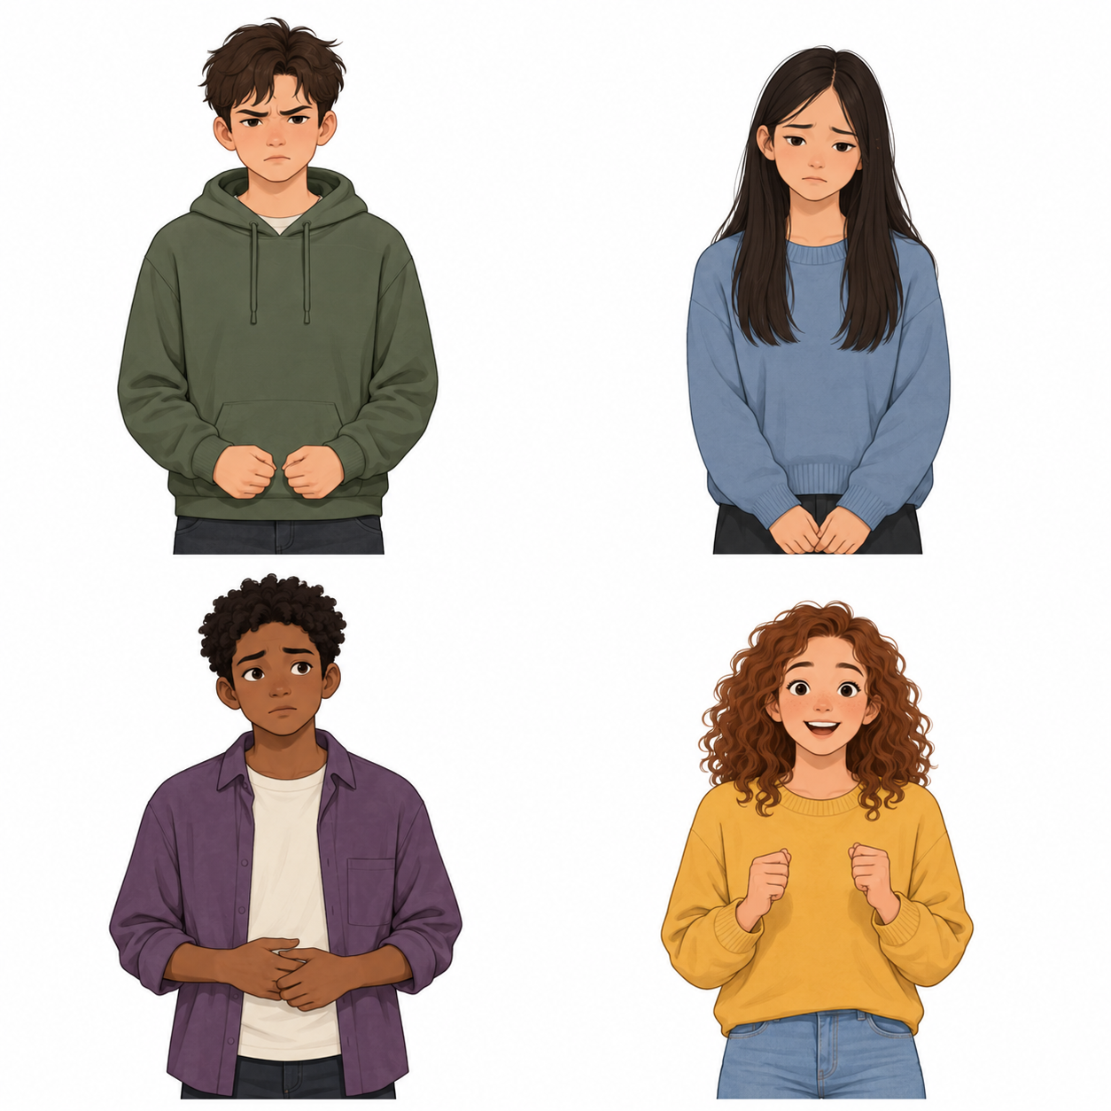
CHUNK 1
3 / 12 · 3–7 min
Our learning and feeling words
Name a big feeling and a way to manage it.
Words: cross, sad, worried, excited.
Start: “The feeling is ... .” Model A: cross.
cross
sad
worried
excited
RSHE-BUILD-S1-W02
Public edition
Lesson resource · CC BY-NC-SA 4.0: free for classroom use, share and adapt with credit, no resale
Notes:
Read C65 exactly. Four labelled generic portrait cards: cross/sad/worried/excited. Illustrations and body clues are possibilities, not proof of a real feeling. Story words state the feeling. Teach feeling as how a person may feel, big as strong. No diagnostic or emotion-recognition test. Pointing/aid choices valid.
Source: scheme_references/BUILD_Scheme.xlsx, BUILD Weekly - Spring row 65 B65/C65. Four invented feeling scenes, optional familiar school help steps and retained Level 2 aids. New generic illustrative portraits; no real person, organisation or place. Lesson resource · CC BY-NC-SA 4.0: free for classroom use, share and adapt with credit, no resale

Slide 4
CHUNK 1 MODEL
4 / 12 · 7–12 min
A story and a model
Story A: a young person waits for a turn.
They say, “I feel cross.” Their hands feel tight.
Words: cross, tight, tell.
Start: “The feeling is ... . Help is ... .”
Model: “When I feel cross I can tell someone.”
Use the story words. A body clue may be a hint.
RSHE-BUILD-S1-W02
Public edition
Lesson resource · CC BY-NC-SA 4.0: free for classroom use, share and adapt with credit, no resale
Notes:
Read full A. CfU privately: which word names the feeling, cross or tell? Key cross; tell someone is a help option. Keep visible bank/starter/model. Practice frame is for the invented character, not a personal disclosure. Other safe agreed choices also fit. Teaching7–11 and quiet reset11–12 inside five-minute allocation.
Source: scheme_references/BUILD_Scheme.xlsx, BUILD Weekly - Spring row 65 B65/C65. Four invented feeling scenes, optional familiar school help steps and retained Level 2 aids. New generic illustrative portraits; no real person, organisation or place. Lesson resource · CC BY-NC-SA 4.0: free for classroom use, share and adapt with credit, no resale

Slide 5
CHUNK 2 GUIDED
5 / 12 · 12–18 min
Match a feeling to a safe step
B says, “I feel sad.” C says, “I feel worried.”
D says, “I feel excited.”
Words: sad, worried, excited, breathe, move, tell, space.
Start: “The story says ... . They could ... .”
Model A: cross; tell someone. More safe help can fit.
Choose a help card. You can point, say or draw.
RSHE-BUILD-S1-W02
Public edition
Lesson resource · CC BY-NC-SA 4.0: free for classroom use, share and adapt with credit, no resale
Notes:
Use complete B/C/D story cards, one short line at a time. Prepared examples Btell/Ctell/Dmove; all four familiar agreed strategies may be valid depending on person/context. Accept a different safe choice with selection or brief explanation. No one-to-one answer key. No promise feelings disappear, compulsory performance or personal account. Drawing plus pointing/naming can show the goal.
Source: scheme_references/BUILD_Scheme.xlsx, BUILD Weekly - Spring row 65 B65/C65. Four invented feeling scenes, optional familiar school help steps and retained Level 2 aids. New generic illustrative portraits; no real person, organisation or place. Lesson resource · CC BY-NC-SA 4.0: free for classroom use, share and adapt with credit, no resale

Slide 6
CHUNK 2 PRIVATE CHECK
6 / 12 · 18–21 min
A clue is not proof
A: a face or body clue proves a feeling.
B: it may be a clue; use the story words.
Words: words, face, may, help.
Start: “A clue may ... . The words say ... .”
Model A states cross. A face alone is not proof.
Choose in private. Keep your usual aid.
RSHE-BUILD-S1-W02
Public edition
Lesson resource · CC BY-NC-SA 4.0: free for classroom use, share and adapt with credit, no resale
Notes:
Main hinge B. Do not score guessing a real person from appearance. Parallel A: choose a safe help step versus B a feeling must go away now; keyA. Re-model and recheck privately with the same bank/starter/model. Pass stays unobserved. Recognise the named feeling and safe familiar option, not a diagnosis or real-life coping performance.
Source: scheme_references/BUILD_Scheme.xlsx, BUILD Weekly - Spring row 65 B65/C65. Four invented feeling scenes, optional familiar school help steps and retained Level 2 aids. New generic illustrative portraits; no real person, organisation or place. Lesson resource · CC BY-NC-SA 4.0: free for classroom use, share and adapt with credit, no resale

Slide 7
CHUNK 2 HELP
7 / 12 · 21–25 min
Four help choices
Choose: breathe, move, tell someone or take space.
Use the safe step the school already uses.
Words: breathe, move, tell, space.
Start: “They could ... .”
Model A: “They could tell a trusted adult.”
Ask for the agreed quiet place, with help.
RSHE-BUILD-S1-W02
Public edition
Lesson resource · CC BY-NC-SA 4.0: free for classroom use, share and adapt with credit, no resale
Notes:
Use the four complete help cards in Support. Breath routine familiar and optional, no holding/counts or depth demand; stop/choose another if uncomfortable. Move in agreed safe way with usual support. Tell trusted adult privately. Take space with adult agreement/support, never leaving supervision. No need to practise techniques for evidence. Teaching21–24 then quiet reset24–25 inside four-minute allocation.
Source: scheme_references/BUILD_Scheme.xlsx, BUILD Weekly - Spring row 65 B65/C65. Four invented feeling scenes, optional familiar school help steps and retained Level 2 aids. New generic illustrative portraits; no real person, organisation or place. Lesson resource · CC BY-NC-SA 4.0: free for classroom use, share and adapt with credit, no resale

Slide 8
CHUNK 3 INDIVIDUAL
8 / 12 · 25–34 min
A practice line or drawing
Pick a story or feeling word. This is a practice line.
Words: cross, sad, worried, excited; breathe, move, tell, space.
In your book: “When I feel ... I can ... .”
Or draw a story face and help step; point or label it.
Model A: “When I feel cross I can tell someone.”
You can use an aid or a scribe. No private story is needed.
RSHE-BUILD-S1-W02
Public edition
Lesson resource · CC BY-NC-SA 4.0: free for classroom use, share and adapt with credit, no resale
Notes:
Individual name-a-feeling and safe-help response using invented story or selected words. Keep all Level2 aids. Supported two choices/short line; Independent supplies thinking with aids; Aspire explains another safe possible choice. Drawn response valid with selected/named feeling and strategy, not art judgement. Exact scribe reads back/corrects. No public sharing, current-feeling check or compulsory personal coping demonstration.
Source: scheme_references/BUILD_Scheme.xlsx, BUILD Weekly - Spring row 65 B65/C65. Four invented feeling scenes, optional familiar school help steps and retained Level 2 aids. New generic illustrative portraits; no real person, organisation or place. Lesson resource · CC BY-NC-SA 4.0: free for classroom use, share and adapt with credit, no resale

Slide 9
CHUNK 3 REVIEW
9 / 12 · 34–37 min
Check the feeling and help
Name one feeling and one safe help step.
Words: feeling, help, ask.
Start: “A feeling is ... . A safe step is ... .”
Model A: cross; tell someone in private.
Use one next step from the adult. Keep your reply.
RSHE-BUILD-S1-W02
Public edition
Lesson resource · CC BY-NC-SA 4.0: free for classroom use, share and adapt with credit, no resale
Notes:
Private formative review of stated feeling and relevant safe familiar option. Keep first response, one NS and learner reply. A safe alternative is valid; no single forced strategy match or proof of symptom reduction. Record normal access separately from supplied answers. All routes keep bank/starter/visible model.
Source: scheme_references/BUILD_Scheme.xlsx, BUILD Weekly - Spring row 65 B65/C65. Four invented feeling scenes, optional familiar school help steps and retained Level 2 aids. New generic illustrative portraits; no real person, organisation or place. Lesson resource · CC BY-NC-SA 4.0: free for classroom use, share and adapt with credit, no resale

Slide 10
CHUNK 3 PRIVATE EXIT
10 / 12 · 37–40 min
A private last step
Words: feeling, help, ask.
Start: “A feeling is ... . A safe step is ... .”
Model A: cross; tell someone in private.
Use a story. You can point, draw or ask for a scribe.
You may pass. No real story is needed.
RSHE-BUILD-S1-W02
Public edition
Lesson resource · CC BY-NC-SA 4.0: free for classroom use, share and adapt with credit, no resale
Notes:
Private exit, no hands-up/public questions. Name big feeling and safe familiar management option; one-line frame may be a rehearsed fictional line. Pass/uncollected response unobserved. E actual evidence; R only after Voice/Audience/NS/reply in the same colour, on the same page or usual mode. Offer to Communication portfolio; staff confirm mapping. Formative, Week6assessing.
Source: scheme_references/BUILD_Scheme.xlsx, BUILD Weekly - Spring row 65 B65/C65. Four invented feeling scenes, optional familiar school help steps and retained Level 2 aids. New generic illustrative portraits; no real person, organisation or place. Lesson resource · CC BY-NC-SA 4.0: free for classroom use, share and adapt with credit, no resale

Slide 11
USE AT ANY TIME
11 / 12
Help in private
Words: help, adult, private.
Point to HELP or say, “Can we talk in private?”
Model: a young person asks an adult for a quiet talk.
Use the school’s help route. You may pass or pause.
If the adult is busy, use the route to another adult.
RSHE-BUILD-S1-W02
Public edition
Lesson resource · CC BY-NC-SA 4.0: free for classroom use, share and adapt with credit, no resale
Notes:
Available throughout, no added time. Confirm actual school help route, trusted adult and supported pause/return before teaching. If disclosure: listen calmly, reassure, pass to safeguarding lead through school procedure; do not probe/promise secrecy. No detail in pack/shared work. No named organisations or services. Use generic private route.
Source: scheme_references/BUILD_Scheme.xlsx, BUILD Weekly - Spring row 65 B65/C65. Four invented feeling scenes, optional familiar school help steps and retained Level 2 aids. New generic illustrative portraits; no real person, organisation or place. Lesson resource · CC BY-NC-SA 4.0: free for classroom use, share and adapt with credit, no resale

Slide 12
STAFF ONLY
12 / 12
Staff reference
BUILD Weekly Spring, PSHE & Citizenship, row 65.
Wednesday 13 January 2027. P1. Three to four learners.
Chunks: 12, 13 and 15 minutes; resets already included.
Every task keeps a bank, starter and visible model.
Spring 1 has six weeks. Week 6 is assessing.
RSHE-BUILD-S1-W02
Public edition
Lesson resource · CC BY-NC-SA 4.0: free for classroom use, share and adapt with credit, no resale
Notes:
Hidden staff slide. Exact B65/C65 checked directly; inherited A64/D64–F64 context generic. Four invented mild scenes and new generic portrait bank. Feelings not diagnosed; clues may differ; safe strategies conditional and familiar. Brief disclosure note listen/reassure/pass to safeguarding lead, no details. Only Week2authored, Weeks3–6rows66–69oneperreturn afterDownloaded.
Source: scheme_references/BUILD_Scheme.xlsx, BUILD Weekly - Spring row 65 B65/C65. Four invented feeling scenes, optional familiar school help steps and retained Level 2 aids. New generic illustrative portraits; no real person, organisation or place. Lesson resource · CC BY-NC-SA 4.0: free for classroom use, share and adapt with credit, no resale

