Slide 1
TITLE AND BIG QUESTION
1 / 12
Show a skill
Year A · Week 6 · 7–11 December 2026 · 40 minutes
A worker says they can do a task. What work could show this?
This helps me explain what I can do and what I want to learn.
Term theme: Identity & Belonging
CAREERS-BUILD-A2-W06
Public edition
Lesson resource · CC BY-NC-SA 4.0: free for classroom use, share and adapt with credit, no resale
Notes:
CAREERS-BUILD-A2-W06 · Year A · Week beginning 7 December 2026
Term theme: Identity & Belonging
Thread tags: SMSC S/So (M/C: none); British Values IL/MR (D/RL/T: none).
Title and big question: 0 minutes.
Teacher: Read the big question and careers line. This is formative; Week 7 assesses.
Evidence: A skill-and-evidence card, a job-role match and a next step; missing work remains clearly marked.
Where this leads: This helps me explain what I can do and what I want to learn.
Source: owner_orders/BUILD_Careers_Autumn2_YearA_outline, revision approved-2026-10-26. Tasks authored first-issue-2026-10-26.
Lesson resource · CC BY-NC-SA 4.0: free for classroom use, share and adapt with credit, no resale

Slide 2
ARRIVAL AND REGULATION
2 / 12 · 3 min
A calm start
Choose a calm place to sit.
Ask for a short pause if needed.
Keep the work space clear.
Ask for help with the words.
Use a point, a word or your aid.
Let each person have time.
CAREERS-BUILD-A2-W06
Public edition
Lesson resource · CC BY-NC-SA 4.0: free for classroom use, share and adapt with credit, no resale
Notes:
CAREERS-BUILD-A2-W06 · Year A · Week beginning 7 December 2026
Term theme: Identity & Belonging
Thread tags: SMSC S/So (M/C: none); British Values IL/MR (D/RL/T: none).
Arrival and regulation: 3 minutes.
Teacher: Offer response mode and pause. Avoid pressure to speak publicly.
Evidence: A skill-and-evidence card, a job-role match and a next step; missing work remains clearly marked.
Where this leads: This helps me explain what I can do and what I want to learn.
Source: owner_orders/BUILD_Careers_Autumn2_YearA_outline, revision approved-2026-10-26. Tasks authored first-issue-2026-10-26.
Lesson resource · CC BY-NC-SA 4.0: free for classroom use, share and adapt with credit, no resale

Slide 3
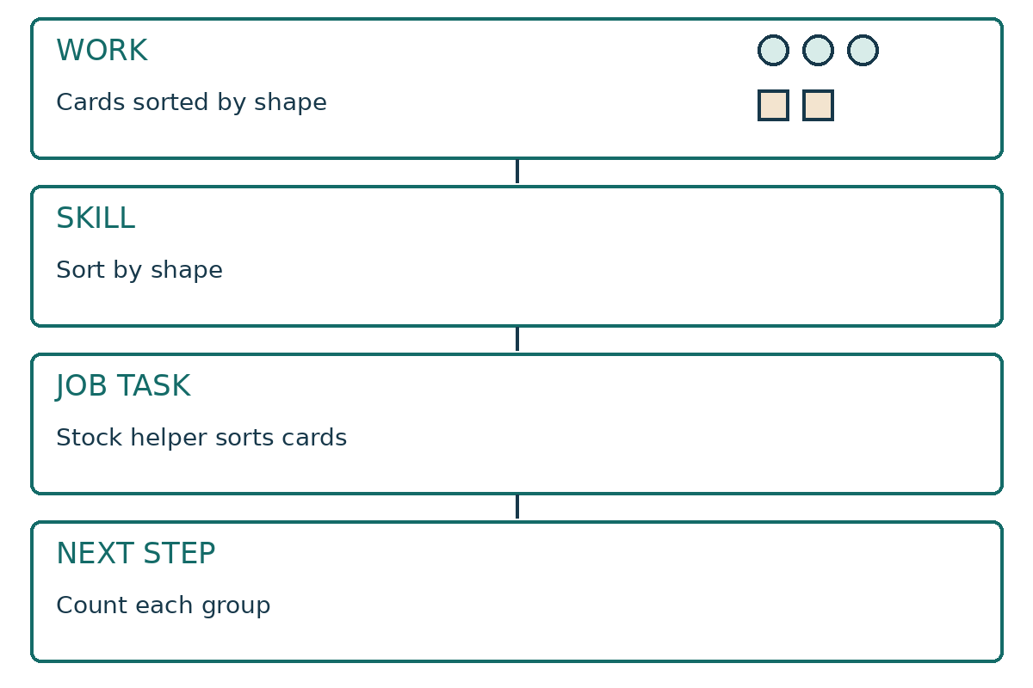
STARTER
3 / 12 · 3 min
Work can show a skill
This is a made-up worker’s model.
The record shows cards sorted by shape.
Which skill does that work show?
Which job task could use that skill?
CAREERS-BUILD-A2-W06
Public edition
Lesson resource · CC BY-NC-SA 4.0: free for classroom use, share and adapt with credit, no resale
Notes:
CAREERS-BUILD-A2-W06 · Year A · Week beginning 7 December 2026
Term theme: Identity & Belonging
Thread tags: SMSC S/So (M/C: none); British Values IL/MR (D/RL/T: none).
Starter: 3 minutes.
Teacher: Read the labelled model diagram. It is an authored teaching model, not learner evidence.
Evidence: A skill-and-evidence card, a job-role match and a next step; missing work remains clearly marked.
Where this leads: This helps me explain what I can do and what I want to learn.
Source: owner_orders/BUILD_Careers_Autumn2_YearA_outline, revision approved-2026-10-26. Tasks authored first-issue-2026-10-26.
Lesson resource · CC BY-NC-SA 4.0: free for classroom use, share and adapt with credit, no resale

Slide 4
TODAY
4 / 12
Today
Choose work that shows a skill. Link it to a job.
Choose one piece of actual work.
Show the skill and a job it could help.
Choose one clear next step.
CAREERS-BUILD-A2-W06
Public edition
Lesson resource · CC BY-NC-SA 4.0: free for classroom use, share and adapt with credit, no resale
Notes:
CAREERS-BUILD-A2-W06 · Year A · Week beginning 7 December 2026
Term theme: Identity & Belonging
Thread tags: SMSC S/So (M/C: none); British Values IL/MR (D/RL/T: none).
Today: 0 minutes.
Teacher: Read the approved objective in the planner and these short success checks.
Evidence: A skill-and-evidence card, a job-role match and a next step; missing work remains clearly marked.
Where this leads: This helps me explain what I can do and what I want to learn.
Source: owner_orders/BUILD_Careers_Autumn2_YearA_outline, revision approved-2026-10-26. Tasks authored first-issue-2026-10-26.
Lesson resource · CC BY-NC-SA 4.0: free for classroom use, share and adapt with credit, no resale

Slide 5
I DO
5 / 12 · 5 min
Watch the model
The model shows three circles and two squares.
They are in two shape groups.
The skill is to sort by shape.
This could help a stock helper sort cards.
A next step is to count each group.
This model is not a learner’s own work.
Choose work. Show the skill. Link a task. Choose a next step.
CAREERS-BUILD-A2-W06
Public edition
Lesson resource · CC BY-NC-SA 4.0: free for classroom use, share and adapt with credit, no resale
Notes:
CAREERS-BUILD-A2-W06 · Year A · Week beginning 7 December 2026
Term theme: Identity & Belonging
Thread tags: SMSC S/So (M/C: none); British Values IL/MR (D/RL/T: none).
I do: 5 minutes.
Teacher: Use only the fictional model on Support Cards page 2. The model worker sorted three circles and two squares into the right groups; an adult observed the action. The skill is sorting by shape. This could help the stock helper sort paper cards. A next step is to count each group and record the totals. This model teaches the link and must not be filed as a learner’s work.
Evidence: A skill-and-evidence card, a job-role match and a next step; missing work remains clearly marked.
Where this leads: This helps me explain what I can do and what I want to learn.
Source: owner_orders/BUILD_Careers_Autumn2_YearA_outline, revision approved-2026-10-26. Tasks authored first-issue-2026-10-26.
Lesson resource · CC BY-NC-SA 4.0: free for classroom use, share and adapt with credit, no resale

Slide 6
WE DO
6 / 12 · 5 min
Which claim has proof
A worker says they can sort by shape. What helps show it?
A Their own work and a clear record of the task.
B A claim with no work to check.
C Work done by someone else.
CAREERS-BUILD-A2-W06
Public edition
Lesson resource · CC BY-NC-SA 4.0: free for classroom use, share and adapt with credit, no resale
Notes:
CAREERS-BUILD-A2-W06 · Year A · Week beginning 7 December 2026
Term theme: Identity & Belonging
Thread tags: SMSC S/So (M/C: none); British Values IL/MR (D/RL/T: none).
We do: 5 minutes.
Teacher: A supports the claim: actual work and a precise observation show the skill and its link to the role. B is an unsupported claim; C is someone else’s work. Ask the learner to point to the part of their selected work that supports the skill. If it does not support that skill, revise the claim or choose a different example. Do not infer a skill from a job picture alone.
Evidence: A skill-and-evidence card, a job-role match and a next step; missing work remains clearly marked.
Where this leads: This helps me explain what I can do and what I want to learn.
Source: owner_orders/BUILD_Careers_Autumn2_YearA_outline, revision approved-2026-10-26. Tasks authored first-issue-2026-10-26.
Lesson resource · CC BY-NC-SA 4.0: free for classroom use, share and adapt with credit, no resale

Slide 7
YOU DO PRACTICE
7 / 12 · 12 min
Try the task
Choose one piece of actual work.
Supported: choose and link it with help.
Independent: explain the skill and job link.
Aspire: compare two pieces and name a gap.
If work is missing, mark the gap and plan a next step.
CAREERS-BUILD-A2-W06
Public edition
Lesson resource · CC BY-NC-SA 4.0: free for classroom use, share and adapt with credit, no resale
Notes:
CAREERS-BUILD-A2-W06 · Year A · Week beginning 7 December 2026
Term theme: Identity & Belonging
Thread tags: SMSC S/So (M/C: none); British Values IL/MR (D/RL/T: none).
You do practice: 12 minutes.
Teacher: Use four minutes to look at actual earlier work and choose an example. Use five minutes to link the observed skill to a task on one fictional role card and practise the explanation to an adult. Use three minutes to choose a next step. If the example is missing, record the gap and a plan to recover it. A brief new task may be recorded as new work, never as recovered earlier evidence. Routes: Review up to two pieces of the learner’s actual earlier work with an adult. Choose one, select a skill and fictional role card, and use a sentence stem to explain the link. Record prompts. Choose actual earlier work, identify one skill it shows and explain how that skill could help a task on a fictional role card. Choose a specific next step. Compare two possible examples, explain which supports the claim more clearly, and name a limit or further evidence needed. Choose a next step that addresses that gap.
Evidence: A skill-and-evidence card, a job-role match and a next step; missing work remains clearly marked.
Where this leads: This helps me explain what I can do and what I want to learn.
Source: owner_orders/BUILD_Careers_Autumn2_YearA_outline, revision approved-2026-10-26. Tasks authored first-issue-2026-10-26.
Lesson resource · CC BY-NC-SA 4.0: free for classroom use, share and adapt with credit, no resale

Slide 8
YOU DO EVIDENCE
8 / 12 · 6 min
My work and skill
Keep the work code and date.
Name the skill that the work shows.
Link it to a task on a job card.
Choose one next step. Keep any gap clear.
CAREERS-BUILD-A2-W06
Public edition
Lesson resource · CC BY-NC-SA 4.0: free for classroom use, share and adapt with credit, no resale
Notes:
CAREERS-BUILD-A2-W06 · Year A · Week beginning 7 December 2026
Term theme: Identity & Belonging
Thread tags: SMSC S/So (M/C: none); British Values IL/MR (D/RL/T: none).
You do evidence: 6 minutes.
Teacher: Keep a specific work reference and date, what the example actually shows, one skill, the chosen fictional role and task, the learner’s explanation of the link, and one next step. Record support and the adult’s reply. Mark missing, unclear or unverified evidence explicitly. A role match is a teaching judgement, not proof of job readiness or qualification completion.
Evidence: A skill-and-evidence card, a job-role match and a next step; missing work remains clearly marked.
Where this leads: This helps me explain what I can do and what I want to learn.
Source: owner_orders/BUILD_Careers_Autumn2_YearA_outline, revision approved-2026-10-26. Tasks authored first-issue-2026-10-26.
Lesson resource · CC BY-NC-SA 4.0: free for classroom use, share and adapt with credit, no resale

Slide 9
TIDY AND EVIDENCE CHECK
9 / 12 · 4 min
Tidy and check
1
Check the code on both sheets.
2
Keep the work and note the help.
3
Put the cards away with care.
4
Tell the adult the next step.
CAREERS-BUILD-A2-W06
Public edition
Lesson resource · CC BY-NC-SA 4.0: free for classroom use, share and adapt with credit, no resale
Notes:
CAREERS-BUILD-A2-W06 · Year A · Week beginning 7 December 2026
Term theme: Identity & Belonging
Thread tags: SMSC S/So (M/C: none); British Values IL/MR (D/RL/T: none).
Tidy and evidence check: 4 minutes.
Teacher: Check learner identifiers and work references before tidying. Do not bank blank forms.
Evidence: A skill-and-evidence card, a job-role match and a next step; missing work remains clearly marked.
Where this leads: This helps me explain what I can do and what I want to learn.
Source: owner_orders/BUILD_Careers_Autumn2_YearA_outline, revision approved-2026-10-26. Tasks authored first-issue-2026-10-26.
Lesson resource · CC BY-NC-SA 4.0: free for classroom use, share and adapt with credit, no resale

Slide 10
EXIT TICKET
10 / 12 · 2 min
Exit task
What work shows the skill?
How could it help with a job task?
What is one next step?
CAREERS-BUILD-A2-W06
Public edition
Lesson resource · CC BY-NC-SA 4.0: free for classroom use, share and adapt with credit, no resale
Notes:
CAREERS-BUILD-A2-W06 · Year A · Week beginning 7 December 2026
Term theme: Identity & Belonging
Thread tags: SMSC S/So (M/C: none); British Values IL/MR (D/RL/T: none).
Exit ticket: 2 minutes.
Teacher: Record an individual response. Use the question to identify a next teaching step.
Evidence: A skill-and-evidence card, a job-role match and a next step; missing work remains clearly marked.
Where this leads: This helps me explain what I can do and what I want to learn.
Source: owner_orders/BUILD_Careers_Autumn2_YearA_outline, revision approved-2026-10-26. Tasks authored first-issue-2026-10-26.
Lesson resource · CC BY-NC-SA 4.0: free for classroom use, share and adapt with credit, no resale

Slide 11
VOCABULARY
11 / 12
Words that help
Skill: Something a person can do.
Match: Link two things for a clear reason.
Work: A task or a record of what was done.
Gap: Work or a fact that is still missing.
Evidence: Work that helps show a claim is true.
Next step: One thing to try or learn next.
Role: One part of the work.
CAREERS-BUILD-A2-W06
Public edition
Lesson resource · CC BY-NC-SA 4.0: free for classroom use, share and adapt with credit, no resale
Notes:
CAREERS-BUILD-A2-W06 · Year A · Week beginning 7 December 2026
Term theme: Identity & Belonging
Thread tags: SMSC S/So (M/C: none); British Values IL/MR (D/RL/T: none).
Vocabulary: 0 minutes.
Teacher: Keep the vocabulary available. Read aloud or use usual communication aid.
Evidence: A skill-and-evidence card, a job-role match and a next step; missing work remains clearly marked.
Where this leads: This helps me explain what I can do and what I want to learn.
Source: owner_orders/BUILD_Careers_Autumn2_YearA_outline, revision approved-2026-10-26. Tasks authored first-issue-2026-10-26.
Lesson resource · CC BY-NC-SA 4.0: free for classroom use, share and adapt with credit, no resale

Slide 12
STAFF BRIEF
12 / 12
Staff brief
Read the planner and support route.
Use only fictional roles and settings.
Scribe exact words; record help.
Keep each learner’s own evidence.
Week 7 is the assessing lesson.
CAREERS-BUILD-A2-W06
Public edition
Lesson resource · CC BY-NC-SA 4.0: free for classroom use, share and adapt with credit, no resale
Notes:
CAREERS-BUILD-A2-W06 · Year A · Week beginning 7 December 2026
Term theme: Identity & Belonging
Thread tags: SMSC S/So (M/C: none); British Values IL/MR (D/RL/T: none).
Staff brief: 0 minutes.
Teacher: Read the Planner and Staff Answers. Prepare each learner’s actual work or specific observation records from Weeks 1–5, including Week 5 if available. Keep adult models in a separate folder marked MODEL. Print the two evidence pages and three support pages for each learner. Do not invent missing work or use another learner’s work. If earlier work is absent, prepare a recovery task using the earlier lesson’s resources; record today’s date and any support. The missing earlier record remains marked missing.
Evidence: A skill-and-evidence card, a job-role match and a next step; missing work remains clearly marked.
Where this leads: This helps me explain what I can do and what I want to learn.
Source: owner_orders/BUILD_Careers_Autumn2_YearA_outline, revision approved-2026-10-26. Tasks authored first-issue-2026-10-26.
Lesson resource · CC BY-NC-SA 4.0: free for classroom use, share and adapt with credit, no resale

