Slide 1

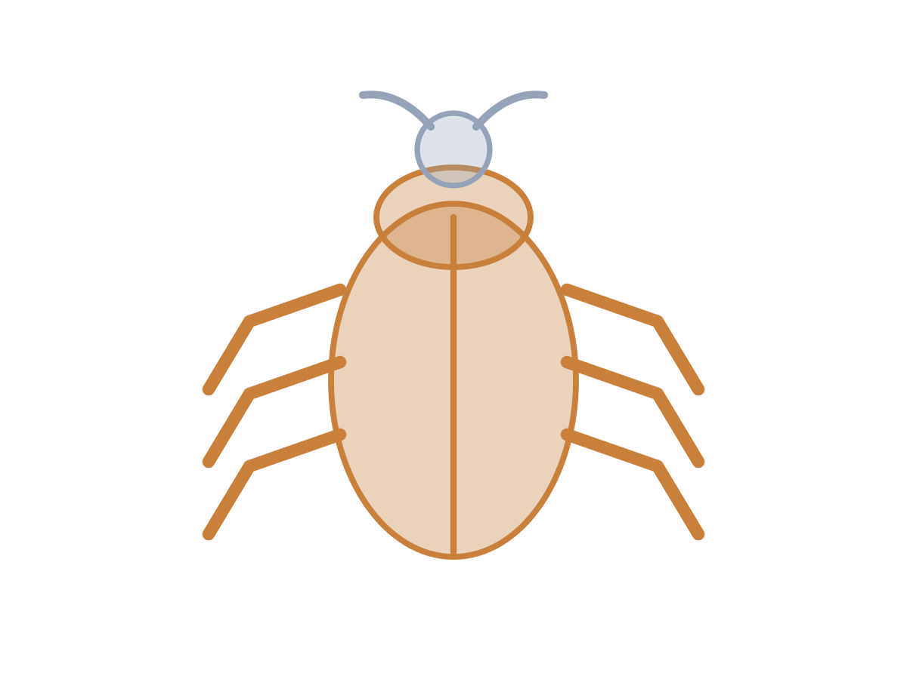
MADE BY MATT / BASE SCIENCE
Backbone evidence lab
Look inside the evidence.
I can justify a classification and improve a clue.
SCIENCE · BASE
01
Notes:
Workshop reference — 0 minutes within the source's 40-minute lesson.
Reference screen only; start the 32-minute workshop immediately. No additional starter or lesson time.

Slide 2
MADE BY MATT / BASE SCIENCE
Return to this lesson’s rule
Find your saved animal sort.
Name or point to the backbone rule.
Choose: read, point, move cards or direct.
SCIENCE · BASE
02
Notes:
Independent Work — retrieve — 4 minutes within the source's 40-minute lesson.
Source preparation phase, four minutes. Retrieve this lesson’s eight-animal vocabulary: fish, bird, frog, lizard, mouse, snail, crab, earthworm. The first five have backbones; last three do not. Do not replace evidence with guessing from fur/size. Adult can read and cut.

Slide 3
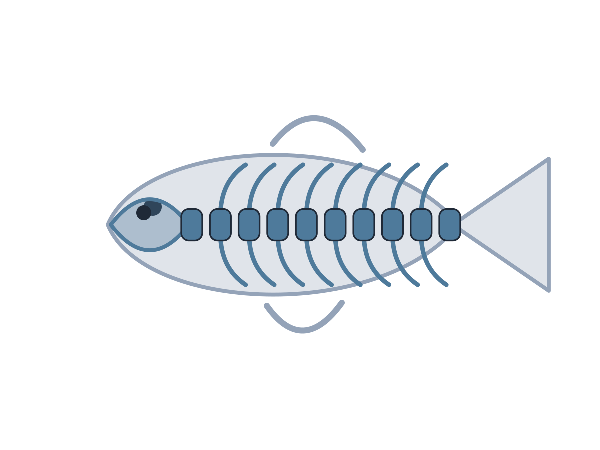
MADE BY MATT / BASE SCIENCE
Goldfish and bat: use body clues
GOLDFISH
BAT
Bones inside its body.
Those bones include a backbone.
Wings on the outside.
An internal backbone.
SCIENCE · BASE
03
Notes:
Independent Work — investigate — 5 minutes within the source's 40-minute lesson.
First five minutes of source 20-minute investigation. Hide each clue initially and record first idea; then reveal clue and classify. Both are vertebrates. Wings do not decide classification; evidence of backbone does. Pupil can leave prediction unsure until evidence is available.

Slide 4

MADE BY MATT / BASE SCIENCE
Beetle and earthworm: compare
BEETLE
EARTHWORM
Hard outer case.
No internal backbone.
Muscles act against fluid inside.
Skin rings are not bones.
SCIENCE · BASE
04
Notes:
Independent Work — investigate — 5 minutes within the source's 40-minute lesson.
Next five minutes. Both are invertebrates but support differs. Beetle exoskeleton is a hard outside; earthworm support comes from muscles/fluid. Explain that no backbone does not mean no support. Native text comparison replaces source illustration; no live animals or handling.

Slide 5
MADE BY MATT / BASE SCIENCE
Make a two-clue mystery card
Choose one animal from this lesson.
Hide its name.
Write or dictate two true body clues.
Make at least one clue about its support.
SCIENCE · BASE
05
Notes:
Independent Work — investigate — 5 minutes within the source's 40-minute lesson.
Next five minutes. Adult can write pupil-dictated clues. One clue must discriminate backbone presence/absence: e.g. internal bones include a backbone, or hard outer case and no backbone. “It is small” alone cannot settle it. Keep hidden answer on the teacher side, not pupil public display.

Slide 6
MADE BY MATT / BASE SCIENCE
Test the clue, then explain
Read the clues to an adult or partner.
Ask: which group, and why?
You can check the card on your own.
Does a clue prove the group?
SCIENCE · BASE
06
Notes:
Independent Work — investigate — 5 minutes within the source's 40-minute lesson.
Final five minutes of 20-minute investigation. No compulsory peer audience. A useful card need not identify the exact species; it should allow group classification. If solver guesses from size, ask author to improve body evidence. Adult notes pupil reasoning and support used.

Slide 7
MADE BY MATT / BASE SCIENCE
Pause and check the rule
Look at one first idea and final choice.
Point to the clue that decided it.
Check: a skin ring is not a backbone.
SCIENCE · BASE
07
Notes:
Independent Work — check — 2 minutes within the source's 40-minute lesson.
Source two-minute check is included in 32, not extra. Ask whether the card distinguishes internal backbone from shell/outer case/fluid support. Let the pupil change an uncertain classification in response to evidence.

Slide 8
MADE BY MATT / BASE SCIENCE
Improve one clue and save it
Make one clue more precise.
Keep your first and improved version.
Explain which animal group it supports.
SCIENCE · BASE
08
Notes:
Independent Work — improve — 4 minutes within the source's 40-minute lesson.
First four minutes of final six-minute source phase. Example improvement: “hard body” becomes “hard case outside and no internal backbone.” A pupil can point to the right existing evidence sentence instead of composing text. Retain reasoning, not only a photograph.

Slide 9
MADE BY MATT / BASE SCIENCE
Leave the evidence ready
Keep the sort, clue and explanation together.
Label your work.
Return labels and clear the table.
SCIENCE · BASE
09
Notes:
Independent Work — tidy — 2 minutes within the source's 40-minute lesson.
Final two minutes of 32-minute workshop. Adult can label work without gathering any extra personal information. Store within normal classroom arrangements; no upload or public audience needed.

Slide 10
MADE BY MATT / BASE SCIENCE
Your voice can change the lesson
What helped you join in?
What could make the next activity easier?
Point, sign, speak, write or pass privately.
Adult: agree one change and explain any limit.
SCIENCE · BASE
10
Notes:
Feedback Loop — 4 minutes within the source's 40-minute lesson.
Four minutes within the source lesson. Receive an actual observation or access request; do not force a peer audience. Name what can change now, make the change where possible and check whether it helped. The adult receives and names back the science shown as well as access feedback.

Slide 11
MADE BY MATT / BASE SCIENCE
Show the science you can explain
Supported: choose an animal with a backbone.
Independent: explain why a crab is invertebrate.
Aspire: why is body size a poor test?
SCIENCE · BASE
11
Notes:
Exit Ticket — 4 minutes within the source's 40-minute lesson.
Offer one route, not three compulsory questions. Answers stay in teacher notes: supported fish/bird/frog/lizard/mouse/bat; standard crab has hard outer case but no internal backbone; stretch tiny mouse has backbone while larger crab/lobster lacks one. Adult receives explanation, names back understanding and records a feasible next teaching step.

