Slide 1
GROW · RE
Religious practice and subject vocabulary
I can find an accurate practice detail.
I can describe a practice using RE words.
I can check the description against the reference notes.
Made by Matt

Slide 2
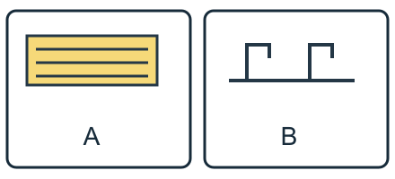
Arrival quiz
Which sketch shows taps?
Picture A
Picture B
Choose first. Check on the next slide.
Made by Matt

Slide 3
Arrival quiz · answer
Picture B
B shows taps above a washing place. A shows rows in an open space.
Right first time: count your first choice only. You may try again.
Made by Matt

Slide 4
Arrival quiz
What does a mihrab help show?
A. Prayer direction.
B. Every community activity.
Choose first. Check on the next slide.
Made by Matt

Slide 5
Arrival quiz · answer
A. Prayer direction.
It helps show the direction for prayer.
Right first time: count your first choice only. You may try again.
Made by Matt

Slide 6
Arrival quiz
Does every mosque have the same activities?
A. Yes, all are identical.
B. No, activities can vary.
Choose first. Check on the next slide.
Made by Matt

Slide 7
Arrival quiz · answer
B. No, activities can vary.
Designs and activities vary between mosques.
Right first time: count your first choice only. You may try again.
Made by Matt

Slide 8
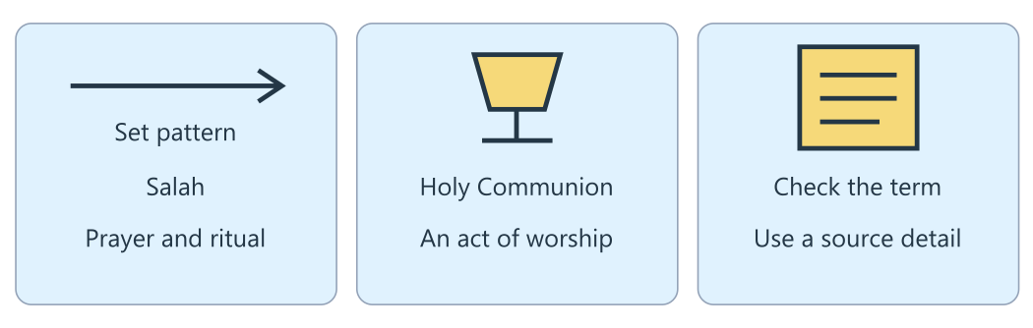
Arrival reference
The lesson diagram
Use this diagram for the four recall prompts.
Made by Matt

Slide 9
Arrival · Supported
Four recall prompts
1. Point to the panel labelled Salah.
2. Choose: a practice is something people do or a building?
3. Choose: a ritual has a set pattern or no meaning?
4. Is all prayer spoken aloud?
Made by Matt

Slide 10
Arrival · Independent
Four recall prompts
1. Name one practice in the diagram.
2. What does practice mean?
3. Define ritual.
4. Is all prayer spoken aloud?
Made by Matt

Slide 11
Arrival · Aspire
Four recall prompts
1. Find one accurate term in each example.
2. Use practice in an accurate example.
3. Explain ritual using a detail about Salah.
4. Why is everyone prays aloud too broad?
Made by Matt

Slide 12
Starter
Which tells us more: They pray or Salah has a set pattern of prayer? Why?
Write a precise sentence: Salah is a Muslim practice of prayer with a set ritual pattern. It is an act of worship.
Made by Matt

Slide 13
Whole class
A precise description
Rule: follow the lights one step at a time.
1. Name the practice 2. Find an action 3. Choose an RE term 4. Check the meaning
Thumbs up if Salah has a set pattern of prayer. Thumbs sideways if you want the source read again. Give one clue before the class agrees.
Made by Matt

Slide 14
I do
The worked model
Start with Salah, Muslim prayer. The reference note names a set pattern of standing, bowing and kneeling.
A ritual is a set of actions done in a fixed way with meaning. This word describes the pattern in Salah.
Write a precise sentence: Salah is a Muslim practice of prayer with a set ritual pattern. It is an act of worship.
Made by Matt

Slide 15
Word help
Words to use
practice: Something people do as part of their beliefs
ritual: A set of actions done in a fixed way with meaning
worship: Showing devotion to God or gods
prayer: Communicating with God, aloud or silently
Made by Matt

Slide 16
We do · hinge
Which sentence uses a precise RE term accurately?
A. Salah follows a set pattern of prayer.
B. Muslims do a thing.
C. Everyone always prays aloud.
Made by Matt

Slide 17
We do · hinge answer
A. Salah follows a set pattern of prayer.
Salah names the practice and set pattern describes its ritual actions. Prayer may be aloud or silent, so everyone always prays aloud is inaccurate.
Made by Matt

Slide 18
I do
Connect the evidence
Compare a vague sentence, They do a thing, with a precise one: Christians share bread and wine in Holy Communion.
Holy Communion is an act of worship that remembers Jesus. Naming the practice makes the description clearer.
Prayer can be aloud or silent. Do not add always aloud to a description of all prayer.
Made by Matt

Slide 19
I do
Connect the evidence · continued
Check your terms against the reference notes. Beliefs and practices vary within a faith; precise language still needs a respectful tone.
Made by Matt

Slide 20
Team game
Pass the word clue
Rule: use the source, swap roles and explain a clue.
Work in four bands, with pairs in each band. Pass a word card or point to it. One partner gives a clue for practice, ritual, worship or prayer. The other chooses the word and uses it in a sentence from the source. Swap. The teacher moves between bands to hear each reason. A seated pointer route is equal.
Made by Matt

Slide 21
Team game
How every band can score
Points: Earn 1 point for the matching word and 1 point for an accurate source sentence. Each band can earn both points. Rephrase and retry without losing points.
In your book: keep one clue and your own reason after the game.
Made by Matt

Slide 22
We do
Accurate practice or incorrect claim?
Muslim prayer: Salah is a Muslim practice of prayer. Check: The reference note identifies Salah as Muslim prayer.
Ritual pattern: Salah has a set pattern of standing, bowing and kneeling. Check: A set pattern of meaningful actions is a ritual.
Worship: Salah is an act of worship through prayer. Check: Prayer can express devotion to God.
Made by Matt

Slide 23
We do
Accurate practice or incorrect claim? · continued
Bread and wine: Christians share bread and wine in Holy Communion. Check: Holy Communion is a Christian act of worship.
Always aloud: All prayer must be spoken aloud. Check: Prayer can be aloud or silent.
Every detail identical: Every believer carries out a practice in exactly the same way. Check: Practices can vary within a faith.
Made by Matt

Slide 24
We do
Repair this claim
All prayer must be spoken aloud.
A. Keep it.
B. Repair it using evidence and its limit.
Made by Matt

Slide 25
We do · answer
The repaired claim
Prayer can be aloud or silent. Use accurate RE words and avoid claiming that every believer does the same thing.
Made by Matt

Slide 26
We do
Check five statements
A ritual has meaningful actions in a set pattern. True: Salah gives an example of such a pattern.
Practice means only an opinion with no actions. False: a practice is something people do as part of their beliefs.
All prayer is spoken aloud. False: prayer can be aloud or silent.
Holy Communion is an act of Christian worship. True: Christians share bread and wine to remember Jesus.
Made by Matt

Slide 27
We do
Check five statements · continued
A precise word proves everyone practises identically. False: belief and practice vary within a faith.
Made by Matt

Slide 28
You do
Your task
In your book: Describe one religious practice using accurate RE vocabulary. Underline or identify your terms and check them against the reference notes.
Made by Matt

Slide 29
You do · Supported
Your route
In your book: Choose Salah. Complete the cloze using prayer, ritual and worship. Salah is Muslim ____. Its set pattern is a ____. It is an act of ____.
Made by Matt

Slide 30
Optional making · Supported
Make your thinking visible
Optional make it: make three word flaps for the cloze. Lift each flap to show the word that fits.
In your book: keep the task response, a labelled sketch or your exact words explaining what it shows.
Made by Matt

Slide 31
You do · Independent
Your route
In your book: Describe one religious practice using at least three RE terms. Underline the terms. Use a reference detail to check each term.
Made by Matt

Slide 32
Optional making · Independent
Make your thinking visible
Optional make it: make a four-frame storyboard of one practice. Caption it with at least three accurate RE terms.
In your book: keep the task response, a labelled sketch or your exact words explaining what it shows.
Made by Matt

Slide 33
You do · Aspire
Your route
In your book: Describe one practice using at least four RE terms and explain its meaning for believers. For Salah, use practice, prayer, ritual and worship. Note that prayer may be aloud or silent.
Made by Matt

Slide 34
Optional making · Aspire
Make your thinking visible
Optional make it: make a fold-out practice guide using four terms. Add meaning and a flap explaining variation.
In your book: keep the task response, a labelled sketch or your exact words explaining what it shows.
Made by Matt

Slide 35
You do · Choice
Your choice route
In your book: Point, sign, speak, draw or write a description of Salah with three RE terms. Use the cloze and word bank; an adult may record your exact words.
You may use the Supported making choice with your usual response mode.
Made by Matt

Slide 36
Reference notes
Evidence for your response
A · Salah: Salah is Muslim prayer offered at set times. Its ritual pattern includes standing, bowing and kneeling.
B · Holy Communion: Christians share bread and wine to remember Jesus. It is an act of worship in community; churches hold it in different ways.
C · Precise description: Vague: They do a thing with bread. Precise: Christians share bread and wine in Holy Communion, an act of worship.
Made by Matt

Slide 37
Reference notes
Evidence for your response · continued
D · Word use: Practice is something people do as part of beliefs. Ritual means meaningful set actions. Worship shows devotion to God or gods; prayer communicates with God, aloud or silently.
Made by Matt

Slide 38
Review and improve
One checked change
Check one term and one detail with an adult or chosen partner. Correct the sentence without changing your own meaning.
Keep your first answer. Use feedback to improve one detail. Mark the edit // in the same colour on the same page.
In your book: explain what changed and why.
Made by Matt

Slide 39
Exit quiz
Which word describes meaningful set actions?
A. Ritual.
B. Building.
Choose first. Check on the next slide.
Made by Matt

Slide 40
Exit quiz · answer
A. Ritual.
A ritual has meaningful actions in a set pattern.
Right first time: count your first choice only. You may try again.
Made by Matt

Slide 41
Exit quiz
Must all prayer be aloud?
A. Yes.
B. No.
Choose first. Check on the next slide.
Made by Matt

Slide 42
Exit quiz · answer
B. No.
Prayer can be aloud or silent.
Right first time: count your first choice only. You may try again.
Made by Matt

Slide 43
Exit quiz
Which description is more precise?
A. They do a thing.
B. Salah is Muslim prayer with a ritual pattern.
Choose first. Check on the next slide.
Made by Matt

Slide 44
Exit quiz · answer
B. Salah is Muslim prayer with a ritual pattern.
The second sentence names the practice and an accurate detail.
Right first time: count your first choice only. You may try again.
Made by Matt

Slide 45
Exit ticket
Your exit prompts
Supported: What is a ritual? Point to a definition or give an example.
Independent: Describe one religious practice using accurate RE terms.
Aspire: Explain why Salah is a ritual and why all prayer is aloud is inaccurate.
Made by Matt

Slide 46
Staff / TA brief
Watch (staff preview first)
none suggested
Preview the activity and choose an accessible response mode. Keep cutting adult-prepared. The points board is for every band.
Keep a learner’s own reason in the book. Team points do not replace individual evidence.
Made by Matt

