Slide 1

MADE BY MATT / BUILD HUMANITIES
Build our community map
How can our labels help a visitor?
Contribute a labelled place and a useful note to a shared community map.
You may point, speak, draw or write.
Autumn 1 · Week 6 · Humanities
01
Notes:
BUILD Humanities, Autumn 1 Week 6. Build our community map. Thursday 11:00-11:40. Humanities lesson; separate RE period is outside this pack.
Slide minutes: 1,3,3,4,5,5,3,8,2,2,2,2 = 40. Adapt within the total.
Read the enquiry. Check that pupils know the response choices.
Objective: Contribute a labelled place and a useful note to a shared community map.
Support: Offer a ready-made place card and two possible use cards. Pupil chooses placement and wording.
Stretch: Give one place two useful notes and explain how the shared map could help a fictional visitor.
Misconceptions: A map is a selected view, not a drawing of everything. A symbol or letter needs a key. A label should not depend on colour alone.
Answer guidance: Use notes: school learning, library borrowing books, clinic appointments, shop purchases, park recreation, bus stop waiting for transport. Several valid uses may apply.
Guided clinic/health, shop/food, park/play. Hinge B names the place and explains its use.
Assess the pupil's own placement/label/note choice. Record exactly what an adult prepared or scribed. An attractive shared map alone does not show who made which decision.
[Sources]
https://madebymatt.uk/Lessons/Humanities_Teesside/BUILD_W1-W8_2026-27/BUILD_HUM_W6_Our_Class_Map.html
[/Sources]

Slide 2
MADE BY MATT / BUILD HUMANITIES
Start with what you know
Read the label library.
What note could explain its use?
Choose a map role: place, label, explain or check.
Autumn 1 · Week 6 · Humanities
02
Notes:
BUILD Humanities, Autumn 1 Week 6. Build our community map. Thursday 11:00-11:40. Humanities lesson; separate RE period is outside this pack.
Slide minutes: 1,3,3,4,5,5,3,8,2,2,2,2 = 40. Adapt within the total.
Retain a first response. Do not supply the answer before the pupil chooses.
Objective: Contribute a labelled place and a useful note to a shared community map.
Support: Offer a ready-made place card and two possible use cards. Pupil chooses placement and wording.
Stretch: Give one place two useful notes and explain how the shared map could help a fictional visitor.
Misconceptions: A map is a selected view, not a drawing of everything. A symbol or letter needs a key. A label should not depend on colour alone.
Answer guidance: Use notes: school learning, library borrowing books, clinic appointments, shop purchases, park recreation, bus stop waiting for transport. Several valid uses may apply.
Guided clinic/health, shop/food, park/play. Hinge B names the place and explains its use.
Assess the pupil's own placement/label/note choice. Record exactly what an adult prepared or scribed. An attractive shared map alone does not show who made which decision.
[Sources]
https://madebymatt.uk/Lessons/Humanities_Teesside/BUILD_W1-W8_2026-27/BUILD_HUM_W6_Our_Class_Map.html
[/Sources]

Slide 3
MADE BY MATT / BUILD HUMANITIES
Words that help
KEY
ROUTE
explains map labels or symbols.
Label: a short place name.
a way between places.
Note: extra information.
Autumn 1 · Week 6 · Humanities
03
Notes:
BUILD Humanities, Autumn 1 Week 6. Build our community map. Thursday 11:00-11:40. Humanities lesson; separate RE period is outside this pack.
Slide minutes: 1,3,3,4,5,5,3,8,2,2,2,2 = 40. Adapt within the total.
Read each term with an example. Ask pupils to point to or use one term.
Objective: Contribute a labelled place and a useful note to a shared community map.
Support: Offer a ready-made place card and two possible use cards. Pupil chooses placement and wording.
Stretch: Give one place two useful notes and explain how the shared map could help a fictional visitor.
Misconceptions: A map is a selected view, not a drawing of everything. A symbol or letter needs a key. A label should not depend on colour alone.
Answer guidance: Use notes: school learning, library borrowing books, clinic appointments, shop purchases, park recreation, bus stop waiting for transport. Several valid uses may apply.
Guided clinic/health, shop/food, park/play. Hinge B names the place and explains its use.
Assess the pupil's own placement/label/note choice. Record exactly what an adult prepared or scribed. An attractive shared map alone does not show who made which decision.
[Sources]
https://madebymatt.uk/Lessons/Humanities_Teesside/BUILD_W1-W8_2026-27/BUILD_HUM_W6_Our_Class_Map.html
[/Sources]

Slide 4
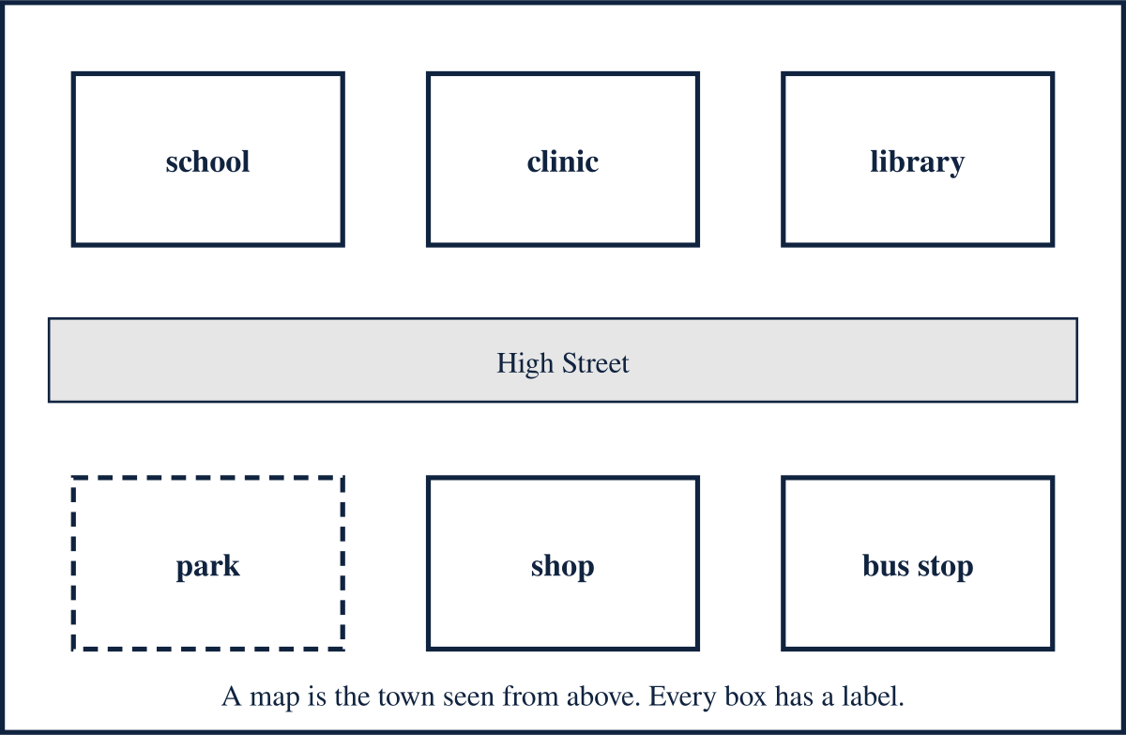
MADE BY MATT / BUILD HUMANITIES
Make the map useful
Map A is a made-up town.
A visitor needs names and uses, not just shapes.
Autumn 1 · Week 6 · Humanities
04
Notes:
BUILD Humanities, Autumn 1 Week 6. Build our community map. Thursday 11:00-11:40. Humanities lesson; separate RE period is outside this pack.
Slide minutes: 1,3,3,4,5,5,3,8,2,2,2,2 = 40. Adapt within the total.
Objective: Contribute a labelled place and a useful note to a shared community map.
Support: Offer a ready-made place card and two possible use cards. Pupil chooses placement and wording.
Stretch: Give one place two useful notes and explain how the shared map could help a fictional visitor.
Misconceptions: A map is a selected view, not a drawing of everything. A symbol or letter needs a key. A label should not depend on colour alone.
Answer guidance: Use notes: school learning, library borrowing books, clinic appointments, shop purchases, park recreation, bus stop waiting for transport. Several valid uses may apply.
Guided clinic/health, shop/food, park/play. Hinge B names the place and explains its use.
Assess the pupil's own placement/label/note choice. Record exactly what an adult prepared or scribed. An attractive shared map alone does not show who made which decision.
[Sources]
https://madebymatt.uk/Lessons/Humanities_Teesside/BUILD_W1-W8_2026-27/BUILD_HUM_W6_Our_Class_Map.html
[/Sources]

Slide 5
MADE BY MATT / BUILD HUMANITIES
Watch a worked example
NOTICE
EXPLAIN
A grey box is a description.
Library is a useful place label.
Library: borrow books is a useful note.
Autumn 1 · Week 6 · Humanities
05
Notes:
BUILD Humanities, Autumn 1 Week 6. Build our community map. Thursday 11:00-11:40. Humanities lesson; separate RE period is outside this pack.
Slide minutes: 1,3,3,4,5,5,3,8,2,2,2,2 = 40. Adapt within the total.
Think aloud: state the detail, then explain what it supports.
Objective: Contribute a labelled place and a useful note to a shared community map.
Support: Offer a ready-made place card and two possible use cards. Pupil chooses placement and wording.
Stretch: Give one place two useful notes and explain how the shared map could help a fictional visitor.
Misconceptions: A map is a selected view, not a drawing of everything. A symbol or letter needs a key. A label should not depend on colour alone.
Answer guidance: Use notes: school learning, library borrowing books, clinic appointments, shop purchases, park recreation, bus stop waiting for transport. Several valid uses may apply.
Guided clinic/health, shop/food, park/play. Hinge B names the place and explains its use.
Assess the pupil's own placement/label/note choice. Record exactly what an adult prepared or scribed. An attractive shared map alone does not show who made which decision.
[Sources]
https://madebymatt.uk/Lessons/Humanities_Teesside/BUILD_W1-W8_2026-27/BUILD_HUM_W6_Our_Class_Map.html
[/Sources]

Slide 6
MADE BY MATT / BUILD HUMANITIES
Try one together
Match: clinic, shop, park.
Use: health appointment, food shopping, play.
Check that another person can follow your label.
Autumn 1 · Week 6 · Humanities
06
Notes:
BUILD Humanities, Autumn 1 Week 6. Build our community map. Thursday 11:00-11:40. Humanities lesson; separate RE period is outside this pack.
Slide minutes: 1,3,3,4,5,5,3,8,2,2,2,2 = 40. Adapt within the total.
Model one part together; invite an independent choice before discussion.
Objective: Contribute a labelled place and a useful note to a shared community map.
Support: Offer a ready-made place card and two possible use cards. Pupil chooses placement and wording.
Stretch: Give one place two useful notes and explain how the shared map could help a fictional visitor.
Misconceptions: A map is a selected view, not a drawing of everything. A symbol or letter needs a key. A label should not depend on colour alone.
Answer guidance: Use notes: school learning, library borrowing books, clinic appointments, shop purchases, park recreation, bus stop waiting for transport. Several valid uses may apply.
Guided clinic/health, shop/food, park/play. Hinge B names the place and explains its use.
Assess the pupil's own placement/label/note choice. Record exactly what an adult prepared or scribed. An attractive shared map alone does not show who made which decision.
[Sources]
https://madebymatt.uk/Lessons/Humanities_Teesside/BUILD_W1-W8_2026-27/BUILD_HUM_W6_Our_Class_Map.html
[/Sources]

Slide 7
MADE BY MATT / BUILD HUMANITIES
Choose, then explain
Which label helps a visitor most?
A. The large grey one.
B. Clinic: health appointments here.
Choose and explain.
Autumn 1 · Week 6 · Humanities
07
Notes:
BUILD Humanities, Autumn 1 Week 6. Build our community map. Thursday 11:00-11:40. Humanities lesson; separate RE period is outside this pack.
Slide minutes: 1,3,3,4,5,5,3,8,2,2,2,2 = 40. Adapt within the total.
Take simultaneous choices where helpful. Ask for the reason. Reteach if the reason reveals the misconception.
Objective: Contribute a labelled place and a useful note to a shared community map.
Support: Offer a ready-made place card and two possible use cards. Pupil chooses placement and wording.
Stretch: Give one place two useful notes and explain how the shared map could help a fictional visitor.
Misconceptions: A map is a selected view, not a drawing of everything. A symbol or letter needs a key. A label should not depend on colour alone.
Answer guidance: Use notes: school learning, library borrowing books, clinic appointments, shop purchases, park recreation, bus stop waiting for transport. Several valid uses may apply.
Guided clinic/health, shop/food, park/play. Hinge B names the place and explains its use.
Assess the pupil's own placement/label/note choice. Record exactly what an adult prepared or scribed. An attractive shared map alone does not show who made which decision.
[Sources]
https://madebymatt.uk/Lessons/Humanities_Teesside/BUILD_W1-W8_2026-27/BUILD_HUM_W6_Our_Class_Map.html
[/Sources]

Slide 8
MADE BY MATT / BUILD HUMANITIES
Now it is your turn
YOUR TASK
EXPLAIN
Add one place to the shared map.
Label it and add what happens there.
Ask a reader to test your note.
Autumn 1 · Week 6 · Humanities
08
Notes:
BUILD Humanities, Autumn 1 Week 6. Build our community map. Thursday 11:00-11:40. Humanities lesson; separate RE period is outside this pack.
Slide minutes: 1,3,3,4,5,5,3,8,2,2,2,2 = 40. Adapt within the total.
Independent attempt. Record the support used. Keep this first response before feedback.
Objective: Contribute a labelled place and a useful note to a shared community map.
Support: Offer a ready-made place card and two possible use cards. Pupil chooses placement and wording.
Stretch: Give one place two useful notes and explain how the shared map could help a fictional visitor.
Misconceptions: A map is a selected view, not a drawing of everything. A symbol or letter needs a key. A label should not depend on colour alone.
Answer guidance: Use notes: school learning, library borrowing books, clinic appointments, shop purchases, park recreation, bus stop waiting for transport. Several valid uses may apply.
Guided clinic/health, shop/food, park/play. Hinge B names the place and explains its use.
Assess the pupil's own placement/label/note choice. Record exactly what an adult prepared or scribed. An attractive shared map alone does not show who made which decision.
[Sources]
https://madebymatt.uk/Lessons/Humanities_Teesside/BUILD_W1-W8_2026-27/BUILD_HUM_W6_Our_Class_Map.html
[/Sources]

Slide 9
MADE BY MATT / BUILD HUMANITIES
Show what you mean
Point to your choice.
Give one reason.
Your listener says what they heard.
Keep your first idea for the check.
Autumn 1 · Week 6 · Humanities
09
Notes:
BUILD Humanities, Autumn 1 Week 6. Build our community map. Thursday 11:00-11:40. Humanities lesson; separate RE period is outside this pack.
Slide minutes: 1,3,3,4,5,5,3,8,2,2,2,2 = 40. Adapt within the total.
Follow the pupil sheet. In assessment lessons, release the second response only after the first is kept.
Objective: Contribute a labelled place and a useful note to a shared community map.
Support: Offer a ready-made place card and two possible use cards. Pupil chooses placement and wording.
Stretch: Give one place two useful notes and explain how the shared map could help a fictional visitor.
Misconceptions: A map is a selected view, not a drawing of everything. A symbol or letter needs a key. A label should not depend on colour alone.
Answer guidance: Use notes: school learning, library borrowing books, clinic appointments, shop purchases, park recreation, bus stop waiting for transport. Several valid uses may apply.
Guided clinic/health, shop/food, park/play. Hinge B names the place and explains its use.
Assess the pupil's own placement/label/note choice. Record exactly what an adult prepared or scribed. An attractive shared map alone does not show who made which decision.
[Sources]
https://madebymatt.uk/Lessons/Humanities_Teesside/BUILD_W1-W8_2026-27/BUILD_HUM_W6_Our_Class_Map.html
[/Sources]

Slide 10
MADE BY MATT / BUILD HUMANITIES
Check the reasoning
A LABEL
A NOTE
Names the place clearly.
Explains the use or who it helps.
Autumn 1 · Week 6 · Humanities
10
Notes:
BUILD Humanities, Autumn 1 Week 6. Build our community map. Thursday 11:00-11:40. Humanities lesson; separate RE period is outside this pack.
Slide minutes: 1,3,3,4,5,5,3,8,2,2,2,2 = 40. Adapt within the total.
Reveal checks now. Accept different defensible answers; do not score opinions as wrong.
Objective: Contribute a labelled place and a useful note to a shared community map.
Support: Offer a ready-made place card and two possible use cards. Pupil chooses placement and wording.
Stretch: Give one place two useful notes and explain how the shared map could help a fictional visitor.
Misconceptions: A map is a selected view, not a drawing of everything. A symbol or letter needs a key. A label should not depend on colour alone.
Answer guidance: Use notes: school learning, library borrowing books, clinic appointments, shop purchases, park recreation, bus stop waiting for transport. Several valid uses may apply.
Guided clinic/health, shop/food, park/play. Hinge B names the place and explains its use.
Assess the pupil's own placement/label/note choice. Record exactly what an adult prepared or scribed. An attractive shared map alone does not show who made which decision.
[Sources]
https://madebymatt.uk/Lessons/Humanities_Teesside/BUILD_W1-W8_2026-27/BUILD_HUM_W6_Our_Class_Map.html
[/Sources]

Slide 11
MADE BY MATT / BUILD HUMANITIES
Your voice shapes the next step
Choose one idea to share, or pass.
Your listener tells you what they heard.
Keep or change your idea; give a reason.
Tell us what would help you next time.
Autumn 1 · Week 6 · Humanities
11
Notes:
BUILD Humanities, Autumn 1 Week 6. Build our community map. Thursday 11:00-11:40. Humanities lesson; separate RE period is outside this pack.
Slide minutes: 1,3,3,4,5,5,3,8,2,2,2,2 = 40. Adapt within the total.
Space: pupil chooses how to respond. Voice: help them express their idea. Audience: read the meaning back and let the pupil correct it. Influence: agree one teaching action, then act on it next lesson.
Objective: Contribute a labelled place and a useful note to a shared community map.
Support: Offer a ready-made place card and two possible use cards. Pupil chooses placement and wording.
Stretch: Give one place two useful notes and explain how the shared map could help a fictional visitor.
Misconceptions: A map is a selected view, not a drawing of everything. A symbol or letter needs a key. A label should not depend on colour alone.
Answer guidance: Use notes: school learning, library borrowing books, clinic appointments, shop purchases, park recreation, bus stop waiting for transport. Several valid uses may apply.
Guided clinic/health, shop/food, park/play. Hinge B names the place and explains its use.
Assess the pupil's own placement/label/note choice. Record exactly what an adult prepared or scribed. An attractive shared map alone does not show who made which decision.
[Sources]
https://madebymatt.uk/Lessons/Humanities_Teesside/BUILD_W1-W8_2026-27/BUILD_HUM_W6_Our_Class_Map.html
[/Sources]

Slide 12
MADE BY MATT / BUILD HUMANITIES
Before you go
Read your map contribution.
What did your reader help you check?
Show one detail that helped.
Choose a next step.
Autumn 1 · Week 6 · Humanities
12
Notes:
BUILD Humanities, Autumn 1 Week 6. Build our community map. Thursday 11:00-11:40. Humanities lesson; separate RE period is outside this pack.
Slide minutes: 1,3,3,4,5,5,3,8,2,2,2,2 = 40. Adapt within the total.
Capture one specific success and one next step. Record the response mode and support.
Objective: Contribute a labelled place and a useful note to a shared community map.
Support: Offer a ready-made place card and two possible use cards. Pupil chooses placement and wording.
Stretch: Give one place two useful notes and explain how the shared map could help a fictional visitor.
Misconceptions: A map is a selected view, not a drawing of everything. A symbol or letter needs a key. A label should not depend on colour alone.
Answer guidance: Use notes: school learning, library borrowing books, clinic appointments, shop purchases, park recreation, bus stop waiting for transport. Several valid uses may apply.
Guided clinic/health, shop/food, park/play. Hinge B names the place and explains its use.
Assess the pupil's own placement/label/note choice. Record exactly what an adult prepared or scribed. An attractive shared map alone does not show who made which decision.
[Sources]
https://madebymatt.uk/Lessons/Humanities_Teesside/BUILD_W1-W8_2026-27/BUILD_HUM_W6_Our_Class_Map.html
[/Sources]

