Slide 1

MADE BY MATT / GROW HUMANITIES
Why move? What changes?
How do causes and consequences differ?
Explain a cause and consequence of migration, using evidence and a time sequence.
Use a detail. Explain what it supports.
Autumn 1 · Week 3 · Humanities
01
Notes:
GROW Humanities, Autumn 1 Week 3. Why move? What changes?. Friday 10:10-10:50. Humanities lesson; separate RE period is outside this pack.
Slide minutes: 1,3,3,4,5,5,3,8,2,2,2,2 = 40. Adapt within the total.
Read the enquiry. Check that pupils know the response choices.
Objective: Explain a cause and consequence of migration, using evidence and a time sequence.
Support: Use A/B/E first, read aloud and offer before/after labels. Pupil directs the chain.
Stretch: Build a chain with two causes and judge which has the stronger evidence; identify what is still unknown.
Misconceptions: A recruitment campaign in the 1950s cannot cause a journey in 1948. A listed occupation is not necessarily a confirmed job in Britain. Push and pull are both possible causes; neither explains every person's decision.
Answer guidance: Source W records names, ages, occupations and proposed addresses. Examples: Kenneth Amos, 21, welder; Rubert Adolphus, 24, carpenter. It does not directly record individual motives or later employment outcomes.
A/C push, B/D pull, E/F consequences. A factor can sometimes be classified differently in a different scenario, but these statements specify the direction and timing.
Example fictional chain: offered a job in another town -> moves -> starts that job. Use because for the cause and as a result for the consequence.
Hinge B. We cannot turn two recorded occupations into a claim about every passenger's motive.
[Sources]
https://madebymatt.uk/Lessons/Humanities_Teesside/GROW_W1-W8_2026-27/GROW_HUM_W3_Why_People_Moved_And_What_Changed.html
https://www.nationalarchives.gov.uk/education/resources/commonwealth-migration-since-1945/passenger-list-from-windrush/
[/Sources]

Slide 2
MADE BY MATT / GROW HUMANITIES
Start with what you know
Migration means moving to live elsewhere.
Does a cause come before or after a move?
Which could attract a move: a job or a storm?
Autumn 1 · Week 3 · Humanities
02
Notes:
GROW Humanities, Autumn 1 Week 3. Why move? What changes?. Friday 10:10-10:50. Humanities lesson; separate RE period is outside this pack.
Slide minutes: 1,3,3,4,5,5,3,8,2,2,2,2 = 40. Adapt within the total.
Retain a first response. Do not supply the answer before the pupil chooses.
Objective: Explain a cause and consequence of migration, using evidence and a time sequence.
Support: Use A/B/E first, read aloud and offer before/after labels. Pupil directs the chain.
Stretch: Build a chain with two causes and judge which has the stronger evidence; identify what is still unknown.
Misconceptions: A recruitment campaign in the 1950s cannot cause a journey in 1948. A listed occupation is not necessarily a confirmed job in Britain. Push and pull are both possible causes; neither explains every person's decision.
Answer guidance: Source W records names, ages, occupations and proposed addresses. Examples: Kenneth Amos, 21, welder; Rubert Adolphus, 24, carpenter. It does not directly record individual motives or later employment outcomes.
A/C push, B/D pull, E/F consequences. A factor can sometimes be classified differently in a different scenario, but these statements specify the direction and timing.
Example fictional chain: offered a job in another town -> moves -> starts that job. Use because for the cause and as a result for the consequence.
Hinge B. We cannot turn two recorded occupations into a claim about every passenger's motive.
[Sources]
https://madebymatt.uk/Lessons/Humanities_Teesside/GROW_W1-W8_2026-27/GROW_HUM_W3_Why_People_Moved_And_What_Changed.html
https://www.nationalarchives.gov.uk/education/resources/commonwealth-migration-since-1945/passenger-list-from-windrush/
[/Sources]

Slide 3
MADE BY MATT / GROW HUMANITIES
Words that help
CAUSE
PUSH
helps explain why.
Consequence: a result.
a reason to leave.
Pull: a reason to move towards.
Autumn 1 · Week 3 · Humanities
03
Notes:
GROW Humanities, Autumn 1 Week 3. Why move? What changes?. Friday 10:10-10:50. Humanities lesson; separate RE period is outside this pack.
Slide minutes: 1,3,3,4,5,5,3,8,2,2,2,2 = 40. Adapt within the total.
Read each term with an example. Ask pupils to point to or use one term.
Objective: Explain a cause and consequence of migration, using evidence and a time sequence.
Support: Use A/B/E first, read aloud and offer before/after labels. Pupil directs the chain.
Stretch: Build a chain with two causes and judge which has the stronger evidence; identify what is still unknown.
Misconceptions: A recruitment campaign in the 1950s cannot cause a journey in 1948. A listed occupation is not necessarily a confirmed job in Britain. Push and pull are both possible causes; neither explains every person's decision.
Answer guidance: Source W records names, ages, occupations and proposed addresses. Examples: Kenneth Amos, 21, welder; Rubert Adolphus, 24, carpenter. It does not directly record individual motives or later employment outcomes.
A/C push, B/D pull, E/F consequences. A factor can sometimes be classified differently in a different scenario, but these statements specify the direction and timing.
Example fictional chain: offered a job in another town -> moves -> starts that job. Use because for the cause and as a result for the consequence.
Hinge B. We cannot turn two recorded occupations into a claim about every passenger's motive.
[Sources]
https://madebymatt.uk/Lessons/Humanities_Teesside/GROW_W1-W8_2026-27/GROW_HUM_W3_Why_People_Moved_And_What_Changed.html
https://www.nationalarchives.gov.uk/education/resources/commonwealth-migration-since-1945/passenger-list-from-windrush/
[/Sources]

Slide 4
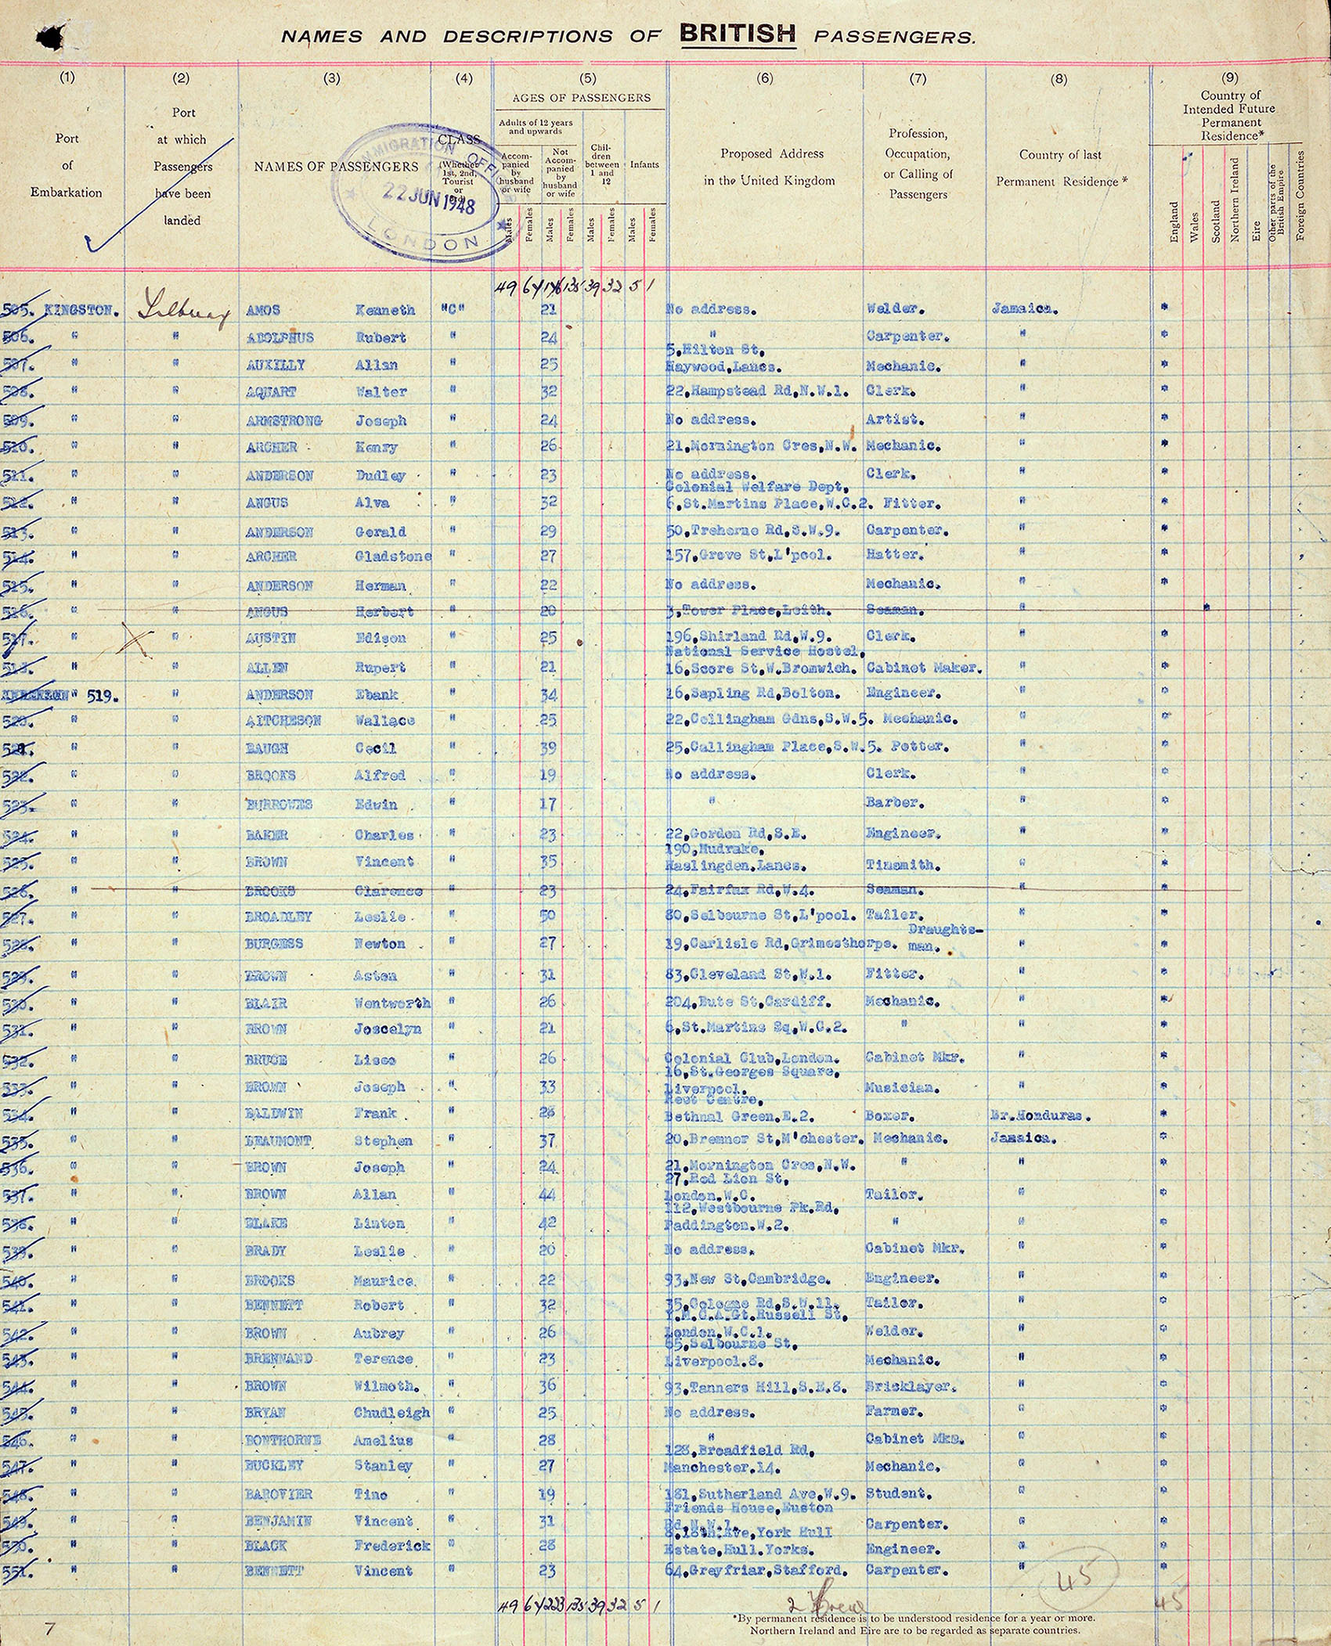
MADE BY MATT / GROW HUMANITIES
Read the record carefully
A passenger list records a journey.
It does not explain every reason for moving.
Autumn 1 · Week 3 · Humanities
04
Notes:
GROW Humanities, Autumn 1 Week 3. Why move? What changes?. Friday 10:10-10:50. Humanities lesson; separate RE period is outside this pack.
Slide minutes: 1,3,3,4,5,5,3,8,2,2,2,2 = 40. Adapt within the total.
Use the larger printed source sheet. Read captions and distinguish the document from its later custodian.
Objective: Explain a cause and consequence of migration, using evidence and a time sequence.
Support: Use A/B/E first, read aloud and offer before/after labels. Pupil directs the chain.
Stretch: Build a chain with two causes and judge which has the stronger evidence; identify what is still unknown.
Misconceptions: A recruitment campaign in the 1950s cannot cause a journey in 1948. A listed occupation is not necessarily a confirmed job in Britain. Push and pull are both possible causes; neither explains every person's decision.
Answer guidance: Source W records names, ages, occupations and proposed addresses. Examples: Kenneth Amos, 21, welder; Rubert Adolphus, 24, carpenter. It does not directly record individual motives or later employment outcomes.
A/C push, B/D pull, E/F consequences. A factor can sometimes be classified differently in a different scenario, but these statements specify the direction and timing.
Example fictional chain: offered a job in another town -> moves -> starts that job. Use because for the cause and as a result for the consequence.
Hinge B. We cannot turn two recorded occupations into a claim about every passenger's motive.
[Sources]
https://madebymatt.uk/Lessons/Humanities_Teesside/GROW_W1-W8_2026-27/GROW_HUM_W3_Why_People_Moved_And_What_Changed.html
https://www.nationalarchives.gov.uk/education/resources/commonwealth-migration-since-1945/passenger-list-from-windrush/
[/Sources]

Slide 5
MADE BY MATT / GROW HUMANITIES
Watch a worked example
CAUSE
CONSEQUENCE
A job offer may attract a move.
A new job may follow a move.
Autumn 1 · Week 3 · Humanities
05
Notes:
GROW Humanities, Autumn 1 Week 3. Why move? What changes?. Friday 10:10-10:50. Humanities lesson; separate RE period is outside this pack.
Slide minutes: 1,3,3,4,5,5,3,8,2,2,2,2 = 40. Adapt within the total.
Think aloud: state the detail, then explain what it supports.
Objective: Explain a cause and consequence of migration, using evidence and a time sequence.
Support: Use A/B/E first, read aloud and offer before/after labels. Pupil directs the chain.
Stretch: Build a chain with two causes and judge which has the stronger evidence; identify what is still unknown.
Misconceptions: A recruitment campaign in the 1950s cannot cause a journey in 1948. A listed occupation is not necessarily a confirmed job in Britain. Push and pull are both possible causes; neither explains every person's decision.
Answer guidance: Source W records names, ages, occupations and proposed addresses. Examples: Kenneth Amos, 21, welder; Rubert Adolphus, 24, carpenter. It does not directly record individual motives or later employment outcomes.
A/C push, B/D pull, E/F consequences. A factor can sometimes be classified differently in a different scenario, but these statements specify the direction and timing.
Example fictional chain: offered a job in another town -> moves -> starts that job. Use because for the cause and as a result for the consequence.
Hinge B. We cannot turn two recorded occupations into a claim about every passenger's motive.
[Sources]
https://madebymatt.uk/Lessons/Humanities_Teesside/GROW_W1-W8_2026-27/GROW_HUM_W3_Why_People_Moved_And_What_Changed.html
https://www.nationalarchives.gov.uk/education/resources/commonwealth-migration-since-1945/passenger-list-from-windrush/
[/Sources]

Slide 6
MADE BY MATT / GROW HUMANITIES
Try one together
A flood damages a home: push or pull?
A job offer elsewhere: push or pull?
These are fictional examples, not Windrush testimony.
Autumn 1 · Week 3 · Humanities
06
Notes:
GROW Humanities, Autumn 1 Week 3. Why move? What changes?. Friday 10:10-10:50. Humanities lesson; separate RE period is outside this pack.
Slide minutes: 1,3,3,4,5,5,3,8,2,2,2,2 = 40. Adapt within the total.
Model one part together; invite an independent choice before discussion.
Objective: Explain a cause and consequence of migration, using evidence and a time sequence.
Support: Use A/B/E first, read aloud and offer before/after labels. Pupil directs the chain.
Stretch: Build a chain with two causes and judge which has the stronger evidence; identify what is still unknown.
Misconceptions: A recruitment campaign in the 1950s cannot cause a journey in 1948. A listed occupation is not necessarily a confirmed job in Britain. Push and pull are both possible causes; neither explains every person's decision.
Answer guidance: Source W records names, ages, occupations and proposed addresses. Examples: Kenneth Amos, 21, welder; Rubert Adolphus, 24, carpenter. It does not directly record individual motives or later employment outcomes.
A/C push, B/D pull, E/F consequences. A factor can sometimes be classified differently in a different scenario, but these statements specify the direction and timing.
Example fictional chain: offered a job in another town -> moves -> starts that job. Use because for the cause and as a result for the consequence.
Hinge B. We cannot turn two recorded occupations into a claim about every passenger's motive.
[Sources]
https://madebymatt.uk/Lessons/Humanities_Teesside/GROW_W1-W8_2026-27/GROW_HUM_W3_Why_People_Moved_And_What_Changed.html
https://www.nationalarchives.gov.uk/education/resources/commonwealth-migration-since-1945/passenger-list-from-windrush/
[/Sources]

Slide 7
MADE BY MATT / GROW HUMANITIES
Choose, then explain
Which claim does Source W support?
A. All passengers came for the same job.
B. Different occupations are recorded.
Choose and explain using the source.
Autumn 1 · Week 3 · Humanities
07
Notes:
GROW Humanities, Autumn 1 Week 3. Why move? What changes?. Friday 10:10-10:50. Humanities lesson; separate RE period is outside this pack.
Slide minutes: 1,3,3,4,5,5,3,8,2,2,2,2 = 40. Adapt within the total.
Take simultaneous choices where helpful. Ask for the reason. Reteach if the reason reveals the misconception.
Objective: Explain a cause and consequence of migration, using evidence and a time sequence.
Support: Use A/B/E first, read aloud and offer before/after labels. Pupil directs the chain.
Stretch: Build a chain with two causes and judge which has the stronger evidence; identify what is still unknown.
Misconceptions: A recruitment campaign in the 1950s cannot cause a journey in 1948. A listed occupation is not necessarily a confirmed job in Britain. Push and pull are both possible causes; neither explains every person's decision.
Answer guidance: Source W records names, ages, occupations and proposed addresses. Examples: Kenneth Amos, 21, welder; Rubert Adolphus, 24, carpenter. It does not directly record individual motives or later employment outcomes.
A/C push, B/D pull, E/F consequences. A factor can sometimes be classified differently in a different scenario, but these statements specify the direction and timing.
Example fictional chain: offered a job in another town -> moves -> starts that job. Use because for the cause and as a result for the consequence.
Hinge B. We cannot turn two recorded occupations into a claim about every passenger's motive.
[Sources]
https://madebymatt.uk/Lessons/Humanities_Teesside/GROW_W1-W8_2026-27/GROW_HUM_W3_Why_People_Moved_And_What_Changed.html
https://www.nationalarchives.gov.uk/education/resources/commonwealth-migration-since-1945/passenger-list-from-windrush/
[/Sources]

Slide 8
MADE BY MATT / GROW HUMANITIES
Now it is your turn
YOUR TASK
EXPLAIN
Sort the six scenario cards.
Build a cause, move, consequence chain.
Explain what Source W can and cannot show.
Autumn 1 · Week 3 · Humanities
08
Notes:
GROW Humanities, Autumn 1 Week 3. Why move? What changes?. Friday 10:10-10:50. Humanities lesson; separate RE period is outside this pack.
Slide minutes: 1,3,3,4,5,5,3,8,2,2,2,2 = 40. Adapt within the total.
Independent attempt. Record the support used. Keep this first response before feedback.
Objective: Explain a cause and consequence of migration, using evidence and a time sequence.
Support: Use A/B/E first, read aloud and offer before/after labels. Pupil directs the chain.
Stretch: Build a chain with two causes and judge which has the stronger evidence; identify what is still unknown.
Misconceptions: A recruitment campaign in the 1950s cannot cause a journey in 1948. A listed occupation is not necessarily a confirmed job in Britain. Push and pull are both possible causes; neither explains every person's decision.
Answer guidance: Source W records names, ages, occupations and proposed addresses. Examples: Kenneth Amos, 21, welder; Rubert Adolphus, 24, carpenter. It does not directly record individual motives or later employment outcomes.
A/C push, B/D pull, E/F consequences. A factor can sometimes be classified differently in a different scenario, but these statements specify the direction and timing.
Example fictional chain: offered a job in another town -> moves -> starts that job. Use because for the cause and as a result for the consequence.
Hinge B. We cannot turn two recorded occupations into a claim about every passenger's motive.
[Sources]
https://madebymatt.uk/Lessons/Humanities_Teesside/GROW_W1-W8_2026-27/GROW_HUM_W3_Why_People_Moved_And_What_Changed.html
https://www.nationalarchives.gov.uk/education/resources/commonwealth-migration-since-1945/passenger-list-from-windrush/
[/Sources]

Slide 9
MADE BY MATT / GROW HUMANITIES
Make the reasoning visible
Point to one detail you used.
Say how it helped your answer.
Name one thing it cannot show.
Keep your first answer for the check.
Autumn 1 · Week 3 · Humanities
09
Notes:
GROW Humanities, Autumn 1 Week 3. Why move? What changes?. Friday 10:10-10:50. Humanities lesson; separate RE period is outside this pack.
Slide minutes: 1,3,3,4,5,5,3,8,2,2,2,2 = 40. Adapt within the total.
Follow the pupil sheet. In assessment lessons, release the second response only after the first is kept.
Objective: Explain a cause and consequence of migration, using evidence and a time sequence.
Support: Use A/B/E first, read aloud and offer before/after labels. Pupil directs the chain.
Stretch: Build a chain with two causes and judge which has the stronger evidence; identify what is still unknown.
Misconceptions: A recruitment campaign in the 1950s cannot cause a journey in 1948. A listed occupation is not necessarily a confirmed job in Britain. Push and pull are both possible causes; neither explains every person's decision.
Answer guidance: Source W records names, ages, occupations and proposed addresses. Examples: Kenneth Amos, 21, welder; Rubert Adolphus, 24, carpenter. It does not directly record individual motives or later employment outcomes.
A/C push, B/D pull, E/F consequences. A factor can sometimes be classified differently in a different scenario, but these statements specify the direction and timing.
Example fictional chain: offered a job in another town -> moves -> starts that job. Use because for the cause and as a result for the consequence.
Hinge B. We cannot turn two recorded occupations into a claim about every passenger's motive.
[Sources]
https://madebymatt.uk/Lessons/Humanities_Teesside/GROW_W1-W8_2026-27/GROW_HUM_W3_Why_People_Moved_And_What_Changed.html
https://www.nationalarchives.gov.uk/education/resources/commonwealth-migration-since-1945/passenger-list-from-windrush/
[/Sources]

Slide 10
MADE BY MATT / GROW HUMANITIES
Check the reasoning
SCENARIO SORT
RESULTS
Push: A, C. Pull: B, D.
E and F are consequences.
Autumn 1 · Week 3 · Humanities
10
Notes:
GROW Humanities, Autumn 1 Week 3. Why move? What changes?. Friday 10:10-10:50. Humanities lesson; separate RE period is outside this pack.
Slide minutes: 1,3,3,4,5,5,3,8,2,2,2,2 = 40. Adapt within the total.
Reveal checks now. Accept different defensible answers; do not score opinions as wrong.
Objective: Explain a cause and consequence of migration, using evidence and a time sequence.
Support: Use A/B/E first, read aloud and offer before/after labels. Pupil directs the chain.
Stretch: Build a chain with two causes and judge which has the stronger evidence; identify what is still unknown.
Misconceptions: A recruitment campaign in the 1950s cannot cause a journey in 1948. A listed occupation is not necessarily a confirmed job in Britain. Push and pull are both possible causes; neither explains every person's decision.
Answer guidance: Source W records names, ages, occupations and proposed addresses. Examples: Kenneth Amos, 21, welder; Rubert Adolphus, 24, carpenter. It does not directly record individual motives or later employment outcomes.
A/C push, B/D pull, E/F consequences. A factor can sometimes be classified differently in a different scenario, but these statements specify the direction and timing.
Example fictional chain: offered a job in another town -> moves -> starts that job. Use because for the cause and as a result for the consequence.
Hinge B. We cannot turn two recorded occupations into a claim about every passenger's motive.
[Sources]
https://madebymatt.uk/Lessons/Humanities_Teesside/GROW_W1-W8_2026-27/GROW_HUM_W3_Why_People_Moved_And_What_Changed.html
https://www.nationalarchives.gov.uk/education/resources/commonwealth-migration-since-1945/passenger-list-from-windrush/
[/Sources]

Slide 11
MADE BY MATT / GROW HUMANITIES
Your voice shapes the next step
Choose one idea to share, or pass.
Your listener tells you what they heard.
Keep or change your idea; give a reason.
Tell us what would help you next time.
Autumn 1 · Week 3 · Humanities
11
Notes:
GROW Humanities, Autumn 1 Week 3. Why move? What changes?. Friday 10:10-10:50. Humanities lesson; separate RE period is outside this pack.
Slide minutes: 1,3,3,4,5,5,3,8,2,2,2,2 = 40. Adapt within the total.
Space: pupil chooses how to respond. Voice: help them express their idea. Audience: read the meaning back and let the pupil correct it. Influence: agree one teaching action, then act on it next lesson.
Objective: Explain a cause and consequence of migration, using evidence and a time sequence.
Support: Use A/B/E first, read aloud and offer before/after labels. Pupil directs the chain.
Stretch: Build a chain with two causes and judge which has the stronger evidence; identify what is still unknown.
Misconceptions: A recruitment campaign in the 1950s cannot cause a journey in 1948. A listed occupation is not necessarily a confirmed job in Britain. Push and pull are both possible causes; neither explains every person's decision.
Answer guidance: Source W records names, ages, occupations and proposed addresses. Examples: Kenneth Amos, 21, welder; Rubert Adolphus, 24, carpenter. It does not directly record individual motives or later employment outcomes.
A/C push, B/D pull, E/F consequences. A factor can sometimes be classified differently in a different scenario, but these statements specify the direction and timing.
Example fictional chain: offered a job in another town -> moves -> starts that job. Use because for the cause and as a result for the consequence.
Hinge B. We cannot turn two recorded occupations into a claim about every passenger's motive.
[Sources]
https://madebymatt.uk/Lessons/Humanities_Teesside/GROW_W1-W8_2026-27/GROW_HUM_W3_Why_People_Moved_And_What_Changed.html
https://www.nationalarchives.gov.uk/education/resources/commonwealth-migration-since-1945/passenger-list-from-windrush/
[/Sources]

Slide 12
MADE BY MATT / GROW HUMANITIES
Before you go
Give one cause and one consequence.
What cannot the passenger list tell us?
Show one detail that helped.
Choose a next step.
Autumn 1 · Week 3 · Humanities
12
Notes:
GROW Humanities, Autumn 1 Week 3. Why move? What changes?. Friday 10:10-10:50. Humanities lesson; separate RE period is outside this pack.
Slide minutes: 1,3,3,4,5,5,3,8,2,2,2,2 = 40. Adapt within the total.
Capture one specific success and one next step. Record the response mode and support.
Objective: Explain a cause and consequence of migration, using evidence and a time sequence.
Support: Use A/B/E first, read aloud and offer before/after labels. Pupil directs the chain.
Stretch: Build a chain with two causes and judge which has the stronger evidence; identify what is still unknown.
Misconceptions: A recruitment campaign in the 1950s cannot cause a journey in 1948. A listed occupation is not necessarily a confirmed job in Britain. Push and pull are both possible causes; neither explains every person's decision.
Answer guidance: Source W records names, ages, occupations and proposed addresses. Examples: Kenneth Amos, 21, welder; Rubert Adolphus, 24, carpenter. It does not directly record individual motives or later employment outcomes.
A/C push, B/D pull, E/F consequences. A factor can sometimes be classified differently in a different scenario, but these statements specify the direction and timing.
Example fictional chain: offered a job in another town -> moves -> starts that job. Use because for the cause and as a result for the consequence.
Hinge B. We cannot turn two recorded occupations into a claim about every passenger's motive.
[Sources]
https://madebymatt.uk/Lessons/Humanities_Teesside/GROW_W1-W8_2026-27/GROW_HUM_W3_Why_People_Moved_And_What_Changed.html
https://www.nationalarchives.gov.uk/education/resources/commonwealth-migration-since-1945/passenger-list-from-windrush/
[/Sources]

