Slide 1

MADE BY MATT / GROW HUMANITIES
Whose history is included?
What shows a long Black presence in Britain?
Use dated evidence to challenge an overgeneralisation about diverse British history.
Use a detail. Explain what it supports.
Autumn 1 · Week 4 · Humanities
01
Notes:
GROW Humanities, Autumn 1 Week 4. Whose history is included?. Friday 10:10-10:50. Humanities lesson; separate RE period is outside this pack.
Slide minutes: 1,3,3,4,5,5,3,8,2,2,2,2 = 40. Adapt within the total.
Read the enquiry. Check that pupils know the response choices.
Objective: Use dated evidence to challenge an overgeneralisation about diverse British history.
Support: Read the three date cards and use a simple earlier/later line. Scribe the pupil's chosen claim.
Stretch: Compare a visual record and a published book: how do their purposes change the questions each helps answer?
Misconceptions: One source cannot count a whole population or represent every experience. A gap in our selected cards is not proof that no people lived here in that period. A later summary is not the original artefact it describes.
Answer guidance: Chronology J 1511, O 1789, W 1948. Both J and O independently challenge a start-date of 1948.
J supports a Black presence at the Tudor court. O supports a Black writer publishing and campaigning in eighteenth-century Britain. W records a particular later journey.
Neither J nor O counts the population; W is one page from one voyage. The secondary cards must not be called primary sources.
Hinge A. Accept well-supported alternative wording and comparisons of source purposes.
[Sources]
https://madebymatt.uk/Lessons/Humanities_Teesside/GROW_W1-W8_2026-27/GROW_HUM_W4_Diverse_British_History.html
https://www.nationalarchives.gov.uk/explore-the-collection/stories/john-blanke/
https://www.londonmuseum.org.uk/collections/london-stories/olaudah-equiano-writer-abolitionist/
https://www.nationalarchives.gov.uk/education/resources/commonwealth-migration-since-1945/passenger-list-from-windrush/
[/Sources]

Slide 2
MADE BY MATT / GROW HUMANITIES
Start with what you know
Put 1511, 1789 and 1948 in order.
Does one ship mark the start of all migration?
Keep your prediction before reading.
Autumn 1 · Week 4 · Humanities
02
Notes:
GROW Humanities, Autumn 1 Week 4. Whose history is included?. Friday 10:10-10:50. Humanities lesson; separate RE period is outside this pack.
Slide minutes: 1,3,3,4,5,5,3,8,2,2,2,2 = 40. Adapt within the total.
Retain a first response. Do not supply the answer before the pupil chooses.
Objective: Use dated evidence to challenge an overgeneralisation about diverse British history.
Support: Read the three date cards and use a simple earlier/later line. Scribe the pupil's chosen claim.
Stretch: Compare a visual record and a published book: how do their purposes change the questions each helps answer?
Misconceptions: One source cannot count a whole population or represent every experience. A gap in our selected cards is not proof that no people lived here in that period. A later summary is not the original artefact it describes.
Answer guidance: Chronology J 1511, O 1789, W 1948. Both J and O independently challenge a start-date of 1948.
J supports a Black presence at the Tudor court. O supports a Black writer publishing and campaigning in eighteenth-century Britain. W records a particular later journey.
Neither J nor O counts the population; W is one page from one voyage. The secondary cards must not be called primary sources.
Hinge A. Accept well-supported alternative wording and comparisons of source purposes.
[Sources]
https://madebymatt.uk/Lessons/Humanities_Teesside/GROW_W1-W8_2026-27/GROW_HUM_W4_Diverse_British_History.html
https://www.nationalarchives.gov.uk/explore-the-collection/stories/john-blanke/
https://www.londonmuseum.org.uk/collections/london-stories/olaudah-equiano-writer-abolitionist/
https://www.nationalarchives.gov.uk/education/resources/commonwealth-migration-since-1945/passenger-list-from-windrush/
[/Sources]

Slide 3
MADE BY MATT / GROW HUMANITIES
Words that help
CHRONOLOGY
CLAIM
order in time.
Source: something we study.
what we say happened.
Limit: what evidence cannot show.
Autumn 1 · Week 4 · Humanities
03
Notes:
GROW Humanities, Autumn 1 Week 4. Whose history is included?. Friday 10:10-10:50. Humanities lesson; separate RE period is outside this pack.
Slide minutes: 1,3,3,4,5,5,3,8,2,2,2,2 = 40. Adapt within the total.
Read each term with an example. Ask pupils to point to or use one term.
Objective: Use dated evidence to challenge an overgeneralisation about diverse British history.
Support: Read the three date cards and use a simple earlier/later line. Scribe the pupil's chosen claim.
Stretch: Compare a visual record and a published book: how do their purposes change the questions each helps answer?
Misconceptions: One source cannot count a whole population or represent every experience. A gap in our selected cards is not proof that no people lived here in that period. A later summary is not the original artefact it describes.
Answer guidance: Chronology J 1511, O 1789, W 1948. Both J and O independently challenge a start-date of 1948.
J supports a Black presence at the Tudor court. O supports a Black writer publishing and campaigning in eighteenth-century Britain. W records a particular later journey.
Neither J nor O counts the population; W is one page from one voyage. The secondary cards must not be called primary sources.
Hinge A. Accept well-supported alternative wording and comparisons of source purposes.
[Sources]
https://madebymatt.uk/Lessons/Humanities_Teesside/GROW_W1-W8_2026-27/GROW_HUM_W4_Diverse_British_History.html
https://www.nationalarchives.gov.uk/explore-the-collection/stories/john-blanke/
https://www.londonmuseum.org.uk/collections/london-stories/olaudah-equiano-writer-abolitionist/
https://www.nationalarchives.gov.uk/education/resources/commonwealth-migration-since-1945/passenger-list-from-windrush/
[/Sources]

Slide 4
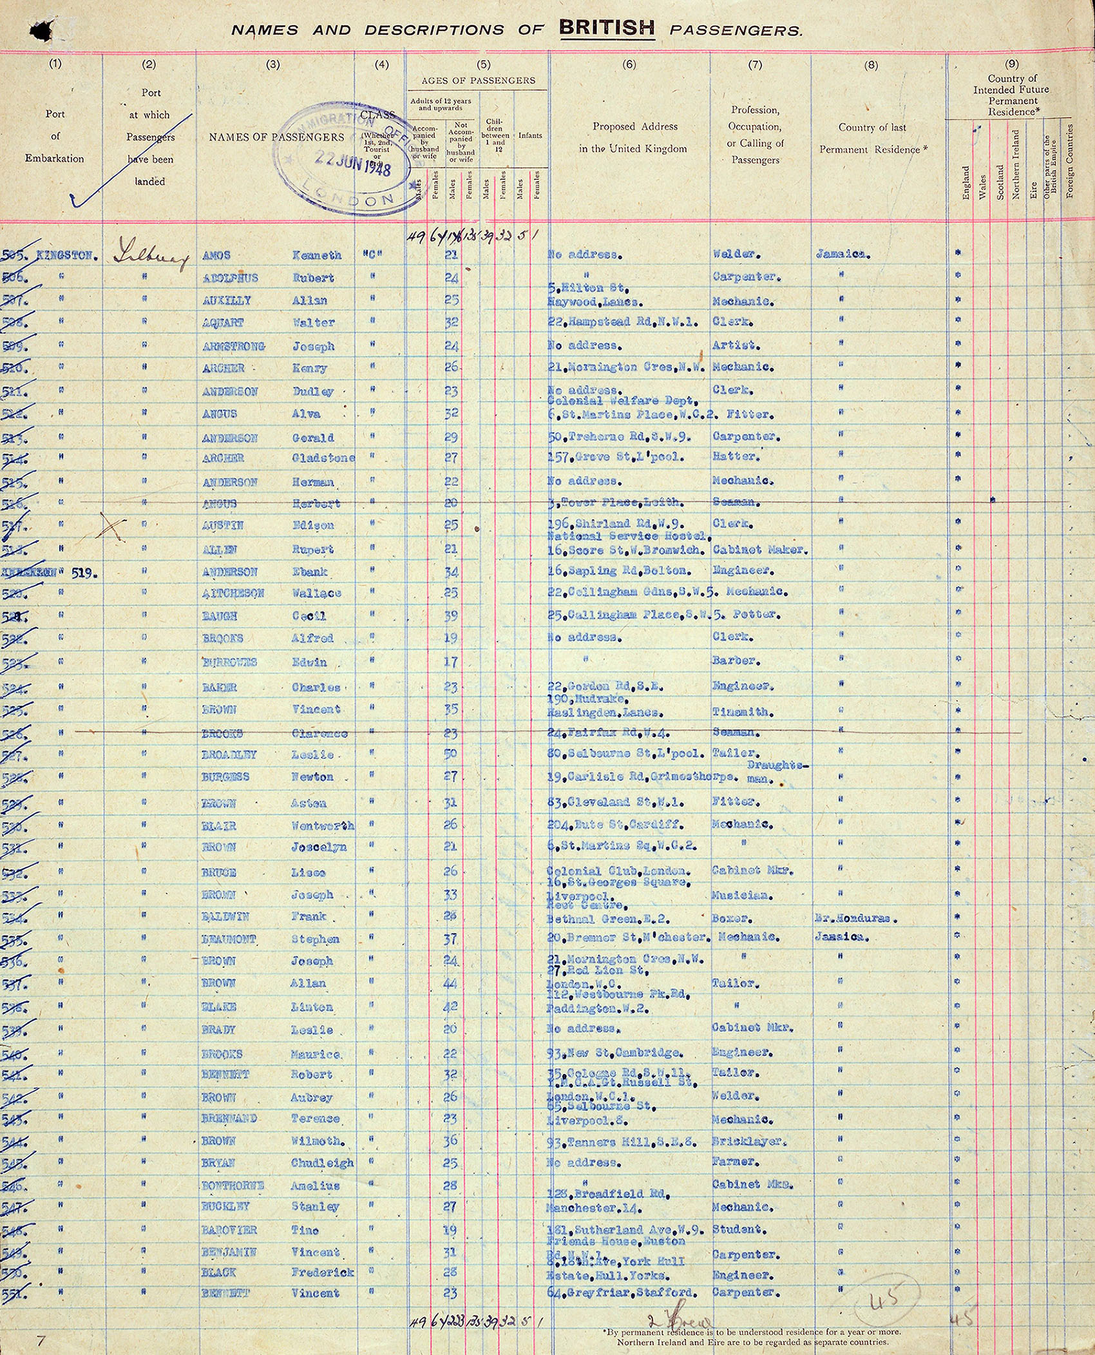
MADE BY MATT / GROW HUMANITIES
One record, a careful claim
Source W records a journey in 1948.
Our other cards show earlier Black British histories.
Autumn 1 · Week 4 · Humanities
04
Notes:
GROW Humanities, Autumn 1 Week 4. Whose history is included?. Friday 10:10-10:50. Humanities lesson; separate RE period is outside this pack.
Slide minutes: 1,3,3,4,5,5,3,8,2,2,2,2 = 40. Adapt within the total.
Use the larger printed source sheet. Read captions and distinguish the document from its later custodian.
Objective: Use dated evidence to challenge an overgeneralisation about diverse British history.
Support: Read the three date cards and use a simple earlier/later line. Scribe the pupil's chosen claim.
Stretch: Compare a visual record and a published book: how do their purposes change the questions each helps answer?
Misconceptions: One source cannot count a whole population or represent every experience. A gap in our selected cards is not proof that no people lived here in that period. A later summary is not the original artefact it describes.
Answer guidance: Chronology J 1511, O 1789, W 1948. Both J and O independently challenge a start-date of 1948.
J supports a Black presence at the Tudor court. O supports a Black writer publishing and campaigning in eighteenth-century Britain. W records a particular later journey.
Neither J nor O counts the population; W is one page from one voyage. The secondary cards must not be called primary sources.
Hinge A. Accept well-supported alternative wording and comparisons of source purposes.
[Sources]
https://madebymatt.uk/Lessons/Humanities_Teesside/GROW_W1-W8_2026-27/GROW_HUM_W4_Diverse_British_History.html
https://www.nationalarchives.gov.uk/explore-the-collection/stories/john-blanke/
https://www.londonmuseum.org.uk/collections/london-stories/olaudah-equiano-writer-abolitionist/
https://www.nationalarchives.gov.uk/education/resources/commonwealth-migration-since-1945/passenger-list-from-windrush/
[/Sources]

Slide 5
MADE BY MATT / GROW HUMANITIES
Watch a worked example
THE CLAIM
THE EVIDENCE
Black history in Britain starts in 1948.
J: 1511. O: 1789. The claim is too broad.
Autumn 1 · Week 4 · Humanities
05
Notes:
GROW Humanities, Autumn 1 Week 4. Whose history is included?. Friday 10:10-10:50. Humanities lesson; separate RE period is outside this pack.
Slide minutes: 1,3,3,4,5,5,3,8,2,2,2,2 = 40. Adapt within the total.
Think aloud: state the detail, then explain what it supports.
Objective: Use dated evidence to challenge an overgeneralisation about diverse British history.
Support: Read the three date cards and use a simple earlier/later line. Scribe the pupil's chosen claim.
Stretch: Compare a visual record and a published book: how do their purposes change the questions each helps answer?
Misconceptions: One source cannot count a whole population or represent every experience. A gap in our selected cards is not proof that no people lived here in that period. A later summary is not the original artefact it describes.
Answer guidance: Chronology J 1511, O 1789, W 1948. Both J and O independently challenge a start-date of 1948.
J supports a Black presence at the Tudor court. O supports a Black writer publishing and campaigning in eighteenth-century Britain. W records a particular later journey.
Neither J nor O counts the population; W is one page from one voyage. The secondary cards must not be called primary sources.
Hinge A. Accept well-supported alternative wording and comparisons of source purposes.
[Sources]
https://madebymatt.uk/Lessons/Humanities_Teesside/GROW_W1-W8_2026-27/GROW_HUM_W4_Diverse_British_History.html
https://www.nationalarchives.gov.uk/explore-the-collection/stories/john-blanke/
https://www.londonmuseum.org.uk/collections/london-stories/olaudah-equiano-writer-abolitionist/
https://www.nationalarchives.gov.uk/education/resources/commonwealth-migration-since-1945/passenger-list-from-windrush/
[/Sources]

Slide 6
MADE BY MATT / GROW HUMANITIES
Try one together
Read J, O and W.
Order them by the printed date.
Choose which card best challenges the claim.
Autumn 1 · Week 4 · Humanities
06
Notes:
GROW Humanities, Autumn 1 Week 4. Whose history is included?. Friday 10:10-10:50. Humanities lesson; separate RE period is outside this pack.
Slide minutes: 1,3,3,4,5,5,3,8,2,2,2,2 = 40. Adapt within the total.
Model one part together; invite an independent choice before discussion.
Objective: Use dated evidence to challenge an overgeneralisation about diverse British history.
Support: Read the three date cards and use a simple earlier/later line. Scribe the pupil's chosen claim.
Stretch: Compare a visual record and a published book: how do their purposes change the questions each helps answer?
Misconceptions: One source cannot count a whole population or represent every experience. A gap in our selected cards is not proof that no people lived here in that period. A later summary is not the original artefact it describes.
Answer guidance: Chronology J 1511, O 1789, W 1948. Both J and O independently challenge a start-date of 1948.
J supports a Black presence at the Tudor court. O supports a Black writer publishing and campaigning in eighteenth-century Britain. W records a particular later journey.
Neither J nor O counts the population; W is one page from one voyage. The secondary cards must not be called primary sources.
Hinge A. Accept well-supported alternative wording and comparisons of source purposes.
[Sources]
https://madebymatt.uk/Lessons/Humanities_Teesside/GROW_W1-W8_2026-27/GROW_HUM_W4_Diverse_British_History.html
https://www.nationalarchives.gov.uk/explore-the-collection/stories/john-blanke/
https://www.londonmuseum.org.uk/collections/london-stories/olaudah-equiano-writer-abolitionist/
https://www.nationalarchives.gov.uk/education/resources/commonwealth-migration-since-1945/passenger-list-from-windrush/
[/Sources]

Slide 7
MADE BY MATT / GROW HUMANITIES
Choose, then explain
What follows from Source J?
A. A Black trumpeter is recorded in Tudor England.
B. We know every Black person's Tudor experience.
Choose the claim that fits.
Autumn 1 · Week 4 · Humanities
07
Notes:
GROW Humanities, Autumn 1 Week 4. Whose history is included?. Friday 10:10-10:50. Humanities lesson; separate RE period is outside this pack.
Slide minutes: 1,3,3,4,5,5,3,8,2,2,2,2 = 40. Adapt within the total.
Take simultaneous choices where helpful. Ask for the reason. Reteach if the reason reveals the misconception.
Objective: Use dated evidence to challenge an overgeneralisation about diverse British history.
Support: Read the three date cards and use a simple earlier/later line. Scribe the pupil's chosen claim.
Stretch: Compare a visual record and a published book: how do their purposes change the questions each helps answer?
Misconceptions: One source cannot count a whole population or represent every experience. A gap in our selected cards is not proof that no people lived here in that period. A later summary is not the original artefact it describes.
Answer guidance: Chronology J 1511, O 1789, W 1948. Both J and O independently challenge a start-date of 1948.
J supports a Black presence at the Tudor court. O supports a Black writer publishing and campaigning in eighteenth-century Britain. W records a particular later journey.
Neither J nor O counts the population; W is one page from one voyage. The secondary cards must not be called primary sources.
Hinge A. Accept well-supported alternative wording and comparisons of source purposes.
[Sources]
https://madebymatt.uk/Lessons/Humanities_Teesside/GROW_W1-W8_2026-27/GROW_HUM_W4_Diverse_British_History.html
https://www.nationalarchives.gov.uk/explore-the-collection/stories/john-blanke/
https://www.londonmuseum.org.uk/collections/london-stories/olaudah-equiano-writer-abolitionist/
https://www.nationalarchives.gov.uk/education/resources/commonwealth-migration-since-1945/passenger-list-from-windrush/
[/Sources]

Slide 8
MADE BY MATT / GROW HUMANITIES
Now it is your turn
YOUR TASK
EXPLAIN
Order three evidence cards.
Write a claim supported by one card.
Add one limit to your claim.
Autumn 1 · Week 4 · Humanities
08
Notes:
GROW Humanities, Autumn 1 Week 4. Whose history is included?. Friday 10:10-10:50. Humanities lesson; separate RE period is outside this pack.
Slide minutes: 1,3,3,4,5,5,3,8,2,2,2,2 = 40. Adapt within the total.
Independent attempt. Record the support used. Keep this first response before feedback.
Objective: Use dated evidence to challenge an overgeneralisation about diverse British history.
Support: Read the three date cards and use a simple earlier/later line. Scribe the pupil's chosen claim.
Stretch: Compare a visual record and a published book: how do their purposes change the questions each helps answer?
Misconceptions: One source cannot count a whole population or represent every experience. A gap in our selected cards is not proof that no people lived here in that period. A later summary is not the original artefact it describes.
Answer guidance: Chronology J 1511, O 1789, W 1948. Both J and O independently challenge a start-date of 1948.
J supports a Black presence at the Tudor court. O supports a Black writer publishing and campaigning in eighteenth-century Britain. W records a particular later journey.
Neither J nor O counts the population; W is one page from one voyage. The secondary cards must not be called primary sources.
Hinge A. Accept well-supported alternative wording and comparisons of source purposes.
[Sources]
https://madebymatt.uk/Lessons/Humanities_Teesside/GROW_W1-W8_2026-27/GROW_HUM_W4_Diverse_British_History.html
https://www.nationalarchives.gov.uk/explore-the-collection/stories/john-blanke/
https://www.londonmuseum.org.uk/collections/london-stories/olaudah-equiano-writer-abolitionist/
https://www.nationalarchives.gov.uk/education/resources/commonwealth-migration-since-1945/passenger-list-from-windrush/
[/Sources]

Slide 9
MADE BY MATT / GROW HUMANITIES
Make the reasoning visible
Point to one detail you used.
Say how it helped your answer.
Name one thing it cannot show.
Keep your first answer for the check.
Autumn 1 · Week 4 · Humanities
09
Notes:
GROW Humanities, Autumn 1 Week 4. Whose history is included?. Friday 10:10-10:50. Humanities lesson; separate RE period is outside this pack.
Slide minutes: 1,3,3,4,5,5,3,8,2,2,2,2 = 40. Adapt within the total.
Follow the pupil sheet. In assessment lessons, release the second response only after the first is kept.
Objective: Use dated evidence to challenge an overgeneralisation about diverse British history.
Support: Read the three date cards and use a simple earlier/later line. Scribe the pupil's chosen claim.
Stretch: Compare a visual record and a published book: how do their purposes change the questions each helps answer?
Misconceptions: One source cannot count a whole population or represent every experience. A gap in our selected cards is not proof that no people lived here in that period. A later summary is not the original artefact it describes.
Answer guidance: Chronology J 1511, O 1789, W 1948. Both J and O independently challenge a start-date of 1948.
J supports a Black presence at the Tudor court. O supports a Black writer publishing and campaigning in eighteenth-century Britain. W records a particular later journey.
Neither J nor O counts the population; W is one page from one voyage. The secondary cards must not be called primary sources.
Hinge A. Accept well-supported alternative wording and comparisons of source purposes.
[Sources]
https://madebymatt.uk/Lessons/Humanities_Teesside/GROW_W1-W8_2026-27/GROW_HUM_W4_Diverse_British_History.html
https://www.nationalarchives.gov.uk/explore-the-collection/stories/john-blanke/
https://www.londonmuseum.org.uk/collections/london-stories/olaudah-equiano-writer-abolitionist/
https://www.nationalarchives.gov.uk/education/resources/commonwealth-migration-since-1945/passenger-list-from-windrush/
[/Sources]

Slide 10
MADE BY MATT / GROW HUMANITIES
Check the reasoning
ORDER
CAREFUL CLAIM
J: 1511; O: 1789; W: 1948.
Evidence of people before 1948; no total count.
Autumn 1 · Week 4 · Humanities
10
Notes:
GROW Humanities, Autumn 1 Week 4. Whose history is included?. Friday 10:10-10:50. Humanities lesson; separate RE period is outside this pack.
Slide minutes: 1,3,3,4,5,5,3,8,2,2,2,2 = 40. Adapt within the total.
Reveal checks now. Accept different defensible answers; do not score opinions as wrong.
Objective: Use dated evidence to challenge an overgeneralisation about diverse British history.
Support: Read the three date cards and use a simple earlier/later line. Scribe the pupil's chosen claim.
Stretch: Compare a visual record and a published book: how do their purposes change the questions each helps answer?
Misconceptions: One source cannot count a whole population or represent every experience. A gap in our selected cards is not proof that no people lived here in that period. A later summary is not the original artefact it describes.
Answer guidance: Chronology J 1511, O 1789, W 1948. Both J and O independently challenge a start-date of 1948.
J supports a Black presence at the Tudor court. O supports a Black writer publishing and campaigning in eighteenth-century Britain. W records a particular later journey.
Neither J nor O counts the population; W is one page from one voyage. The secondary cards must not be called primary sources.
Hinge A. Accept well-supported alternative wording and comparisons of source purposes.
[Sources]
https://madebymatt.uk/Lessons/Humanities_Teesside/GROW_W1-W8_2026-27/GROW_HUM_W4_Diverse_British_History.html
https://www.nationalarchives.gov.uk/explore-the-collection/stories/john-blanke/
https://www.londonmuseum.org.uk/collections/london-stories/olaudah-equiano-writer-abolitionist/
https://www.nationalarchives.gov.uk/education/resources/commonwealth-migration-since-1945/passenger-list-from-windrush/
[/Sources]

Slide 11
MADE BY MATT / GROW HUMANITIES
Your voice shapes the next step
Choose one idea to share, or pass.
Your listener tells you what they heard.
Keep or change your idea; give a reason.
Tell us what would help you next time.
Autumn 1 · Week 4 · Humanities
11
Notes:
GROW Humanities, Autumn 1 Week 4. Whose history is included?. Friday 10:10-10:50. Humanities lesson; separate RE period is outside this pack.
Slide minutes: 1,3,3,4,5,5,3,8,2,2,2,2 = 40. Adapt within the total.
Space: pupil chooses how to respond. Voice: help them express their idea. Audience: read the meaning back and let the pupil correct it. Influence: agree one teaching action, then act on it next lesson.
Objective: Use dated evidence to challenge an overgeneralisation about diverse British history.
Support: Read the three date cards and use a simple earlier/later line. Scribe the pupil's chosen claim.
Stretch: Compare a visual record and a published book: how do their purposes change the questions each helps answer?
Misconceptions: One source cannot count a whole population or represent every experience. A gap in our selected cards is not proof that no people lived here in that period. A later summary is not the original artefact it describes.
Answer guidance: Chronology J 1511, O 1789, W 1948. Both J and O independently challenge a start-date of 1948.
J supports a Black presence at the Tudor court. O supports a Black writer publishing and campaigning in eighteenth-century Britain. W records a particular later journey.
Neither J nor O counts the population; W is one page from one voyage. The secondary cards must not be called primary sources.
Hinge A. Accept well-supported alternative wording and comparisons of source purposes.
[Sources]
https://madebymatt.uk/Lessons/Humanities_Teesside/GROW_W1-W8_2026-27/GROW_HUM_W4_Diverse_British_History.html
https://www.nationalarchives.gov.uk/explore-the-collection/stories/john-blanke/
https://www.londonmuseum.org.uk/collections/london-stories/olaudah-equiano-writer-abolitionist/
https://www.nationalarchives.gov.uk/education/resources/commonwealth-migration-since-1945/passenger-list-from-windrush/
[/Sources]

Slide 12
MADE BY MATT / GROW HUMANITIES
Before you go
Give one pre-1948 example.
Name a limit of one card.
Show one detail that helped.
Choose a next step.
Autumn 1 · Week 4 · Humanities
12
Notes:
GROW Humanities, Autumn 1 Week 4. Whose history is included?. Friday 10:10-10:50. Humanities lesson; separate RE period is outside this pack.
Slide minutes: 1,3,3,4,5,5,3,8,2,2,2,2 = 40. Adapt within the total.
Capture one specific success and one next step. Record the response mode and support.
Objective: Use dated evidence to challenge an overgeneralisation about diverse British history.
Support: Read the three date cards and use a simple earlier/later line. Scribe the pupil's chosen claim.
Stretch: Compare a visual record and a published book: how do their purposes change the questions each helps answer?
Misconceptions: One source cannot count a whole population or represent every experience. A gap in our selected cards is not proof that no people lived here in that period. A later summary is not the original artefact it describes.
Answer guidance: Chronology J 1511, O 1789, W 1948. Both J and O independently challenge a start-date of 1948.
J supports a Black presence at the Tudor court. O supports a Black writer publishing and campaigning in eighteenth-century Britain. W records a particular later journey.
Neither J nor O counts the population; W is one page from one voyage. The secondary cards must not be called primary sources.
Hinge A. Accept well-supported alternative wording and comparisons of source purposes.
[Sources]
https://madebymatt.uk/Lessons/Humanities_Teesside/GROW_W1-W8_2026-27/GROW_HUM_W4_Diverse_British_History.html
https://www.nationalarchives.gov.uk/explore-the-collection/stories/john-blanke/
https://www.londonmuseum.org.uk/collections/london-stories/olaudah-equiano-writer-abolitionist/
https://www.nationalarchives.gov.uk/education/resources/commonwealth-migration-since-1945/passenger-list-from-windrush/
[/Sources]

