Slide 1
Pictures on a timeline
Order pictures on a simple timeline.
BUILD / Humanities / Spring 1 / Week 3
Speak, point, draw, type or write.
BUILD Humanities Spring 1 W3 1
Notes:
F: timeline and recorded explanation.
Use one-step instructions, symbols and a model first. Offer talk, point, draw, type or write. Reduce the number of choices; extend by asking for a reason or a second example. Adults prompt the first response then fade support.
Use questioning and the exit response to decide the next step. Record the learner’s individual contribution and the access support used.

Slide 2
Arrival questions 1 and 2
1. What function do both phones share?
2. Which meaning fits past?
BUILD Humanities Spring 1 W3 2
Notes:
Previous lesson reminder:
Use the reminder strip or talk it through with an adult. Answer: They allow a conversation over distance.
Choose: A time before now OR The time we are in now. Answer: A time before now

Slide 3
Arrival questions 3 and 4
3. What information establishes the order?
4. Does putting one event after another prove a cause?
BUILD Humanities Spring 1 W3 3
Notes:
Use the model evidence anchor C or read one relevant card together. Answer: The source dates.
Give a reason when ready. Answer: No. Order alone does not show why something happened.

Slide 4
Words for this lesson
past
A time before now
present
The time we are in now
change
Something that becomes different
continuity
Something that stays the same
BUILD Humanities Spring 1 W3 4
Notes:
Read the words aloud. Offer a concrete example before asking for a definition.

Slide 5

Starter
Make a floor or desk timeline from the dated source cards.
Make a first choice. Explain what helped you decide.
Show two choices. Read one short instruction. Point, match or say a word, then add a reason when ready.
BUILD Humanities Spring 1 W3 5
Notes:
F: timeline and recorded explanation.
Use one-step instructions, symbols and a model first. Offer talk, point, draw, type or write. Reduce the number of choices; extend by asking for a reason or a second example. Adults prompt the first response then fade support.
Use questioning and the exit response to decide the next step. Record the learner’s individual contribution and the access support used.

Slide 6
Model question
Question: What information establishes the order?
BUILD Humanities Spring 1 W3 6
Notes:
Original captioned teaching model made for this pack. It demonstrates the supplied reasoning; it is not historical footage, survivor testimony or a documentary. The full transcript and factual source credits are included.
F: timeline and recorded explanation.
Use one-step instructions, symbols and a model first. Offer talk, point, draw, type or write. Reduce the number of choices; extend by asking for a reason or a second example. Adults prompt the first response then fade support.
Use questioning and the exit response to decide the next step. Record the learner’s individual contribution and the access support used.

Slide 7
Model evidence
Evidence: C Photo enquiry: Use the paired local photographs supplied with this unit. Read the captions and dates. Point to one feature in each image before deciding what changed.
BUILD Humanities Spring 1 W3 7
Notes:
Original captioned teaching model made for this pack. It demonstrates the supplied reasoning; it is not historical footage, survivor testimony or a documentary. The full transcript and factual source credits are included.
F: timeline and recorded explanation.
Use one-step instructions, symbols and a model first. Offer talk, point, draw, type or write. Reduce the number of choices; extend by asking for a reason or a second example. Adults prompt the first response then fade support.
Use questioning and the exit response to decide the next step. Record the learner’s individual contribution and the access support used.

Slide 8
Model explanation
Think aloud: The source dates.
BUILD Humanities Spring 1 W3 8
Notes:
Original captioned teaching model made for this pack. It demonstrates the supplied reasoning; it is not historical footage, survivor testimony or a documentary. The full transcript and factual source credits are included.
F: timeline and recorded explanation.
Use one-step instructions, symbols and a model first. Offer talk, point, draw, type or write. Reduce the number of choices; extend by asking for a reason or a second example. Adults prompt the first response then fade support.
Use questioning and the exit response to decide the next step. Record the learner’s individual contribution and the access support used.

Slide 9
Model check
Check: Does putting one event after another prove a cause? No. Order alone does not show why something happened.
BUILD Humanities Spring 1 W3 9
Notes:
Original captioned teaching model made for this pack. It demonstrates the supplied reasoning; it is not historical footage, survivor testimony or a documentary. The full transcript and factual source credits are included.
F: timeline and recorded explanation.
Use one-step instructions, symbols and a model first. Offer talk, point, draw, type or write. Reduce the number of choices; extend by asking for a reason or a second example. Adults prompt the first response then fade support.
Use questioning and the exit response to decide the next step. Record the learner’s individual contribution and the access support used.

Slide 10
We do
Make a floor or desk timeline from the dated source cards.
Check the date before moving a card.
Suggest a choice. Check the evidence together. Swap roles when ready.
BUILD Humanities Spring 1 W3 10
Notes:
Show two choices. Read one short instruction. Point, match or say a word, then add a reason when ready.
Make a floor or desk timeline from the dated source cards. Say or show what helped you decide.
Explain why unequal gaps between dates should not be treated as equal time.
F: timeline and recorded explanation.
Use one-step instructions, symbols and a model first. Offer talk, point, draw, type or write. Reduce the number of choices; extend by asking for a reason or a second example. Adults prompt the first response then fade support.
Use questioning and the exit response to decide the next step. Record the learner’s individual contribution and the access support used.

Slide 11
Shared activity cards
21 November 2008 photograph
31 January 2020 photograph
BUILD Humanities Spring 1 W3 11
Notes:
21 November 2008 photograph — 1 — The date is credited to Oliver Dixon.
31 January 2020 photograph — 2 — The date is credited to Reading Tom.
Use the HTML lesson for the interactive version, or the paper cards.

Slide 12
Independent task supported
Place two to four pictures on a timeline.
Explain one placement using before or after and the supplied dates.
Keep an individual copy or photograph of your order.
BUILD Humanities Spring 1 W3 12
Notes:
Show two choices. Read one short instruction. Point, match or say a word, then add a reason when ready. Complete the organiser one space at a time. ___ belongs before ___ because ___ is earlier than ___.
An adult may read or scribe your exact response. They should not choose the answer.
F: timeline and recorded explanation.
Use one-step instructions, symbols and a model first. Offer talk, point, draw, type or write. Reduce the number of choices; extend by asking for a reason or a second example. Adults prompt the first response then fade support.
Use questioning and the exit response to decide the next step. Record the learner’s individual contribution and the access support used.

Slide 13
Independent task standard
Place two to four pictures on a timeline.
Explain one placement using before or after and the supplied dates.
Keep an individual copy or photograph of your order.
BUILD Humanities Spring 1 W3 13
Notes:
___ belongs before ___ because ___ is earlier than ___.
Check the required evidence and revise one detail.
F: timeline and recorded explanation.
Use one-step instructions, symbols and a model first. Offer talk, point, draw, type or write. Reduce the number of choices; extend by asking for a reason or a second example. Adults prompt the first response then fade support.
Use questioning and the exit response to decide the next step. Record the learner’s individual contribution and the access support used.

Slide 14
Independent task stretch
Place two to four pictures on a timeline.
Explain one placement using before or after and the supplied dates.
Keep an individual copy or photograph of your order.
Explain why unequal gaps between dates should not be treated as equal time.
BUILD Humanities Spring 1 W3 14
Notes:
Choose the evidence independently. Use the frame only if it helps.
Explain why unequal gaps between dates should not be treated as equal time.
F: timeline and recorded explanation.
Use one-step instructions, symbols and a model first. Offer talk, point, draw, type or write. Reduce the number of choices; extend by asking for a reason or a second example. Adults prompt the first response then fade support.
Use questioning and the exit response to decide the next step. Record the learner’s individual contribution and the access support used.

Slide 15
Review and improve
Check the required evidence: timeline and recorded explanation.
Point to one part that meets the goal.
Improve one detail.
BUILD Humanities Spring 1 W3 15
Notes:
F: timeline and recorded explanation.
Use one-step instructions, symbols and a model first. Offer talk, point, draw, type or write. Reduce the number of choices; extend by asking for a reason or a second example. Adults prompt the first response then fade support.
Use questioning and the exit response to decide the next step. Record the learner’s individual contribution and the access support used.

Slide 16
Exit ticket
What information establishes the order?
Does putting one event after another prove a cause?
You can share your response privately.
BUILD Humanities Spring 1 W3 16
Notes:
The source dates.
No. Order alone does not show why something happened.
Support: ___ belongs before ___ because ___ is earlier than ___.
Extension: Explain why unequal gaps between dates should not be treated as equal time.

Slide 17
Evidence A A fictional week
Monday: choose a club activity. Wednesday: practise the activity. Friday: share what was made. The words Monday, Wednesday and Friday supply the order.
Source: Authored classroom case
Limit: This example does not describe every person or place.
BUILD Humanities Spring 1 W3 17
Notes:
F: timeline and recorded explanation.
Use one-step instructions, symbols and a model first. Offer talk, point, draw, type or write. Reduce the number of choices; extend by asking for a reason or a second example. Adults prompt the first response then fade support.
Use questioning and the exit response to decide the next step. Record the learner’s individual contribution and the access support used.

Slide 18
Evidence B Telephone comparison
A rotary telephone and a smartphone both support conversations over distance. A smartphone can also show a video call; a rotary dial selects numbers differently.
Source: Authored comparison of familiar objects
Limit: A newer object is not automatically better for every person or purpose.
BUILD Humanities Spring 1 W3 18
Notes:
F: timeline and recorded explanation.
Use one-step instructions, symbols and a model first. Offer talk, point, draw, type or write. Reduce the number of choices; extend by asking for a reason or a second example. Adults prompt the first response then fade support.
Use questioning and the exit response to decide the next step. Record the learner’s individual contribution and the access support used.

Slide 19
Evidence C Photo enquiry
Use the paired local photographs supplied with this unit. Read the captions and dates. Point to one feature in each image before deciding what changed.
Source: See photograph captions and credits
Limit: A camera angle or season can make features appear different; a photograph alone may not explain why.
BUILD Humanities Spring 1 W3 19
Notes:
F: timeline and recorded explanation.
Use one-step instructions, symbols and a model first. Offer talk, point, draw, type or write. Reduce the number of choices; extend by asking for a reason or a second example. Adults prompt the first response then fade support.
Use questioning and the exit response to decide the next step. Record the learner’s individual contribution and the access support used.

Slide 20
Evidence D Questions worth asking
Who used this object? When was this photo made? A dated catalogue entry can help with time; a user’s account can help with experience.
Source: Authored classroom case
Limit: This example does not describe every person or place.
BUILD Humanities Spring 1 W3 20
Notes:
F: timeline and recorded explanation.
Use one-step instructions, symbols and a model first. Offer talk, point, draw, type or write. Reduce the number of choices; extend by asking for a reason or a second example. Adults prompt the first response then fade support.
Use questioning and the exit response to decide the next step. Record the learner’s individual contribution and the access support used.

Slide 21
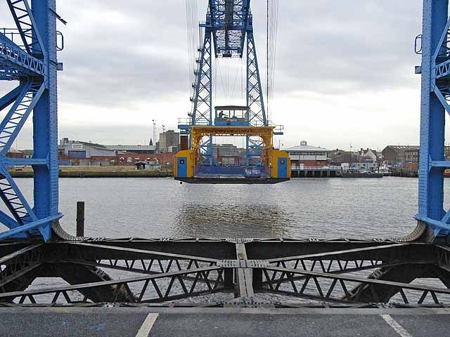
Visual resource 1
21 November 2008 · Oliver Dixon · CC BY-SA 2.0
BUILD Humanities Spring 1 W3 21
Notes:
F: timeline and recorded explanation.
Use one-step instructions, symbols and a model first. Offer talk, point, draw, type or write. Reduce the number of choices; extend by asking for a reason or a second example. Adults prompt the first response then fade support.
Use questioning and the exit response to decide the next step. Record the learner’s individual contribution and the access support used.
See the pupil pack for source credits and the paired enquiry prompts.

Slide 22
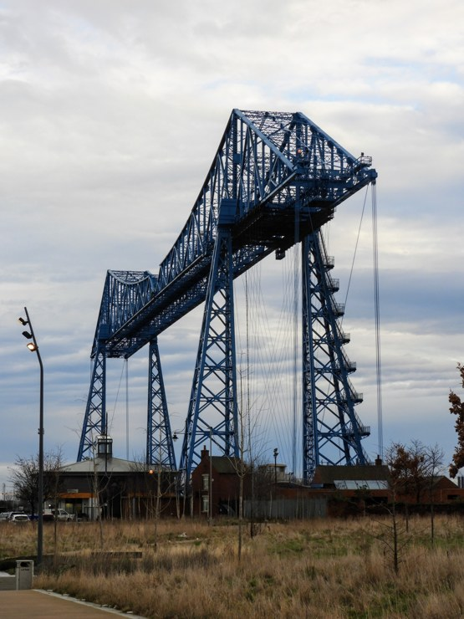
Visual resource 2
31 January 2020 · Reading Tom · CC BY 2.0
BUILD Humanities Spring 1 W3 22
Notes:
F: timeline and recorded explanation.
Use one-step instructions, symbols and a model first. Offer talk, point, draw, type or write. Reduce the number of choices; extend by asking for a reason or a second example. Adults prompt the first response then fade support.
Use questioning and the exit response to decide the next step. Record the learner’s individual contribution and the access support used.
See the pupil pack for source credits and the paired enquiry prompts.

