Slide 1
How a local place changes
Talk about how my local area has changed.
BUILD / Humanities / Spring 1 / Week 4
Speak, point, draw, type or write.
BUILD Humanities Spring 1 W4 1
Notes:
F: annotated comparison.
Use one-step instructions, symbols and a model first. Offer talk, point, draw, type or write. Reduce the number of choices; extend by asking for a reason or a second example. Adults prompt the first response then fade support.
Use questioning and the exit response to decide the next step. Record the learner’s individual contribution and the access support used.

Slide 2
Arrival questions 1 and 2
1. What information establishes the order?
2. Which meaning fits past?
BUILD Humanities Spring 1 W4 2
Notes:
Previous lesson reminder:
Use the reminder strip or talk it through with an adult. Answer: The source dates.
Choose: A time before now OR The time we are in now. Answer: A time before now

Slide 3
Arrival questions 3 and 4
3. What is continuity?
4. Can photographs alone always explain why a place changed?
BUILD Humanities Spring 1 W4 3
Notes:
Use the model evidence anchor C or read one relevant card together. Answer: Something that stays the same across the evidence being compared.
Give a reason when ready. Answer: No. Another source may be needed for the reason.

Slide 4
Words for this lesson
past
A time before now
present
The time we are in now
change
Something that becomes different
continuity
Something that stays the same
BUILD Humanities Spring 1 W4 4
Notes:
Read the words aloud. Offer a concrete example before asking for a definition.

Slide 5

Starter
Compare the local bridge photographs.
Make a first choice. Explain what helped you decide.
Show two choices. Read one short instruction. Point, match or say a word, then add a reason when ready.
BUILD Humanities Spring 1 W4 5
Notes:
F: annotated comparison.
Use one-step instructions, symbols and a model first. Offer talk, point, draw, type or write. Reduce the number of choices; extend by asking for a reason or a second example. Adults prompt the first response then fade support.
Use questioning and the exit response to decide the next step. Record the learner’s individual contribution and the access support used.

Slide 6
Model question
Question: What is continuity?
BUILD Humanities Spring 1 W4 6
Notes:
Original captioned teaching model made for this pack. It demonstrates the supplied reasoning; it is not historical footage, survivor testimony or a documentary. The full transcript and factual source credits are included.
F: annotated comparison.
Use one-step instructions, symbols and a model first. Offer talk, point, draw, type or write. Reduce the number of choices; extend by asking for a reason or a second example. Adults prompt the first response then fade support.
Use questioning and the exit response to decide the next step. Record the learner’s individual contribution and the access support used.

Slide 7
Model evidence
Evidence: C Photo enquiry: Use the paired local photographs supplied with this unit. Read the captions and dates. Point to one feature in each image before deciding what changed.
BUILD Humanities Spring 1 W4 7
Notes:
Original captioned teaching model made for this pack. It demonstrates the supplied reasoning; it is not historical footage, survivor testimony or a documentary. The full transcript and factual source credits are included.
F: annotated comparison.
Use one-step instructions, symbols and a model first. Offer talk, point, draw, type or write. Reduce the number of choices; extend by asking for a reason or a second example. Adults prompt the first response then fade support.
Use questioning and the exit response to decide the next step. Record the learner’s individual contribution and the access support used.

Slide 8
Model explanation
Think aloud: Something that stays the same across the evidence being compared.
BUILD Humanities Spring 1 W4 8
Notes:
Original captioned teaching model made for this pack. It demonstrates the supplied reasoning; it is not historical footage, survivor testimony or a documentary. The full transcript and factual source credits are included.
F: annotated comparison.
Use one-step instructions, symbols and a model first. Offer talk, point, draw, type or write. Reduce the number of choices; extend by asking for a reason or a second example. Adults prompt the first response then fade support.
Use questioning and the exit response to decide the next step. Record the learner’s individual contribution and the access support used.

Slide 9
Model check
Check: Can photographs alone always explain why a place changed? No. Another source may be needed for the reason.
BUILD Humanities Spring 1 W4 9
Notes:
Original captioned teaching model made for this pack. It demonstrates the supplied reasoning; it is not historical footage, survivor testimony or a documentary. The full transcript and factual source credits are included.
F: annotated comparison.
Use one-step instructions, symbols and a model first. Offer talk, point, draw, type or write. Reduce the number of choices; extend by asking for a reason or a second example. Adults prompt the first response then fade support.
Use questioning and the exit response to decide the next step. Record the learner’s individual contribution and the access support used.

Slide 10
We do
Compare the local bridge photographs.
Mark one visible continuity and one visible change.
Suggest a choice. Check the evidence together. Swap roles when ready.
BUILD Humanities Spring 1 W4 10
Notes:
Show two choices. Read one short instruction. Point, match or say a word, then add a reason when ready.
Compare the local bridge photographs. Say or show what helped you decide.
State a limitation caused by viewpoint and suggest another photo that would help.
F: annotated comparison.
Use one-step instructions, symbols and a model first. Offer talk, point, draw, type or write. Reduce the number of choices; extend by asking for a reason or a second example. Adults prompt the first response then fade support.
Use questioning and the exit response to decide the next step. Record the learner’s individual contribution and the access support used.

Slide 11
Shared investigation record
Evidence from the first example
Evidence from the second example
One similarity
One difference or change
BUILD Humanities Spring 1 W4 11
Notes:
Use the visual or evidence appendix alongside this slide. Compare the local bridge photographs. Mark one visible continuity and one visible change.

Slide 12
Independent task supported
Annotate the two credited photographs.
Add one change and one continuity using arrows or numbered captions.
Record a careful spoken or written comparison.
BUILD Humanities Spring 1 W4 12
Notes:
Show two choices. Read one short instruction. Point, match or say a word, then add a reason when ready. Complete the organiser one space at a time. In photo ___ I can see ___. In photo ___ ___. Both ___.
An adult may read or scribe your exact response. They should not choose the answer.
F: annotated comparison.
Use one-step instructions, symbols and a model first. Offer talk, point, draw, type or write. Reduce the number of choices; extend by asking for a reason or a second example. Adults prompt the first response then fade support.
Use questioning and the exit response to decide the next step. Record the learner’s individual contribution and the access support used.

Slide 13
Independent task standard
Annotate the two credited photographs.
Add one change and one continuity using arrows or numbered captions.
Record a careful spoken or written comparison.
BUILD Humanities Spring 1 W4 13
Notes:
In photo ___ I can see ___. In photo ___ ___. Both ___.
Check the required evidence and revise one detail.
F: annotated comparison.
Use one-step instructions, symbols and a model first. Offer talk, point, draw, type or write. Reduce the number of choices; extend by asking for a reason or a second example. Adults prompt the first response then fade support.
Use questioning and the exit response to decide the next step. Record the learner’s individual contribution and the access support used.

Slide 14
Independent task stretch
Annotate the two credited photographs.
Add one change and one continuity using arrows or numbered captions.
Record a careful spoken or written comparison.
State a limitation caused by viewpoint and suggest another photo that would help.
BUILD Humanities Spring 1 W4 14
Notes:
Choose the evidence independently. Use the frame only if it helps.
State a limitation caused by viewpoint and suggest another photo that would help.
F: annotated comparison.
Use one-step instructions, symbols and a model first. Offer talk, point, draw, type or write. Reduce the number of choices; extend by asking for a reason or a second example. Adults prompt the first response then fade support.
Use questioning and the exit response to decide the next step. Record the learner’s individual contribution and the access support used.

Slide 15
Review and improve
Check the required evidence: annotated comparison.
Point to one part that meets the goal.
Improve one detail.
BUILD Humanities Spring 1 W4 15
Notes:
F: annotated comparison.
Use one-step instructions, symbols and a model first. Offer talk, point, draw, type or write. Reduce the number of choices; extend by asking for a reason or a second example. Adults prompt the first response then fade support.
Use questioning and the exit response to decide the next step. Record the learner’s individual contribution and the access support used.

Slide 16
Exit ticket
What is continuity?
Can photographs alone always explain why a place changed?
You can share your response privately.
BUILD Humanities Spring 1 W4 16
Notes:
Something that stays the same across the evidence being compared.
No. Another source may be needed for the reason.
Support: In photo ___ I can see ___. In photo ___ ___. Both ___.
Extension: State a limitation caused by viewpoint and suggest another photo that would help.

Slide 17
Evidence A A fictional week
Monday: choose a club activity. Wednesday: practise the activity. Friday: share what was made. The words Monday, Wednesday and Friday supply the order.
Source: Authored classroom case
Limit: This example does not describe every person or place.
BUILD Humanities Spring 1 W4 17
Notes:
F: annotated comparison.
Use one-step instructions, symbols and a model first. Offer talk, point, draw, type or write. Reduce the number of choices; extend by asking for a reason or a second example. Adults prompt the first response then fade support.
Use questioning and the exit response to decide the next step. Record the learner’s individual contribution and the access support used.

Slide 18
Evidence B Telephone comparison
A rotary telephone and a smartphone both support conversations over distance. A smartphone can also show a video call; a rotary dial selects numbers differently.
Source: Authored comparison of familiar objects
Limit: A newer object is not automatically better for every person or purpose.
BUILD Humanities Spring 1 W4 18
Notes:
F: annotated comparison.
Use one-step instructions, symbols and a model first. Offer talk, point, draw, type or write. Reduce the number of choices; extend by asking for a reason or a second example. Adults prompt the first response then fade support.
Use questioning and the exit response to decide the next step. Record the learner’s individual contribution and the access support used.

Slide 19
Evidence C Photo enquiry
Use the paired local photographs supplied with this unit. Read the captions and dates. Point to one feature in each image before deciding what changed.
Source: See photograph captions and credits
Limit: A camera angle or season can make features appear different; a photograph alone may not explain why.
BUILD Humanities Spring 1 W4 19
Notes:
F: annotated comparison.
Use one-step instructions, symbols and a model first. Offer talk, point, draw, type or write. Reduce the number of choices; extend by asking for a reason or a second example. Adults prompt the first response then fade support.
Use questioning and the exit response to decide the next step. Record the learner’s individual contribution and the access support used.

Slide 20
Evidence D Questions worth asking
Who used this object? When was this photo made? A dated catalogue entry can help with time; a user’s account can help with experience.
Source: Authored classroom case
Limit: This example does not describe every person or place.
BUILD Humanities Spring 1 W4 20
Notes:
F: annotated comparison.
Use one-step instructions, symbols and a model first. Offer talk, point, draw, type or write. Reduce the number of choices; extend by asking for a reason or a second example. Adults prompt the first response then fade support.
Use questioning and the exit response to decide the next step. Record the learner’s individual contribution and the access support used.

Slide 21
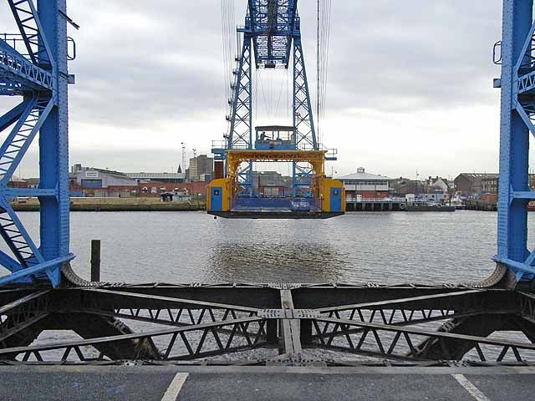
Visual resource 1
21 November 2008 · Oliver Dixon · CC BY-SA 2.0
BUILD Humanities Spring 1 W4 21
Notes:
F: annotated comparison.
Use one-step instructions, symbols and a model first. Offer talk, point, draw, type or write. Reduce the number of choices; extend by asking for a reason or a second example. Adults prompt the first response then fade support.
Use questioning and the exit response to decide the next step. Record the learner’s individual contribution and the access support used.
See the pupil pack for source credits and the paired enquiry prompts.

Slide 22
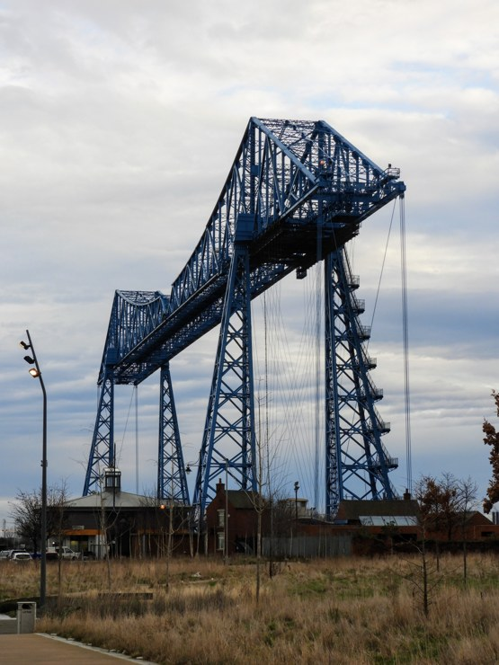
Visual resource 2
31 January 2020 · Reading Tom · CC BY 2.0
BUILD Humanities Spring 1 W4 22
Notes:
F: annotated comparison.
Use one-step instructions, symbols and a model first. Offer talk, point, draw, type or write. Reduce the number of choices; extend by asking for a reason or a second example. Adults prompt the first response then fade support.
Use questioning and the exit response to decide the next step. Record the learner’s individual contribution and the access support used.
See the pupil pack for source credits and the paired enquiry prompts.

