Slide 1
A question about the past
Ask a question about the past.
BUILD / Humanities / Spring 1 / Week 5
Speak, point, draw, type or write.
BUILD Humanities Spring 1 W5 1
Notes:
F: enquiry question and source suggestion.
Use one-step instructions, symbols and a model first. Offer talk, point, draw, type or write. Reduce the number of choices; extend by asking for a reason or a second example. Adults prompt the first response then fade support.
Use questioning and the exit response to decide the next step. Record the learner’s individual contribution and the access support used.

Slide 2
Arrival questions 1 and 2
1. What is continuity?
2. Which meaning fits past?
BUILD Humanities Spring 1 W5 2
Notes:
Previous lesson reminder:
Use the reminder strip or talk it through with an adult. Answer: Something that stays the same across the evidence being compared.
Choose: A time before now OR The time we are in now. Answer: A time before now

Slide 3
Arrival questions 3 and 4
3. What source could help date an old telephone?
4. Would looking at the object tell us every user’s experience?
BUILD Humanities Spring 1 W5 3
Notes:
Use the model evidence anchor D or read one relevant card together. Answer: A dated manufacturer’s catalogue or museum record.
Give a reason when ready. Answer: No. A user account could help with that question.

Slide 4
Words for this lesson
past
A time before now
present
The time we are in now
change
Something that becomes different
continuity
Something that stays the same
BUILD Humanities Spring 1 W5 4
Notes:
Read the words aloud. Offer a concrete example before asking for a definition.

Slide 5
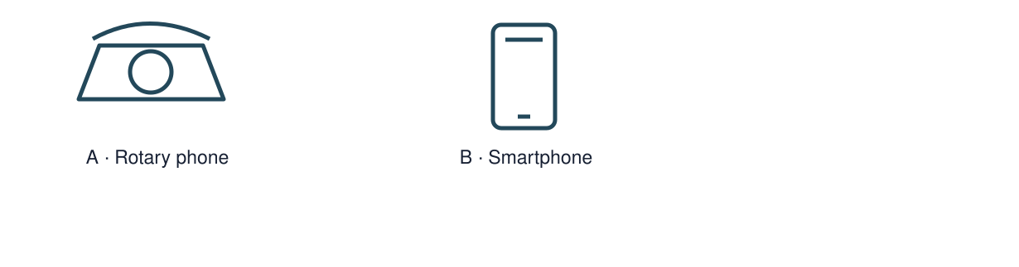
Starter
Inspect the telephone as a mystery object.
Make a first choice. Explain what helped you decide.
Show two choices. Read one short instruction. Point, match or say a word, then add a reason when ready.
BUILD Humanities Spring 1 W5 5
Notes:
F: enquiry question and source suggestion.
Use one-step instructions, symbols and a model first. Offer talk, point, draw, type or write. Reduce the number of choices; extend by asking for a reason or a second example. Adults prompt the first response then fade support.
Use questioning and the exit response to decide the next step. Record the learner’s individual contribution and the access support used.

Slide 6
Model question
Question: What source could help date an old telephone?
BUILD Humanities Spring 1 W5 6
Notes:
Original captioned teaching model made for this pack. It demonstrates the supplied reasoning; it is not historical footage, survivor testimony or a documentary. The full transcript and factual source credits are included.
F: enquiry question and source suggestion.
Use one-step instructions, symbols and a model first. Offer talk, point, draw, type or write. Reduce the number of choices; extend by asking for a reason or a second example. Adults prompt the first response then fade support.
Use questioning and the exit response to decide the next step. Record the learner’s individual contribution and the access support used.

Slide 7
Model evidence
Evidence: D Questions worth asking: Who used this object? When was this photo made? A dated catalogue entry can help with time; a user’s account can help with experience.
BUILD Humanities Spring 1 W5 7
Notes:
Original captioned teaching model made for this pack. It demonstrates the supplied reasoning; it is not historical footage, survivor testimony or a documentary. The full transcript and factual source credits are included.
F: enquiry question and source suggestion.
Use one-step instructions, symbols and a model first. Offer talk, point, draw, type or write. Reduce the number of choices; extend by asking for a reason or a second example. Adults prompt the first response then fade support.
Use questioning and the exit response to decide the next step. Record the learner’s individual contribution and the access support used.

Slide 8
Model explanation
Think aloud: A dated manufacturer’s catalogue or museum record.
BUILD Humanities Spring 1 W5 8
Notes:
Original captioned teaching model made for this pack. It demonstrates the supplied reasoning; it is not historical footage, survivor testimony or a documentary. The full transcript and factual source credits are included.
F: enquiry question and source suggestion.
Use one-step instructions, symbols and a model first. Offer talk, point, draw, type or write. Reduce the number of choices; extend by asking for a reason or a second example. Adults prompt the first response then fade support.
Use questioning and the exit response to decide the next step. Record the learner’s individual contribution and the access support used.

Slide 9
Model check
Check: Would looking at the object tell us every user’s experience? No. A user account could help with that question.
BUILD Humanities Spring 1 W5 9
Notes:
Original captioned teaching model made for this pack. It demonstrates the supplied reasoning; it is not historical footage, survivor testimony or a documentary. The full transcript and factual source credits are included.
F: enquiry question and source suggestion.
Use one-step instructions, symbols and a model first. Offer talk, point, draw, type or write. Reduce the number of choices; extend by asking for a reason or a second example. Adults prompt the first response then fade support.
Use questioning and the exit response to decide the next step. Record the learner’s individual contribution and the access support used.

Slide 10
We do
Inspect the telephone as a mystery object.
Choose which questions can be answered by looking and which need another source.
Suggest a choice. Check the evidence together. Swap roles when ready.
BUILD Humanities Spring 1 W5 10
Notes:
Show two choices. Read one short instruction. Point, match or say a word, then add a reason when ready.
Inspect the telephone as a mystery object. Say or show what helped you decide.
Compare two possible sources and identify what each might miss.
F: enquiry question and source suggestion.
Use one-step instructions, symbols and a model first. Offer talk, point, draw, type or write. Reduce the number of choices; extend by asking for a reason or a second example. Adults prompt the first response then fade support.
Use questioning and the exit response to decide the next step. Record the learner’s individual contribution and the access support used.

Slide 11
Shared activity cards
How many finger holes are visible?
When was this model made?
How did a user feel about it?
BUILD Humanities Spring 1 W5 11
Notes:
How many finger holes are visible? — Look at the object — A visible count can be checked directly.
When was this model made? — Find another source — A dated catalogue could help.
How did a user feel about it? — Find another source — A user’s account could help.
Use the HTML lesson for the interactive version, or the paper cards.

Slide 12
Independent task supported
Write or record one who, what, where, when or why question.
Suggest a source that could help investigate it.
Explain why that source fits the question.
BUILD Humanities Spring 1 W5 12
Notes:
Show two choices. Read one short instruction. Point, match or say a word, then add a reason when ready. Complete the organiser one space at a time. My question is ___. I could use ___ because ___.
An adult may read or scribe your exact response. They should not choose the answer.
F: enquiry question and source suggestion.
Use one-step instructions, symbols and a model first. Offer talk, point, draw, type or write. Reduce the number of choices; extend by asking for a reason or a second example. Adults prompt the first response then fade support.
Use questioning and the exit response to decide the next step. Record the learner’s individual contribution and the access support used.

Slide 13
Independent task standard
Write or record one who, what, where, when or why question.
Suggest a source that could help investigate it.
Explain why that source fits the question.
BUILD Humanities Spring 1 W5 13
Notes:
My question is ___. I could use ___ because ___.
Check the required evidence and revise one detail.
F: enquiry question and source suggestion.
Use one-step instructions, symbols and a model first. Offer talk, point, draw, type or write. Reduce the number of choices; extend by asking for a reason or a second example. Adults prompt the first response then fade support.
Use questioning and the exit response to decide the next step. Record the learner’s individual contribution and the access support used.

Slide 14
Independent task stretch
Write or record one who, what, where, when or why question.
Suggest a source that could help investigate it.
Explain why that source fits the question.
Compare two possible sources and identify what each might miss.
BUILD Humanities Spring 1 W5 14
Notes:
Choose the evidence independently. Use the frame only if it helps.
Compare two possible sources and identify what each might miss.
F: enquiry question and source suggestion.
Use one-step instructions, symbols and a model first. Offer talk, point, draw, type or write. Reduce the number of choices; extend by asking for a reason or a second example. Adults prompt the first response then fade support.
Use questioning and the exit response to decide the next step. Record the learner’s individual contribution and the access support used.

Slide 15
Review and improve
Check the required evidence: enquiry question and source suggestion.
Point to one part that meets the goal.
Improve one detail.
BUILD Humanities Spring 1 W5 15
Notes:
F: enquiry question and source suggestion.
Use one-step instructions, symbols and a model first. Offer talk, point, draw, type or write. Reduce the number of choices; extend by asking for a reason or a second example. Adults prompt the first response then fade support.
Use questioning and the exit response to decide the next step. Record the learner’s individual contribution and the access support used.

Slide 16
Exit ticket
What source could help date an old telephone?
Would looking at the object tell us every user’s experience?
You can share your response privately.
BUILD Humanities Spring 1 W5 16
Notes:
A dated manufacturer’s catalogue or museum record.
No. A user account could help with that question.
Support: My question is ___. I could use ___ because ___.
Extension: Compare two possible sources and identify what each might miss.

Slide 17
Evidence A A fictional week
Monday: choose a club activity. Wednesday: practise the activity. Friday: share what was made. The words Monday, Wednesday and Friday supply the order.
Source: Authored classroom case
Limit: This example does not describe every person or place.
BUILD Humanities Spring 1 W5 17
Notes:
F: enquiry question and source suggestion.
Use one-step instructions, symbols and a model first. Offer talk, point, draw, type or write. Reduce the number of choices; extend by asking for a reason or a second example. Adults prompt the first response then fade support.
Use questioning and the exit response to decide the next step. Record the learner’s individual contribution and the access support used.

Slide 18
Evidence B Telephone comparison
A rotary telephone and a smartphone both support conversations over distance. A smartphone can also show a video call; a rotary dial selects numbers differently.
Source: Authored comparison of familiar objects
Limit: A newer object is not automatically better for every person or purpose.
BUILD Humanities Spring 1 W5 18
Notes:
F: enquiry question and source suggestion.
Use one-step instructions, symbols and a model first. Offer talk, point, draw, type or write. Reduce the number of choices; extend by asking for a reason or a second example. Adults prompt the first response then fade support.
Use questioning and the exit response to decide the next step. Record the learner’s individual contribution and the access support used.

Slide 19
Evidence C Photo enquiry
Use the paired local photographs supplied with this unit. Read the captions and dates. Point to one feature in each image before deciding what changed.
Source: See photograph captions and credits
Limit: A camera angle or season can make features appear different; a photograph alone may not explain why.
BUILD Humanities Spring 1 W5 19
Notes:
F: enquiry question and source suggestion.
Use one-step instructions, symbols and a model first. Offer talk, point, draw, type or write. Reduce the number of choices; extend by asking for a reason or a second example. Adults prompt the first response then fade support.
Use questioning and the exit response to decide the next step. Record the learner’s individual contribution and the access support used.

Slide 20
Evidence D Questions worth asking
Who used this object? When was this photo made? A dated catalogue entry can help with time; a user’s account can help with experience.
Source: Authored classroom case
Limit: This example does not describe every person or place.
BUILD Humanities Spring 1 W5 20
Notes:
F: enquiry question and source suggestion.
Use one-step instructions, symbols and a model first. Offer talk, point, draw, type or write. Reduce the number of choices; extend by asking for a reason or a second example. Adults prompt the first response then fade support.
Use questioning and the exit response to decide the next step. Record the learner’s individual contribution and the access support used.

Slide 21
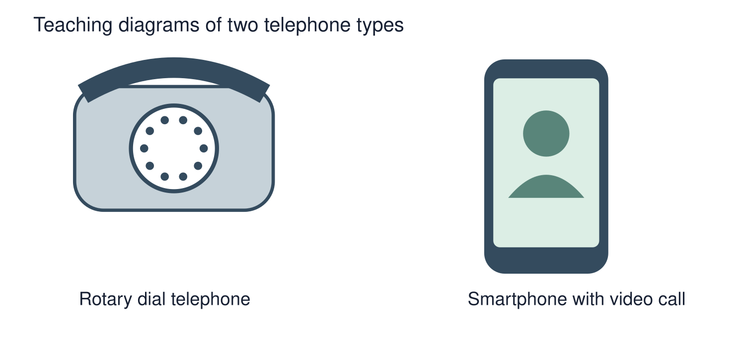
Visual resource
BUILD Humanities Spring 1 W5 21
Notes:
F: enquiry question and source suggestion.
Use one-step instructions, symbols and a model first. Offer talk, point, draw, type or write. Reduce the number of choices; extend by asking for a reason or a second example. Adults prompt the first response then fade support.
Use questioning and the exit response to decide the next step. Record the learner’s individual contribution and the access support used.
See the pupil pack for source credits and the paired enquiry prompts.

