Slide 1

CREATIVE ARTS GROW SPRING 1 WEEK 4 LESSON 2
OPENING RESILIENCE & CHANGE
Developing my resilience piece
I can develop my piece and explain my changes.
Weekly outcome
Create my resilience-themed piece.
Explore level. You can point, speak, sign, draw or write. You may share privately.
ART_GROW_S1_W04_P2 Wednesday 27 January 2027 P5 1/11
Made by Matt
Notes:
Wednesday 27 January 2027 P5. GROW Weekly Spring row 91. Year A. Explore. Weekly outcome verbatim: Create my resilience-themed piece.
I can continue my piece from the real next step.
I can check it against my intended idea.
I can log my decisions, changes and actual stage.
For up to five pupils: five real first versions with their Week 3 plans and Monday logs, five pencils and small workspaces. Retrieve the optional Week 2 skill records if using stretch.
Check each plan materials list in advance. Drawing fallback: five sheets plus scrap and five familiar drawing tools. Paper route: clean scrap and shared glue sticks. Use familiar materials and local procedures.
For paint only if planned and approved: mats, stable water pots, brushes, a small amount of familiar washable paint and cloths. Keep wet work away from electrical equipment.
Sound needs no instrument: quiet fingertips and a stop signal. Silent movement or directed adult actions need no materials. Offer seated, quiet and private options.
Set aside five safe storage places for unfinished work with its plan and actual log. No phone or media recording is required.
If prior work is missing, offer a brief honest restart: choose an invented idea and a small achievable form, state a first step and needed tools or no-materials route, then make a first version. Date it today and label it a new start. Do not claim missing earlier evidence.

Slide 2
CREATIVE ARTS GROW SPRING 1 WEEK 4 LESSON 2
ARRIVAL 3 MINUTES
A choice and a new start
Find your plan, first version and log.
Read the next step you chose.
Check what you can finish today.
ART_GROW_S1_W04_P2 Wednesday 27 January 2027 P5 2/11
Made by Matt
Notes:
Say and do: Reconnect the actual first version with Monday log. Let the pupil confirm or revise the next step. If absent, use the catch-up route and keep the reduced scope clear. Do not fabricate work from Monday.
Look for: Pupil identifies existing work and a manageable continuation.
Materials-free: Read back the actual action sequence and next step, then pupil confirms or corrects it.
Check and response: A short piece can be enough. Record any unfinished work honestly.

Slide 3
CREATIVE ARTS GROW SPRING 1 WEEK 4 LESSON 2
STARTER 3 MINUTES
A feature to notice
Show the part that suggests resilience.
What still needs making or checking?
Choose one target for today.
ART_GROW_S1_W04_P2 Wednesday 27 January 2027 P5 3/11
Made by Matt
Notes:
Say and do: Ask the pupil to name a visible or performed feature and its intended effect. Choose one completion target within the fourteen-minute making time. It can be completing an ending, clarifying a turn or making a sequence repeatable.
Look for: The target is specific and achievable without changing the maker intention.
Materials-free: Select one part of the silent sequence to complete or make clearer.
Check and response: Resilience can be shown as getting help, pausing or finding another way. Avoid personal disclosure prompts.

Slide 4
CREATIVE ARTS GROW SPRING 1 WEEK 4 LESSON 2
I DO 6 MINUTES
The method in small steps
Look at the real first version.
Complete one planned part.
Check the effect. Try one small change.
Keep the version that fits your idea.
ART_GROW_S1_W04_P2 Wednesday 27 January 2027 P5 4/11
Made by Matt
Notes:
Say and do: Use the adult first section from Monday. Complete the new route into open space. Check whether the turn is clear. Try a longer gap on scrap or pause in the sequence; compare with the first version. I keep the short pause because it feels like a brief check before moving. I record the change from my plan and my reason. For visual work, keep the trial beside the piece; for movement, keep a precise witnessed sequence.
Look for: Adult completes a part, compares an actual change and records the maker decision. A changed choice is not automatically an improvement.
Materials-free: Perform the original short pause and a longer pause in the same hand sequence. Choose one and explain its effect.
Check and response: CfU: Does a longer pause always improve the piece? No. It depends on the intended effect. Ask which version fits the maker idea.

Slide 5
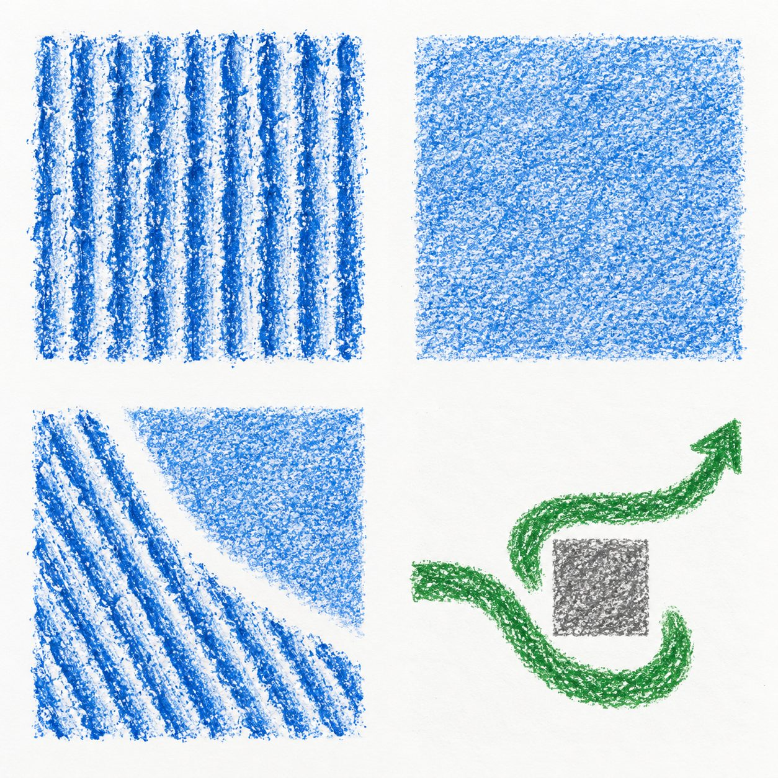
CREATIVE ARTS GROW SPRING 1 WEEK 4 LESSON 2
WITHIN I DO ORIGINAL CLASS MODELS
Original examples and your own choices
Look at the textures and the path.
These are original class examples.
What feature could fit your idea?
Your work can look different.
ART_GROW_S1_W04_P2 Wednesday 27 January 2027 P5 5/11
Made by Matt
Notes:
Original generated classroom examples, not pupil evidence or photographs of actual rubbings. Show real tests alongside these.
Teacher example only: I finished the route. I tested a longer gap but kept the short gap because I wanted a clear, steady turn.
Teacher example only: my final movement is forward, stop, turn, continue. I kept a short pause and can repeat the sequence.

Slide 6
CREATIVE ARTS GROW SPRING 1 WEEK 4 LESSON 2
WE DO 6 MINUTES
A shared choice
Compare the first version with a small change.
What effect does the change have?
The maker chooses what to keep.
Say what is really finished.
ART_GROW_S1_W04_P2 Wednesday 27 January 2027 P5 6/11
Made by Matt
Notes:
Say and do: Compare the two adult versions. Hinge: only the start of a piece is made. A: record finished; B: record what exists and the next step. Ask every pupil to choose, with private pointing allowed.
Look for: Pupil selects B and gives an accurate completion statement.
Materials-free: Use two live silent versions and identify exactly which parts were performed.
Check and response: B. If A, show the incomplete ending and model an honest record. Parallel check: a witness saw only the first two actions; may the record claim all four? No. Proceed when each pupil can state an actual next action.

Slide 7
CREATIVE ARTS GROW SPRING 1 WEEK 4 LESSON 2
CREATE 14 MINUTES
Your own making
Use your next step to develop the piece.
Keep the idea clear in the work.
Check one feature. Keep it or change it for a reason.
Keep the actual work and decisions.
ART_GROW_S1_W04_P2 Wednesday 27 January 2027 P5 7/11
Made by Matt
Notes:
Say and do: Use about two minutes to retrieve and set up, nine to complete or develop the target, and three to check and record. Adapt to access needs. The pupil can use visual art, original quiet sound or silent movement as planned. Stop sound on a raised hand. Keep wet work stable. Avoid a wholesale restart unless the pupil can explain why and accept a smaller result. If the piece is already complete, use the time to refine one feature or rehearse a repeatable sequence, recording the real decision.
Look for: Pupil develops an actual piece and explains at least one decision, including a justified decision to keep a feature. The true completion stage is recorded.
Materials-free: Develop or direct a short silent sequence. Staff witness the final order, pauses, changes, help and pupil meaning. No recorded media is required.
Check and response: Example only: I completed the turn and ending. I tried a longer pause but kept the short pause because the route still feels steady.
Keep actual tests or versions, the pupil choice and reason, dated arts-log entry and actual support. A precise confirmed witness note is valid for performance or directed work. Do not prefill model answers as pupil evidence.

Slide 8
CREATIVE ARTS GROW SPRING 1 WEEK 4 LESSON 2
WITHIN CREATE ONE ROUTE AT A TIME
Supported, Independent or Aspire
Supported
Independent
Aspire
Read your next step with an adult.
Continue from the real first version.
Complete the core making task.
Make or direct one small part.
Check one feature against your intention.
Compare the first version and a new test.
Choose what to keep or change.
Explain your keep-or-change decision.
Explain which effect fits the intention.
Confirm what is finished and what comes next.
Log the actual stage and next step.
Use or decline feedback with a reason.
ART_GROW_S1_W04_P2 Wednesday 27 January 2027 P5 8/11
Made by Matt
Notes:
Use one route at a time within Create. All routes retain pupil choices.
Keep actual tests or versions, the pupil choice and reason, dated arts-log entry and actual support. A precise confirmed witness note is valid for performance or directed work. Do not prefill model answers as pupil evidence.

Slide 9
CREATIVE ARTS GROW SPRING 1 WEEK 4 LESSON 2
WITHIN CREATE OPTIONAL STRETCH
Optional next level stretch
Your Explore work is complete without this task.
Compare your first and current versions against the Week 2 skill goal and Week 3 intention. Explain one feedback decision. Say what the tests show and what they do not show. Set a specific next practice step.
Keep actual versions or witness notes, pupil evaluation, feedback decision with reason and next skill goal.
ART_GROW_S1_W04_P2 Wednesday 27 January 2027 P5 9/11
Made by Matt
Notes:
Pupil evaluates actual change against intention and skill, acknowledges a limit and justifies a next step.
Your Explore work is complete without this task. Extra evidence can inform a later level review; it does not certify a higher award.
Adult records the same evaluation prompts after witnessing the actual silent versions, using the pupil confirmed words.

Slide 10
CREATIVE ARTS GROW SPRING 1 WEEK 4 LESSON 2
REVIEW 5 MINUTES
A check and a reason
Show a chosen part privately or to a partner.
Ask: What do you notice?
Check it against your intended idea.
Tidy and store the piece with your plan.
ART_GROW_S1_W04_P2 Wednesday 27 January 2027 P5 10/11
Made by Matt
Notes:
Say and do: Invite a respectful observation rather than praise alone. The maker states whether the observed feature matches the intention. They may keep the piece without further change. In the final two minutes tidy materials and store work safely; keep trials and logs.
Look for: Pupil links actual features to intention, and stores evidence without claiming a later share or encounter.
Materials-free: Adult repeats the final sequence and reads back the witness description for correction.
Check and response: The audience can read the piece differently. The maker explanation and actual features are both worth keeping.

Slide 11
CREATIVE ARTS GROW SPRING 1 WEEK 4 LESSON 2
EXIT 3 MINUTES
Your arts log
Arts log: My piece shows ___ through ___.
I kept or changed ___ because ___.
My piece is finished / still needs ___.
Next I would ___.
ART_GROW_S1_W04_P2 Wednesday 27 January 2027 P5 11/11
Made by Matt
Notes:
Say and do: Retain dated actual work or the final witnessed sequence, plan, decision and changes. Record support. Pupils can draw, dictate or confirm by gesture. Keep optional stretch distinct from core Explore evidence. This is making and review, not a claim that the full award is complete.
Look for: The entry states the final current form, features, decisions, real completion stage and next step.
Materials-free: Confirm an oral entry and record the exact witnessed version and pupil words at the next opportunity.
Check and response: Example only: My silent piece shows another way forward through a pause and turn. It is complete as a short sequence; I would practise the ending next.

