Slide 1
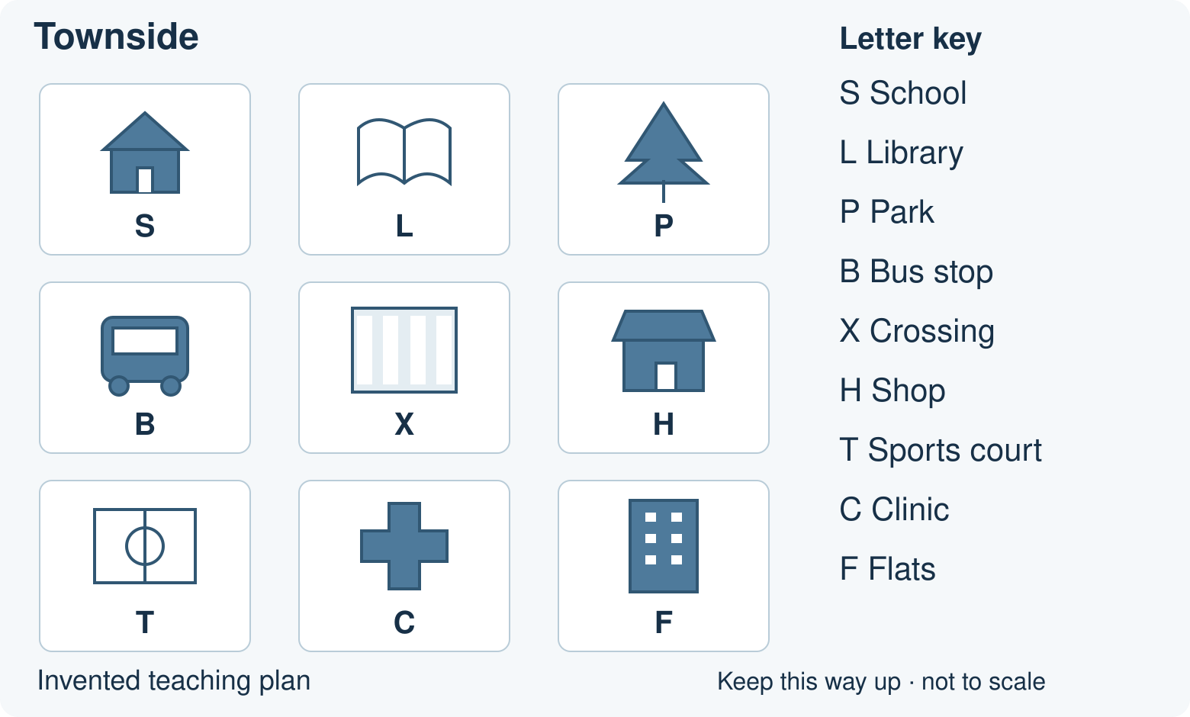
BUILD HUMANITIES SUMMER 1 WEEK 2
Routes on a familiar plan
Use a simple map or plan of a familiar place.
Can a partner follow my route?
Point, speak, draw, type or write.
Opening · 40-minute lesson
1
Notes:
BUILD_SU1_W02. Opening. 0 minutes.
Learning goal: Use a simple map or plan of a familiar place.
If unsure, reduce to two choices and try a new example.
Access: One instruction at a time. Point, speak, draw, type or write. Use the supported route for a smaller choice set. Fade content prompts before the independent check.
Townside is an invented practice plan. Use the editable familiar-place plan sheet to add a checked school plan before teaching. Keep the plan the same way up. Left and right mean on the page; pupils do not turn their bodies. On Townside, move only to an adjacent square, never diagonally.
Source: Humanities Scheme of Work 2026–27(1).docx, page 11, BUILD Summer 1 Week 2. Practice diagrams are original invented teaching plans.

Slide 2
BUILD HUMANITIES SUMMER 1 WEEK 2
Arrival: a quick evidence check
1. What does S mean?
2. From S, move one square right. Where are you?
3. From L, move one square down. Where are you?
4. What does destination mean?
Use your chosen arrival sheet. Ask for one step at a time.
Arrival · 4 minutes
2
Notes:
BUILD_SU1_W02. Arrival. 4 minutes.
Learning goal: Use a simple map or plan of a familiar place.
If unsure, reduce to two choices and try a new example.
Access: One instruction at a time. Point, speak, draw, type or write. Use the supported route for a smaller choice set. Fade content prompts before the independent check.
Arrival answers: Supported: S is in the top-left square. Right is towards the key. B, the bus stop. A destination is the place a route ends.
Standard: S means school. L, the library. X, the crossing. The place a route ends.
Stretch: L, the library. F, the flats. Different starts can give different destinations. Right then down, or down then right.
Source: Humanities Scheme of Work 2026–27(1).docx, page 11, BUILD Summer 1 Week 2. Practice diagrams are original invented teaching plans.

Slide 3
BUILD HUMANITIES SUMMER 1 WEEK 2
Directions on a plan
Show left, right, up and down on the page.
Keep the plan still.
Use the picture keys and labels.
Starter · 3 minutes
3
Notes:
BUILD_SU1_W02. Starter. 3 minutes.
Learning goal: Use a simple map or plan of a familiar place.
Ask for one visible clue, then hear the revised explanation.
Access: One instruction at a time. Point, speak, draw, type or write. Use the supported route for a smaller choice set. Fade content prompts before the independent check.
Townside is an invented practice plan. Use the editable familiar-place plan sheet to add a checked school plan before teaching. Keep the plan the same way up. Left and right mean on the page; pupils do not turn their bodies. On Townside, move only to an adjacent square, never diagonally.
Source: Humanities Scheme of Work 2026–27(1).docx, page 11, BUILD Summer 1 Week 2. Practice diagrams are original invented teaching plans.
HTML starter varies automatically; use the word bank as a paper/PowerPoint alternative.

Slide 4
BUILD HUMANITIES SUMMER 1 WEEK 2
The worked method
1. Where does this route finish? Start at S. Move right, then down.
2. The key names S as school. One move right reaches L, the library.
3. One move down from L reaches X, the crossing. X is the destination.
4. Trace S to L to X again. Two moves, no diagonal jump.
I do · 6 minutes
4
Notes:
BUILD_SU1_W02. I do. 6 minutes.
Learning goal: Use a simple map or plan of a familiar place.
Model one step, then let the learner do the next.
Access: One instruction at a time. Point, speak, draw, type or write. Use the supported route for a smaller choice set. Fade content prompts before the independent check.
Question: Where does this route finish? Start at S. Move right, then down.
Evidence: The key names S as school. One move right reaches L, the library.
Explain: One move down from L reaches X, the crossing. X is the destination.
Check: Trace S to L to X again. Two moves, no diagonal jump.
Source: Humanities Scheme of Work 2026–27(1).docx, page 11, BUILD Summer 1 Week 2. Practice diagrams are original invented teaching plans.

Slide 5
BUILD HUMANITIES SUMMER 1 WEEK 2
Partner route challenge
1. Navigator: choose a start and give two moves on the plan.
2. Checker: trace the moves with a counter and mark the destination.
3. Compare with the navigator’s intended destination. Swap roles.
Use a counter. Swap navigator and checker roles.
We do · 7 minutes
5
Notes:
BUILD_SU1_W02. We do. 7 minutes.
Learning goal: Use a simple map or plan of a familiar place.
Ask the learner which support helped. Use it, hear their response and agree the next attempt.
Access: One instruction at a time. Point, speak, draw, type or write. Use the supported route for a smaller choice set. Fade content prompts before the independent check.
Shared activity answers: Start S. Right, then down. X: Crossing. S to L to X is right, then down.
Start S. Down, then down. T: Sports court. S to B to T is two moves down.
Start P. Down, then left. X: Crossing. P to H to X is down, then left.
Start F. Left, then up. X: Crossing. F to C to X is left, then up.
Start X. Left, then down. T: Sports court. X to B to T is left, then down.
Source: Humanities Scheme of Work 2026–27(1).docx, page 11, BUILD Summer 1 Week 2. Practice diagrams are original invented teaching plans.

Slide 6
BUILD HUMANITIES SUMMER 1 WEEK 2
Check the claim
Start S. Right, then down.
A visitor marks the shop.
Check every move.
Is the destination correct?
Check · 2 minutes
6
Notes:
BUILD_SU1_W02. Check. 2 minutes.
Learning goal: Use a simple map or plan of a familiar place.
Use the repair question to reveal the misconception; recheck with a new example.
Access: One instruction at a time. Point, speak, draw, type or write. Use the supported route for a smaller choice set. Fade content prompts before the independent check.
The destination is X, the crossing. H needs one more move right. Trace S to L to X.
Source: Humanities Scheme of Work 2026–27(1).docx, page 11, BUILD Summer 1 Week 2. Practice diagrams are original invented teaching plans.

Slide 7
BUILD HUMANITIES SUMMER 1 WEEK 2
Your independent task
Supported
Standard
Stretch
1. Find the start on the familiar-place plan with an adult.
2. Follow one short route, with directions read aloud.
3. Mark or point to the destination yourself.
1. Mark a start on the familiar-place plan.
2. Build a short route for a partner. Swap roles.
3. Follow the new route and mark its destination independently.
1. Give a precise route on the familiar-place plan.
2. Ask a partner to test it. Repair any unclear instruction.
3. Follow a fresh route and mark its destination independently.
4. Explain one check using a feature on the plan.
Use the checked local sources and your task sheet.
Independent · 12 minutes
7
Notes:
BUILD_SU1_W02. Independent. 12 minutes.
Learning goal: Use a simple map or plan of a familiar place.
Fade the content prompt. Keep usual reading and communication support.
Access: One instruction at a time. Point, speak, draw, type or write. Use the supported route for a smaller choice set. Fade content prompts before the independent check.
Keep reading and communication support. Fade route-content prompts for the final response. Record the start, route, destination and support used. Answers depend on teacher-checked local sources.
Source: Humanities Scheme of Work 2026–27(1).docx, page 11, BUILD Summer 1 Week 2. Practice diagrams are original invented teaching plans.

Slide 8
BUILD HUMANITIES SUMMER 1 WEEK 2
Review and improve
Check the start and every move. Improve one direction so a partner can follow it.
Show what you changed.
Explain one improvement to your teacher.
Review · 3 minutes
8
Notes:
BUILD_SU1_W02. Review. 3 minutes.
Learning goal: Use a simple map or plan of a familiar place.
Name one precise improvement, then give time to make it.
Access: One instruction at a time. Point, speak, draw, type or write. Use the supported route for a smaller choice set. Fade content prompts before the independent check.
Townside is an invented practice plan. Use the editable familiar-place plan sheet to add a checked school plan before teaching. Keep the plan the same way up. Left and right mean on the page; pupils do not turn their bodies. On Townside, move only to an adjacent square, never diagonally.
Source: Humanities Scheme of Work 2026–27(1).docx, page 11, BUILD Summer 1 Week 2. Practice diagrams are original invented teaching plans.

Slide 9
BUILD HUMANITIES SUMMER 1 WEEK 2
Two final checks
1. Where does the new route on your plan finish?
2. How did you check one direction?
Give your own response. Point, speak, draw or write.
Exit · 3 minutes
9
Notes:
BUILD_SU1_W02. Exit. 3 minutes.
Learning goal: Use a simple map or plan of a familiar place.
Use the independent response to decide whether to revisit, consolidate or extend.
Access: One instruction at a time. Point, speak, draw, type or write. Use the supported route for a smaller choice set. Fade content prompts before the independent check.
Keep reading and communication support. Fade route-content prompts for the final response. Record the start, route, destination and support used. Answers depend on teacher-checked local sources.
Source: Humanities Scheme of Work 2026–27(1).docx, page 11, BUILD Summer 1 Week 2. Practice diagrams are original invented teaching plans.
HTML exit quick-check varies automatically. Retain the two independent questions shown here.

Slide 10
BUILD HUMANITIES SUMMER 1 WEEK 2
Lesson vocabulary
plan
A view from above showing where things are.
route
The way from a start to a destination.
destination
The place where a route ends.
key
A guide to the symbols on a map.
Vocabulary reference
10
Notes:
Use the same definitions as the lesson and knowledge organiser. plan: A view from above showing where things are.
route: The way from a start to a destination.
destination: The place where a route ends.
key: A guide to the symbols on a map.

