Slide 1
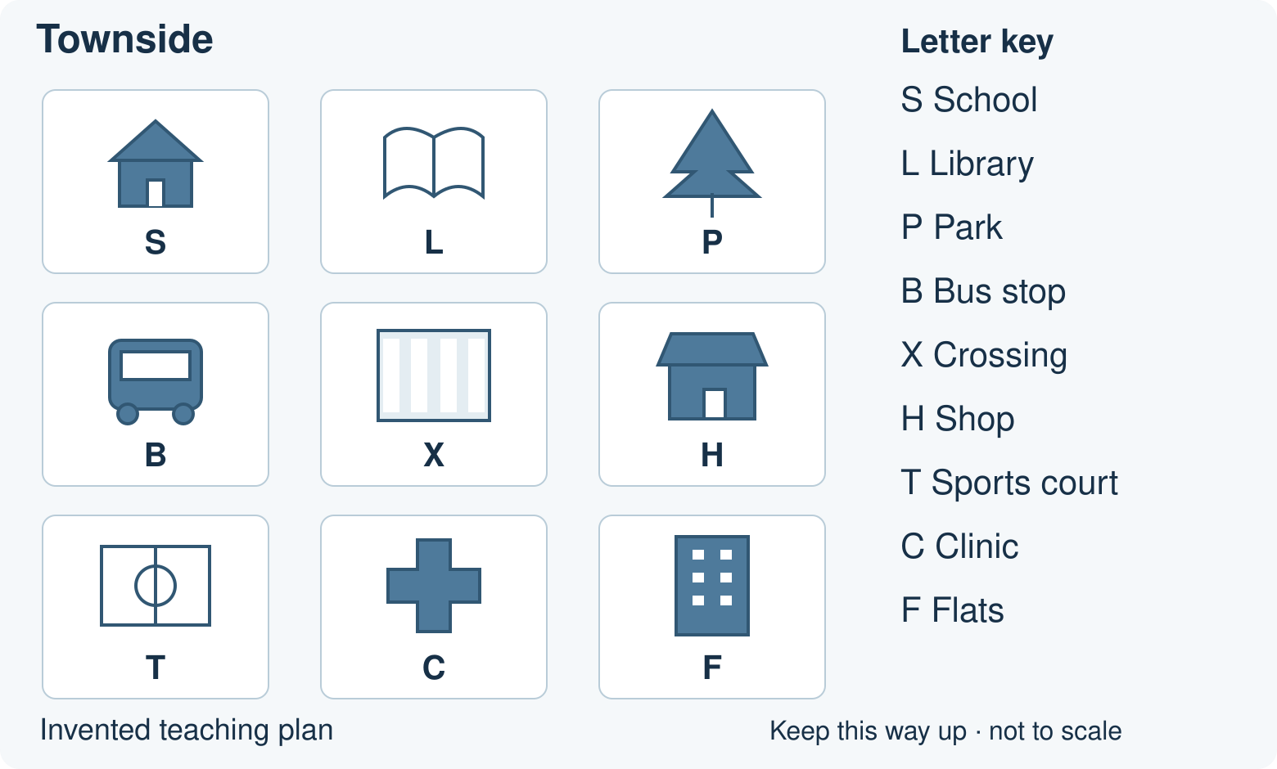
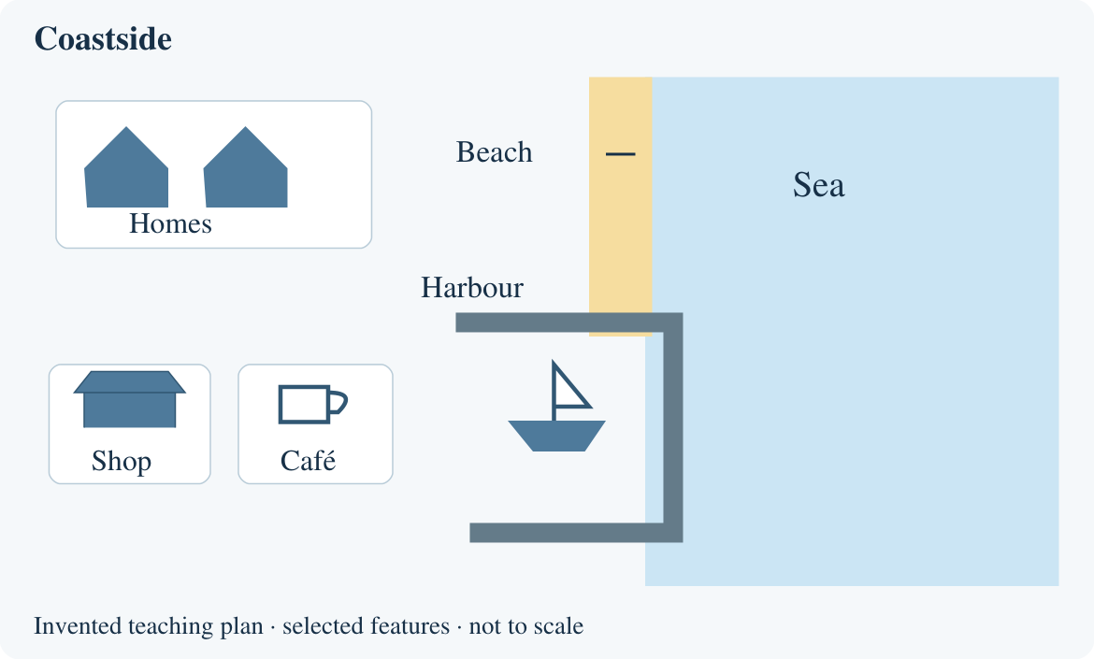
BUILD HUMANITIES SUMMER 1 WEEK 3
Comparing two places
Compare my place with a contrasting place.
What is the same and different about two places?
Point, speak, draw, type or write.
Opening · 40-minute lesson
1
Notes:
BUILD_SU1_W03. Opening. 0 minutes.
Learning goal: Compare my place with a contrasting place.
If unsure, reduce to two choices and try a new example.
Access: One instruction at a time. Point, speak, draw, type or write. Use the supported route for a smaller choice set. Fade content prompts before the independent check.
Townside and Coastside are invented practice places. Before teaching, add two labelled local photos or a checked local plan and a contrasting place photo/map set to the editable evidence sheet. Do not present the practice plans as the learner’s actual place. Compare the same feature in both sets. A missing symbol is not proof that a feature is absent from a real place.
Source: Humanities Scheme of Work 2026–27(1).docx, page 11, BUILD Summer 1 Week 3. Practice diagrams are original invented teaching plans.

Slide 2
BUILD HUMANITIES SUMMER 1 WEEK 3
Arrival: a quick evidence check
1. Name one feature shown on Townside.
2. Name one feature shown on Coastside.
3. Name one feature shown on both.
4. Which plan shows a beach? What is your evidence?
Use your chosen arrival sheet. Ask for one step at a time.
Arrival · 4 minutes
2
Notes:
BUILD_SU1_W03. Arrival. 4 minutes.
Learning goal: Compare my place with a contrasting place.
If unsure, reduce to two choices and try a new example.
Access: One instruction at a time. Point, speak, draw, type or write. Use the supported route for a smaller choice set. Fade content prompts before the independent check.
Arrival answers: Supported: H marks the Townside shop. The shop is on the lower left. Coastside. A similarity: both show a shop.
Standard: Accept school, library, park, bus stop, crossing, shop, court, clinic or flats. Accept harbour, beach, sea, shop, café or homes. Both show shops or homes. Coastside: the beach label and sand beside the sea.
Stretch: Both show homes: Townside flats and Coastside homes. Townside shows a park; Coastside shows a beach. No. There are no noise measurements. No. It may be outside the selected area or omitted.
Source: Humanities Scheme of Work 2026–27(1).docx, page 11, BUILD Summer 1 Week 3. Practice diagrams are original invented teaching plans.

Slide 3
BUILD HUMANITIES SUMMER 1 WEEK 3
Same and different
Find a shop on each plan.
What is the same?
What else can you see?
Use the picture keys and labels.
Starter · 3 minutes
3
Notes:
BUILD_SU1_W03. Starter. 3 minutes.
Learning goal: Compare my place with a contrasting place.
Ask for one visible clue, then hear the revised explanation.
Access: One instruction at a time. Point, speak, draw, type or write. Use the supported route for a smaller choice set. Fade content prompts before the independent check.
Townside and Coastside are invented practice places. Before teaching, add two labelled local photos or a checked local plan and a contrasting place photo/map set to the editable evidence sheet. Do not present the practice plans as the learner’s actual place. Compare the same feature in both sets. A missing symbol is not proof that a feature is absent from a real place.
Source: Humanities Scheme of Work 2026–27(1).docx, page 11, BUILD Summer 1 Week 3. Practice diagrams are original invented teaching plans.
HTML starter varies automatically; use the word bank as a paper/PowerPoint alternative.

Slide 4
BUILD HUMANITIES SUMMER 1 WEEK 3
The worked method
1. What is different about the green and open spaces shown?
2. Townside shows a park with a tree symbol. Coastside shows a beach beside the sea.
3. The plans show different kinds of open space: a park and a beach.
4. Point to both symbols and keys. These plans do not tell us which place is better.
I do · 6 minutes
4
Notes:
BUILD_SU1_W03. I do. 6 minutes.
Learning goal: Compare my place with a contrasting place.
Model one step, then let the learner do the next.
Access: One instruction at a time. Point, speak, draw, type or write. Use the supported route for a smaller choice set. Fade content prompts before the independent check.
Question: What is different about the green and open spaces shown?
Evidence: Townside shows a park with a tree symbol. Coastside shows a beach beside the sea.
Explain: The plans show different kinds of open space: a park and a beach.
Check: Point to both symbols and keys. These plans do not tell us which place is better.
Source: Humanities Scheme of Work 2026–27(1).docx, page 11, BUILD Summer 1 Week 3. Practice diagrams are original invented teaching plans.

Slide 5
BUILD HUMANITIES SUMMER 1 WEEK 3
Evidence sort and comparison
1. Together, sort each evidence card: both plans, Townside only or Coastside only.
2. Build one comparison row: feature, Townside evidence, Coastside evidence.
3. Swap observer and recorder roles. Explain one difference with both sources.
Use the evidence sort and comparison grid on your sheet.
We do · 7 minutes
5
Notes:
BUILD_SU1_W03. We do. 7 minutes.
Learning goal: Compare my place with a contrasting place.
Ask the learner which support helped. Use it, hear their response and agree the next attempt.
Access: One instruction at a time. Point, speak, draw, type or write. Use the supported route for a smaller choice set. Fade content prompts before the independent check.
Shared activity answers: A shop is shown. Both plans. Townside H and the Coastside shop symbol both show shops.
A park is shown. Townside only. Townside P marks a park; no park symbol is shown on Coastside.
A beach is shown. Coastside only. The Coastside beach label marks sand beside the sea.
Homes are shown. Both plans. Townside F shows flats. Coastside shows homes.
A harbour is shown. Coastside only. The harbour is labelled on Coastside; none is shown on Townside.
Source: Humanities Scheme of Work 2026–27(1).docx, page 11, BUILD Summer 1 Week 3. Practice diagrams are original invented teaching plans.

Slide 6
BUILD HUMANITIES SUMMER 1 WEEK 3
Check the claim
“No school symbol means
Coastside has no school.”
Can this plan prove that?
Explain using its limits.
Check · 2 minutes
6
Notes:
BUILD_SU1_W03. Check. 2 minutes.
Learning goal: Compare my place with a contrasting place.
Use the repair question to reveal the misconception; recheck with a new example.
Access: One instruction at a time. Point, speak, draw, type or write. Use the supported route for a smaller choice set. Fade content prompts before the independent check.
No. The plan shows selected features only. We can say no school is shown, but we need more evidence to say there is no school.
Source: Humanities Scheme of Work 2026–27(1).docx, page 11, BUILD Summer 1 Week 3. Practice diagrams are original invented teaching plans.

Slide 7
BUILD HUMANITIES SUMMER 1 WEEK 3
Your independent task
Supported
Standard
Stretch
1. Choose one feature on the local source set with your teacher.
2. Point to or draw what each place shows in the two columns.
3. Say one difference using both sources.
1. Use the local and contrasting source sets.
2. Complete two rows of the comparison grid.
3. Explain one important difference using evidence from both places.
1. Choose three features to compare in the two source sets.
2. Record accurate observations from both.
3. Explain which contrast could matter most for one activity.
4. State one limit of the evidence.
Use the checked local sources and your task sheet.
Independent · 12 minutes
7
Notes:
BUILD_SU1_W03. Independent. 12 minutes.
Learning goal: Compare my place with a contrasting place.
Fade the content prompt. Keep usual reading and communication support.
Access: One instruction at a time. Point, speak, draw, type or write. Use the supported route for a smaller choice set. Fade content prompts before the independent check.
Retain the learner’s observation and comparison. Record the source labels and support used. Accept pointing, speech, drawing or writing with evidence from both places. Answers depend on teacher-checked local sources.
Source: Humanities Scheme of Work 2026–27(1).docx, page 11, BUILD Summer 1 Week 3. Practice diagrams are original invented teaching plans.

Slide 8
BUILD HUMANITIES SUMMER 1 WEEK 3
Review and improve
Check both evidence columns. Improve one comparison by adding what the second source shows.
Show what you changed.
Explain one improvement to your teacher.
Review · 3 minutes
8
Notes:
BUILD_SU1_W03. Review. 3 minutes.
Learning goal: Compare my place with a contrasting place.
Name one precise improvement, then give time to make it.
Access: One instruction at a time. Point, speak, draw, type or write. Use the supported route for a smaller choice set. Fade content prompts before the independent check.
Townside and Coastside are invented practice places. Before teaching, add two labelled local photos or a checked local plan and a contrasting place photo/map set to the editable evidence sheet. Do not present the practice plans as the learner’s actual place. Compare the same feature in both sets. A missing symbol is not proof that a feature is absent from a real place.
Source: Humanities Scheme of Work 2026–27(1).docx, page 11, BUILD Summer 1 Week 3. Practice diagrams are original invented teaching plans.

Slide 9
BUILD HUMANITIES SUMMER 1 WEEK 3
Two final checks
1. Give one comparison of your place and the contrasting place.
2. What evidence supports your comparison?
Give your own response. Point, speak, draw or write.
Exit · 3 minutes
9
Notes:
BUILD_SU1_W03. Exit. 3 minutes.
Learning goal: Compare my place with a contrasting place.
Use the independent response to decide whether to revisit, consolidate or extend.
Access: One instruction at a time. Point, speak, draw, type or write. Use the supported route for a smaller choice set. Fade content prompts before the independent check.
Retain the learner’s observation and comparison. Record the source labels and support used. Accept pointing, speech, drawing or writing with evidence from both places. Answers depend on teacher-checked local sources.
Source: Humanities Scheme of Work 2026–27(1).docx, page 11, BUILD Summer 1 Week 3. Practice diagrams are original invented teaching plans.
HTML exit quick-check varies automatically. Retain the two independent questions shown here.

Slide 10
BUILD HUMANITIES SUMMER 1 WEEK 3
Lesson vocabulary
compare
Look at two things to find what is the same and different.
similarity
Something that is the same or alike.
difference
Something that is not the same.
evidence
What we can point to or observe to support an idea.
Vocabulary reference
10
Notes:
Use the same definitions as the lesson and knowledge organiser. compare: Look at two things to find what is the same and different.
similarity: Something that is the same or alike.
difference: Something that is not the same.
evidence: What we can point to or observe to support an idea.

