Slide 1
GROW · RE
Belonging across faiths
I can find belonging clues in two fictional profiles.
I can compare people, place, practice and values.
I can explain a similarity and why belonging can vary.
Made by Matt

Slide 2
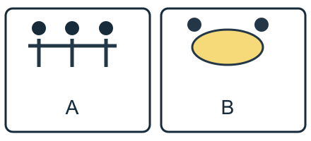
Arrival quiz
Which sketch shows people standing together?
Picture A
Picture B
Choose first. Check on the next slide.
Made by Matt

Slide 3
Arrival quiz · answer
Picture A
A shows three people standing together. B shows a plate for a shared meal.
Right first time: count your first choice only. You may try again.
Made by Matt

Slide 4
Arrival quiz
Which action can help someone feel welcome?
A. Include them in a shared activity.
B. Mock their choice.
Choose first. Check on the next slide.
Made by Matt

Slide 5
Arrival quiz · answer
A. Include them in a shared activity.
An invitation can help someone feel included. People can choose how to join.
Right first time: count your first choice only. You may try again.
Made by Matt

Slide 6
Arrival quiz
Must everyone in a group feel the same way?
A. Yes.
B. No.
Choose first. Check on the next slide.
Made by Matt

Slide 7
Arrival quiz · answer
B. No.
People have different experiences. One person cannot speak for everyone.
Right first time: count your first choice only. You may try again.
Made by Matt

Slide 8
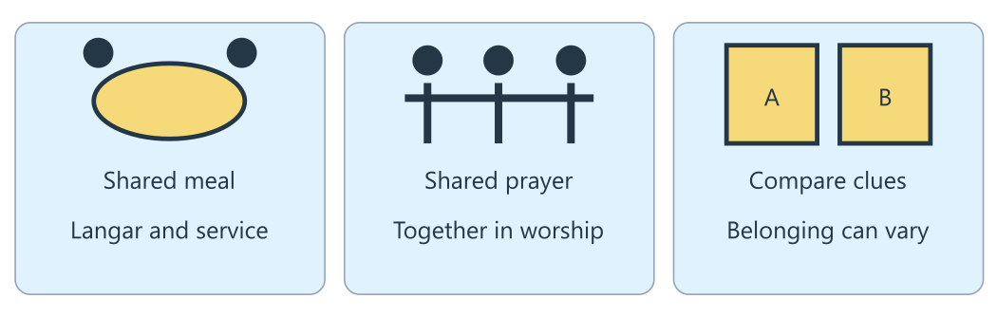
Arrival reference
The lesson diagram
Use this diagram for the four recall prompts.
Made by Matt

Slide 9
Arrival · Supported
Four recall prompts
1. Point to the Shared meal panel.
2. Choose: belonging means welcome or being left out?
3. Choose one way to support belonging: serve others or mock them?
4. Does everyone feel belonging in the same way?
Made by Matt

Slide 10
Arrival · Independent
Four recall prompts
1. Name a shared practice shown in the diagram.
2. What does belonging mean?
3. Give one way a faith community can support belonging.
4. Do all members of a community feel the same way?
Made by Matt

Slide 11
Arrival · Aspire
Four recall prompts
1. Find one meal clue and one prayer clue.
2. Use belonging in a sentence about the fictional Sikh profile.
3. Which detail supports the link between service and belonging?
4. Why can one profile not speak for everyone?
Made by Matt

Slide 12
Starter
How might sharing a meal or helping others make someone feel part of a group?
Link the detail to belonging: shared food and service can help someone feel welcome and part of a community.
Made by Matt

Slide 13
Whole class
Clues to belonging
Rule: follow the lights one step at a time.
1. Find the people 2. Find the place 3. Name a shared practice 4. Explain a belonging clue
Show one finger for only one profile, or two for both. Vote on People do something together. Give a source clue. You may pass.
Made by Matt

Slide 14
I do
The worked model
Read the fictional Sikh profile. At the gurdwara, a volunteer helps serve langar, a free meal for anyone.
The volunteer says serving others creates a feeling of being part of something. The practice gives a role in the group.
Link the detail to belonging: shared food and service can help someone feel welcome and part of a community.
Made by Matt

Slide 15
Word help
Words to use
belonging: Feeling part of a group and welcome in it
faith community: People who share a religion and meet together
practice: Something people do as part of their beliefs
support: Help given to someone
Made by Matt

Slide 16
We do · hinge
Which detail best explains belonging in the Sikh profile?
A. Serving a free meal for anyone and feeling part of the group.
B. Being left out of the meal.
C. Everyone having exactly the same experience.
Made by Matt

Slide 17
We do · hinge answer
A. Serving a free meal for anyone and feeling part of the group.
The volunteer describes belonging through serving langar. Shared food and service give a role in the group. The profile cannot tell us how everyone feels.
Made by Matt

Slide 18
I do
Connect the evidence
Read the fictional Muslim profile. At communal prayers, a participant stands shoulder to shoulder with others. During Ramadan the community breaks the fast together.
Use four lenses: people, place, practice and values. Identify who is there, where they meet, what they do and what seems to matter.
Made by Matt

Slide 19
I do
Connect the evidence · continued
Both profiles link belonging to doing something together. Serving langar and joining communal prayer are different practices.
A profile shows one person’s experience. People in the same faith community may belong in different ways, and belonging can change.
Made by Matt

Slide 20
Team game
Four-lens walk
Rule: use the source, swap roles and explain a clue.
Work in four bands, with pairs in each band. Give each pair a people, place, practice or values card. Volunteers move the cards into a comparison, or direct a seated partner. The teacher walks between bands and asks for a clue. Swap roles. Use the fictional profiles and keep your own beliefs private.
Made by Matt

Slide 21
Team game
How every band can score
Points: Earn 1 point for a detail in the right lens and 1 point for explaining how it can support belonging. All bands can score. A careful limit about individual experience counts as an explanation too.
In your book: keep one clue and your own reason after the game.
Made by Matt

Slide 22
We do
Sikh profile, Muslim profile or both?
Gurdwara: The volunteer helps at the gurdwara. Check: The Sikh profile names the gurdwara as its place.
Langar: The volunteer serves a free meal for anyone. Check: Serving langar is the practice described in the Sikh profile.
Service role: The volunteer says serving others creates a feeling of being part of something. Check: The Sikh profile directly links service with belonging.
Made by Matt

Slide 23
We do
Sikh profile, Muslim profile or both? · continued
Communal prayer: The participant stands shoulder to shoulder at prayer and breaks the Ramadan fast with the community. Check: These practices are described in the Muslim profile.
Shared practice: Doing something with other people can help a person feel part of a group. Check: Both profiles connect shared practices with belonging.
Made by Matt

Slide 24
We do
Sikh profile, Muslim profile or both? · continued
Individual experience: This is one person’s experience and cannot speak for everyone. Check: The same limit applies to both fictional profiles.
Made by Matt

Slide 25
We do
Repair this claim
Everyone in a faith community feels belonging in exactly the same way.
A. Keep it.
B. Repair it using evidence and its limit.
Made by Matt

Slide 26
We do · answer
The repaired claim
The profiles show individual experiences. People may belong in quieter ways, belong to several communities, or change how they feel. One person cannot speak for everyone.
Made by Matt

Slide 27
We do
Check five statements
Belonging can mean feeling welcome and part of a group. True: the volunteer links shared service with feeling part of something.
Langar in this profile is a meal only for one named family. False: the profile describes a free meal for anyone.
The Muslim profile says everyone is left out of prayer. False: it describes standing shoulder to shoulder at communal prayer.
Made by Matt

Slide 28
We do
Check five statements · continued
Both profiles describe shared practices. True: serving langar, communal prayer and breaking a fast involve other people.
One profile proves how every believer feels. False: experiences of belonging vary between individuals.
Made by Matt

Slide 29
You do
Your task
In your book: Compare belonging in the Sikh and Muslim fictional profiles. Use four lenses: people, place, practice and values. Explain a similarity with a profile detail and keep individual differences clear.
Made by Matt

Slide 30
You do · Supported
Your route
In your book: Choose one profile. Match its place and practice. Then choose one practice from the other profile. Finish: Belonging can mean ____. Use gurdwara and langar, or communal prayer and breaking the fast together.
Made by Matt

Slide 31
Optional making · Supported
Make your thinking visible
Optional make it: make place-and-practice flaps for one profile, then add a practice flap for the other.
In your book: keep the task response, a labelled sketch or your exact words explaining what it shows.
Made by Matt

Slide 32
You do · Independent
Your route
In your book: Map both profiles using people, place, practice and values. Find a similarity. Finish one sentence for each community: Belonging can mean ____ because ____. Distinguish source details from your inference.
Made by Matt

Slide 33
Optional making · Independent
Make your thinking visible
Optional make it: make a folded comparison map for both profiles using people, place, practice and values.
In your book: keep the task response, a labelled sketch or your exact words explaining what it shows.
Made by Matt

Slide 34
You do · Aspire
Your route
In your book: Map both profiles and explain one similarity and one difference with supporting details. Explain why belonging varies between individuals and identify a limit of the profiles.
Made by Matt

Slide 35
Optional making · Aspire
Make your thinking visible
Optional make it: make a two-profile lift-flap map. Add a similarity, difference and limit under separate flaps.
In your book: keep the task response, a labelled sketch or your exact words explaining what it shows.
Made by Matt

Slide 36
You do · Choice
Your choice route
In your book: Point, sign, speak, draw or write a place and practice for one profile, then a practice for the other. Give a belonging reason. Keep your own labels, choices or exact words in the book.
You may use the Supported making choice with your usual response mode.
Made by Matt

Slide 37
Reference notes
Evidence for your response
A · Sikh profile: Fictional profile: a Sikh volunteer helps serve langar, a free meal for anyone, at the gurdwara. The volunteer says serving others makes them feel part of something.
B · Muslim profile: Fictional profile: a Muslim participant stands shoulder to shoulder with others at communal prayers. During Ramadan the community breaks the fast together.
Made by Matt

Slide 38
Reference notes
Evidence for your response · continued
C · Four lenses: People: who is there? Place: where do they meet? Practice: what do they do? Values: what matters? Use a clue when inferring a value from the profile.
D · Belonging varies: Some people feel strong belonging to a faith community. Others belong in quieter ways or to several communities. Belonging is personal and can change.
Made by Matt

Slide 39
Review and improve
One checked change
Check a profile detail and a comparison with an adult or chosen partner. Correct one label and explain why individual experiences may differ.
Keep your first answer. Use feedback to improve one detail. Mark the edit // in the same colour on the same page.
In your book: explain what changed and why.
Made by Matt

Slide 40
Exit quiz
What can belonging mean?
A. Feeling welcome and part of a group.
B. Everyone feeling exactly the same.
Choose first. Check on the next slide.
Made by Matt

Slide 41
Exit quiz · answer
A. Feeling welcome and part of a group.
Belonging can mean feeling welcome and part of a group.
Right first time: count your first choice only. You may try again.
Made by Matt

Slide 42
Exit quiz
Which practice is in the Sikh profile?
A. Serving langar, a free meal for anyone.
B. Being excluded from every meal.
Choose first. Check on the next slide.
Made by Matt

Slide 43
Exit quiz · answer
A. Serving langar, a free meal for anyone.
The volunteer serves langar and links service with belonging.
Right first time: count your first choice only. You may try again.
Made by Matt

Slide 44
Exit quiz
Can either profile speak for every believer?
A. Yes.
B. No.
Choose first. Check on the next slide.
Made by Matt

Slide 45
Exit quiz · answer
B. No.
Both are fictional individual profiles. Experiences vary.
Right first time: count your first choice only. You may try again.
Made by Matt

Slide 46
Exit ticket
Your exit prompts
Supported: How can serving langar help someone feel they belong?
Independent: Describe belonging in both fictional profiles using a detail from each.
Aspire: Explain a similarity and difference, and why the two profiles cannot speak for everyone.
Made by Matt

Slide 47
Staff / TA brief
Watch (staff preview first)
none suggested
Preview the activity and choose an accessible response mode. Keep cutting adult-prepared. The points board is for every band.
Keep a learner’s own reason in the book. Team points do not replace individual evidence.
Made by Matt

