Slide 1
GROW · RE
Place of worship enquiry
I can find features of a mosque.
I can match a feature to its purpose.
I can explain one feature in a visitor guide.
Made by Matt

Slide 2
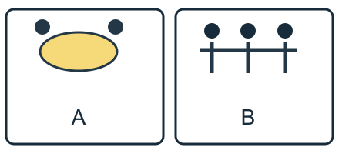
Arrival quiz
Which sketch shows a shared meal?
Picture A
Picture B
Choose first. Check on the next slide.
Made by Matt

Slide 3
Arrival quiz · answer
Picture A
A shows a plate for a shared meal. B shows people together at prayer.
Right first time: count your first choice only. You may try again.
Made by Matt

Slide 4
Arrival quiz
How can service support belonging?
A. It can give someone a role in a group.
B. It makes every person feel the same.
Choose first. Check on the next slide.
Made by Matt

Slide 5
Arrival quiz · answer
A. It can give someone a role in a group.
Helping others can give a person a role. Experiences still vary.
Right first time: count your first choice only. You may try again.
Made by Matt

Slide 6
Arrival quiz
Can one profile speak for everyone?
A. Yes, always.
B. No, people have different experiences.
Choose first. Check on the next slide.
Made by Matt

Slide 7
Arrival quiz · answer
B. No, people have different experiences.
One profile shows one experience. It cannot speak for everyone.
Right first time: count your first choice only. You may try again.
Made by Matt

Slide 8
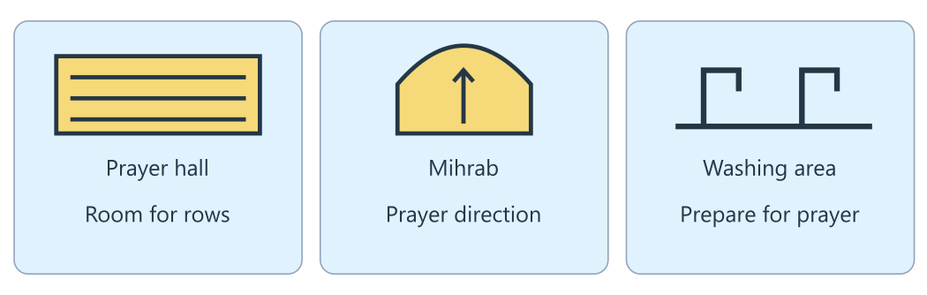
Arrival reference
The lesson diagram
Use this diagram for the four recall prompts.
Made by Matt

Slide 9
Arrival · Supported
Four recall prompts
1. Point to the prayer hall in the diagram.
2. Choose: a place of worship is a building or one feature?
3. Point to the mihrab and choose its job: direction or meals?
4. Can a mosque offer a shared meal as well as prayer?
Made by Matt

Slide 10
Arrival · Independent
Four recall prompts
1. Name a feature shown in the diagram.
2. What does place of worship mean?
3. Name one mosque feature and its purpose.
4. Is a place of worship used only for worship?
Made by Matt

Slide 11
Arrival · Aspire
Four recall prompts
1. Find two different features in the diagram.
2. How is a feature different from a place of worship?
3. What does a mihrab tell us about prayer?
4. What can a mosque offer besides worship, and what may vary?
Made by Matt

Slide 12
Starter
How can a faith group help people belong?
Link the feature to its purpose: the mihrab helps people face a set direction when they pray.
Made by Matt

Slide 13
Whole class
A feature and its job
Rule: follow the lights one step at a time.
1. Find the feature 2. Read its purpose 3. Link it to a practice 4. Check what may vary
Show one finger for a purpose that helps prayer, or two for a community use. Vote on a shared meal, then give a clue.
Made by Matt

Slide 14
I do
The worked model
Look at the mihrab: a niche in a mosque wall. A feature is one part of the building.
The mihrab shows the direction Muslims face for prayer. Its purpose is to show that direction.
Link the feature to its purpose: the mihrab helps people face a set direction when they pray.
Made by Matt

Slide 15
Word help
Words to use
place of worship: A building where people meet to worship.
feature: A part of a building with a job to do.
purpose: What something is for.
mihrab: A niche in a mosque wall that shows the direction for prayer.
Made by Matt

Slide 16
We do · hinge
Which claim fits the prayer hall and community-use notes?
A. A mosque can support worship and community use.
B. A mosque is used only for prayer.
C. A mosque is used only for shared meals.
Made by Matt

Slide 17
We do · hinge answer
A. A mosque can support worship and community use.
The prayer hall supports worship. Classes, food banks and shared meals are examples of community use. Activities vary between mosques.
Made by Matt

Slide 18
I do
Connect the evidence
The open prayer hall gives people room to pray in rows. The washing area supports preparation for prayer.
Wudu is washing in a set way before prayer. A washing area helps people carry out this practice.
Some mosques offer classes, food banks or shared meals. These are community uses as well as worship.
Made by Matt

Slide 19
I do
Connect the evidence · continued
Check a visitor tip: follow the host’s guidance about shoes and avoid interrupting worship. Mosque designs and activities vary.
Made by Matt

Slide 20
Team game
Describe, draw, compare
Rule: use the source, swap roles and explain a clue.
Work in four bands, with pairs in each band. One partner faces away from the diagram. The other describes a feature without saying its label. Draw it, then turn and compare. Swap roles. The teacher walks between bands and checks the clue. Stay seated or direct a partner if you prefer.
Made by Matt

Slide 21
Team game
How every band can score
Points: Earn 1 point for a matching feature and 1 point for an accurate purpose explained with a clue. Each band can score in every round. Repair and retry are welcome.
In your book: keep one clue and your own reason after the game.
Made by Matt

Slide 22
We do
Worship, community or incorrect?
Prayer hall: The open floor gives room to pray in rows. Check: The hall supports worship by providing space for prayer.
Mihrab: A niche shows the direction for prayer. Check: The mihrab helps people face a set direction during worship.
Washing area: People can prepare for prayer by washing. Check: The washing area supports wudu before prayer.
Made by Matt

Slide 23
We do
Worship, community or incorrect? · continued
Shared meal: A mosque may provide a meal for the community. Check: A shared meal is one example of community use.
Only prayer: Every mosque is used only for prayer. Check: Some mosques also offer classes, food or meals.
Same design: Every mosque has exactly the same design. Check: Mosques differ in size, design and activities.
Made by Matt

Slide 24
We do
Repair this claim
A mosque is used only for prayer.
A. Keep it.
B. Repair it using evidence and its limit.
Made by Matt

Slide 25
We do · answer
The repaired claim
A mosque supports worship and may also serve the community. Use the hall and shared-meal notes as two clues; activities vary.
Made by Matt

Slide 26
We do
Check five statements
The mihrab shows a direction for prayer. True: it helps Muslims face a set direction.
A feature is the whole faith community. False: a feature is one part of a building.
Every mosque looks the same. False: mosques differ in size and design.
Some mosques offer classes or meals. True: these are examples of community use.
A visitor should ignore the host’s guidance. False: following the host’s guidance helps show respect.
Made by Matt

Slide 27
You do
Your task
In your book: Make a visitor guide: identify mosque features, explain their purposes and give a respectful visitor tip. Use the diagram and reference notes.
Made by Matt

Slide 28
You do · Supported
Your route
In your book: Label two features in a sketch. Match each to its purpose. Use the word bank and frame: The ____ is for ____.
Made by Matt

Slide 29
Optional making · Supported
Make your thinking visible
Optional make it: fold two label-and-lift flaps. Put a feature on each flap and its purpose underneath.
In your book: keep the task response, a labelled sketch or your exact words explaining what it shows.
Made by Matt

Slide 30
You do · Independent
Your route
In your book: Make a visitor guide with three features, their purposes and one respectful tip. Check each link with the reference notes.
Made by Matt

Slide 31
Optional making · Independent
Make your thinking visible
Optional make it: fold a three-part paper visitor guide with a feature, purpose and respectful tip in each part.
In your book: keep the task response, a labelled sketch or your exact words explaining what it shows.
Made by Matt

Slide 32
You do · Aspire
Your route
In your book: Make a guide with three features and purposes. Link one feature to a practice. Explain why your visitor tip shows respect; note that mosques vary.
Made by Matt

Slide 33
Optional making · Aspire
Make your thinking visible
Optional make it: build a simple card feature model. Lift a label to explain its link to a practice and one limit.
In your book: keep the task response, a labelled sketch or your exact words explaining what it shows.
Made by Matt

Slide 34
You do · Choice
Your choice route
In your book: Point, draw, sign or tell an adult two features and their purposes. Give one visitor tip. Keep your own drawing or exact words in your book.
You may use the Supported making choice with your usual response mode.
Made by Matt

Slide 35
Reference notes
Evidence for your response
A · Prayer hall: Many prayer halls have open carpeted space for rows. Chairs or other changes can support access.
B · Mihrab and minbar: The mihrab is a niche showing prayer direction. The minbar is a raised platform used by the imam to give a talk.
C · Washing area: Many Muslims perform wudu before prayer. Follow the host’s guidance about shoes.
Made by Matt

Slide 36
Reference notes
Evidence for your response · continued
D · Community use: Some mosques offer classes, food banks or shared meals. The activities vary.
Made by Matt

Slide 37
Review and improve
One checked change
Check a label and purpose with an adult or chosen partner. Correct one detail and explain your tip.
Keep your first answer. Use feedback to improve one detail. Mark the edit // in the same colour on the same page.
In your book: explain what changed and why.
Made by Matt

Slide 38
Exit quiz
What does a mihrab show?
A. A direction for prayer.
B. A list of shared meals.
Choose first. Check on the next slide.
Made by Matt

Slide 39
Exit quiz · answer
A. A direction for prayer.
The mihrab shows a direction for prayer.
Right first time: count your first choice only. You may try again.
Made by Matt

Slide 40
Exit quiz
Can a mosque support community use?
A. No, never.
B. Yes, some offer classes or meals.
Choose first. Check on the next slide.
Made by Matt

Slide 41
Exit quiz · answer
B. Yes, some offer classes or meals.
Some offer classes, food or meals. Activities vary.
Right first time: count your first choice only. You may try again.
Made by Matt

Slide 42
Exit quiz
Which visitor tip shows respect?
A. Interrupt people at prayer.
B. Follow the host’s guidance.
Choose first. Check on the next slide.
Made by Matt

Slide 43
Exit quiz · answer
B. Follow the host’s guidance.
Following the host’s guidance helps a visitor show respect.
Right first time: count your first choice only. You may try again.
Made by Matt

Slide 44
Exit ticket
Your exit prompts
Supported: Name or point to one mosque feature and its job.
Independent: Name a mosque feature and explain its purpose.
Aspire: Use two clues to explain why a mosque may have more than one use.
Made by Matt

Slide 45
Staff / TA brief
Watch (staff preview first)
none suggested
Preview the activity and choose an accessible response mode. Keep cutting adult-prepared. The points board is for every band.
Keep a learner’s own reason in the book. Team points do not replace individual evidence.
Made by Matt

