Slide 1
GROW · RE
Big question: do beliefs make us who we are?
I can state a viewpoint about identity.
I can support it with a reason and example.
I can respond to another view respectfully.
Made by Matt

Slide 2
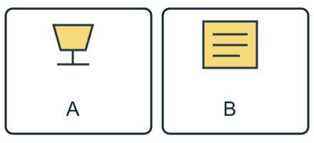
Arrival quiz
Which sketch shows a cup?
Picture A
Picture B
Choose first. Check on the next slide.
Made by Matt

Slide 3
Arrival quiz · answer
Picture A
A shows a cup shape. B shows a sheet with lines.
Right first time: count your first choice only. You may try again.
Made by Matt

Slide 4
Arrival quiz
What makes a description precise?
A. Naming a practice with an accurate detail.
B. Saying They do a thing.
Choose first. Check on the next slide.
Made by Matt

Slide 5
Arrival quiz · answer
A. Naming a practice with an accurate detail.
A named practice and accurate detail make the meaning clearer.
Right first time: count your first choice only. You may try again.
Made by Matt

Slide 6
Arrival quiz
Can practice vary within a faith?
A. No, never.
B. Yes.
Choose first. Check on the next slide.
Made by Matt

Slide 7
Arrival quiz · answer
B. Yes.
People within a faith may practise differently.
Right first time: count your first choice only. You may try again.
Made by Matt

Slide 8
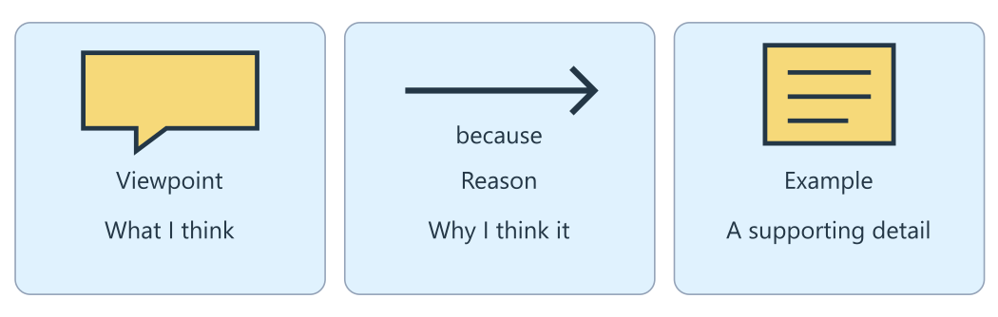
Arrival reference
The lesson diagram
Use this diagram for the four recall prompts.
Made by Matt

Slide 9
Arrival · Supported
Four recall prompts
1. Point to the viewpoint panel.
2. Choose: viewpoint means what someone thinks or a building?
3. Finish a respectful phrase: I see your point, but ____.
4. Can it depends be acceptable with a reason?
Made by Matt

Slide 10
Arrival · Independent
Four recall prompts
1. Find the reason in Beliefs matter because they guide choices.
2. What is a viewpoint?
3. Give a respectful discussion phrase.
4. Is it depends acceptable? Explain.
Made by Matt

Slide 11
Arrival · Aspire
Four recall prompts
1. Distinguish a viewpoint from its supporting reason.
2. Give a viewpoint about identity without sharing personal beliefs.
3. Give a respectful disagreement and its reason.
4. Why does it depends need more explanation?
Made by Matt

Slide 12
Starter
Can two people share a belief and still be different? Give a possible reason.
Model a reply: I see your point, but family can shape who we are too. This addresses the idea and offers a reason.
Made by Matt

Slide 13
Whole class
A viewpoint with a reason
Rule: follow the lights one step at a time.
1. State a viewpoint 2. Give a reason 3. Use an example 4. Hear another view
Use fingers to vote: 1 agree, 2 disagree, 3 depends. Vote on the big question, then give a reason from an example. You may pass.
Made by Matt

Slide 14
I do
The worked model
The big question is: Do beliefs make us who we are? A viewpoint says what a person thinks about that question.
One view is yes: beliefs can guide values and choices. Another view is that family, friends and place shape people too.
Model a reply: I see your point, but family can shape who we are too. This addresses the idea and offers a reason.
Made by Matt

Slide 15
Word help
Words to use
viewpoint: What a person thinks about a question
reason: Why you think something
evidence: An example or fact that supports a reason
depends: When the answer changes with the situation
Made by Matt

Slide 16
We do · hinge
Which reply disagrees with a reason and respects the speaker?
A. I see your point, but family can shape people too.
B. Your view is silly.
C. I disagree, just because.
Made by Matt

Slide 17
We do · hinge answer
A. I see your point, but family can shape people too.
The first reply addresses the idea and gives family as another influence. Calling a view silly or saying just because gives no useful reason.
Made by Matt

Slide 18
I do
Connect the evidence
A reason explains why you think something. An example helps support that reason.
Teaching example: a person’s belief in helping others guides a choice to share food. This illustrates one possible link, not every person’s identity.
A different reason is that two people with the same belief can be very different. Family and friends may also influence choices.
Made by Matt

Slide 19
I do
Connect the evidence · continued
You can answer it depends if you explain what it depends on. Discuss the idea without mocking the person; tone matters too.
Made by Matt

Slide 20
Team game
Human reason chain
Rule: use the source, swap roles and explain a clue.
Work in four bands. Choose cards for a viewpoint, reason, example and respectful reply. Volunteers stand in an order that makes sense, or arrange cards at a table. Explain the links. The teacher moves between bands and invites a different view. Swap roles without asking anyone to share a personal belief.
Made by Matt

Slide 21
Team game
How every band can score
Points: Earn 1 point for a clear link between viewpoint and reason, and 1 point for a relevant example or respectful reply. Every band can score. A different well-supported view earns the same points.
In your book: keep one clue and your own reason after the game.
Made by Matt

Slide 22
We do
Reason, invitation or repair?
Agree with a reason: I agree because beliefs can guide choices. Check: This gives a reason about the idea.
Disagree with a reason: I see your point, but friends can shape people too. Check: This offers another influence without mocking the person.
Depends with a reason: It depends, because people with the same belief can make different choices. Check: It depends is supported by a reason.
Made by Matt

Slide 23
We do
Reason, invitation or repair? · continued
Ask for evidence: Can you give an example of how a belief shapes a choice? Check: This invites the speaker to explain their reason.
Mock the view: Your view is silly. Check: Replace mockery with a reason about the claim.
No reason: I disagree, just because. Check: Add a clear reason and, if possible, an example.
Made by Matt

Slide 24
We do
Repair this claim
It depends is never an acceptable answer.
A. Keep it.
B. Repair it using evidence and its limit.
Made by Matt

Slide 25
We do · answer
The repaired claim
It depends is acceptable when you explain what changes with the situation and give a reason. More than one viewpoint can be well supported.
Made by Matt

Slide 26
We do
Check five statements
A viewpoint is what someone thinks about a question. True: it states a position on the big question.
Respectful disagreement means you must agree. False: you may disagree while addressing the idea with care.
It depends can never be a good answer. False: it can be good when supported by a reason.
An example can support a reason. True: it shows how the reason may apply.
Made by Matt

Slide 27
We do
Check five statements · continued
One example proves every person is the same. False: one example does not describe everyone.
Made by Matt

Slide 28
You do
Your task
In your book: Respond to Do beliefs make us who we are? Give a viewpoint, a reason and a supplied example. Address a different view respectfully.
Made by Matt

Slide 29
You do · Supported
Your route
In your book: Choose agree, disagree or depends on the big question. Match a reason. Finish: I think ____ because ____. Use one example note.
Made by Matt

Slide 30
Optional making · Supported
Make your thinking visible
Optional make it: make a two-flap card. Put a viewpoint on one flap and a matching reason underneath.
In your book: keep the task response, a labelled sketch or your exact words explaining what it shows.
Made by Matt

Slide 31
You do · Independent
Your route
In your book: State a viewpoint about the big question with a reason and an example. Use the supplied examples; keep personal beliefs private if you wish.
Made by Matt

Slide 32
Optional making · Independent
Make your thinking visible
Optional make it: make a four-frame viewpoint storyboard with a position, reason, example and respectful reply.
In your book: keep the task response, a labelled sketch or your exact words explaining what it shows.
Made by Matt

Slide 33
You do · Aspire
Your route
In your book: State a viewpoint, reason and example. Give the strongest reason against it. Reply respectfully and explain whether your viewpoint stays or changes.
Made by Matt

Slide 34
Optional making · Aspire
Make your thinking visible
Optional make it: make a two-sided argument card. Show the strongest reason for each view and a respectful response.
In your book: keep the task response, a labelled sketch or your exact words explaining what it shows.
Made by Matt

Slide 35
You do · Choice
Your choice route
In your book: Point, sign, speak, draw or write agree, disagree or depends with a reason. Choose an example and keep your own words or choices in the book.
You may use the Supported making choice with your usual response mode.
Made by Matt

Slide 36
Reference notes
Evidence for your response
A · The big question: Do beliefs make us who we are? More than one answer can have a good reason.
B · Agree: One view is that beliefs guide values and choices. Teaching example: belief in helping others leads a person to share food. This is an example, not a record of a real pupil.
C · Disagree or depends: Family, friends and place shape people too. Two people with the same belief can be very different.
Made by Matt

Slide 37
Reference notes
Evidence for your response · continued
D · Discussion phrases: I see your point, but… I agree because… It depends on… Can you give an example? Discuss the idea with a respectful tone.
Made by Matt

Slide 38
Review and improve
One checked change
Ask an adult or chosen partner to check your reason. Improve one phrase or explain why you kept it.
Keep your first answer. Use feedback to improve one detail. Mark the edit // in the same colour on the same page.
In your book: explain what changed and why.
Made by Matt

Slide 39
Exit quiz
What is a viewpoint?
A. What someone thinks about a question.
B. A fact that everyone must accept.
Choose first. Check on the next slide.
Made by Matt

Slide 40
Exit quiz · answer
A. What someone thinks about a question.
A viewpoint states what someone thinks about the question.
Right first time: count your first choice only. You may try again.
Made by Matt

Slide 41
Exit quiz
When can It depends be a good answer?
A. When it includes a clear reason.
B. Only when no reason is given.
Choose first. Check on the next slide.
Made by Matt

Slide 42
Exit quiz · answer
A. When it includes a clear reason.
Explain what the answer depends on and why.
Right first time: count your first choice only. You may try again.
Made by Matt

Slide 43
Exit quiz
Which reply disagrees respectfully?
A. Your view is silly.
B. I see your point, but family can shape people too.
Choose first. Check on the next slide.
Made by Matt

Slide 44
Exit quiz · answer
B. I see your point, but family can shape people too.
The second reply addresses the idea and gives a reason.
Right first time: count your first choice only. You may try again.
Made by Matt

Slide 45
Exit ticket
Your exit prompts
Supported: Give one phrase for disagreeing respectfully.
Independent: State a viewpoint about identity and give a reason.
Aspire: Explain a different viewpoint and respond respectfully with a reason.
Made by Matt

Slide 46
Staff / TA brief
Watch (staff preview first)
none suggested
Preview the activity and choose an accessible response mode. Keep cutting adult-prepared. The points board is for every band.
Keep a learner’s own reason in the book. Team points do not replace individual evidence.
Made by Matt

