Slide 1
GROW · RE
Questions for a faith or belief visitor
I can choose an open and respectful question.
I can record one thing learned from the source or visitor.
I can explain why one account cannot speak for everyone.
Made by Matt

Slide 2
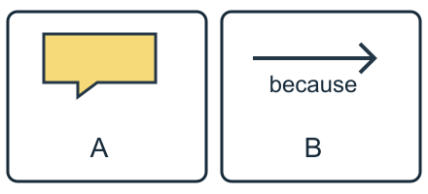
Arrival quiz
Which sketch shows a speech bubble?
Picture A
Picture B
Choose first. Check on the next slide.
Made by Matt

Slide 3
Arrival quiz · answer
Picture A
A has a speech bubble with a tail. B has an arrow.
Right first time: count your first choice only. You may try again.
Made by Matt

Slide 4
Arrival quiz
Which reply gives a respectful reason?
A. I see your point, but friends matter too.
B. Your view is silly.
Choose first. Check on the next slide.
Made by Matt

Slide 5
Arrival quiz · answer
A. I see your point, but friends matter too.
The first reply adds a reason without mocking the speaker.
Right first time: count your first choice only. You may try again.
Made by Matt

Slide 6
Arrival quiz
Must two people with the same belief be identical?
A. Yes.
B. No.
Choose first. Check on the next slide.
Made by Matt

Slide 7
Arrival quiz · answer
B. No.
People with the same belief can have different experiences and choices.
Right first time: count your first choice only. You may try again.
Made by Matt

Slide 8
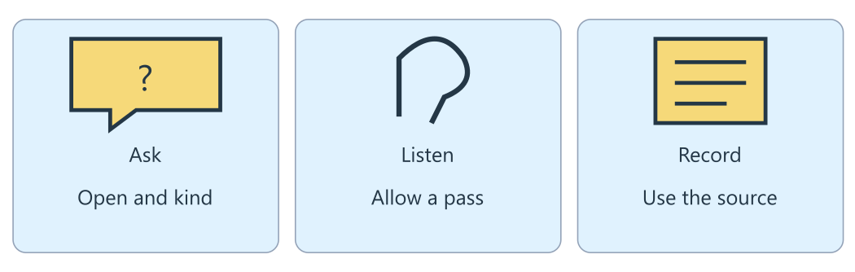
Arrival reference
The lesson diagram
Use this diagram for the four recall prompts.
Made by Matt

Slide 9
Arrival · Supported
Four recall prompts
1. Point to Ask in the diagram.
2. Choose: lived experience means one person’s life or everyone’s identical life?
3. Finish a question: What does ____ mean to you?
4. Does one visitor speak for everyone?
Made by Matt

Slide 10
Arrival · Independent
Four recall prompts
1. Name a respectful action in the diagram.
2. What is lived experience?
3. Give one respectful open question stem.
4. Does one visitor speak for everyone in a worldview?
Made by Matt

Slide 11
Arrival · Aspire
Four recall prompts
1. Find the step where a boundary must be checked.
2. Explain lived experience without using a personal example.
3. Explain why to you improves a question.
4. What should you do if the source does not answer a follow-up?
Made by Matt

Slide 12
Starter
How can we ask a curious question while respecting someone’s right to pass?
Check the topic with an adult. The visitor may decline, and pupils may choose to listen. A boundary protects that choice.
Made by Matt

Slide 13
Whole class
A question we can learn from
Rule: follow the lights one step at a time.
1. Choose an open stem 2. Check the boundary 3. Listen or read 4. Record the source answer
Thumbs up for What does this practice mean to you? Thumbs sideways to ask for a change. Give a clue about openness and the right to pass.
Made by Matt

Slide 14
I do
The worked model
Start with What does this practice mean to you? It is open: it invites more than yes or no.
The words to you ask about one person’s lived experience. A respectful question is curious and kind.
Check the topic with an adult. The visitor may decline, and pupils may choose to listen. A boundary protects that choice.
Made by Matt

Slide 15
Word help
Words to use
lived experience: What life is really like for a person
respectful question: A question that is curious and kind
open question: A question that needs more than yes or no
boundary: A limit that keeps people comfortable and safe
Made by Matt

Slide 16
We do · hinge
Which question should an adult approve for a visitor?
A. What does this practice mean to you?
B. Why do you lot do that?
C. What does every person in your worldview think?
Made by Matt

Slide 17
We do · hinge answer
A. What does this practice mean to you?
What does this practice mean to you? is open and asks about the visitor’s own experience. The other questions stereotype or ask one person to speak for everyone.
Made by Matt

Slide 18
I do
Connect the evidence
Questions can explore belief, practice or community: what matters to you, what do you do, or who do you share it with?
Use the supplied ceremony summary when there is no visitor. It explains that a Humanist naming ceremony welcomes a child.
Record only what the source supports: families may shape a ceremony with a tree planting or poem. Do not invent an answer to a follow-up.
Made by Matt

Slide 19
I do
Connect the evidence · continued
Write unanswered if the source does not tell you. A visitor speaks from their own experience, not for everyone in a worldview.
Made by Matt

Slide 20
Team game
Question and answer relay
Rule: use the source, swap roles and explain a clue.
Work in four bands, with pairs in each band. Pass a question card or point to it. One partner checks that it is open and kind. The other finds the supported answer in the ceremony summary. Swap. The teacher moves between bands and checks that no answer is invented. You may stay seated or choose a listening role.
Made by Matt

Slide 21
Team game
How every band can score
Points: Earn 1 point for an open respectful question and 1 point for a source-supported answer or an honest unanswered label. All bands can score. Respecting a pass earns the same check as a spoken reply.
In your book: keep one clue and your own reason after the game.
Made by Matt

Slide 22
We do
Open question, listening or repair?
Belief question: What matters most to you in your worldview? Check: This asks about one person’s beliefs; agree the topic first.
Practice question: What does your usual practice look like for you? Check: This open question invites a personal account without claiming everyone is the same.
Community question: Who do you share a celebration with? Check: This explores community; the visitor can choose what to share.
Made by Matt

Slide 23
We do
Open question, listening or repair? · continued
Allow a pass: Thank you. You do not have to answer that question. Check: Respectful listening includes accepting a boundary.
Stereotype: Why do you lot do that? Check: Replace you lot with an open question about this person’s experience.
Speak for all: Tell us what everyone in your worldview thinks. Check: One visitor cannot speak for everyone in a worldview.
Made by Matt

Slide 24
We do
Repair this claim
One visitor speaks for everyone who shares their worldview.
A. Keep it.
B. Repair it using evidence and its limit.
Made by Matt

Slide 25
We do · answer
The repaired claim
A visitor speaks from their own lived experience. Others may think or practise differently. Record what this source supports and mark unanswered questions honestly.
Made by Matt

Slide 26
We do
Check five statements
An open question invites more than yes or no. True: What does this mean to you? invites explanation.
A visitor must answer every question. False: the visitor can decline any question.
One visitor speaks for a whole worldview. False: one account cannot represent everyone.
A source may leave a follow-up unanswered. True: mark it unanswered instead of inventing a reply.
Made by Matt

Slide 27
We do
Check five statements · continued
Pupils must share their personal beliefs. False: pupils may listen, pass or respond privately.
Made by Matt

Slide 28
You do
Your task
In your book: Choose or write a respectful question, read the supplied ceremony summary or listen to an approved visitor, and record one thing learned with its source.
Made by Matt

Slide 29
You do · Supported
Your route
In your book: Choose: What can a Humanist naming ceremony include? Read reference C. Complete: I learned that a family may ____ or ____. Use tree planting and poem.
Made by Matt

Slide 30
Optional making · Supported
Make your thinking visible
Optional make it: make a question flap. Put a supported ceremony detail under it using a word, symbol or exact scribed words.
In your book: keep the task response, a labelled sketch or your exact words explaining what it shows.
Made by Matt

Slide 31
You do · Independent
Your route
In your book: Write one respectful open question. Record a supported source answer and one thing learned. Use reference C or an approved visitor response. Say which source you used.
Made by Matt

Slide 32
Optional making · Independent
Make your thinking visible
Optional make it: make a four-frame question record: ask, source, answer and one thing learned.
In your book: keep the task response, a labelled sketch or your exact words explaining what it shows.
Made by Matt

Slide 33
You do · Aspire
Your route
In your book: Write an open question answered by reference C and a follow-up. Record the supported answer. Mark an unsupported follow-up unanswered; explain why experiences vary.
Made by Matt

Slide 34
Optional making · Aspire
Make your thinking visible
Optional make it: make a fold-out enquiry card with a supported answer, a follow-up flap and an unanswered label where needed.
In your book: keep the task response, a labelled sketch or your exact words explaining what it shows.
Made by Matt

Slide 35
You do · Choice
Your choice route
In your book: Point, sign, speak, draw or write one thing learned from reference C. Choose a question and record your own word, symbol or exact scribed response.
You may use the Supported making choice with your usual response mode.
Made by Matt

Slide 36
Reference notes
Evidence for your response
A · Good questions: What does your usual practice look like for you? Which festival means most to you, and why? Ask about the person’s own experience.
B · Boundaries: Agree topics with an adult and visitor first. The visitor can decline, pupils may listen, and no one speaks for a whole worldview.
Made by Matt

Slide 37
Reference notes
Evidence for your response · continued
C · Ceremony summary: A Humanist naming ceremony is a non-religious occasion welcoming a child. Families help shape it; possible elements include planting a tree or reading a poem. This adapted classroom summary does not identify a real person.
D · Three areas: Belief asks about what matters or what a person believes. Practice asks what they do. Community asks who they share it with. Some questions overlap.
Made by Matt

Slide 38
Review and improve
One checked change
Check the question’s tone and one recorded detail with an adult. Keep the visitor’s right to decline and the pupil’s right to listen.
Keep your first answer. Use feedback to improve one detail. Mark the edit // in the same colour on the same page.
In your book: explain what changed and why.
Made by Matt

Slide 39
Exit quiz
Which question is open and respectful?
A. What does this practice mean to you?
B. Why do you lot do that?
Choose first. Check on the next slide.
Made by Matt

Slide 40
Exit quiz · answer
A. What does this practice mean to you?
The first question is kind and asks about one person’s experience.
Right first time: count your first choice only. You may try again.
Made by Matt

Slide 41
Exit quiz
What if the source does not answer a follow-up?
A. Invent a likely reply.
B. Mark it unanswered.
Choose first. Check on the next slide.
Made by Matt

Slide 42
Exit quiz · answer
B. Mark it unanswered.
Mark it unanswered. Record only what the source supports.
Right first time: count your first choice only. You may try again.
Made by Matt

Slide 43
Exit quiz
Does one account speak for a whole worldview?
A. Yes.
B. No.
Choose first. Check on the next slide.
Made by Matt

Slide 44
Exit quiz · answer
B. No.
Experiences vary. One account cannot speak for everyone.
Right first time: count your first choice only. You may try again.
Made by Matt

Slide 45
Exit ticket
Your exit prompts
Supported: Give one respectful question stem.
Independent: Record one thing learned from the ceremony summary and name your source.
Aspire: Explain why one account cannot speak for everyone and identify an unanswered follow-up.
Made by Matt

Slide 46
Staff / TA brief
Watch (staff preview first)
none suggested
Preview the activity and choose an accessible response mode. Keep cutting adult-prepared. The points board is for every band.
Keep a learner’s own reason in the book. Team points do not replace individual evidence.
Made by Matt

