Slide 1

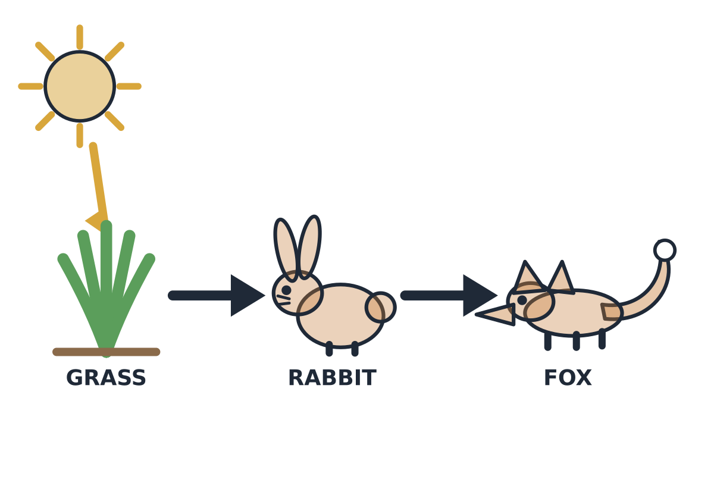
MADE BY MATT / BASE SCIENCE
Food-chain change investigation
Build it. Test the arrows. Explain a change.
I can use feeding clues to make and improve a prediction.
SCIENCE · BASE
01
Notes:
Workshop reference — 0 minutes within the source's 40-minute lesson.
Reference screen only; start the 32-minute workshop immediately. No additional starter or lesson time.

Slide 2
MADE BY MATT / BASE SCIENCE
Retrieve a chain and read one arrow
Find this lesson’s three-organism chain.
Follow one arrow from food to eater.
Use the feeding clue to check it.
SCIENCE · BASE
02
Notes:
Independent Work — retrieve — 4 minutes within the source's 40-minute lesson.
Four-minute source preparation. Grass → rabbit → fox. Explain food/energy passes to eater. Choose card mover, pointer, adult director or recorder. Keep models on table; no real organism collection.

Slide 3

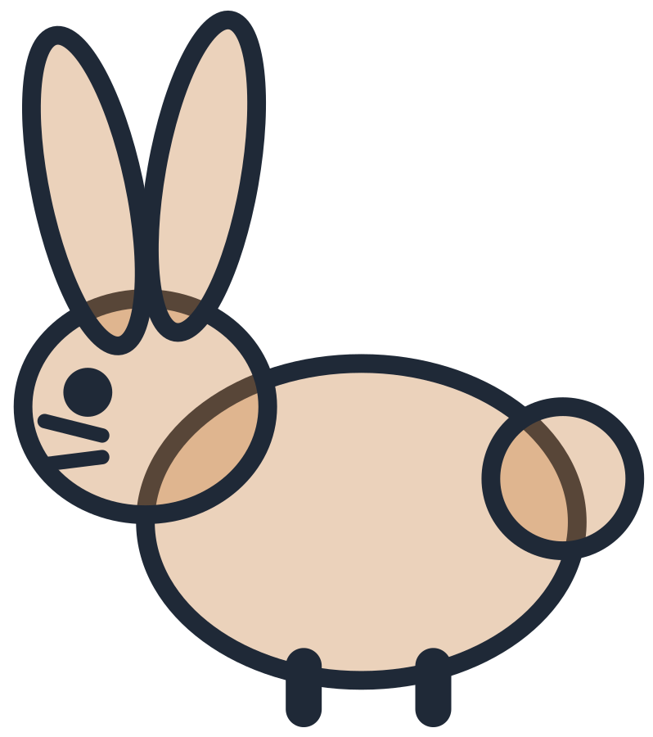
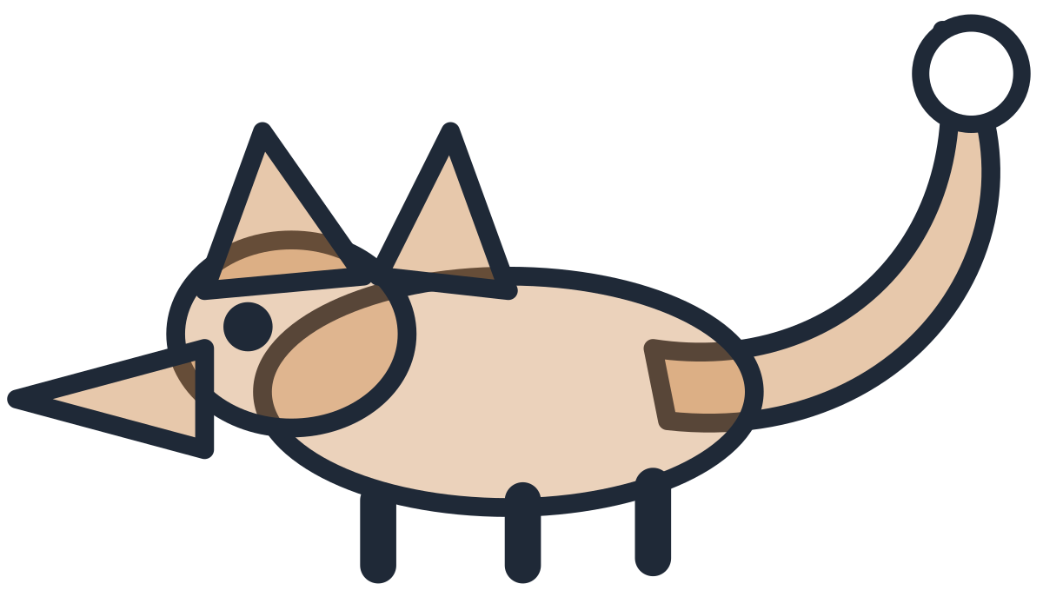
MADE BY MATT / BASE SCIENCE
Build the grass chain from evidence
A rabbit can eat grass.
A fox can eat a rabbit.
Place grass, rabbit, fox and two arrows.
Add producer and consumer labels.
SCIENCE · BASE
03
Notes:
Independent Work — investigate — 5 minutes within the source's 40-minute lesson.
First five minutes of source 20-minute investigation. Correct grass → rabbit → fox; grass producer, animals consumers. Every pupil uses evidence rather than simply remembering sequence. Alternative adult moves cards under pupil direction.

Slide 4

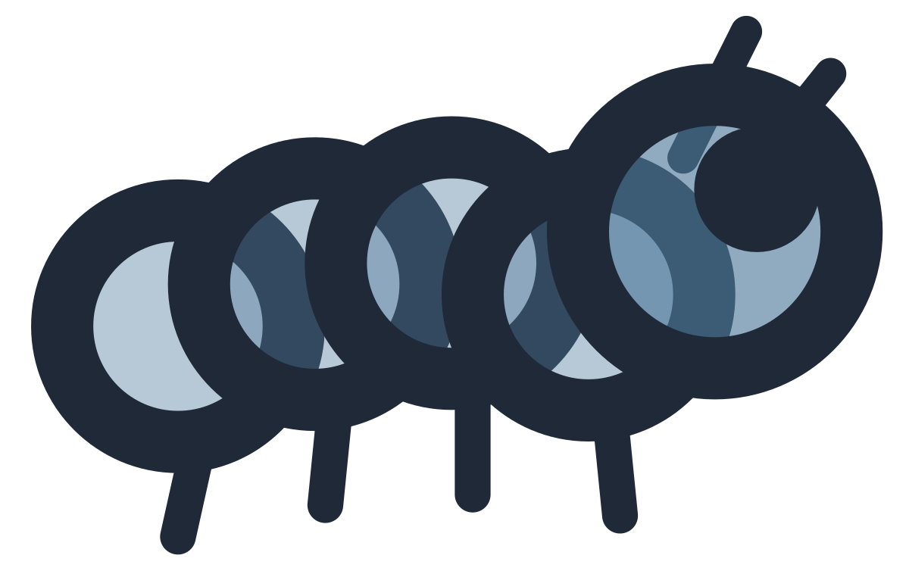
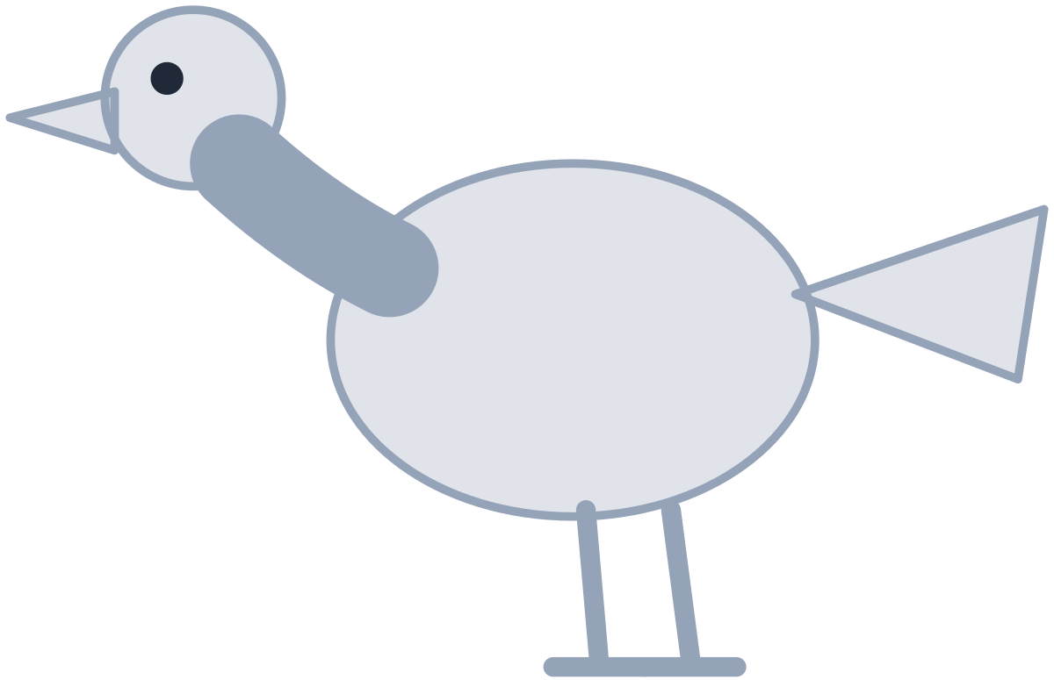
MADE BY MATT / BASE SCIENCE
Build the second chain
A caterpillar can eat leaves. A robin can eat a caterpillar.
leaves
caterpillar
robin
producer
consumer
consumer
The green plant is the producer in this model.
food / energy passes to the eater
SCIENCE · BASE
04
Notes:
Independent Work — investigate — 5 minutes within the source's 40-minute lesson.
Next five minutes. Leaves → caterpillar → robin. Leaves represent part of a green producer plant. Consumer labels apply caterpillar/robin. Diagram shows selected links only. Printed labels are original and remain usable without any online animation.

Slide 5
MADE BY MATT / BASE SCIENCE
Make an error, then repair it
Reverse one arrow deliberately.
Say what that wrong arrow would mean.
Read the feeding clue again.
Turn the arrow back and explain why.
SCIENCE · BASE
05
Notes:
Independent Work — investigate — 5 minutes within the source's 40-minute lesson.
Next five minutes. Example wrong robin → caterpillar would pass food from robin to caterpillar, conflicting with supplied clue robin eats caterpillar. Correct leaves → caterpillar → robin. No requirement to generate a novel biological counterexample.

Slide 6
MADE BY MATT / BASE SCIENCE
Cover the plant and predict
Cover the plant in one model chain.
Who may lose a food source first?
What could change for the next consumer?
Use might or could and give a reason.
SCIENCE · BASE
06
Notes:
Independent Work — investigate — 5 minutes within the source's 40-minute lesson.
Final five minutes of source 20-minute phase. Reduced plant resource may affect direct consumer, and indirectly later consumer. Model cannot predict exact survival/population counts; real organisms may use other food sources. Paper cover represents hypothetical reduced availability, not experimental data.

Slide 7
MADE BY MATT / BASE SCIENCE
Pause and test your explanation
Check one arrow against a feeding clue.
Check one prediction: what is the link?
Does the model show every food source?
SCIENCE · BASE
07
Notes:
Independent Work — check — 2 minutes within the source's 40-minute lesson.
Source two-minute check. Adult/partner optional; independent checking valid. A prediction should link food availability through a stated chain, not merely “everything dies”. Real food webs, conditions and time add uncertainty.

Slide 8
MADE BY MATT / BASE SCIENCE
Improve, save and clear the model
Put the chain back or revise it.
Improve one arrow reason or prediction.
State one limit of this simple model.
Save the record and put the cards away.
SCIENCE · BASE
08
Notes:
Independent Work — improve — 6 minutes within the source's 40-minute lesson.
Source final six-minute phase includes tidy. Record first and revised reasoning. A qualified conclusion can be “less grass may mean less food for rabbits; that could affect foxes, but they may eat other foods.” No pupil measurements or real ecological experiment claimed.

Slide 9
MADE BY MATT / BASE SCIENCE
Your voice can change the lesson
What helped you join in?
What could make the next activity easier?
Point, sign, speak, write or pass privately.
Adult: agree one change and explain any limit.
SCIENCE · BASE
09
Notes:
Feedback Loop — 4 minutes within the source's 40-minute lesson.
Four minutes within the source lesson. Receive an actual observation or access request; do not force a peer audience. Name what can change now, make the change where possible and check whether it helped. The adult receives and names back the science shown as well as access feedback.

Slide 10
MADE BY MATT / BASE SCIENCE
Read the evidence behind the chain
Supported: point from food to eater.
Independent: explain an indirect plant link.
Aspire: why can’t we predict exact numbers?
SCIENCE · BASE
10
Notes:
Exit Ticket — 4 minutes within the source's 40-minute lesson.
Supported can read grass → rabbit as grass is eaten by rabbit. Independent fox may be affected by grass via rabbits despite not directly eating the grass. Aspire model omits other foods, conditions, behaviour and time, so exact numbers unsupported. Adult receives explanation and records next step. Separate this topic enrichment/checkpoint remains outside this W3-7 pack.

