Slide 1
TITLE AND BIG QUESTION
1 / 12
Things I can do
Year A · Week 1 · 2–6 November 2026 · 40 minutes
How can a skill help with a job?
This helps me see how a skill can be useful at work.
Term theme: Identity & Belonging
CAREERS-BUILD-A2-W01
Public edition
Lesson resource · CC BY-NC-SA 4.0: free for classroom use, share and adapt with credit, no resale
Notes:
CAREERS-BUILD-A2-W01 · Year A · Week beginning 2 November 2026
Term theme: Identity & Belonging
Thread tags: SMSC S/So (M/C: none); British Values IL/MR (D/RL/T: none).
Title and big question: 0 minutes.
Teacher: Read the big question and careers line before the timed sequence.
Routes: Supported: choose from two skill cards, then sort three tokens with a model available. Independent: match three worker cards, sort six tokens and check both sets. Aspire: explain a second skill, or show how checking improves the first sort.
Evidence: A strength-to-task match and an individual observation of the practical task, including support used.
Careers: This helps me see how a skill can be useful at work.
Source: owner_orders/BUILD_Careers_Autumn2_YearA_outline; revision approved-2026-10-26.
Fictional worker illustration is an authored visual prompt, not evidence of a real employer or vacancy.
Week 7 is the assessing lesson.
Sources and limits: FACTS_LEDGER.md
Lesson resource · CC BY-NC-SA 4.0: free for classroom use, share and adapt with credit, no resale

Slide 2
ARRIVAL AND REGULATION
2 / 12 · 3 min
A calm start
Choose a calm place to sit.
Ask for a short pause if needed.
Keep the work space clear.
Ask for help with the words.
Use a point, a word or your aid.
Let each person have time.
CAREERS-BUILD-A2-W01
Public edition
Lesson resource · CC BY-NC-SA 4.0: free for classroom use, share and adapt with credit, no resale
Notes:
CAREERS-BUILD-A2-W01 · Year A · Week beginning 2 November 2026
Term theme: Identity & Belonging
Thread tags: SMSC S/So (M/C: none); British Values IL/MR (D/RL/T: none).
Arrival and regulation: 3 minutes.
Teacher: Offer a calm seat, usual communication aid and help choice. No personal disclosure is required.
Routes: Supported: choose from two skill cards, then sort three tokens with a model available. Independent: match three worker cards, sort six tokens and check both sets. Aspire: explain a second skill, or show how checking improves the first sort.
Evidence: A strength-to-task match and an individual observation of the practical task, including support used.
Careers: This helps me see how a skill can be useful at work.
Source: owner_orders/BUILD_Careers_Autumn2_YearA_outline; revision approved-2026-10-26.
Fictional worker illustration is an authored visual prompt, not evidence of a real employer or vacancy.
Week 7 is the assessing lesson.
Sources and limits: FACTS_LEDGER.md
Lesson resource · CC BY-NC-SA 4.0: free for classroom use, share and adapt with credit, no resale

Slide 3
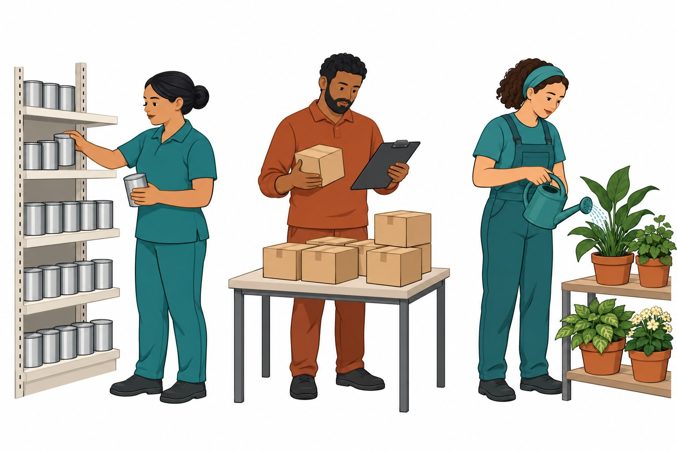
STARTER
3 / 12 · 3 min
Look at the workers
Look at each worker.
What task can you see?
Which one checks a list?
Point to a task.
CAREERS-BUILD-A2-W01
Public edition
Lesson resource · CC BY-NC-SA 4.0: free for classroom use, share and adapt with credit, no resale
Notes:
CAREERS-BUILD-A2-W01 · Year A · Week beginning 2 November 2026
Term theme: Identity & Belonging
Thread tags: SMSC S/So (M/C: none); British Values IL/MR (D/RL/T: none).
Starter: 3 minutes.
Teacher: Read the fictional role captions. Ask about the action, not the worker’s appearance. Accept pointing, speech or an aid.
Routes: Supported: choose from two skill cards, then sort three tokens with a model available. Independent: match three worker cards, sort six tokens and check both sets. Aspire: explain a second skill, or show how checking improves the first sort.
Evidence: A strength-to-task match and an individual observation of the practical task, including support used.
Careers: This helps me see how a skill can be useful at work.
Source: owner_orders/BUILD_Careers_Autumn2_YearA_outline; revision approved-2026-10-26.
Fictional worker illustration is an authored visual prompt, not evidence of a real employer or vacancy.
Week 7 is the assessing lesson.
Sources and limits: FACTS_LEDGER.md
Lesson resource · CC BY-NC-SA 4.0: free for classroom use, share and adapt with credit, no resale

Slide 4
TODAY
4 / 12
Today
Identify one strength and link it to a work task.
I can match a skill to a task.
I can sort and check the cards.
I can show one skill I used.
CAREERS-BUILD-A2-W01
Public edition
Lesson resource · CC BY-NC-SA 4.0: free for classroom use, share and adapt with credit, no resale
Notes:
CAREERS-BUILD-A2-W01 · Year A · Week beginning 2 November 2026
Term theme: Identity & Belonging
Thread tags: SMSC S/So (M/C: none); British Values IL/MR (D/RL/T: none).
Today: 0 minutes.
Teacher: Read the approved objective and three success checks. Explain any new word with a concrete action.
Routes: Supported: choose from two skill cards, then sort three tokens with a model available. Independent: match three worker cards, sort six tokens and check both sets. Aspire: explain a second skill, or show how checking improves the first sort.
Evidence: A strength-to-task match and an individual observation of the practical task, including support used.
Careers: This helps me see how a skill can be useful at work.
Source: owner_orders/BUILD_Careers_Autumn2_YearA_outline; revision approved-2026-10-26.
Fictional worker illustration is an authored visual prompt, not evidence of a real employer or vacancy.
Week 7 is the assessing lesson.
Sources and limits: FACTS_LEDGER.md
Lesson resource · CC BY-NC-SA 4.0: free for classroom use, share and adapt with credit, no resale

Slide 5
I DO
5 / 12 · 5 min
Watch the model
This made-up worker sorts tins.
The tins go in neat rows.
Sorting is a useful skill.
Now watch me sort these cards.
I put like shapes in a set.
I check each set to make sure.
Look at the task. Name the skill. Show it.
CAREERS-BUILD-A2-W01
Public edition
Lesson resource · CC BY-NC-SA 4.0: free for classroom use, share and adapt with credit, no resale
Notes:
CAREERS-BUILD-A2-W01 · Year A · Week beginning 2 November 2026
Term theme: Identity & Belonging
Thread tags: SMSC S/So (M/C: none); British Values IL/MR (D/RL/T: none).
I Do: 5 minutes.
Teacher: Model the six lines, using a separate token set or task card. Identify the stated fact that supports the match. Do not record the adult model as learner evidence.
Routes: Supported: choose from two skill cards, then sort three tokens with a model available. Independent: match three worker cards, sort six tokens and check both sets. Aspire: explain a second skill, or show how checking improves the first sort.
Evidence: A strength-to-task match and an individual observation of the practical task, including support used.
Careers: This helps me see how a skill can be useful at work.
Source: owner_orders/BUILD_Careers_Autumn2_YearA_outline; revision approved-2026-10-26.
Fictional worker illustration is an authored visual prompt, not evidence of a real employer or vacancy.
Week 7 is the assessing lesson.
Sources and limits: FACTS_LEDGER.md
Lesson resource · CC BY-NC-SA 4.0: free for classroom use, share and adapt with credit, no resale

Slide 6
WE DO
6 / 12 · 5 min
Which task fits
A worker checks boxes on a list. Which skill fits?
A Check.
B Run fast.
C Sing.
CAREERS-BUILD-A2-W01
Public edition
Lesson resource · CC BY-NC-SA 4.0: free for classroom use, share and adapt with credit, no resale
Notes:
CAREERS-BUILD-A2-W01 · Year A · Week beginning 2 November 2026
Term theme: Identity & Belonging
Thread tags: SMSC S/So (M/C: none); British Values IL/MR (D/RL/T: none).
We Do: 5 minutes.
Teacher: A: checking is supported by the stated action. Speed, neatness or confidence alone is not the target. Recheck using the helper card: ask which action shows helping. Accept another skill only when the learner links it to a stated action.
Routes: Supported: choose from two skill cards, then sort three tokens with a model available. Independent: match three worker cards, sort six tokens and check both sets. Aspire: explain a second skill, or show how checking improves the first sort.
Evidence: A strength-to-task match and an individual observation of the practical task, including support used.
Careers: This helps me see how a skill can be useful at work.
Source: owner_orders/BUILD_Careers_Autumn2_YearA_outline; revision approved-2026-10-26.
Fictional worker illustration is an authored visual prompt, not evidence of a real employer or vacancy.
Week 7 is the assessing lesson.
Sources and limits: FACTS_LEDGER.md
Lesson resource · CC BY-NC-SA 4.0: free for classroom use, share and adapt with credit, no resale

Slide 7
YOU DO PRACTICE
7 / 12 · 12 min
Try the task
Choose the help you need.
Supported: match one. Sort three.
Independent: match three. Sort six.
Aspire: show a second skill.
Check the sets. Show a skill you used.
CAREERS-BUILD-A2-W01
Public edition
Lesson resource · CC BY-NC-SA 4.0: free for classroom use, share and adapt with credit, no resale
Notes:
CAREERS-BUILD-A2-W01 · Year A · Week beginning 2 November 2026
Term theme: Identity & Belonging
Thread tags: SMSC S/So (M/C: none); British Values IL/MR (D/RL/T: none).
You Do practice: 12 minutes.
Teacher: Use four minutes to match worker cards to sort, check or help. Use five minutes for an individual shape sort: supported route uses three tokens; independent route uses all six. Use three minutes to check sets and identify one skill actually shown. Give one specific prompt and preserve the first result and changed response. A card match alone does not prove the practical skill.
Routes: Supported: choose from two skill cards, then sort three tokens with a model available. Independent: match three worker cards, sort six tokens and check both sets. Aspire: explain a second skill, or show how checking improves the first sort.
Evidence: A strength-to-task match and an individual observation of the practical task, including support used.
Careers: This helps me see how a skill can be useful at work.
Source: owner_orders/BUILD_Careers_Autumn2_YearA_outline; revision approved-2026-10-26.
Fictional worker illustration is an authored visual prompt, not evidence of a real employer or vacancy.
Week 7 is the assessing lesson.
Sources and limits: FACTS_LEDGER.md
Lesson resource · CC BY-NC-SA 4.0: free for classroom use, share and adapt with credit, no resale

Slide 8
YOU DO EVIDENCE
8 / 12 · 6 min
My work
Keep the match you made.
Show the sets you made.
Point to a skill used in the task.
Keep the first try and the change.
CAREERS-BUILD-A2-W01
Public edition
Lesson resource · CC BY-NC-SA 4.0: free for classroom use, share and adapt with credit, no resale
Notes:
CAREERS-BUILD-A2-W01 · Year A · Week beginning 2 November 2026
Term theme: Identity & Belonging
Thread tags: SMSC S/So (M/C: none); British Values IL/MR (D/RL/T: none).
You Do evidence: 6 minutes.
Teacher: Capture each learner’s actual match, reason and practical action as applicable. Record prompts and changed responses separately. Do not infer learning from a group answer.
Routes: Supported: choose from two skill cards, then sort three tokens with a model available. Independent: match three worker cards, sort six tokens and check both sets. Aspire: explain a second skill, or show how checking improves the first sort.
Evidence: A strength-to-task match and an individual observation of the practical task, including support used.
Careers: This helps me see how a skill can be useful at work.
Source: owner_orders/BUILD_Careers_Autumn2_YearA_outline; revision approved-2026-10-26.
Fictional worker illustration is an authored visual prompt, not evidence of a real employer or vacancy.
Week 7 is the assessing lesson.
Sources and limits: FACTS_LEDGER.md
Lesson resource · CC BY-NC-SA 4.0: free for classroom use, share and adapt with credit, no resale

Slide 9
TIDY AND EVIDENCE CHECK
9 / 12 · 4 min
Tidy and check
1
Check the code on both sheets.
2
Keep the work and note the help.
3
Put the cards away with care.
4
Tell the adult the next step.
CAREERS-BUILD-A2-W01
Public edition
Lesson resource · CC BY-NC-SA 4.0: free for classroom use, share and adapt with credit, no resale
Notes:
CAREERS-BUILD-A2-W01 · Year A · Week beginning 2 November 2026
Term theme: Identity & Belonging
Thread tags: SMSC S/So (M/C: none); British Values IL/MR (D/RL/T: none).
Tidy and evidence check: 4 minutes.
Teacher: Check learner IDs, actual work references and support. Store the evidence only when it exists; leave gaps visible.
Routes: Supported: choose from two skill cards, then sort three tokens with a model available. Independent: match three worker cards, sort six tokens and check both sets. Aspire: explain a second skill, or show how checking improves the first sort.
Evidence: A strength-to-task match and an individual observation of the practical task, including support used.
Careers: This helps me see how a skill can be useful at work.
Source: owner_orders/BUILD_Careers_Autumn2_YearA_outline; revision approved-2026-10-26.
Fictional worker illustration is an authored visual prompt, not evidence of a real employer or vacancy.
Week 7 is the assessing lesson.
Sources and limits: FACTS_LEDGER.md
Lesson resource · CC BY-NC-SA 4.0: free for classroom use, share and adapt with credit, no resale

Slide 10
EXIT TICKET
10 / 12 · 2 min
Exit task
Which skill did the task show?
How could it help at work?
What is the next step?
CAREERS-BUILD-A2-W01
Public edition
Lesson resource · CC BY-NC-SA 4.0: free for classroom use, share and adapt with credit, no resale
Notes:
CAREERS-BUILD-A2-W01 · Year A · Week beginning 2 November 2026
Term theme: Identity & Belonging
Thread tags: SMSC S/So (M/C: none); British Values IL/MR (D/RL/T: none).
Exit ticket: 2 minutes.
Teacher: Take an individual exit response. Agree one next teaching step, without requiring public speaking.
Routes: Supported: choose from two skill cards, then sort three tokens with a model available. Independent: match three worker cards, sort six tokens and check both sets. Aspire: explain a second skill, or show how checking improves the first sort.
Evidence: A strength-to-task match and an individual observation of the practical task, including support used.
Careers: This helps me see how a skill can be useful at work.
Source: owner_orders/BUILD_Careers_Autumn2_YearA_outline; revision approved-2026-10-26.
Fictional worker illustration is an authored visual prompt, not evidence of a real employer or vacancy.
Week 7 is the assessing lesson.
Sources and limits: FACTS_LEDGER.md
Lesson resource · CC BY-NC-SA 4.0: free for classroom use, share and adapt with credit, no resale

Slide 11
VOCABULARY
11 / 12
Words that help
Skill: Something you can do.
Check: Look to see if it is right.
Strength: A skill you do well.
Help: Give a hand with a task.
Job: Work a person does.
Task: A piece of work.
Sort: Put things in sets.
CAREERS-BUILD-A2-W01
Public edition
Lesson resource · CC BY-NC-SA 4.0: free for classroom use, share and adapt with credit, no resale
Notes:
CAREERS-BUILD-A2-W01 · Year A · Week beginning 2 November 2026
Term theme: Identity & Belonging
Thread tags: SMSC S/So (M/C: none); British Values IL/MR (D/RL/T: none).
Vocabulary: 0 minutes.
Teacher: Read and show each word with an action or concrete example. Keep the mat available.
Routes: Supported: choose from two skill cards, then sort three tokens with a model available. Independent: match three worker cards, sort six tokens and check both sets. Aspire: explain a second skill, or show how checking improves the first sort.
Evidence: A strength-to-task match and an individual observation of the practical task, including support used.
Careers: This helps me see how a skill can be useful at work.
Source: owner_orders/BUILD_Careers_Autumn2_YearA_outline; revision approved-2026-10-26.
Fictional worker illustration is an authored visual prompt, not evidence of a real employer or vacancy.
Week 7 is the assessing lesson.
Sources and limits: FACTS_LEDGER.md
Lesson resource · CC BY-NC-SA 4.0: free for classroom use, share and adapt with credit, no resale

Slide 12
STAFF BRIEF
12 / 12
Staff brief
Read the planner and support route.
Use only fictional roles and settings.
Scribe exact words; record help.
Keep each learner’s own evidence.
Week 7 is the assessing lesson.
CAREERS-BUILD-A2-W01
Public edition
Lesson resource · CC BY-NC-SA 4.0: free for classroom use, share and adapt with credit, no resale
Notes:
CAREERS-BUILD-A2-W01 · Year A · Week beginning 2 November 2026
Term theme: Identity & Belonging
Thread tags: SMSC S/So (M/C: none); British Values IL/MR (D/RL/T: none).
Staff brief: 0 minutes.
Teacher: All worker profiles, job roles, employers and settings are fictional. Use only the supplied classroom tasks; no real employers, applications or personal contact details. No names are required. Do not ask about family, body or private experiences. Respect a choice to pause or respond privately. No forced pair work or public performance. Follow the setting’s safeguarding route if a concern is raised.
Routes: Supported: choose from two skill cards, then sort three tokens with a model available. Independent: match three worker cards, sort six tokens and check both sets. Aspire: explain a second skill, or show how checking improves the first sort.
Evidence: A strength-to-task match and an individual observation of the practical task, including support used.
Careers: This helps me see how a skill can be useful at work.
Source: owner_orders/BUILD_Careers_Autumn2_YearA_outline; revision approved-2026-10-26.
Fictional worker illustration is an authored visual prompt, not evidence of a real employer or vacancy.
Week 7 is the assessing lesson.
Sources and limits: FACTS_LEDGER.md
Lesson resource · CC BY-NC-SA 4.0: free for classroom use, share and adapt with credit, no resale

