Slide 1
TITLE AND BIG QUESTION
1 / 12
People who care
Year A · Week 1 · 2–6 November 2026 · 40 minutes
A young person needs help. Who could help? What could they do?
This helps me recognise respectful support from people I learn or work with.
Term theme: Identity & Belonging
RSHE-BUILD-A2-W01
Public edition
Lesson resource · CC BY-NC-SA 4.0: free for classroom use, share and adapt with credit, no resale
Notes:
RSHE-BUILD-A2-W01 · Year A · Week beginning 2 November 2026
Term theme: Identity & Belonging
Thread tags: SMSC S/M/So (C: none); British Values IL/MR (D/RL/T: none).
Title and big question: 0 minutes.
Teacher: Read the big question and approved careers line as a statement, not an invitation to personal disclosure.
Routes: Supported: use two caring-action choices, then make a support map with two supplied role cards and reading or scribing support. Independent: match three caring actions and build the fictional support map, giving one reason from a card. Aspire: explain why a helpful action respects choice and add a second help route if the first adult is unavailable.
Evidence: A caring-action match and a fictional support map, with the learner’s explanation and support recorded.
Careers: This helps me recognise respectful support from people I learn or work with.
Source: owner_orders/BUILD_RSHE_Autumn2_YearA_outline; revision approved-2026-10-26.
Fictional illustration supports the story; appearance is not proof of a feeling or a safe relationship.
Week 7 is the assessing lesson.
Sources and limits: FACTS_LEDGER.md
Lesson resource · CC BY-NC-SA 4.0: free for classroom use, share and adapt with credit, no resale

Slide 2
ARRIVAL AND REGULATION
2 / 12 · 3 min
A calm start
These stories are all made up.
No one needs to share a real story.
A young person can ask for a pause.
A young person can use an aid.
A young person can pass on a question.
Each person can have time.
RSHE-BUILD-A2-W01
Public edition
Lesson resource · CC BY-NC-SA 4.0: free for classroom use, share and adapt with credit, no resale
Notes:
RSHE-BUILD-A2-W01 · Year A · Week beginning 2 November 2026
Term theme: Identity & Belonging
Thread tags: SMSC S/M/So (C: none); British Values IL/MR (D/RL/T: none).
Arrival and regulation: 3 minutes.
Teacher: Read the fictional-case boundary. Offer a pass, quiet response and usual aid without asking why.
Routes: Supported: use two caring-action choices, then make a support map with two supplied role cards and reading or scribing support. Independent: match three caring actions and build the fictional support map, giving one reason from a card. Aspire: explain why a helpful action respects choice and add a second help route if the first adult is unavailable.
Evidence: A caring-action match and a fictional support map, with the learner’s explanation and support recorded.
Careers: This helps me recognise respectful support from people I learn or work with.
Source: owner_orders/BUILD_RSHE_Autumn2_YearA_outline; revision approved-2026-10-26.
Fictional illustration supports the story; appearance is not proof of a feeling or a safe relationship.
Week 7 is the assessing lesson.
Sources and limits: FACTS_LEDGER.md
Lesson resource · CC BY-NC-SA 4.0: free for classroom use, share and adapt with credit, no resale

Slide 3
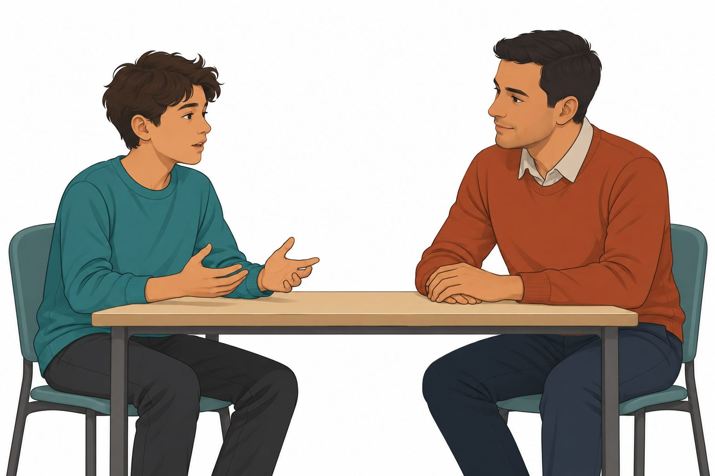
STARTER
3 / 12 · 3 min
The young person’s story
The young person has a worry.
The adult gives them time to talk.
What does the adult do to help?
Which act shows care?
RSHE-BUILD-A2-W01
Public edition
Lesson resource · CC BY-NC-SA 4.0: free for classroom use, share and adapt with credit, no resale
Notes:
RSHE-BUILD-A2-W01 · Year A · Week beginning 2 November 2026
Term theme: Identity & Belonging
Thread tags: SMSC S/M/So (C: none); British Values IL/MR (D/RL/T: none).
Starter: 3 minutes.
Teacher: Read the four fictional family cards on Support Cards page 1 and the pictured story. Ask which stated acts show care. Families can look different. Do not invite comparisons with learners’ own families or infer care from a person’s appearance.
Routes: Supported: use two caring-action choices, then make a support map with two supplied role cards and reading or scribing support. Independent: match three caring actions and build the fictional support map, giving one reason from a card. Aspire: explain why a helpful action respects choice and add a second help route if the first adult is unavailable.
Evidence: A caring-action match and a fictional support map, with the learner’s explanation and support recorded.
Careers: This helps me recognise respectful support from people I learn or work with.
Source: owner_orders/BUILD_RSHE_Autumn2_YearA_outline; revision approved-2026-10-26.
Fictional illustration supports the story; appearance is not proof of a feeling or a safe relationship.
Week 7 is the assessing lesson.
Sources and limits: FACTS_LEDGER.md
Lesson resource · CC BY-NC-SA 4.0: free for classroom use, share and adapt with credit, no resale

Slide 4
TODAY
4 / 12
Today
Spot a caring act that helps a young person.
Match a caring act to a need.
Show who could help the young person.
Give a reason from the story.
RSHE-BUILD-A2-W01
Public edition
Lesson resource · CC BY-NC-SA 4.0: free for classroom use, share and adapt with credit, no resale
Notes:
RSHE-BUILD-A2-W01 · Year A · Week beginning 2 November 2026
Term theme: Identity & Belonging
Thread tags: SMSC S/M/So (C: none); British Values IL/MR (D/RL/T: none).
Today: 0 minutes.
Teacher: Read the accessible objective and checks. Keep the exact approved objective in the Planner.
Routes: Supported: use two caring-action choices, then make a support map with two supplied role cards and reading or scribing support. Independent: match three caring actions and build the fictional support map, giving one reason from a card. Aspire: explain why a helpful action respects choice and add a second help route if the first adult is unavailable.
Evidence: A caring-action match and a fictional support map, with the learner’s explanation and support recorded.
Careers: This helps me recognise respectful support from people I learn or work with.
Source: owner_orders/BUILD_RSHE_Autumn2_YearA_outline; revision approved-2026-10-26.
Fictional illustration supports the story; appearance is not proof of a feeling or a safe relationship.
Week 7 is the assessing lesson.
Sources and limits: FACTS_LEDGER.md
Lesson resource · CC BY-NC-SA 4.0: free for classroom use, share and adapt with credit, no resale

Slide 5
I DO
5 / 12 · 5 min
A helpful response
A young person needs help with a task.
A tutor listens to their question.
The tutor shows one small step.
This act can show care.
The young person can ask once more.
The tutor checks what help is wanted.
The story gives the facts. Look for the act of care.
RSHE-BUILD-A2-W01
Public edition
Lesson resource · CC BY-NC-SA 4.0: free for classroom use, share and adapt with credit, no resale
Notes:
RSHE-BUILD-A2-W01 · Year A · Week beginning 2 November 2026
Term theme: Identity & Belonging
Thread tags: SMSC S/M/So (C: none); British Values IL/MR (D/RL/T: none).
I Do: 5 minutes.
Teacher: Model only the fictional case using a separate set. The adult model is not learner evidence.
Routes: Supported: use two caring-action choices, then make a support map with two supplied role cards and reading or scribing support. Independent: match three caring actions and build the fictional support map, giving one reason from a card. Aspire: explain why a helpful action respects choice and add a second help route if the first adult is unavailable.
Evidence: A caring-action match and a fictional support map, with the learner’s explanation and support recorded.
Careers: This helps me recognise respectful support from people I learn or work with.
Source: owner_orders/BUILD_RSHE_Autumn2_YearA_outline; revision approved-2026-10-26.
Fictional illustration supports the story; appearance is not proof of a feeling or a safe relationship.
Week 7 is the assessing lesson.
Sources and limits: FACTS_LEDGER.md
Lesson resource · CC BY-NC-SA 4.0: free for classroom use, share and adapt with credit, no resale

Slide 6
WE DO
6 / 12 · 5 min
A choice for the young person
A young person asks for help. Which act shows care?
A Listen and ask what help is needed.
B Laugh at the young person.
C Make the choice for them each time.
RSHE-BUILD-A2-W01
Public edition
Lesson resource · CC BY-NC-SA 4.0: free for classroom use, share and adapt with credit, no resale
Notes:
RSHE-BUILD-A2-W01 · Year A · Week beginning 2 November 2026
Term theme: Identity & Belonging
Thread tags: SMSC S/M/So (C: none); British Values IL/MR (D/RL/T: none).
We Do: 5 minutes.
Teacher: A is supported by the caring action. B is unkind. C removes choice rather than checking what help is wanted. An adult’s role alone does not prove that an action is caring. Reteach with the card about waiting while a person speaks; ask what that action allows.
Routes: Supported: use two caring-action choices, then make a support map with two supplied role cards and reading or scribing support. Independent: match three caring actions and build the fictional support map, giving one reason from a card. Aspire: explain why a helpful action respects choice and add a second help route if the first adult is unavailable.
Evidence: A caring-action match and a fictional support map, with the learner’s explanation and support recorded.
Careers: This helps me recognise respectful support from people I learn or work with.
Source: owner_orders/BUILD_RSHE_Autumn2_YearA_outline; revision approved-2026-10-26.
Fictional illustration supports the story; appearance is not proof of a feeling or a safe relationship.
Week 7 is the assessing lesson.
Sources and limits: FACTS_LEDGER.md
Lesson resource · CC BY-NC-SA 4.0: free for classroom use, share and adapt with credit, no resale

Slide 7
YOU DO PRACTICE
7 / 12 · 12 min
The story task
The task is about the made-up young person.
Supported: match one act. Make a map.
Independent: match three. Make a map.
Aspire: add a second way to get help.
What makes the chosen act caring?
RSHE-BUILD-A2-W01
Public edition
Lesson resource · CC BY-NC-SA 4.0: free for classroom use, share and adapt with credit, no resale
Notes:
RSHE-BUILD-A2-W01 · Year A · Week beginning 2 November 2026
Term theme: Identity & Belonging
Thread tags: SMSC S/M/So (C: none); British Values IL/MR (D/RL/T: none).
You Do practice: 12 minutes.
Teacher: Use four minutes to match caring actions to fictional situations. Use five minutes to make a support map for the supplied young person using the tutor and support-adult cards. Use three minutes to explain one caring action and consider the next help route if the first adult is busy. Preserve the first response and any prompted change.
Routes: Supported: use two caring-action choices, then make a support map with two supplied role cards and reading or scribing support. Independent: match three caring actions and build the fictional support map, giving one reason from a card. Aspire: explain why a helpful action respects choice and add a second help route if the first adult is unavailable.
Evidence: A caring-action match and a fictional support map, with the learner’s explanation and support recorded.
Careers: This helps me recognise respectful support from people I learn or work with.
Source: owner_orders/BUILD_RSHE_Autumn2_YearA_outline; revision approved-2026-10-26.
Fictional illustration supports the story; appearance is not proof of a feeling or a safe relationship.
Week 7 is the assessing lesson.
Sources and limits: FACTS_LEDGER.md
Lesson resource · CC BY-NC-SA 4.0: free for classroom use, share and adapt with credit, no resale

Slide 8
YOU DO EVIDENCE
8 / 12 · 6 min
The story record
Keep one care match for the young person.
Keep the map of who could help.
Keep the reason from the story.
The adult notes the help used.
RSHE-BUILD-A2-W01
Public edition
Lesson resource · CC BY-NC-SA 4.0: free for classroom use, share and adapt with credit, no resale
Notes:
RSHE-BUILD-A2-W01 · Year A · Week beginning 2 November 2026
Term theme: Identity & Belonging
Thread tags: SMSC S/M/So (C: none); British Values IL/MR (D/RL/T: none).
You Do evidence: 6 minutes.
Teacher: Record the actual case response, explanation and support. Do not infer understanding from a group answer.
Routes: Supported: use two caring-action choices, then make a support map with two supplied role cards and reading or scribing support. Independent: match three caring actions and build the fictional support map, giving one reason from a card. Aspire: explain why a helpful action respects choice and add a second help route if the first adult is unavailable.
Evidence: A caring-action match and a fictional support map, with the learner’s explanation and support recorded.
Careers: This helps me recognise respectful support from people I learn or work with.
Source: owner_orders/BUILD_RSHE_Autumn2_YearA_outline; revision approved-2026-10-26.
Fictional illustration supports the story; appearance is not proof of a feeling or a safe relationship.
Week 7 is the assessing lesson.
Sources and limits: FACTS_LEDGER.md
Lesson resource · CC BY-NC-SA 4.0: free for classroom use, share and adapt with credit, no resale

Slide 9
TIDY AND EVIDENCE CHECK
9 / 12 · 4 min
Tidy and check
1
Keep the work about the made-up person.
2
Keep each story and its response together.
3
The adult notes the help and any change.
4
Which next step could help the person?
RSHE-BUILD-A2-W01
Public edition
Lesson resource · CC BY-NC-SA 4.0: free for classroom use, share and adapt with credit, no resale
Notes:
RSHE-BUILD-A2-W01 · Year A · Week beginning 2 November 2026
Term theme: Identity & Belonging
Thread tags: SMSC S/M/So (C: none); British Values IL/MR (D/RL/T: none).
Tidy and evidence check: 4 minutes.
Teacher: Check the case references and learner ID. Keep prompts and changed responses distinct.
Routes: Supported: use two caring-action choices, then make a support map with two supplied role cards and reading or scribing support. Independent: match three caring actions and build the fictional support map, giving one reason from a card. Aspire: explain why a helpful action respects choice and add a second help route if the first adult is unavailable.
Evidence: A caring-action match and a fictional support map, with the learner’s explanation and support recorded.
Careers: This helps me recognise respectful support from people I learn or work with.
Source: owner_orders/BUILD_RSHE_Autumn2_YearA_outline; revision approved-2026-10-26.
Fictional illustration supports the story; appearance is not proof of a feeling or a safe relationship.
Week 7 is the assessing lesson.
Sources and limits: FACTS_LEDGER.md
Lesson resource · CC BY-NC-SA 4.0: free for classroom use, share and adapt with credit, no resale

Slide 10
EXIT TICKET
10 / 12 · 2 min
Exit task
Which act shows care for the young person?
Who could help with the task?
What could happen if that adult is busy?
RSHE-BUILD-A2-W01
Public edition
Lesson resource · CC BY-NC-SA 4.0: free for classroom use, share and adapt with credit, no resale
Notes:
RSHE-BUILD-A2-W01 · Year A · Week beginning 2 November 2026
Term theme: Identity & Belonging
Thread tags: SMSC S/M/So (C: none); British Values IL/MR (D/RL/T: none).
Exit ticket: 2 minutes.
Teacher: Use the three questions about the fictional young person. Agree a next teaching step.
Routes: Supported: use two caring-action choices, then make a support map with two supplied role cards and reading or scribing support. Independent: match three caring actions and build the fictional support map, giving one reason from a card. Aspire: explain why a helpful action respects choice and add a second help route if the first adult is unavailable.
Evidence: A caring-action match and a fictional support map, with the learner’s explanation and support recorded.
Careers: This helps me recognise respectful support from people I learn or work with.
Source: owner_orders/BUILD_RSHE_Autumn2_YearA_outline; revision approved-2026-10-26.
Fictional illustration supports the story; appearance is not proof of a feeling or a safe relationship.
Week 7 is the assessing lesson.
Sources and limits: FACTS_LEDGER.md
Lesson resource · CC BY-NC-SA 4.0: free for classroom use, share and adapt with credit, no resale

Slide 11
VOCABULARY
11 / 12
Words that help
Care: Help keep a person safe and well.
Trust: Feel able to ask a person for help.
Family: People linked by care or birth.
Support: Help a person with a need.
Respect: Treat a person with care.
Listen: Hear what a person has to say.
Choice: An option a person can pick.
RSHE-BUILD-A2-W01
Public edition
Lesson resource · CC BY-NC-SA 4.0: free for classroom use, share and adapt with credit, no resale
Notes:
RSHE-BUILD-A2-W01 · Year A · Week beginning 2 November 2026
Term theme: Identity & Belonging
Thread tags: SMSC S/M/So (C: none); British Values IL/MR (D/RL/T: none).
Vocabulary: 0 minutes.
Teacher: Explain each word through the supplied fictional story. No personal examples or body checks.
Routes: Supported: use two caring-action choices, then make a support map with two supplied role cards and reading or scribing support. Independent: match three caring actions and build the fictional support map, giving one reason from a card. Aspire: explain why a helpful action respects choice and add a second help route if the first adult is unavailable.
Evidence: A caring-action match and a fictional support map, with the learner’s explanation and support recorded.
Careers: This helps me recognise respectful support from people I learn or work with.
Source: owner_orders/BUILD_RSHE_Autumn2_YearA_outline; revision approved-2026-10-26.
Fictional illustration supports the story; appearance is not proof of a feeling or a safe relationship.
Week 7 is the assessing lesson.
Sources and limits: FACTS_LEDGER.md
Lesson resource · CC BY-NC-SA 4.0: free for classroom use, share and adapt with credit, no resale

Slide 12
STAFF BRIEF
12 / 12
Staff brief
Read the planner and support route.
Use only fictional young people and settings.
Scribe exact words; record help.
Keep each learner’s own evidence.
Week 7 is the assessing lesson.
RSHE-BUILD-A2-W01
Public edition
Lesson resource · CC BY-NC-SA 4.0: free for classroom use, share and adapt with credit, no resale
Notes:
RSHE-BUILD-A2-W01 · Year A · Week beginning 2 November 2026
Term theme: Identity & Belonging
Thread tags: SMSC S/M/So (C: none); British Values IL/MR (D/RL/T: none).
Staff brief: 0 minutes.
Teacher: Every teaching prompt concerns a fictional young person. Never ask learners about their own bodies, families or experiences, or use a real person as the case. Read fictional cards without inviting comparison with home. No touching, body checking, forced eye contact, acting out distress or personal role-play. Allow a pass, quiet response or pause. If a learner raises a personal concern, follow the setting’s safeguarding procedure; do not turn the disclosure into lesson evidence. Staff use the setting’s agreed support arrangements.
Routes: Supported: use two caring-action choices, then make a support map with two supplied role cards and reading or scribing support. Independent: match three caring actions and build the fictional support map, giving one reason from a card. Aspire: explain why a helpful action respects choice and add a second help route if the first adult is unavailable.
Evidence: A caring-action match and a fictional support map, with the learner’s explanation and support recorded.
Careers: This helps me recognise respectful support from people I learn or work with.
Source: owner_orders/BUILD_RSHE_Autumn2_YearA_outline; revision approved-2026-10-26.
Fictional illustration supports the story; appearance is not proof of a feeling or a safe relationship.
Week 7 is the assessing lesson.
Sources and limits: FACTS_LEDGER.md
Lesson resource · CC BY-NC-SA 4.0: free for classroom use, share and adapt with credit, no resale

