Slide 1
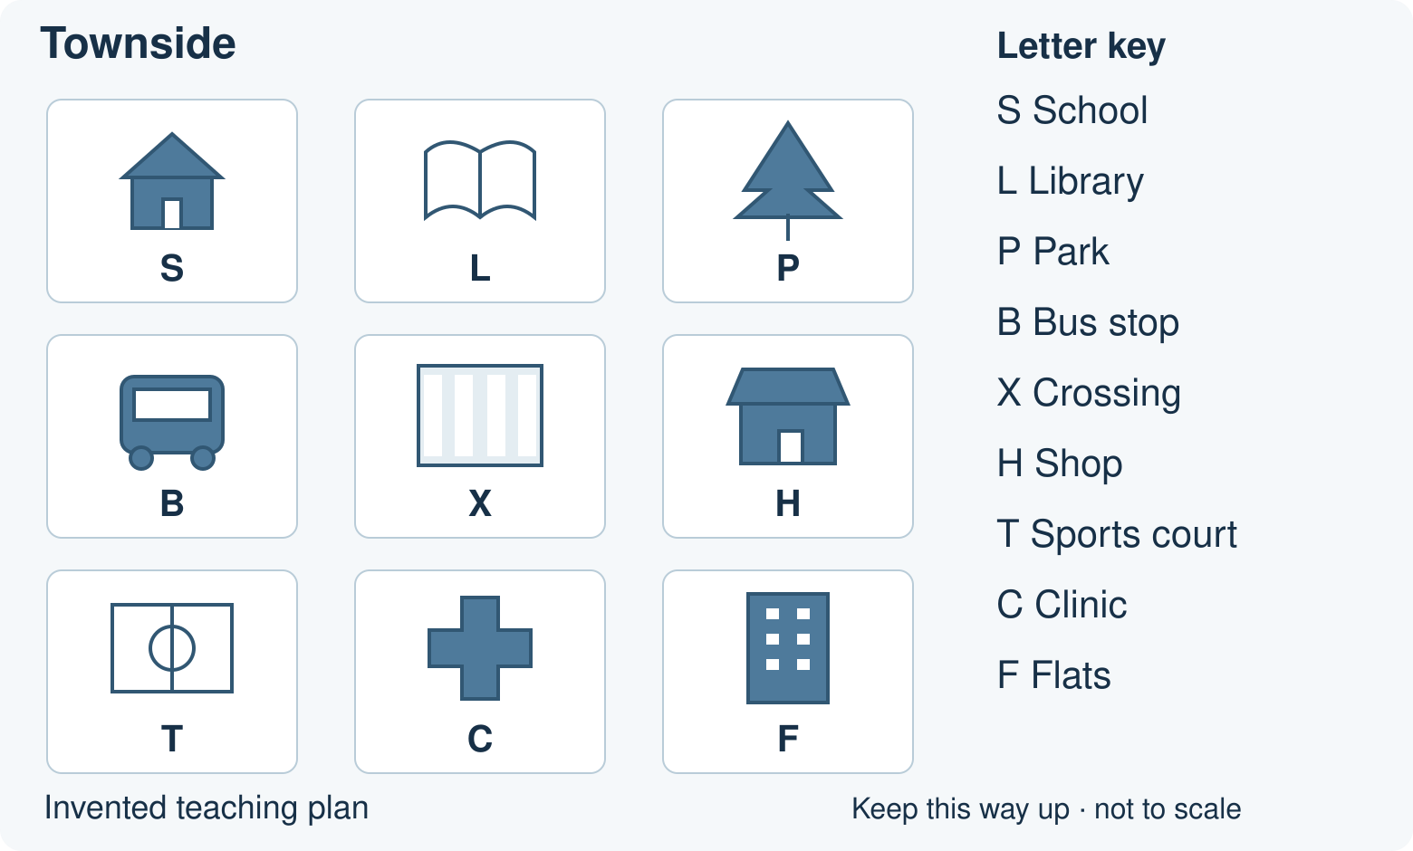
BUILD HUMANITIES SUMMER 1 WEEK 1
Our school and local features
Name and locate my school and local features.
How can we help a visitor find a place?
Point, speak, draw, type or write.
Opening · 40-minute lesson
1
Notes:
Prepare the school plan and chosen route. No prior lesson is assumed. Offer a quiet first attempt and a choice of response mode.
Outcome: Name and locate my school and local features.
Assessment: F: map check plus one independent location question.
Source: Humanities Scheme of Work 2026–27, BUILD Summer 1 Week 1. Townside is an original invented teaching plan. Use a teacher-supplied checked plan for the real-school task.

Slide 2
BUILD HUMANITIES SUMMER 1 WEEK 1
Arrival: a quick map check
1. Where is the school on the plan?
2. What does L in the key mean?
3. Which place is to the right of the library?
4. Which place is directly below the school?
Use your chosen arrival sheet. Ask for one step at a time.
Arrival · 4 minutes
2
Notes:
Use the route pages from the pupil resources. Supported: Point to the school picture. Answer: The school is in the top-left square.
Which picture shows a park? Answer: The tree picture shows the park.
Point to the place beside the school on its right. Answer: That place is the library.
Find B in the key. What place does it mark? Answer: B marks the bus stop.
Standard: The school is in the top-left square.; L means the library.; The park is to the right of the library.; The bus stop is directly below the school.
Stretch: Locate the school without using a place name. Answer: The school is in the top-left square.
Why is a key useful to a visitor? Answer: A key explains what the map symbols mean.
From the school, move two squares right. Where are you? Answer: Two squares right takes you to the park.
Is the library nearer to the school than the park on this plan? Answer: On this plan the library is nearer: one square rather than two.
Outcome: Name and locate my school and local features.
Assessment: F: map check plus one independent location question.
Source: Humanities Scheme of Work 2026–27, BUILD Summer 1 Week 1. Townside is an original invented teaching plan. Use a teacher-supplied checked plan for the real-school task.

Slide 3
BUILD HUMANITIES SUMMER 1 WEEK 1
Mystery place
I have shelves of books.
You can borrow one.
Which place am I?
Point to a picture. Say which clue helped.
Starter · 3 minutes
3
Notes:
Answer: library. If a pupil guesses, ask which clue helped. Offer two pictures, then repeat with a different clue.
Outcome: Name and locate my school and local features.
Assessment: F: map check plus one independent location question.
Source: Humanities Scheme of Work 2026–27, BUILD Summer 1 Week 1. Townside is an original invented teaching plan. Use a teacher-supplied checked plan for the real-school task.

Slide 4
BUILD HUMANITIES SUMMER 1 WEEK 1
The worked map method
1. Where is the library on the Townside plan?
2. The key says L is the library. Find the open-book picture.
3. From the school, move one square right. You reach the library.
4. Point to S, then L. Keep the plan the same way up.
I do · 6 minutes
4
Notes:
Question: Where is the library on the Townside plan?
Evidence: The key says L is the library. Find the open-book picture.
Explain: From the school, move one square right. You reach the library.
Check: Point to S, then L. Keep the plan the same way up.
Use the matching 36-second captioned video or the four manual steps in the HTML. Pause between steps.
Outcome: Name and locate my school and local features.
Assessment: F: map check plus one independent location question.
Source: Humanities Scheme of Work 2026–27, BUILD Summer 1 Week 1. Townside is an original invented teaching plan. Use a teacher-supplied checked plan for the real-school task.

Slide 5
BUILD HUMANITIES SUMMER 1 WEEK 1
Clue to place
1. I want to borrow a book.
2. I need a place to wait for a bus.
3. I want an open green space.
4. I have an appointment with a nurse.
Choose a place. Explain one match with the picture key.
We do · 7 minutes
5
Notes:
Run one card at a time in the HTML or use the paper clue hunt. Answers: L: Library. The open-book picture and L identify the library.
B: Bus stop. The bus picture and B identify the bus stop.
P: Park. The tree picture and P identify the park.
C: Clinic. The cross picture and C identify the clinic.
One partner suggests. The other checks a picture. Swap after one turn.
Outcome: Name and locate my school and local features.
Assessment: F: map check plus one independent location question.
Source: Humanities Scheme of Work 2026–27, BUILD Summer 1 Week 1. Townside is an original invented teaching plan. Use a teacher-supplied checked plan for the real-school task.

Slide 6
BUILD HUMANITIES SUMMER 1 WEEK 1
Repair the visitor note
“The library is to the left
of the school.”
Check the plan.
Change one word.
Check · 2 minutes
6
Notes:
Answer: Change left to right. Keep the plan the same way up. Invite the pupil to trace from S to L and then repair the note in their own response.
Outcome: Name and locate my school and local features.
Assessment: F: map check plus one independent location question.
Source: Humanities Scheme of Work 2026–27, BUILD Summer 1 Week 1. Townside is an original invented teaching plan. Use a teacher-supplied checked plan for the real-school task.

Slide 7
BUILD HUMANITIES SUMMER 1 WEEK 1
Our real school: your route
Supported
Standard
Stretch
1. Choose the school label from two labels on your teacher’s plan.
2. Point to the school. Name it or show its label.
3. Find one local feature, then try a second with less help.
1. Name and mark the school on your teacher’s plan.
2. Circle two local features. Name each one.
3. Tell or write where one feature is in relation to the school.
1. Locate and label the school and three local features.
2. Choose one feature that a visitor might need.
3. Describe a short route from the school to that feature.
4. Check each turn. Explain how the key helped.
Use the plan and task sheet your teacher gives you.
Independent · 12 minutes
7
Notes:
Choose one route. Use the teacher-supplied checked school plan. Keep the same outcome across routes. Fade content prompts before the final independent location question.
Outcome: Name and locate my school and local features.
Assessment: F: map check plus one independent location question.
Source: Humanities Scheme of Work 2026–27, BUILD Summer 1 Week 1. Townside is an original invented teaching plan. Use a teacher-supplied checked plan for the real-school task.

Slide 8
BUILD HUMANITIES SUMMER 1 WEEK 1
Review and improve
Find the school on your plan.
Check a local feature and its label.
Improve one response after feedback.
What changed? Show or tell your teacher.
Review · 3 minutes
8
Notes:
Hear the pupil response. Identify one precise improvement. Let them make it. Check whether it helped, then choose the next step from their new response.
Outcome: Name and locate my school and local features.
Assessment: F: map check plus one independent location question.
Source: Humanities Scheme of Work 2026–27, BUILD Summer 1 Week 1. Townside is an original invented teaching plan. Use a teacher-supplied checked plan for the real-school task.

Slide 9
BUILD HUMANITIES SUMMER 1 WEEK 1
Two final checks
1. Name and locate your school on the plan.
2. Where is one local feature in relation
to the school?
Give your own response. Point, speak, draw or write.
Exit · 3 minutes
9
Notes:
Use the chosen exit route. Responses depend on the supplied school plan. Check school name, location and one local feature. No content prompt for the independent location question. Record normal access support.
Supported and Stretch alternatives: Supported: Show your school on the teacher’s plan. Show one local feature without a content prompt.
Standard: Name and locate your school on the teacher’s plan. Where is one local feature in relation to the school?
Stretch: Locate your school and two local features on the teacher’s plan. Give a short route from the school to one feature.
Outcome: Name and locate my school and local features.
Assessment: F: map check plus one independent location question.
Source: Humanities Scheme of Work 2026–27, BUILD Summer 1 Week 1. Townside is an original invented teaching plan. Use a teacher-supplied checked plan for the real-school task.

Slide 10
BUILD HUMANITIES SUMMER 1 WEEK 1
Lesson vocabulary
local
Near the place we are talking about.
feature
Something in a place, such as a park or road.
map
A picture that shows where places are.
key
A guide to the symbols on a map.
Vocabulary reference
10
Notes:
Use the same definitions as the lesson and knowledge organiser. local: Near the place we are talking about.
feature: Something in a place, such as a park or road.
map: A picture that shows where places are.
key: A guide to the symbols on a map.

