Slide 1
LAUNCH CAREERS
1 / 12
Health and safety at work
Year A · Friday 15 January 2027 · P1 · 40 minutes
Our invented paper-pack workplace returns.
Theme: Resilience & Change
Notice a hazard, keep clear and report it.
CAREERS-LAUNCH-S1-W02
Public edition
Lesson resource · CC BY-NC-SA 4.0: free for classroom use, share and adapt with credit, no resale
Notes:
C89 exact Health & safety at work. Friday 15 January 2027 P1, pair, forty minutes formative. Same business/roles/order as Week 1. Pictured hazards only; no real spill, obstruction, climb, unstable stack or equipment demonstration. One short risk/control card each. W6 assessing.
Source: scheme_references/LAUNCH_SOW.xlsx, LAUNCH Weekly - Spring row 89 C89. Invented scenes A–D and simplified safety-sign teaching diagram in assets. No real person, employer, regulator or place. Lesson resource · CC BY-NC-SA 4.0: free for classroom use, share and adapt with credit, no resale

Slide 2
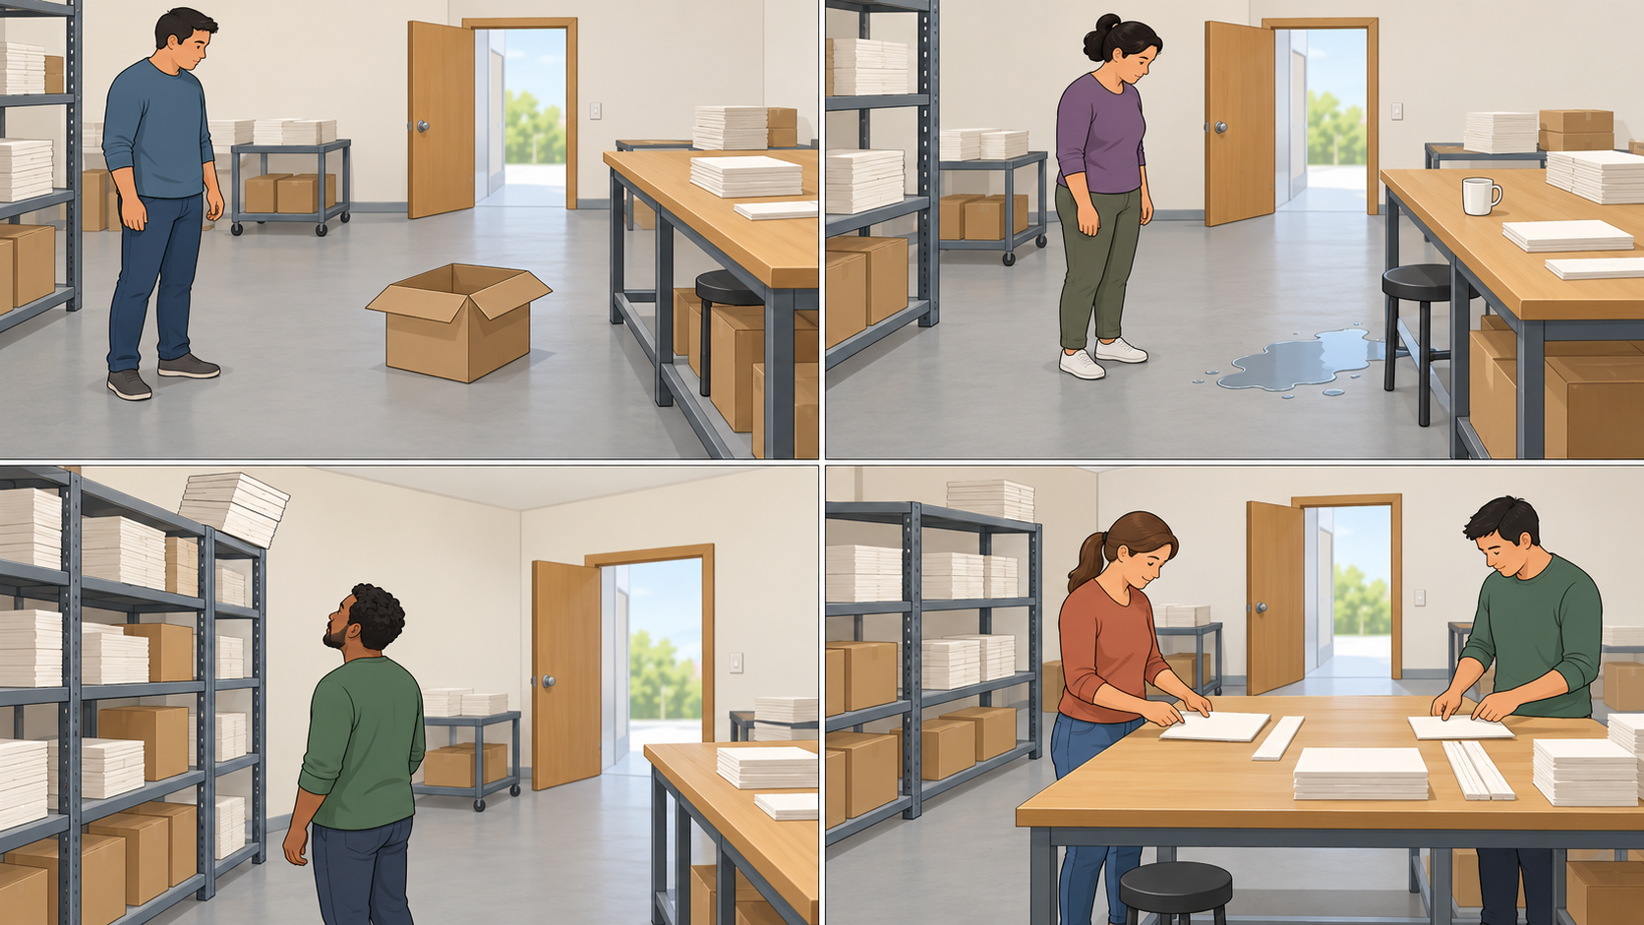
ARRIVAL AND RETRIEVAL
2 / 12 · 0–5 min
A first look at the room
What helped workers use this space?
Use the picture facts. Ask about what is unclear.
CAREERS-LAUNCH-S1-W02
Public edition
Lesson resource · CC BY-NC-SA 4.0: free for classroom use, share and adapt with credit, no resale
Notes:
Scene D controls: route appears clear, floor dry and work materials reachable/stable. Do not declare room risk-free or infer a real inspection. Retrieve Week 1 safety/help and clarification expectation. A pass or usual aid is available. All workers/scenes invented.
Source: scheme_references/LAUNCH_SOW.xlsx, LAUNCH Weekly - Spring row 89 C89. Invented scenes A–D and simplified safety-sign teaching diagram in assets. No real person, employer, regulator or place. Lesson resource · CC BY-NC-SA 4.0: free for classroom use, share and adapt with credit, no resale

Slide 3
I DO WORDS
3 / 12 · 5–9 min
Hazard risk and control
Health & safety at work.
A hazard is something that could cause harm.
Risk considers how likely and how serious harm could be.
A control is a step that reduces risk.
Keep clear of danger and tell the supervisor.
CAREERS-LAUNCH-S1-W02
Public edition
Lesson resource · CC BY-NC-SA 4.0: free for classroom use, share and adapt with credit, no resale
Notes:
Distinguish cause from possible harm. Use A box in route then trip/fall. Risk includes chance and severity; no numeric matrix requested. Do not invent a risk rating or say control removes every risk. Supervisor is played by an adult. Read difficult words with the Vocabulary Mat.
Source: scheme_references/LAUNCH_SOW.xlsx, LAUNCH Weekly - Spring row 89 C89. Invented scenes A–D and simplified safety-sign teaching diagram in assets. No real person, employer, regulator or place. Lesson resource · CC BY-NC-SA 4.0: free for classroom use, share and adapt with credit, no resale

Slide 4
I DO MODEL
4 / 12 · 9–13 min
Model A: the walking route
What is the hazard, and who could be harmed?
Keep clear. Report it. Supervisor arranges removal and a check.
CAREERS-LAUNCH-S1-W02
Public edition
Lesson resource · CC BY-NC-SA 4.0: free for classroom use, share and adapt with credit, no resale
Notes:
Scene A box in walkway is hazard; worker could trip/fall. Model message names what/where and possible harm, keeping clear, request for action. Do not ask learner to move a real box. Check box or fall names hazard? Key box. Keep model/words, fade only answer cues. Introduce four sign types on next slide.
Source: scheme_references/LAUNCH_SOW.xlsx, LAUNCH Weekly - Spring row 89 C89. Invented scenes A–D and simplified safety-sign teaching diagram in assets. No real person, employer, regulator or place. Lesson resource · CC BY-NC-SA 4.0: free for classroom use, share and adapt with credit, no resale

Slide 5
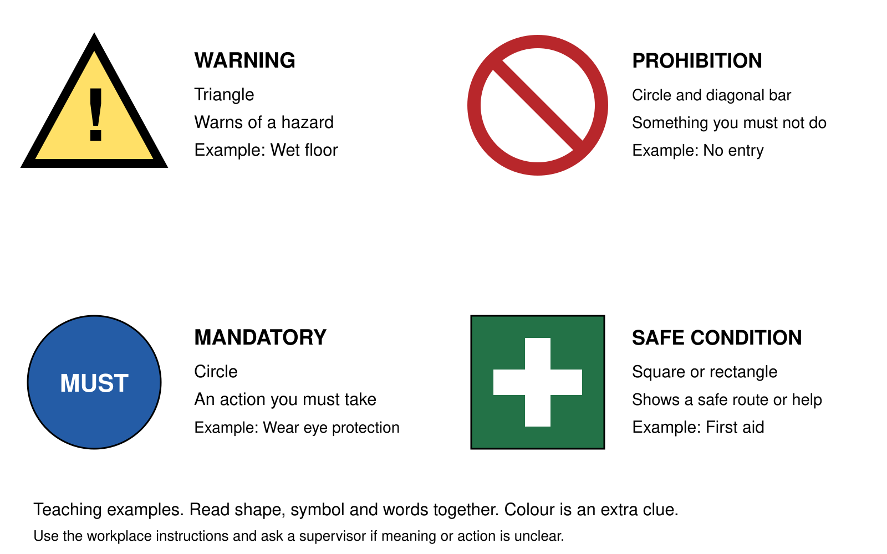
WE DO
5 / 12 · 13–19 min
Safety sign shapes and words
Warning triangle: warns of a hazard, such as a wet floor.
Prohibition circle with a bar: an action you must not do.
Mandatory circle: an action you must take.
Safe-condition square or rectangle: a safe route or help.
CAREERS-LAUNCH-S1-W02
Public edition
Lesson resource · CC BY-NC-SA 4.0: free for classroom use, share and adapt with credit, no resale
Notes:
Use shape, symbol and words; colour extra clue. Crop icons from declared teaching diagram, full meanings in editable text and Support Card 5. Examples no entry, wear eye protection and first aid. Simplified teaching categories, not installation artwork. No PPE trial. Compare A/D briefly and rehearse what/where/harm/report; adult acknowledges. Signs help communicate but do not replace controls.
Source: scheme_references/LAUNCH_SOW.xlsx, LAUNCH Weekly - Spring row 89 C89. Invented scenes A–D and simplified safety-sign teaching diagram in assets. No real person, employer, regulator or place. Lesson resource · CC BY-NC-SA 4.0: free for classroom use, share and adapt with credit, no resale

Slide 6
WE DO CHECK
6 / 12 · 19–23 min
A warning and a control
A wet-floor warning is in place. Is the spill dealt with?
A: the sign removes the spill.
B: it warns people; the spill still needs control and a check.
Choose privately. Keep your usual aid.
CAREERS-LAUNCH-S1-W02
Public edition
Lesson resource · CC BY-NC-SA 4.0: free for classroom use, share and adapt with credit, no resale
Notes:
Main B. Re-model warning versus dealing with cause. Parallel A pause and ask about unclear safety instruction, versus B guess and continue. Key A. Pass unobserved. Do not create real hazards; staff role-play supervisor and retain actual response/prompts.
Source: scheme_references/LAUNCH_SOW.xlsx, LAUNCH Weekly - Spring row 89 C89. Invented scenes A–D and simplified safety-sign teaching diagram in assets. No real person, employer, regulator or place. Lesson resource · CC BY-NC-SA 4.0: free for classroom use, share and adapt with credit, no resale

Slide 7
YOU DO
7 / 12 · 23–35 min
My risk and control card
Choose B or C with your tier pack. Keep your own card.
B: beside the table.
C: the high shelf.
Name hazard, possible harm, control and who to tell.
CAREERS-LAUNCH-S1-W02
Public edition
Lesson resource · CC BY-NC-SA 4.0: free for classroom use, share and adapt with credit, no resale
Notes:
Supported choices/frames/model; Standard linked explanation/report; Stretch compare warning/control and remaining risk. 23–27 prompt, 27–32 card, 32–35 brief report. Adult may partner privately. One card each. Do not copy model as independent evidence. Who/how harmed, who arranges control, immediate action and check/unknown retained.
Source: scheme_references/LAUNCH_SOW.xlsx, LAUNCH Weekly - Spring row 89 C89. Invented scenes A–D and simplified safety-sign teaching diagram in assets. No real person, employer, regulator or place. Lesson resource · CC BY-NC-SA 4.0: free for classroom use, share and adapt with credit, no resale

Slide 8
SAME TASK TIME
8 / 12 · 23–35 min
A clear report
“There is ... at ... .”
“Someone could ... .”
“I am keeping clear.”
“Please check it and arrange ... .”
Tell the supervisor, played by an adult.
Use voice, an aid, writing or a selected message.
CAREERS-LAUNCH-S1-W02
Public edition
Lesson resource · CC BY-NC-SA 4.0: free for classroom use, share and adapt with credit, no resale
Notes:
Alternative/support slide in same twelve-minute window. B spill beside table could cause slip/fall; C leaning packs could fall. Learner keeps clear and tells supervisor/adult; adult arranges appropriate control/check. If first adult unavailable, agreed route to another responsible adult. No real message sent to a workplace.
Source: scheme_references/LAUNCH_SOW.xlsx, LAUNCH Weekly - Spring row 89 C89. Invented scenes A–D and simplified safety-sign teaching diagram in assets. No real person, employer, regulator or place. Lesson resource · CC BY-NC-SA 4.0: free for classroom use, share and adapt with credit, no resale

Slide 9
REVIEW
9 / 12 · 35–38 min
Our private card check
Does my hazard explain what could cause harm?
Have I said who could be harmed and how?
Does the control fit, and who arranges it?
Is my report clear about what and where?
Keep first try, one next step and your reply.
CAREERS-LAUNCH-S1-W02
Public edition
Lesson resource · CC BY-NC-SA 4.0: free for classroom use, share and adapt with credit, no resale
Notes:
Check one individual card. Accept plausible visible alternatives explained from facts. Distinguish warning from actual control; no unsupported claim fixed/checked. One NS and reply. Normal aid separate from supplied answers. No public questioning or personal accident story.
Source: scheme_references/LAUNCH_SOW.xlsx, LAUNCH Weekly - Spring row 89 C89. Invented scenes A–D and simplified safety-sign teaching diagram in assets. No real person, employer, regulator or place. Lesson resource · CC BY-NC-SA 4.0: free for classroom use, share and adapt with credit, no resale

Slide 10
EXIT
10 / 12 · 38–40 min
Before work resumes
Who would I tell, and what would I say?
What would I do while waiting for action?
What still needs to be checked?
Save the individual card and report evidence.
The same invented workplace returns next week.
CAREERS-LAUNCH-S1-W02
Public edition
Lesson resource · CC BY-NC-SA 4.0: free for classroom use, share and adapt with credit, no resale
Notes:
E actual banked work; R after Voice, Audience, NS/reply in the same colour, on the same page or usual mode. Card includes hazard/place, who/how, control/role, report, immediate action and check/unknown. Offer Communication portfolio; staff confirm mapping. No real incident/inspection/compliance inference. W3 experiencing work then W4 instructions/teamwork, W5 customer service, W6 reflection.
Source: scheme_references/LAUNCH_SOW.xlsx, LAUNCH Weekly - Spring row 89 C89. Invented scenes A–D and simplified safety-sign teaching diagram in assets. No real person, employer, regulator or place. Lesson resource · CC BY-NC-SA 4.0: free for classroom use, share and adapt with credit, no resale

Slide 11
AVAILABLE THROUGHOUT
11 / 12
Help and a safe pause
Keep clear and tell the supervisor if a task seems unsafe.
Ask a trusted adult or use the school’s help route.
If one adult is busy, seek another through the route.
You may pass, pause and return with support.
No personal accident story is needed.
CAREERS-LAUNCH-S1-W02
Public edition
Lesson resource · CC BY-NC-SA 4.0: free for classroom use, share and adapt with credit, no resale
Notes:
Pictured task only. Real concerns follow school/workplace reporting and emergency procedures with adult support. No cleanup, moving hazards, climbing, catching stacks or equipment use by learners. Private help available; listen calmly, avoid probing/secrecy promises, follow usual procedure.
Source: scheme_references/LAUNCH_SOW.xlsx, LAUNCH Weekly - Spring row 89 C89. Invented scenes A–D and simplified safety-sign teaching diagram in assets. No real person, employer, regulator or place. Lesson resource · CC BY-NC-SA 4.0: free for classroom use, share and adapt with credit, no resale

Slide 12
STAFF ONLY
12 / 12
Staff reference
LAUNCH Weekly Spring row 89. C89 exact outcome.
Friday 15 January 2027. P1. A pair of learners.
Forty minutes. Formative. Week 6 assessing.
Supported, Standard and Stretch packs. Cover plan.
Evidence: one risk-and-control card and report each.
CAREERS-LAUNCH-S1-W02
Public edition
Lesson resource · CC BY-NC-SA 4.0: free for classroom use, share and adapt with credit, no resale
Notes:
Hidden staff slide. C89/B89 exact. Identifying inherited framework names generic. Scene and sign teaching examples authored. Business unchanged from accepted W1. No real employer, product, regulator or place. W3–W6 not authored; one per return after Downloaded. Further GROW Careers paused.
Source: scheme_references/LAUNCH_SOW.xlsx, LAUNCH Weekly - Spring row 89 C89. Invented scenes A–D and simplified safety-sign teaching diagram in assets. No real person, employer, regulator or place. Lesson resource · CC BY-NC-SA 4.0: free for classroom use, share and adapt with credit, no resale

