Slide 1
Old and new objects
Compare old and new objects.
BUILD / Humanities / Spring 1 / Week 2
Speak, point, draw, type or write.
BUILD Humanities Spring 1 W2 1
Notes:
F: comparison and caption.
Use one-step instructions, symbols and a model first. Offer talk, point, draw, type or write. Reduce the number of choices; extend by asking for a reason or a second example. Adults prompt the first response then fade support.
Use questioning and the exit response to decide the next step. Record the learner’s individual contribution and the access support used.

Slide 2
Arrival questions 1 and 2
1. Which comes first: Wednesday or Friday?
2. Which meaning fits past?
BUILD Humanities Spring 1 W2 2
Notes:
Previous lesson reminder:
Use the reminder strip or talk it through with an adult. Answer: Wednesday.
Choose: A time before now OR The time we are in now. Answer: A time before now

Slide 3
Arrival questions 3 and 4
3. What function do both phones share?
4. Does newer always mean better for everyone?
BUILD Humanities Spring 1 W2 3
Notes:
Use the model evidence anchor B or read one relevant card together. Answer: They allow a conversation over distance.
Give a reason when ready. Answer: No. Suitability depends on the user and purpose.

Slide 4
Words for this lesson
past
A time before now
present
The time we are in now
change
Something that becomes different
continuity
Something that stays the same
BUILD Humanities Spring 1 W2 4
Notes:
Read the words aloud. Offer a concrete example before asking for a definition.

Slide 5
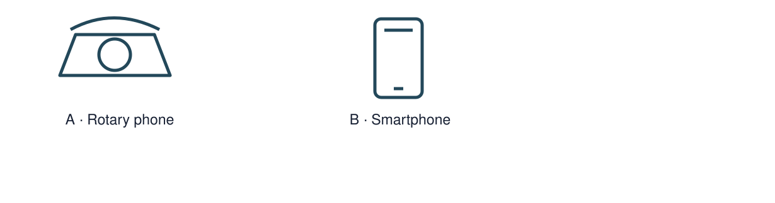
Starter
Pair-match a rotary telephone and smartphone.
Make a first choice. Explain what helped you decide.
Show two choices. Read one short instruction. Point, match or say a word, then add a reason when ready.
BUILD Humanities Spring 1 W2 5
Notes:
F: comparison and caption.
Use one-step instructions, symbols and a model first. Offer talk, point, draw, type or write. Reduce the number of choices; extend by asking for a reason or a second example. Adults prompt the first response then fade support.
Use questioning and the exit response to decide the next step. Record the learner’s individual contribution and the access support used.

Slide 6
Model question
Question: What function do both phones share?
BUILD Humanities Spring 1 W2 6
Notes:
Original captioned teaching model made for this pack. It demonstrates the supplied reasoning; it is not historical footage, survivor testimony or a documentary. The full transcript and factual source credits are included.
F: comparison and caption.
Use one-step instructions, symbols and a model first. Offer talk, point, draw, type or write. Reduce the number of choices; extend by asking for a reason or a second example. Adults prompt the first response then fade support.
Use questioning and the exit response to decide the next step. Record the learner’s individual contribution and the access support used.

Slide 7
Model evidence
Evidence: B Telephone comparison: A rotary telephone and a smartphone both support conversations over distance. A smartphone can also show a video call; a rotary dial selects numbers differently.
BUILD Humanities Spring 1 W2 7
Notes:
Original captioned teaching model made for this pack. It demonstrates the supplied reasoning; it is not historical footage, survivor testimony or a documentary. The full transcript and factual source credits are included.
F: comparison and caption.
Use one-step instructions, symbols and a model first. Offer talk, point, draw, type or write. Reduce the number of choices; extend by asking for a reason or a second example. Adults prompt the first response then fade support.
Use questioning and the exit response to decide the next step. Record the learner’s individual contribution and the access support used.

Slide 8
Model explanation
Think aloud: They allow a conversation over distance.
BUILD Humanities Spring 1 W2 8
Notes:
Original captioned teaching model made for this pack. It demonstrates the supplied reasoning; it is not historical footage, survivor testimony or a documentary. The full transcript and factual source credits are included.
F: comparison and caption.
Use one-step instructions, symbols and a model first. Offer talk, point, draw, type or write. Reduce the number of choices; extend by asking for a reason or a second example. Adults prompt the first response then fade support.
Use questioning and the exit response to decide the next step. Record the learner’s individual contribution and the access support used.

Slide 9
Model check
Check: Does newer always mean better for everyone? No. Suitability depends on the user and purpose.
BUILD Humanities Spring 1 W2 9
Notes:
Original captioned teaching model made for this pack. It demonstrates the supplied reasoning; it is not historical footage, survivor testimony or a documentary. The full transcript and factual source credits are included.
F: comparison and caption.
Use one-step instructions, symbols and a model first. Offer talk, point, draw, type or write. Reduce the number of choices; extend by asking for a reason or a second example. Adults prompt the first response then fade support.
Use questioning and the exit response to decide the next step. Record the learner’s individual contribution and the access support used.

Slide 10
We do
Pair-match a rotary telephone and smartphone.
Sort visible differences from functions they share.
Suggest a choice. Check the evidence together. Swap roles when ready.
BUILD Humanities Spring 1 W2 10
Notes:
Show two choices. Read one short instruction. Point, match or say a word, then add a reason when ready.
Pair-match a rotary telephone and smartphone. Say or show what helped you decide.
Explain why a different user might prefer one object for a particular purpose.
F: comparison and caption.
Use one-step instructions, symbols and a model first. Offer talk, point, draw, type or write. Reduce the number of choices; extend by asking for a reason or a second example. Adults prompt the first response then fade support.
Use questioning and the exit response to decide the next step. Record the learner’s individual contribution and the access support used.

Slide 11
Shared investigation record
Evidence from the first example
Evidence from the second example
One similarity
One difference or change
BUILD Humanities Spring 1 W2 11
Notes:
Use the visual or evidence appendix alongside this slide. Pair-match a rotary telephone and smartphone. Sort visible differences from functions they share.

Slide 12
Independent task supported
Make an object comparison card.
Record one change and one thing unchanged.
Add a caption based on a diagram or an object you can inspect.
BUILD Humanities Spring 1 W2 12
Notes:
Show two choices. Read one short instruction. Point, match or say a word, then add a reason when ready. Complete the organiser one space at a time. Both objects ___. One difference is ___.
An adult may read or scribe your exact response. They should not choose the answer.
F: comparison and caption.
Use one-step instructions, symbols and a model first. Offer talk, point, draw, type or write. Reduce the number of choices; extend by asking for a reason or a second example. Adults prompt the first response then fade support.
Use questioning and the exit response to decide the next step. Record the learner’s individual contribution and the access support used.

Slide 13
Independent task standard
Make an object comparison card.
Record one change and one thing unchanged.
Add a caption based on a diagram or an object you can inspect.
BUILD Humanities Spring 1 W2 13
Notes:
Both objects ___. One difference is ___.
Check the required evidence and revise one detail.
F: comparison and caption.
Use one-step instructions, symbols and a model first. Offer talk, point, draw, type or write. Reduce the number of choices; extend by asking for a reason or a second example. Adults prompt the first response then fade support.
Use questioning and the exit response to decide the next step. Record the learner’s individual contribution and the access support used.

Slide 14
Independent task stretch
Make an object comparison card.
Record one change and one thing unchanged.
Add a caption based on a diagram or an object you can inspect.
Explain why a different user might prefer one object for a particular purpose.
BUILD Humanities Spring 1 W2 14
Notes:
Choose the evidence independently. Use the frame only if it helps.
Explain why a different user might prefer one object for a particular purpose.
F: comparison and caption.
Use one-step instructions, symbols and a model first. Offer talk, point, draw, type or write. Reduce the number of choices; extend by asking for a reason or a second example. Adults prompt the first response then fade support.
Use questioning and the exit response to decide the next step. Record the learner’s individual contribution and the access support used.

Slide 15
Review and improve
Check the required evidence: comparison and caption.
Point to one part that meets the goal.
Improve one detail.
BUILD Humanities Spring 1 W2 15
Notes:
F: comparison and caption.
Use one-step instructions, symbols and a model first. Offer talk, point, draw, type or write. Reduce the number of choices; extend by asking for a reason or a second example. Adults prompt the first response then fade support.
Use questioning and the exit response to decide the next step. Record the learner’s individual contribution and the access support used.

Slide 16
Exit ticket
What function do both phones share?
Does newer always mean better for everyone?
You can share your response privately.
BUILD Humanities Spring 1 W2 16
Notes:
They allow a conversation over distance.
No. Suitability depends on the user and purpose.
Support: Both objects ___. One difference is ___.
Extension: Explain why a different user might prefer one object for a particular purpose.

Slide 17
Evidence A A fictional week
Monday: choose a club activity. Wednesday: practise the activity. Friday: share what was made. The words Monday, Wednesday and Friday supply the order.
Source: Authored classroom case
Limit: This example does not describe every person or place.
BUILD Humanities Spring 1 W2 17
Notes:
F: comparison and caption.
Use one-step instructions, symbols and a model first. Offer talk, point, draw, type or write. Reduce the number of choices; extend by asking for a reason or a second example. Adults prompt the first response then fade support.
Use questioning and the exit response to decide the next step. Record the learner’s individual contribution and the access support used.

Slide 18
Evidence B Telephone comparison
A rotary telephone and a smartphone both support conversations over distance. A smartphone can also show a video call; a rotary dial selects numbers differently.
Source: Authored comparison of familiar objects
Limit: A newer object is not automatically better for every person or purpose.
BUILD Humanities Spring 1 W2 18
Notes:
F: comparison and caption.
Use one-step instructions, symbols and a model first. Offer talk, point, draw, type or write. Reduce the number of choices; extend by asking for a reason or a second example. Adults prompt the first response then fade support.
Use questioning and the exit response to decide the next step. Record the learner’s individual contribution and the access support used.

Slide 19
Evidence C Photo enquiry
Use the paired local photographs supplied with this unit. Read the captions and dates. Point to one feature in each image before deciding what changed.
Source: See photograph captions and credits
Limit: A camera angle or season can make features appear different; a photograph alone may not explain why.
BUILD Humanities Spring 1 W2 19
Notes:
F: comparison and caption.
Use one-step instructions, symbols and a model first. Offer talk, point, draw, type or write. Reduce the number of choices; extend by asking for a reason or a second example. Adults prompt the first response then fade support.
Use questioning and the exit response to decide the next step. Record the learner’s individual contribution and the access support used.

Slide 20
Evidence D Questions worth asking
Who used this object? When was this photo made? A dated catalogue entry can help with time; a user’s account can help with experience.
Source: Authored classroom case
Limit: This example does not describe every person or place.
BUILD Humanities Spring 1 W2 20
Notes:
F: comparison and caption.
Use one-step instructions, symbols and a model first. Offer talk, point, draw, type or write. Reduce the number of choices; extend by asking for a reason or a second example. Adults prompt the first response then fade support.
Use questioning and the exit response to decide the next step. Record the learner’s individual contribution and the access support used.

Slide 21
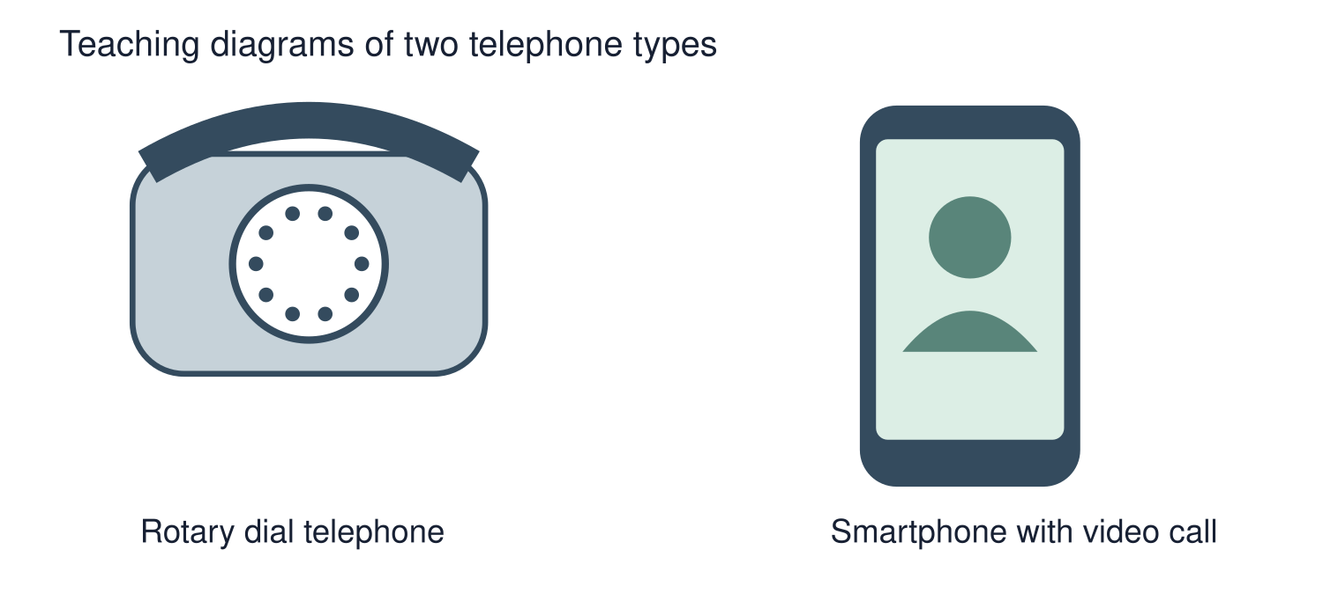
Visual resource
BUILD Humanities Spring 1 W2 21
Notes:
F: comparison and caption.
Use one-step instructions, symbols and a model first. Offer talk, point, draw, type or write. Reduce the number of choices; extend by asking for a reason or a second example. Adults prompt the first response then fade support.
Use questioning and the exit response to decide the next step. Record the learner’s individual contribution and the access support used.
See the pupil pack for source credits and the paired enquiry prompts.

