Slide 1

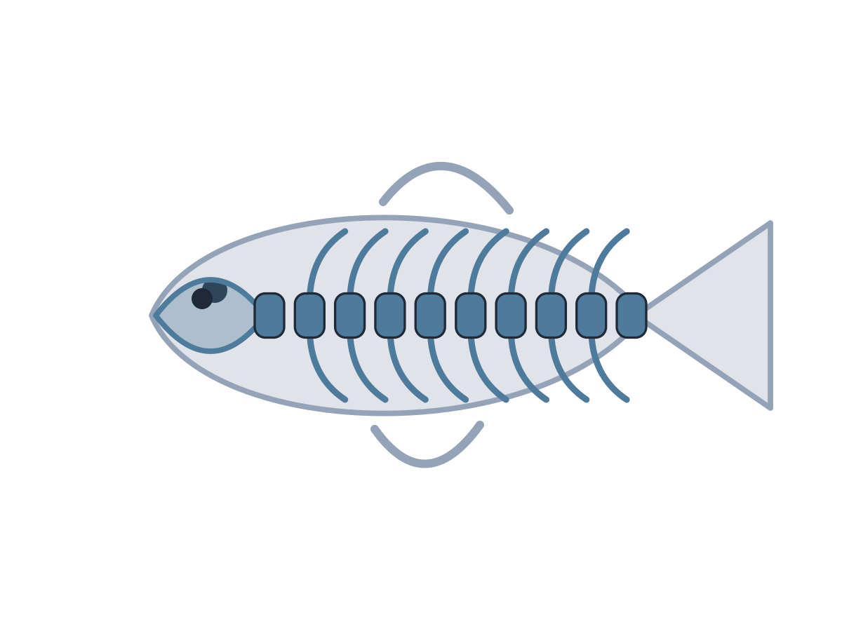
MADE BY MATT / BUILD SCIENCE
Backbones and no backbones
One body clue. Two animal groups.
I can use evidence to decide whether an animal has a backbone.
AUTUMN 1 · WEEK 3 · LESSON A
01
Notes:
Overview — 1 minutes within the source's 40-minute lesson.
Monday P3, 11:00-11:40. This one-minute overview is included in the 40-minute lesson.
[Sources]
https://github.com/MattRoper1977/Lessons/blob/main/Science_Teesside/Build/SCI_B_W3_Backbones.html
Git blob: 349b5b8637ba978dd594f77d80fbd7998dac1ff2.
SHA256: b3c0a0b3c66bfa199a9bce613bad2c7b5a35eaf97733e069fb5da8ebfe523442.
User-supplied logo: approved-logo.jpg (unchanged attachment bytes).
White Rose Education, Year 3 Autumn Block 1 (2024): Skeletons, steps 3-5; uploaded source lessons about animal bones, animals with/without a spine and comparing skeletons. Steps 1-2 provide optional prerequisite vocabulary; they are not relabelled as completed baseline teaching.
[/Sources]
[Sources] https://madebymatt.uk/Lessons/Science_Teesside/Teaching_Packs/BUILD/ — original lesson text, timings and teacher notes retained. https://madebymatt.uk/Lessons/Science_Teesside/Build/ — existing Made by Matt scientific artwork, where shown. [/Sources]

Slide 2
MADE BY MATT / BUILD SCIENCE
Start with your own idea
Name or point to an animal.
Do you think it has a backbone?
Keep your first idea. We will check evidence.
AUTUMN 1 · WEEK 3 · LESSON A
02
Notes:
Arrival Task — 4 minutes within the source's 40-minute lesson.
Do not claim pupils learnt bones in Weeks 1-2: these were baseline weeks. Supported: offer fish/snail labels and read aloud. Standard: name an animal and predict. Stretch: name one possible example in each group. No checking of pupils’ own spines.
[Sources]
https://github.com/MattRoper1977/Lessons/blob/main/Science_Teesside/Build/SCI_B_W3_Backbones.html
Git blob: 349b5b8637ba978dd594f77d80fbd7998dac1ff2.
SHA256: b3c0a0b3c66bfa199a9bce613bad2c7b5a35eaf97733e069fb5da8ebfe523442.
User-supplied logo: approved-logo.jpg (unchanged attachment bytes).
White Rose Education, Year 3 Autumn Block 1 (2024): Skeletons, steps 3-5; uploaded source lessons about animal bones, animals with/without a spine and comparing skeletons. Steps 1-2 provide optional prerequisite vocabulary; they are not relabelled as completed baseline teaching.
[/Sources]
[Sources] https://madebymatt.uk/Lessons/Science_Teesside/Teaching_Packs/BUILD/ — original lesson text, timings and teacher notes retained. https://madebymatt.uk/Lessons/Science_Teesside/Build/ — existing Made by Matt scientific artwork, where shown. [/Sources]

Slide 3
MADE BY MATT / BUILD SCIENCE
Three things we will do
Find a backbone in a model.
Sort animals using body evidence.
Explain one decision using because.
AUTUMN 1 · WEEK 3 · LESSON A
03
Notes:
Today at a Glance — 2 minutes within the source's 40-minute lesson.
Read the goal and introduce backbone, vertebrate and invertebrate orally. Pupils may point, sign, dictate or use an adult reader. This is the current Monday sequence; practical clue-card investigation is reserved for Wednesday.
[Sources]
https://github.com/MattRoper1977/Lessons/blob/main/Science_Teesside/Build/SCI_B_W3_Backbones.html
Git blob: 349b5b8637ba978dd594f77d80fbd7998dac1ff2.
SHA256: b3c0a0b3c66bfa199a9bce613bad2c7b5a35eaf97733e069fb5da8ebfe523442.
User-supplied logo: approved-logo.jpg (unchanged attachment bytes).
White Rose Education, Year 3 Autumn Block 1 (2024): Skeletons, steps 3-5; uploaded source lessons about animal bones, animals with/without a spine and comparing skeletons. Steps 1-2 provide optional prerequisite vocabulary; they are not relabelled as completed baseline teaching.
[/Sources]
[Sources] https://madebymatt.uk/Lessons/Science_Teesside/Teaching_Packs/BUILD/ — original lesson text, timings and teacher notes retained. https://madebymatt.uk/Lessons/Science_Teesside/Build/ — existing Made by Matt scientific artwork, where shown. [/Sources]

Slide 4
MADE BY MATT / BUILD SCIENCE
Look for bones inside
A backbone is a connected series of small bones down the back.
small bones
An animal with a backbone is a vertebrate.
simplified backbone
AUTUMN 1 · WEEK 3 · LESSON A
04
Notes:
I Do 1 — 5 minutes within the source's 40-minute lesson.
Original native schematic of a short section of backbone, not a complete animal skeleton or diagnostic image. Trace the sequence of small bones with a pointer. A fish has an internal backbone even though it has no legs. Explain that pictures alone may hide internal structures; we use the stated body evidence.
[Sources]
https://github.com/MattRoper1977/Lessons/blob/main/Science_Teesside/Build/SCI_B_W3_Backbones.html
Git blob: 349b5b8637ba978dd594f77d80fbd7998dac1ff2.
SHA256: b3c0a0b3c66bfa199a9bce613bad2c7b5a35eaf97733e069fb5da8ebfe523442.
User-supplied logo: approved-logo.jpg (unchanged attachment bytes).
White Rose Education, Year 3 Autumn Block 1 (2024): Skeletons, steps 3-5; uploaded source lessons about animal bones, animals with/without a spine and comparing skeletons. Steps 1-2 provide optional prerequisite vocabulary; they are not relabelled as completed baseline teaching.
[/Sources]
[Sources] https://madebymatt.uk/Lessons/Science_Teesside/Teaching_Packs/BUILD/ — original lesson text, timings and teacher notes retained. https://madebymatt.uk/Lessons/Science_Teesside/Build/ — existing Made by Matt scientific artwork, where shown. [/Sources]

Slide 5
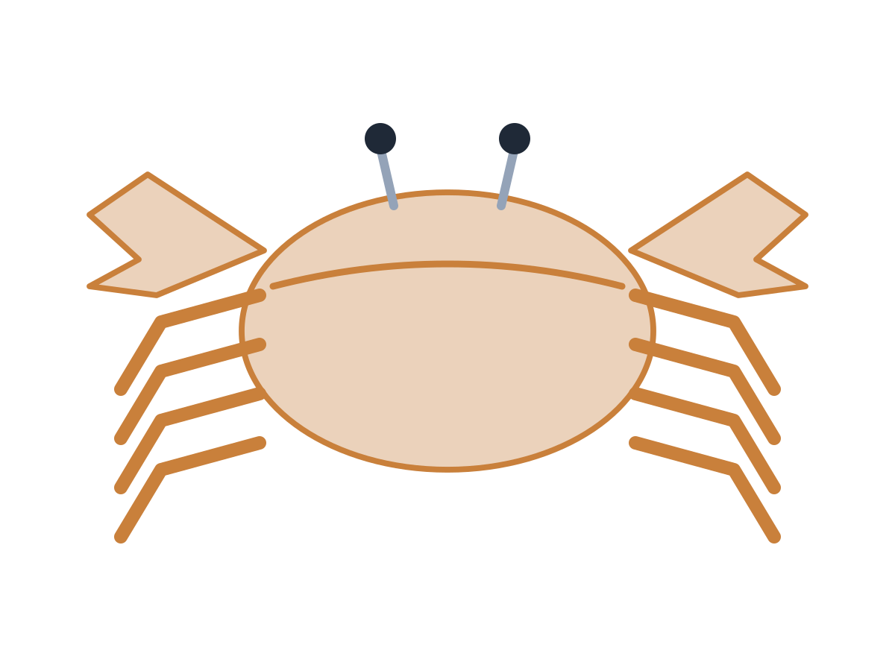
MADE BY MATT / BUILD SCIENCE
A hard outside is different
FISH
CRAB
Bones inside the body.
A backbone inside.
Vertebrate.
Hard case outside the body.
No backbone.
Invertebrate.
AUTUMN 1 · WEEK 3 · LESSON A
05
Notes:
I Do 1b — 4 minutes within the source's 40-minute lesson.
Read a body-evidence card for each animal. A crab’s hard exoskeleton supports/protects it but is not an internal backbone. Invertebrate does not mean soft, small or unsupported. An earthworm can use muscles and fluid support. No live animals needed.
[Sources]
https://github.com/MattRoper1977/Lessons/blob/main/Science_Teesside/Build/SCI_B_W3_Backbones.html
Git blob: 349b5b8637ba978dd594f77d80fbd7998dac1ff2.
SHA256: b3c0a0b3c66bfa199a9bce613bad2c7b5a35eaf97733e069fb5da8ebfe523442.
User-supplied logo: approved-logo.jpg (unchanged attachment bytes).
White Rose Education, Year 3 Autumn Block 1 (2024): Skeletons, steps 3-5; uploaded source lessons about animal bones, animals with/without a spine and comparing skeletons. Steps 1-2 provide optional prerequisite vocabulary; they are not relabelled as completed baseline teaching.
[/Sources]
[Sources] https://madebymatt.uk/Lessons/Science_Teesside/Teaching_Packs/BUILD/ — original lesson text, timings and teacher notes retained. https://madebymatt.uk/Lessons/Science_Teesside/Build/ — existing Made by Matt scientific artwork, where shown. [/Sources]

Slide 6
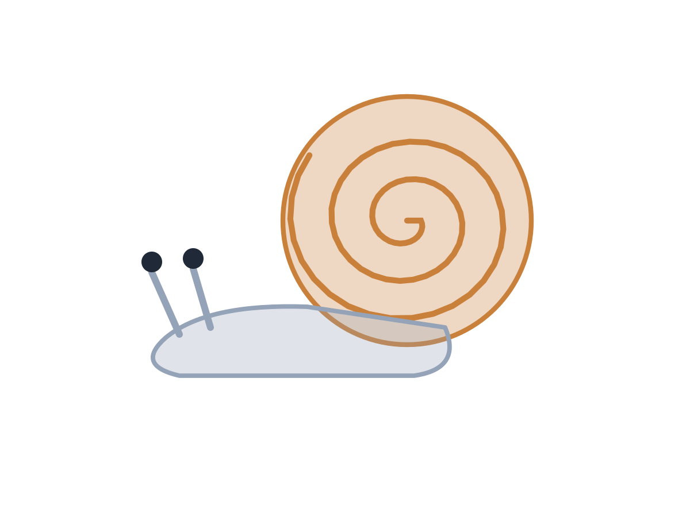
MADE BY MATT / BUILD SCIENCE
Decide before the explanation
Fish: bones inside include a backbone.
Snail: a shell, but no backbone.
Frog: bones inside include a backbone.
Choose: vertebrate or invertebrate.
AUTUMN 1 · WEEK 3 · LESSON A
06
Notes:
We Do 1 — first responses — 3 minutes within the source's 40-minute lesson.
Read each body clue, allow processing time and collect each pupil’s choice before confirming. Fish/frog = vertebrate; snail = invertebrate. Optional verbal clues and movable labels replace online animation. Ask which evidence made the decision possible.
[Sources]
https://github.com/MattRoper1977/Lessons/blob/main/Science_Teesside/Build/SCI_B_W3_Backbones.html
Git blob: 349b5b8637ba978dd594f77d80fbd7998dac1ff2.
SHA256: b3c0a0b3c66bfa199a9bce613bad2c7b5a35eaf97733e069fb5da8ebfe523442.
User-supplied logo: approved-logo.jpg (unchanged attachment bytes).
White Rose Education, Year 3 Autumn Block 1 (2024): Skeletons, steps 3-5; uploaded source lessons about animal bones, animals with/without a spine and comparing skeletons. Steps 1-2 provide optional prerequisite vocabulary; they are not relabelled as completed baseline teaching.
[/Sources]
[Sources] https://madebymatt.uk/Lessons/Science_Teesside/Teaching_Packs/BUILD/ — original lesson text, timings and teacher notes retained. https://madebymatt.uk/Lessons/Science_Teesside/Build/ — existing Made by Matt scientific artwork, where shown. [/Sources]

Slide 7

MADE BY MATT / BUILD SCIENCE
Try the rule again
Mouse: an internal backbone.
Crab: a hard outside; no backbone.
Earthworm: fluid support; no backbone.
Which body clue decides each group?
AUTUMN 1 · WEEK 3 · LESSON A
07
Notes:
We Do 1 — second responses — 3 minutes within the source's 40-minute lesson.
Mouse = vertebrate; crab/earthworm = invertebrate. The tiny mouse counters size-based guessing. Explain that a shell or outer case is useful support but is not a spine. Correct the rule gently rather than describing a pupil as wrong.
[Sources]
https://github.com/MattRoper1977/Lessons/blob/main/Science_Teesside/Build/SCI_B_W3_Backbones.html
Git blob: 349b5b8637ba978dd594f77d80fbd7998dac1ff2.
SHA256: b3c0a0b3c66bfa199a9bce613bad2c7b5a35eaf97733e069fb5da8ebfe523442.
User-supplied logo: approved-logo.jpg (unchanged attachment bytes).
White Rose Education, Year 3 Autumn Block 1 (2024): Skeletons, steps 3-5; uploaded source lessons about animal bones, animals with/without a spine and comparing skeletons. Steps 1-2 provide optional prerequisite vocabulary; they are not relabelled as completed baseline teaching.
[/Sources]
[Sources] https://madebymatt.uk/Lessons/Science_Teesside/Teaching_Packs/BUILD/ — original lesson text, timings and teacher notes retained. https://madebymatt.uk/Lessons/Science_Teesside/Build/ — existing Made by Matt scientific artwork, where shown. [/Sources]

Slide 8
MADE BY MATT / BUILD SCIENCE
Different outsides, same test
THE ANIMALS
THE BODY EVIDENCE
Fish and frog
Bird and lizard
Very different outsides.
All have an internal backbone.
All are vertebrates.
Fur and legs are not the test.
AUTUMN 1 · WEEK 3 · LESSON A
08
Notes:
We Do 1b — 4 minutes within the source's 40-minute lesson.
Ask pupils to identify the shared evidence. Contrast a mouse and a large lobster if helpful: body size cannot decide the group. Use these four named examples; do not infer classifications from appearance alone.
[Sources]
https://github.com/MattRoper1977/Lessons/blob/main/Science_Teesside/Build/SCI_B_W3_Backbones.html
Git blob: 349b5b8637ba978dd594f77d80fbd7998dac1ff2.
SHA256: b3c0a0b3c66bfa199a9bce613bad2c7b5a35eaf97733e069fb5da8ebfe523442.
User-supplied logo: approved-logo.jpg (unchanged attachment bytes).
White Rose Education, Year 3 Autumn Block 1 (2024): Skeletons, steps 3-5; uploaded source lessons about animal bones, animals with/without a spine and comparing skeletons. Steps 1-2 provide optional prerequisite vocabulary; they are not relabelled as completed baseline teaching.
[/Sources]
[Sources] https://madebymatt.uk/Lessons/Science_Teesside/Teaching_Packs/BUILD/ — original lesson text, timings and teacher notes retained. https://madebymatt.uk/Lessons/Science_Teesside/Build/ — existing Made by Matt scientific artwork, where shown. [/Sources]

Slide 9
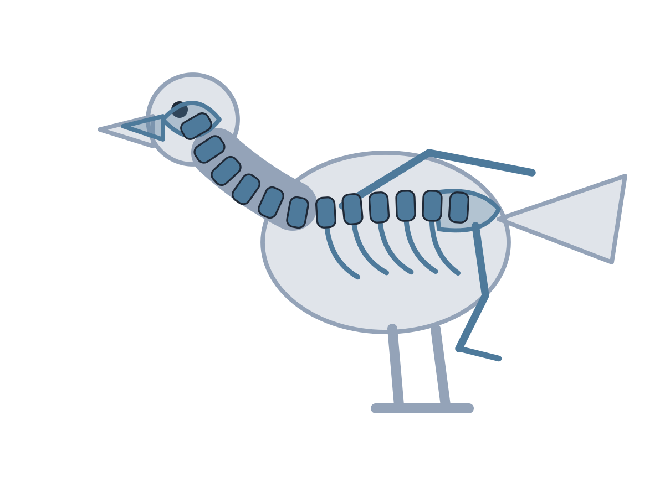
MADE BY MATT / BUILD SCIENCE
Use because to show your reason
The robin is a vertebrate because its body has an internal backbone.
Name the animal. Name the group. Give the body evidence.
AUTUMN 1 · WEEK 3 · LESSON A
09
Notes:
I Do 2 — 4 minutes within the source's 40-minute lesson.
Model the source evidence loop. Supported: point to group and backbone clue; adult repeats pupil meaning. Standard: complete because sentence. Stretch: contrast why a hard outer case would not prove a backbone. A recorded pupil explanation is stronger evidence than a photo of a sort alone.
[Sources]
https://github.com/MattRoper1977/Lessons/blob/main/Science_Teesside/Build/SCI_B_W3_Backbones.html
Git blob: 349b5b8637ba978dd594f77d80fbd7998dac1ff2.
SHA256: b3c0a0b3c66bfa199a9bce613bad2c7b5a35eaf97733e069fb5da8ebfe523442.
User-supplied logo: approved-logo.jpg (unchanged attachment bytes).
White Rose Education, Year 3 Autumn Block 1 (2024): Skeletons, steps 3-5; uploaded source lessons about animal bones, animals with/without a spine and comparing skeletons. Steps 1-2 provide optional prerequisite vocabulary; they are not relabelled as completed baseline teaching.
[/Sources]
[Sources] https://madebymatt.uk/Lessons/Science_Teesside/Teaching_Packs/BUILD/ — original lesson text, timings and teacher notes retained. https://madebymatt.uk/Lessons/Science_Teesside/Build/ — existing Made by Matt scientific artwork, where shown. [/Sources]

Slide 10
MADE BY MATT / BUILD SCIENCE
Sort the evidence cards
ANIMAL CARDS
IS THIS A RELIABLE TEST?
Bat
Crab
Snake
Jellyfish
It has a backbone inside.
It is furry.
It is small.
AUTUMN 1 · WEEK 3 · LESSON A
10
Notes:
We Do 2 — sort — 5 minutes within the source's 40-minute lesson.
Worksheet supplies body evidence for each animal. Bat/snake = vertebrate; crab/jellyfish = invertebrate. The only reliable diagnostic criterion among these three is internal backbone. Size and fur are not universal tests. Let pupils place or direct labels before reveal; this is an original paper version of the source classification activity.
[Sources]
https://github.com/MattRoper1977/Lessons/blob/main/Science_Teesside/Build/SCI_B_W3_Backbones.html
Git blob: 349b5b8637ba978dd594f77d80fbd7998dac1ff2.
SHA256: b3c0a0b3c66bfa199a9bce613bad2c7b5a35eaf97733e069fb5da8ebfe523442.
User-supplied logo: approved-logo.jpg (unchanged attachment bytes).
White Rose Education, Year 3 Autumn Block 1 (2024): Skeletons, steps 3-5; uploaded source lessons about animal bones, animals with/without a spine and comparing skeletons. Steps 1-2 provide optional prerequisite vocabulary; they are not relabelled as completed baseline teaching.
[/Sources]
[Sources] https://madebymatt.uk/Lessons/Science_Teesside/Teaching_Packs/BUILD/ — original lesson text, timings and teacher notes retained. https://madebymatt.uk/Lessons/Science_Teesside/Build/ — existing Made by Matt scientific artwork, where shown. [/Sources]

Slide 11
MADE BY MATT / BUILD SCIENCE
Check one choice and keep it
Choose one animal card.
Point to or say the body evidence.
Keep or change your first choice.
Label and save your work for Wednesday.
AUTUMN 1 · WEEK 3 · LESSON A
11
Notes:
We Do 2 — explain and save — 5 minutes within the source's 40-minute lesson.
Five minutes completes source ten-minute We Do 2. Include checking rather than additional timed exit. Ask whether size, fur or legs prove the claim; they do not. Learner can pass or speak privately. End Monday here, retaining one explanation and the sort for the Wednesday evidence workshop.
[Sources]
https://github.com/MattRoper1977/Lessons/blob/main/Science_Teesside/Build/SCI_B_W3_Backbones.html
Git blob: 349b5b8637ba978dd594f77d80fbd7998dac1ff2.
SHA256: b3c0a0b3c66bfa199a9bce613bad2c7b5a35eaf97733e069fb5da8ebfe523442.
User-supplied logo: approved-logo.jpg (unchanged attachment bytes).
White Rose Education, Year 3 Autumn Block 1 (2024): Skeletons, steps 3-5; uploaded source lessons about animal bones, animals with/without a spine and comparing skeletons. Steps 1-2 provide optional prerequisite vocabulary; they are not relabelled as completed baseline teaching.
[/Sources]
[Sources] https://madebymatt.uk/Lessons/Science_Teesside/Teaching_Packs/BUILD/ — original lesson text, timings and teacher notes retained. https://madebymatt.uk/Lessons/Science_Teesside/Build/ — existing Made by Matt scientific artwork, where shown. [/Sources]

