Slide 1

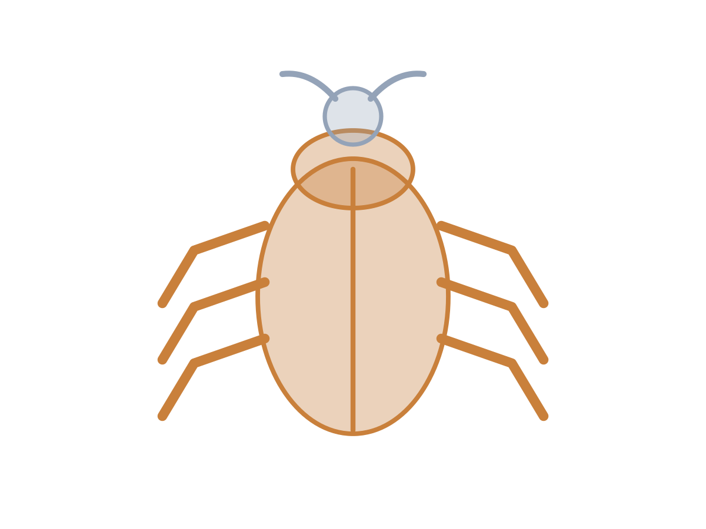
MADE BY MATT / BUILD SCIENCE
Backbone evidence lab
Look inside the evidence.
I can justify a classification and improve a clue.
AUTUMN 1 · WEEK 3 · LESSON B
01
Notes:
Workshop reference — 0 minutes within the source's 40-minute lesson.
Wednesday P2, 10:10-10:50. Reference screen only; start the 32-minute workshop immediately. No additional starter or lesson time.
[Sources]
https://github.com/MattRoper1977/Lessons/blob/main/Science_Teesside/Build/SCI_B_W3_Backbones.html
Git blob: 349b5b8637ba978dd594f77d80fbd7998dac1ff2.
SHA256: b3c0a0b3c66bfa199a9bce613bad2c7b5a35eaf97733e069fb5da8ebfe523442.
User-supplied logo: approved-logo.jpg (unchanged attachment bytes).
White Rose Education, Year 3 Autumn Block 1 (2024): Skeletons, steps 3-5; uploaded source lessons about animal bones, animals with/without a spine and comparing skeletons. Steps 1-2 provide optional prerequisite vocabulary; they are not relabelled as completed baseline teaching.
[/Sources]
[Sources] https://madebymatt.uk/Lessons/Science_Teesside/Teaching_Packs/BUILD/ — original lesson text, timings and teacher notes retained. https://madebymatt.uk/Lessons/Science_Teesside/Build/ — existing Made by Matt scientific artwork, where shown. [/Sources]

Slide 2
MADE BY MATT / BUILD SCIENCE
Return to Monday’s rule
Find your saved animal sort.
Name or point to the backbone rule.
Choose: read, point, move cards or direct.
AUTUMN 1 · WEEK 3 · LESSON B
02
Notes:
Independent Work — retrieve — 4 minutes within the source's 40-minute lesson.
Source preparation phase, four minutes. Retrieve Monday’s eight-animal vocabulary: fish, bird, frog, lizard, mouse, snail, crab, earthworm. The first five have backbones; last three do not. Do not replace evidence with guessing from fur/size. Adult can read and cut.
[Sources]
https://github.com/MattRoper1977/Lessons/blob/main/Science_Teesside/Build/SCI_B_W3_Backbones.html
Git blob: 349b5b8637ba978dd594f77d80fbd7998dac1ff2.
SHA256: b3c0a0b3c66bfa199a9bce613bad2c7b5a35eaf97733e069fb5da8ebfe523442.
User-supplied logo: approved-logo.jpg (unchanged attachment bytes).
White Rose Education, Year 3 Autumn Block 1 (2024): Skeletons, steps 3-5; uploaded source lessons about animal bones, animals with/without a spine and comparing skeletons. Steps 1-2 provide optional prerequisite vocabulary; they are not relabelled as completed baseline teaching.
[/Sources]
[Sources] https://madebymatt.uk/Lessons/Science_Teesside/Teaching_Packs/BUILD/ — original lesson text, timings and teacher notes retained. https://madebymatt.uk/Lessons/Science_Teesside/Build/ — existing Made by Matt scientific artwork, where shown. [/Sources]

Slide 3
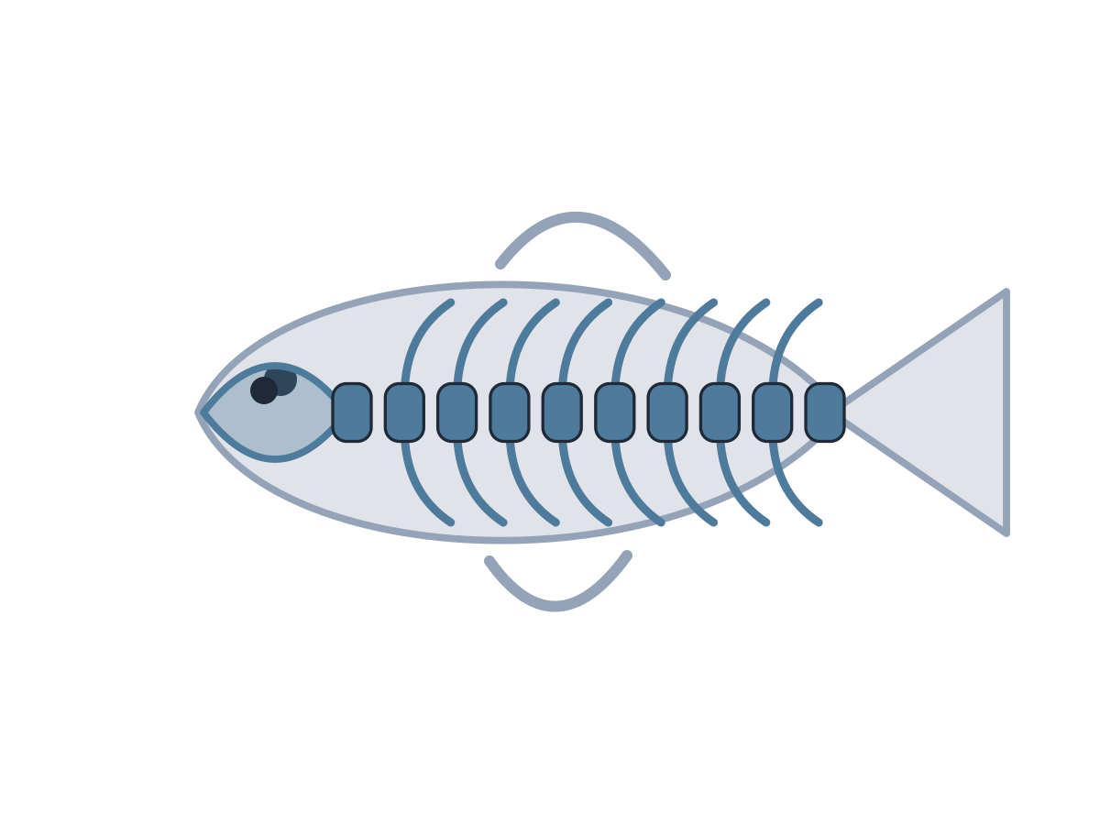
MADE BY MATT / BUILD SCIENCE
Goldfish and bat: use body clues
GOLDFISH
BAT
Bones inside its body.
Those bones include a backbone.
Wings on the outside.
An internal backbone.
AUTUMN 1 · WEEK 3 · LESSON B
03
Notes:
Independent Work — investigate — 5 minutes within the source's 40-minute lesson.
First five minutes of source 20-minute investigation. Hide each clue initially and record first idea; then reveal clue and classify. Both are vertebrates. Wings do not decide classification; evidence of backbone does. Pupil can leave prediction unsure until evidence is available.
[Sources]
https://github.com/MattRoper1977/Lessons/blob/main/Science_Teesside/Build/SCI_B_W3_Backbones.html
Git blob: 349b5b8637ba978dd594f77d80fbd7998dac1ff2.
SHA256: b3c0a0b3c66bfa199a9bce613bad2c7b5a35eaf97733e069fb5da8ebfe523442.
User-supplied logo: approved-logo.jpg (unchanged attachment bytes).
White Rose Education, Year 3 Autumn Block 1 (2024): Skeletons, steps 3-5; uploaded source lessons about animal bones, animals with/without a spine and comparing skeletons. Steps 1-2 provide optional prerequisite vocabulary; they are not relabelled as completed baseline teaching.
[/Sources]
[Sources] https://madebymatt.uk/Lessons/Science_Teesside/Teaching_Packs/BUILD/ — original lesson text, timings and teacher notes retained. https://madebymatt.uk/Lessons/Science_Teesside/Build/ — existing Made by Matt scientific artwork, where shown. [/Sources]

Slide 4

MADE BY MATT / BUILD SCIENCE
Beetle and earthworm: compare
BEETLE
EARTHWORM
Hard outer case.
No internal backbone.
Muscles act against fluid inside.
Skin rings are not bones.
AUTUMN 1 · WEEK 3 · LESSON B
04
Notes:
Independent Work — investigate — 5 minutes within the source's 40-minute lesson.
Next five minutes. Both are invertebrates but support differs. Beetle exoskeleton is a hard outside; earthworm support comes from muscles/fluid. Explain that no backbone does not mean no support. Native text comparison replaces source illustration; no live animals or handling.
[Sources]
https://github.com/MattRoper1977/Lessons/blob/main/Science_Teesside/Build/SCI_B_W3_Backbones.html
Git blob: 349b5b8637ba978dd594f77d80fbd7998dac1ff2.
SHA256: b3c0a0b3c66bfa199a9bce613bad2c7b5a35eaf97733e069fb5da8ebfe523442.
User-supplied logo: approved-logo.jpg (unchanged attachment bytes).
White Rose Education, Year 3 Autumn Block 1 (2024): Skeletons, steps 3-5; uploaded source lessons about animal bones, animals with/without a spine and comparing skeletons. Steps 1-2 provide optional prerequisite vocabulary; they are not relabelled as completed baseline teaching.
[/Sources]
[Sources] https://madebymatt.uk/Lessons/Science_Teesside/Teaching_Packs/BUILD/ — original lesson text, timings and teacher notes retained. https://madebymatt.uk/Lessons/Science_Teesside/Build/ — existing Made by Matt scientific artwork, where shown. [/Sources]

Slide 5
MADE BY MATT / BUILD SCIENCE
Make a two-clue mystery card
Choose one animal from Monday.
Hide its name.
Write or dictate two true body clues.
Make at least one clue about its support.
AUTUMN 1 · WEEK 3 · LESSON B
05
Notes:
Independent Work — investigate — 5 minutes within the source's 40-minute lesson.
Next five minutes. Adult can write pupil-dictated clues. One clue must discriminate backbone presence/absence: e.g. internal bones include a backbone, or hard outer case and no backbone. “It is small” alone cannot settle it. Keep hidden answer on the teacher side, not pupil public display.
[Sources]
https://github.com/MattRoper1977/Lessons/blob/main/Science_Teesside/Build/SCI_B_W3_Backbones.html
Git blob: 349b5b8637ba978dd594f77d80fbd7998dac1ff2.
SHA256: b3c0a0b3c66bfa199a9bce613bad2c7b5a35eaf97733e069fb5da8ebfe523442.
User-supplied logo: approved-logo.jpg (unchanged attachment bytes).
White Rose Education, Year 3 Autumn Block 1 (2024): Skeletons, steps 3-5; uploaded source lessons about animal bones, animals with/without a spine and comparing skeletons. Steps 1-2 provide optional prerequisite vocabulary; they are not relabelled as completed baseline teaching.
[/Sources]
[Sources] https://madebymatt.uk/Lessons/Science_Teesside/Teaching_Packs/BUILD/ — original lesson text, timings and teacher notes retained. https://madebymatt.uk/Lessons/Science_Teesside/Build/ — existing Made by Matt scientific artwork, where shown. [/Sources]

Slide 6
MADE BY MATT / BUILD SCIENCE
Test the clue, then explain
Read the clues to an adult or partner.
Ask: which group, and why?
You can check the card on your own.
Does a clue prove the group?
AUTUMN 1 · WEEK 3 · LESSON B
06
Notes:
Independent Work — investigate — 5 minutes within the source's 40-minute lesson.
Final five minutes of 20-minute investigation. No compulsory peer audience. A useful card need not identify the exact species; it should allow group classification. If solver guesses from size, ask author to improve body evidence. Adult notes pupil reasoning and support used.
[Sources]
https://github.com/MattRoper1977/Lessons/blob/main/Science_Teesside/Build/SCI_B_W3_Backbones.html
Git blob: 349b5b8637ba978dd594f77d80fbd7998dac1ff2.
SHA256: b3c0a0b3c66bfa199a9bce613bad2c7b5a35eaf97733e069fb5da8ebfe523442.
User-supplied logo: approved-logo.jpg (unchanged attachment bytes).
White Rose Education, Year 3 Autumn Block 1 (2024): Skeletons, steps 3-5; uploaded source lessons about animal bones, animals with/without a spine and comparing skeletons. Steps 1-2 provide optional prerequisite vocabulary; they are not relabelled as completed baseline teaching.
[/Sources]
[Sources] https://madebymatt.uk/Lessons/Science_Teesside/Teaching_Packs/BUILD/ — original lesson text, timings and teacher notes retained. https://madebymatt.uk/Lessons/Science_Teesside/Build/ — existing Made by Matt scientific artwork, where shown. [/Sources]

Slide 7
MADE BY MATT / BUILD SCIENCE
Pause and check the rule
Look at one first idea and final choice.
Point to the clue that decided it.
Check: a skin ring is not a backbone.
AUTUMN 1 · WEEK 3 · LESSON B
07
Notes:
Independent Work — check — 2 minutes within the source's 40-minute lesson.
Source two-minute check is included in 32, not extra. Ask whether the card distinguishes internal backbone from shell/outer case/fluid support. Let the pupil change an uncertain classification in response to evidence.
[Sources]
https://github.com/MattRoper1977/Lessons/blob/main/Science_Teesside/Build/SCI_B_W3_Backbones.html
Git blob: 349b5b8637ba978dd594f77d80fbd7998dac1ff2.
SHA256: b3c0a0b3c66bfa199a9bce613bad2c7b5a35eaf97733e069fb5da8ebfe523442.
User-supplied logo: approved-logo.jpg (unchanged attachment bytes).
White Rose Education, Year 3 Autumn Block 1 (2024): Skeletons, steps 3-5; uploaded source lessons about animal bones, animals with/without a spine and comparing skeletons. Steps 1-2 provide optional prerequisite vocabulary; they are not relabelled as completed baseline teaching.
[/Sources]
[Sources] https://madebymatt.uk/Lessons/Science_Teesside/Teaching_Packs/BUILD/ — original lesson text, timings and teacher notes retained. https://madebymatt.uk/Lessons/Science_Teesside/Build/ — existing Made by Matt scientific artwork, where shown. [/Sources]

Slide 8
MADE BY MATT / BUILD SCIENCE
Improve one clue and save it
Make one clue more precise.
Keep your first and improved version.
Explain which animal group it supports.
AUTUMN 1 · WEEK 3 · LESSON B
08
Notes:
Independent Work — improve — 4 minutes within the source's 40-minute lesson.
First four minutes of final six-minute source phase. Example improvement: “hard body” becomes “hard case outside and no internal backbone.” A pupil can point to the right existing evidence sentence instead of composing text. Retain reasoning, not only a photograph.
[Sources]
https://github.com/MattRoper1977/Lessons/blob/main/Science_Teesside/Build/SCI_B_W3_Backbones.html
Git blob: 349b5b8637ba978dd594f77d80fbd7998dac1ff2.
SHA256: b3c0a0b3c66bfa199a9bce613bad2c7b5a35eaf97733e069fb5da8ebfe523442.
User-supplied logo: approved-logo.jpg (unchanged attachment bytes).
White Rose Education, Year 3 Autumn Block 1 (2024): Skeletons, steps 3-5; uploaded source lessons about animal bones, animals with/without a spine and comparing skeletons. Steps 1-2 provide optional prerequisite vocabulary; they are not relabelled as completed baseline teaching.
[/Sources]
[Sources] https://madebymatt.uk/Lessons/Science_Teesside/Teaching_Packs/BUILD/ — original lesson text, timings and teacher notes retained. https://madebymatt.uk/Lessons/Science_Teesside/Build/ — existing Made by Matt scientific artwork, where shown. [/Sources]

Slide 9
MADE BY MATT / BUILD SCIENCE
Leave the evidence ready
Keep the sort, clue and explanation together.
Label your work.
Return labels and clear the table.
AUTUMN 1 · WEEK 3 · LESSON B
09
Notes:
Independent Work — tidy — 2 minutes within the source's 40-minute lesson.
Final two minutes of 32-minute workshop. Adult can label work without gathering any extra personal information. Store within normal classroom arrangements; no upload or public audience needed.
[Sources]
https://github.com/MattRoper1977/Lessons/blob/main/Science_Teesside/Build/SCI_B_W3_Backbones.html
Git blob: 349b5b8637ba978dd594f77d80fbd7998dac1ff2.
SHA256: b3c0a0b3c66bfa199a9bce613bad2c7b5a35eaf97733e069fb5da8ebfe523442.
User-supplied logo: approved-logo.jpg (unchanged attachment bytes).
White Rose Education, Year 3 Autumn Block 1 (2024): Skeletons, steps 3-5; uploaded source lessons about animal bones, animals with/without a spine and comparing skeletons. Steps 1-2 provide optional prerequisite vocabulary; they are not relabelled as completed baseline teaching.
[/Sources]
[Sources] https://madebymatt.uk/Lessons/Science_Teesside/Teaching_Packs/BUILD/ — original lesson text, timings and teacher notes retained. https://madebymatt.uk/Lessons/Science_Teesside/Build/ — existing Made by Matt scientific artwork, where shown. [/Sources]

Slide 10
MADE BY MATT / BUILD SCIENCE
Your voice can change the lesson
What helped you join in?
What could make the next activity easier?
Point, sign, speak, write or pass privately.
Adult: agree one change and explain any limit.
AUTUMN 1 · WEEK 3 · LESSON B
10
Notes:
Lundy Loop — 4 minutes within the source's 40-minute lesson.
Four minutes within the source lesson. Receive an actual observation or access request; do not force a peer audience. Name what can change now, make the change where possible and check whether it helped. The adult receives and names back the science shown as well as access feedback.
[Sources]
https://github.com/MattRoper1977/Lessons/blob/main/Science_Teesside/Build/SCI_B_W3_Backbones.html
Git blob: 349b5b8637ba978dd594f77d80fbd7998dac1ff2.
SHA256: b3c0a0b3c66bfa199a9bce613bad2c7b5a35eaf97733e069fb5da8ebfe523442.
User-supplied logo: approved-logo.jpg (unchanged attachment bytes).
White Rose Education, Year 3 Autumn Block 1 (2024): Skeletons, steps 3-5; uploaded source lessons about animal bones, animals with/without a spine and comparing skeletons. Steps 1-2 provide optional prerequisite vocabulary; they are not relabelled as completed baseline teaching.
[/Sources]
[Sources] https://madebymatt.uk/Lessons/Science_Teesside/Teaching_Packs/BUILD/ — original lesson text, timings and teacher notes retained. https://madebymatt.uk/Lessons/Science_Teesside/Build/ — existing Made by Matt scientific artwork, where shown. [/Sources]

Slide 11
MADE BY MATT / BUILD SCIENCE
Show the science you can explain
Supported: choose an animal with a backbone.
Standard: explain why a crab is invertebrate.
Stretch: why is body size a poor test?
AUTUMN 1 · WEEK 3 · LESSON B
11
Notes:
Exit Ticket — 4 minutes within the source's 40-minute lesson.
Offer one route, not three compulsory questions. Answers stay in teacher notes: supported fish/bird/frog/lizard/mouse/bat; standard crab has hard outer case but no internal backbone; stretch tiny mouse has backbone while larger crab/lobster lacks one. Adult receives explanation, names back understanding and records a feasible next teaching step.
[Sources]
https://github.com/MattRoper1977/Lessons/blob/main/Science_Teesside/Build/SCI_B_W3_Backbones.html
Git blob: 349b5b8637ba978dd594f77d80fbd7998dac1ff2.
SHA256: b3c0a0b3c66bfa199a9bce613bad2c7b5a35eaf97733e069fb5da8ebfe523442.
User-supplied logo: approved-logo.jpg (unchanged attachment bytes).
White Rose Education, Year 3 Autumn Block 1 (2024): Skeletons, steps 3-5; uploaded source lessons about animal bones, animals with/without a spine and comparing skeletons. Steps 1-2 provide optional prerequisite vocabulary; they are not relabelled as completed baseline teaching.
[/Sources]
[Sources] https://madebymatt.uk/Lessons/Science_Teesside/Teaching_Packs/BUILD/ — original lesson text, timings and teacher notes retained. https://madebymatt.uk/Lessons/Science_Teesside/Build/ — existing Made by Matt scientific artwork, where shown. [/Sources]

