Slide 1

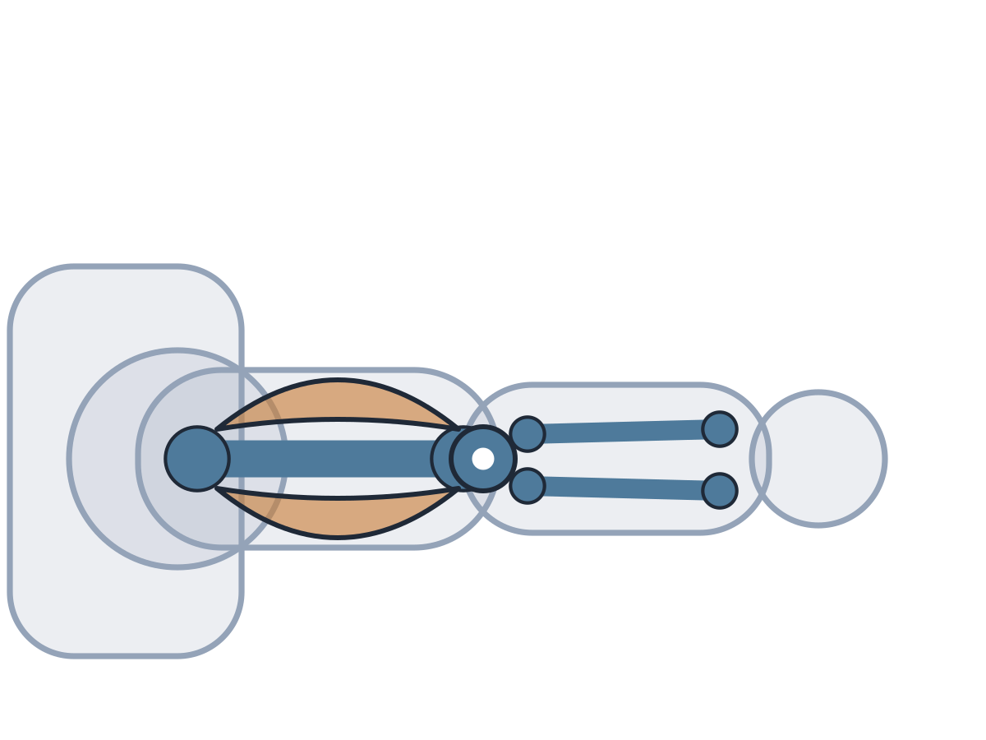
MADE BY MATT / BUILD SCIENCE
Muscles work in pairs
Two muscles. Two pulling jobs.
I can explain a bend and an active straighten at the elbow.
AUTUMN 1 · WEEK 4 · LESSON A
01
Notes:
Overview — 1 minutes within the source's 40-minute lesson.
Monday P3, 11:00-11:40. This one-minute overview is included in the 40-minute lesson.
[Sources]
https://github.com/MattRoper1977/Lessons/blob/main/Science_Teesside/Build/SCI_B_W4_Muscle_Pairs.html
Git blob: 25c277b919c5fcc62a4891abf2f7cbecf4999396.
SHA256: 4178be1248b51b44ea553d6b33735f09ddfbcc83fc58f28069f5386698ced06a.
User-supplied logo: approved-logo.jpg (unchanged attachment bytes).
White Rose Education, Year 3 Autumn Block 2 (2024): Movement, steps 1 Joints and 2 How we move. Public materials use original text and native diagrams; the accepted website string model replaces source stretched elastic.
[/Sources]
[Sources] https://madebymatt.uk/Lessons/Science_Teesside/Teaching_Packs/BUILD/ — original lesson text, timings and teacher notes retained. https://madebymatt.uk/Lessons/Science_Teesside/Build/ — existing Made by Matt scientific artwork, where shown. [/Sources]

Slide 2
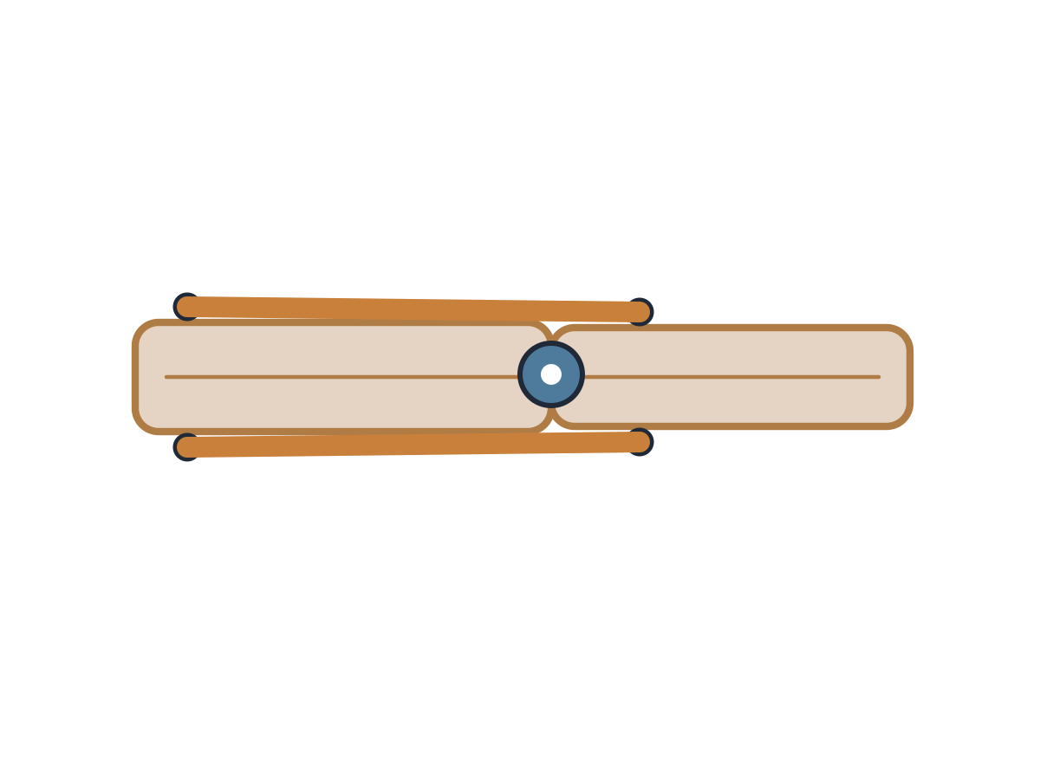
MADE BY MATT / BUILD SCIENCE
Watch a bend and a straighten
Watch the adult’s card arm model.
Which pull makes the model bend?
Which pull makes it straighten?
AUTUMN 1 · WEEK 4 · LESSON A
02
Notes:
Arrival Task — 4 minutes within the source's 40-minute lesson.
Use a card model, not compulsory body movement. Supported: point to the pull. Standard: predict which muscle acts. Stretch: compare both actions. Retrieve last week’s internal skeleton; do not assume anatomical vocabulary beyond it.
[Sources]
https://github.com/MattRoper1977/Lessons/blob/main/Science_Teesside/Build/SCI_B_W4_Muscle_Pairs.html
Git blob: 25c277b919c5fcc62a4891abf2f7cbecf4999396.
SHA256: 4178be1248b51b44ea553d6b33735f09ddfbcc83fc58f28069f5386698ced06a.
User-supplied logo: approved-logo.jpg (unchanged attachment bytes).
White Rose Education, Year 3 Autumn Block 2 (2024): Movement, steps 1 Joints and 2 How we move. Public materials use original text and native diagrams; the accepted website string model replaces source stretched elastic.
[/Sources]
[Sources] https://madebymatt.uk/Lessons/Science_Teesside/Teaching_Packs/BUILD/ — original lesson text, timings and teacher notes retained. https://madebymatt.uk/Lessons/Science_Teesside/Build/ — existing Made by Matt scientific artwork, where shown. [/Sources]

Slide 3
MADE BY MATT / BUILD SCIENCE
Three things we will do
Meet the muscle pair.
Compare a bend and a straighten.
Explain which muscle contracts.
AUTUMN 1 · WEEK 4 · LESSON A
03
Notes:
Today at a Glance — 2 minutes within the source's 40-minute lesson.
Introduce biceps/triceps, contract/relax with spoken repetition and printed labels. Adult manipulates the model first; pupils do not handle pins or stretched elastic.
[Sources]
https://github.com/MattRoper1977/Lessons/blob/main/Science_Teesside/Build/SCI_B_W4_Muscle_Pairs.html
Git blob: 25c277b919c5fcc62a4891abf2f7cbecf4999396.
SHA256: 4178be1248b51b44ea553d6b33735f09ddfbcc83fc58f28069f5386698ced06a.
User-supplied logo: approved-logo.jpg (unchanged attachment bytes).
White Rose Education, Year 3 Autumn Block 2 (2024): Movement, steps 1 Joints and 2 How we move. Public materials use original text and native diagrams; the accepted website string model replaces source stretched elastic.
[/Sources]
[Sources] https://madebymatt.uk/Lessons/Science_Teesside/Teaching_Packs/BUILD/ — original lesson text, timings and teacher notes retained. https://madebymatt.uk/Lessons/Science_Teesside/Build/ — existing Made by Matt scientific artwork, where shown. [/Sources]

Slide 4
MADE BY MATT / BUILD SCIENCE
A model helps us see a pull
gentle pull
Card represents bones. The join represents an elbow.
card bone
elbow join
Loose string represents a muscle pull; it does not contract itself.
AUTUMN 1 · WEEK 4 · LESSON A
04
Notes:
I Do 1 — 5 minutes within the source's 40-minute lesson.
Original simplified card-arm diagram, not anatomical scale. Adult demonstrates gentle manual pull with a loose string anchored to a forearm tab. Model is supported at the upper strip. A string stands for the effect of a pulling muscle but does not shorten itself. Keep small split pin fixed; adult makes holes.
[Sources]
https://github.com/MattRoper1977/Lessons/blob/main/Science_Teesside/Build/SCI_B_W4_Muscle_Pairs.html
Git blob: 25c277b919c5fcc62a4891abf2f7cbecf4999396.
SHA256: 4178be1248b51b44ea553d6b33735f09ddfbcc83fc58f28069f5386698ced06a.
User-supplied logo: approved-logo.jpg (unchanged attachment bytes).
White Rose Education, Year 3 Autumn Block 2 (2024): Movement, steps 1 Joints and 2 How we move. Public materials use original text and native diagrams; the accepted website string model replaces source stretched elastic.
[/Sources]
[Sources] https://madebymatt.uk/Lessons/Science_Teesside/Teaching_Packs/BUILD/ — original lesson text, timings and teacher notes retained. https://madebymatt.uk/Lessons/Science_Teesside/Build/ — existing Made by Matt scientific artwork, where shown. [/Sources]

Slide 5
MADE BY MATT / BUILD SCIENCE
The body has a working pair
BEND THE ELBOW
ACTIVELY STRAIGHTEN
Biceps contracts.
Triceps relaxes.
Triceps contracts.
Biceps relaxes.
AUTUMN 1 · WEEK 4 · LESSON A
05
Notes:
I Do 1b — 5 minutes within the source's 40-minute lesson.
Map card to bone, pin to elbow and string to muscle pull. Contracting muscle develops tension and can shorten to pull; at this level use the simple shortening model. Do not say relaxed muscle is disconnected or that every lowering action requires triceps contraction: gravity can lower an unsupported arm. Teach active movement in this chosen model.
[Sources]
https://github.com/MattRoper1977/Lessons/blob/main/Science_Teesside/Build/SCI_B_W4_Muscle_Pairs.html
Git blob: 25c277b919c5fcc62a4891abf2f7cbecf4999396.
SHA256: 4178be1248b51b44ea553d6b33735f09ddfbcc83fc58f28069f5386698ced06a.
User-supplied logo: approved-logo.jpg (unchanged attachment bytes).
White Rose Education, Year 3 Autumn Block 2 (2024): Movement, steps 1 Joints and 2 How we move. Public materials use original text and native diagrams; the accepted website string model replaces source stretched elastic.
[/Sources]
[Sources] https://madebymatt.uk/Lessons/Science_Teesside/Teaching_Packs/BUILD/ — original lesson text, timings and teacher notes retained. https://madebymatt.uk/Lessons/Science_Teesside/Build/ — existing Made by Matt scientific artwork, where shown. [/Sources]

Slide 6
MADE BY MATT / BUILD SCIENCE
Choose the pulling muscle
The card arm bends.
Choose: biceps or triceps contracts?
Say, sign or point before the explanation.
AUTUMN 1 · WEEK 4 · LESSON A
06
Notes:
We Do 1 — commit — 3 minutes within the source's 40-minute lesson.
All pupils commit before teacher confirms. Bend = biceps contracts while triceps relaxes in the simplified elbow model. Offer colour/word labels together so colour is not the only identifier.
[Sources]
https://github.com/MattRoper1977/Lessons/blob/main/Science_Teesside/Build/SCI_B_W4_Muscle_Pairs.html
Git blob: 25c277b919c5fcc62a4891abf2f7cbecf4999396.
SHA256: 4178be1248b51b44ea553d6b33735f09ddfbcc83fc58f28069f5386698ced06a.
User-supplied logo: approved-logo.jpg (unchanged attachment bytes).
White Rose Education, Year 3 Autumn Block 2 (2024): Movement, steps 1 Joints and 2 How we move. Public materials use original text and native diagrams; the accepted website string model replaces source stretched elastic.
[/Sources]
[Sources] https://madebymatt.uk/Lessons/Science_Teesside/Teaching_Packs/BUILD/ — original lesson text, timings and teacher notes retained. https://madebymatt.uk/Lessons/Science_Teesside/Build/ — existing Made by Matt scientific artwork, where shown. [/Sources]

Slide 7
MADE BY MATT / BUILD SCIENCE
Now swap the action
The model actively straightens.
Which muscle contracts now?
What happens to its partner?
AUTUMN 1 · WEEK 4 · LESSON A
07
Notes:
We Do 1 — compare — 3 minutes within the source's 40-minute lesson.
Active straighten = triceps contracts, biceps relaxes. Ask pupil to direct adult model movement. Do not require pupil to show their own arm; accept pointing to word labels.
[Sources]
https://github.com/MattRoper1977/Lessons/blob/main/Science_Teesside/Build/SCI_B_W4_Muscle_Pairs.html
Git blob: 25c277b919c5fcc62a4891abf2f7cbecf4999396.
SHA256: 4178be1248b51b44ea553d6b33735f09ddfbcc83fc58f28069f5386698ced06a.
User-supplied logo: approved-logo.jpg (unchanged attachment bytes).
White Rose Education, Year 3 Autumn Block 2 (2024): Movement, steps 1 Joints and 2 How we move. Public materials use original text and native diagrams; the accepted website string model replaces source stretched elastic.
[/Sources]
[Sources] https://madebymatt.uk/Lessons/Science_Teesside/Teaching_Packs/BUILD/ — original lesson text, timings and teacher notes retained. https://madebymatt.uk/Lessons/Science_Teesside/Build/ — existing Made by Matt scientific artwork, where shown. [/Sources]

Slide 8
MADE BY MATT / BUILD SCIENCE
Model and muscle: compare
WHAT THE MODEL SHOWS
WHAT IT DOES NOT SHOW
A joint allows movement.
A pull acts on each side.
The roles can swap.
String does not shorten itself.
Card is not living bone.
This is a simplified elbow.
AUTUMN 1 · WEEK 4 · LESSON A
08
Notes:
We Do 1b — 4 minutes within the source's 40-minute lesson.
Ask how two different materials represent the same relationship. Both movements need a pulling action; a string cannot push the forearm. A model has limits and is not a complete anatomical explanation.
[Sources]
https://github.com/MattRoper1977/Lessons/blob/main/Science_Teesside/Build/SCI_B_W4_Muscle_Pairs.html
Git blob: 25c277b919c5fcc62a4891abf2f7cbecf4999396.
SHA256: 4178be1248b51b44ea553d6b33735f09ddfbcc83fc58f28069f5386698ced06a.
User-supplied logo: approved-logo.jpg (unchanged attachment bytes).
White Rose Education, Year 3 Autumn Block 2 (2024): Movement, steps 1 Joints and 2 How we move. Public materials use original text and native diagrams; the accepted website string model replaces source stretched elastic.
[/Sources]
[Sources] https://madebymatt.uk/Lessons/Science_Teesside/Teaching_Packs/BUILD/ — original lesson text, timings and teacher notes retained. https://madebymatt.uk/Lessons/Science_Teesside/Build/ — existing Made by Matt scientific artwork, where shown. [/Sources]

Slide 9
MADE BY MATT / BUILD SCIENCE
Explain both muscle jobs
When the elbow bends, the biceps contracts and the triceps relaxes.
When it actively straightens, the pair swaps jobs.
AUTUMN 1 · WEEK 4 · LESSON A
09
Notes:
I Do 2 — 4 minutes within the source's 40-minute lesson.
Model a full sentence including both muscles rather than “the top one moves.” Accept placing CONTRACTS/RELAXES beside biceps/triceps labels. Adult notes the decision and explanation; photo of the model alone is insufficient.
[Sources]
https://github.com/MattRoper1977/Lessons/blob/main/Science_Teesside/Build/SCI_B_W4_Muscle_Pairs.html
Git blob: 25c277b919c5fcc62a4891abf2f7cbecf4999396.
SHA256: 4178be1248b51b44ea553d6b33735f09ddfbcc83fc58f28069f5386698ced06a.
User-supplied logo: approved-logo.jpg (unchanged attachment bytes).
White Rose Education, Year 3 Autumn Block 2 (2024): Movement, steps 1 Joints and 2 How we move. Public materials use original text and native diagrams; the accepted website string model replaces source stretched elastic.
[/Sources]
[Sources] https://madebymatt.uk/Lessons/Science_Teesside/Teaching_Packs/BUILD/ — original lesson text, timings and teacher notes retained. https://madebymatt.uk/Lessons/Science_Teesside/Build/ — existing Made by Matt scientific artwork, where shown. [/Sources]

Slide 10
MADE BY MATT / BUILD SCIENCE
True or needs correcting?
READ EACH CLAIM
EXPLAIN THE CORRECTION
Muscles can pull.
Muscles can push bones.
Biceps and triceps form a pair.
Which claims fit the model?
Which word needs changing?
Show the action that supports you.
AUTUMN 1 · WEEK 4 · LESSON A
10
Notes:
We Do 2 — sort — 5 minutes within the source's 40-minute lesson.
True: muscles pull; biceps/triceps form pair. False: muscles push bones. Add source claim “bones move on their own” as false if time: muscles generate forces moving bones at joints. Preserve response before discussion.
[Sources]
https://github.com/MattRoper1977/Lessons/blob/main/Science_Teesside/Build/SCI_B_W4_Muscle_Pairs.html
Git blob: 25c277b919c5fcc62a4891abf2f7cbecf4999396.
SHA256: 4178be1248b51b44ea553d6b33735f09ddfbcc83fc58f28069f5386698ced06a.
User-supplied logo: approved-logo.jpg (unchanged attachment bytes).
White Rose Education, Year 3 Autumn Block 2 (2024): Movement, steps 1 Joints and 2 How we move. Public materials use original text and native diagrams; the accepted website string model replaces source stretched elastic.
[/Sources]
[Sources] https://madebymatt.uk/Lessons/Science_Teesside/Teaching_Packs/BUILD/ — original lesson text, timings and teacher notes retained. https://madebymatt.uk/Lessons/Science_Teesside/Build/ — existing Made by Matt scientific artwork, where shown. [/Sources]

Slide 11
MADE BY MATT / BUILD SCIENCE
Direct two moves and keep labels
Direct one bend and one active straighten.
Place CONTRACTS and RELAXES labels.
Check one swap and correct it if needed.
Keep the labels for Wednesday.
AUTUMN 1 · WEEK 4 · LESSON A
11
Notes:
We Do 2 — check and save — 4 minutes within the source's 40-minute lesson.
Final four minutes completes nine-minute source We Do 2 and exact 40 minutes. Let pupils direct adult movements if fine-motor access is a barrier. Do not begin Wednesday construction early. All elastic-band source ideas are replaced with loose strings under adult control.
[Sources]
https://github.com/MattRoper1977/Lessons/blob/main/Science_Teesside/Build/SCI_B_W4_Muscle_Pairs.html
Git blob: 25c277b919c5fcc62a4891abf2f7cbecf4999396.
SHA256: 4178be1248b51b44ea553d6b33735f09ddfbcc83fc58f28069f5386698ced06a.
User-supplied logo: approved-logo.jpg (unchanged attachment bytes).
White Rose Education, Year 3 Autumn Block 2 (2024): Movement, steps 1 Joints and 2 How we move. Public materials use original text and native diagrams; the accepted website string model replaces source stretched elastic.
[/Sources]
[Sources] https://madebymatt.uk/Lessons/Science_Teesside/Teaching_Packs/BUILD/ — original lesson text, timings and teacher notes retained. https://madebymatt.uk/Lessons/Science_Teesside/Build/ — existing Made by Matt scientific artwork, where shown. [/Sources]

