Slide 1

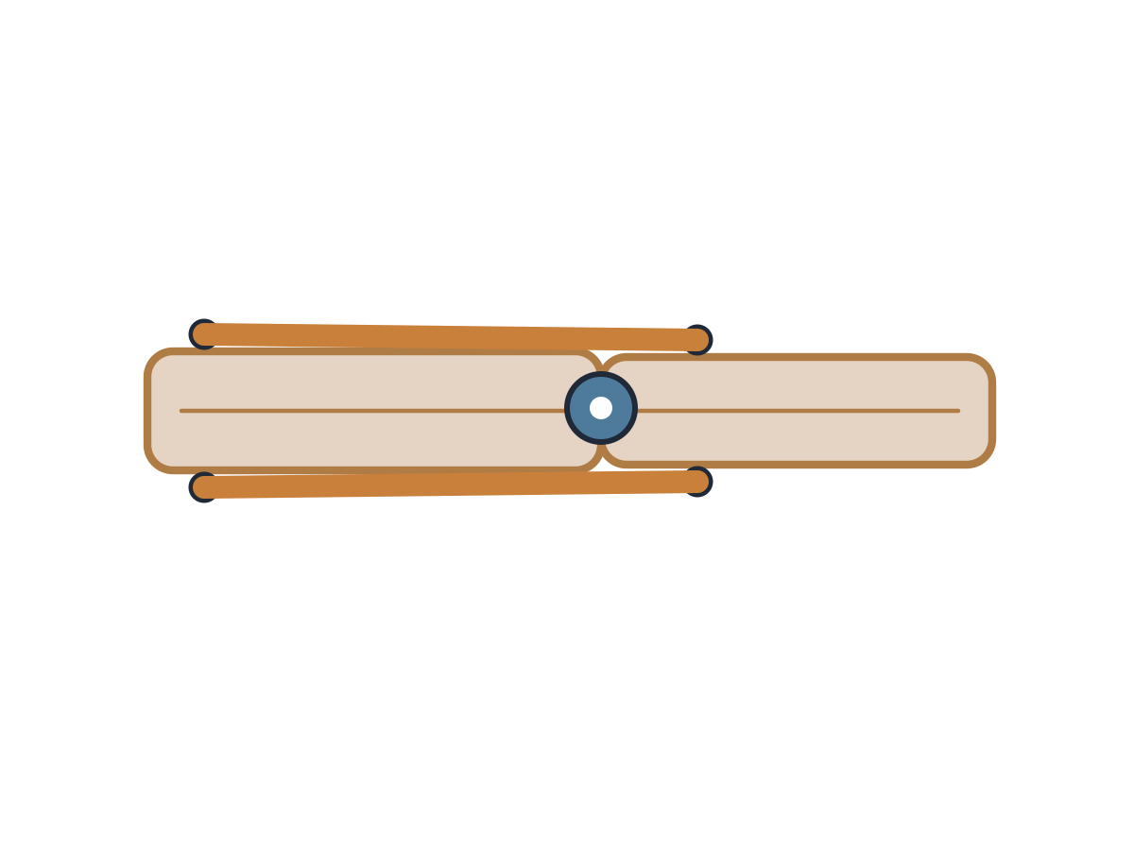
MADE BY MATT / BUILD SCIENCE
Build and test a muscle model
A model you can explain.
I can use the pair labels to explain two movements.
AUTUMN 1 · WEEK 4 · LESSON B
01
Notes:
Workshop reference — 0 minutes within the source's 40-minute lesson.
Wednesday P2, 10:10-10:50. Reference screen only; start the 32-minute workshop immediately. No additional starter or lesson time.
[Sources]
https://github.com/MattRoper1977/Lessons/blob/main/Science_Teesside/Build/SCI_B_W4_Muscle_Pairs.html
Git blob: 25c277b919c5fcc62a4891abf2f7cbecf4999396.
SHA256: 4178be1248b51b44ea553d6b33735f09ddfbcc83fc58f28069f5386698ced06a.
User-supplied logo: approved-logo.jpg (unchanged attachment bytes).
White Rose Education, Year 3 Autumn Block 2 (2024): Movement, steps 1 Joints and 2 How we move. Public materials use original text and native diagrams; the accepted website string model replaces source stretched elastic.
[/Sources]
[Sources] https://madebymatt.uk/Lessons/Science_Teesside/Teaching_Packs/BUILD/ — original lesson text, timings and teacher notes retained. https://madebymatt.uk/Lessons/Science_Teesside/Build/ — existing Made by Matt scientific artwork, where shown. [/Sources]

Slide 2
MADE BY MATT / BUILD SCIENCE
Retrieve the pair and check the join
Find Monday’s biceps and triceps labels.
Check that the prepared elbow can turn.
Choose: build, direct, label or explain.
AUTUMN 1 · WEEK 4 · LESSON B
02
Notes:
Independent Work — retrieve — 4 minutes within the source's 40-minute lesson.
Four-minute preparation. Adult checks two card strips, pre-made holes, secured split pin and two loose strings fixed to opposite-side forearm tabs. If apparatus is not ready, use adult’s prepared model; pupil direction retains the scientific goal.
[Sources]
https://github.com/MattRoper1977/Lessons/blob/main/Science_Teesside/Build/SCI_B_W4_Muscle_Pairs.html
Git blob: 25c277b919c5fcc62a4891abf2f7cbecf4999396.
SHA256: 4178be1248b51b44ea553d6b33735f09ddfbcc83fc58f28069f5386698ced06a.
User-supplied logo: approved-logo.jpg (unchanged attachment bytes).
White Rose Education, Year 3 Autumn Block 2 (2024): Movement, steps 1 Joints and 2 How we move. Public materials use original text and native diagrams; the accepted website string model replaces source stretched elastic.
[/Sources]
[Sources] https://madebymatt.uk/Lessons/Science_Teesside/Teaching_Packs/BUILD/ — original lesson text, timings and teacher notes retained. https://madebymatt.uk/Lessons/Science_Teesside/Build/ — existing Made by Matt scientific artwork, where shown. [/Sources]

Slide 3
MADE BY MATT / BUILD SCIENCE
Build with an adult’s preparation
Adult prepares and secures the turning join.
Put the model flat on the table.
Attach the loose pull strings to the tabs.
Keep each free end clear and untangled.
AUTUMN 1 · WEEK 4 · LESSON B
03
Notes:
Independent Work — investigate — 5 minutes within the source's 40-minute lesson.
First five minutes of 20-minute workshop. Adult cuts strips, makes holes and fits the split pin so elbow rotates without sharp points. Attach pull strings on opposite sides of forearm near elbow; adult checks one gentle pull bends and another straightens before use. No stretched elastic or strings tied to body. Demonstration model is fallback if a mechanism fails.
[Sources]
https://github.com/MattRoper1977/Lessons/blob/main/Science_Teesside/Build/SCI_B_W4_Muscle_Pairs.html
Git blob: 25c277b919c5fcc62a4891abf2f7cbecf4999396.
SHA256: 4178be1248b51b44ea553d6b33735f09ddfbcc83fc58f28069f5386698ced06a.
User-supplied logo: approved-logo.jpg (unchanged attachment bytes).
White Rose Education, Year 3 Autumn Block 2 (2024): Movement, steps 1 Joints and 2 How we move. Public materials use original text and native diagrams; the accepted website string model replaces source stretched elastic.
[/Sources]
[Sources] https://madebymatt.uk/Lessons/Science_Teesside/Teaching_Packs/BUILD/ — original lesson text, timings and teacher notes retained. https://madebymatt.uk/Lessons/Science_Teesside/Build/ — existing Made by Matt scientific artwork, where shown. [/Sources]

Slide 4
MADE BY MATT / BUILD SCIENCE
Make one careful bend
Hold the upper card steady.
Gently pull the bending string.
Place BICEPS — CONTRACTS.
Place TRICEPS — RELAXES.
AUTUMN 1 · WEEK 4 · LESSON B
04
Notes:
Independent Work — investigate — 5 minutes within the source's 40-minute lesson.
Next five minutes. Pupil may tell adult which string to pull and where to put labels. The pulling string represents effect of biceps shortening, not a living contracting muscle. Do not increase force if card jams; pause for adult adjustment.
[Sources]
https://github.com/MattRoper1977/Lessons/blob/main/Science_Teesside/Build/SCI_B_W4_Muscle_Pairs.html
Git blob: 25c277b919c5fcc62a4891abf2f7cbecf4999396.
SHA256: 4178be1248b51b44ea553d6b33735f09ddfbcc83fc58f28069f5386698ced06a.
User-supplied logo: approved-logo.jpg (unchanged attachment bytes).
White Rose Education, Year 3 Autumn Block 2 (2024): Movement, steps 1 Joints and 2 How we move. Public materials use original text and native diagrams; the accepted website string model replaces source stretched elastic.
[/Sources]
[Sources] https://madebymatt.uk/Lessons/Science_Teesside/Teaching_Packs/BUILD/ — original lesson text, timings and teacher notes retained. https://madebymatt.uk/Lessons/Science_Teesside/Build/ — existing Made by Matt scientific artwork, where shown. [/Sources]

Slide 5
MADE BY MATT / BUILD SCIENCE
Actively straighten and swap roles
Let the bending string slacken.
Gently use the opposite pull.
Place TRICEPS — CONTRACTS.
Place BICEPS — RELAXES.
AUTUMN 1 · WEEK 4 · LESSON B
05
Notes:
Independent Work — investigate — 5 minutes within the source's 40-minute lesson.
Next five minutes. Explicitly teach active straightening in the model rather than passive dropping under gravity. Adult checks the opposite-side pull works safely. A card model that needs manual repositioning can still support label explanation; state the limitation, do not fake successful mechanism.
[Sources]
https://github.com/MattRoper1977/Lessons/blob/main/Science_Teesside/Build/SCI_B_W4_Muscle_Pairs.html
Git blob: 25c277b919c5fcc62a4891abf2f7cbecf4999396.
SHA256: 4178be1248b51b44ea553d6b33735f09ddfbcc83fc58f28069f5386698ced06a.
User-supplied logo: approved-logo.jpg (unchanged attachment bytes).
White Rose Education, Year 3 Autumn Block 2 (2024): Movement, steps 1 Joints and 2 How we move. Public materials use original text and native diagrams; the accepted website string model replaces source stretched elastic.
[/Sources]
[Sources] https://madebymatt.uk/Lessons/Science_Teesside/Teaching_Packs/BUILD/ — original lesson text, timings and teacher notes retained. https://madebymatt.uk/Lessons/Science_Teesside/Build/ — existing Made by Matt scientific artwork, where shown. [/Sources]

Slide 6
MADE BY MATT / BUILD SCIENCE
Explain both actions with labels
Direct a bend, then an active straighten.
Name the contracting muscle each time.
Say what happens to its partner.
Record the actions in your table.
AUTUMN 1 · WEEK 4 · LESSON B
06
Notes:
Independent Work — investigate — 5 minutes within the source's 40-minute lesson.
Final five minutes of 20-minute phase. Check that labels follow muscle names rather than card colours or screen position. Support: adult reads answer options; standard complete pair statement; stretch compare what string and living muscle do.
[Sources]
https://github.com/MattRoper1977/Lessons/blob/main/Science_Teesside/Build/SCI_B_W4_Muscle_Pairs.html
Git blob: 25c277b919c5fcc62a4891abf2f7cbecf4999396.
SHA256: 4178be1248b51b44ea553d6b33735f09ddfbcc83fc58f28069f5386698ced06a.
User-supplied logo: approved-logo.jpg (unchanged attachment bytes).
White Rose Education, Year 3 Autumn Block 2 (2024): Movement, steps 1 Joints and 2 How we move. Public materials use original text and native diagrams; the accepted website string model replaces source stretched elastic.
[/Sources]
[Sources] https://madebymatt.uk/Lessons/Science_Teesside/Teaching_Packs/BUILD/ — original lesson text, timings and teacher notes retained. https://madebymatt.uk/Lessons/Science_Teesside/Build/ — existing Made by Matt scientific artwork, where shown. [/Sources]

Slide 7
MADE BY MATT / BUILD SCIENCE
Pause and check your model
Can the join turn without forcing it?
Is there a pull for each direction?
Do the labels match the chosen action?
AUTUMN 1 · WEEK 4 · LESSON B
07
Notes:
Independent Work — check — 2 minutes within the source's 40-minute lesson.
Source two-minute pause. Adult adjusts any insecure pin or jam. Pupil can direct. Record the scientific reason for a label correction, not simply “teacher said”.
[Sources]
https://github.com/MattRoper1977/Lessons/blob/main/Science_Teesside/Build/SCI_B_W4_Muscle_Pairs.html
Git blob: 25c277b919c5fcc62a4891abf2f7cbecf4999396.
SHA256: 4178be1248b51b44ea553d6b33735f09ddfbcc83fc58f28069f5386698ced06a.
User-supplied logo: approved-logo.jpg (unchanged attachment bytes).
White Rose Education, Year 3 Autumn Block 2 (2024): Movement, steps 1 Joints and 2 How we move. Public materials use original text and native diagrams; the accepted website string model replaces source stretched elastic.
[/Sources]
[Sources] https://madebymatt.uk/Lessons/Science_Teesside/Teaching_Packs/BUILD/ — original lesson text, timings and teacher notes retained. https://madebymatt.uk/Lessons/Science_Teesside/Build/ — existing Made by Matt scientific artwork, where shown. [/Sources]

Slide 8
MADE BY MATT / BUILD SCIENCE
Improve, explain and tidy
Fix one label or join with the adult.
Show or direct both actions again.
Name one way this differs from a real arm.
Keep your record and put the model away.
AUTUMN 1 · WEEK 4 · LESSON B
08
Notes:
Independent Work — improve — 6 minutes within the source's 40-minute lesson.
Final six-minute phase includes improvement, explanation and tidy. Scientific limit: string is pulled by a person rather than contracting; card/pin simplify anatomy and omit nerves/tendons. Adult repairs mechanism, pupil owns the classification/explanation. Keep small parts secured.
[Sources]
https://github.com/MattRoper1977/Lessons/blob/main/Science_Teesside/Build/SCI_B_W4_Muscle_Pairs.html
Git blob: 25c277b919c5fcc62a4891abf2f7cbecf4999396.
SHA256: 4178be1248b51b44ea553d6b33735f09ddfbcc83fc58f28069f5386698ced06a.
User-supplied logo: approved-logo.jpg (unchanged attachment bytes).
White Rose Education, Year 3 Autumn Block 2 (2024): Movement, steps 1 Joints and 2 How we move. Public materials use original text and native diagrams; the accepted website string model replaces source stretched elastic.
[/Sources]
[Sources] https://madebymatt.uk/Lessons/Science_Teesside/Teaching_Packs/BUILD/ — original lesson text, timings and teacher notes retained. https://madebymatt.uk/Lessons/Science_Teesside/Build/ — existing Made by Matt scientific artwork, where shown. [/Sources]

Slide 9
MADE BY MATT / BUILD SCIENCE
Your voice can change the lesson
What helped you join in?
What could make the next activity easier?
Point, sign, speak, write or pass privately.
Adult: agree one change and explain any limit.
AUTUMN 1 · WEEK 4 · LESSON B
09
Notes:
Lundy Loop — 4 minutes within the source's 40-minute lesson.
Four minutes within the source lesson. Receive an actual observation or access request; do not force a peer audience. Name what can change now, make the change where possible and check whether it helped. The adult receives and names back the science shown as well as access feedback.
[Sources]
https://github.com/MattRoper1977/Lessons/blob/main/Science_Teesside/Build/SCI_B_W4_Muscle_Pairs.html
Git blob: 25c277b919c5fcc62a4891abf2f7cbecf4999396.
SHA256: 4178be1248b51b44ea553d6b33735f09ddfbcc83fc58f28069f5386698ced06a.
User-supplied logo: approved-logo.jpg (unchanged attachment bytes).
White Rose Education, Year 3 Autumn Block 2 (2024): Movement, steps 1 Joints and 2 How we move. Public materials use original text and native diagrams; the accepted website string model replaces source stretched elastic.
[/Sources]
[Sources] https://madebymatt.uk/Lessons/Science_Teesside/Teaching_Packs/BUILD/ — original lesson text, timings and teacher notes retained. https://madebymatt.uk/Lessons/Science_Teesside/Build/ — existing Made by Matt scientific artwork, where shown. [/Sources]

Slide 10
MADE BY MATT / BUILD SCIENCE
What does the pair do?
Supported: show which muscle contracts in a bend.
Standard: explain the pair during active straighten.
Stretch: explain why one pull cannot push.
AUTUMN 1 · WEEK 4 · LESSON B
10
Notes:
Exit Ticket — 4 minutes within the source's 40-minute lesson.
Answer key in teacher notes only: bend biceps contracts, triceps relaxes. Active straighten triceps contracts, biceps relaxes. Opposing muscles/pulls provide opposite active movement because muscles pull rather than push. Accept a directed demonstration with pupil meaning. Record next step without compulsory written closing line.
[Sources]
https://github.com/MattRoper1977/Lessons/blob/main/Science_Teesside/Build/SCI_B_W4_Muscle_Pairs.html
Git blob: 25c277b919c5fcc62a4891abf2f7cbecf4999396.
SHA256: 4178be1248b51b44ea553d6b33735f09ddfbcc83fc58f28069f5386698ced06a.
User-supplied logo: approved-logo.jpg (unchanged attachment bytes).
White Rose Education, Year 3 Autumn Block 2 (2024): Movement, steps 1 Joints and 2 How we move. Public materials use original text and native diagrams; the accepted website string model replaces source stretched elastic.
[/Sources]
[Sources] https://madebymatt.uk/Lessons/Science_Teesside/Teaching_Packs/BUILD/ — original lesson text, timings and teacher notes retained. https://madebymatt.uk/Lessons/Science_Teesside/Build/ — existing Made by Matt scientific artwork, where shown. [/Sources]

