Slide 1

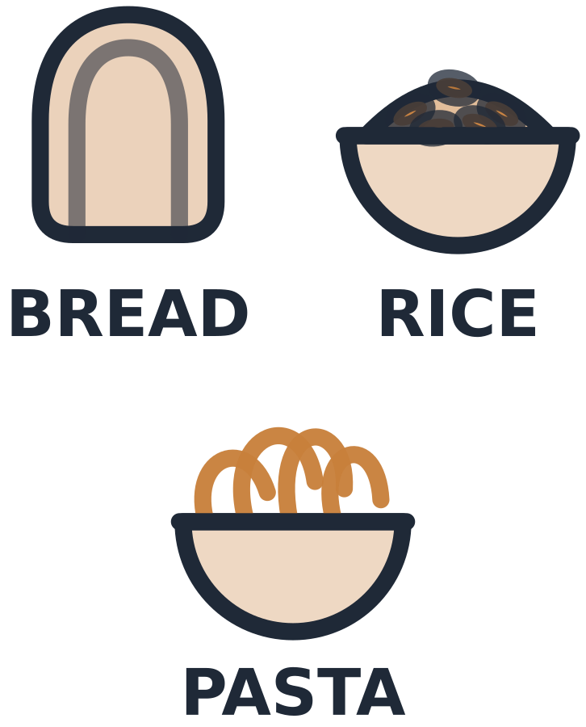
MADE BY MATT / BUILD SCIENCE
What a body needs
Food has more than one job.
I can explain why a body needs a range of nutrients.
AUTUMN 1 · WEEK 5 · LESSON A
01
Notes:
Overview — 1 minutes within the source's 40-minute lesson.
Monday P3, 11:00-11:40. This one-minute overview is included in the 40-minute lesson.
[Sources]
https://github.com/MattRoper1977/Lessons/blob/main/Science_Teesside/Build/SCI_B_W5_Right_Nutrition.html
Git blob: 21014244de9f92bea3c1e10e53d0ce8592ea43ce.
SHA256: 1d06ba869b18be8328cf4723cc91b46298a63c494f95e92aa9563f23b15161d3.
User-supplied logo: approved-logo.jpg (unchanged attachment bytes).
White Rose Education, Year 3 Autumn Block 3 (2024): Nutrition and diet, steps 1 Food groups, 2 Understand the five food groups and 5 Animal diets. Concepts inform original card tasks; source photographs and printables are not redistributed.
[/Sources]
[Sources] https://madebymatt.uk/Lessons/Science_Teesside/Teaching_Packs/BUILD/ — original lesson text, timings and teacher notes retained. https://madebymatt.uk/Lessons/Science_Teesside/Build/ — existing Made by Matt scientific artwork, where shown. [/Sources]

Slide 2
MADE BY MATT / BUILD SCIENCE
Start with a body job
Think about a model body, not your own meals.
What does food help a body do?
Name, draw or point to one job.
AUTUMN 1 · WEEK 5 · LESSON A
02
Notes:
Arrival Task — 4 minutes within the source's 40-minute lesson.
Do not request personal diet disclosure. Supported: choose energy/growth labels. Standard: name a job. Stretch: name two and distinguish them. Retrieve the idea that muscles need a working body; no calorie discussion.
[Sources]
https://github.com/MattRoper1977/Lessons/blob/main/Science_Teesside/Build/SCI_B_W5_Right_Nutrition.html
Git blob: 21014244de9f92bea3c1e10e53d0ce8592ea43ce.
SHA256: 1d06ba869b18be8328cf4723cc91b46298a63c494f95e92aa9563f23b15161d3.
User-supplied logo: approved-logo.jpg (unchanged attachment bytes).
White Rose Education, Year 3 Autumn Block 3 (2024): Nutrition and diet, steps 1 Food groups, 2 Understand the five food groups and 5 Animal diets. Concepts inform original card tasks; source photographs and printables are not redistributed.
[/Sources]
[Sources] https://madebymatt.uk/Lessons/Science_Teesside/Teaching_Packs/BUILD/ — original lesson text, timings and teacher notes retained. https://madebymatt.uk/Lessons/Science_Teesside/Build/ — existing Made by Matt scientific artwork, where shown. [/Sources]

Slide 3
MADE BY MATT / BUILD SCIENCE
Three things we will do
Match food to body jobs.
Compare what different animals eat.
Explain why variety matters.
AUTUMN 1 · WEEK 5 · LESSON A
03
Notes:
Today at a Glance — 2 minutes within the source's 40-minute lesson.
Use energy, growth and repair, vitamins/minerals, fibre and water as age-appropriate vocabulary. These categories overlap: one food can supply more than one nutrient.
[Sources]
https://github.com/MattRoper1977/Lessons/blob/main/Science_Teesside/Build/SCI_B_W5_Right_Nutrition.html
Git blob: 21014244de9f92bea3c1e10e53d0ce8592ea43ce.
SHA256: 1d06ba869b18be8328cf4723cc91b46298a63c494f95e92aa9563f23b15161d3.
User-supplied logo: approved-logo.jpg (unchanged attachment bytes).
White Rose Education, Year 3 Autumn Block 3 (2024): Nutrition and diet, steps 1 Food groups, 2 Understand the five food groups and 5 Animal diets. Concepts inform original card tasks; source photographs and printables are not redistributed.
[/Sources]
[Sources] https://madebymatt.uk/Lessons/Science_Teesside/Teaching_Packs/BUILD/ — original lesson text, timings and teacher notes retained. https://madebymatt.uk/Lessons/Science_Teesside/Build/ — existing Made by Matt scientific artwork, where shown. [/Sources]

Slide 4
MADE BY MATT / BUILD SCIENCE
Food can help in several ways
EXAMPLE FOODS
SOME OF THEIR JOBS
Bread or potatoes
Beans or lentils
Fruit and vegetables
Starchy carbohydrate gives energy.
Protein supports growth and repair.
Vitamins, minerals and fibre.
AUTUMN 1 · WEEK 5 · LESSON A
04
Notes:
I Do 1 — 5 minutes within the source's 40-minute lesson.
Model food/job links as examples, not exclusive categories. Bread also provides some protein, vitamins and minerals; beans/lentils also carbohydrate/fibre. Fruit/vegetables differ in nutrients. Do not claim a food has a single job or that one food can provide everything.
[Sources]
https://github.com/MattRoper1977/Lessons/blob/main/Science_Teesside/Build/SCI_B_W5_Right_Nutrition.html
Git blob: 21014244de9f92bea3c1e10e53d0ce8592ea43ce.
SHA256: 1d06ba869b18be8328cf4723cc91b46298a63c494f95e92aa9563f23b15161d3.
User-supplied logo: approved-logo.jpg (unchanged attachment bytes).
White Rose Education, Year 3 Autumn Block 3 (2024): Nutrition and diet, steps 1 Food groups, 2 Understand the five food groups and 5 Animal diets. Concepts inform original card tasks; source photographs and printables are not redistributed.
[/Sources]
[Sources] https://madebymatt.uk/Lessons/Science_Teesside/Teaching_Packs/BUILD/ — original lesson text, timings and teacher notes retained. https://madebymatt.uk/Lessons/Science_Teesside/Build/ — existing Made by Matt scientific artwork, where shown. [/Sources]

Slide 5

MADE BY MATT / BUILD SCIENCE
Water matters too
Water helps move substances around the body and helps control body temperature.
Water does not supply food energy.
AUTUMN 1 · WEEK 5 · LESSON A
05
Notes:
I Do 1b — 4 minutes within the source's 40-minute lesson.
Water is needed alongside food and is present in many foods/drinks. Do not invent personal intake targets or encourage any restriction. Explain source model’s point: a collection of food cards is incomplete as a picture of bodily needs; water has functions despite no food energy.
[Sources]
https://github.com/MattRoper1977/Lessons/blob/main/Science_Teesside/Build/SCI_B_W5_Right_Nutrition.html
Git blob: 21014244de9f92bea3c1e10e53d0ce8592ea43ce.
SHA256: 1d06ba869b18be8328cf4723cc91b46298a63c494f95e92aa9563f23b15161d3.
User-supplied logo: approved-logo.jpg (unchanged attachment bytes).
White Rose Education, Year 3 Autumn Block 3 (2024): Nutrition and diet, steps 1 Food groups, 2 Understand the five food groups and 5 Animal diets. Concepts inform original card tasks; source photographs and printables are not redistributed.
[/Sources]
[Sources] https://madebymatt.uk/Lessons/Science_Teesside/Teaching_Packs/BUILD/ — original lesson text, timings and teacher notes retained. https://madebymatt.uk/Lessons/Science_Teesside/Build/ — existing Made by Matt scientific artwork, where shown. [/Sources]

Slide 6
MADE BY MATT / BUILD SCIENCE
Name one job, then check
Bread or potato: which body job fits?
Beans or lentils: which job fits?
Give your reason before the explanation.
AUTUMN 1 · WEEK 5 · LESSON A
06
Notes:
We Do 1 — first responses — 3 minutes within the source's 40-minute lesson.
Collect all pupil responses before modelling. Expected examples: starchy foods provide energy; beans/lentils supply protein for growth/repair. Accept other correct nutrient-linked jobs if justified. Do not treat one answer as excluding all other food functions.
[Sources]
https://github.com/MattRoper1977/Lessons/blob/main/Science_Teesside/Build/SCI_B_W5_Right_Nutrition.html
Git blob: 21014244de9f92bea3c1e10e53d0ce8592ea43ce.
SHA256: 1d06ba869b18be8328cf4723cc91b46298a63c494f95e92aa9563f23b15161d3.
User-supplied logo: approved-logo.jpg (unchanged attachment bytes).
White Rose Education, Year 3 Autumn Block 3 (2024): Nutrition and diet, steps 1 Food groups, 2 Understand the five food groups and 5 Animal diets. Concepts inform original card tasks; source photographs and printables are not redistributed.
[/Sources]
[Sources] https://madebymatt.uk/Lessons/Science_Teesside/Teaching_Packs/BUILD/ — original lesson text, timings and teacher notes retained. https://madebymatt.uk/Lessons/Science_Teesside/Build/ — existing Made by Matt scientific artwork, where shown. [/Sources]

Slide 7
MADE BY MATT / BUILD SCIENCE
Can one food do more than one job?
Beans can provide protein and carbohydrate.
Fruit and vegetables provide different nutrients.
Why might a range of foods help?
AUTUMN 1 · WEEK 5 · LESSON A
07
Notes:
We Do 1 — compare — 3 minutes within the source's 40-minute lesson.
Variety can supply a broader range of nutrients than relying on one food. Adult reads the information table so pupils do not need to memorise all terms. Correct “only protein” gently with the supplied evidence.
[Sources]
https://github.com/MattRoper1977/Lessons/blob/main/Science_Teesside/Build/SCI_B_W5_Right_Nutrition.html
Git blob: 21014244de9f92bea3c1e10e53d0ce8592ea43ce.
SHA256: 1d06ba869b18be8328cf4723cc91b46298a63c494f95e92aa9563f23b15161d3.
User-supplied logo: approved-logo.jpg (unchanged attachment bytes).
White Rose Education, Year 3 Autumn Block 3 (2024): Nutrition and diet, steps 1 Food groups, 2 Understand the five food groups and 5 Animal diets. Concepts inform original card tasks; source photographs and printables are not redistributed.
[/Sources]
[Sources] https://madebymatt.uk/Lessons/Science_Teesside/Teaching_Packs/BUILD/ — original lesson text, timings and teacher notes retained. https://madebymatt.uk/Lessons/Science_Teesside/Build/ — existing Made by Matt scientific artwork, where shown. [/Sources]

Slide 8
MADE BY MATT / BUILD SCIENCE
Different animals, different needs
EXAMPLE ANIMALS
EXAMPLE FOOD LINKS
Cow
Owl
Caterpillar
Goldfish
Grass
Mouse
Leaves
Suitable fish food
AUTUMN 1 · WEEK 5 · LESSON A
08
Notes:
We Do 1b — 4 minutes within the source's 40-minute lesson.
Use matching cards: cow can eat grass, owl can eat mice, caterpillars can eat leaves, goldfish can eat suitable fish food. These are examples, not complete diets for every species. Adults, not pupils, manage actual animal feeding. Ask why giving any animal any food is not a sound rule.
[Sources]
https://github.com/MattRoper1977/Lessons/blob/main/Science_Teesside/Build/SCI_B_W5_Right_Nutrition.html
Git blob: 21014244de9f92bea3c1e10e53d0ce8592ea43ce.
SHA256: 1d06ba869b18be8328cf4723cc91b46298a63c494f95e92aa9563f23b15161d3.
User-supplied logo: approved-logo.jpg (unchanged attachment bytes).
White Rose Education, Year 3 Autumn Block 3 (2024): Nutrition and diet, steps 1 Food groups, 2 Understand the five food groups and 5 Animal diets. Concepts inform original card tasks; source photographs and printables are not redistributed.
[/Sources]
[Sources] https://madebymatt.uk/Lessons/Science_Teesside/Teaching_Packs/BUILD/ — original lesson text, timings and teacher notes retained. https://madebymatt.uk/Lessons/Science_Teesside/Build/ — existing Made by Matt scientific artwork, where shown. [/Sources]

Slide 9

MADE BY MATT / BUILD SCIENCE
Build a reason with because
A model body needs a variety of foods because foods provide different nutrients.
One food can do several jobs; it does not provide everything.
AUTUMN 1 · WEEK 5 · LESSON A
09
Notes:
I Do 2 — 4 minutes within the source's 40-minute lesson.
Model because as evidence language. Supported: point from food to job; standard name a nutrient/job; stretch explain overlap. Food amount and type both matter, but no quantity/weight/calorie calculations or individual dietary advice.
[Sources]
https://github.com/MattRoper1977/Lessons/blob/main/Science_Teesside/Build/SCI_B_W5_Right_Nutrition.html
Git blob: 21014244de9f92bea3c1e10e53d0ce8592ea43ce.
SHA256: 1d06ba869b18be8328cf4723cc91b46298a63c494f95e92aa9563f23b15161d3.
User-supplied logo: approved-logo.jpg (unchanged attachment bytes).
White Rose Education, Year 3 Autumn Block 3 (2024): Nutrition and diet, steps 1 Food groups, 2 Understand the five food groups and 5 Animal diets. Concepts inform original card tasks; source photographs and printables are not redistributed.
[/Sources]
[Sources] https://madebymatt.uk/Lessons/Science_Teesside/Teaching_Packs/BUILD/ — original lesson text, timings and teacher notes retained. https://madebymatt.uk/Lessons/Science_Teesside/Build/ — existing Made by Matt scientific artwork, where shown. [/Sources]

Slide 10
MADE BY MATT / BUILD SCIENCE
Match and challenge a claim
MATCH THE EXAMPLES
CHECK THE CLAIM
Cow — ?
Owl — ?
Caterpillar — ?
Goldfish — ?
“Every animal needs the same food.”
Agree or correct it.
Use two examples as evidence.
AUTUMN 1 · WEEK 5 · LESSON A
10
Notes:
We Do 2 — sort — 5 minutes within the source's 40-minute lesson.
Read example food labels aloud. Correct matches as in previous comparison. Claim false: animals have different feeding needs, e.g. cow eating grass and owl eating a mouse. Do not use the cards to decide actual feeding instructions for a pet.
[Sources]
https://github.com/MattRoper1977/Lessons/blob/main/Science_Teesside/Build/SCI_B_W5_Right_Nutrition.html
Git blob: 21014244de9f92bea3c1e10e53d0ce8592ea43ce.
SHA256: 1d06ba869b18be8328cf4723cc91b46298a63c494f95e92aa9563f23b15161d3.
User-supplied logo: approved-logo.jpg (unchanged attachment bytes).
White Rose Education, Year 3 Autumn Block 3 (2024): Nutrition and diet, steps 1 Food groups, 2 Understand the five food groups and 5 Animal diets. Concepts inform original card tasks; source photographs and printables are not redistributed.
[/Sources]
[Sources] https://madebymatt.uk/Lessons/Science_Teesside/Teaching_Packs/BUILD/ — original lesson text, timings and teacher notes retained. https://madebymatt.uk/Lessons/Science_Teesside/Build/ — existing Made by Matt scientific artwork, where shown. [/Sources]

Slide 11
MADE BY MATT / BUILD SCIENCE
Compare two choices and save
Choose two animals and two food cards.
Would the same food suit both examples?
Explain or point to your evidence.
Save the cards and your reason.
AUTUMN 1 · WEEK 5 · LESSON A
11
Notes:
We Do 2 — explain and save — 5 minutes within the source's 40-minute lesson.
Five minutes completes source ten-minute stage. Explain that different types of food matter as well as how much. Learner can pass or tell adult privately. Retain paper cards for Wednesday; never test the idea by feeding animals.
[Sources]
https://github.com/MattRoper1977/Lessons/blob/main/Science_Teesside/Build/SCI_B_W5_Right_Nutrition.html
Git blob: 21014244de9f92bea3c1e10e53d0ce8592ea43ce.
SHA256: 1d06ba869b18be8328cf4723cc91b46298a63c494f95e92aa9563f23b15161d3.
User-supplied logo: approved-logo.jpg (unchanged attachment bytes).
White Rose Education, Year 3 Autumn Block 3 (2024): Nutrition and diet, steps 1 Food groups, 2 Understand the five food groups and 5 Animal diets. Concepts inform original card tasks; source photographs and printables are not redistributed.
[/Sources]
[Sources] https://madebymatt.uk/Lessons/Science_Teesside/Teaching_Packs/BUILD/ — original lesson text, timings and teacher notes retained. https://madebymatt.uk/Lessons/Science_Teesside/Build/ — existing Made by Matt scientific artwork, where shown. [/Sources]

