Slide 1


MADE BY MATT / BUILD SCIENCE
Food-jobs evidence mission
Choose. Explain. Revise.
I can use food information to improve a fictional model.
AUTUMN 1 · WEEK 5 · LESSON B
01
Notes:
Workshop reference — 0 minutes within the source's 40-minute lesson.
Wednesday P2, 10:10-10:50. Reference screen only; start the 32-minute workshop immediately. No additional starter or lesson time.
[Sources]
https://github.com/MattRoper1977/Lessons/blob/main/Science_Teesside/Build/SCI_B_W5_Right_Nutrition.html
Git blob: 21014244de9f92bea3c1e10e53d0ce8592ea43ce.
SHA256: 1d06ba869b18be8328cf4723cc91b46298a63c494f95e92aa9563f23b15161d3.
User-supplied logo: approved-logo.jpg (unchanged attachment bytes).
White Rose Education, Year 3 Autumn Block 3 (2024): Nutrition and diet, steps 1 Food groups, 2 Understand the five food groups and 5 Animal diets. Concepts inform original card tasks; source photographs and printables are not redistributed.
[/Sources]
[Sources] https://madebymatt.uk/Lessons/Science_Teesside/Teaching_Packs/BUILD/ — original lesson text, timings and teacher notes retained. https://madebymatt.uk/Lessons/Science_Teesside/Build/ — existing Made by Matt scientific artwork, where shown. [/Sources]

Slide 2
MADE BY MATT / BUILD SCIENCE
Retrieve the food-job cards
Find Monday’s food-job choices.
Use the information table as evidence.
We use made-up menus, not personal meals.
AUTUMN 1 · WEEK 5 · LESSON B
02
Notes:
Independent Work — retrieve — 4 minutes within the source's 40-minute lesson.
Four-minute preparation. Six revisit foods: bread, potato, beans, lentils, carrot, apple; water card. Adult can read or cut. No real food, personal meal reporting or portion calculations.
[Sources]
https://github.com/MattRoper1977/Lessons/blob/main/Science_Teesside/Build/SCI_B_W5_Right_Nutrition.html
Git blob: 21014244de9f92bea3c1e10e53d0ce8592ea43ce.
SHA256: 1d06ba869b18be8328cf4723cc91b46298a63c494f95e92aa9563f23b15161d3.
User-supplied logo: approved-logo.jpg (unchanged attachment bytes).
White Rose Education, Year 3 Autumn Block 3 (2024): Nutrition and diet, steps 1 Food groups, 2 Understand the five food groups and 5 Animal diets. Concepts inform original card tasks; source photographs and printables are not redistributed.
[/Sources]
[Sources] https://madebymatt.uk/Lessons/Science_Teesside/Teaching_Packs/BUILD/ — original lesson text, timings and teacher notes retained. https://madebymatt.uk/Lessons/Science_Teesside/Build/ — existing Made by Matt scientific artwork, where shown. [/Sources]

Slide 3


MADE BY MATT / BUILD SCIENCE
Case 1: only bread and water
Keep the bread and water cards.
What jobs do they help with?
Which body needs are not well represented?
AUTUMN 1 · WEEK 5 · LESSON B
03
Notes:
Independent Work — investigate — 5 minutes within the source's 40-minute lesson.
First five minutes of source 20-minute investigation. Bread provides starchy carbohydrate and other nutrients; water has transport/temperature roles but no food energy. The fictional model is limited in range. Do not call a child’s lunch bad; discuss only this constructed case.
[Sources]
https://github.com/MattRoper1977/Lessons/blob/main/Science_Teesside/Build/SCI_B_W5_Right_Nutrition.html
Git blob: 21014244de9f92bea3c1e10e53d0ce8592ea43ce.
SHA256: 1d06ba869b18be8328cf4723cc91b46298a63c494f95e92aa9563f23b15161d3.
User-supplied logo: approved-logo.jpg (unchanged attachment bytes).
White Rose Education, Year 3 Autumn Block 3 (2024): Nutrition and diet, steps 1 Food groups, 2 Understand the five food groups and 5 Animal diets. Concepts inform original card tasks; source photographs and printables are not redistributed.
[/Sources]
[Sources] https://madebymatt.uk/Lessons/Science_Teesside/Teaching_Packs/BUILD/ — original lesson text, timings and teacher notes retained. https://madebymatt.uk/Lessons/Science_Teesside/Build/ — existing Made by Matt scientific artwork, where shown. [/Sources]

Slide 4
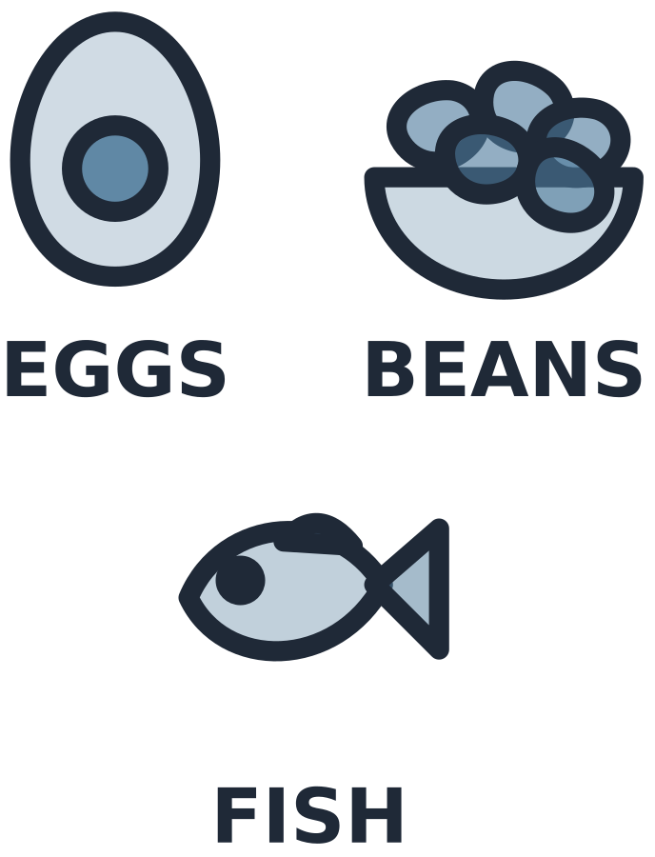
MADE BY MATT / BUILD SCIENCE
Add variety and give evidence
Add a source of protein.
Add fruit or vegetables.
Explain what each addition can provide.
AUTUMN 1 · WEEK 5 · LESSON B
04
Notes:
Independent Work — investigate — 5 minutes within the source's 40-minute lesson.
Next five minutes. Example add beans/lentils for protein growth/repair and carrot/apple for vitamins/minerals/fibre. Multiple valid sets; no prescribed personal meal plan or exact portions. A food may supply several nutrients.
[Sources]
https://github.com/MattRoper1977/Lessons/blob/main/Science_Teesside/Build/SCI_B_W5_Right_Nutrition.html
Git blob: 21014244de9f92bea3c1e10e53d0ce8592ea43ce.
SHA256: 1d06ba869b18be8328cf4723cc91b46298a63c494f95e92aa9563f23b15161d3.
User-supplied logo: approved-logo.jpg (unchanged attachment bytes).
White Rose Education, Year 3 Autumn Block 3 (2024): Nutrition and diet, steps 1 Food groups, 2 Understand the five food groups and 5 Animal diets. Concepts inform original card tasks; source photographs and printables are not redistributed.
[/Sources]
[Sources] https://madebymatt.uk/Lessons/Science_Teesside/Teaching_Packs/BUILD/ — original lesson text, timings and teacher notes retained. https://madebymatt.uk/Lessons/Science_Teesside/Build/ — existing Made by Matt scientific artwork, where shown. [/Sources]

Slide 5

MADE BY MATT / BUILD SCIENCE
Case 2: change the protein source
Start model: meat, rice and vegetables.
Now make the model meat-free.
Which card can replace meat’s protein role?
AUTUMN 1 · WEEK 5 · LESSON B
05
Notes:
Independent Work — investigate — 5 minutes within the source's 40-minute lesson.
Next five minutes. Beans or lentils can replace the meat as a protein source in this simplified model. Rice and vegetables remain. No requirement to disclose beliefs, religion or diet; fictitious requirement suffices.
[Sources]
https://github.com/MattRoper1977/Lessons/blob/main/Science_Teesside/Build/SCI_B_W5_Right_Nutrition.html
Git blob: 21014244de9f92bea3c1e10e53d0ce8592ea43ce.
SHA256: 1d06ba869b18be8328cf4723cc91b46298a63c494f95e92aa9563f23b15161d3.
User-supplied logo: approved-logo.jpg (unchanged attachment bytes).
White Rose Education, Year 3 Autumn Block 3 (2024): Nutrition and diet, steps 1 Food groups, 2 Understand the five food groups and 5 Animal diets. Concepts inform original card tasks; source photographs and printables are not redistributed.
[/Sources]
[Sources] https://madebymatt.uk/Lessons/Science_Teesside/Teaching_Packs/BUILD/ — original lesson text, timings and teacher notes retained. https://madebymatt.uk/Lessons/Science_Teesside/Build/ — existing Made by Matt scientific artwork, where shown. [/Sources]

Slide 6
MADE BY MATT / BUILD SCIENCE
Compare two workable choices
Try a beans version and a lentils version.
Which body job does each help with?
How are the choices alike and different?
AUTUMN 1 · WEEK 5 · LESSON B
06
Notes:
Independent Work — investigate — 5 minutes within the source's 40-minute lesson.
Final five minutes of 20-minute phase. Both supply protein and additional nutrients. Pupils can point to information table or dictate. Do not claim exact nutritional equivalence per gram or that one model covers all bodily needs.
[Sources]
https://github.com/MattRoper1977/Lessons/blob/main/Science_Teesside/Build/SCI_B_W5_Right_Nutrition.html
Git blob: 21014244de9f92bea3c1e10e53d0ce8592ea43ce.
SHA256: 1d06ba869b18be8328cf4723cc91b46298a63c494f95e92aa9563f23b15161d3.
User-supplied logo: approved-logo.jpg (unchanged attachment bytes).
White Rose Education, Year 3 Autumn Block 3 (2024): Nutrition and diet, steps 1 Food groups, 2 Understand the five food groups and 5 Animal diets. Concepts inform original card tasks; source photographs and printables are not redistributed.
[/Sources]
[Sources] https://madebymatt.uk/Lessons/Science_Teesside/Teaching_Packs/BUILD/ — original lesson text, timings and teacher notes retained. https://madebymatt.uk/Lessons/Science_Teesside/Build/ — existing Made by Matt scientific artwork, where shown. [/Sources]

Slide 7
MADE BY MATT / BUILD SCIENCE
Pause: check the reason
Does the reason name a body job?
Check it against the food information.
“I like it” does not show its nutrient job.
AUTUMN 1 · WEEK 5 · LESSON B
07
Notes:
Independent Work — check — 2 minutes within the source's 40-minute lesson.
Two-minute check within source workshop. Preference may be valid in life, but this task’s evidence must connect food and body function. Keep original choice even if reason needs revision.
[Sources]
https://github.com/MattRoper1977/Lessons/blob/main/Science_Teesside/Build/SCI_B_W5_Right_Nutrition.html
Git blob: 21014244de9f92bea3c1e10e53d0ce8592ea43ce.
SHA256: 1d06ba869b18be8328cf4723cc91b46298a63c494f95e92aa9563f23b15161d3.
User-supplied logo: approved-logo.jpg (unchanged attachment bytes).
White Rose Education, Year 3 Autumn Block 3 (2024): Nutrition and diet, steps 1 Food groups, 2 Understand the five food groups and 5 Animal diets. Concepts inform original card tasks; source photographs and printables are not redistributed.
[/Sources]
[Sources] https://madebymatt.uk/Lessons/Science_Teesside/Teaching_Packs/BUILD/ — original lesson text, timings and teacher notes retained. https://madebymatt.uk/Lessons/Science_Teesside/Build/ — existing Made by Matt scientific artwork, where shown. [/Sources]

Slide 8
MADE BY MATT / BUILD SCIENCE
Improve one choice or explanation
Keep the first version of a case.
Change one choice or make the reason clearer.
Show what the food provides.
Save both versions and tidy the cards.
AUTUMN 1 · WEEK 5 · LESSON B
08
Notes:
Independent Work — improve — 6 minutes within the source's 40-minute lesson.
Source final six minutes includes revision and tidy. Example vague “healthy” becomes “lentils provide protein for growth and repair.” Pupil can dictate exact meaning. Retain both versions; no photographs/public sharing required.
[Sources]
https://github.com/MattRoper1977/Lessons/blob/main/Science_Teesside/Build/SCI_B_W5_Right_Nutrition.html
Git blob: 21014244de9f92bea3c1e10e53d0ce8592ea43ce.
SHA256: 1d06ba869b18be8328cf4723cc91b46298a63c494f95e92aa9563f23b15161d3.
User-supplied logo: approved-logo.jpg (unchanged attachment bytes).
White Rose Education, Year 3 Autumn Block 3 (2024): Nutrition and diet, steps 1 Food groups, 2 Understand the five food groups and 5 Animal diets. Concepts inform original card tasks; source photographs and printables are not redistributed.
[/Sources]
[Sources] https://madebymatt.uk/Lessons/Science_Teesside/Teaching_Packs/BUILD/ — original lesson text, timings and teacher notes retained. https://madebymatt.uk/Lessons/Science_Teesside/Build/ — existing Made by Matt scientific artwork, where shown. [/Sources]

Slide 9
MADE BY MATT / BUILD SCIENCE
Your voice can change the lesson
What helped you join in?
What could make the next activity easier?
Point, sign, speak, write or pass privately.
Adult: agree one change and explain any limit.
AUTUMN 1 · WEEK 5 · LESSON B
09
Notes:
Lundy Loop — 4 minutes within the source's 40-minute lesson.
Four minutes within the source lesson. Receive an actual observation or access request; do not force a peer audience. Name what can change now, make the change where possible and check whether it helped. The adult receives and names back the science shown as well as access feedback.
[Sources]
https://github.com/MattRoper1977/Lessons/blob/main/Science_Teesside/Build/SCI_B_W5_Right_Nutrition.html
Git blob: 21014244de9f92bea3c1e10e53d0ce8592ea43ce.
SHA256: 1d06ba869b18be8328cf4723cc91b46298a63c494f95e92aa9563f23b15161d3.
User-supplied logo: approved-logo.jpg (unchanged attachment bytes).
White Rose Education, Year 3 Autumn Block 3 (2024): Nutrition and diet, steps 1 Food groups, 2 Understand the five food groups and 5 Animal diets. Concepts inform original card tasks; source photographs and printables are not redistributed.
[/Sources]
[Sources] https://madebymatt.uk/Lessons/Science_Teesside/Teaching_Packs/BUILD/ — original lesson text, timings and teacher notes retained. https://madebymatt.uk/Lessons/Science_Teesside/Build/ — existing Made by Matt scientific artwork, where shown. [/Sources]

Slide 10
MADE BY MATT / BUILD SCIENCE
Explain a food job
Supported: name one body job of food.
Standard: explain why variety matters.
Stretch: can one food help several jobs?
AUTUMN 1 · WEEK 5 · LESSON B
10
Notes:
Exit Ticket — 4 minutes within the source's 40-minute lesson.
Answers in teacher notes: food gives energy and nutrients for growth/repair and body functions; variety supplies a wider range of nutrients; beans/lentils provide protein plus carbohydrate/fibre. Water essential but no food energy. Accept evidence-linked speech/sign/pointing and record support.
[Sources]
https://github.com/MattRoper1977/Lessons/blob/main/Science_Teesside/Build/SCI_B_W5_Right_Nutrition.html
Git blob: 21014244de9f92bea3c1e10e53d0ce8592ea43ce.
SHA256: 1d06ba869b18be8328cf4723cc91b46298a63c494f95e92aa9563f23b15161d3.
User-supplied logo: approved-logo.jpg (unchanged attachment bytes).
White Rose Education, Year 3 Autumn Block 3 (2024): Nutrition and diet, steps 1 Food groups, 2 Understand the five food groups and 5 Animal diets. Concepts inform original card tasks; source photographs and printables are not redistributed.
[/Sources]
[Sources] https://madebymatt.uk/Lessons/Science_Teesside/Teaching_Packs/BUILD/ — original lesson text, timings and teacher notes retained. https://madebymatt.uk/Lessons/Science_Teesside/Build/ — existing Made by Matt scientific artwork, where shown. [/Sources]

