Slide 1


MADE BY MATT / BUILD SCIENCE
Building a balanced plate
Different foods. A shared set of groups.
I can sort foods and explain what this model can show.
AUTUMN 1 · WEEK 6 · LESSON A
01
Notes:
Overview — 1 minutes within the source's 40-minute lesson.
Monday P3, 11:00-11:40. This one-minute overview is included in the 40-minute lesson.
[Sources]
https://github.com/MattRoper1977/Lessons/blob/main/Science_Teesside/Build/SCI_B_W6_Balanced_Plate.html
Git blob: 186a497288fca4483f58539306d07e5a12d7d819.
SHA256: 238e4f1c87b3932dd255105b0f7fcffa9cd55c9fefc39a89defa500f1c8ae8a2.
User-supplied logo: approved-logo.jpg (unchanged attachment bytes).
White Rose Education, Year 3 Autumn Block 3 (2024): Nutrition and diet, steps 1-4, including Balanced diets and Compare diets. Original teaching models follow current website safeguards and NHS Eatwell grouping; no publisher slide/media copied.
[/Sources]
[Sources] https://madebymatt.uk/Lessons/Science_Teesside/Teaching_Packs/BUILD/ — original lesson text, timings and teacher notes retained. https://madebymatt.uk/Lessons/Science_Teesside/Build/ — existing Made by Matt scientific artwork, where shown. [/Sources]

Slide 2
MADE BY MATT / BUILD SCIENCE
Retrieve a food-job idea
Name or point to a food from last week.
What can it provide for a body?
Now we will group example foods.
AUTUMN 1 · WEEK 6 · LESSON A
02
Notes:
Arrival Task — 4 minutes within the source's 40-minute lesson.
No pupil meal or diet disclosure. Supported points to a food label; standard names a job; stretch recognises overlap. Explain that this model is about broad groups, not judging any individual’s food.
[Sources]
https://github.com/MattRoper1977/Lessons/blob/main/Science_Teesside/Build/SCI_B_W6_Balanced_Plate.html
Git blob: 186a497288fca4483f58539306d07e5a12d7d819.
SHA256: 238e4f1c87b3932dd255105b0f7fcffa9cd55c9fefc39a89defa500f1c8ae8a2.
User-supplied logo: approved-logo.jpg (unchanged attachment bytes).
White Rose Education, Year 3 Autumn Block 3 (2024): Nutrition and diet, steps 1-4, including Balanced diets and Compare diets. Original teaching models follow current website safeguards and NHS Eatwell grouping; no publisher slide/media copied.
[/Sources]
[Sources] https://madebymatt.uk/Lessons/Science_Teesside/Teaching_Packs/BUILD/ — original lesson text, timings and teacher notes retained. https://madebymatt.uk/Lessons/Science_Teesside/Build/ — existing Made by Matt scientific artwork, where shown. [/Sources]

Slide 3
MADE BY MATT / BUILD SCIENCE
Three things we will do
Name the broad food groups.
Sort eight example cards.
Explain balance over a day or week.
AUTUMN 1 · WEEK 6 · LESSON A
03
Notes:
Today at a Glance — 2 minutes within the source's 40-minute lesson.
Prepare eight source cards: rice, bread, carrot, apple, chicken, beans, milk, fortified soya alternative. The source model also names oils/spreads as a small group; do not imply the eight-card set itself shows every food needed.
[Sources]
https://github.com/MattRoper1977/Lessons/blob/main/Science_Teesside/Build/SCI_B_W6_Balanced_Plate.html
Git blob: 186a497288fca4483f58539306d07e5a12d7d819.
SHA256: 238e4f1c87b3932dd255105b0f7fcffa9cd55c9fefc39a89defa500f1c8ae8a2.
User-supplied logo: approved-logo.jpg (unchanged attachment bytes).
White Rose Education, Year 3 Autumn Block 3 (2024): Nutrition and diet, steps 1-4, including Balanced diets and Compare diets. Original teaching models follow current website safeguards and NHS Eatwell grouping; no publisher slide/media copied.
[/Sources]
[Sources] https://madebymatt.uk/Lessons/Science_Teesside/Teaching_Packs/BUILD/ — original lesson text, timings and teacher notes retained. https://madebymatt.uk/Lessons/Science_Teesside/Build/ — existing Made by Matt scientific artwork, where shown. [/Sources]

Slide 4
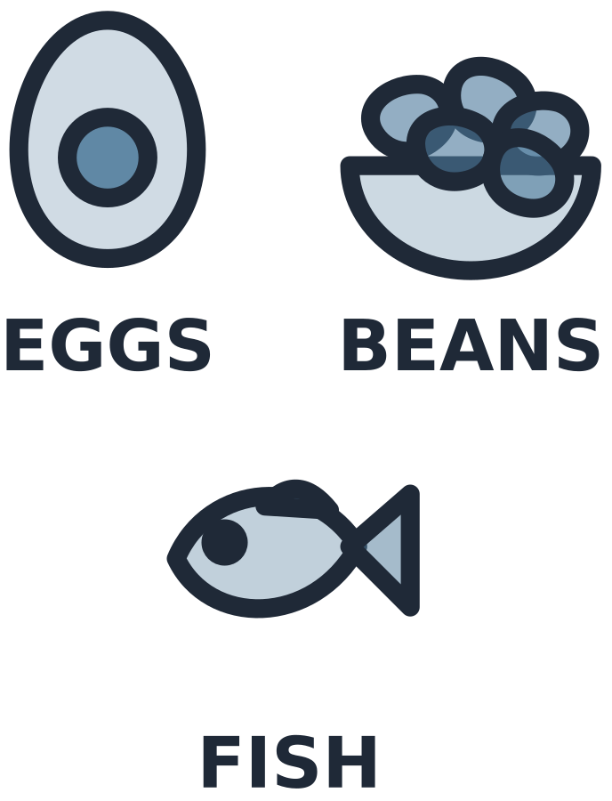
MADE BY MATT / BUILD SCIENCE
Five broad food groups
TWO LARGE GROUPS
OTHER GROUPS
Fruit and vegetables
Starchy carbohydrate foods
Protein-source foods
Dairy and alternatives
Oils and spreads
AUTUMN 1 · WEEK 6 · LESSON A
04
Notes:
I Do 1 — 5 minutes within the source's 40-minute lesson.
Name full protein group orally: beans, pulses, fish, eggs, meat and other protein. These are broad Eatwell groups; fats/sugars is not substituted as a fifth group. Oils/spreads form a small group in the guide. No exact area proportions or personal portion targets inferred from this text model.
[Sources]
https://github.com/MattRoper1977/Lessons/blob/main/Science_Teesside/Build/SCI_B_W6_Balanced_Plate.html
Git blob: 186a497288fca4483f58539306d07e5a12d7d819.
SHA256: 238e4f1c87b3932dd255105b0f7fcffa9cd55c9fefc39a89defa500f1c8ae8a2.
User-supplied logo: approved-logo.jpg (unchanged attachment bytes).
White Rose Education, Year 3 Autumn Block 3 (2024): Nutrition and diet, steps 1-4, including Balanced diets and Compare diets. Original teaching models follow current website safeguards and NHS Eatwell grouping; no publisher slide/media copied.
[/Sources]
[Sources] https://madebymatt.uk/Lessons/Science_Teesside/Teaching_Packs/BUILD/ — original lesson text, timings and teacher notes retained. https://madebymatt.uk/Lessons/Science_Teesside/Build/ — existing Made by Matt scientific artwork, where shown. [/Sources]

Slide 5

MADE BY MATT / BUILD SCIENCE
Place one food, explain its group
Pasta belongs with starchy carbohydrate foods, such as bread, rice and potatoes.
The group is about the food’s broad place in this model.
AUTUMN 1 · WEEK 6 · LESSON A
05
Notes:
I Do 1b — 4 minutes within the source's 40-minute lesson.
Model evidence rather than preference. Potato is classed with starchy foods in Eatwell grouping, although botanically a plant food. A mixed dish may contain several groups; not every food has one exclusive nutrient role.
[Sources]
https://github.com/MattRoper1977/Lessons/blob/main/Science_Teesside/Build/SCI_B_W6_Balanced_Plate.html
Git blob: 186a497288fca4483f58539306d07e5a12d7d819.
SHA256: 238e4f1c87b3932dd255105b0f7fcffa9cd55c9fefc39a89defa500f1c8ae8a2.
User-supplied logo: approved-logo.jpg (unchanged attachment bytes).
White Rose Education, Year 3 Autumn Block 3 (2024): Nutrition and diet, steps 1-4, including Balanced diets and Compare diets. Original teaching models follow current website safeguards and NHS Eatwell grouping; no publisher slide/media copied.
[/Sources]
[Sources] https://madebymatt.uk/Lessons/Science_Teesside/Teaching_Packs/BUILD/ — original lesson text, timings and teacher notes retained. https://madebymatt.uk/Lessons/Science_Teesside/Build/ — existing Made by Matt scientific artwork, where shown. [/Sources]

Slide 6
MADE BY MATT / BUILD SCIENCE
Where do these four cards go?
Rice and bread
Carrot and apple
Choose the broad group for each pair.
AUTUMN 1 · WEEK 6 · LESSON A
06
Notes:
We Do 1 — first sort — 3 minutes within the source's 40-minute lesson.
Collect choices before explanation. Rice/bread = starchy foods. Carrot/apple = fruit and vegetables. Pupil may point to the groups; colour is supplementary, words stay visible.
[Sources]
https://github.com/MattRoper1977/Lessons/blob/main/Science_Teesside/Build/SCI_B_W6_Balanced_Plate.html
Git blob: 186a497288fca4483f58539306d07e5a12d7d819.
SHA256: 238e4f1c87b3932dd255105b0f7fcffa9cd55c9fefc39a89defa500f1c8ae8a2.
User-supplied logo: approved-logo.jpg (unchanged attachment bytes).
White Rose Education, Year 3 Autumn Block 3 (2024): Nutrition and diet, steps 1-4, including Balanced diets and Compare diets. Original teaching models follow current website safeguards and NHS Eatwell grouping; no publisher slide/media copied.
[/Sources]
[Sources] https://madebymatt.uk/Lessons/Science_Teesside/Teaching_Packs/BUILD/ — original lesson text, timings and teacher notes retained. https://madebymatt.uk/Lessons/Science_Teesside/Build/ — existing Made by Matt scientific artwork, where shown. [/Sources]

Slide 7

MADE BY MATT / BUILD SCIENCE
Now place the other four cards
Chicken and beans
Milk and fortified soya alternative
Name the group; then check the labels.
AUTUMN 1 · WEEK 6 · LESSON A
07
Notes:
We Do 1 — second sort — 3 minutes within the source's 40-minute lesson.
Chicken/beans = broad protein group. Milk/fortified soya alternative = dairy and alternatives. “Alternative” does not mean identical nutrient profile; chosen example is fortified soya. Check package evidence in real life, but use only paper cards here.
[Sources]
https://github.com/MattRoper1977/Lessons/blob/main/Science_Teesside/Build/SCI_B_W6_Balanced_Plate.html
Git blob: 186a497288fca4483f58539306d07e5a12d7d819.
SHA256: 238e4f1c87b3932dd255105b0f7fcffa9cd55c9fefc39a89defa500f1c8ae8a2.
User-supplied logo: approved-logo.jpg (unchanged attachment bytes).
White Rose Education, Year 3 Autumn Block 3 (2024): Nutrition and diet, steps 1-4, including Balanced diets and Compare diets. Original teaching models follow current website safeguards and NHS Eatwell grouping; no publisher slide/media copied.
[/Sources]
[Sources] https://madebymatt.uk/Lessons/Science_Teesside/Teaching_Packs/BUILD/ — original lesson text, timings and teacher notes retained. https://madebymatt.uk/Lessons/Science_Teesside/Build/ — existing Made by Matt scientific artwork, where shown. [/Sources]

Slide 8
MADE BY MATT / BUILD SCIENCE
What does balance mean?
THE MODEL HELPS SHOW
IT DOES NOT REQUIRE
A range across the groups.
Variety within the groups.
Patterns over a day or week.
Every meal to copy a diagram.
Exact portions from these cards.
Judging anyone’s real food.
AUTUMN 1 · WEEK 6 · LESSON A
08
Notes:
We Do 1b — 4 minutes within the source's 40-minute lesson.
Ask which two groups are the largest in the Eatwell model: fruit/vegetables and starchy foods. State oils/spreads is small. The eight source cards omit an oil example; this is a limitation of a simplified activity, not a ban. Teacher may name olive oil as a reference example without requiring extra food.
[Sources]
https://github.com/MattRoper1977/Lessons/blob/main/Science_Teesside/Build/SCI_B_W6_Balanced_Plate.html
Git blob: 186a497288fca4483f58539306d07e5a12d7d819.
SHA256: 238e4f1c87b3932dd255105b0f7fcffa9cd55c9fefc39a89defa500f1c8ae8a2.
User-supplied logo: approved-logo.jpg (unchanged attachment bytes).
White Rose Education, Year 3 Autumn Block 3 (2024): Nutrition and diet, steps 1-4, including Balanced diets and Compare diets. Original teaching models follow current website safeguards and NHS Eatwell grouping; no publisher slide/media copied.
[/Sources]
[Sources] https://madebymatt.uk/Lessons/Science_Teesside/Teaching_Packs/BUILD/ — original lesson text, timings and teacher notes retained. https://madebymatt.uk/Lessons/Science_Teesside/Build/ — existing Made by Matt scientific artwork, where shown. [/Sources]

Slide 9

MADE BY MATT / BUILD SCIENCE
Explain it without a vague label
A balanced pattern includes a range of food groups over a day or week.
One plate of cards cannot show all a person’s food needs.
AUTUMN 1 · WEEK 6 · LESSON A
09
Notes:
I Do 2 — 4 minutes within the source's 40-minute lesson.
The word healthy alone is not the scientific explanation. Model a specific explanation with variety, groups and time. Avoid “bad food”, banned food, weight or calorie discussion. Teacher follow individual support plan outside this lesson.
[Sources]
https://github.com/MattRoper1977/Lessons/blob/main/Science_Teesside/Build/SCI_B_W6_Balanced_Plate.html
Git blob: 186a497288fca4483f58539306d07e5a12d7d819.
SHA256: 238e4f1c87b3932dd255105b0f7fcffa9cd55c9fefc39a89defa500f1c8ae8a2.
User-supplied logo: approved-logo.jpg (unchanged attachment bytes).
White Rose Education, Year 3 Autumn Block 3 (2024): Nutrition and diet, steps 1-4, including Balanced diets and Compare diets. Original teaching models follow current website safeguards and NHS Eatwell grouping; no publisher slide/media copied.
[/Sources]
[Sources] https://madebymatt.uk/Lessons/Science_Teesside/Teaching_Packs/BUILD/ — original lesson text, timings and teacher notes retained. https://madebymatt.uk/Lessons/Science_Teesside/Build/ — existing Made by Matt scientific artwork, where shown. [/Sources]

Slide 10
MADE BY MATT / BUILD SCIENCE
Which claims need improving?
READ THE CLAIM
TEST IT WITH THE MODEL
Some from the different groups.
Only one group is needed.
Sometimes foods are banned.
What can a range provide?
Does a single group show variety?
Does the guide ban foods?
AUTUMN 1 · WEEK 6 · LESSON A
10
Notes:
We Do 2 — sort — 5 minutes within the source's 40-minute lesson.
First claim fits broad concept; only one group is insufficient to represent balance; banned claim false. Foods high in fat/salt/sugar can be included less often/in smaller amounts in official general guide, but no individual targets or moral labels. Source false claim “chips are a bad food” is challenged rather than endorsed.
[Sources]
https://github.com/MattRoper1977/Lessons/blob/main/Science_Teesside/Build/SCI_B_W6_Balanced_Plate.html
Git blob: 186a497288fca4483f58539306d07e5a12d7d819.
SHA256: 238e4f1c87b3932dd255105b0f7fcffa9cd55c9fefc39a89defa500f1c8ae8a2.
User-supplied logo: approved-logo.jpg (unchanged attachment bytes).
White Rose Education, Year 3 Autumn Block 3 (2024): Nutrition and diet, steps 1-4, including Balanced diets and Compare diets. Original teaching models follow current website safeguards and NHS Eatwell grouping; no publisher slide/media copied.
[/Sources]
[Sources] https://madebymatt.uk/Lessons/Science_Teesside/Teaching_Packs/BUILD/ — original lesson text, timings and teacher notes retained. https://madebymatt.uk/Lessons/Science_Teesside/Build/ — existing Made by Matt scientific artwork, where shown. [/Sources]

Slide 11
MADE BY MATT / BUILD SCIENCE
Swap within a group and save
Swap rice for bread.
Swap chicken for beans.
Explain why the broad group still fits.
Save the labelled cards for Wednesday.
AUTUMN 1 · WEEK 6 · LESSON A
11
Notes:
We Do 2 — check and save — 5 minutes within the source's 40-minute lesson.
Five minutes completes source ten-minute stage. Swaps preserve broad group, not exact nutrient equivalence or portion. Each learner can point, sign or direct. A mixed-food example can be unpacked if offered; no personal eating disclosures.
[Sources]
https://github.com/MattRoper1977/Lessons/blob/main/Science_Teesside/Build/SCI_B_W6_Balanced_Plate.html
Git blob: 186a497288fca4483f58539306d07e5a12d7d819.
SHA256: 238e4f1c87b3932dd255105b0f7fcffa9cd55c9fefc39a89defa500f1c8ae8a2.
User-supplied logo: approved-logo.jpg (unchanged attachment bytes).
White Rose Education, Year 3 Autumn Block 3 (2024): Nutrition and diet, steps 1-4, including Balanced diets and Compare diets. Original teaching models follow current website safeguards and NHS Eatwell grouping; no publisher slide/media copied.
[/Sources]
[Sources] https://madebymatt.uk/Lessons/Science_Teesside/Teaching_Packs/BUILD/ — original lesson text, timings and teacher notes retained. https://madebymatt.uk/Lessons/Science_Teesside/Build/ — existing Made by Matt scientific artwork, where shown. [/Sources]

