Slide 1

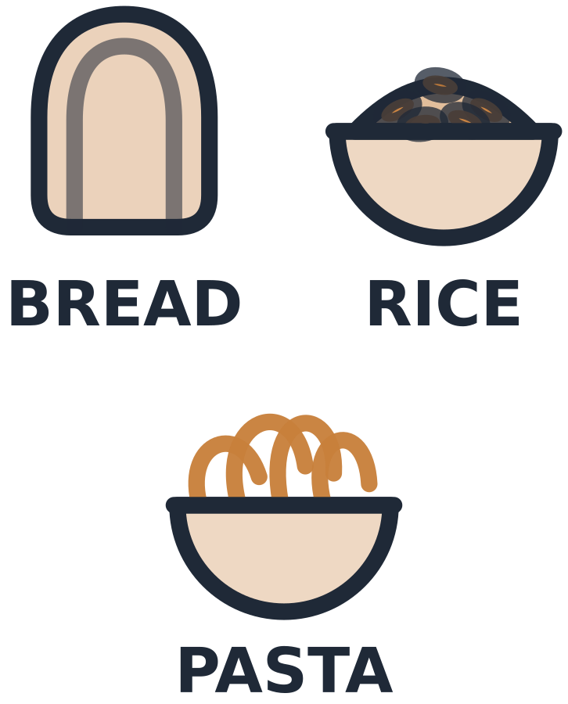
MADE BY MATT / BUILD SCIENCE
Compare and revise model plates
A different food can fit the same group.
I can justify a swap and explain the model’s limits.
AUTUMN 1 · WEEK 6 · LESSON B
01
Notes:
Workshop reference — 0 minutes within the source's 40-minute lesson.
Wednesday P2, 10:10-10:50. Reference screen only; start the 32-minute workshop immediately. No additional starter or lesson time.
[Sources]
https://github.com/MattRoper1977/Lessons/blob/main/Science_Teesside/Build/SCI_B_W6_Balanced_Plate.html
Git blob: 186a497288fca4483f58539306d07e5a12d7d819.
SHA256: 238e4f1c87b3932dd255105b0f7fcffa9cd55c9fefc39a89defa500f1c8ae8a2.
User-supplied logo: approved-logo.jpg (unchanged attachment bytes).
White Rose Education, Year 3 Autumn Block 3 (2024): Nutrition and diet, steps 1-4, including Balanced diets and Compare diets. Original teaching models follow current website safeguards and NHS Eatwell grouping; no publisher slide/media copied.
[/Sources]
[Sources] https://madebymatt.uk/Lessons/Science_Teesside/Teaching_Packs/BUILD/ — original lesson text, timings and teacher notes retained. https://madebymatt.uk/Lessons/Science_Teesside/Build/ — existing Made by Matt scientific artwork, where shown. [/Sources]

Slide 2
MADE BY MATT / BUILD SCIENCE
Return to your labelled groups
Find Monday’s group labels and cards.
Name or point to the five broad groups.
Choose: move, draw, label or direct.
AUTUMN 1 · WEEK 6 · LESSON B
02
Notes:
Independent Work — retrieve — 4 minutes within the source's 40-minute lesson.
Four-minute source preparation. Use eight reference food cards and five broad group labels. Oils/spreads group remains in the reference although the eight-card set has no oil card. This is a simplified model, not actual meals.
[Sources]
https://github.com/MattRoper1977/Lessons/blob/main/Science_Teesside/Build/SCI_B_W6_Balanced_Plate.html
Git blob: 186a497288fca4483f58539306d07e5a12d7d819.
SHA256: 238e4f1c87b3932dd255105b0f7fcffa9cd55c9fefc39a89defa500f1c8ae8a2.
User-supplied logo: approved-logo.jpg (unchanged attachment bytes).
White Rose Education, Year 3 Autumn Block 3 (2024): Nutrition and diet, steps 1-4, including Balanced diets and Compare diets. Original teaching models follow current website safeguards and NHS Eatwell grouping; no publisher slide/media copied.
[/Sources]
[Sources] https://madebymatt.uk/Lessons/Science_Teesside/Teaching_Packs/BUILD/ — original lesson text, timings and teacher notes retained. https://madebymatt.uk/Lessons/Science_Teesside/Build/ — existing Made by Matt scientific artwork, where shown. [/Sources]

Slide 3
MADE BY MATT / BUILD SCIENCE
Case A: group the four foods
Rice
Chicken
Carrot
Milk
AUTUMN 1 · WEEK 6 · LESSON B
03
Notes:
Independent Work — investigate — 5 minutes within the source's 40-minute lesson.
First five minutes of 20-minute investigation. Read case A as fictional food cards. Expected groups: starchy, protein, fruit/vegetables, dairy/alternatives. Ask pupil to place labels. Do not claim a complete balanced real meal from these four cards or infer portions.
[Sources]
https://github.com/MattRoper1977/Lessons/blob/main/Science_Teesside/Build/SCI_B_W6_Balanced_Plate.html
Git blob: 186a497288fca4483f58539306d07e5a12d7d819.
SHA256: 238e4f1c87b3932dd255105b0f7fcffa9cd55c9fefc39a89defa500f1c8ae8a2.
User-supplied logo: approved-logo.jpg (unchanged attachment bytes).
White Rose Education, Year 3 Autumn Block 3 (2024): Nutrition and diet, steps 1-4, including Balanced diets and Compare diets. Original teaching models follow current website safeguards and NHS Eatwell grouping; no publisher slide/media copied.
[/Sources]
[Sources] https://madebymatt.uk/Lessons/Science_Teesside/Teaching_Packs/BUILD/ — original lesson text, timings and teacher notes retained. https://madebymatt.uk/Lessons/Science_Teesside/Build/ — existing Made by Matt scientific artwork, where shown. [/Sources]

Slide 4
MADE BY MATT / BUILD SCIENCE
Case B: different cards
Bread
Beans
Apple
Fortified soya alternative
AUTUMN 1 · WEEK 6 · LESSON B
04
Notes:
Independent Work — investigate — 5 minutes within the source's 40-minute lesson.
Next five minutes. Same broad group pattern as case A using different foods. Fortified soya is a labelled example, not every plant drink automatically nutritionally equivalent. Keep examples fictional and neutral.
[Sources]
https://github.com/MattRoper1977/Lessons/blob/main/Science_Teesside/Build/SCI_B_W6_Balanced_Plate.html
Git blob: 186a497288fca4483f58539306d07e5a12d7d819.
SHA256: 238e4f1c87b3932dd255105b0f7fcffa9cd55c9fefc39a89defa500f1c8ae8a2.
User-supplied logo: approved-logo.jpg (unchanged attachment bytes).
White Rose Education, Year 3 Autumn Block 3 (2024): Nutrition and diet, steps 1-4, including Balanced diets and Compare diets. Original teaching models follow current website safeguards and NHS Eatwell grouping; no publisher slide/media copied.
[/Sources]
[Sources] https://madebymatt.uk/Lessons/Science_Teesside/Teaching_Packs/BUILD/ — original lesson text, timings and teacher notes retained. https://madebymatt.uk/Lessons/Science_Teesside/Build/ — existing Made by Matt scientific artwork, where shown. [/Sources]

Slide 5
MADE BY MATT / BUILD SCIENCE
Compare the two models
WHAT CHANGED?
WHAT IS ALIKE?
Rice → bread
Chicken → beans
Carrot → apple
Milk → fortified soya
The specific foods differ.
Broad groups are similar.
Both models remain limited.
AUTUMN 1 · WEEK 6 · LESSON B
05
Notes:
Independent Work — investigate — 5 minutes within the source's 40-minute lesson.
Next five minutes. These arrows indicate a card swap, not food-chain energy arrows. Adult can read full fortified-soya-alternative label. Same group pattern does not mean matching nutrients/portions. Ask learners to explain one correspondence.
[Sources]
https://github.com/MattRoper1977/Lessons/blob/main/Science_Teesside/Build/SCI_B_W6_Balanced_Plate.html
Git blob: 186a497288fca4483f58539306d07e5a12d7d819.
SHA256: 238e4f1c87b3932dd255105b0f7fcffa9cd55c9fefc39a89defa500f1c8ae8a2.
User-supplied logo: approved-logo.jpg (unchanged attachment bytes).
White Rose Education, Year 3 Autumn Block 3 (2024): Nutrition and diet, steps 1-4, including Balanced diets and Compare diets. Original teaching models follow current website safeguards and NHS Eatwell grouping; no publisher slide/media copied.
[/Sources]
[Sources] https://madebymatt.uk/Lessons/Science_Teesside/Teaching_Packs/BUILD/ — original lesson text, timings and teacher notes retained. https://madebymatt.uk/Lessons/Science_Teesside/Build/ — existing Made by Matt scientific artwork, where shown. [/Sources]

Slide 6

MADE BY MATT / BUILD SCIENCE
Make a protein-source swap
Start with the chicken card in case A.
Use beans to make a meat-free model.
Name the broad group that stays the same.
Could lentils be another option?
AUTUMN 1 · WEEK 6 · LESSON B
06
Notes:
Independent Work — investigate — 5 minutes within the source's 40-minute lesson.
Final five minutes of source 20-minute phase. Beans/lentils are protein-source examples. Lentils can be written as an additional answer; main eight-card set stays intact. Multiple alternatives allowed; no personal belief/diet justification required.
[Sources]
https://github.com/MattRoper1977/Lessons/blob/main/Science_Teesside/Build/SCI_B_W6_Balanced_Plate.html
Git blob: 186a497288fca4483f58539306d07e5a12d7d819.
SHA256: 238e4f1c87b3932dd255105b0f7fcffa9cd55c9fefc39a89defa500f1c8ae8a2.
User-supplied logo: approved-logo.jpg (unchanged attachment bytes).
White Rose Education, Year 3 Autumn Block 3 (2024): Nutrition and diet, steps 1-4, including Balanced diets and Compare diets. Original teaching models follow current website safeguards and NHS Eatwell grouping; no publisher slide/media copied.
[/Sources]
[Sources] https://madebymatt.uk/Lessons/Science_Teesside/Teaching_Packs/BUILD/ — original lesson text, timings and teacher notes retained. https://madebymatt.uk/Lessons/Science_Teesside/Build/ — existing Made by Matt scientific artwork, where shown. [/Sources]

Slide 7
MADE BY MATT / BUILD SCIENCE
Pause and check what is missing
Check the five-group reference.
Does either model show every group?
Could a food appear at another time?
AUTUMN 1 · WEEK 6 · LESSON B
07
Notes:
Independent Work — check — 2 minutes within the source's 40-minute lesson.
Two-minute source check. Eight-card examples omit oils/spreads. A simplified single model does not show the full day/week or all requirements. Do not mark pupil as unhealthy because a paper model is incomplete.
[Sources]
https://github.com/MattRoper1977/Lessons/blob/main/Science_Teesside/Build/SCI_B_W6_Balanced_Plate.html
Git blob: 186a497288fca4483f58539306d07e5a12d7d819.
SHA256: 238e4f1c87b3932dd255105b0f7fcffa9cd55c9fefc39a89defa500f1c8ae8a2.
User-supplied logo: approved-logo.jpg (unchanged attachment bytes).
White Rose Education, Year 3 Autumn Block 3 (2024): Nutrition and diet, steps 1-4, including Balanced diets and Compare diets. Original teaching models follow current website safeguards and NHS Eatwell grouping; no publisher slide/media copied.
[/Sources]
[Sources] https://madebymatt.uk/Lessons/Science_Teesside/Teaching_Packs/BUILD/ — original lesson text, timings and teacher notes retained. https://madebymatt.uk/Lessons/Science_Teesside/Build/ — existing Made by Matt scientific artwork, where shown. [/Sources]

Slide 8
MADE BY MATT / BUILD SCIENCE
Revise, explain and keep evidence
Keep your first and revised models together.
Give a reason for one swap.
Name one thing the model cannot tell us.
Save the record and put cards away.
AUTUMN 1 · WEEK 6 · LESSON B
08
Notes:
Independent Work — improve — 6 minutes within the source's 40-minute lesson.
Final six-minute phase includes tidy. Explanation: beans replace chicken within broad protein group; whole diets and exact amounts not established. Pupil can point to matching group or dictate a reason. No real food, photos or public sharing needed.
[Sources]
https://github.com/MattRoper1977/Lessons/blob/main/Science_Teesside/Build/SCI_B_W6_Balanced_Plate.html
Git blob: 186a497288fca4483f58539306d07e5a12d7d819.
SHA256: 238e4f1c87b3932dd255105b0f7fcffa9cd55c9fefc39a89defa500f1c8ae8a2.
User-supplied logo: approved-logo.jpg (unchanged attachment bytes).
White Rose Education, Year 3 Autumn Block 3 (2024): Nutrition and diet, steps 1-4, including Balanced diets and Compare diets. Original teaching models follow current website safeguards and NHS Eatwell grouping; no publisher slide/media copied.
[/Sources]
[Sources] https://madebymatt.uk/Lessons/Science_Teesside/Teaching_Packs/BUILD/ — original lesson text, timings and teacher notes retained. https://madebymatt.uk/Lessons/Science_Teesside/Build/ — existing Made by Matt scientific artwork, where shown. [/Sources]

Slide 9
MADE BY MATT / BUILD SCIENCE
Your voice can change the lesson
What helped you join in?
What could make the next activity easier?
Point, sign, speak, write or pass privately.
Adult: agree one change and explain any limit.
AUTUMN 1 · WEEK 6 · LESSON B
09
Notes:
Lundy Loop — 4 minutes within the source's 40-minute lesson.
Four minutes within the source lesson. Receive an actual observation or access request; do not force a peer audience. Name what can change now, make the change where possible and check whether it helped. The adult receives and names back the science shown as well as access feedback.
[Sources]
https://github.com/MattRoper1977/Lessons/blob/main/Science_Teesside/Build/SCI_B_W6_Balanced_Plate.html
Git blob: 186a497288fca4483f58539306d07e5a12d7d819.
SHA256: 238e4f1c87b3932dd255105b0f7fcffa9cd55c9fefc39a89defa500f1c8ae8a2.
User-supplied logo: approved-logo.jpg (unchanged attachment bytes).
White Rose Education, Year 3 Autumn Block 3 (2024): Nutrition and diet, steps 1-4, including Balanced diets and Compare diets. Original teaching models follow current website safeguards and NHS Eatwell grouping; no publisher slide/media copied.
[/Sources]
[Sources] https://madebymatt.uk/Lessons/Science_Teesside/Teaching_Packs/BUILD/ — original lesson text, timings and teacher notes retained. https://madebymatt.uk/Lessons/Science_Teesside/Build/ — existing Made by Matt scientific artwork, where shown. [/Sources]

Slide 10
MADE BY MATT / BUILD SCIENCE
What stays the same after a swap?
Supported: name a food in the protein group.
Standard: explain the chicken-to-beans swap.
Stretch: why can’t one plate show all needs?
AUTUMN 1 · WEEK 6 · LESSON B
10
Notes:
Exit Ticket — 4 minutes within the source's 40-minute lesson.
Teacher answers only: chicken/beans/lentils/fish/eggs etc in protein group; swap preserves broad group but not exact nutrient equivalence; personal needs, full day/week intake and portions lie outside this simple model. Adult receives actual reasoning and chooses next step.
[Sources]
https://github.com/MattRoper1977/Lessons/blob/main/Science_Teesside/Build/SCI_B_W6_Balanced_Plate.html
Git blob: 186a497288fca4483f58539306d07e5a12d7d819.
SHA256: 238e4f1c87b3932dd255105b0f7fcffa9cd55c9fefc39a89defa500f1c8ae8a2.
User-supplied logo: approved-logo.jpg (unchanged attachment bytes).
White Rose Education, Year 3 Autumn Block 3 (2024): Nutrition and diet, steps 1-4, including Balanced diets and Compare diets. Original teaching models follow current website safeguards and NHS Eatwell grouping; no publisher slide/media copied.
[/Sources]
[Sources] https://madebymatt.uk/Lessons/Science_Teesside/Teaching_Packs/BUILD/ — original lesson text, timings and teacher notes retained. https://madebymatt.uk/Lessons/Science_Teesside/Build/ — existing Made by Matt scientific artwork, where shown. [/Sources]

