Slide 1

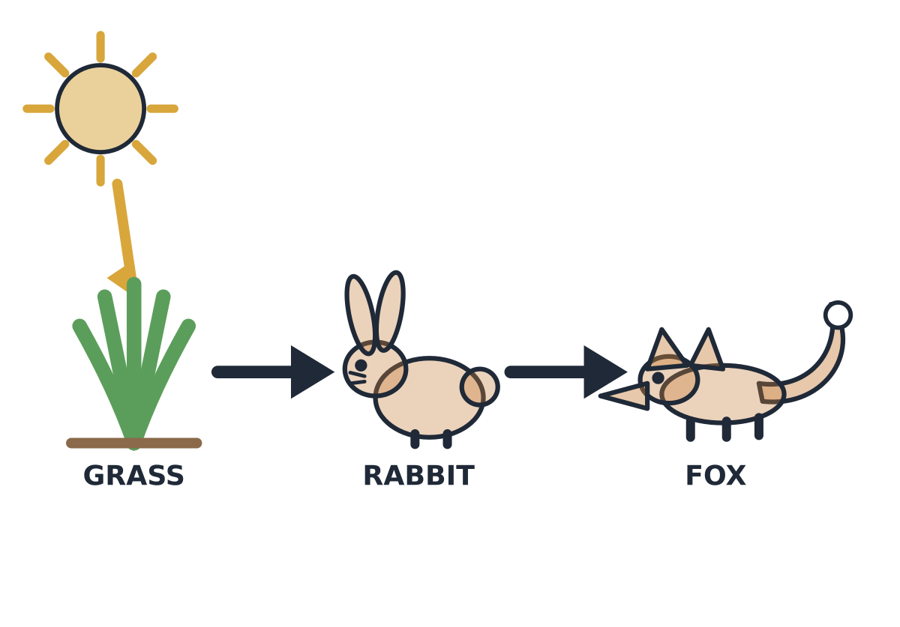
MADE BY MATT / BUILD SCIENCE
Animals get food by eating
Follow the food and its energy.
I can build a food chain and explain its arrows.
AUTUMN 1 · WEEK 7 · LESSON A
01
Notes:
Overview — 1 minutes within the source's 40-minute lesson.
Monday P3, 11:00-11:40. This one-minute overview is included in the 40-minute lesson.
[Sources]
https://github.com/MattRoper1977/Lessons/blob/main/Science_Teesside/Build/SCI_B_W7_Where_Food_Comes_From.html
Git blob: 3d5eb9032e658d14ac5911d9031b5bc5fe6fa393.
SHA256: a5d84a74f963224ee2d643bb8e2f98397f61ae569ba685ba571331d63a35f767.
User-supplied logo: approved-logo.jpg (unchanged attachment bytes).
White Rose Education, Year 3 Autumn Block 3 (2024), step 5 Animal diets, enriches producer/consumer discussion from the current website. Original food-chain models supply the current curriculum content; publisher media and worksheets are not copied.
[/Sources]
[Sources] https://madebymatt.uk/Lessons/Science_Teesside/Teaching_Packs/BUILD/ — original lesson text, timings and teacher notes retained. https://madebymatt.uk/Lessons/Science_Teesside/Build/ — existing Made by Matt scientific artwork, where shown. [/Sources]

Slide 2

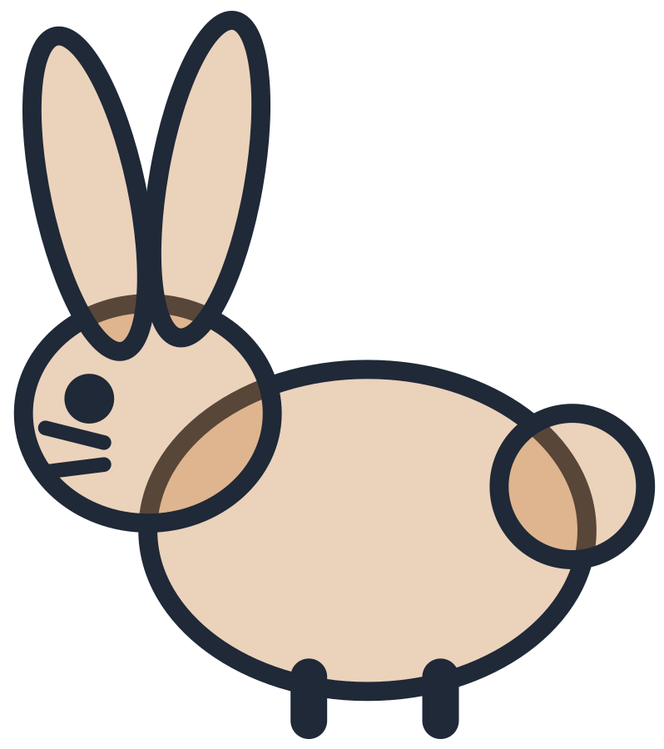
MADE BY MATT / BUILD SCIENCE
Start with a feeding link
A rabbit can eat grass.
Which living thing is the plant?
Who gets the food when the rabbit eats?
AUTUMN 1 · WEEK 7 · LESSON A
02
Notes:
Arrival Task — 4 minutes within the source's 40-minute lesson.
Supported points to grass label; standard names rabbit food; stretch proposes one feeding link. Use source examples, not a pupil’s own food. No collecting or feeding animals. First idea can be uncertain.
[Sources]
https://github.com/MattRoper1977/Lessons/blob/main/Science_Teesside/Build/SCI_B_W7_Where_Food_Comes_From.html
Git blob: 3d5eb9032e658d14ac5911d9031b5bc5fe6fa393.
SHA256: a5d84a74f963224ee2d643bb8e2f98397f61ae569ba685ba571331d63a35f767.
User-supplied logo: approved-logo.jpg (unchanged attachment bytes).
White Rose Education, Year 3 Autumn Block 3 (2024), step 5 Animal diets, enriches producer/consumer discussion from the current website. Original food-chain models supply the current curriculum content; publisher media and worksheets are not copied.
[/Sources]
[Sources] https://madebymatt.uk/Lessons/Science_Teesside/Teaching_Packs/BUILD/ — original lesson text, timings and teacher notes retained. https://madebymatt.uk/Lessons/Science_Teesside/Build/ — existing Made by Matt scientific artwork, where shown. [/Sources]

Slide 3
MADE BY MATT / BUILD SCIENCE
Three things we will do
Identify a producer and consumers.
Read the food-chain arrow.
Build and check a simple chain.
AUTUMN 1 · WEEK 7 · LESSON A
03
Notes:
Today at a Glance — 2 minutes within the source's 40-minute lesson.
Producer/consumer are roles in these examples. Green plants make food using light; animals obtain food from eating. Do not teach that plant roots take food from soil or that all producers must be plants.
[Sources]
https://github.com/MattRoper1977/Lessons/blob/main/Science_Teesside/Build/SCI_B_W7_Where_Food_Comes_From.html
Git blob: 3d5eb9032e658d14ac5911d9031b5bc5fe6fa393.
SHA256: a5d84a74f963224ee2d643bb8e2f98397f61ae569ba685ba571331d63a35f767.
User-supplied logo: approved-logo.jpg (unchanged attachment bytes).
White Rose Education, Year 3 Autumn Block 3 (2024), step 5 Animal diets, enriches producer/consumer discussion from the current website. Original food-chain models supply the current curriculum content; publisher media and worksheets are not copied.
[/Sources]
[Sources] https://madebymatt.uk/Lessons/Science_Teesside/Teaching_Packs/BUILD/ — original lesson text, timings and teacher notes retained. https://madebymatt.uk/Lessons/Science_Teesside/Build/ — existing Made by Matt scientific artwork, where shown. [/Sources]

Slide 4
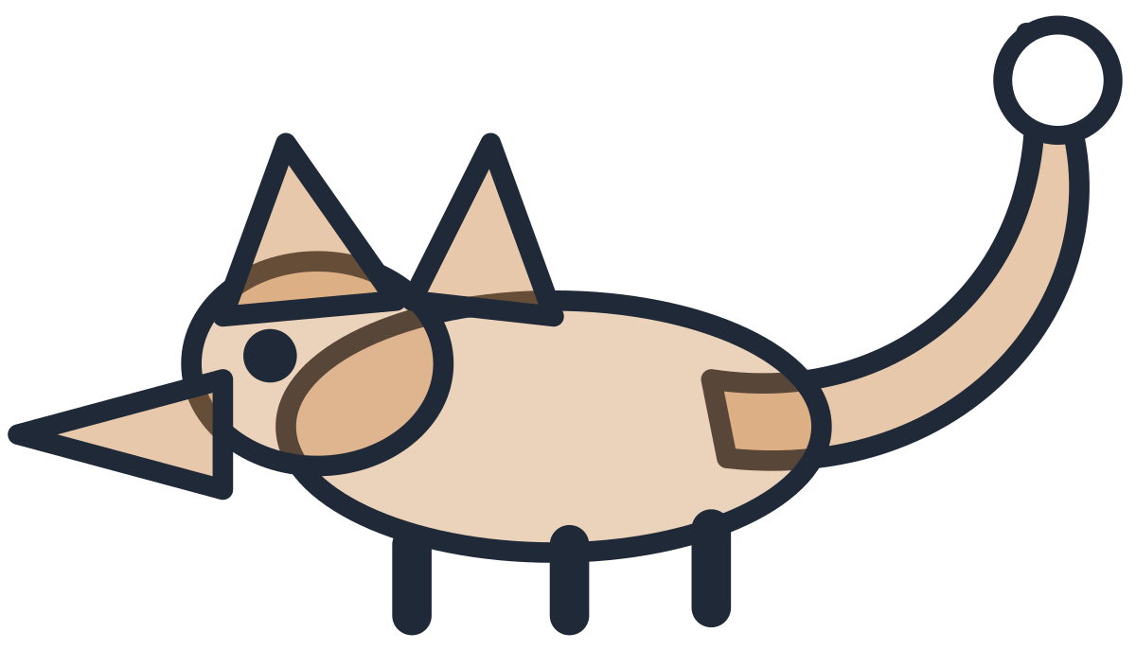
MADE BY MATT / BUILD SCIENCE
Read the chain from food to eater
Grass can be eaten by a rabbit. A rabbit can be eaten by a fox.
grass
rabbit
fox
producer
consumer
consumer
The arrows show food and energy passing to the eater.
food / energy passes to the eater
AUTUMN 1 · WEEK 7 · LESSON A
04
Notes:
I Do 1 — 5 minutes within the source's 40-minute lesson.
Original native editable scientific chain. Arrows run grass → rabbit → fox. “Is eaten by” is the accessible reading. Grass is the producer in this model; rabbit and fox are consumers. The chain selects possible feeding links rather than describing everything the animals eat.
[Sources]
https://github.com/MattRoper1977/Lessons/blob/main/Science_Teesside/Build/SCI_B_W7_Where_Food_Comes_From.html
Git blob: 3d5eb9032e658d14ac5911d9031b5bc5fe6fa393.
SHA256: a5d84a74f963224ee2d643bb8e2f98397f61ae569ba685ba571331d63a35f767.
User-supplied logo: approved-logo.jpg (unchanged attachment bytes).
White Rose Education, Year 3 Autumn Block 3 (2024), step 5 Animal diets, enriches producer/consumer discussion from the current website. Original food-chain models supply the current curriculum content; publisher media and worksheets are not copied.
[/Sources]
[Sources] https://madebymatt.uk/Lessons/Science_Teesside/Teaching_Packs/BUILD/ — original lesson text, timings and teacher notes retained. https://madebymatt.uk/Lessons/Science_Teesside/Build/ — existing Made by Matt scientific artwork, where shown. [/Sources]

Slide 5
MADE BY MATT / BUILD SCIENCE
A reversed arrow changes meaning
WRONG FOR THESE CLUES
CHECK THE EVIDENCE
Rabbit → grass
This would pass food to grass.
Grass → rabbit
The rabbit eats the grass.
AUTUMN 1 · WEEK 7 · LESSON A
05
Notes:
I Do 1b — 4 minutes within the source's 40-minute lesson.
Use feeding clue to diagnose the source deliberate error. Ask who gets the food. Do not explain arrows as “points to what the animal eats”, which reverses this convention. A pupil can physically turn a paper arrow to correct it.
[Sources]
https://github.com/MattRoper1977/Lessons/blob/main/Science_Teesside/Build/SCI_B_W7_Where_Food_Comes_From.html
Git blob: 3d5eb9032e658d14ac5911d9031b5bc5fe6fa393.
SHA256: a5d84a74f963224ee2d643bb8e2f98397f61ae569ba685ba571331d63a35f767.
User-supplied logo: approved-logo.jpg (unchanged attachment bytes).
White Rose Education, Year 3 Autumn Block 3 (2024), step 5 Animal diets, enriches producer/consumer discussion from the current website. Original food-chain models supply the current curriculum content; publisher media and worksheets are not copied.
[/Sources]
[Sources] https://madebymatt.uk/Lessons/Science_Teesside/Teaching_Packs/BUILD/ — original lesson text, timings and teacher notes retained. https://madebymatt.uk/Lessons/Science_Teesside/Build/ — existing Made by Matt scientific artwork, where shown. [/Sources]

Slide 6
MADE BY MATT / BUILD SCIENCE
Producer or consumer?
Green grass makes food using light.
A rabbit eats plants.
A fox eats other animals.
Choose the role before the explanation.
AUTUMN 1 · WEEK 7 · LESSON A
06
Notes:
We Do 1 — commit — 3 minutes within the source's 40-minute lesson.
Grass producer; rabbit and fox consumers. Do not imply fox eats only rabbits or every green plant/animal interaction is represented. At this level focus on these stated examples.
[Sources]
https://github.com/MattRoper1977/Lessons/blob/main/Science_Teesside/Build/SCI_B_W7_Where_Food_Comes_From.html
Git blob: 3d5eb9032e658d14ac5911d9031b5bc5fe6fa393.
SHA256: a5d84a74f963224ee2d643bb8e2f98397f61ae569ba685ba571331d63a35f767.
User-supplied logo: approved-logo.jpg (unchanged attachment bytes).
White Rose Education, Year 3 Autumn Block 3 (2024), step 5 Animal diets, enriches producer/consumer discussion from the current website. Original food-chain models supply the current curriculum content; publisher media and worksheets are not copied.
[/Sources]
[Sources] https://madebymatt.uk/Lessons/Science_Teesside/Teaching_Packs/BUILD/ — original lesson text, timings and teacher notes retained. https://madebymatt.uk/Lessons/Science_Teesside/Build/ — existing Made by Matt scientific artwork, where shown. [/Sources]

Slide 7

MADE BY MATT / BUILD SCIENCE
Try a second set of living things
Green leaves on a plant
Caterpillar
Robin
Which one makes food using light?
AUTUMN 1 · WEEK 7 · LESSON A
07
Notes:
We Do 1 — compare — 3 minutes within the source's 40-minute lesson.
The green plant bearing the leaves is producer; caterpillar/robin consumers. Leaves are part of the producer plant, not a separate species. Caterpillars can eat leaves and robins can eat caterpillars. State “can” because real diets vary.
[Sources]
https://github.com/MattRoper1977/Lessons/blob/main/Science_Teesside/Build/SCI_B_W7_Where_Food_Comes_From.html
Git blob: 3d5eb9032e658d14ac5911d9031b5bc5fe6fa393.
SHA256: a5d84a74f963224ee2d643bb8e2f98397f61ae569ba685ba571331d63a35f767.
User-supplied logo: approved-logo.jpg (unchanged attachment bytes).
White Rose Education, Year 3 Autumn Block 3 (2024), step 5 Animal diets, enriches producer/consumer discussion from the current website. Original food-chain models supply the current curriculum content; publisher media and worksheets are not copied.
[/Sources]
[Sources] https://madebymatt.uk/Lessons/Science_Teesside/Teaching_Packs/BUILD/ — original lesson text, timings and teacher notes retained. https://madebymatt.uk/Lessons/Science_Teesside/Build/ — existing Made by Matt scientific artwork, where shown. [/Sources]

Slide 8
MADE BY MATT / BUILD SCIENCE
Cover the plant: what might change?
Cover the grass in the model chain.
What food source does the rabbit lose?
Could a fox be affected later?
AUTUMN 1 · WEEK 7 · LESSON A
08
Notes:
We Do 1b — 4 minutes within the source's 40-minute lesson.
Pupils predict without pretending a paper cover is measured ecological data. Less grass can mean less food for rabbits and indirectly affect foxes; exact changes uncertain because other foods and conditions matter. The plant starts food production in this model; sunlight is the energy source, not an edible food-chain organism.
[Sources]
https://github.com/MattRoper1977/Lessons/blob/main/Science_Teesside/Build/SCI_B_W7_Where_Food_Comes_From.html
Git blob: 3d5eb9032e658d14ac5911d9031b5bc5fe6fa393.
SHA256: a5d84a74f963224ee2d643bb8e2f98397f61ae569ba685ba571331d63a35f767.
User-supplied logo: approved-logo.jpg (unchanged attachment bytes).
White Rose Education, Year 3 Autumn Block 3 (2024), step 5 Animal diets, enriches producer/consumer discussion from the current website. Original food-chain models supply the current curriculum content; publisher media and worksheets are not copied.
[/Sources]
[Sources] https://madebymatt.uk/Lessons/Science_Teesside/Teaching_Packs/BUILD/ — original lesson text, timings and teacher notes retained. https://madebymatt.uk/Lessons/Science_Teesside/Build/ — existing Made by Matt scientific artwork, where shown. [/Sources]

Slide 9
MADE BY MATT / BUILD SCIENCE
Explain a consumer using because
The fox is a consumer because it obtains food by eating other living things.
Food-chain arrows show food and energy passing to the eater.
AUTUMN 1 · WEEK 7 · LESSON A
09
Notes:
I Do 2 — 4 minutes within the source's 40-minute lesson.
Model complete role-plus-reason statement. Green plants in model produce food using light; animals do not make food in that way. Supported learner can point from fox to consumer and feeding clue; teacher records actual meaning.
[Sources]
https://github.com/MattRoper1977/Lessons/blob/main/Science_Teesside/Build/SCI_B_W7_Where_Food_Comes_From.html
Git blob: 3d5eb9032e658d14ac5911d9031b5bc5fe6fa393.
SHA256: a5d84a74f963224ee2d643bb8e2f98397f61ae569ba685ba571331d63a35f767.
User-supplied logo: approved-logo.jpg (unchanged attachment bytes).
White Rose Education, Year 3 Autumn Block 3 (2024), step 5 Animal diets, enriches producer/consumer discussion from the current website. Original food-chain models supply the current curriculum content; publisher media and worksheets are not copied.
[/Sources]
[Sources] https://madebymatt.uk/Lessons/Science_Teesside/Teaching_Packs/BUILD/ — original lesson text, timings and teacher notes retained. https://madebymatt.uk/Lessons/Science_Teesside/Build/ — existing Made by Matt scientific artwork, where shown. [/Sources]

Slide 10
MADE BY MATT / BUILD SCIENCE
Put the chain the right way round
USE THE FEEDING CLUES
CHECK THE CLAIMS
Rabbits can eat grass.
Foxes can eat rabbits.
Which organism comes first?
Where does each arrow point?
“Animals make their own food.”
AUTUMN 1 · WEEK 7 · LESSON A
10
Notes:
We Do 2 — sort — 5 minutes within the source's 40-minute lesson.
Build grass → rabbit → fox and correct source reversed chain fox → rabbit → grass. “Animals make their own food” false in intended biology sense; they obtain it by eating. We are discussing biological food production, not human cooking.
[Sources]
https://github.com/MattRoper1977/Lessons/blob/main/Science_Teesside/Build/SCI_B_W7_Where_Food_Comes_From.html
Git blob: 3d5eb9032e658d14ac5911d9031b5bc5fe6fa393.
SHA256: a5d84a74f963224ee2d643bb8e2f98397f61ae569ba685ba571331d63a35f767.
User-supplied logo: approved-logo.jpg (unchanged attachment bytes).
White Rose Education, Year 3 Autumn Block 3 (2024), step 5 Animal diets, enriches producer/consumer discussion from the current website. Original food-chain models supply the current curriculum content; publisher media and worksheets are not copied.
[/Sources]
[Sources] https://madebymatt.uk/Lessons/Science_Teesside/Teaching_Packs/BUILD/ — original lesson text, timings and teacher notes retained. https://madebymatt.uk/Lessons/Science_Teesside/Build/ — existing Made by Matt scientific artwork, where shown. [/Sources]

Slide 11
MADE BY MATT / BUILD SCIENCE
Repair one arrow and save it
Turn one arrow the wrong way on purpose.
Use the feeding clue to repair it.
Say who receives food at that arrow.
Keep the chain for Wednesday.
AUTUMN 1 · WEEK 7 · LESSON A
11
Notes:
We Do 2 — explain and save — 5 minutes within the source's 40-minute lesson.
Five minutes completes current ten-minute We Do 2. Every pupil may point, direct, sign or speak before teacher reveal. Keep the first and repaired arrangement or a note of reason. Do not begin Wednesday change investigation early.
[Sources]
https://github.com/MattRoper1977/Lessons/blob/main/Science_Teesside/Build/SCI_B_W7_Where_Food_Comes_From.html
Git blob: 3d5eb9032e658d14ac5911d9031b5bc5fe6fa393.
SHA256: a5d84a74f963224ee2d643bb8e2f98397f61ae569ba685ba571331d63a35f767.
User-supplied logo: approved-logo.jpg (unchanged attachment bytes).
White Rose Education, Year 3 Autumn Block 3 (2024), step 5 Animal diets, enriches producer/consumer discussion from the current website. Original food-chain models supply the current curriculum content; publisher media and worksheets are not copied.
[/Sources]
[Sources] https://madebymatt.uk/Lessons/Science_Teesside/Teaching_Packs/BUILD/ — original lesson text, timings and teacher notes retained. https://madebymatt.uk/Lessons/Science_Teesside/Build/ — existing Made by Matt scientific artwork, where shown. [/Sources]

