Slide 1

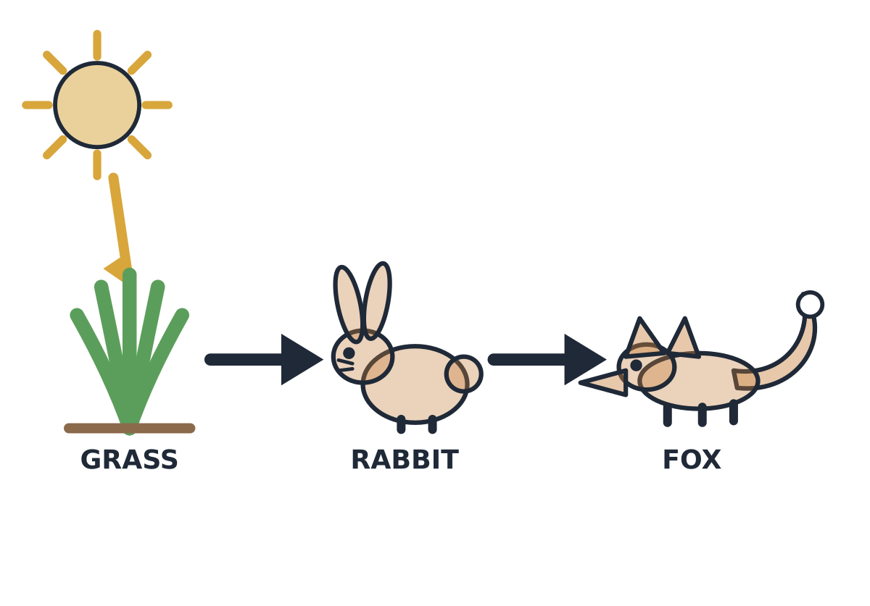
MADE BY MATT / BUILD SCIENCE
Food-chain change investigation
Build it. Test the arrows. Explain a change.
I can use feeding clues to make and improve a prediction.
AUTUMN 1 · WEEK 7 · LESSON B
01
Notes:
Workshop reference — 0 minutes within the source's 40-minute lesson.
Wednesday P2, 10:10-10:50. Reference screen only; start the 32-minute workshop immediately. No additional starter or lesson time.
[Sources]
https://github.com/MattRoper1977/Lessons/blob/main/Science_Teesside/Build/SCI_B_W7_Where_Food_Comes_From.html
Git blob: 3d5eb9032e658d14ac5911d9031b5bc5fe6fa393.
SHA256: a5d84a74f963224ee2d643bb8e2f98397f61ae569ba685ba571331d63a35f767.
User-supplied logo: approved-logo.jpg (unchanged attachment bytes).
White Rose Education, Year 3 Autumn Block 3 (2024), step 5 Animal diets, enriches producer/consumer discussion from the current website. Original food-chain models supply the current curriculum content; publisher media and worksheets are not copied.
[/Sources]
[Sources] https://madebymatt.uk/Lessons/Science_Teesside/Teaching_Packs/BUILD/ — original lesson text, timings and teacher notes retained. https://madebymatt.uk/Lessons/Science_Teesside/Build/ — existing Made by Matt scientific artwork, where shown. [/Sources]

Slide 2
MADE BY MATT / BUILD SCIENCE
Retrieve a chain and read one arrow
Find Monday’s three-organism chain.
Follow one arrow from food to eater.
Use the feeding clue to check it.
AUTUMN 1 · WEEK 7 · LESSON B
02
Notes:
Independent Work — retrieve — 4 minutes within the source's 40-minute lesson.
Four-minute source preparation. Grass → rabbit → fox. Explain food/energy passes to eater. Choose card mover, pointer, adult director or recorder. Keep models on table; no real organism collection.
[Sources]
https://github.com/MattRoper1977/Lessons/blob/main/Science_Teesside/Build/SCI_B_W7_Where_Food_Comes_From.html
Git blob: 3d5eb9032e658d14ac5911d9031b5bc5fe6fa393.
SHA256: a5d84a74f963224ee2d643bb8e2f98397f61ae569ba685ba571331d63a35f767.
User-supplied logo: approved-logo.jpg (unchanged attachment bytes).
White Rose Education, Year 3 Autumn Block 3 (2024), step 5 Animal diets, enriches producer/consumer discussion from the current website. Original food-chain models supply the current curriculum content; publisher media and worksheets are not copied.
[/Sources]
[Sources] https://madebymatt.uk/Lessons/Science_Teesside/Teaching_Packs/BUILD/ — original lesson text, timings and teacher notes retained. https://madebymatt.uk/Lessons/Science_Teesside/Build/ — existing Made by Matt scientific artwork, where shown. [/Sources]

Slide 3

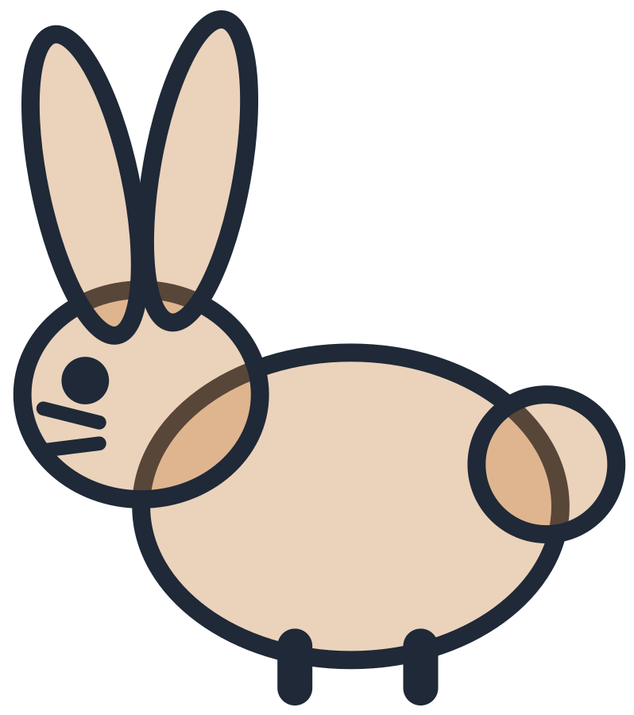

MADE BY MATT / BUILD SCIENCE
Build the grass chain from evidence
A rabbit can eat grass.
A fox can eat a rabbit.
Place grass, rabbit, fox and two arrows.
Add producer and consumer labels.
AUTUMN 1 · WEEK 7 · LESSON B
03
Notes:
Independent Work — investigate — 5 minutes within the source's 40-minute lesson.
First five minutes of source 20-minute investigation. Correct grass → rabbit → fox; grass producer, animals consumers. Every pupil uses evidence rather than simply remembering sequence. Alternative adult moves cards under pupil direction.
[Sources]
https://github.com/MattRoper1977/Lessons/blob/main/Science_Teesside/Build/SCI_B_W7_Where_Food_Comes_From.html
Git blob: 3d5eb9032e658d14ac5911d9031b5bc5fe6fa393.
SHA256: a5d84a74f963224ee2d643bb8e2f98397f61ae569ba685ba571331d63a35f767.
User-supplied logo: approved-logo.jpg (unchanged attachment bytes).
White Rose Education, Year 3 Autumn Block 3 (2024), step 5 Animal diets, enriches producer/consumer discussion from the current website. Original food-chain models supply the current curriculum content; publisher media and worksheets are not copied.
[/Sources]
[Sources] https://madebymatt.uk/Lessons/Science_Teesside/Teaching_Packs/BUILD/ — original lesson text, timings and teacher notes retained. https://madebymatt.uk/Lessons/Science_Teesside/Build/ — existing Made by Matt scientific artwork, where shown. [/Sources]

Slide 4


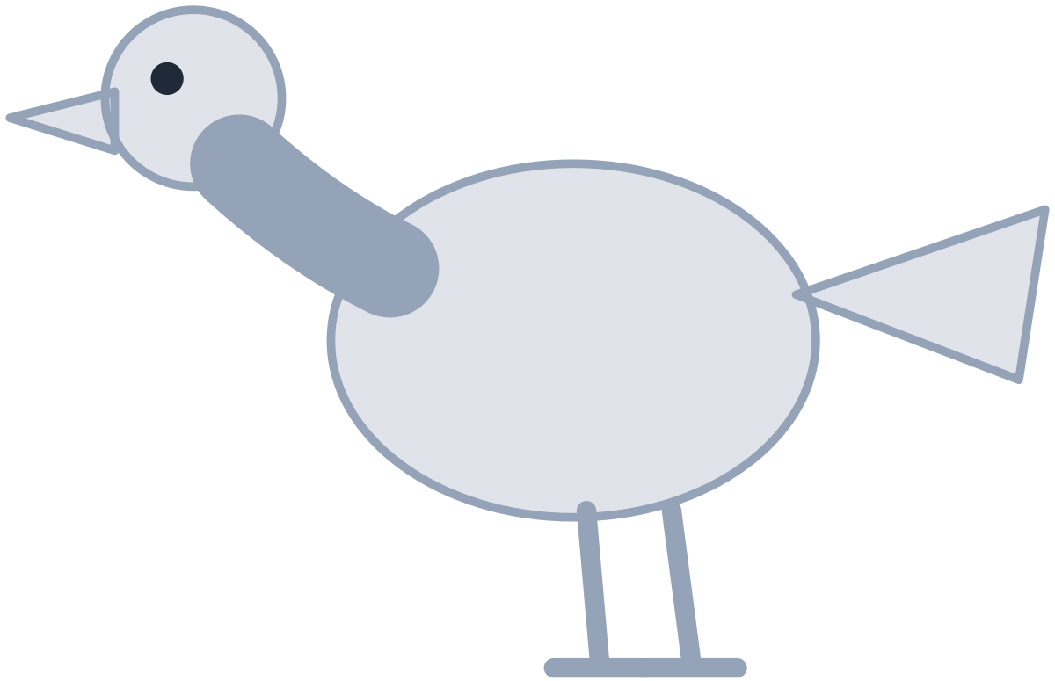
MADE BY MATT / BUILD SCIENCE
Build the second chain
A caterpillar can eat leaves. A robin can eat a caterpillar.
leaves
caterpillar
robin
producer
consumer
consumer
The green plant is the producer in this model.
food / energy passes to the eater
AUTUMN 1 · WEEK 7 · LESSON B
04
Notes:
Independent Work — investigate — 5 minutes within the source's 40-minute lesson.
Next five minutes. Leaves → caterpillar → robin. Leaves represent part of a green producer plant. Consumer labels apply caterpillar/robin. Diagram shows selected links only. Printed labels are original and remain usable without any online animation.
[Sources]
https://github.com/MattRoper1977/Lessons/blob/main/Science_Teesside/Build/SCI_B_W7_Where_Food_Comes_From.html
Git blob: 3d5eb9032e658d14ac5911d9031b5bc5fe6fa393.
SHA256: a5d84a74f963224ee2d643bb8e2f98397f61ae569ba685ba571331d63a35f767.
User-supplied logo: approved-logo.jpg (unchanged attachment bytes).
White Rose Education, Year 3 Autumn Block 3 (2024), step 5 Animal diets, enriches producer/consumer discussion from the current website. Original food-chain models supply the current curriculum content; publisher media and worksheets are not copied.
[/Sources]
[Sources] https://madebymatt.uk/Lessons/Science_Teesside/Teaching_Packs/BUILD/ — original lesson text, timings and teacher notes retained. https://madebymatt.uk/Lessons/Science_Teesside/Build/ — existing Made by Matt scientific artwork, where shown. [/Sources]

Slide 5
MADE BY MATT / BUILD SCIENCE
Make an error, then repair it
Reverse one arrow deliberately.
Say what that wrong arrow would mean.
Read the feeding clue again.
Turn the arrow back and explain why.
AUTUMN 1 · WEEK 7 · LESSON B
05
Notes:
Independent Work — investigate — 5 minutes within the source's 40-minute lesson.
Next five minutes. Example wrong robin → caterpillar would pass food from robin to caterpillar, conflicting with supplied clue robin eats caterpillar. Correct leaves → caterpillar → robin. No requirement to generate a novel biological counterexample.
[Sources]
https://github.com/MattRoper1977/Lessons/blob/main/Science_Teesside/Build/SCI_B_W7_Where_Food_Comes_From.html
Git blob: 3d5eb9032e658d14ac5911d9031b5bc5fe6fa393.
SHA256: a5d84a74f963224ee2d643bb8e2f98397f61ae569ba685ba571331d63a35f767.
User-supplied logo: approved-logo.jpg (unchanged attachment bytes).
White Rose Education, Year 3 Autumn Block 3 (2024), step 5 Animal diets, enriches producer/consumer discussion from the current website. Original food-chain models supply the current curriculum content; publisher media and worksheets are not copied.
[/Sources]
[Sources] https://madebymatt.uk/Lessons/Science_Teesside/Teaching_Packs/BUILD/ — original lesson text, timings and teacher notes retained. https://madebymatt.uk/Lessons/Science_Teesside/Build/ — existing Made by Matt scientific artwork, where shown. [/Sources]

Slide 6
MADE BY MATT / BUILD SCIENCE
Cover the plant and predict
Cover the plant in one model chain.
Who may lose a food source first?
What could change for the next consumer?
Use might or could and give a reason.
AUTUMN 1 · WEEK 7 · LESSON B
06
Notes:
Independent Work — investigate — 5 minutes within the source's 40-minute lesson.
Final five minutes of source 20-minute phase. Reduced plant resource may affect direct consumer, and indirectly later consumer. Model cannot predict exact survival/population counts; real organisms may use other food sources. Paper cover represents hypothetical reduced availability, not experimental data.
[Sources]
https://github.com/MattRoper1977/Lessons/blob/main/Science_Teesside/Build/SCI_B_W7_Where_Food_Comes_From.html
Git blob: 3d5eb9032e658d14ac5911d9031b5bc5fe6fa393.
SHA256: a5d84a74f963224ee2d643bb8e2f98397f61ae569ba685ba571331d63a35f767.
User-supplied logo: approved-logo.jpg (unchanged attachment bytes).
White Rose Education, Year 3 Autumn Block 3 (2024), step 5 Animal diets, enriches producer/consumer discussion from the current website. Original food-chain models supply the current curriculum content; publisher media and worksheets are not copied.
[/Sources]
[Sources] https://madebymatt.uk/Lessons/Science_Teesside/Teaching_Packs/BUILD/ — original lesson text, timings and teacher notes retained. https://madebymatt.uk/Lessons/Science_Teesside/Build/ — existing Made by Matt scientific artwork, where shown. [/Sources]

Slide 7
MADE BY MATT / BUILD SCIENCE
Pause and test your explanation
Check one arrow against a feeding clue.
Check one prediction: what is the link?
Does the model show every food source?
AUTUMN 1 · WEEK 7 · LESSON B
07
Notes:
Independent Work — check — 2 minutes within the source's 40-minute lesson.
Source two-minute check. Adult/partner optional; independent checking valid. A prediction should link food availability through a stated chain, not merely “everything dies”. Real food webs, conditions and time add uncertainty.
[Sources]
https://github.com/MattRoper1977/Lessons/blob/main/Science_Teesside/Build/SCI_B_W7_Where_Food_Comes_From.html
Git blob: 3d5eb9032e658d14ac5911d9031b5bc5fe6fa393.
SHA256: a5d84a74f963224ee2d643bb8e2f98397f61ae569ba685ba571331d63a35f767.
User-supplied logo: approved-logo.jpg (unchanged attachment bytes).
White Rose Education, Year 3 Autumn Block 3 (2024), step 5 Animal diets, enriches producer/consumer discussion from the current website. Original food-chain models supply the current curriculum content; publisher media and worksheets are not copied.
[/Sources]
[Sources] https://madebymatt.uk/Lessons/Science_Teesside/Teaching_Packs/BUILD/ — original lesson text, timings and teacher notes retained. https://madebymatt.uk/Lessons/Science_Teesside/Build/ — existing Made by Matt scientific artwork, where shown. [/Sources]

Slide 8
MADE BY MATT / BUILD SCIENCE
Improve, save and clear the model
Put the chain back or revise it.
Improve one arrow reason or prediction.
State one limit of this simple model.
Save the record and put the cards away.
AUTUMN 1 · WEEK 7 · LESSON B
08
Notes:
Independent Work — improve — 6 minutes within the source's 40-minute lesson.
Source final six-minute phase includes tidy. Record first and revised reasoning. A qualified conclusion can be “less grass may mean less food for rabbits; that could affect foxes, but they may eat other foods.” No pupil measurements or real ecological experiment claimed.
[Sources]
https://github.com/MattRoper1977/Lessons/blob/main/Science_Teesside/Build/SCI_B_W7_Where_Food_Comes_From.html
Git blob: 3d5eb9032e658d14ac5911d9031b5bc5fe6fa393.
SHA256: a5d84a74f963224ee2d643bb8e2f98397f61ae569ba685ba571331d63a35f767.
User-supplied logo: approved-logo.jpg (unchanged attachment bytes).
White Rose Education, Year 3 Autumn Block 3 (2024), step 5 Animal diets, enriches producer/consumer discussion from the current website. Original food-chain models supply the current curriculum content; publisher media and worksheets are not copied.
[/Sources]
[Sources] https://madebymatt.uk/Lessons/Science_Teesside/Teaching_Packs/BUILD/ — original lesson text, timings and teacher notes retained. https://madebymatt.uk/Lessons/Science_Teesside/Build/ — existing Made by Matt scientific artwork, where shown. [/Sources]

Slide 9
MADE BY MATT / BUILD SCIENCE
Your voice can change the lesson
What helped you join in?
What could make the next activity easier?
Point, sign, speak, write or pass privately.
Adult: agree one change and explain any limit.
AUTUMN 1 · WEEK 7 · LESSON B
09
Notes:
Lundy Loop — 4 minutes within the source's 40-minute lesson.
Four minutes within the source lesson. Receive an actual observation or access request; do not force a peer audience. Name what can change now, make the change where possible and check whether it helped. The adult receives and names back the science shown as well as access feedback.
[Sources]
https://github.com/MattRoper1977/Lessons/blob/main/Science_Teesside/Build/SCI_B_W7_Where_Food_Comes_From.html
Git blob: 3d5eb9032e658d14ac5911d9031b5bc5fe6fa393.
SHA256: a5d84a74f963224ee2d643bb8e2f98397f61ae569ba685ba571331d63a35f767.
User-supplied logo: approved-logo.jpg (unchanged attachment bytes).
White Rose Education, Year 3 Autumn Block 3 (2024), step 5 Animal diets, enriches producer/consumer discussion from the current website. Original food-chain models supply the current curriculum content; publisher media and worksheets are not copied.
[/Sources]
[Sources] https://madebymatt.uk/Lessons/Science_Teesside/Teaching_Packs/BUILD/ — original lesson text, timings and teacher notes retained. https://madebymatt.uk/Lessons/Science_Teesside/Build/ — existing Made by Matt scientific artwork, where shown. [/Sources]

Slide 10
MADE BY MATT / BUILD SCIENCE
Read the evidence behind the chain
Supported: point from food to eater.
Standard: explain an indirect plant link.
Stretch: why can’t we predict exact numbers?
AUTUMN 1 · WEEK 7 · LESSON B
10
Notes:
Exit Ticket — 4 minutes within the source's 40-minute lesson.
Supported can read grass → rabbit as grass is eaten by rabbit. Standard fox may be affected by grass via rabbits despite not directly eating the grass. Stretch model omits other foods, conditions, behaviour and time, so exact numbers unsupported. Adult receives explanation and records next step. Separate Week 8 enrichment/checkpoint remains outside this W3-7 pack.
[Sources]
https://github.com/MattRoper1977/Lessons/blob/main/Science_Teesside/Build/SCI_B_W7_Where_Food_Comes_From.html
Git blob: 3d5eb9032e658d14ac5911d9031b5bc5fe6fa393.
SHA256: a5d84a74f963224ee2d643bb8e2f98397f61ae569ba685ba571331d63a35f767.
User-supplied logo: approved-logo.jpg (unchanged attachment bytes).
White Rose Education, Year 3 Autumn Block 3 (2024), step 5 Animal diets, enriches producer/consumer discussion from the current website. Original food-chain models supply the current curriculum content; publisher media and worksheets are not copied.
[/Sources]
[Sources] https://madebymatt.uk/Lessons/Science_Teesside/Teaching_Packs/BUILD/ — original lesson text, timings and teacher notes retained. https://madebymatt.uk/Lessons/Science_Teesside/Build/ — existing Made by Matt scientific artwork, where shown. [/Sources]

