Slide 1
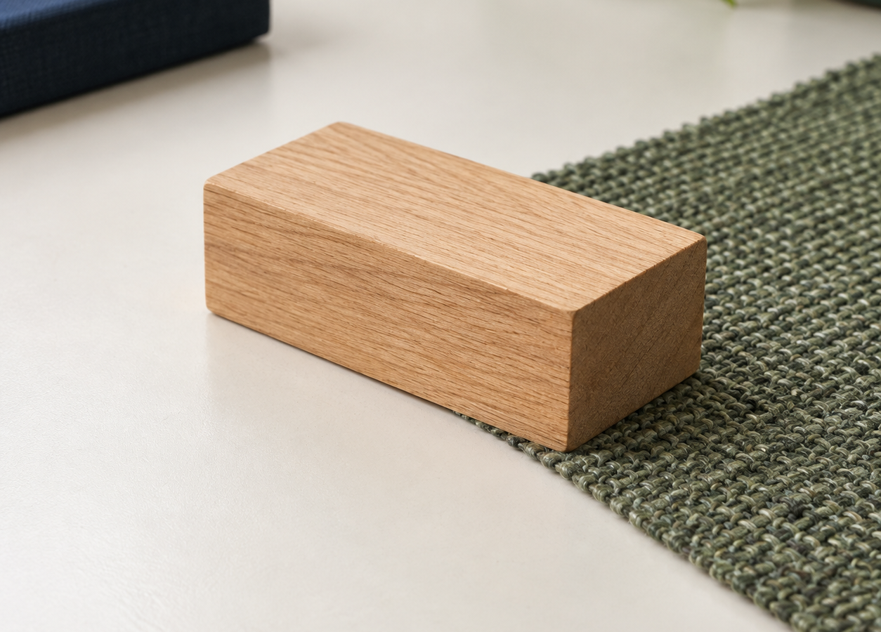
MADE BY MATT / GROW SCIENCE
Friction: friend and enemy
One force. Different jobs.
Explain what friction does, and when it helps or hinders.
FORCES / CONTACT / EVIDENCE
AUTUMN 1 · WEEK 3 · LESSON A
01
Notes:
Title — 1 minute. This slide is within Monday's existing 40-minute sequence, not extra teaching time.
Introduce the objective from the current weekly lesson: explain what friction does and when it helps or hinders. Read the success criteria aloud: identify the contact force, give a helpful and an unhelpful example, and predict a surface comparison. The actual comparison investigation takes place in Lesson B.
[Sources]
https://github.com/MattRoper1977/Lessons/blob/main/Science_Teesside/Grow/SCI_G_W3_Friction.html
Source Git blob: 170d772a5e9d23909e95a534c5c1e16ee7df67c8. Source read 6 September 2026. Native editable diagrams are original explanatory models; no source publisher media copied.
[/Sources]
[Sources] Generated contextual illustration for this visual edition; not measured or recorded experimental evidence. [/Sources]

Slide 2
MADE BY MATT / GROW SCIENCE
What do you notice?
01
Supported: gently rub your hands for five seconds.
02
Standard: describe what you feel and name the force.
03
Stretch: explain where the warmth came from.
You can watch, point, speak, draw or write.
AUTUMN 1 · WEEK 3 · LESSON A
02
Notes:
Arrival Task — 4 minutes. This slide is within Monday's existing 40-minute sequence, not extra teaching time.
Hand rubbing is optional. Offer observation, remembered experience or a spoken description as an equal route. Supported: notice warmth. Standard: name friction. Stretch: explain movement energy transferring to heat. Do not rub hard enough to hurt or make a pupil perform a sensory task. Use the selected response route on pupil page1.
[Sources]
https://github.com/MattRoper1977/Lessons/blob/main/Science_Teesside/Grow/SCI_G_W3_Friction.html
Source Git blob: 170d772a5e9d23909e95a534c5c1e16ee7df67c8. Source read 6 September 2026. Native editable diagrams are original explanatory models; no source publisher media copied.
[/Sources]

Slide 3
MADE BY MATT / GROW SCIENCE
Three things to work out
1 What is friction?
2 When does friction help or hinder?
3 What will happen on two different surfaces?
AUTUMN 1 · WEEK 3 · LESSON A
03
Notes:
Today at a Glance — 2 minutes. This slide is within Monday's existing 40-minute sequence, not extra teaching time.
Maintain the source lesson sequence. The demonstration supports a prediction; do not claim pupil practical completion today. Establish before the demonstration which mode of response/access support each learner prefers.
[Sources]
https://github.com/MattRoper1977/Lessons/blob/main/Science_Teesside/Grow/SCI_G_W3_Friction.html
Source Git blob: 170d772a5e9d23909e95a534c5c1e16ee7df67c8. Source read 6 September 2026. Native editable diagrams are original explanatory models; no source publisher media copied.
[/Sources]

Slide 4
MADE BY MATT / GROW SCIENCE
Friction acts at a contact
sliding right
A force between surfaces that slide, or try to slide, past each other.
BLOCK
Name the two touching surfaces.
friction on the block
AUTUMN 1 · WEEK 3 · LESSON A
04
Notes:
I Do 1 — definition and model — 3 minutes. This slide is within Monday's existing 40-minute sequence, not extra teaching time.
Use the native block-and-surface diagram as a simplified model. The block slides right relative to the surface; sliding friction on the block acts left. Explain surface, grip and wear. Qualify the source shorthand “friction always acts against movement”: friction opposes relative sliding or attempted sliding at a contact; static friction can help a person walk forward. The arrow length is not a measured force.
[Sources]
https://github.com/MattRoper1977/Lessons/blob/main/Science_Teesside/Grow/SCI_G_W3_Friction.html
Source Git blob: 170d772a5e9d23909e95a534c5c1e16ee7df67c8. Source read 6 September 2026. Native editable diagrams are original explanatory models; no source publisher media copied.
[/Sources]

Slide 5
MADE BY MATT / GROW SCIENCE
Change one thing: the surface
Keep the block, ramp and release the same.
sliding
Change only the run-out surface.
BLOCK
Predict where the block will stop. Then observe.
friction
surface contact
What stayed the same? What changed?
AUTUMN 1 · WEEK 3 · LESSON A
05
Notes:
I Do 1 — demonstration — 6 minutes. This slide is within Monday's existing 40-minute sequence, not extra teaching time.
Same block, same adult-secured low ramp, same release mark and fixed angle; no push. Change the level run-out surface only. Repeat a release before changing surfaces. Measure from the same ramp-foot zero to the same edge of the stopped block. Record no slide honestly. Keep the ramp-to-surface join fixed and hands clear. Use a padded stop; no oil, loose powders or pupils sliding on floors. If equipment is unavailable, use the schematic below and ask for a prediction, not an invented observation. The diagram is not a measured result. Identify model limits and avoid a universal rough-versus-smooth ranking.
[Sources]
https://github.com/MattRoper1977/Lessons/blob/main/Science_Teesside/Grow/SCI_G_W3_Friction.html
Source Git blob: 170d772a5e9d23909e95a534c5c1e16ee7df67c8. Source read 6 September 2026. Native editable diagrams are original explanatory models; no source publisher media copied.
[/Sources]

Slide 6
MADE BY MATT / GROW SCIENCE
Helpful or unhelpful?
01
Bike brakes
02
Trainers on a wet floor
03
Moving engine parts rubbing
04
Pushing a heavy box across carpet
05
A door handle
Name the surfaces. Explain the job.
AUTUMN 1 · WEEK 3 · LESSON A
06
Notes:
We Do 1 — first decisions — 6 minutes. This slide is within Monday's existing 40-minute sequence, not extra teaching time.
Ask for a decision before revealing the next slide. Begin with bike brakes and moving engine parts, as in the weekly source extension. Identify the surface pair, the relative movement and the intended job for each. Trainers on a wet floor means friction helps grip; this is discussion, not a wet-floor practical. Engine friction can cause unwanted heat and wear. A heavy box is harder to slide across carpet. Grip on a handle is helpful. Remaining examples are optional practice within the ten-minute source stage.
[Sources]
https://github.com/MattRoper1977/Lessons/blob/main/Science_Teesside/Grow/SCI_G_W3_Friction.html
Source Git blob: 170d772a5e9d23909e95a534c5c1e16ee7df67c8. Source read 6 September 2026. Native editable diagrams are original explanatory models; no source publisher media copied.
[/Sources]

Slide 7
MADE BY MATT / GROW SCIENCE
The job changes the answer
HELPS THE JOB
HINDERS THE JOB
Braking a wheel
Gripping the floor
Holding a handle
Moving parts heating and wearing
Sliding a box across carpet
AUTUMN 1 · WEEK 3 · LESSON A
07
Notes:
We Do 1 — check and explain — 4 minutes. This slide is within Monday's existing 40-minute sequence, not extra teaching time.
Reveal after an attempt. Use this as teacher-led feedback, not a self-scoring activity. Useful friction: brake pad and wheel/disc; shoe and floor; hand and handle. Unwanted resistance: moving engine parts; box and carpet when sliding it is the goal. Discuss that a real situation can have more than one effect. Pupil correction is part of the existing stage.
[Sources]
https://github.com/MattRoper1977/Lessons/blob/main/Science_Teesside/Grow/SCI_G_W3_Friction.html
Source Git blob: 170d772a5e9d23909e95a534c5c1e16ee7df67c8. Source read 6 September 2026. Native editable diagrams are original explanatory models; no source publisher media copied.
[/Sources]

Slide 8
MADE BY MATT / GROW SCIENCE
Explain both sides
Friction is helpful here because…
…but it is unhelpful here because…
Use the touching surfaces and the job in your explanation.
AUTUMN 1 · WEEK 3 · LESSON A
08
Notes:
I Do 2 — 4 minutes. This slide is within Monday's existing 40-minute sequence, not extra teaching time.
Model the source sentence shape aloud. Focus on naming contact surfaces and linking friction to the intended job. Learners may point, dictate or write. The weekly source witness triad includes predicting/testing/recording: mark the demonstration/prediction today and retain the actual investigation evidence for Lesson B. Do not assume photography or public sharing; follow existing consent and evidence safeguards.
[Sources]
https://github.com/MattRoper1977/Lessons/blob/main/Science_Teesside/Grow/SCI_G_W3_Friction.html
Source Git blob: 170d772a5e9d23909e95a534c5c1e16ee7df67c8. Source read 6 September 2026. Native editable diagrams are original explanatory models; no source publisher media copied.
[/Sources]

Slide 9
MADE BY MATT / GROW SCIENCE
Sort the claims
TRUE / FALSE / NOT A SCIENTIFIC CLAIM
01
Sliding friction opposes sliding at the contact.
02
Friction only happens with rough surfaces.
03
Oil can reduce friction in suitable lubricated contacts.
04
Without friction we could not walk normally.
05
Friction is a bad force.
AUTUMN 1 · WEEK 3 · LESSON A
09
Notes:
We Do 2 — sort — 4 minutes. This slide is within Monday's existing 40-minute sequence, not extra teaching time.
Use pupil sheet2 or cut-out cards; sort by pointing, speaking or moving paper. This replaces HTML drag/tap sorting. Three categories: true, false, not a scientific claim. Scientific qualifications are intentional: replace the over-broad source “Friction acts against movement” with “Sliding friction opposes sliding at the contact”; qualify “Oil reduces friction” to suitable lubricated contacts. Do not use oil in the practical. Make decisions before going to the answer slide.
[Sources]
https://github.com/MattRoper1977/Lessons/blob/main/Science_Teesside/Grow/SCI_G_W3_Friction.html
Source Git blob: 170d772a5e9d23909e95a534c5c1e16ee7df67c8. Source read 6 September 2026. Native editable diagrams are original explanatory models; no source publisher media copied.
[/Sources]

Slide 10
MADE BY MATT / GROW SCIENCE
Check the science
01
TRUE Sliding friction opposes sliding at the contact.
02
FALSE Smooth surfaces can have friction too.
03
TRUE Suitable lubrication can reduce friction.
04
TRUE Walking normally needs grip at the ground.
05
JUDGEMENT “Bad” depends on the job.
AUTUMN 1 · WEEK 3 · LESSON A
10
Notes:
We Do 2 — check — 3 minutes. This slide is within Monday's existing 40-minute sequence, not extra teaching time.
Answers match the qualified claims. Sliding friction opposes sliding at contact: true. Only rough surfaces: false; smooth surfaces also have friction. Oil can reduce friction in suitable contacts: true, not a universal guarantee. Walking normally needs static grip: true. Bad force: value judgement; ask the job/context. Test a changed case in discussion: smooth rubber and smooth glass can still grip. A material nickname alone does not establish a universal ranking.
[Sources]
https://github.com/MattRoper1977/Lessons/blob/main/Science_Teesside/Grow/SCI_G_W3_Friction.html
Source Git blob: 170d772a5e9d23909e95a534c5c1e16ee7df67c8. Source read 6 September 2026. Native editable diagrams are original explanatory models; no source publisher media copied.
[/Sources]

Slide 11
MADE BY MATT / GROW SCIENCE
Build a complete explanation
Friction is helpful at a bike brake: it transfers movement energy to heat and slows the wheel.
MOVEMENT ENERGY
It can be unhelpful between moving engine parts because rubbing heats and wears them.
HEAT
AUTUMN 1 · WEEK 3 · LESSON A
11
Notes:
We Do 2 — model explanation — 2 minutes. This slide is within Monday's existing 40-minute sequence, not extra teaching time.
Offer the model only after a first attempt. This is the source WAGOLL with a precision edit: “transfers movement energy to heat and slows the wheel” rather than “converts the movement into heat and stops the wheel”. Learners correct one detail using the model or explain the same contrast in their own mode. Do not require copying the whole model.
[Sources]
https://github.com/MattRoper1977/Lessons/blob/main/Science_Teesside/Grow/SCI_G_W3_Friction.html
Source Git blob: 170d772a5e9d23909e95a534c5c1e16ee7df67c8. Source read 6 September 2026. Native editable diagrams are original explanatory models; no source publisher media copied.
[/Sources]

Slide 12
MADE BY MATT / GROW SCIENCE
Keep your prediction for next time
01
Keep your named worksheet and first prediction.
02
Next lesson: compare three surfaces and repeated results.
03
Point to one idea you want to check again.
AUTUMN 1 · WEEK 3 · LESSON A
12
Notes:
We Do 2 — stop and retain work — 1 minute. This slide is within Monday's existing 40-minute sequence, not extra teaching time.
End Monday here, exactly as the source period break requires. Label and keep the work. Learners identify one helpful/unhelpful example or improvement already discussed. Do not add Tuesday’s workshop, feedback or exit ticket to today. Tuesday source: 32-minute investigation/workshop, 4-minute pupil feedback, 4-minute exit ticket. A separate Lesson B deck will retain that pacing and the source three-surface repeated-trial task.
[Sources]
https://github.com/MattRoper1977/Lessons/blob/main/Science_Teesside/Grow/SCI_G_W3_Friction.html
Source Git blob: 170d772a5e9d23909e95a534c5c1e16ee7df67c8. Source read 6 September 2026. Native editable diagrams are original explanatory models; no source publisher media copied.
[/Sources]

