Slide 1
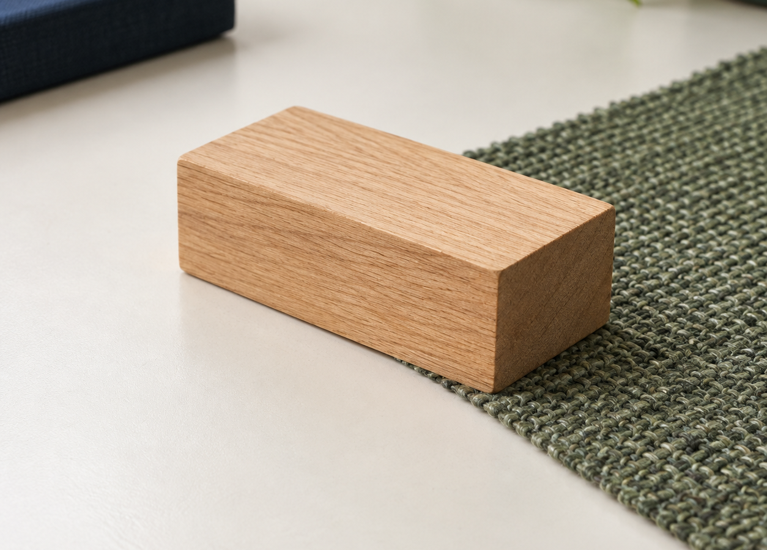
MADE BY MATT / GROW SCIENCE
Friction: test the surfaces
One block. Three surfaces. Evidence.
Use repeated results to explain what happened in this setup.
AUTUMN 1 · WEEK 3 · LESSON B
01
Notes:
Independent Work — workshop reference — 0 minutes within the source's 40-minute lesson.
Reference screen only: no extra starter time. Tuesday begins with the source's 32-minute Independent Work workshop. Retain Monday's prediction; use slide 2 immediately.
[Sources]
https://github.com/MattRoper1977/Lessons/blob/main/Science_Teesside/Grow/SCI_G_W3_Friction.html
Git blob: 170d772a5e9d23909e95a534c5c1e16ee7df67c8.
SHA256: 56c1655062d8f483a390cb7671603b576c992bca156ea4cdc586d6bcf908a2d5.
[/Sources]
[Sources] Generated contextual illustration for this visual edition; not measured or recorded experimental evidence. [/Sources]

Slide 2
MADE BY MATT / GROW SCIENCE
Return to your prediction
01
Find Monday’s prediction. Do not erase it.
02
Which surface do you think will stop the block sooner?
03
Choose a role: tester, observer, director or recorder.
AUTUMN 1 · WEEK 3 · LESSON B
02
Notes:
Independent Work — retrieve and prepare — 2 minutes within the source's 40-minute lesson.
First half of source four-minute preparation phase. Supported: point or direct an adult; standard: explain prediction; stretch: name a control or an uncertainty. Prediction can be wrong and still useful. Agree clear start/stop signals and sensory adjustments.
[Sources]
https://github.com/MattRoper1977/Lessons/blob/main/Science_Teesside/Grow/SCI_G_W3_Friction.html
Git blob: 170d772a5e9d23909e95a534c5c1e16ee7df67c8.
SHA256: 56c1655062d8f483a390cb7671603b576c992bca156ea4cdc586d6bcf908a2d5.
[/Sources]

Slide 3
MADE BY MATT / GROW SCIENCE
Set up a safe comparison
01
Adult checks the low ramp and padded stop.
02
Use the same block, release mark and ramp height.
03
Keep each surface level and the ramp join fixed.
04
Hands clear. Release gently; never add a push.
AUTUMN 1 · WEEK 3 · LESSON B
03
Notes:
Independent Work — retrieve and prepare — 2 minutes within the source's 40-minute lesson.
Completes source four-minute preparation. Equipment: adult-secured low ramp, one small sliding block, three level surface samples, ruler/tape, tray or padded stop. No oil, loose powders or pupils sliding on floors. Adult-operated apparatus or no-equipment data route are available.
[Sources]
https://github.com/MattRoper1977/Lessons/blob/main/Science_Teesside/Grow/SCI_G_W3_Friction.html
Git blob: 170d772a5e9d23909e95a534c5c1e16ee7df67c8.
SHA256: 56c1655062d8f483a390cb7671603b576c992bca156ea4cdc586d6bcf908a2d5.
[/Sources]

Slide 4
MADE BY MATT / GROW SCIENCE
Where will you measure from?
stopped block
Measure from the same ramp-foot zero to the same front edge of the stopped block.
fixed zero
same front edge each time
Record centimetres: cm.
AUTUMN 1 · WEEK 3 · LESSON B
04
Notes:
Independent Work — test and record — 2 minutes within the source's 40-minute lesson.
First two minutes of the source 20-minute test phase. Diagram is a measurement schematic, not measured data: arrow starts under fixed zero and ends under front/right edge of stopped block. Choose the front edge and use it every time. Check ruler zero rather than its physical end. Do not label a block that never reaches the run-out as a made-up distance: write 'did not slide' and describe what happened.
[Sources]
https://github.com/MattRoper1977/Lessons/blob/main/Science_Teesside/Grow/SCI_G_W3_Friction.html
Git blob: 170d772a5e9d23909e95a534c5c1e16ee7df67c8.
SHA256: 56c1655062d8f483a390cb7671603b576c992bca156ea4cdc586d6bcf908a2d5.
[/Sources]

Slide 5
MADE BY MATT / GROW SCIENCE
Surface 1: release, record, repeat
01
Name the surface in your results table.
02
Release from the mark without a push.
03
Measure the stopping distance in cm.
04
Reset everything and run Trial 2.
05
Keep both results, even if they differ.
AUTUMN 1 · WEEK 3 · LESSON B
05
Notes:
Independent Work — test and record — 6 minutes within the source's 40-minute lesson.
Six minutes within source 20-minute test phase. Adult/director checks start and zero. Record surface, Trial 1/cm, Trial 2/cm and what stayed the same. Supported pupils can point, dictate or enter selected values. If using source model data, identify card 42 and 44 cm as invented teaching data, not observed results.
[Sources]
https://github.com/MattRoper1977/Lessons/blob/main/Science_Teesside/Grow/SCI_G_W3_Friction.html
Git blob: 170d772a5e9d23909e95a534c5c1e16ee7df67c8.
SHA256: 56c1655062d8f483a390cb7671603b576c992bca156ea4cdc586d6bcf908a2d5.
[/Sources]

Slide 6
MADE BY MATT / GROW SCIENCE
Surface 2: change only the sample
01
Replace the level surface sample.
02
Keep the block, ramp, release and join the same.
03
Measure Trial 1 and Trial 2 from the same zero.
04
Write a note if the method changed.
AUTUMN 1 · WEEK 3 · LESSON B
06
Notes:
Independent Work — test and record — 6 minutes within the source's 40-minute lesson.
Next six minutes of the source 20-minute test. Check that sample thickness has not changed the ramp join; adult adjusts safely before release. Do not restart the test with a different block. For no-equipment route, source model fabric values are 25 and 27 cm, clearly labelled invented.
[Sources]
https://github.com/MattRoper1977/Lessons/blob/main/Science_Teesside/Grow/SCI_G_W3_Friction.html
Git blob: 170d772a5e9d23909e95a534c5c1e16ee7df67c8.
SHA256: 56c1655062d8f483a390cb7671603b576c992bca156ea4cdc586d6bcf908a2d5.
[/Sources]

Slide 7
MADE BY MATT / GROW SCIENCE
Surface 3: finish the comparison
01
Check the controls before the first release.
02
Record two trials if time and access allow.
03
Which results are close? Which need checking?
04
Record unfinished trials honestly.
AUTUMN 1 · WEEK 3 · LESSON B
07
Notes:
Independent Work — test and record — 6 minutes within the source's 40-minute lesson.
Final six minutes of source 20-minute test. No rush to operate unsafe kit. Adult-recorded data are acceptable but identify who operated and who interpreted. No-equipment model rubber-mat values: 15 and 18 cm. Their difference alone does not prove an error. Do not invent the second run if it was not performed.
[Sources]
https://github.com/MattRoper1977/Lessons/blob/main/Science_Teesside/Grow/SCI_G_W3_Friction.html
Git blob: 170d772a5e9d23909e95a534c5c1e16ee7df67c8.
SHA256: 56c1655062d8f483a390cb7671603b576c992bca156ea4cdc586d6bcf908a2d5.
[/Sources]

Slide 8
MADE BY MATT / GROW SCIENCE
No equipment? Use model data
INVENTED TEACHING DATA
DISCUSS THE EVIDENCE
Card: 42 cm, 44 cm
Fabric: 25 cm, 27 cm
Rubber mat: 15 cm, 18 cm
Which stopped the block sooner?
What had to stay the same?
What can these values not prove?
AUTUMN 1 · WEEK 3 · LESSON B
08
Notes:
Independent Work — alternative reference — 0 minutes within the source's 40-minute lesson.
Alternative reference within the same test time; not an additional activity. Exact model data provided in current source. Model answer: rubber mat has the shortest distances in both trials, supporting greater resistance to sliding in this stated setup if the controls were kept. Cannot claim a pupil experiment occurred or that rubber always has the greatest friction. For real experiments, keep actual results even if unlike these values.
[Sources]
https://github.com/MattRoper1977/Lessons/blob/main/Science_Teesside/Grow/SCI_G_W3_Friction.html
Git blob: 170d772a5e9d23909e95a534c5c1e16ee7df67c8.
SHA256: 56c1655062d8f483a390cb7671603b576c992bca156ea4cdc586d6bcf908a2d5.
[/Sources]

Slide 9
MADE BY MATT / GROW SCIENCE
Pause and check the method
01
Pause the equipment and compare your repeats.
02
Check one control: release, slope or measuring zero.
03
Mark an uncertain run. Keep the original value.
AUTUMN 1 · WEEK 3 · LESSON B
09
Notes:
Independent Work — evidence check — 2 minutes within the source's 40-minute lesson.
Source's planned two-minute check. Pens down if writing, but speech/signing allowed. A changed push, slope or zero weakens the comparison. Variation need not mean a mistake. Ask 'What did we notice about the method?' before proposing a repeat. No photography or public sharing required.
[Sources]
https://github.com/MattRoper1977/Lessons/blob/main/Science_Teesside/Grow/SCI_G_W3_Friction.html
Git blob: 170d772a5e9d23909e95a534c5c1e16ee7df67c8.
SHA256: 56c1655062d8f483a390cb7671603b576c992bca156ea4cdc586d6bcf908a2d5.
[/Sources]

Slide 10
MADE BY MATT / GROW SCIENCE
Repeat one doubtful run
01
Choose one specific method concern.
02
Correct that concern with the adult.
03
If time allows, repeat and label the new result.
04
Keep the first result and the reason for retrying.
AUTUMN 1 · WEEK 3 · LESSON B
10
Notes:
Independent Work — improve and conclude — 2 minutes within the source's 40-minute lesson.
First two minutes of source final six-minute phase. A valid reason is 'the block was pushed' or 'the sample moved'; not 'I wanted the result to match'. If no concern or safe time remains, compare controls and evidence instead. Do not erase or selectively keep data.
[Sources]
https://github.com/MattRoper1977/Lessons/blob/main/Science_Teesside/Grow/SCI_G_W3_Friction.html
Git blob: 170d772a5e9d23909e95a534c5c1e16ee7df67c8.
SHA256: 56c1655062d8f483a390cb7671603b576c992bca156ea4cdc586d6bcf908a2d5.
[/Sources]

Slide 11
MADE BY MATT / GROW SCIENCE
Use numbers in your conclusion
In our setup, ___ stopped the block
over a shorter distance: ___ cm and ___ cm.
This supports ___ because ___. A control or uncertainty to check is ___.
AUTUMN 1 · WEEK 3 · LESSON B
11
Notes:
Independent Work — improve and conclude — 3 minutes within the source's 40-minute lesson.
Three minutes within final six-minute phase. Accept pointing to the relevant pair and dictating conclusion. Model-data answer: rubber mat 15/18 cm shorter than card 42/44 cm and fabric 25/27 cm; evidence supports more resistance to sliding for this block and setup. Do not force real results into that order. Stretch: qualify conclusion and explain one measurement/control improvement.
[Sources]
https://github.com/MattRoper1977/Lessons/blob/main/Science_Teesside/Grow/SCI_G_W3_Friction.html
Git blob: 170d772a5e9d23909e95a534c5c1e16ee7df67c8.
SHA256: 56c1655062d8f483a390cb7671603b576c992bca156ea4cdc586d6bcf908a2d5.
[/Sources]

Slide 12
MADE BY MATT / GROW SCIENCE
Leave a clear record
01
Name and date your record; keep the prediction.
02
Label any model data or unfinished trials.
03
Return samples, block and measuring tools safely.
AUTUMN 1 · WEEK 3 · LESSON B
12
Notes:
Independent Work — improve and conclude — 1 minutes within the source's 40-minute lesson.
Final minute of source six-minute improvement/conclusion/tidy phase. Keep prediction, results, conclusion and control check together. Distinguish participation, observation and independent interpretation in teacher record. No photo/export requirement.
[Sources]
https://github.com/MattRoper1977/Lessons/blob/main/Science_Teesside/Grow/SCI_G_W3_Friction.html
Git blob: 170d772a5e9d23909e95a534c5c1e16ee7df67c8.
SHA256: 56c1655062d8f483a390cb7671603b576c992bca156ea4cdc586d6bcf908a2d5.
[/Sources]

Slide 13
MADE BY MATT / GROW SCIENCE
Your voice can change the lesson
01
What helped you test, observe or record?
02
What could make the next activity easier to access?
03
Point, sign, speak, write—or pass privately.
04
Adult: agree one change and explain any limit.
AUTUMN 1 · WEEK 3 · LESSON B
13
Notes:
Lundy Loop — pupil feedback — 4 minutes within the source's 40-minute lesson.
Exact four-minute source feedback stage. Ramps can clatter; recorder/director role remains science. Adult listens, names what can change now, acts where possible and checks whether it helped. Examples: quieter landing tray, clearer release signal, wider table. No display, photography or sharing assumed.
[Sources]
https://github.com/MattRoper1977/Lessons/blob/main/Science_Teesside/Grow/SCI_G_W3_Friction.html
Git blob: 170d772a5e9d23909e95a534c5c1e16ee7df67c8.
SHA256: 56c1655062d8f483a390cb7671603b576c992bca156ea4cdc586d6bcf908a2d5.
[/Sources]

Slide 14
MADE BY MATT / GROW SCIENCE
Explain one use of friction
01
Supported: name one place friction helps.
02
Standard: explain how a car’s brakes help it stop.
03
Stretch: explain a helpful and a harmful effect.
AUTUMN 1 · WEEK 3 · LESSON B
14
Notes:
Exit Ticket — 3 minutes within the source's 40-minute lesson.
First three minutes of four-minute source exit. Choose a response route appropriate to the learner; not three compulsory questions. Supported: brakes, shoes, tyres or handles. Standard: brake pads rub a disc/wheel; energy transfers to heat and wheel slows, with tyre-road grip also needed. Stretch: contrast intended functions, not a claim that friction always acts opposite overall movement.
[Sources]
https://github.com/MattRoper1977/Lessons/blob/main/Science_Teesside/Grow/SCI_G_W3_Friction.html
Git blob: 170d772a5e9d23909e95a534c5c1e16ee7df67c8.
SHA256: 56c1655062d8f483a390cb7671603b576c992bca156ea4cdc586d6bcf908a2d5.
[/Sources]

Slide 15
MADE BY MATT / GROW SCIENCE
Check and improve one detail
Brake friction transfers movement energy to heat.
It helps slow the wheel.
Rubbing in moving engine parts can cause unwanted heating and wear.
AUTUMN 1 · WEEK 3 · LESSON B
15
Notes:
Exit Ticket — 1 minutes within the source's 40-minute lesson.
Reveal after response, final exit minute. Accept equivalent scientifically sound answers. Record whether pupil named a surface pair, helpful/unhelpful effect and evidence from the comparison. Clarify that friction opposes relative sliding or attempted sliding at a contact; static grip can help a person walk forwards.
[Sources]
https://github.com/MattRoper1977/Lessons/blob/main/Science_Teesside/Grow/SCI_G_W3_Friction.html
Git blob: 170d772a5e9d23909e95a534c5c1e16ee7df67c8.
SHA256: 56c1655062d8f483a390cb7671603b576c992bca156ea4cdc586d6bcf908a2d5.
[/Sources]

