Slide 1
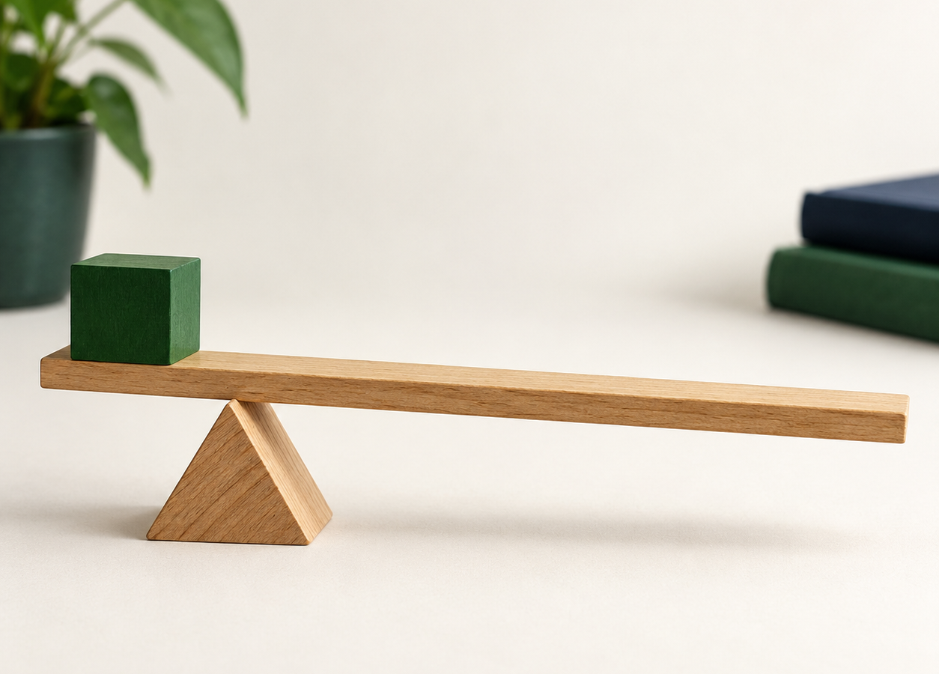
MADE BY MATT / GROW SCIENCE
Two lever positions, one load
Compare effort
and hand travel.
Explain what changes when the pivot moves nearer the load.
AUTUMN 1 · WEEK 4 · LESSON B
01
Notes:
Independent Work — workshop reference — 0 minutes within the source's 40-minute lesson.
Reference title only; source 32-minute workshop begins immediately with retrieval. No extra ten-minute starter/practical substituted from an older pack.
[Sources]
https://github.com/MattRoper1977/Lessons/blob/main/Science_Teesside/Grow/SCI_G_W4_Mechanisms.html
Git blob: 8aa3e1f001c3d3c944207d4eb44b93b1df4d7e46.
SHA256: a2d4bd4b2ec87aace94167b285bd1724bb9e2907f86a472b74b84fa48ffa53a0.
[/Sources]
[Sources] Generated contextual illustration for this visual edition; not measured or recorded experimental evidence. [/Sources]

Slide 2
MADE BY MATT / GROW SCIENCE
Recover Monday’s lever rule
01
Point to the effort, pivot and load.
02
What might happen if the pivot moves near the load?
03
Choose to test, direct, observe or record.
AUTUMN 1 · WEEK 4 · LESSON B
02
Notes:
Independent Work — retrieve and prepare — 2 minutes within the source's 40-minute lesson.
First two minutes of source four-minute preparation. Supported: point/choose; standard: describe change in effort arm; stretch: predict effort and hand travel for same load rise. Keep prediction visible. No compulsory equipment handling.
[Sources]
https://github.com/MattRoper1977/Lessons/blob/main/Science_Teesside/Grow/SCI_G_W4_Mechanisms.html
Git blob: 8aa3e1f001c3d3c944207d4eb44b93b1df4d7e46.
SHA256: a2d4bd4b2ec87aace94167b285bd1724bb9e2907f86a472b74b84fa48ffa53a0.
[/Sources]

Slide 3
MADE BY MATT / GROW SCIENCE
Check the model before touching
01
Adult checks the lever, stable pivot and secured load.
02
Use a light load and a small lift target.
03
Keep hands clear of the pivot.
04
Never flick the lever or launch the load.
AUTUMN 1 · WEEK 4 · LESSON B
03
Notes:
Independent Work — retrieve and prepare — 2 minutes within the source's 40-minute lesson.
Final two minutes of preparation. Source kit: adult-secured ruler/card lever, broad stable pivot, light secured eraser, two marked pivot positions, fixed effort point, small target height. Adult-preassembled or operated option. Do not use heavy masses. A ruler/tape may measure hand travel; force values require suitable meter.
[Sources]
https://github.com/MattRoper1977/Lessons/blob/main/Science_Teesside/Grow/SCI_G_W4_Mechanisms.html
Git blob: 8aa3e1f001c3d3c944207d4eb44b93b1df4d7e46.
SHA256: a2d4bd4b2ec87aace94167b285bd1724bb9e2907f86a472b74b84fa48ffa53a0.
[/Sources]

Slide 4
MADE BY MATT / GROW SCIENCE
What stays the same?
01
The same light load
02
The same effort point
03
The same small height the load rises
04
The same way of judging or measuring effort
AUTUMN 1 · WEEK 4 · LESSON B
04
Notes:
Independent Work — compare positions — 3 minutes within the source's 40-minute lesson.
First three minutes of source 20-minute comparison. Change the pivot position only. Mark target height with adult. Keep load position on lever fixed too; moving pivot changes relative arm lengths. Do not compare a tiny lift with a large lift. Agree easier/similar/harder as qualitative observations. Explain no numbers may be invented to make table look complete.
[Sources]
https://github.com/MattRoper1977/Lessons/blob/main/Science_Teesside/Grow/SCI_G_W4_Mechanisms.html
Git blob: 8aa3e1f001c3d3c944207d4eb44b93b1df4d7e46.
SHA256: a2d4bd4b2ec87aace94167b285bd1724bb9e2907f86a472b74b84fa48ffa53a0.
[/Sources]

Slide 5
MADE BY MATT / GROW SCIENCE
Compare the two arm lengths
MIDDLE PIVOT
Nearer the load, the effort arm is longer relative to the load arm.
PIVOT NEAR LOAD
Predict: what will your hand do?
effort at left • load at right
AUTUMN 1 · WEEK 4 · LESSON B
05
Notes:
Independent Work — compare positions — 3 minutes within the source's 40-minute lesson.
Next three minutes within 20-minute comparison. Diagram is schematic, not actual measurements. Left effort point and right load position stay fixed. Triangle is pivot; eraser block load. Near-load arm ratio means lower effort force ideally but larger effort travel for equal small load rise. For no kit, use diagram to explain prediction, label task 'diagram explanation' rather than performed test.
[Sources]
https://github.com/MattRoper1977/Lessons/blob/main/Science_Teesside/Grow/SCI_G_W4_Mechanisms.html
Git blob: 8aa3e1f001c3d3c944207d4eb44b93b1df4d7e46.
SHA256: a2d4bd4b2ec87aace94167b285bd1724bb9e2907f86a472b74b84fa48ffa53a0.
[/Sources]

Slide 6
MADE BY MATT / GROW SCIENCE
Try the middle pivot
01
Adult checks the middle pivot mark.
02
Raise the load to the small target height.
03
Notice the effort and the hand’s travel.
04
Record what you observed.
AUTUMN 1 · WEEK 4 · LESSON B
06
Notes:
Independent Work — compare positions — 5 minutes within the source's 40-minute lesson.
Five minutes of source 20-minute comparison. Keep light secured load, fixed effort point and hands clear. Teacher/director may operate. Record baseline effort qualitatively; later compare second position. If measuring hand travel, mark start/end and unit, using an appropriate method; arc motion is not automatically equal to straight-line displacement. Repeat small controlled lift if safe.
[Sources]
https://github.com/MattRoper1977/Lessons/blob/main/Science_Teesside/Grow/SCI_G_W4_Mechanisms.html
Git blob: 8aa3e1f001c3d3c944207d4eb44b93b1df4d7e46.
SHA256: a2d4bd4b2ec87aace94167b285bd1724bb9e2907f86a472b74b84fa48ffa53a0.
[/Sources]

Slide 7
MADE BY MATT / GROW SCIENCE
Try the pivot nearer the load
01
Adult moves the pivot to its second mark.
02
Keep the same load, effort point and load rise.
03
Does it feel easier, similar or harder?
04
Compare hand travel with the first position.
AUTUMN 1 · WEEK 4 · LESSON B
07
Notes:
Independent Work — compare positions — 5 minutes within the source's 40-minute lesson.
Next five minutes in 20-minute comparison. Do not lead pupils into claiming easier if it felt similar. Expected ideal trend: smaller effort force; effort end moves farther for same rise. Real friction/bending may obscure the effect. Report uncertainty honestly. Stop if pivot slips or load detaches.
[Sources]
https://github.com/MattRoper1977/Lessons/blob/main/Science_Teesside/Grow/SCI_G_W4_Mechanisms.html
Git blob: 8aa3e1f001c3d3c944207d4eb44b93b1df4d7e46.
SHA256: a2d4bd4b2ec87aace94167b285bd1724bb9e2907f86a472b74b84fa48ffa53a0.
[/Sources]

Slide 8
MADE BY MATT / GROW SCIENCE
Make your record precise
RECORD FOR BOTH POSITIONS
USE HONEST EVIDENCE
Same load/rise checked?
Effort: easier/similar/harder
Hand travel: what changed?
Observation is valid evidence.
Add cm only if measured.
Add N only with a force meter.
AUTUMN 1 · WEEK 4 · LESSON B
08
Notes:
Independent Work — compare positions — 4 minutes within the source's 40-minute lesson.
Final four minutes of 20-minute comparison. Native worksheet table should use configuration columns middle/near load. Mark whether observation or measurement. Supported: tick/dictate; standard: compare and explain arm ratio; stretch: hand-travel observation/measurement and model limitations. A force estimate from feeling is not a measurement in newtons.
[Sources]
https://github.com/MattRoper1977/Lessons/blob/main/Science_Teesside/Grow/SCI_G_W4_Mechanisms.html
Git blob: 8aa3e1f001c3d3c944207d4eb44b93b1df4d7e46.
SHA256: a2d4bd4b2ec87aace94167b285bd1724bb9e2907f86a472b74b84fa48ffa53a0.
[/Sources]

Slide 9
MADE BY MATT / GROW SCIENCE
Pause: was the comparison fair?
01
Did the load stay the same?
02
Did it rise to the same target height?
03
Did the effort act at the same point?
04
Name one observation you want to check.
AUTUMN 1 · WEEK 4 · LESSON B
09
Notes:
Independent Work — evidence check — 2 minutes within the source's 40-minute lesson.
Exact source two-minute workshop pause. An adult/partner can move apparatus while learner observes. A changed effort point or load rise prevents clean comparison. Check labels on sketch. No compulsory sharing or photo evidence.
[Sources]
https://github.com/MattRoper1977/Lessons/blob/main/Science_Teesside/Grow/SCI_G_W4_Mechanisms.html
Git blob: 8aa3e1f001c3d3c944207d4eb44b93b1df4d7e46.
SHA256: a2d4bd4b2ec87aace94167b285bd1724bb9e2907f86a472b74b84fa48ffa53a0.
[/Sources]

Slide 10
MADE BY MATT / GROW SCIENCE
Repeat one careful comparison
01
Correct one setup or recording issue.
02
Compare both positions again if safe.
03
Keep any earlier observation and explain the change.
AUTUMN 1 · WEEK 4 · LESSON B
10
Notes:
Independent Work — improve and conclude — 3 minutes within the source's 40-minute lesson.
First three of source final six-minute phase. Adult resets to same light load, lift target and effort position. Do not keep only expected observations. If kit unavailable, revise labelled explanation using the diagram; identify this as no-equipment route.
[Sources]
https://github.com/MattRoper1977/Lessons/blob/main/Science_Teesside/Grow/SCI_G_W4_Mechanisms.html
Git blob: 8aa3e1f001c3d3c944207d4eb44b93b1df4d7e46.
SHA256: a2d4bd4b2ec87aace94167b285bd1724bb9e2907f86a472b74b84fa48ffa53a0.
[/Sources]

Slide 11
MADE BY MATT / GROW SCIENCE
Explain the gain and the trade-off
With the pivot nearer the load, our model felt ___.
The hand travelled ___.
For the same load rise, a longer effort arm
can trade a smaller force for more travel.
AUTUMN 1 · WEEK 4 · LESSON B
11
Notes:
Independent Work — improve and conclude — 2 minutes within the source's 40-minute lesson.
Next two minutes final six. Expected explanation links effort arm relative to load arm, not 'longer lever creates energy'. Supported may select easier/similar/harder and point; standard describes arm change; stretch qualifies real friction/bending. Actual observation may be uncertain. No invented force/distance figures.
[Sources]
https://github.com/MattRoper1977/Lessons/blob/main/Science_Teesside/Grow/SCI_G_W4_Mechanisms.html
Git blob: 8aa3e1f001c3d3c944207d4eb44b93b1df4d7e46.
SHA256: a2d4bd4b2ec87aace94167b285bd1724bb9e2907f86a472b74b84fa48ffa53a0.
[/Sources]

Slide 12
MADE BY MATT / GROW SCIENCE
Tidy and keep the evidence
01
Label EFFORT, PIVOT and LOAD on the sketch.
02
Keep observations beside your explanation.
03
Return the light load and all small parts.
AUTUMN 1 · WEEK 4 · LESSON B
12
Notes:
Independent Work — improve and conclude — 1 minutes within the source's 40-minute lesson.
Final minute 32-minute workshop. Adult secures/stores apparatus. Note independent/observed/directed participation accurately; diagram-only work is not recorded as a practical. No new photographs needed.
[Sources]
https://github.com/MattRoper1977/Lessons/blob/main/Science_Teesside/Grow/SCI_G_W4_Mechanisms.html
Git blob: 8aa3e1f001c3d3c944207d4eb44b93b1df4d7e46.
SHA256: a2d4bd4b2ec87aace94167b285bd1724bb9e2907f86a472b74b84fa48ffa53a0.
[/Sources]

Slide 13
MADE BY MATT / GROW SCIENCE
What would help next time?
01
Did the equipment or waiting make learning harder?
02
Point, sign, speak, write—or pass privately.
03
Tell the adult teaching this lesson.
04
Agree one useful change and check whether it helps.
AUTUMN 1 · WEEK 4 · LESSON B
13
Notes:
Lundy Loop — pupil feedback — 4 minutes within the source's 40-minute lesson.
Four-minute source feedback. Adult listens and explains what can change or limits. Keep feet clear if objects are dropped; anyone can ask for adult operation. Possible adjustments: stable preassembled model, quieter reset, larger labels. Do not assume public display or sharing.
[Sources]
https://github.com/MattRoper1977/Lessons/blob/main/Science_Teesside/Grow/SCI_G_W4_Mechanisms.html
Git blob: 8aa3e1f001c3d3c944207d4eb44b93b1df4d7e46.
SHA256: a2d4bd4b2ec87aace94167b285bd1724bb9e2907f86a472b74b84fa48ffa53a0.
[/Sources]

Slide 14
MADE BY MATT / GROW SCIENCE
Show what you can explain
01
Supported: name the turning point of a lever.
02
Standard: why can a near-load pivot help lifting?
03
Stretch: explain why the benefit has a cost.
AUTUMN 1 · WEEK 4 · LESSON B
14
Notes:
Exit Ticket — 3 minutes within the source's 40-minute lesson.
First three minutes source four-minute exit. Choose appropriate route. Answers: pivot; effort arm longer relative to load arm so less effort force needed ideally; effort moves farther for same load rise and mechanism cannot create energy. Accept communication aids or dictated answer.
[Sources]
https://github.com/MattRoper1977/Lessons/blob/main/Science_Teesside/Grow/SCI_G_W4_Mechanisms.html
Git blob: 8aa3e1f001c3d3c944207d4eb44b93b1df4d7e46.
SHA256: a2d4bd4b2ec87aace94167b285bd1724bb9e2907f86a472b74b84fa48ffa53a0.
[/Sources]

Slide 15
MADE BY MATT / GROW SCIENCE
Check the force–distance trade-off
The pivot is the turning point. Moving it near the load can reduce the effort force.
EFFORT
LOAD
The effort end travels farther. Real friction and bending can affect the result.
PIVOT
AUTUMN 1 · WEEK 4 · LESSON B
15
Notes:
Exit Ticket — 1 minutes within the source's 40-minute lesson.
Final exit minute. Reveal after attempt, correct one detail. Do not claim all mechanisms make every force smaller; fixed pulley example changes direction. Record whether gain and cost are both understood and any unresolved practical limitation.
[Sources]
https://github.com/MattRoper1977/Lessons/blob/main/Science_Teesside/Grow/SCI_G_W4_Mechanisms.html
Git blob: 8aa3e1f001c3d3c944207d4eb44b93b1df4d7e46.
SHA256: a2d4bd4b2ec87aace94167b285bd1724bb9e2907f86a472b74b84fa48ffa53a0.
[/Sources]

