Slide 1
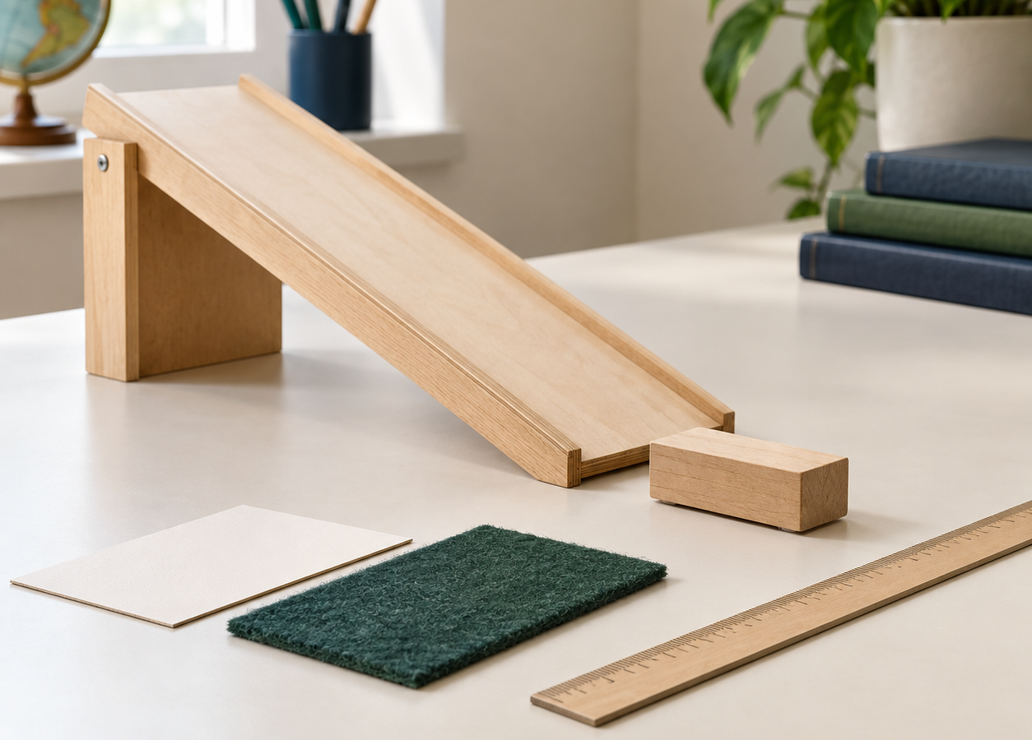
MADE BY MATT / GROW SCIENCE
Planning a fair test
Change one thing.
Trust the comparison.
Plan variables, record with units and judge what the evidence can support.
AUTUMN 1 · WEEK 5 · LESSON A
01
Notes:
Title — 1 minutes within the source's 40-minute lesson.
Introduce current weekly intention; Monday plans and models, Tuesday runs the investigation. Here 'fair' means controlling a comparison, not merely sharing turns. No claim to have completed Tuesday's practical.
[Sources]
https://github.com/MattRoper1977/Lessons/blob/main/Science_Teesside/Grow/SCI_G_W5_Fair_Test.html
Git blob: efdaeab196acc3a8a07e04b088c646ea3a8c724c.
SHA256: bb73bf1bb84d91f21cb25a128b08842daa4e54e9810262258a122fb69f91c779.
[/Sources]
[Sources] Generated contextual illustration for this visual edition; not measured or recorded experimental evidence. [/Sources]

Slide 2
MADE BY MATT / GROW SCIENCE
What will we change?
Does the run-out surface affect how far a trolley travels before stopping?
same release • no push
Name one thing to CHANGE. If ready, name two things to KEEP THE SAME.
0
cm
AUTUMN 1 · WEEK 5 · LESSON A
02
Notes:
Arrival Task — 4 minutes within the source's 40-minute lesson.
Source arrival tier choices: supported circle/point to the one change, standard write/dictate it, stretch also two controls. Answer: run-out surface; controls include same trolley, ramp height, release point and no push. Same fixed measuring zero. Board question explicitly supplied so pupil can answer without internet.
[Sources]
https://github.com/MattRoper1977/Lessons/blob/main/Science_Teesside/Grow/SCI_G_W5_Fair_Test.html
Git blob: efdaeab196acc3a8a07e04b088c646ea3a8c724c.
SHA256: bb73bf1bb84d91f21cb25a128b08842daa4e54e9810262258a122fb69f91c779.
[/Sources]

Slide 3
MADE BY MATT / GROW SCIENCE
Three steps in the investigation
1 Name the variables.
2 Plan three trials for each surface.
3 Judge what the results can tell us.
AUTUMN 1 · WEEK 5 · LESSON A
03
Notes:
Today at a Glance — 2 minutes within the source's 40-minute lesson.
Source sequence: name variables, run three trials, judge data. Explain actual pupil/director trials are in Tuesday period. Agree accessible record mode before apparatus. No compulsory writing if pointing/dictation demonstrates same science.
[Sources]
https://github.com/MattRoper1977/Lessons/blob/main/Science_Teesside/Grow/SCI_G_W5_Fair_Test.html
Git blob: efdaeab196acc3a8a07e04b088c646ea3a8c724c.
SHA256: bb73bf1bb84d91f21cb25a128b08842daa4e54e9810262258a122fb69f91c779.
[/Sources]

Slide 4
MADE BY MATT / GROW SCIENCE
Watch an unfair comparison
01
The adult changes the surface AND adds a push.
02
The trolley stops farther away.
03
Which change caused that difference?
04
What would you change about the method?
AUTUMN 1 · WEEK 5 · LESSON A
04
Notes:
I Do 1 — 4 minutes within the source's 40-minute lesson.
First four minutes source nine-minute I Do 1. Adult demonstrates carefully on low secured ramp with padded stop, clear run and light trolley; no dangerous hard push. If no apparatus, describe hypothetical case clearly. Cannot identify cause because both surface and push changed. Avoid saying all data are worthless; comparison cannot isolate surface effect.
[Sources]
https://github.com/MattRoper1977/Lessons/blob/main/Science_Teesside/Grow/SCI_G_W5_Fair_Test.html
Git blob: efdaeab196acc3a8a07e04b088c646ea3a8c724c.
SHA256: bb73bf1bb84d91f21cb25a128b08842daa4e54e9810262258a122fb69f91c779.
[/Sources]

Slide 5
MADE BY MATT / GROW SCIENCE
Repair the method
A variable is something that could change in the investigation.
CHANGE: run-out surface
KEEP: trolley, slope, release
MEASURE: stopping distance / cm
Plan each box before testing.
AUTUMN 1 · WEEK 5 · LESSON A
05
Notes:
I Do 1 — 5 minutes within the source's 40-minute lesson.
Last five minutes source nine-minute I Do 1. Independent variable=deliberate change; dependent variable=measurement; control variables=things deliberately kept same. Re-run adult model with no-push release from fixed mark. Same ramp height, trolley, join, level samples and measurement zero. Diagram is editable plan, not experiment result.
[Sources]
https://github.com/MattRoper1977/Lessons/blob/main/Science_Teesside/Grow/SCI_G_W5_Fair_Test.html
Git blob: efdaeab196acc3a8a07e04b088c646ea3a8c724c.
SHA256: bb73bf1bb84d91f21cb25a128b08842daa4e54e9810262258a122fb69f91c779.
[/Sources]

Slide 6
MADE BY MATT / GROW SCIENCE
Classify the five variables
01
The surface the trolley rolls on
02
Distance the trolley travels
03
Height of the ramp
04
Which trolley we use
05
How the trolley is released
AUTUMN 1 · WEEK 5 · LESSON A
06
Notes:
We Do 1 — 5 minutes within the source's 40-minute lesson.
First five of source ten-minute We Do 1. Decide CHANGE, MEASURE or KEEP for each before checking. Source 'how hard we push' is clarified to no-push release: keep release procedure constant, don't attempt to match a subjective push. Speaking/pointing/card sort substitutes tapping.
[Sources]
https://github.com/MattRoper1977/Lessons/blob/main/Science_Teesside/Grow/SCI_G_W5_Fair_Test.html
Git blob: efdaeab196acc3a8a07e04b088c646ea3a8c724c.
SHA256: bb73bf1bb84d91f21cb25a128b08842daa4e54e9810262258a122fb69f91c779.
[/Sources]

Slide 7
MADE BY MATT / GROW SCIENCE
Check the variable roles
CHANGE AND MEASURE
KEEP THE SAME
CHANGE: run-out surface
MEASURE: stopping distance / cm
Ramp height
Same trolley
Release mark; no push
AUTUMN 1 · WEEK 5 · LESSON A
07
Notes:
We Do 1 — 3 minutes within the source's 40-minute lesson.
Next three minutes source We Do 1. Reveal after attempt. Add same level run-out, ramp join and fixed zero. Control list need not imply every environmental factor perfectly controlled; choose relevant practical controls. A dependent variable is what is measured, not what is deliberately changed.
[Sources]
https://github.com/MattRoper1977/Lessons/blob/main/Science_Teesside/Grow/SCI_G_W5_Fair_Test.html
Git blob: efdaeab196acc3a8a07e04b088c646ea3a8c724c.
SHA256: bb73bf1bb84d91f21cb25a128b08842daa4e54e9810262258a122fb69f91c779.
[/Sources]

Slide 8
MADE BY MATT / GROW SCIENCE
Direct one useful correction
01
Check the ruler’s zero against the agreed start.
02
Is the ruler end the same as its zero mark?
03
Direct the adult to correct one control.
AUTUMN 1 · WEEK 5 · LESSON A
08
Notes:
We Do 1 — 2 minutes within the source's 40-minute lesson.
Final two minutes source We Do 1. Use source's deliberately misplaced ruler-zero example. Real ruler edge may precede zero. Check distance from same ramp-foot mark to same trolley edge at rest. Safe adult handles apparatus. For paper alternative, point to agreed start and explain correction without fabricated readings.
[Sources]
https://github.com/MattRoper1977/Lessons/blob/main/Science_Teesside/Grow/SCI_G_W5_Fair_Test.html
Git blob: efdaeab196acc3a8a07e04b088c646ea3a8c724c.
SHA256: bb73bf1bb84d91f21cb25a128b08842daa4e54e9810262258a122fb69f91c779.
[/Sources]

Slide 9
MADE BY MATT / GROW SCIENCE
Say the plan before touching kit
I will change ___.
I will keep ___ and ___ the same.
I will measure ___ in ___.
Your plan should make the comparison clear.
AUTUMN 1 · WEEK 5 · LESSON A
09
Notes:
I Do 2 — 4 minutes within the source's 40-minute lesson.
Exact source four-minute evidence loop. Model: change run-out surface; keep same trolley and ramp/release mark, release without push; measure stopping distance in centimetres from fixed zero. Planning and results together will later support evidence; no compulsory photographs. Witness variable naming, correct-unit record and evaluation at actual independence level.
[Sources]
https://github.com/MattRoper1977/Lessons/blob/main/Science_Teesside/Grow/SCI_G_W5_Fair_Test.html
Git blob: efdaeab196acc3a8a07e04b088c646ea3a8c724c.
SHA256: bb73bf1bb84d91f21cb25a128b08842daa4e54e9810262258a122fb69f91c779.
[/Sources]

Slide 10
MADE BY MATT / GROW SCIENCE
Fair method or a problem?
01
Same ramp height; different surfaces
02
Different ramp heights AND different surfaces
03
Three repeats for each surface
04
Ignoring a result you did not like
05
Measuring in ‘about a ruler’
AUTUMN 1 · WEEK 5 · LESSON A
10
Notes:
We Do 2 — 4 minutes within the source's 40-minute lesson.
First four minutes of source ten-minute We Do 2. Sort source bins FAIR/NOT FAIR/NOT SCIENCE/NOT A UNIT. Qualify same-height/different-surface as consistent with fair method only if other relevant controls held. Three repeats support consistency but alone do not make an unfair method fair. Decide before answer reveal.
[Sources]
https://github.com/MattRoper1977/Lessons/blob/main/Science_Teesside/Grow/SCI_G_W5_Fair_Test.html
Git blob: efdaeab196acc3a8a07e04b088c646ea3a8c724c.
SHA256: bb73bf1bb84d91f21cb25a128b08842daa4e54e9810262258a122fb69f91c779.
[/Sources]

Slide 11
MADE BY MATT / GROW SCIENCE
Check what each problem means
SUPPORTS THE COMPARISON
NEEDS CORRECTION
Same height; one planned change
Repeats with method unchanged
Two changed causes: unclear
Discarding disliked data: biased
‘About a ruler’: no clear unit
AUTUMN 1 · WEEK 5 · LESSON A
11
Notes:
We Do 2 — 2 minutes within the source's 40-minute lesson.
Next two source We Do 2 minutes. Source classification: fair, not fair, fair, not science, not a unit. Explain 'not science' refers to rejecting data just because disliked, not a surprising result itself. Prefer precise diagnosis to labels alone. Units should be cm in this planned investigation.
[Sources]
https://github.com/MattRoper1977/Lessons/blob/main/Science_Teesside/Grow/SCI_G_W5_Fair_Test.html
Git blob: efdaeab196acc3a8a07e04b088c646ea3a8c724c.
SHA256: bb73bf1bb84d91f21cb25a128b08842daa4e54e9810262258a122fb69f91c779.
[/Sources]

Slide 12
MADE BY MATT / GROW SCIENCE
Keep an unexpected result
A trolley stopped much farther away on Trial 3.
That is something to investigate.
Keep the value. Note any method issue. Plan a repeat.
AUTUMN 1 · WEEK 5 · LESSON A
12
Notes:
We Do 2 — 2 minutes within the source's 40-minute lesson.
Next two minutes source We Do 2 extension. A surprising observation isn't automatically a mistake. If adult observed a push, note that known method issue separately. If no known cause, keep uncertainty. Never remove or replace a value only to make a mean or pattern look better. No extra invented numerical data needed.
[Sources]
https://github.com/MattRoper1977/Lessons/blob/main/Science_Teesside/Grow/SCI_G_W5_Fair_Test.html
Git blob: efdaeab196acc3a8a07e04b088c646ea3a8c724c.
SHA256: bb73bf1bb84d91f21cb25a128b08842daa4e54e9810262258a122fb69f91c779.
[/Sources]

Slide 13
MADE BY MATT / GROW SCIENCE
Keep your plan for Tuesday
I will change the surface, control the release
and measure stopping distance in cm.
Three repeats can show consistency. They cannot repair an unfair method.
AUTUMN 1 · WEEK 5 · LESSON A
13
Notes:
We Do 2 — 2 minutes within the source's 40-minute lesson.
Final two minutes source We Do 2. Label and keep planning frame. Stop Monday here; Tuesday is 32-minute workshop plus 4-minute feedback and 4-minute exit. Source sample carpet conclusion is not copied as pupil evidence because current test has not occurred. Next lesson uses actual results or explicitly labelled model data.
[Sources]
https://github.com/MattRoper1977/Lessons/blob/main/Science_Teesside/Grow/SCI_G_W5_Fair_Test.html
Git blob: efdaeab196acc3a8a07e04b088c646ea3a8c724c.
SHA256: bb73bf1bb84d91f21cb25a128b08842daa4e54e9810262258a122fb69f91c779.
[/Sources]

