Slide 1
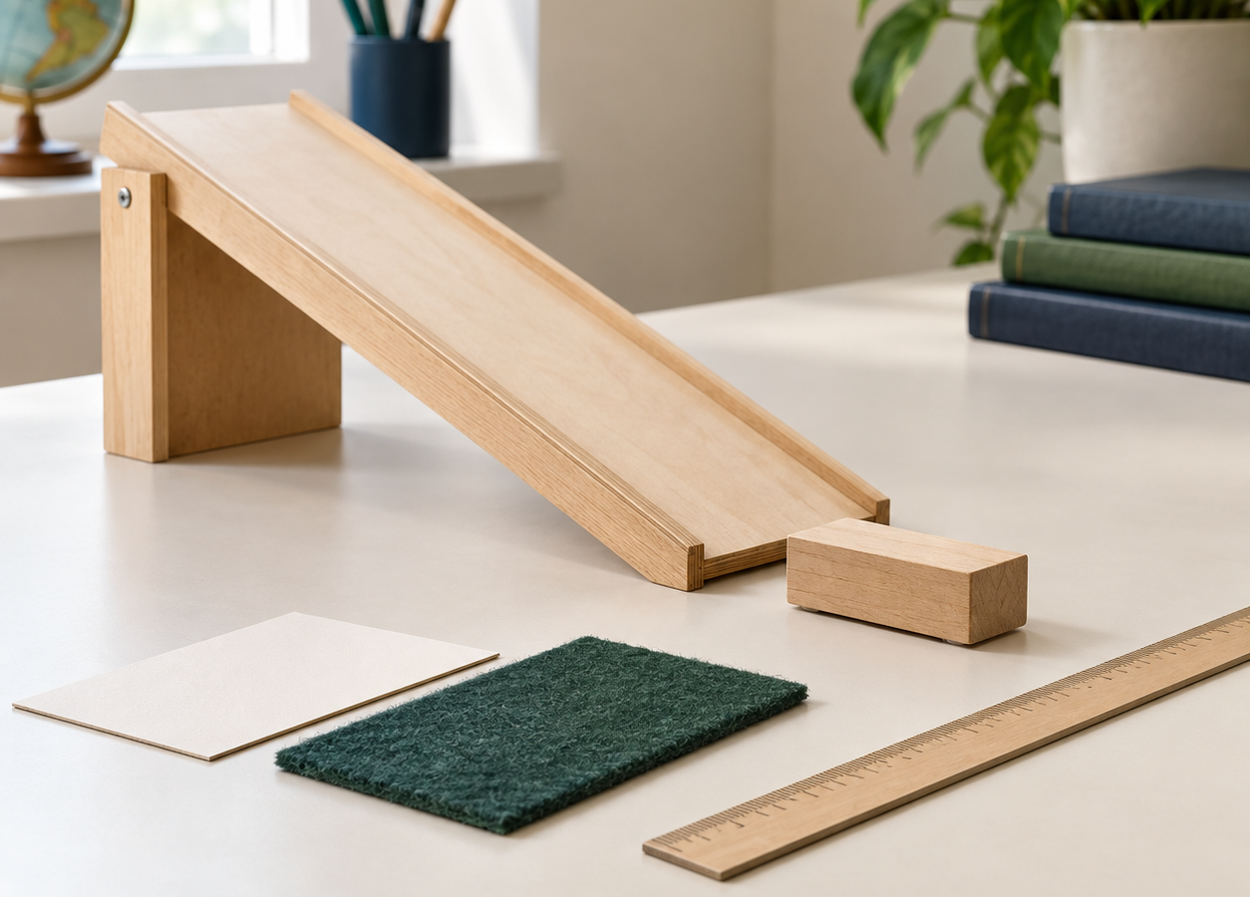
MADE BY MATT / GROW SCIENCE
Run and judge a fair test
Plan. Repeat. Check. Conclude.
Use evidence to answer the question, and explain its limits.
AUTUMN 1 · WEEK 5 · LESSON B
01
Notes:
Independent Work — workshop reference — 0 minutes within the source's 40-minute lesson.
Reference title only, no added starter. Begin source 32-minute workshop immediately: 7-minute plan/setup, 17-minute trials, 2-minute check, 6-minute improve/conclude/tidy.
[Sources]
https://github.com/MattRoper1977/Lessons/blob/main/Science_Teesside/Grow/SCI_G_W5_Fair_Test.html
Git blob: efdaeab196acc3a8a07e04b088c646ea3a8c724c.
SHA256: bb73bf1bb84d91f21cb25a128b08842daa4e54e9810262258a122fb69f91c779.
[/Sources]
[Sources] Generated contextual illustration for this visual edition; not measured or recorded experimental evidence. [/Sources]

Slide 2
MADE BY MATT / GROW SCIENCE
Recover the question and your plan
Does the run-out surface affect the trolley’s stopping distance?
same release • no push
Choose two surfaces. Complete CHANGE / KEEP / MEASURE.
0
cm
AUTUMN 1 · WEEK 5 · LESSON B
02
Notes:
Independent Work — plan and set up — 3 minutes within the source's 40-minute lesson.
First three source seven-minute plan phase. Use Monday plan. Supported: choose or point with adult and direct trials; standard: write/dictate full plan; stretch: explain controls and intended evaluation. Select two actual available level samples, not automatically carpet/board. Measure distance in centimetres.
[Sources]
https://github.com/MattRoper1977/Lessons/blob/main/Science_Teesside/Grow/SCI_G_W5_Fair_Test.html
Git blob: efdaeab196acc3a8a07e04b088c646ea3a8c724c.
SHA256: bb73bf1bb84d91f21cb25a128b08842daa4e54e9810262258a122fb69f91c779.
[/Sources]

Slide 3
MADE BY MATT / GROW SCIENCE
Check a safe, controlled setup
01
Adult secures a low ramp, clear run and padded stop.
02
Keep the trolley, ramp height and release mark fixed.
03
Keep the run-out level and the ramp join unchanged.
04
Agree the zero, trolley edge and no-push release.
AUTUMN 1 · WEEK 5 · LESSON B
03
Notes:
Independent Work — plan and set up — 4 minutes within the source's 40-minute lesson.
Final four minutes source seven-minute plan phase. Equipment: same trolley, adult-secured low ramp, two level surface samples, tape/ruler, padded stop. Hands clear; agree audible/visual release signal and roles. Observation/direction equals valid participation. Do not accept an unclear zero or changed sample height without correction. Use data alternative if safe setup unavailable.
[Sources]
https://github.com/MattRoper1977/Lessons/blob/main/Science_Teesside/Grow/SCI_G_W5_Fair_Test.html
Git blob: efdaeab196acc3a8a07e04b088c646ea3a8c724c.
SHA256: bb73bf1bb84d91f21cb25a128b08842daa4e54e9810262258a122fb69f91c779.
[/Sources]

Slide 4
MADE BY MATT / GROW SCIENCE
Record in a useful table
01
Name each surface before testing.
02
Use columns: Trial 1 / cm, Trial 2 / cm, Trial 3 / cm.
03
Record from the same zero to the same trolley edge.
04
Keep notes about any method change or non-run.
AUTUMN 1 · WEEK 5 · LESSON B
04
Notes:
Independent Work — run trials — 2 minutes within the source's 40-minute lesson.
First two of source 17-minute trials. Keep units in headers; no numeric entry for unperformed run. Optional XLSX can record results, but paper/dictation remains equivalent. Add named observer/recorder only according to ordinary classroom practice, no account or upload required.
[Sources]
https://github.com/MattRoper1977/Lessons/blob/main/Science_Teesside/Grow/SCI_G_W5_Fair_Test.html
Git blob: efdaeab196acc3a8a07e04b088c646ea3a8c724c.
SHA256: bb73bf1bb84d91f21cb25a128b08842daa4e54e9810262258a122fb69f91c779.
[/Sources]

Slide 5
MADE BY MATT / GROW SCIENCE
Surface A: make three releases
01
Release without a push. Wait until the trolley stops.
02
Measure and record the first distance.
03
Reset to the same mark; repeat twice if practicable.
04
Keep every value and any method note.
AUTUMN 1 · WEEK 5 · LESSON B
05
Notes:
Independent Work — run trials — 6 minutes within the source's 40-minute lesson.
Six minutes of source 17-minute trials. Adult checks run clear before each release; no racing. Supported may direct these three trials and later compare adult-recorded second surface. Three trials are target, not permission to invent missing values. Retain surprising measurements. Alternative source set A=48, 50, 49 cm is invented teaching data only.
[Sources]
https://github.com/MattRoper1977/Lessons/blob/main/Science_Teesside/Grow/SCI_G_W5_Fair_Test.html
Git blob: efdaeab196acc3a8a07e04b088c646ea3a8c724c.
SHA256: bb73bf1bb84d91f21cb25a128b08842daa4e54e9810262258a122fb69f91c779.
[/Sources]

Slide 6
MADE BY MATT / GROW SCIENCE
Surface B: keep the controls
01
Change only the level run-out sample.
02
Recheck the ramp join, release and measuring zero.
03
Run three no-push trials if practicable.
04
Record distances in centimetres and note any issue.
AUTUMN 1 · WEEK 5 · LESSON B
06
Notes:
Independent Work — run trials — 6 minutes within the source's 40-minute lesson.
Next six source 17-minute trials. Keep same trolley, ramp height, release mark and measuring edge. If second surface handled by adult, learner can direct and interpret; identify actual contribution. No-equipment source B=27, 29, 28 cm remains invented model data, never pupil observations.
[Sources]
https://github.com/MattRoper1977/Lessons/blob/main/Science_Teesside/Grow/SCI_G_W5_Fair_Test.html
Git blob: efdaeab196acc3a8a07e04b088c646ea3a8c724c.
SHA256: bb73bf1bb84d91f21cb25a128b08842daa4e54e9810262258a122fb69f91c779.
[/Sources]

Slide 7
MADE BY MATT / GROW SCIENCE
Compare the repeated values
01
Are the three values for each surface close?
02
Is one run noticeably different? Keep it.
03
What did you observe about the method?
04
Use values from both surfaces in your explanation.
AUTUMN 1 · WEEK 5 · LESSON B
07
Notes:
Independent Work — run trials — 3 minutes within the source's 40-minute lesson.
Final three minutes source 17-minute trial phase. Compare within-surface consistency and between-surface differences. Do not call every unusual value an error; uncertainty can remain. Stretch may prepare optional means; basic comparison doesn't require mean. Unfinished trials must remain labelled unperformed.
[Sources]
https://github.com/MattRoper1977/Lessons/blob/main/Science_Teesside/Grow/SCI_G_W5_Fair_Test.html
Git blob: efdaeab196acc3a8a07e04b088c646ea3a8c724c.
SHA256: bb73bf1bb84d91f21cb25a128b08842daa4e54e9810262258a122fb69f91c779.
[/Sources]

Slide 8
MADE BY MATT / GROW SCIENCE
No kit? Interpret this model set
INVENTED TEACHING DATA
WHAT MUST BE TRUE?
A: 48 cm, 50 cm, 49 cm
B: 27 cm, 29 cm, 28 cm
These are not your measurements.
Same trolley and ramp?
Same no-push release and zero?
Only run-out surface changed?
AUTUMN 1 · WEEK 5 · LESSON B
08
Notes:
Independent Work — alternative reference — 0 minutes within the source's 40-minute lesson.
Reference alternative within existing trial time, not extra stage. Exact source values. Model conclusion: all B distances shorter than A for stipulated setup; supports surface effect if controlled. State this is interpreting supplied data, not performing an experiment. Names A/B intentionally do not invent actual surface materials.
[Sources]
https://github.com/MattRoper1977/Lessons/blob/main/Science_Teesside/Grow/SCI_G_W5_Fair_Test.html
Git blob: efdaeab196acc3a8a07e04b088c646ea3a8c724c.
SHA256: bb73bf1bb84d91f21cb25a128b08842daa4e54e9810262258a122fb69f91c779.
[/Sources]

Slide 9
MADE BY MATT / GROW SCIENCE
Pause and inspect one uncertainty
01
Pause the kit. Compare the repeats.
02
Mark an unusual run or possible method issue.
03
Do not delete a result because it differs.
04
Decide whether one controlled retry would help.
AUTUMN 1 · WEEK 5 · LESSON B
09
Notes:
Independent Work — evidence check — 2 minutes within the source's 40-minute lesson.
Source's two-minute planned check. Pens down if writing; adult/pupil may discuss privately. Difference alone not reason to delete. If pushed release observed, note it as specific method issue; keep original. Mean of unfair trials remains unfair.
[Sources]
https://github.com/MattRoper1977/Lessons/blob/main/Science_Teesside/Grow/SCI_G_W5_Fair_Test.html
Git blob: efdaeab196acc3a8a07e04b088c646ea3a8c724c.
SHA256: bb73bf1bb84d91f21cb25a128b08842daa4e54e9810262258a122fb69f91c779.
[/Sources]

Slide 10
MADE BY MATT / GROW SCIENCE
Retry a method issue if time allows
01
Name the concern before repeating.
02
Correct it, then use the same planned method.
03
Label the retry separately from the original trial.
AUTUMN 1 · WEEK 5 · LESSON B
10
Notes:
Independent Work — improve and conclude — 2 minutes within the source's 40-minute lesson.
First two of source final six-minute phase. Retry only safe feasible issue; no compelled extra trials if time unavailable. Keep original and repeated values with reason. Alternative route: evaluate control needed, don't fabricate a repeated model-data measurement.
[Sources]
https://github.com/MattRoper1977/Lessons/blob/main/Science_Teesside/Grow/SCI_G_W5_Fair_Test.html
Git blob: efdaeab196acc3a8a07e04b088c646ea3a8c724c.
SHA256: bb73bf1bb84d91f21cb25a128b08842daa4e54e9810262258a122fb69f91c779.
[/Sources]

Slide 11
MADE BY MATT / GROW SCIENCE
Optional: calculate a mean
Mean = total of the three distances ÷ 3
Model A: (48 + 50 + 49) ÷ 3 = 49 cm.
AUTUMN 1 · WEEK 5 · LESSON B
11
Notes:
Independent Work — improve and conclude — 1 minutes within the source's 40-minute lesson.
One minute within source final six, optional stretch only. Model B=(27 + 29 + 28)/3=28 cm. Real mean only when all three valid comparable numeric trials available; missing trial isn't zero. Keep original trial data and any separately labelled retry. A mean doesn't cure unfair setup or prove all surfaces behave universally. Other learners use this minute to compare repeated values.
[Sources]
https://github.com/MattRoper1977/Lessons/blob/main/Science_Teesside/Grow/SCI_G_W5_Fair_Test.html
Git blob: efdaeab196acc3a8a07e04b088c646ea3a8c724c.
SHA256: bb73bf1bb84d91f21cb25a128b08842daa4e54e9810262258a122fb69f91c779.
[/Sources]

Slide 12
MADE BY MATT / GROW SCIENCE
Answer using the evidence
Our evidence supports ___ because the distances were ___.
This applies to this setup. One limit or method concern is ___.
AUTUMN 1 · WEEK 5 · LESSON B
12
Notes:
Independent Work — improve and conclude — 2 minutes within the source's 40-minute lesson.
Two minutes source final six. Real conclusion uses actual numbers, even no clear difference. Source model answer: B 27/29/28 cm consistently shorter than A 48/50/49 cm; suggests greater overall resistance to rolling on B under controlled setup. Do not imply trolley stopping distance directly measures friction force, or invent carpet identity. Rolling wheels also affected by deformation/bearings; qualify to setup.
[Sources]
https://github.com/MattRoper1977/Lessons/blob/main/Science_Teesside/Grow/SCI_G_W5_Fair_Test.html
Git blob: efdaeab196acc3a8a07e04b088c646ea3a8c724c.
SHA256: bb73bf1bb84d91f21cb25a128b08842daa4e54e9810262258a122fb69f91c779.
[/Sources]

Slide 13
MADE BY MATT / GROW SCIENCE
Keep the plan with the results
01
Keep your plan, all results and conclusion together.
02
Label actual, adult-recorded or model-data work.
03
Reset the space and return the equipment.
AUTUMN 1 · WEEK 5 · LESSON B
13
Notes:
Independent Work — improve and conclude — 1 minutes within the source's 40-minute lesson.
Final minute 32-minute workshop. Teacher witness records observed variable knowledge, unit use and evaluation with actual support level; no photo/public upload required. Keep raw values and retries, not just spreadsheet mean.
[Sources]
https://github.com/MattRoper1977/Lessons/blob/main/Science_Teesside/Grow/SCI_G_W5_Fair_Test.html
Git blob: efdaeab196acc3a8a07e04b088c646ea3a8c724c.
SHA256: bb73bf1bb84d91f21cb25a128b08842daa4e54e9810262258a122fb69f91c779.
[/Sources]

Slide 14
MADE BY MATT / GROW SCIENCE
Your feedback has an audience
01
What helped while you waited between trials?
02
What could make testing or recording more accessible?
03
Point, sign, speak, write—or pass privately.
04
Adult: agree a change, explain limits and check back.
AUTUMN 1 · WEEK 5 · LESSON B
14
Notes:
Lundy Loop — pupil feedback — 4 minutes within the source's 40-minute lesson.
Exact four-minute feedback stage. Waiting is part of a measured investigation. Offer meaningful observer/director tasks or quieter space without excluding science. Adult acts on one feasible suggestion and explains any limits. No assumption of classroom display or onward sharing.
[Sources]
https://github.com/MattRoper1977/Lessons/blob/main/Science_Teesside/Grow/SCI_G_W5_Fair_Test.html
Git blob: efdaeab196acc3a8a07e04b088c646ea3a8c724c.
SHA256: bb73bf1bb84d91f21cb25a128b08842daa4e54e9810262258a122fb69f91c779.
[/Sources]

Slide 15
MADE BY MATT / GROW SCIENCE
Explain why the method matters
01
Supported: how many variables did we plan to change?
02
Standard: name one control variable from this test.
03
Stretch: why are repeats more useful than one result?
AUTUMN 1 · WEEK 5 · LESSON B
15
Notes:
Exit Ticket — 3 minutes within the source's 40-minute lesson.
First three source exit minutes. One chosen route, not mandatory all. Answers: one planned independent variable; same trolley/ramp height/release point/no push/zero; repeats show consistency and help identify unusual results, improving judgement of reliability. They do not guarantee truth or fix confounding.
[Sources]
https://github.com/MattRoper1977/Lessons/blob/main/Science_Teesside/Grow/SCI_G_W5_Fair_Test.html
Git blob: efdaeab196acc3a8a07e04b088c646ea3a8c724c.
SHA256: bb73bf1bb84d91f21cb25a128b08842daa4e54e9810262258a122fb69f91c779.
[/Sources]

Slide 16
MADE BY MATT / GROW SCIENCE
Check and improve your answer
We changed the surface and controlled the release. Repeats helped us judge consistency.
An unexpected result stays in the record, with any method concern noted.
AUTUMN 1 · WEEK 5 · LESSON B
16
Notes:
Exit Ticket — 1 minutes within the source's 40-minute lesson.
Final exit minute. Reveal after attempts. Accept qualified real conclusion including insufficient evidence. Teacher logs unresolved measurement/control misconceptions for next lesson. Preserve source intent to judge data rather than reward a predetermined answer.
[Sources]
https://github.com/MattRoper1977/Lessons/blob/main/Science_Teesside/Grow/SCI_G_W5_Fair_Test.html
Git blob: efdaeab196acc3a8a07e04b088c646ea3a8c724c.
SHA256: bb73bf1bb84d91f21cb25a128b08842daa4e54e9810262258a122fb69f91c779.
[/Sources]

