Slide 1
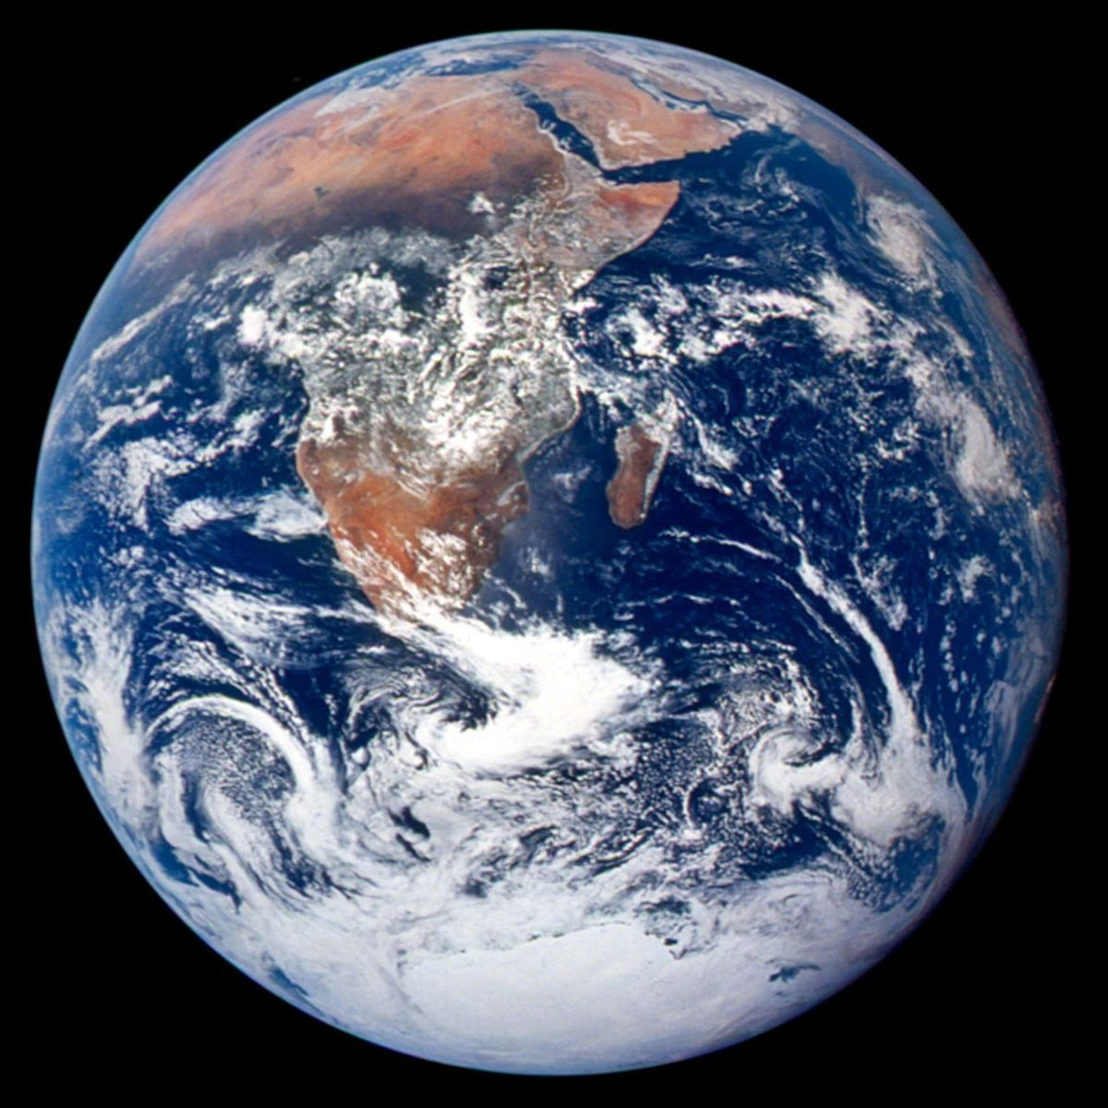
MADE BY MATT / GROW SCIENCE
Earth and the planets
Order. Orbit. Explain.
Describe how Earth and the other planets move around the Sun.
AUTUMN 1 · WEEK 6 · LESSON A
01
Notes:
Title — 1 minutes within the source's 40-minute lesson.
Current W6 objective. Success: order eight planets; describe near-circular orbits; explain the Sun's inward gravitational pull. Assess these through pupil responses, not completion of slide viewing. This deck is Monday's 40-minute lesson.
[Sources]
https://github.com/MattRoper1977/Lessons/blob/main/Science_Teesside/Grow/SCI_G_W6_Earth_And_Planets.html
Git blob: 4a5f555bb496b2ba8f691b4811ca23a0a0c2b1e3.
SHA256: 83eaeaca1b23925984d12c25ba3af86d8e952f0547e35303b78a50d734d82bee.
[/Sources]
[Sources] NASA, The Blue Marble, Apollo 17, 1972. https://science.nasa.gov/resource/the-blue-marble/ [/Sources]

Slide 2
MADE BY MATT / GROW SCIENCE
Start with the planets you know
01
Supported: order Mercury, Venus, Earth and Mars.
02
Standard: write the first four planets from the Sun.
03
Stretch: try all eight planets in order.
AUTUMN 1 · WEEK 6 · LESSON A
02
Notes:
Arrival Task — 4 minutes within the source's 40-minute lesson.
Offer four name cards to supported pupils, including an accessible pointing/directing route. Standard answer Mercury, Venus, Earth, Mars. Stretch continues Jupiter, Saturn, Uranus, Neptune. Keep initial answer for later correction; do not treat this as a timed memory competition.
[Sources]
https://github.com/MattRoper1977/Lessons/blob/main/Science_Teesside/Grow/SCI_G_W6_Earth_And_Planets.html
Git blob: 4a5f555bb496b2ba8f691b4811ca23a0a0c2b1e3.
SHA256: 83eaeaca1b23925984d12c25ba3af86d8e952f0547e35303b78a50d734d82bee.
[/Sources]

Slide 3
MADE BY MATT / GROW SCIENCE
Three things to work out
1 Get the order right.
2 Model an orbit.
3 Explain what keeps the path curving.
AUTUMN 1 · WEEK 6 · LESSON A
03
Notes:
Today at a Glance — 2 minutes within the source's 40-minute lesson.
Use current source sequence. An orbit is a curved path around another object. A year here means one planet's time for an orbit of the Sun; it is not the same number of days for every planet.
[Sources]
https://github.com/MattRoper1977/Lessons/blob/main/Science_Teesside/Grow/SCI_G_W6_Earth_And_Planets.html
Git blob: 4a5f555bb496b2ba8f691b4811ca23a0a0c2b1e3.
SHA256: 83eaeaca1b23925984d12c25ba3af86d8e952f0547e35303b78a50d734d82bee.
[/Sources]

Slide 4
MADE BY MATT / GROW SCIENCE
Eight planets, one order
ROCKY INNER PLANETS
OUTER GIANTS
Mercury
Venus
Earth
Mars
Jupiter — gas giant
Saturn — gas giant
Uranus — ice giant
Neptune — ice giant
AUTUMN 1 · WEEK 6 · LESSON A
04
Notes:
I Do 1 — 3 minutes within the source's 40-minute lesson.
Read from the Sun outwards. Sun is a star, not one of the eight planets. Source terms: Solar System means Sun and everything orbiting it; gravity attracts objects; orbit is path; year is orbit time. Rocky planets are the inner four, while outer group contains two gas and two ice giants.
[Sources]
https://github.com/MattRoper1977/Lessons/blob/main/Science_Teesside/Grow/SCI_G_W6_Earth_And_Planets.html
Git blob: 4a5f555bb496b2ba8f691b4811ca23a0a0c2b1e3.
SHA256: 83eaeaca1b23925984d12c25ba3af86d8e952f0547e35303b78a50d734d82bee.
[/Sources]

Slide 5
MADE BY MATT / GROW SCIENCE
Gravity changes the direction
motion
Motion is along the path. Gravity pulls towards the Sun.
gravity
SUN
Earth
Motion direction is not another force.
AUTUMN 1 · WEEK 6 · LESSON A
05
Notes:
I Do 1 — 3 minutes within the source's 40-minute lesson.
Explain the existing two-arrow model. Amber is the direction of the planet's velocity, not a force; teal is gravitational force towards the Sun. Their directions are approximately perpendicular for a near-circular orbit. Gravity changes motion continuously. Do not describe equal opposing forces or an outward gravitational push. The schematic circle represents a near-circular orbit; sizes and distances are not to scale.
[Sources]
https://github.com/MattRoper1977/Lessons/blob/main/Science_Teesside/Grow/SCI_G_W6_Earth_And_Planets.html
Git blob: 4a5f555bb496b2ba8f691b4811ca23a0a0c2b1e3.
SHA256: 83eaeaca1b23925984d12c25ba3af86d8e952f0547e35303b78a50d734d82bee.
[/Sources]

Slide 6
MADE BY MATT / GROW SCIENCE
Move the model, then challenge it
01
Put a Sun label on the desk and an Earth counter beside it.
02
Move Earth around the Sun. At two places, reset both arrows.
03
If gravity vanished, trace the straight-on direction.
AUTUMN 1 · WEEK 6 · LESSON A
06
Notes:
I Do 1 — 3 minutes within the source's 40-minute lesson.
Use desk counters rather than require public walking. Gravity arrow points Sunward; motion arrow is tangent to the path at that point. Without gravity, the straight-on tangent is the idealised prediction, not a line directly away from the Sun. Counters are moved by hand; this demonstrates an explanation, not gravity in action. Do not swing objects on strings.
[Sources]
https://github.com/MattRoper1977/Lessons/blob/main/Science_Teesside/Grow/SCI_G_W6_Earth_And_Planets.html
Git blob: 4a5f555bb496b2ba8f691b4811ca23a0a0c2b1e3.
SHA256: 83eaeaca1b23925984d12c25ba3af86d8e952f0547e35303b78a50d734d82bee.
[/Sources]

Slide 7
MADE BY MATT / GROW SCIENCE
Rocky or giant?
Mercury
Mars
Jupiter
Neptune
Which has the longer year: Earth or Mars?
AUTUMN 1 · WEEK 6 · LESSON A
07
Notes:
We Do 1 — 5 minutes within the source's 40-minute lesson.
Use spoken answers or two paper headings. Ask pupils to choose before revealing. Mercury and Mars rocky; Jupiter gas giant; Neptune ice giant. For the year comparison supply Earth 365 and Mars 687 Earth days. Mars takes longer because 687 is greater than 365.
[Sources]
https://github.com/MattRoper1977/Lessons/blob/main/Science_Teesside/Grow/SCI_G_W6_Earth_And_Planets.html
Git blob: 4a5f555bb496b2ba8f691b4811ca23a0a0c2b1e3.
SHA256: 83eaeaca1b23925984d12c25ba3af86d8e952f0547e35303b78a50d734d82bee.
[/Sources]

Slide 8
MADE BY MATT / GROW SCIENCE
Check a reason, not just a label
CLASSIFICATION CHECK
YEAR CHECK
Mercury and Mars: rocky
Jupiter: gas giant
Neptune: ice giant
Earth: 365 Earth days
Mars: 687 Earth days
Mars takes 322 more days.
AUTUMN 1 · WEEK 6 · LESSON A
08
Notes:
We Do 1 — 5 minutes within the source's 40-minute lesson.
Correct one card and explain the group. Difference 687 − 365 = 322 days is optional arithmetic; required science is Mars takes longer for one orbit. Further-out Solar System planets have longer orbital periods. Do not infer the diagram gives accurate distances or speed. Repeat the inner-planet order; remaining source cards optional within stage.
[Sources]
https://github.com/MattRoper1977/Lessons/blob/main/Science_Teesside/Grow/SCI_G_W6_Earth_And_Planets.html
Git blob: 4a5f555bb496b2ba8f691b4811ca23a0a0c2b1e3.
SHA256: 83eaeaca1b23925984d12c25ba3af86d8e952f0547e35303b78a50d734d82bee.
[/Sources]

Slide 9
MADE BY MATT / GROW SCIENCE
Build the explanation
The Sun's gravity pulls Earth inward, continually bending its moving path into an orbit.
motion
Sun
Name the force, then explain its effect.
gravity
Schematic: sizes and distances not to scale
AUTUMN 1 · WEEK 6 · LESSON A
09
Notes:
I Do 2 — 4 minutes within the source's 40-minute lesson.
Source answer shape and evidence loop. Look for order, rocky/giant classification and gravity's role. An adult may keep pupil work or write an observation with independence level; photographs are optional and not assumed. Use pupil's own explanation, with pointing to arrows equivalent to writing.
[Sources]
https://github.com/MattRoper1977/Lessons/blob/main/Science_Teesside/Grow/SCI_G_W6_Earth_And_Planets.html
Git blob: 4a5f555bb496b2ba8f691b4811ca23a0a0c2b1e3.
SHA256: 83eaeaca1b23925984d12c25ba3af86d8e952f0547e35303b78a50d734d82bee.
[/Sources]

Slide 10
MADE BY MATT / GROW SCIENCE
Sort five statements
01
Planets orbit the Sun.
02
The Sun orbits Earth.
03
Gravity keeps the planets in orbit.
04
There is no gravity in space.
05
Further-out planets have longer years.
AUTUMN 1 · WEEK 6 · LESSON A
10
Notes:
We Do 2 — 4 minutes within the source's 40-minute lesson.
Pupils choose TRUE/FALSE for each and prepare one reason. Expected T,F,T,F,T for the simplified Solar System context. If a pupil raises motion around the Solar System's shared centre of mass, acknowledge extension but keep required heliocentric model clear. Avoid pretending 'Sun never moves' is necessary.
[Sources]
https://github.com/MattRoper1977/Lessons/blob/main/Science_Teesside/Grow/SCI_G_W6_Earth_And_Planets.html
Git blob: 4a5f555bb496b2ba8f691b4811ca23a0a0c2b1e3.
SHA256: 83eaeaca1b23925984d12c25ba3af86d8e952f0547e35303b78a50d734d82bee.
[/Sources]

Slide 11
MADE BY MATT / GROW SCIENCE
Answers to the five claims
TRUE CLAIMS
FALSE CLAIMS
Planets orbit the Sun.
Gravity keeps them in orbit.
Outer planets have longer years.
The Sun orbits Earth.
There is no gravity in space.
AUTUMN 1 · WEEK 6 · LESSON A
11
Notes:
We Do 2 — 3 minutes within the source's 40-minute lesson.
Check the five original statements in order T,F,T,F,T. Repair false claims: Earth orbits Sun; gravity acts in space and curves planetary paths. Do not add a false claim that Sun never moves. Correct one explanation after pupils have attempted the sort.
[Sources]
https://github.com/MattRoper1977/Lessons/blob/main/Science_Teesside/Grow/SCI_G_W6_Earth_And_Planets.html
Git blob: 4a5f555bb496b2ba8f691b4811ca23a0a0c2b1e3.
SHA256: 83eaeaca1b23925984d12c25ba3af86d8e952f0547e35303b78a50d734d82bee.
[/Sources]

Slide 12
MADE BY MATT / GROW SCIENCE
Use time as evidence
Neptune's year is much longer than Earth's: about 165 Earth years for one orbit.
A year means one orbit, not always 365 days.
AUTUMN 1 · WEEK 6 · LESSON A
12
Notes:
We Do 2 — 2 minutes within the source's 40-minute lesson.
Source WAGOLL. Neptune's approximately 60,190 Earth days ÷365 is about 165. Its longer period reflects both a larger orbital path and lower orbital speed; do not imply equal speed. Comparing numbers suffices at supported level. No additional numerical assessment beyond source intent.
[Sources]
https://github.com/MattRoper1977/Lessons/blob/main/Science_Teesside/Grow/SCI_G_W6_Earth_And_Planets.html
Git blob: 4a5f555bb496b2ba8f691b4811ca23a0a0c2b1e3.
SHA256: 83eaeaca1b23925984d12c25ba3af86d8e952f0547e35303b78a50d734d82bee.
[/Sources]

Slide 13
MADE BY MATT / GROW SCIENCE
Keep your orbit explanation
01
Label and keep today's order strip and explanation.
02
Next lesson: build the model and test year comparisons.
03
Choose one arrow or idea to check again.
AUTUMN 1 · WEEK 6 · LESSON A
13
Notes:
We Do 2 — 1 minutes within the source's 40-minute lesson.
Stop Monday here as current source directs. Do not add Tuesday 32-minute workshop or exit now. Pupil may save a dictated or adult-scribed response. Next session checks model limitations, two year comparisons at standard level, and the same source success criteria.
[Sources]
https://github.com/MattRoper1977/Lessons/blob/main/Science_Teesside/Grow/SCI_G_W6_Earth_And_Planets.html
Git blob: 4a5f555bb496b2ba8f691b4811ca23a0a0c2b1e3.
SHA256: 83eaeaca1b23925984d12c25ba3af86d8e952f0547e35303b78a50d734d82bee.
[/Sources]

