Slide 1
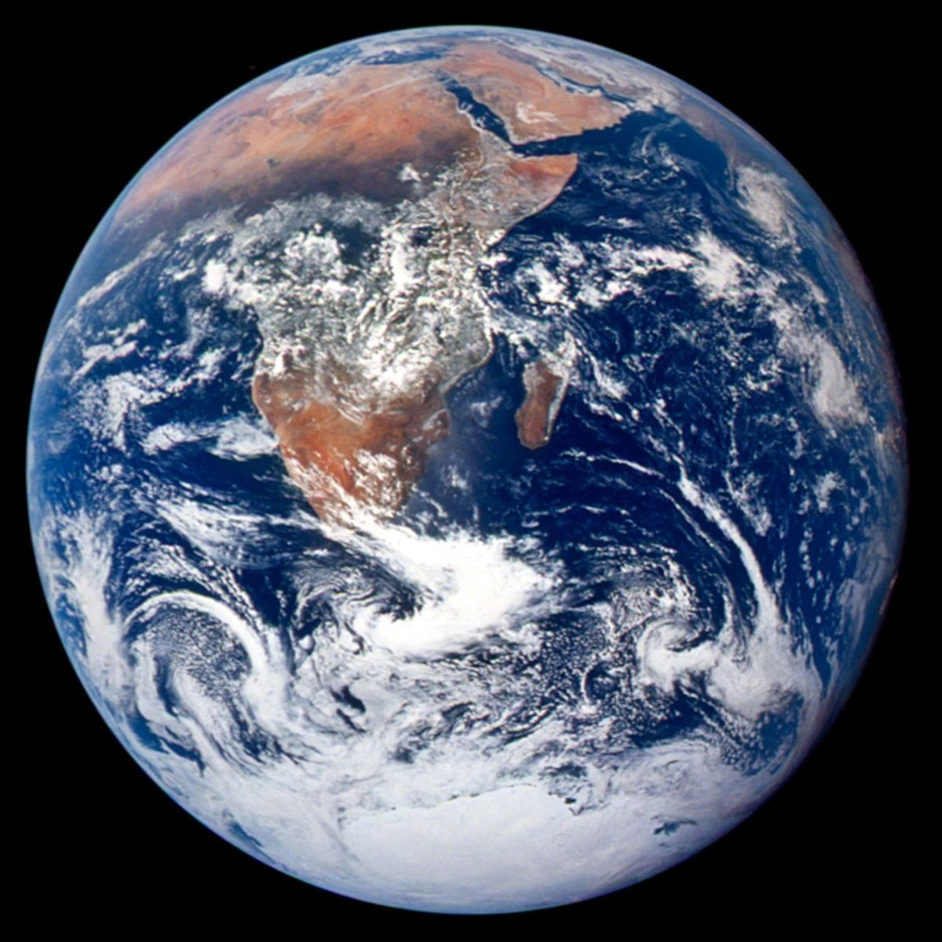
MADE BY MATT / GROW SCIENCE
Build an orbit model
Show it. Check it.
Improve it.
Explain an orbit and compare the time planets take.
AUTUMN 1 · WEEK 6 · LESSON B
01
Notes:
Workshop · retrieve — 1 minutes within the source's 40-minute lesson.
First minute of the source 4-minute retrieval, not an extra starter. Return Monday's order strip. Today's 32-minute workshop includes all setup, work, check and tidy; feedback and exit follow.
[Sources]
https://github.com/MattRoper1977/Lessons/blob/main/Science_Teesside/Grow/SCI_G_W6_Earth_And_Planets.html
Git blob: 4a5f555bb496b2ba8f691b4811ca23a0a0c2b1e3.
SHA256: 83eaeaca1b23925984d12c25ba3af86d8e952f0547e35303b78a50d734d82bee.
[/Sources]
[Sources] NASA, The Blue Marble, Apollo 17, 1972. https://science.nasa.gov/resource/the-blue-marble/ [/Sources]

Slide 2
MADE BY MATT / GROW SCIENCE
Retrieve the order and arrows
01
Order the eight planet names from the Sun.
02
Point towards the Sun for gravity.
03
Point along the orbit for motion.
AUTUMN 1 · WEEK 6 · LESSON B
02
Notes:
Workshop · retrieve — 3 minutes within the source's 40-minute lesson.
Order Mercury, Venus, Earth, Mars, Jupiter, Saturn, Uranus, Neptune. Provide all eight cards; adult can hold or read them. At current model position, gravity points inward; motion tangent. Support may direct an adult, draw or use counters. This completes the source 4-minute retrieval.
[Sources]
https://github.com/MattRoper1977/Lessons/blob/main/Science_Teesside/Grow/SCI_G_W6_Earth_And_Planets.html
Git blob: 4a5f555bb496b2ba8f691b4811ca23a0a0c2b1e3.
SHA256: 83eaeaca1b23925984d12c25ba3af86d8e952f0547e35303b78a50d734d82bee.
[/Sources]

Slide 3
MADE BY MATT / GROW SCIENCE
Choose a route and set up
01
Use Sun/Earth labels, counters, two paper arrows and the year table.
02
Choose desk model, drawing, or directing an adult.
03
Keep the kit on the desk. No swinging objects.
AUTUMN 1 · WEEK 6 · LESSON B
03
Notes:
Workshop · build and compare — 4 minutes within the source's 40-minute lesson.
First 4 of the 20-minute model/data phase. Supported: order names with support and Earth/Mars comparison. Standard: order and group, two arrows, two data pairs. Stretch: test farther-out/longer-year prediction and model limits. No bodily movement required. Supply paper ruler only if useful for layout; this is not distance measurement.
[Sources]
https://github.com/MattRoper1977/Lessons/blob/main/Science_Teesside/Grow/SCI_G_W6_Earth_And_Planets.html
Git blob: 4a5f555bb496b2ba8f691b4811ca23a0a0c2b1e3.
SHA256: 83eaeaca1b23925984d12c25ba3af86d8e952f0547e35303b78a50d734d82bee.
[/Sources]

Slide 4
MADE BY MATT / GROW SCIENCE
Two arrows, two meanings
motion
Place Earth in two positions. Change both arrows each time.
gravity
SUN
Earth
Motion direction is not another force.
AUTUMN 1 · WEEK 6 · LESSON B
04
Notes:
Workshop · build and compare — 4 minutes within the source's 40-minute lesson.
Pupils manipulate their own or adult-operated model. Inward arrow represents gravitational force, tangent arrow represents direction of motion. They are not two opposing forces. Native schematic is an explanation aid; hand motion supplies movement in classroom model. No claim that counter orbit demonstrates gravity experimentally.
[Sources]
https://github.com/MattRoper1977/Lessons/blob/main/Science_Teesside/Grow/SCI_G_W6_Earth_And_Planets.html
Git blob: 4a5f555bb496b2ba8f691b4811ca23a0a0c2b1e3.
SHA256: 83eaeaca1b23925984d12c25ba3af86d8e952f0547e35303b78a50d734d82bee.
[/Sources]

Slide 5
MADE BY MATT / GROW SCIENCE
Use the supplied year data
Mercury 88 Earth days
Earth 365 Earth days
Mars 687 Earth days
Jupiter 4,333 Earth days
Neptune 60,190 Earth days
AUTUMN 1 · WEEK 6 · LESSON B
05
Notes:
Workshop · build and compare — 5 minutes within the source's 40-minute lesson.
Current source approximate orbital periods. Compare one pair supported; two pairs standard. All numbers share unit Earth days. Ask which finishes a single orbit first when starting together; shorter year finishes first. These are supplied scientific data, not student measurements. NASA Space Place years-on-other-planets and NASA planets are source facts; no internet needed.
[Sources]
https://github.com/MattRoper1977/Lessons/blob/main/Science_Teesside/Grow/SCI_G_W6_Earth_And_Planets.html
Git blob: 4a5f555bb496b2ba8f691b4811ca23a0a0c2b1e3.
SHA256: 83eaeaca1b23925984d12c25ba3af86d8e952f0547e35303b78a50d734d82bee.
[/Sources]

Slide 6
MADE BY MATT / GROW SCIENCE
Make a claim, then check it
01
Choose a pair. Predict which has the longer year.
02
Check the numbers and name the evidence.
03
Try a second pair or explain one model limit.
AUTUMN 1 · WEEK 6 · LESSON B
06
Notes:
Workshop · build and compare — 5 minutes within the source's 40-minute lesson.
Worked answer for adult after attempt: Mars 687 > Earth 365, so Mars takes longer and Earth completes one orbit first; Neptune 60,190 > Jupiter 4,333, so Neptune longer. Mercury 88 < Earth 365, so Mercury shorter. Stretch checks farther-out pattern using given order and table. No invented relation that planets move at equal speed.
[Sources]
https://github.com/MattRoper1977/Lessons/blob/main/Science_Teesside/Grow/SCI_G_W6_Earth_And_Planets.html
Git blob: 4a5f555bb496b2ba8f691b4811ca23a0a0c2b1e3.
SHA256: 83eaeaca1b23925984d12c25ba3af86d8e952f0547e35303b78a50d734d82bee.
[/Sources]

Slide 7
MADE BY MATT / GROW SCIENCE
Record your evidence
_____ has the longer year because_____ days
is more than_____ days.
Our model shows_____, but it does not show_____.
AUTUMN 1 · WEEK 6 · LESSON B
07
Notes:
Workshop · build and compare — 2 minutes within the source's 40-minute lesson.
Final 2 minutes of source 20-minute build/data phase. Scribe or accept dictated/pointed evidence. Model shows Sunward pull direction and curving path/order; does not show accurate size, distance, speed or actual gravitational mechanism. Pupils can use two supported sentence halves rather than full paragraph. Keep own predictions visible.
[Sources]
https://github.com/MattRoper1977/Lessons/blob/main/Science_Teesside/Grow/SCI_G_W6_Earth_And_Planets.html
Git blob: 4a5f555bb496b2ba8f691b4811ca23a0a0c2b1e3.
SHA256: 83eaeaca1b23925984d12c25ba3af86d8e952f0547e35303b78a50d734d82bee.
[/Sources]

Slide 8
MADE BY MATT / GROW SCIENCE
Pause for a two-minute check
01
Ask an adult or chosen partner to check one arrow.
02
Explain one year comparison.
03
Does ‘longer year’ mean more time for one orbit?
AUTUMN 1 · WEEK 6 · LESSON B
08
Notes:
Workshop · check — 2 minutes within the source's 40-minute lesson.
Exact source 2-minute check inside 32. Expected yes: longer time, not a bigger physical planet. Use 365/687 to verify unit understanding. Adult records actual demonstrated science and independence. An incorrect first arrow is an opportunity to correct, not proof of failure.
[Sources]
https://github.com/MattRoper1977/Lessons/blob/main/Science_Teesside/Grow/SCI_G_W6_Earth_And_Planets.html
Git blob: 4a5f555bb496b2ba8f691b4811ca23a0a0c2b1e3.
SHA256: 83eaeaca1b23925984d12c25ba3af86d8e952f0547e35303b78a50d734d82bee.
[/Sources]

Slide 9
MADE BY MATT / GROW SCIENCE
Improve one thing
01
Correct one arrow or number comparison.
02
Record two things the model shows.
03
Name one thing it does not show accurately.
AUTUMN 1 · WEEK 6 · LESSON B
09
Notes:
Workshop · correct and tidy — 3 minutes within the source's 40-minute lesson.
First 3 of source 6-minute correction/tidy. Examples shows orbit path and inward pull direction; does not show scale, speed or real gravitational movement. Differentiate: adult records a spoken model limit, standard writes one, stretch explains why a hand-moved counter is no gravity experiment.
[Sources]
https://github.com/MattRoper1977/Lessons/blob/main/Science_Teesside/Grow/SCI_G_W6_Earth_And_Planets.html
Git blob: 4a5f555bb496b2ba8f691b4811ca23a0a0c2b1e3.
SHA256: 83eaeaca1b23925984d12c25ba3af86d8e952f0547e35303b78a50d734d82bee.
[/Sources]

Slide 10
MADE BY MATT / GROW SCIENCE
Keep the evidence; return the kit
01
Check your name, planet order and recorded comparison.
02
Keep the drawing or explanation you want to use.
03
Return counters, arrows and labels.
AUTUMN 1 · WEEK 6 · LESSON B
10
Notes:
Workshop · correct and tidy — 3 minutes within the source's 40-minute lesson.
Completes 32-minute workshop. Keep or record evidence without assuming a photograph/public display. Adult can record direct observation instead of forcing writing. No extension consumes feedback/exit. Do not award external accreditation solely because a worksheet exists.
[Sources]
https://github.com/MattRoper1977/Lessons/blob/main/Science_Teesside/Grow/SCI_G_W6_Earth_And_Planets.html
Git blob: 4a5f555bb496b2ba8f691b4811ca23a0a0c2b1e3.
SHA256: 83eaeaca1b23925984d12c25ba3af86d8e952f0547e35303b78a50d734d82bee.
[/Sources]

Slide 11
MADE BY MATT / GROW SCIENCE
Your voice can change the lesson
01
What helped you understand the orbit?
02
What made the model or task difficult?
03
Point, speak privately, sign, or pass.
AUTUMN 1 · WEEK 6 · LESSON B
11
Notes:
Pupil feedback — 2 minutes within the source's 40-minute lesson.
First 2 of source 4-minute Lundy/pupil feedback. Ask about science or access, e.g. colour distinction, movement demand, instruction pace. Offer chosen partner to convey feedback. Do not require public performance or disclosure.
[Sources]
https://github.com/MattRoper1977/Lessons/blob/main/Science_Teesside/Grow/SCI_G_W6_Earth_And_Planets.html
Git blob: 4a5f555bb496b2ba8f691b4811ca23a0a0c2b1e3.
SHA256: 83eaeaca1b23925984d12c25ba3af86d8e952f0547e35303b78a50d734d82bee.
[/Sources]

Slide 12
MADE BY MATT / GROW SCIENCE
Agree one useful change
You said_____. We can change_____.
Did that change help? What still needs explaining?
AUTUMN 1 · WEEK 6 · LESSON B
12
Notes:
Pupil feedback — 2 minutes within the source's 40-minute lesson.
Adult makes one possible change, e.g. labelled paper arrows instead of colour alone, static drawing instead of movement. Explain real limits and check response. Pupil may pass. A brief private note can preserve voice/action; no unnecessary photograph or sharing.
[Sources]
https://github.com/MattRoper1977/Lessons/blob/main/Science_Teesside/Grow/SCI_G_W6_Earth_And_Planets.html
Git blob: 4a5f555bb496b2ba8f691b4811ca23a0a0c2b1e3.
SHA256: 83eaeaca1b23925984d12c25ba3af86d8e952f0547e35303b78a50d734d82bee.
[/Sources]

Slide 13
MADE BY MATT / GROW SCIENCE
Exit: show what you understand
01
Supported: which planet is third from the Sun?
02
Standard: what force keeps a planet in orbit?
03
Stretch: why does Earth not simply fall into the Sun?
AUTUMN 1 · WEEK 6 · LESSON B
13
Notes:
Exit Ticket — 2 minutes within the source's 40-minute lesson.
Pupil chooses agreed source tier; not all three compulsory. Responses may be spoken/pointed/drawn. Answers on next slide/teacher notes after independent attempt. Source assessed outcomes: order, orbit description, gravitational explanation. Prompting level should be recorded.
[Sources]
https://github.com/MattRoper1977/Lessons/blob/main/Science_Teesside/Grow/SCI_G_W6_Earth_And_Planets.html
Git blob: 4a5f555bb496b2ba8f691b4811ca23a0a0c2b1e3.
SHA256: 83eaeaca1b23925984d12c25ba3af86d8e952f0547e35303b78a50d734d82bee.
[/Sources]

Slide 14
MADE BY MATT / GROW SCIENCE
Check the science before you leave
Earth is third from the Sun.
motion
The Sun's gravity keeps
curving the planet's path.
Sun
gravity
Earth keeps moving while
gravity pulls it inward.
Schematic: sizes and distances not to scale
AUTUMN 1 · WEEK 6 · LESSON B
14
Notes:
Exit Ticket — 2 minutes within the source's 40-minute lesson.
Source answers. Stretch: its sideways motion and inward gravitational pull combine to produce a continuing curved orbit rather than a radial fall. Avoid false 'gravity cancels forward motion' or 'there is no gravity'. Ask pupil to correct one word or arrow. This completes 40 minutes, not a new activity.
[Sources]
https://github.com/MattRoper1977/Lessons/blob/main/Science_Teesside/Grow/SCI_G_W6_Earth_And_Planets.html
Git blob: 4a5f555bb496b2ba8f691b4811ca23a0a0c2b1e3.
SHA256: 83eaeaca1b23925984d12c25ba3af86d8e952f0547e35303b78a50d734d82bee.
[/Sources]

