Slide 1
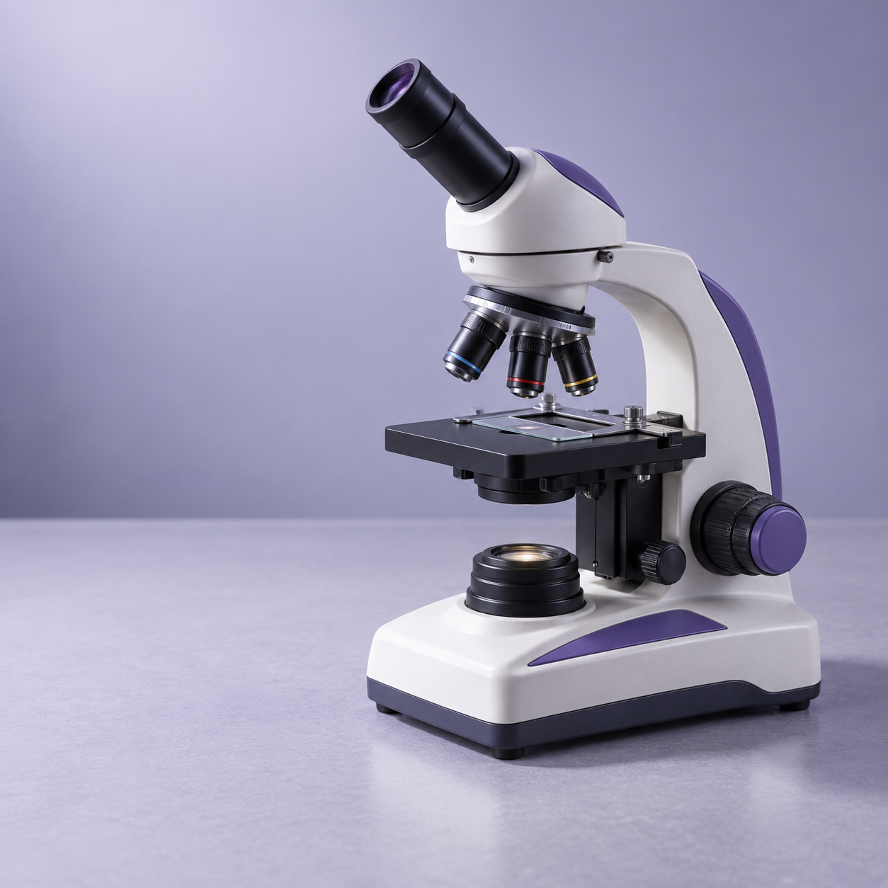
LAUNCH SCIENCE / W3L1
Arrival · 3 min
Microscopy
I can use a light microscope model and explain the difference between magnification and resolution.
Notice. Recall. Be ready to explain.
1
What tool could help us see cells that are too small for the eye?
2
What might make an image look bigger?
Retrieval answers
Arrival
Starter
I Do
We Do
I Do 2
We Do 2
Independent
Exit
Resources
Notes:
Stage: Arrival, 3 minutes. Monday / Wednesday / Friday P1, 09:30–10:10. Use reveals within this slot; appendix slides are not added time.
Retrieval answers: A microscope. | Greater magnification, e.g. a higher-power lens or enlarging a print. | Suitable resolution/optics and correct focus; enlargement alone is not enough.
Core explanation: Magnification is how many times larger an image is. Resolution is whether close points can be seen separately. Enlarging a blur does not recover detail.
Watch for: Do not add the lens powers. At high power use fine focus only; follow the microscope’s approved procedure.
Least help first: Ask which change is about size and which is about detail before naming either term.
Support cue: Total magnification = eyepiece × objective. A bigger image is not always a clearer image. Describe what you can see before you explain it.
[Sources]
User-supplied LAUNCH W3–W7 pack: W3 Magnification slides 5–7; microscopy is retained from the LAUNCH baseline.
Made by Matt LAUNCH Science draft, lesson-content.json, W3L1; existing illustrative diagrams reused, active-transport direction corrected to lower → higher.
Pearson Edexcel GCSE Biology specification, sections 1.1–1.6 and 1.15–1.17: https://qualifications.pearson.com/content/dam/pdf/GCSE/Science/2016/Specification/gcse-biology-spec.pdf
Optional concept video: freesciencelessons, Microscopy, https://www.youtube.com/watch?v=L5StAE_uuxM (link located 5 September 2026).
[/Sources]
[Sources]
Source editable lesson: Original LAUNCH Science OneDrive pack, 5 September 2026, W3L1. Source teaching content preserved. Current HTML reference: https://madebymatt.uk/Lessons/Science_Teesside/Launch/. Native diagrams restate the source explanation and are not experimental measurements.
Opening microscope illustration generated for this pack; not experimental evidence.
[/Sources]

Slide 2
LAUNCH SCIENCE / W3L1
Starter · 4 min
Make a prediction
A cell image becomes larger but stays blurred. Has its resolution improved? Commit a view before the model opens.
A Yes — bigger always means clearer
B No — size and detail are different
C Not sure yet — I need evidence
Commit, then check
Arrival
Starter
I Do
We Do
I Do 2
We Do 2
Independent
Exit
Resources
Notes:
Stage: Starter, 4 minutes. Monday / Wednesday / Friday P1, 09:30–10:10. Use reveals within this slot; appendix slides are not added time.
Correct: No — size and detail are different. Ask for the reason, then return to the original prediction.
Core explanation: Magnification is how many times larger an image is. Resolution is whether close points can be seen separately. Enlarging a blur does not recover detail.
Watch for: Do not add the lens powers. At high power use fine focus only; follow the microscope’s approved procedure.
Least help first: Ask which change is about size and which is about detail before naming either term.
Support cue: Total magnification = eyepiece × objective. A bigger image is not always a clearer image. Describe what you can see before you explain it.
[Sources]
User-supplied LAUNCH W3–W7 pack: W3 Magnification slides 5–7; microscopy is retained from the LAUNCH baseline.
Made by Matt LAUNCH Science draft, lesson-content.json, W3L1; existing illustrative diagrams reused, active-transport direction corrected to lower → higher.
Pearson Edexcel GCSE Biology specification, sections 1.1–1.6 and 1.15–1.17: https://qualifications.pearson.com/content/dam/pdf/GCSE/Science/2016/Specification/gcse-biology-spec.pdf
Optional concept video: freesciencelessons, Microscopy, https://www.youtube.com/watch?v=L5StAE_uuxM (link located 5 September 2026).
[/Sources]
[Sources]
Source editable lesson: Original LAUNCH Science OneDrive pack, 5 September 2026, W3L1. Source teaching content preserved. Current HTML reference: https://madebymatt.uk/Lessons/Science_Teesside/Launch/. Native diagrams restate the source explanation and are not experimental measurements.
[/Sources]

Slide 3
LAUNCH SCIENCE / W3L1
I Do · 5 min
Watch the model
1
Begin on the lowest-power objective so the specimen is easier to find.
Two lenses magnify
EYEPIECE
OBJECTIVE
×10
×
×4
2
Use coarse focus only at low power, then fine focus. Use fine focus only at high power.
Total magnification
×40
3
Total magnification equals eyepiece magnification multiplied by objective magnification.
View labelled diagram
Optional video
Arrival
Starter
I Do
We Do
I Do 2
We Do 2
Independent
Exit
Resources
Notes:
Stage: I Do, 5 minutes. Monday / Wednesday / Friday P1, 09:30–10:10. Use reveals within this slot; appendix slides are not added time.
The model shows how lens choice changes field of view and apparent size.
Model limit: A screen model cannot reproduce the full optical quality, handling or specimen preparation of a real microscope.
Video replaces up to 90 seconds of explanation; use the still diagram if unavailable.
Core explanation: Magnification is how many times larger an image is. Resolution is whether close points can be seen separately. Enlarging a blur does not recover detail.
Watch for: Do not add the lens powers. At high power use fine focus only; follow the microscope’s approved procedure.
Least help first: Ask which change is about size and which is about detail before naming either term.
Support cue: Total magnification = eyepiece × objective. A bigger image is not always a clearer image. Describe what you can see before you explain it.
[Sources]
User-supplied LAUNCH W3–W7 pack: W3 Magnification slides 5–7; microscopy is retained from the LAUNCH baseline.
Made by Matt LAUNCH Science draft, lesson-content.json, W3L1; existing illustrative diagrams reused, active-transport direction corrected to lower → higher.
Pearson Edexcel GCSE Biology specification, sections 1.1–1.6 and 1.15–1.17: https://qualifications.pearson.com/content/dam/pdf/GCSE/Science/2016/Specification/gcse-biology-spec.pdf
Optional concept video: freesciencelessons, Microscopy, https://www.youtube.com/watch?v=L5StAE_uuxM (link located 5 September 2026).
[/Sources]
[Sources]
Source editable lesson: Original LAUNCH Science OneDrive pack, 5 September 2026, W3L1. Source teaching content preserved. Current HTML reference: https://madebymatt.uk/Lessons/Science_Teesside/Launch/. Native diagrams restate the source explanation and are not experimental measurements.
[/Sources]

Slide 4
LAUNCH SCIENCE / W3L1
We Do · 5 min
Choose and justify
A microscope uses a ×10 eyepiece and a ×40 objective. What is the total magnification?
A ×50
B ×400
C ×4
D ×4000
Give the deciding clue before checking.
Check the reasoning
Arrival
Starter
I Do
We Do
I Do 2
We Do 2
Independent
Exit
Resources
Notes:
Stage: We Do, 5 minutes. Monday / Wednesday / Friday P1, 09:30–10:10. Use reveals within this slot; appendix slides are not added time.
A: ×50 — Additive thinking is the error here. Total magnification uses multiplication.
B: ×400 — Correct relationship. Now state which two lens values were multiplied.
C: ×4 — Dividing makes the answer smaller than either useful lens combination.
D: ×4000 — Check the place value: 10 × 40 is 400, not 4000.
Core explanation: Magnification is how many times larger an image is. Resolution is whether close points can be seen separately. Enlarging a blur does not recover detail.
Watch for: Do not add the lens powers. At high power use fine focus only; follow the microscope’s approved procedure.
Least help first: Ask which change is about size and which is about detail before naming either term.
Support cue: Total magnification = eyepiece × objective. A bigger image is not always a clearer image. Describe what you can see before you explain it.
[Sources]
User-supplied LAUNCH W3–W7 pack: W3 Magnification slides 5–7; microscopy is retained from the LAUNCH baseline.
Made by Matt LAUNCH Science draft, lesson-content.json, W3L1; existing illustrative diagrams reused, active-transport direction corrected to lower → higher.
Pearson Edexcel GCSE Biology specification, sections 1.1–1.6 and 1.15–1.17: https://qualifications.pearson.com/content/dam/pdf/GCSE/Science/2016/Specification/gcse-biology-spec.pdf
Optional concept video: freesciencelessons, Microscopy, https://www.youtube.com/watch?v=L5StAE_uuxM (link located 5 September 2026).
[/Sources]
[Sources]
Source editable lesson: Original LAUNCH Science OneDrive pack, 5 September 2026, W3L1. Source teaching content preserved. Current HTML reference: https://madebymatt.uk/Lessons/Science_Teesside/Launch/. Native diagrams restate the source explanation and are not experimental measurements.
[/Sources]

Slide 5
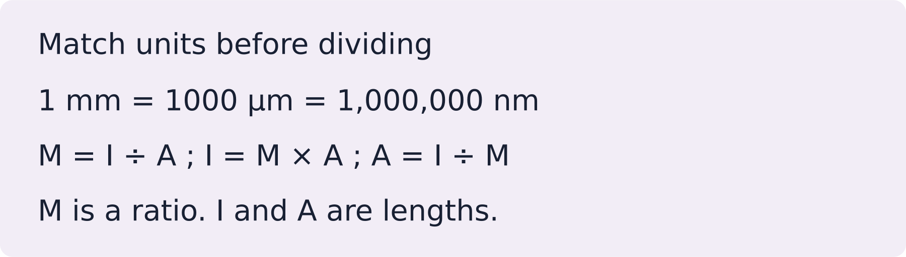
LAUNCH SCIENCE / W3L1
I Do 2 · 4 min
Connect the science
1
Magnification describes how many times larger the image appears.
2
Resolution describes whether two close points can be seen as separate detail.
3
A larger image is not automatically a more detailed image.
Arrival
Starter
I Do
We Do
I Do 2
We Do 2
Independent
Exit
Resources
Notes:
Stage: I Do 2, 4 minutes. Monday / Wednesday / Friday P1, 09:30–10:10. Use reveals within this slot; appendix slides are not added time.
A screen model cannot reproduce the full optical quality, handling or specimen preparation of a real microscope.
Core explanation: Magnification is how many times larger an image is. Resolution is whether close points can be seen separately. Enlarging a blur does not recover detail.
Watch for: Do not add the lens powers. At high power use fine focus only; follow the microscope’s approved procedure.
Least help first: Ask which change is about size and which is about detail before naming either term.
Support cue: Total magnification = eyepiece × objective. A bigger image is not always a clearer image. Describe what you can see before you explain it.
[Sources]
User-supplied LAUNCH W3–W7 pack: W3 Magnification slides 5–7; microscopy is retained from the LAUNCH baseline.
Made by Matt LAUNCH Science draft, lesson-content.json, W3L1; existing illustrative diagrams reused, active-transport direction corrected to lower → higher.
Pearson Edexcel GCSE Biology specification, sections 1.1–1.6 and 1.15–1.17: https://qualifications.pearson.com/content/dam/pdf/GCSE/Science/2016/Specification/gcse-biology-spec.pdf
Optional concept video: freesciencelessons, Microscopy, https://www.youtube.com/watch?v=L5StAE_uuxM (link located 5 September 2026).
[/Sources]
[Sources]
Source editable lesson: Original LAUNCH Science OneDrive pack, 5 September 2026, W3L1. Source teaching content preserved. Current HTML reference: https://madebymatt.uk/Lessons/Science_Teesside/Launch/. Native diagrams restate the source explanation and are not experimental measurements.
[/Sources]

Slide 6
LAUNCH SCIENCE / W3L1
We Do 2 · Task · 6 min
Lens detective
Choose the first safe step. Then predict what changes at higher power.
1
Start at ×4 objective.
2
Find and centre the specimen.
3
Focus, then increase power.
Reveal shared reasoning
Arrival
Starter
I Do
We Do
I Do 2
We Do 2
Independent
Exit
Resources
Notes:
Stage: We Do 2 · Task, 6 minutes. Monday / Wednesday / Friday P1, 09:30–10:10. Use reveals within this slot; appendix slides are not added time.
With a ×10 eyepiece: ×4 gives ×40; ×40 gives ×400. The field of view shrinks. A larger image is not automatically clearer.
Run the printed activity or this board; one route is enough.
Core explanation: Magnification is how many times larger an image is. Resolution is whether close points can be seen separately. Enlarging a blur does not recover detail.
Watch for: Do not add the lens powers. At high power use fine focus only; follow the microscope’s approved procedure.
Least help first: Ask which change is about size and which is about detail before naming either term.
Support cue: Total magnification = eyepiece × objective. A bigger image is not always a clearer image. Describe what you can see before you explain it.
[Sources]
User-supplied LAUNCH W3–W7 pack: W3 Magnification slides 5–7; microscopy is retained from the LAUNCH baseline.
Made by Matt LAUNCH Science draft, lesson-content.json, W3L1; existing illustrative diagrams reused, active-transport direction corrected to lower → higher.
Pearson Edexcel GCSE Biology specification, sections 1.1–1.6 and 1.15–1.17: https://qualifications.pearson.com/content/dam/pdf/GCSE/Science/2016/Specification/gcse-biology-spec.pdf
Optional concept video: freesciencelessons, Microscopy, https://www.youtube.com/watch?v=L5StAE_uuxM (link located 5 September 2026).
[/Sources]
[Sources]
Source editable lesson: Original LAUNCH Science OneDrive pack, 5 September 2026, W3L1. Source teaching content preserved. Current HTML reference: https://madebymatt.uk/Lessons/Science_Teesside/Launch/. Native diagrams restate the source explanation and are not experimental measurements.
[/Sources]

Slide 7
LAUNCH SCIENCE / W3L1
Independent Task · 10 min
Your independent evidence
A pupil changes from a ×4 objective to a ×40 objective while keeping a ×10 eyepiece. Explain the change in total magnification, field of view and visible detail. Include one limitation of the digital model.
Optional support
Total magnification = eyepiece × objective. A bigger image is not always a clearer image. Describe what you can see before you explain it.
Make one precise correction to the same work after feedback.
Open worksheet pages
Model after first attempt
Arrival
Starter
I Do
We Do
I Do 2
We Do 2
Independent
Exit
Resources
Notes:
Stage: Independent Task, 10 minutes. Monday / Wednesday / Friday P1, 09:30–10:10. Use reveals within this slot; appendix slides are not added time.
Model answer: The total magnification changes from ×40 to ×400 because 10 × 40 = 400. The field of view becomes smaller, so less of the specimen is visible. The image appears larger, but improved resolution depends on the optics and focus, not magnification alone. The digital model does not reproduce real specimen preparation or optical limits.
Select only questions that fit the ten-minute slot. W7L3: Q2, Q3 and Q5 total 11 marks. The full paper needs a separate 25-minute slot.
Core explanation: Magnification is how many times larger an image is. Resolution is whether close points can be seen separately. Enlarging a blur does not recover detail.
Watch for: Do not add the lens powers. At high power use fine focus only; follow the microscope’s approved procedure.
Least help first: Ask which change is about size and which is about detail before naming either term.
Support cue: Total magnification = eyepiece × objective. A bigger image is not always a clearer image. Describe what you can see before you explain it.
[Sources]
User-supplied LAUNCH W3–W7 pack: W3 Magnification slides 5–7; microscopy is retained from the LAUNCH baseline.
Made by Matt LAUNCH Science draft, lesson-content.json, W3L1; existing illustrative diagrams reused, active-transport direction corrected to lower → higher.
Pearson Edexcel GCSE Biology specification, sections 1.1–1.6 and 1.15–1.17: https://qualifications.pearson.com/content/dam/pdf/GCSE/Science/2016/Specification/gcse-biology-spec.pdf
Optional concept video: freesciencelessons, Microscopy, https://www.youtube.com/watch?v=L5StAE_uuxM (link located 5 September 2026).
[/Sources]
[Sources]
Source editable lesson: Original LAUNCH Science OneDrive pack, 5 September 2026, W3L1. Source teaching content preserved. Current HTML reference: https://madebymatt.uk/Lessons/Science_Teesside/Launch/. Native diagrams restate the source explanation and are not experimental measurements.
[/Sources]

Slide 8
LAUNCH SCIENCE / W3L1
Exit · 3 min
What changed in your thinking?
In one sentence, explain why a bigger image is not always a better-resolved image.
1
Point to one improvement in your work.
2
Choose what you want to revisit.
3
Tell your teacher; agree the next step together.
Arrival
Starter
I Do
We Do
I Do 2
We Do 2
Independent
Exit
Resources
Notes:
Stage: Exit, 3 minutes. Monday / Wednesday / Friday P1, 09:30–10:10. Use reveals within this slot; appendix slides are not added time.
Exit answer: A larger image may still be blurred; resolution concerns seeing nearby points separately.
Receive the request, record the agreed next action and check it next lesson. Keep responses private when requested.
Core explanation: Magnification is how many times larger an image is. Resolution is whether close points can be seen separately. Enlarging a blur does not recover detail.
Watch for: Do not add the lens powers. At high power use fine focus only; follow the microscope’s approved procedure.
Least help first: Ask which change is about size and which is about detail before naming either term.
Support cue: Total magnification = eyepiece × objective. A bigger image is not always a clearer image. Describe what you can see before you explain it.
[Sources]
User-supplied LAUNCH W3–W7 pack: W3 Magnification slides 5–7; microscopy is retained from the LAUNCH baseline.
Made by Matt LAUNCH Science draft, lesson-content.json, W3L1; existing illustrative diagrams reused, active-transport direction corrected to lower → higher.
Pearson Edexcel GCSE Biology specification, sections 1.1–1.6 and 1.15–1.17: https://qualifications.pearson.com/content/dam/pdf/GCSE/Science/2016/Specification/gcse-biology-spec.pdf
Optional concept video: freesciencelessons, Microscopy, https://www.youtube.com/watch?v=L5StAE_uuxM (link located 5 September 2026).
[/Sources]
[Sources]
Source editable lesson: Original LAUNCH Science OneDrive pack, 5 September 2026, W3L1. Source teaching content preserved. Current HTML reference: https://madebymatt.uk/Lessons/Science_Teesside/Launch/. Native diagrams restate the source explanation and are not experimental measurements.
[/Sources]

Slide 9
LAUNCH SCIENCE / W3L1
Resources
Retrieval and prediction check
1
A microscope.
2
Greater magnification, e.g. a higher-power lens or enlarging a print.
No — size and detail are different
Return to Starter
Arrival
Starter
I Do
We Do
I Do 2
We Do 2
Independent
Exit
Resources
Notes:
Read only after an attempt; retain the pupil’s first view.
Core explanation: Magnification is how many times larger an image is. Resolution is whether close points can be seen separately. Enlarging a blur does not recover detail.
Watch for: Do not add the lens powers. At high power use fine focus only; follow the microscope’s approved procedure.
Least help first: Ask which change is about size and which is about detail before naming either term.
Support cue: Total magnification = eyepiece × objective. A bigger image is not always a clearer image. Describe what you can see before you explain it.
[Sources]
User-supplied LAUNCH W3–W7 pack: W3 Magnification slides 5–7; microscopy is retained from the LAUNCH baseline.
Made by Matt LAUNCH Science draft, lesson-content.json, W3L1; existing illustrative diagrams reused, active-transport direction corrected to lower → higher.
Pearson Edexcel GCSE Biology specification, sections 1.1–1.6 and 1.15–1.17: https://qualifications.pearson.com/content/dam/pdf/GCSE/Science/2016/Specification/gcse-biology-spec.pdf
Optional concept video: freesciencelessons, Microscopy, https://www.youtube.com/watch?v=L5StAE_uuxM (link located 5 September 2026).
[/Sources]
[Sources]
Source editable lesson: Original LAUNCH Science OneDrive pack, 5 September 2026, W3L1. Source teaching content preserved. Current HTML reference: https://madebymatt.uk/Lessons/Science_Teesside/Launch/. Native diagrams restate the source explanation and are not experimental measurements.
[/Sources]

Slide 10
LAUNCH SCIENCE / W3L1
Resources
Check the deciding clue
×400
Correct relationship. Now state which two lens values were multiplied.
Compare your reason. Correct one step if needed.
Return to We Do
Arrival
Starter
I Do
We Do
I Do 2
We Do 2
Independent
Exit
Resources
Notes:
Additive thinking is the error here. Total magnification uses multiplication.
Correct relationship. Now state which two lens values were multiplied.
Dividing makes the answer smaller than either useful lens combination.
Check the place value: 10 × 40 is 400, not 4000.
Core explanation: Magnification is how many times larger an image is. Resolution is whether close points can be seen separately. Enlarging a blur does not recover detail.
Watch for: Do not add the lens powers. At high power use fine focus only; follow the microscope’s approved procedure.
Least help first: Ask which change is about size and which is about detail before naming either term.
Support cue: Total magnification = eyepiece × objective. A bigger image is not always a clearer image. Describe what you can see before you explain it.
[Sources]
User-supplied LAUNCH W3–W7 pack: W3 Magnification slides 5–7; microscopy is retained from the LAUNCH baseline.
Made by Matt LAUNCH Science draft, lesson-content.json, W3L1; existing illustrative diagrams reused, active-transport direction corrected to lower → higher.
Pearson Edexcel GCSE Biology specification, sections 1.1–1.6 and 1.15–1.17: https://qualifications.pearson.com/content/dam/pdf/GCSE/Science/2016/Specification/gcse-biology-spec.pdf
Optional concept video: freesciencelessons, Microscopy, https://www.youtube.com/watch?v=L5StAE_uuxM (link located 5 September 2026).
[/Sources]
[Sources]
Source editable lesson: Original LAUNCH Science OneDrive pack, 5 September 2026, W3L1. Source teaching content preserved. Current HTML reference: https://madebymatt.uk/Lessons/Science_Teesside/Launch/. Native diagrams restate the source explanation and are not experimental measurements.
[/Sources]

Slide 11
LAUNCH SCIENCE / W3L1
Resources
Our shared reasoning
With a ×10 eyepiece: ×4 gives ×40; ×40 gives ×400. The field of view shrinks. A larger image is not automatically clearer.
Return to shared task
Arrival
Starter
I Do
We Do
I Do 2
We Do 2
Independent
Exit
Resources
Notes:
Pupils should justify, compare and revise rather than copy a complete answer before trying.
Core explanation: Magnification is how many times larger an image is. Resolution is whether close points can be seen separately. Enlarging a blur does not recover detail.
Watch for: Do not add the lens powers. At high power use fine focus only; follow the microscope’s approved procedure.
Least help first: Ask which change is about size and which is about detail before naming either term.
Support cue: Total magnification = eyepiece × objective. A bigger image is not always a clearer image. Describe what you can see before you explain it.
[Sources]
User-supplied LAUNCH W3–W7 pack: W3 Magnification slides 5–7; microscopy is retained from the LAUNCH baseline.
Made by Matt LAUNCH Science draft, lesson-content.json, W3L1; existing illustrative diagrams reused, active-transport direction corrected to lower → higher.
Pearson Edexcel GCSE Biology specification, sections 1.1–1.6 and 1.15–1.17: https://qualifications.pearson.com/content/dam/pdf/GCSE/Science/2016/Specification/gcse-biology-spec.pdf
Optional concept video: freesciencelessons, Microscopy, https://www.youtube.com/watch?v=L5StAE_uuxM (link located 5 September 2026).
[/Sources]
[Sources]
Source editable lesson: Original LAUNCH Science OneDrive pack, 5 September 2026, W3L1. Source teaching content preserved. Current HTML reference: https://madebymatt.uk/Lessons/Science_Teesside/Launch/. Native diagrams restate the source explanation and are not experimental measurements.
[/Sources]

Slide 12
LAUNCH SCIENCE / W3L1
Resources
Compare after your first attempt
The total magnification changes from ×40 to ×400 because 10 × 40 = 400. The field of view becomes smaller, so less of the specimen is visible. The image appears larger, but improved resolution depends on the optics and focus, not magnification alone. The digital model does not reproduce real specimen preparation or optical limits.
Use the model to improve your explanation in your own words.
Return to independent task
Arrival
Starter
I Do
We Do
I Do 2
We Do 2
Independent
Exit
Resources
Notes:
Staff guide includes question-by-question answers. Do not distribute this presentation as a secure assessment paper.
Core explanation: Magnification is how many times larger an image is. Resolution is whether close points can be seen separately. Enlarging a blur does not recover detail.
Watch for: Do not add the lens powers. At high power use fine focus only; follow the microscope’s approved procedure.
Least help first: Ask which change is about size and which is about detail before naming either term.
Support cue: Total magnification = eyepiece × objective. A bigger image is not always a clearer image. Describe what you can see before you explain it.
[Sources]
User-supplied LAUNCH W3–W7 pack: W3 Magnification slides 5–7; microscopy is retained from the LAUNCH baseline.
Made by Matt LAUNCH Science draft, lesson-content.json, W3L1; existing illustrative diagrams reused, active-transport direction corrected to lower → higher.
Pearson Edexcel GCSE Biology specification, sections 1.1–1.6 and 1.15–1.17: https://qualifications.pearson.com/content/dam/pdf/GCSE/Science/2016/Specification/gcse-biology-spec.pdf
Optional concept video: freesciencelessons, Microscopy, https://www.youtube.com/watch?v=L5StAE_uuxM (link located 5 September 2026).
[/Sources]
[Sources]
Source editable lesson: Original LAUNCH Science OneDrive pack, 5 September 2026, W3L1. Source teaching content preserved. Current HTML reference: https://madebymatt.uk/Lessons/Science_Teesside/Launch/. Native diagrams restate the source explanation and are not experimental measurements.
[/Sources]

Slide 13
LAUNCH SCIENCE / W3L1
Resources
Your lesson resources
Worksheet pages are stored inside this PowerPoint.
Worksheet · page 1
Worksheet · page 2
Standard PDF
Supported PDF
Depth PDF
Editable Word worksheet
Open online lesson / model
Named files are in this week’s folder. Online lesson and video need internet.
Optional concept video
Arrival
Starter
I Do
We Do
I Do 2
We Do 2
Independent
Exit
Resources
Notes:
File buttons use relative links for downloaded/synced folders. OneDrive preview may not resolve relative links. Use the embedded pages or open the named file in the week folder.
Core explanation: Magnification is how many times larger an image is. Resolution is whether close points can be seen separately. Enlarging a blur does not recover detail.
Watch for: Do not add the lens powers. At high power use fine focus only; follow the microscope’s approved procedure.
Least help first: Ask which change is about size and which is about detail before naming either term.
Support cue: Total magnification = eyepiece × objective. A bigger image is not always a clearer image. Describe what you can see before you explain it.
[Sources]
User-supplied LAUNCH W3–W7 pack: W3 Magnification slides 5–7; microscopy is retained from the LAUNCH baseline.
Made by Matt LAUNCH Science draft, lesson-content.json, W3L1; existing illustrative diagrams reused, active-transport direction corrected to lower → higher.
Pearson Edexcel GCSE Biology specification, sections 1.1–1.6 and 1.15–1.17: https://qualifications.pearson.com/content/dam/pdf/GCSE/Science/2016/Specification/gcse-biology-spec.pdf
Optional concept video: freesciencelessons, Microscopy, https://www.youtube.com/watch?v=L5StAE_uuxM (link located 5 September 2026).
[/Sources]
[Sources]
Source editable lesson: Original LAUNCH Science OneDrive pack, 5 September 2026, W3L1. Source teaching content preserved. Current HTML reference: https://madebymatt.uk/Lessons/Science_Teesside/Launch/. Native diagrams restate the source explanation and are not experimental measurements.
[/Sources]

Slide 14
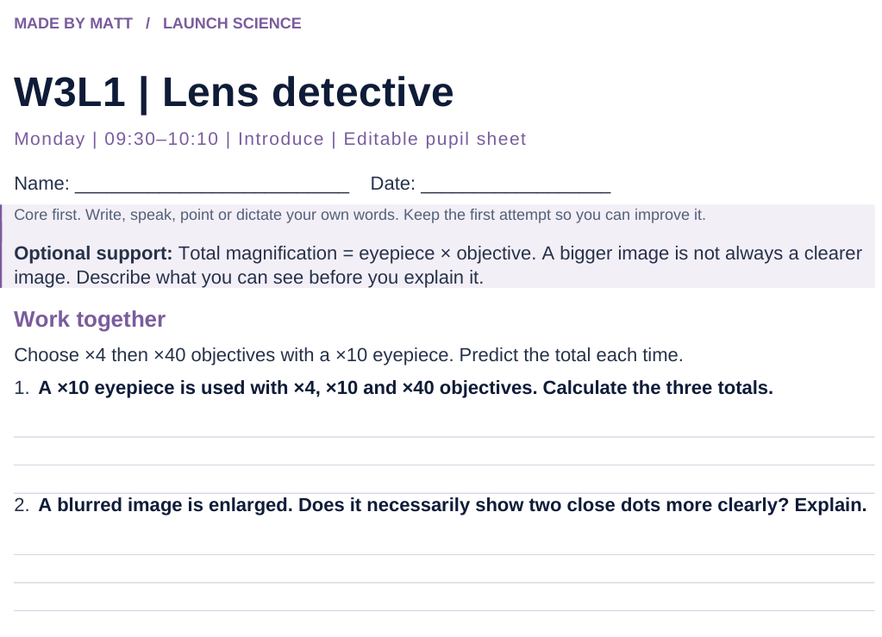
LAUNCH SCIENCE / W3L1
Resources
Worksheet · page 1
Use your printed copy.
Keep the first attempt.
Return to task
Arrival
Starter
I Do
We Do
I Do 2
We Do 2
Independent
Exit
Resources
Notes:
Embedded worksheet reference; print the separate PDF at A4 for writable space.
Core explanation: Magnification is how many times larger an image is. Resolution is whether close points can be seen separately. Enlarging a blur does not recover detail.
Watch for: Do not add the lens powers. At high power use fine focus only; follow the microscope’s approved procedure.
Least help first: Ask which change is about size and which is about detail before naming either term.
Support cue: Total magnification = eyepiece × objective. A bigger image is not always a clearer image. Describe what you can see before you explain it.
[Sources]
User-supplied LAUNCH W3–W7 pack: W3 Magnification slides 5–7; microscopy is retained from the LAUNCH baseline.
Made by Matt LAUNCH Science draft, lesson-content.json, W3L1; existing illustrative diagrams reused, active-transport direction corrected to lower → higher.
Pearson Edexcel GCSE Biology specification, sections 1.1–1.6 and 1.15–1.17: https://qualifications.pearson.com/content/dam/pdf/GCSE/Science/2016/Specification/gcse-biology-spec.pdf
Optional concept video: freesciencelessons, Microscopy, https://www.youtube.com/watch?v=L5StAE_uuxM (link located 5 September 2026).
[/Sources]
[Sources]
Source editable lesson: Original LAUNCH Science OneDrive pack, 5 September 2026, W3L1. Source teaching content preserved. Current HTML reference: https://madebymatt.uk/Lessons/Science_Teesside/Launch/. Native diagrams restate the source explanation and are not experimental measurements.
[/Sources]

Slide 15
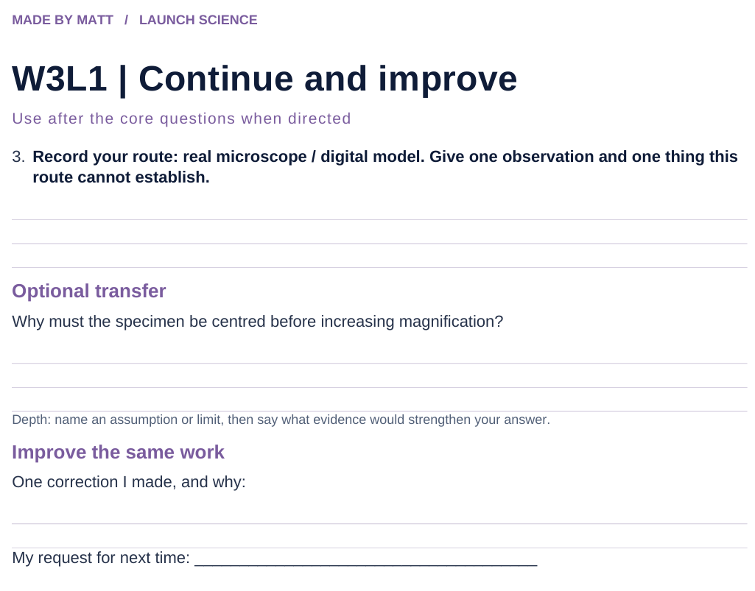
LAUNCH SCIENCE / W3L1
Resources
Worksheet · page 2
Continuation is optional.
Improve the same work.
Return to task
Arrival
Starter
I Do
We Do
I Do 2
We Do 2
Independent
Exit
Resources
Notes:
Embedded worksheet reference; print the separate PDF at A4 for writable space.
Core explanation: Magnification is how many times larger an image is. Resolution is whether close points can be seen separately. Enlarging a blur does not recover detail.
Watch for: Do not add the lens powers. At high power use fine focus only; follow the microscope’s approved procedure.
Least help first: Ask which change is about size and which is about detail before naming either term.
Support cue: Total magnification = eyepiece × objective. A bigger image is not always a clearer image. Describe what you can see before you explain it.
[Sources]
User-supplied LAUNCH W3–W7 pack: W3 Magnification slides 5–7; microscopy is retained from the LAUNCH baseline.
Made by Matt LAUNCH Science draft, lesson-content.json, W3L1; existing illustrative diagrams reused, active-transport direction corrected to lower → higher.
Pearson Edexcel GCSE Biology specification, sections 1.1–1.6 and 1.15–1.17: https://qualifications.pearson.com/content/dam/pdf/GCSE/Science/2016/Specification/gcse-biology-spec.pdf
Optional concept video: freesciencelessons, Microscopy, https://www.youtube.com/watch?v=L5StAE_uuxM (link located 5 September 2026).
[/Sources]
[Sources]
Source editable lesson: Original LAUNCH Science OneDrive pack, 5 September 2026, W3L1. Source teaching content preserved. Current HTML reference: https://madebymatt.uk/Lessons/Science_Teesside/Launch/. Native diagrams restate the source explanation and are not experimental measurements.
[/Sources]

Slide 16
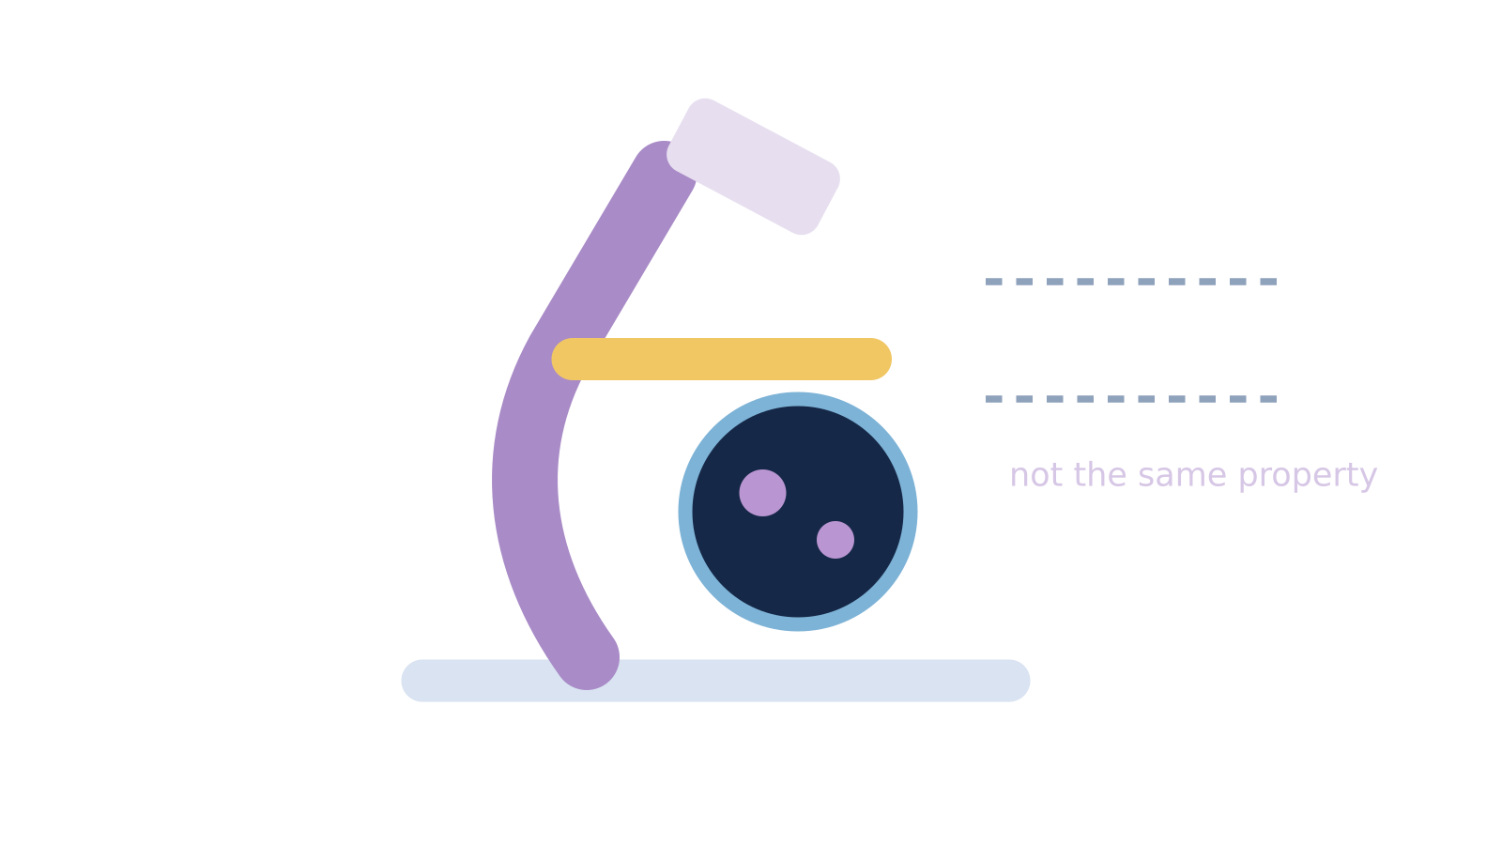
LAUNCH SCIENCE / W3L1
Resources
Watch, pause and explain
Microscopy
What is the difference between making an image bigger and resolving more detail?
Play freesciencelessons video
No connection? Use the still model and explain the same question.
Arrival
Starter
I Do
We Do
I Do 2
We Do 2
Independent
Exit
Resources
Notes:
Use at most 90 seconds within I Do. Pause on the first relevant example; ask for a reason. This is an optional concept clip, not evidence of practical completion.
Core explanation: Magnification is how many times larger an image is. Resolution is whether close points can be seen separately. Enlarging a blur does not recover detail.
Watch for: Do not add the lens powers. At high power use fine focus only; follow the microscope’s approved procedure.
Least help first: Ask which change is about size and which is about detail before naming either term.
Support cue: Total magnification = eyepiece × objective. A bigger image is not always a clearer image. Describe what you can see before you explain it.
[Sources]
User-supplied LAUNCH W3–W7 pack: W3 Magnification slides 5–7; microscopy is retained from the LAUNCH baseline.
Made by Matt LAUNCH Science draft, lesson-content.json, W3L1; existing illustrative diagrams reused, active-transport direction corrected to lower → higher.
Pearson Edexcel GCSE Biology specification, sections 1.1–1.6 and 1.15–1.17: https://qualifications.pearson.com/content/dam/pdf/GCSE/Science/2016/Specification/gcse-biology-spec.pdf
Optional concept video: freesciencelessons, Microscopy, https://www.youtube.com/watch?v=L5StAE_uuxM (link located 5 September 2026).
[/Sources]
[Sources]
Source editable lesson: Original LAUNCH Science OneDrive pack, 5 September 2026, W3L1. Source teaching content preserved. Current HTML reference: https://madebymatt.uk/Lessons/Science_Teesside/Launch/. Native diagrams restate the source explanation and are not experimental measurements.
[/Sources]

Slide 17
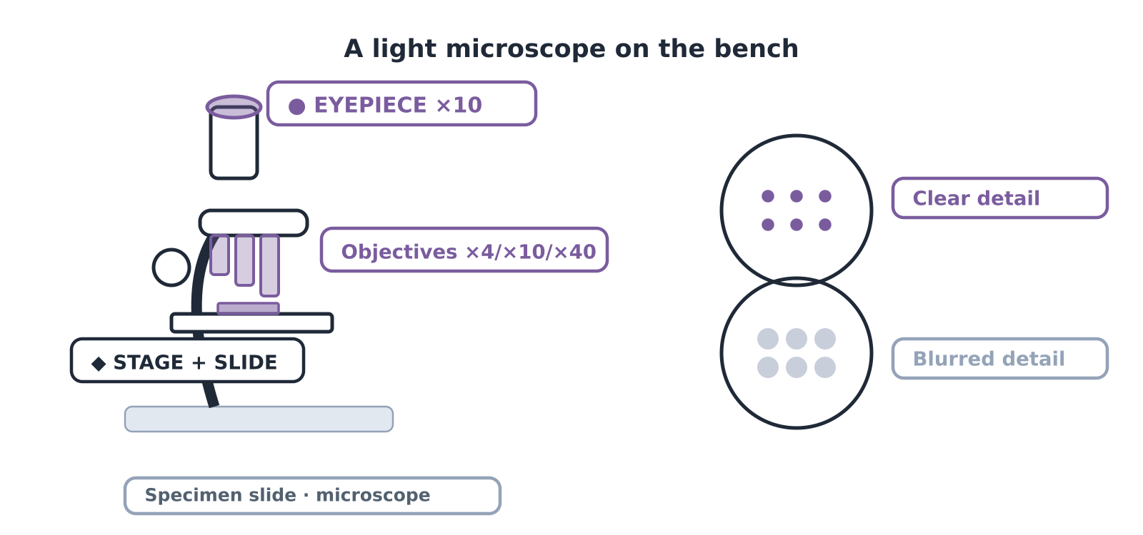
LAUNCH SCIENCE / W3L1
Resources
Look closely at the model
A model illustration: use the stated data for calculations.
Return to I Do
Arrival
Starter
I Do
We Do
I Do 2
We Do 2
Independent
Exit
Resources
Notes:
Source image: https://madebymatt.uk/Lessons/Science_Teesside/Launch/SCI_L_W3_L1_Microscopy.html; existing vector illustration embedded for offline use.
Core explanation: Magnification is how many times larger an image is. Resolution is whether close points can be seen separately. Enlarging a blur does not recover detail.
Watch for: Do not add the lens powers. At high power use fine focus only; follow the microscope’s approved procedure.
Least help first: Ask which change is about size and which is about detail before naming either term.
Support cue: Total magnification = eyepiece × objective. A bigger image is not always a clearer image. Describe what you can see before you explain it.
[Sources]
User-supplied LAUNCH W3–W7 pack: W3 Magnification slides 5–7; microscopy is retained from the LAUNCH baseline.
Made by Matt LAUNCH Science draft, lesson-content.json, W3L1; existing illustrative diagrams reused, active-transport direction corrected to lower → higher.
Pearson Edexcel GCSE Biology specification, sections 1.1–1.6 and 1.15–1.17: https://qualifications.pearson.com/content/dam/pdf/GCSE/Science/2016/Specification/gcse-biology-spec.pdf
Optional concept video: freesciencelessons, Microscopy, https://www.youtube.com/watch?v=L5StAE_uuxM (link located 5 September 2026).
[/Sources]
[Sources]
Source editable lesson: Original LAUNCH Science OneDrive pack, 5 September 2026, W3L1. Source teaching content preserved. Current HTML reference: https://madebymatt.uk/Lessons/Science_Teesside/Launch/. Native diagrams restate the source explanation and are not experimental measurements.
[/Sources]

